Slide 1

PRE-OPENING Q&A SESSION
[PROJECT LOCATION]
DATE

Slide 2
How to use this document
Instructions – Remove this page before using
This presentation template can be use for the pre-opening Q&A session to provide employees with information on the opening of the new workplace including the design and amenities.
This document is to be used after the opening has been announced to employees and before the opening week.
The session should be hosted by the Project Sponsor along with the Integrated project team and the change manager. It is important to have representatives from IM, IT, Security, OSH and HR to this session to respond to employees’ specific questions.
Proposed agenda for this one hour session:
  Introduction (5 min)
  What we have achieved so far (5 min)
  What to expect (2 min)
  Sneak peak at our new workplace (10 min)
  Next activities and how to get ready (5 min)
  Q&A (30min)
  Thank you (3 min)
On most slides, we are proposing content highlighted in yellow. Please do not hesitate to adapt to your reality.
In the Annex, you will find generic slides on GCworkplace design, Activity-based working and workpoints. If you feel that it would be beneficial to reinforce some of those key concepts, do not hesitate to use these slides.
* The French version of this document is available here : FR version

Slide 3
Introduction
Project sponsor welcomes everyone
Purpose of this session: first look at our new Activity-based workplace, addressing questions from employees on the workplace design and amenities available, communicating next activities and milestones
Provide a personal anecdote that demonstrates being open and dedicated to the new way of working, ‘walking the talk’. Explain how other senior leaders will also contribute and participate in this new way of working
Thank everyone for participating

Slide 4
What we have achieved so far
Include a timeline with milestones, or projects achievements, statistics on project (e.g. weight of paper disposed, number of filing cabinets emptied, number of participants to some activities, etc.)

Slide 5
What to expect: our new workplace is opening soon!
How does this benefit you?
  Modern, efficient and inclusive workplace which responds to your needs and supports a flexible way of working.
  Activity Based Working (ABW) environment that offers all employees shared use to a variety of workpoints, allowing you to choose the optimal setting to perform your tasks and functions.
  Optimal workplace experience as part of a flexible hybrid work model – both at home and in the office.
Choice and flexibility of where & how to work
Adaptable to personal needs & preferences
Access to a wide range of workpoints and amenities
Accessible and inclusive
Enhances your employee experience
Supports all workplace activities such as learning, focusing, collaborating and socializing

Slide 6
What to expect: our new way of working
If available, include photos of your senior leaders working in the space (photos can be taken during their visit of the space) or of senior leaders ‘walking the talk’ of the new way of working and community norms/workplace etiquette (ex: using a phone booth for a call, having a meeting in a lounge, wiping down a desk after use, storing their bag in a day locker, checking into Archibus, etc.)

Slide 7
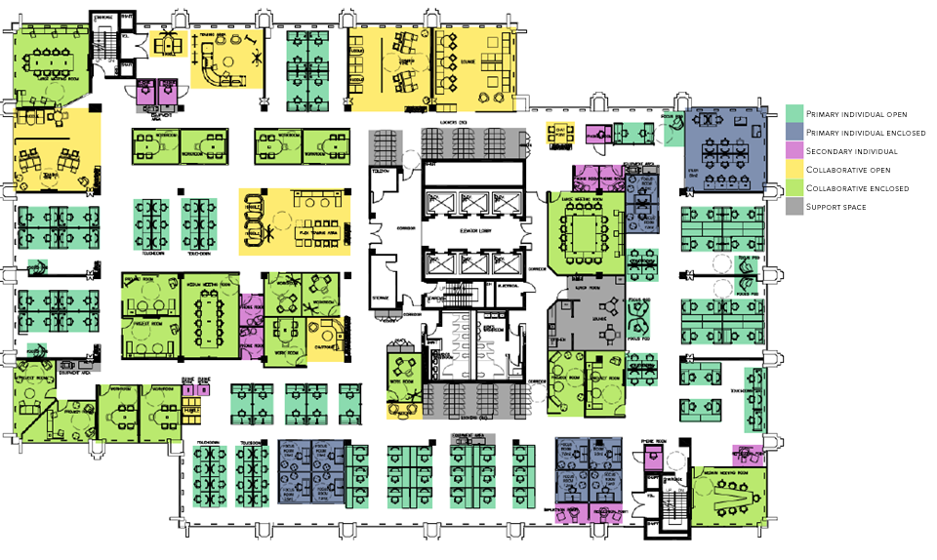
Sneak peak of our new workplace – Floor plan
Use the plan provided in the Floor Plan announcement activity

Slide 8
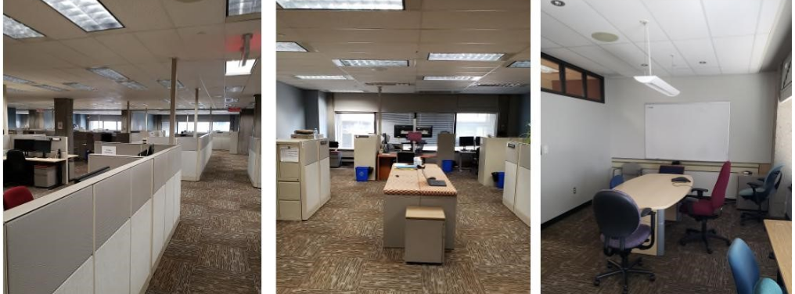
Sneak peak of our new workplace – Before photos
Use your before photos if you have any

Slide 9
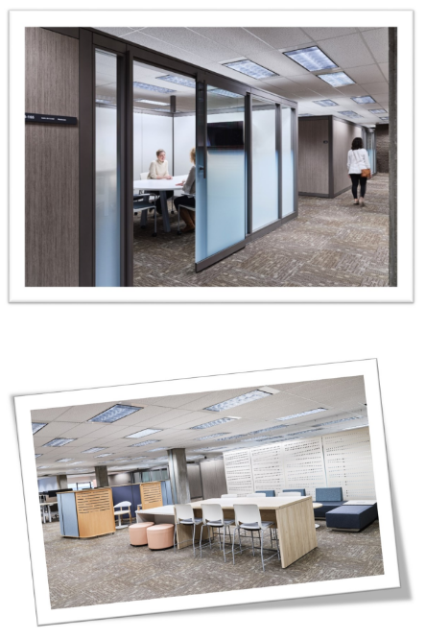
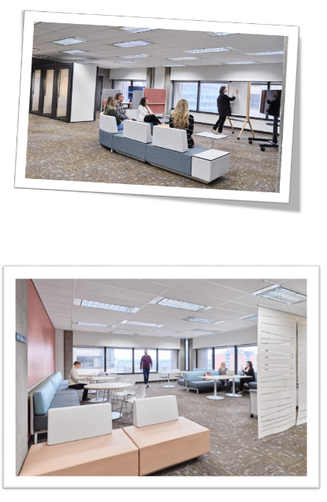
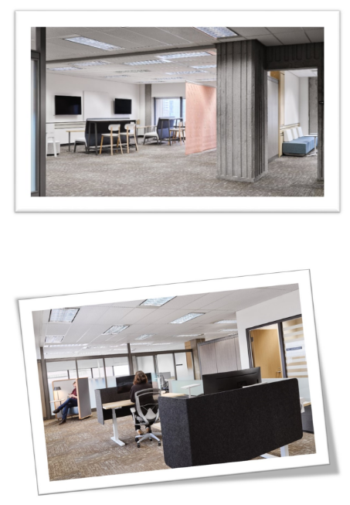
Sneak peak of our new workplace – New photos
Replace with photos of your new space – Show just enough to get employee’s interest – but to see more they have to take the official tour

Slide 10
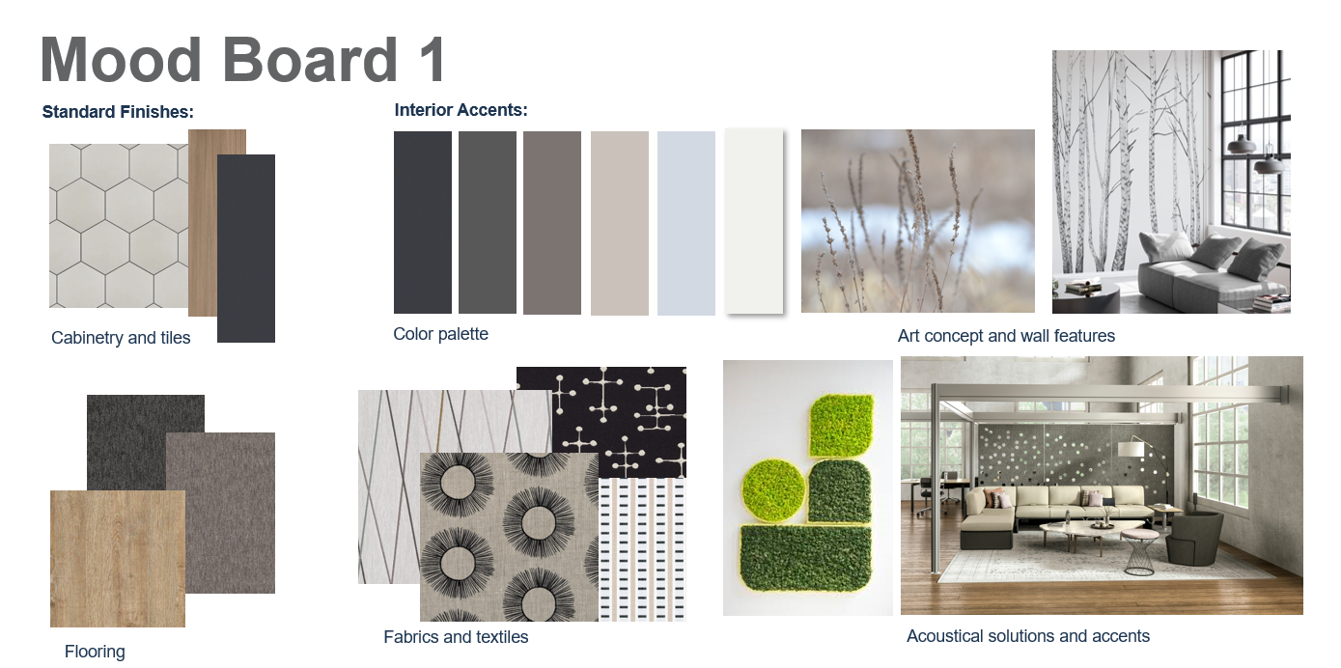
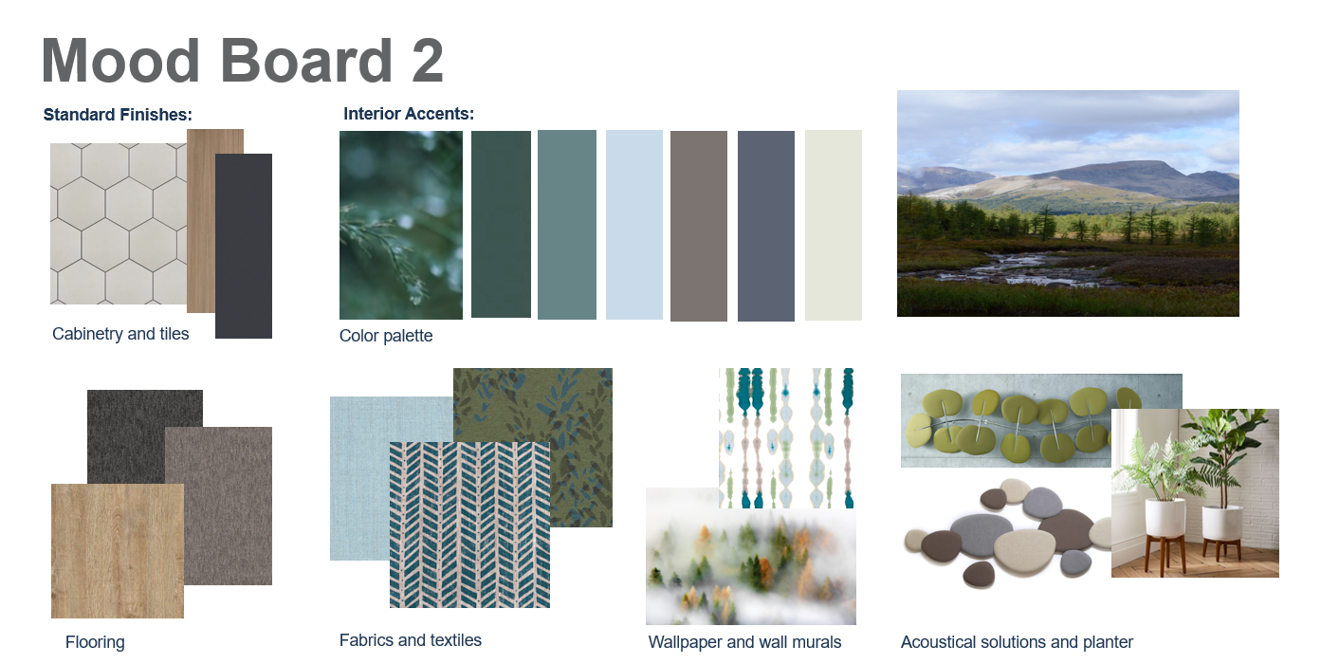
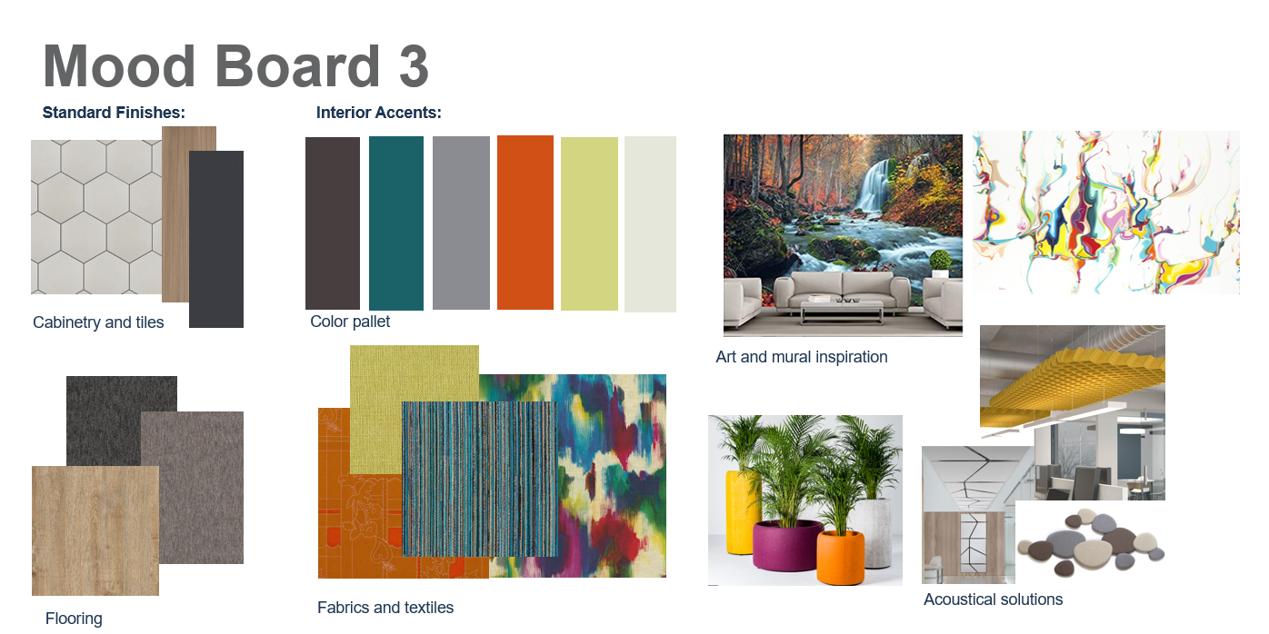
Sneak peak of our new workplace – Colours and finishes
Show the mood board that was selected by your organization with photos of some of the actual finishes that were used (a photo of a piece of furniture, a design feature, a wall, etc.)

Slide 11
Next activities and how to get ready
Reminder to managers to book guided tours for their team
Reminder to employees to attend opening week events
Reminder to book a workpoint for their first day onsite
Reminder to review the Employee Toolkit, intranet site, A day-in-a life presentation and attend organized guided tours

Slide 12
Q & A
Give employees an opportunity to ask questions about the new workplace including design features and amenities available.
Address questions/concerns with subject experts/project team in attendance to answer design/feature specific questions

Slide 13
Thank you!
Thank everyone for attending
We look forward to welcoming you to our new workplace. This is an opportunity to improve our workplace and our ways of working to continue delivering our mandate – from a workspace that will sustain our achievements today and tomorrow.

Slide 14
Annex
Instructions – Remove this section before using
This annex is a reference section for your presentation. It proposes multiple slides you have used before in the A Day in a life presentation.
Use the slides containing information about subjects that still need to be reiterated to employees before the workplace opens. This is one of the last times you will get to communicate this information before the opening week; use this opportunity to ensure employees understand the basics of Activity-based working.
The slides can be added to your presentation or simply used as speaking points, depending your organization’s needs.
There is proposed content highlighted in yellow. Please do not hesitate to adapt to your reality.

Slide 15

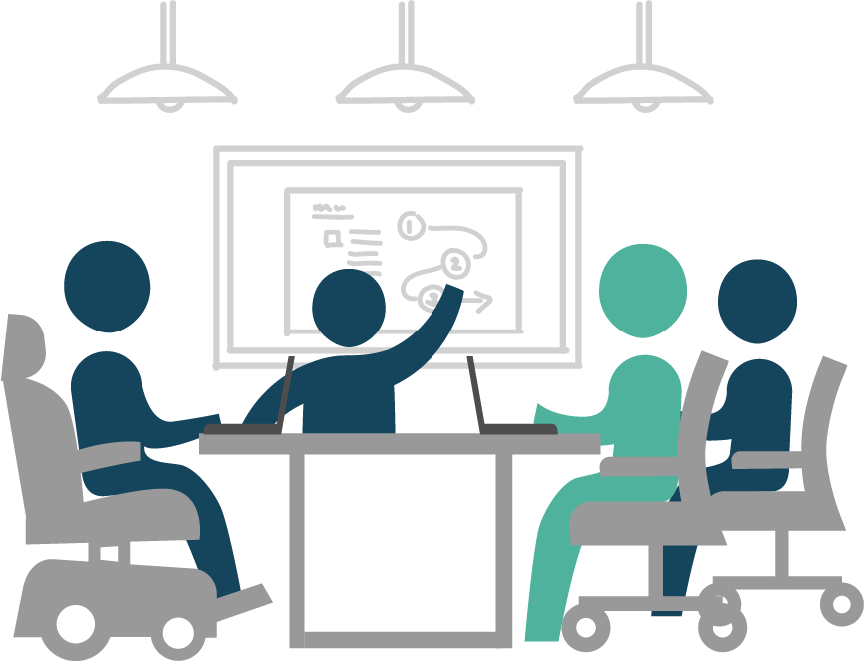
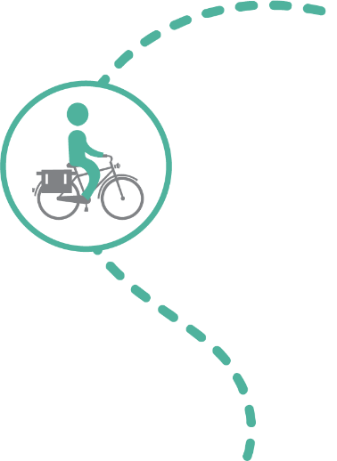
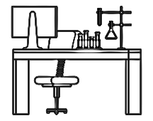

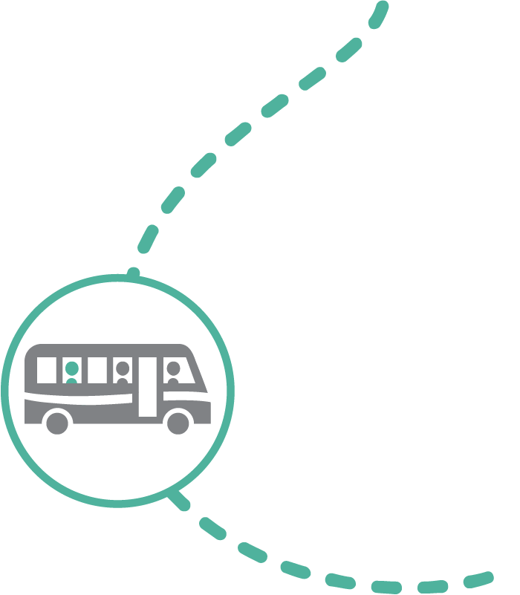
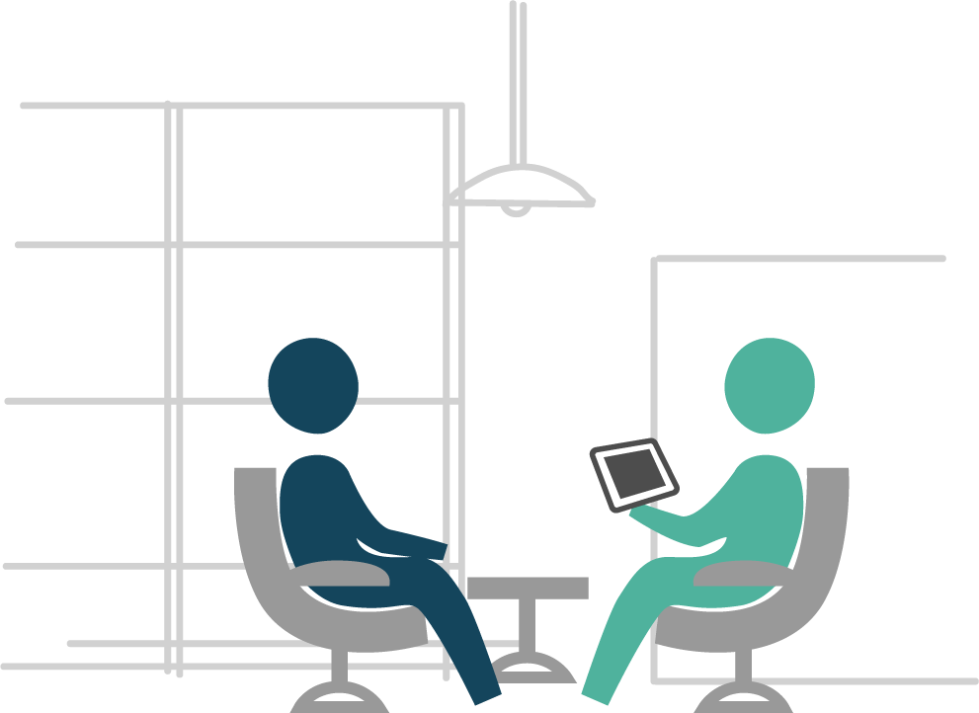
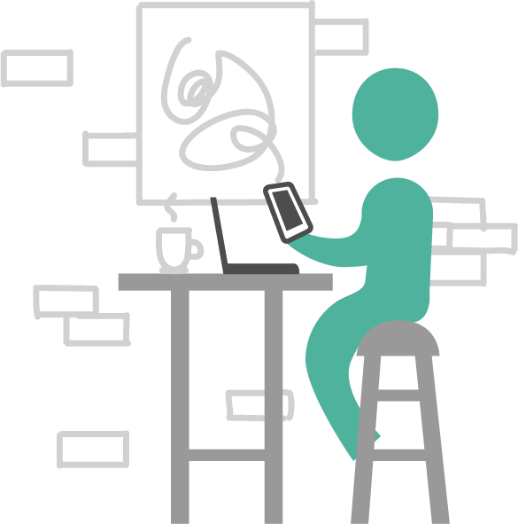
Understanding the flexibility provided by an ecosystem of spaces
Home
Office & Functional space
"I had an appointment this morning close to home, so I decided to work from home for the rest of the afternoon. I planned my week in advance to save my non-urgent individual tasks to complete this afternoon."
"Today my team is brainstorming for a new communications tool that we will be developing. The office is the best place for today's tasks as we will need a lot of space and a large TV monitor."
"Today I have to work at a lab where I need to perform some testing. This functional space will be the best place for today's tasks. If required, I will be able to also book a workpoint in the office space to perform other type of activities.
GCcoworking
Other
"I'm working on a project with my colleague today, and since we both live in the same neighbourhood we decided to meet at our local GCcoworking site. This will save us 30 minutes of commute time to the office!"
"My day today is filled with client meetings! There are no GCcoworking locations nearby and I would lose a lot of time by commuting back and forth to the office so I will be working in a coffee shop in between my meetings."
Review to align to your organization’s ecosystem
Notes:
Flexibility means employees are empowered to decide where it makes the most sense for them to work. Let’s look at a few real-life testimonials.
"I had an appointment this morning close to home, so I decided to work from home for the rest of the afternoon. I planned my week in advance to save my non-urgent individual tasks to complete this afternoon.“ Can you think of other reasons why it would make more sense for you to work from home?
"I'm working on a project with my colleague today, and since we both live in the same neighbourhood, we decided to meet at our local GCcoworking site. This will save us 30 minutes of commute time to the office!“ What are other reasons why you would decide to work from a GCcoworking site?
"Today my team is brainstorming for a new communications tool that we will be developing. The office is the best place for today's tasks as we will need a lot of space and a large TV monitor.“ Can you give examples of situations where going to the office would make the most sense?
"My day today is filled with client meetings! There are no GCcoworking locations nearby and I would lose a lot of time by commuting back and forth to the office so I will be working in a coffee shop in between my meetings.“ When you think about your typical week, can you think of a moment where you would be most efficient at another location like the coffee shop?
With these examples, we can see that having the flexibility to choose where and how you want to work allows for better productivity and can contribute to work-life balance. Having flexibility is what allows you to define your own ways of working; working where it makes the most sense to you!

Slide 16
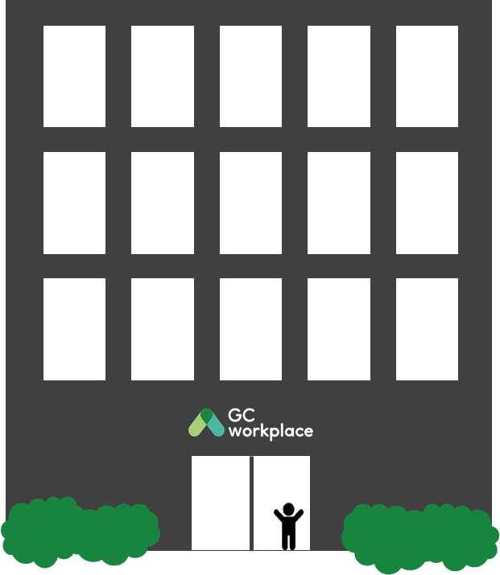


In an office setting…
ACTIVITY-BASED WORKING (ABW)
Notes:
This is an ACTIVITY-BASED WORKPLACE, an environment that supports a new way of working and is based on the principle of activity-based working (ABW). [CLICK TO ANIMATE SLIDE]
ACTIVITY-BASED WORKING (ABW) is a design concept that recognizes that through the course of any day, employees engage in many different activities and that they need and can choose different types of workpoints to accommodate these activities. An ABW environment focuses on the employees and provides the freedom to decide for themselves: how to work, where to work, which tools to use and with whom to collaborate to get the work done.

Slide 17
Understanding workpoints
In an ABW environment, WORKPOINTS are the building blocks and refer to any area where work can be done—this can range from a lounge chair or a desk, to a meeting room or collaborative hub.
Employees have access to all workpoints in all zones - both open and enclosed work areas.
This enables employees to choose from a multitude of settings to perform their work.

Slide 18



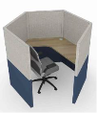
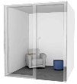
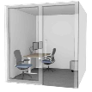

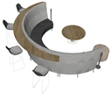
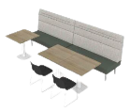


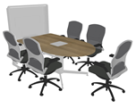



Understanding workpoints: variety for everyone and every task!
Types of individual workpoints
Workstation
Touchdown
Study
Focus pod
Phonebooth
Focus room
OPEN
SEMI-ENCLOSED
ENCLOSED
Chat point
Teaming area
Lounge
Huddle
Workroom
Project room
Meeting room
Types of collaborative workpoints
Confirm with the project team the workpoints that will be available in your future workspace
Notes:
In your future workplace, you will find a variety of workpoints available to you based on your requirement to perform individual or collaborative work—but also if an open, semi-enclosed or closed workpoint is required or preferred to perform your activity.
You can go through the different workpoints by naming them and explaining that they are organized by individual/collaborative workpoints, but also by open/semi-enclosed/enclosed workpoints.

Slide 19
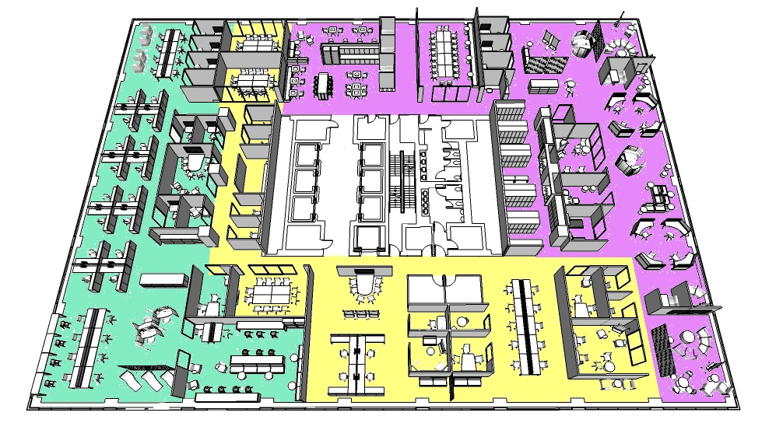
A GCworkplace is functionally zoned to support a variety of work activities
A quiet zone includes open, semi-enclosed, and enclosed individual workpoints. In this zone, the intent is to encourage individual focus work and to support the need for quiet or private spaces.
In an interactive zone, socialization and group collaboration is promoted and strongly encouraged. Providing a variety of group workpoints, and locating these activities away from the quiet zone.
A transitional zone includes a variety of open and enclosed spaces where less intense concentration is supported. The transitional zone may include open individual and group workpoints, semi-enclosed collaboration, and support spaces such as lockers or shared equipment areas.
Consider replacing the sample floorplan with your floorplan and adjusting the zoning accordingly

Slide 20
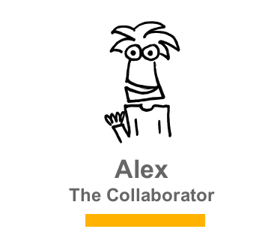
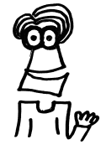
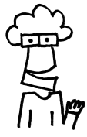
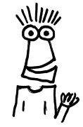
Different ways of working
Although we all work on the same team, with similar jobs, we all have different working styles.
There’s no WRONG way to work, just DIFFERENT ways.
I work best when I’m collaborating with my team.
I thrive when I have a strong routine that I can count on each day!
Trust and confidence from my team is important for my independent working style.
With the right tools and flexibility, I will get the job done!
ALEX
SAM
KRIS
PAT
Adaptable
Creative
Inclusive
Values interaction
Habitual
Organized
Detail oriented
Values predictability
Dynamic
Flexible
Early adopter
Autonomous
Pragmatic
Composed
Focused
Efficient
Notes:
Although you all might be part of the same team, with similar jobs, you all have your own preferences and working styles. There is no wrong way to work, just different ways. For example, these 4 colleagues:
They all work in the same team and perform similar activities, but are very different from each other. *Notice that these personas are non-gender specific; therefore, try to refrain from using personal pronouns.
[CLICK TO ANIMATE SLIDE] Here’s Alex. Alex is very adaptable, creative and inclusive, and values facetime; [CLICK TO ANIMATE SLIDE] so Alex works best when collaborating with the team.
[CLICK TO ANIMATE SLIDE] This is Sam. Sam is habitual, organized, detail oriented and values personalization; [CLICK TO ANIMATE SLIDE] so Sam thrives when there is a strong routine to count on each day.
[CLICK TO ANIMATE SLIDE] That’s Kris, the dynamic, flexible, early adopter and autonomous one of the group. [CLICK TO ANIMATE SLIDE] Kris finds that trust and confidence from the team is important in order to have an independent working style.
[CLICK TO ANIMATE SLIDE] And finally, he’s Pat; a pragmatic, nonchalant, focused and efficient colleague. [CLICK TO ANIMATE SLIDE] Pat feels that with the right tools and flexibility, the job can get done.
As you can see, all of them work in the same team and are very different people, but they all benefit from the flexibility of choosing where and how to work.

Slide 21
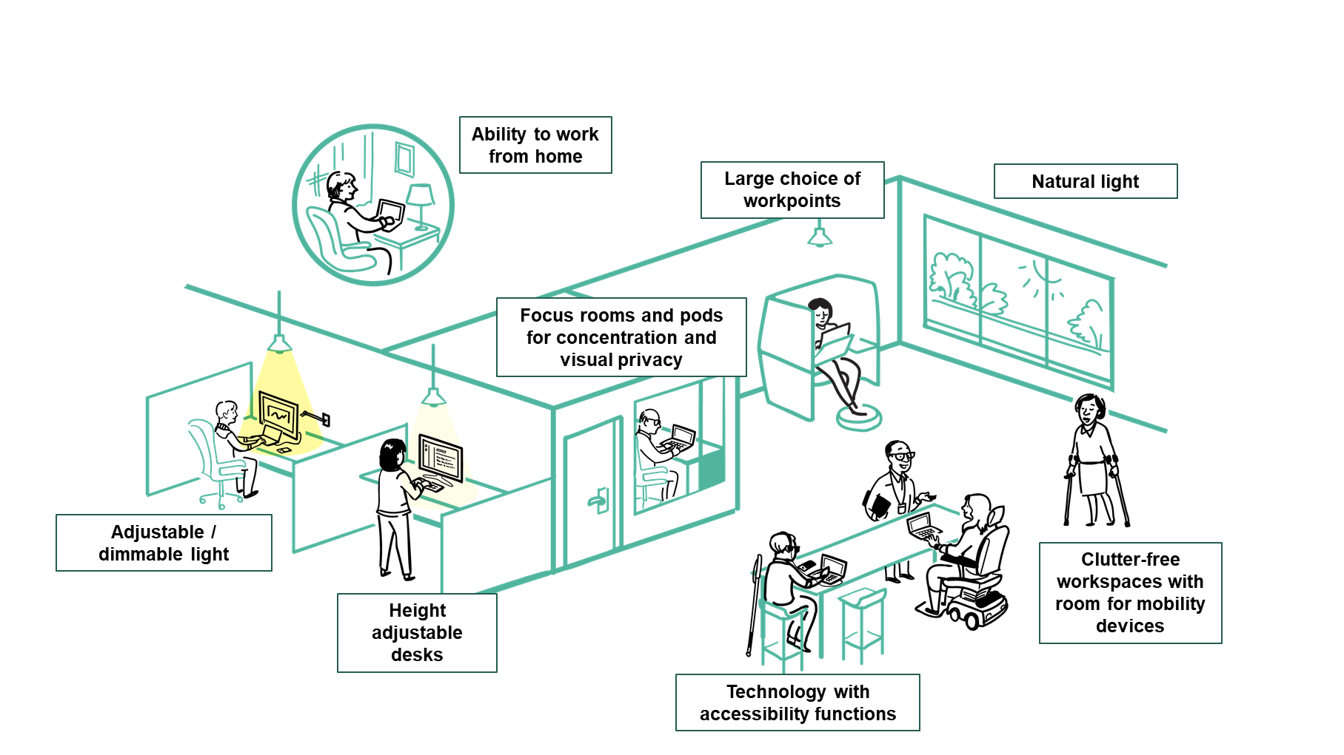
An accessible and inclusive workplace by design
GCworkplace has been developed to be an accessible and inclusive workplace design standard. It provides employees with full control over the work settings that best suits their functional needs, knowing that we all have different abilities, disabilities and personal preferences.

