Slide 1
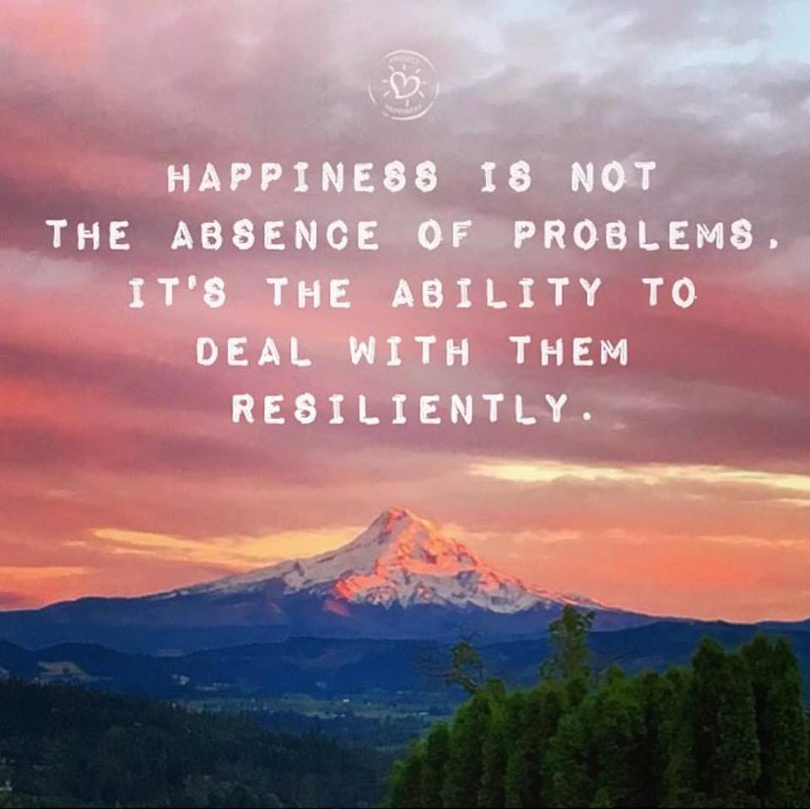
Welcome
Notes:
(Prep for sharing audio & video, including French CC and 100% font size)
In case needed: https://archive.org/details/LovingKindness15Minsb
Video: Mindfulness & EQ connection - https://www.youtube.com/watch?v=s57sce71zNI
Optional: skip the body scan, starting at around 5:18, with a quick intro “take a couple of breaths, close your eyes…” and resume the recording

Slide 2
Mindful Change Leadership Development Program
Week 7 (of 8)
6 June 2022
Notes:
« Vous savez maintenant que vous pouvez exprimer vos commentaires ou poser vos questions dans la langue officielle de votre choix »
By now, you know you can use the language of your choice to express your comments or questions

Slide 3



Mindful Self-Love Exercise – Centering
Notes:
For today’s centering exercise, we’ll use a slight variation…. Similar to previous ones, the idea is to shift from “doing” to “being”
Let’s start by doing the following...
Sit in a comfortable attentive position
It helps if you close or semi-close your eyes
Focus on your breathing…
and repeat any of the following phrases aloud or in your mind as they may feel right to you, in this moment…
(read them allowing space in between)
I am a kind person (Je suis amiable)
I love myself (Je m’aime)
I do my best (Je fais de mon mieux)
I am enough (je suis assez moi-même)
(Repeat once a minute over three to five minutes, then ask participants to…)
take a couple of deep breaths, slowly open their eyes, and return to the group session.

Slide 4











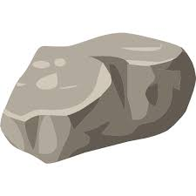
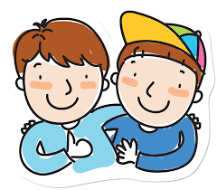

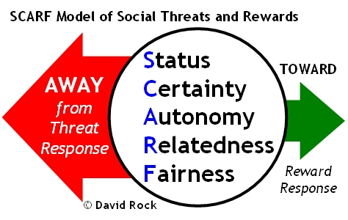


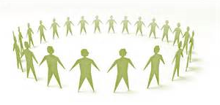


Questions/Insights from last week (6)
Notes:
Plenary: Open mic to share your comments, challenges, surprises… particularly would like to hear from those who haven’t shared yet
the gratitude journaling
Your practice
Mindful eating
Human Being is enough
Present
Mindful – Win Win Win
Raise your hand to speak, type in the chat… be mindful about the time, let’s take as many as we can in 10 mins.

Slide 5

Agenda – week 7
Centering exercise
Questions/Insights from last week (6)
Today’s intentions:
Focus, Compassion, Clarity, Creativity
Mindful Walking Exercise
Mindful Loving Kindness
Some articles regarding EQ, Leadership
Your take away assignment

Slide 6


Mindful Walking Exercise
“Where can you take a mindful walk during your day?”
“If you can, go outside and into nature when you walk. Researchers in Finland found that city dwellers reported significantly more stress relief when they took a walk through a park or woodland than those who strolled through a city center.” - https://siyli.org/mindful-walking/
For us, let’s go for a mindful walk down the hallway, up and down the stairs, or outside in the garden … for 10 minutes
Pay attention to your pace, your breathing, your
steps, your motion, your effort, your balance,
your heart
Be safe
Notes:
Always be safe when doing the exercises
An alternative to this exercise is to
stand up,
hold onto a stable chair, a desk, or a wall
and feel your balance
now close your eyes
and notice your feelings, your thoughts…
now lift one leg
… What did you notice?
Now for the Mindful Walking exercise… (read the slide)
Now let’s take 10 minutes to do the exercise… the goal is to be aware… of what you feel, how you feel, what you hear, what you think… as always, if your mind wanders, that’s fine; just acknowledge the side-trip and gently bring your mind back to the exercise.
10 mins timer starting now.
(after 10 mins… Acknowledge those who came back)
hope everything went well, Remember there will be time to do a debrief

Slide 7
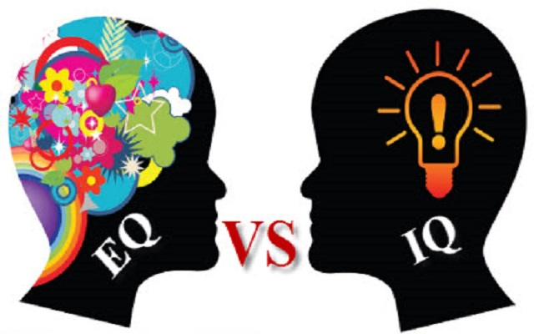
EQ: a core leadership skill
Self-awareness… allows people to tune into their feelings… involves recognizing one’s own emotions and their effects, and also having confidence in one’s self-worth and capabilities.
Self-control/self-regulation… ability to manage disruptive impulses and moods, and the propensity to suspend judgment and to think before acting… maintaining standards of honesty and integrity, taking responsibility for one’s behaviour, being adaptable in the face of change and being innovative and open to new ideas.
Internal Motivation… passion for work … not just about money and status… inner vision of what is important in life, a joy in doing something, curiosity in learning
Empathy… ability to understand others’ emotional makeup, the skill to treat people according to their emotional reactions… can read an organization’s dynamics, emotional currents and relationships, while sensing what people working for… service to clients and customers.
Social skills/Interpersonal skills… know how to negotiate and resolve conflicts, collaborate, co-operate, and create group synergy in pursuing collective goals/find common ground and build rapport… managing relationships and building networks… effective in leading change, persuasiveness, and expertise building and leading teams
Adapted from: https://bluenotes.anz.com/posts/2017/04/emotional-intelligence-a-core-leadership-skill/
Notes:
(paraphrase from the slide)

Slide 8
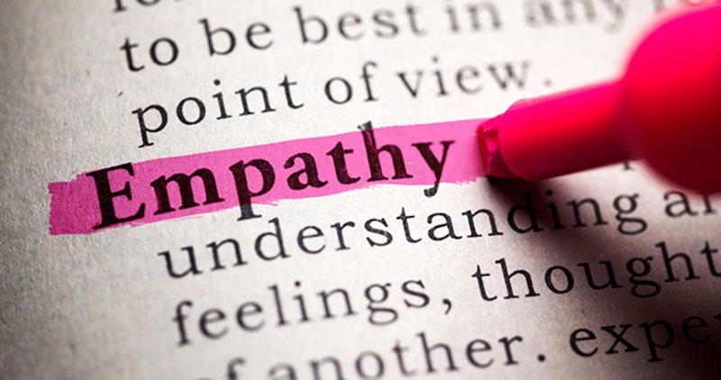
Empathy: the key to effective leadership
“… You must always remember that whoever you are, you are nothing without other people… Without empathy, you will never move past zero.
…Empathy means
understanding that the
decisions you make
every single day impact
not just you… when you
understand that you move from “me” to “we”… ”
http://www.businessinsider.com/why-empathy-is-key-to-effective-leadership-2017-4
Notes:
This is a story from recognized author and successful leader, he says: “…the leadership principle a grandfather shared with him as a child, it is the same one I now teach Fortune 500 execs: Empathy”
(read the slide)
Resources…
The leadership principle my grandfather shared with me as a child is the same one I now teach Fortune 500 execs – Article
http://www.businessinsider.com/why-empathy-is-key-to-effective-leadership-2017-4
Empathy vs. Compassion - https://ascentleader.org/difference-between-empathy-and-compassion/

Slide 9
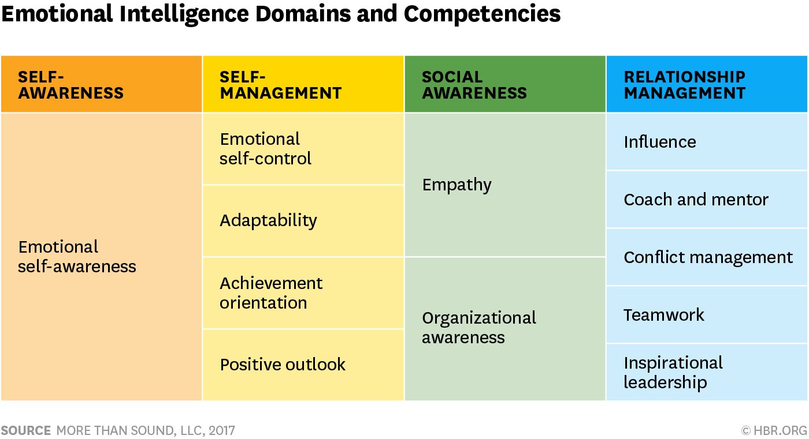

Emotional Intelligence Domains and Competencies
Article: https://hbr.org/2017/02/emotional-intelligence-has-12-elements-which-do-you-need-to-work-on
Self-assessment: https://www.tsw.co.uk/blog/leadership-and-management/daniel-goleman-emotional-intelligence/
Notes:
This table shows the 12 competencies related to EQ’s domains
Self-awareness, although the least visible emotion it is an incredible predictor of the level of emotional intelligence. Therefore, Self-aware Leaders Show Higher EQ
And those who have high self-awareness tend to have at least 10 or 12 competencies, while those who are low have one or two
Resources…
https://hbr.org/2017/02/emotional-intelligence-has-12-elements-which-do-you-need-to-work-on
Self assessment: https://www.tsw.co.uk/blog/leadership-and-management/daniel-goleman-emotional-intelligence/
Video: Mindfulness & EQ connection - https://www.youtube.com/watch?v=s57sce71zNI
Resources in French:
Self assessment: https://nomadity.be/blog_confiance/4-piliers-pour-developper-votre-intelligence-emotionnelle/
9

Slide 10

To Be An Effective Leader, Keep A
Leadership (Reflecting) Journal
Ten Questions For Your Leadership (Reflecting) Journal
What’s present for me now?
What’s going well? What’s creating that?
What's challenging? What's creating that?
What needs my attention?
What’s meaningful?
What strengths do I notice in myself?
What strengths and contributions do I notice in others?
What am I learning?
What is an action I am committing to?
“The idea here is getting people to come to terms with who they are, where they want to go… I think of expressive writing as a life course correction.”
– Dr. Pennebaker
https://www.forbes.com/sites/hennainam/2017/04/02/to-be-an-effective-leader-keep-a-leadership-journal/
http://well.blogs.nytimes.com/2015/01/19/writing-your-way-to-happiness/
Notes:
(read a few bullets, then the quote on the right)
Any questions anyone?
(if nobody has a question, perhaps read one/two with the **
if someone has a question regarding the list, read from the text)
What’s present for me now? This may feel like an esoteric question to start with but it’s a useful one to get present to what’s going on in this moment for you. Take a few deep breaths, close your eyes, and bring awareness to your body. Stretch and release any tension you’re feeling. Look inside yourself. Notice what emotions are present. Often, we rush through our day without checking in with ourselves. This is an opportunity to greet an old friend and see how they are. It will set you up for rich learning in the questions that follow.
What’s going well? What’s creating that? Acknowledging what's good helps you take a step back from what may have been a very stressful day. It helps you acknowledge yourself and others for the good that’s happening. It helps you learn what’s positive and what's helping you achieve goals.
** What's challenging? What's creating that? Acknowledging what's challenging focuses you on what needs your attention for learning and growth. Often, we start off by blaming others, ourselves, or circumstances for what is challenging. That’s fine and a perfectly human response. You can start there. And I urge you to look deeper within yourself. What are your beliefs, attitudes, or actions that contribute to what is challenging for you? This process of taking responsibility (without judgement!) is a key driver to feeling empowered as a leader rather than a victim of circumstances. It opens you up to experimenting with other ways of leading that may be more effective.
What needs my attention? This is a great question for scanning your environment, both work and personal. Your quality attention is your most precious asset. This helps you become mindful and choose where you invest it.
** What’s meaningful? Finding meaning in each day keeps you fueled. It helps you learn about what values are important to you and then lead from those values. It helps you discover purpose and lead from purpose, inspiring and engaging yourself and those around you. Another question in this same vein is what am I grateful for? This helps you focus on what’s going right overall, which helps to reduce stress and improve overall well-being. Keeping a gratitude journal has been shown to clinically improve your immune system. It also increases resilience.
What strengths do I notice in myself? This helps you become aware of your strengths and put them into action. You may also want to journal about values you exercised. It builds confidence, trust in yourself, and resilience.
What strengths and contributions do I notice in others? This helps you appreciate and see what others are contributing. You can then powerfully acknowledge and appreciate them. It helps build productive and trusting work relationships.
What am I learning? Scan your writing. Capture any learning that feels most important.
What is an action I am committing to? This helps you move the learning forward into action.
Try this exercise. Bullet-point answers are fine. I challenge you to try it as a gift to yourself for the next seven days. My hope is that it will help you to become a more inspired, authentic and agile leader.
Resources…
Writing Your Way to Happiness – Article http://well.blogs.nytimes.com/2015/01/19/writing-your-way-to-happiness/
To Be An Effective Leader, Keep A Leadership Journal – Article https://www.forbes.com/sites/hennainam/2017/04/02/to-be-an-effective-leader-keep-a-leadership-journal/

Slide 11
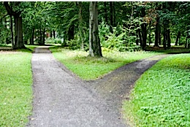
Making
Big or Small
Decisions?
Resisting the Negative
  People who meditated focused less on the past and future, which led to them experiencing less negative emotion,” Hafenbrack says. “That helped them reduce the sunk-cost bias.”
Short-term or Long-term?
  [The research doesn’t] undermine the idea that [meditating] as a long-term practice could be effective,” Barsade says. “However, one of the novel and important things [about the research] is that you can take a brief time out and get a result.”
Mindful Decision-making
  “Applying mindfulness techniques to decision-making leads to clearer thinking and to staying connected to your core values, which is crucial to your peace of mind.” – Phillip Moffitt
http://knowledge.wharton.upenn.edu/article/making-big-small-decision-meditation-can-help/
https://dharmawisdom.org/decision-time/
Notes:
Making a Big (or Small) Decision? Mindfulness Practice Can Help
(paraphrase from the slide)
Resources…
Article - Making a Big (or Small) Decision? How Meditation Can Help: http://knowledge.wharton.upenn.edu/article/making-big-small-decision-meditation-can-help/
Article - Decision Time: https://dharmawisdom.org/decision-time/

Slide 12
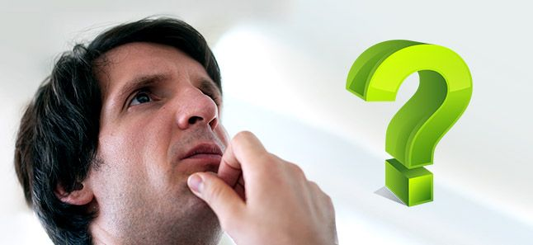
Mindfulness for Better Decision-making
A good decision is the reflection
of your thoughts and experiences,
and this can be augmented through
a mindfulness practice.
#1 – Focused mind
#2 – The right balance
#3 – Rational thinking
#4 – A strong mind
#5 – Intuition, perception and observation
#6 – Focus on the present
Calmer mind
Drop the baggage
A strong mind
Strong intuition
https://www.artofliving.org/us-en/meditation/meditation-for-you/meditation-for-better-decision-making
https://www.artofliving.org/meditation/meditation-for-you/meditation-for-better-decision-making
Notes:
Article - Have better decision-making abilities https://www.artofliving.org/meditation/meditation-for-you/meditation-for-better-decision-making
Article - Better Decision Making Ability https://www.artofliving.org/us-en/meditation/meditation-for-you/meditation-for-better-decision-making

Slide 13

Mindful Loving Kindness exercise
Time required – 15 minutes
First, do a Mindfulness Body Scan – Relaxation exercise
Then, follow my voice
During this exercise, I’ll say a few sentences
I invite you to repeat the ones that resonate with you the most, the ones that are true to yourself
  May I be happy
  May I be healthy
  May I live with ease
  May I be free from pain and suffering
  May I be able to let go of everything
  over which I have no control
  May I find success in all areas about which
  I’m passionate
Mindfulness exercise – Loving Kindness – 15 mins (https://archive.org/details/LovingKindness15Minsb)
  Download link: https://archive.org/download/LovingKindness15Minsb/Loving%20Kindness%2015%20minsb.mp3
Notes:
Iterations, as follows… think about:
Start with yourself
Then, move to somebody you care about deeply, someone you admire, bring the image of their face into your mind, their eyes, their smile. And see if you could wish them these good thoughts
Repeat the sentences; if your mind is struggling, just gently come back to the sensation of your breath, and keep repeating the sentences
Next, bring to mind somebody you’re familiar with and who is going through a hard time, someone you know would benefit from these good wishes
Now, bring to mind someone who plays a function in your life, someone who you don’t know very well; it could be the Commissionaire on your way in, perhaps the person who serves you coffee in the coffee shop, the bus driver, or even someone in your office you don’t know that well.
Get a feeling for their presence, what they look like, see how you can wish them these good thoughts.
Next, see if you can wish these good thoughts to everyone listening today, see if you can wish these good thoughts to all of your co-workers, everyone in your building, everyone in your city.
See if you can wish these good thoughts to every single living being (two legs, four legs, more legs) on this planet.
Keep your eyes closed for a few moments
Taking a moment to show yourself gratitude for taking the opportunity out of your busy day to slow down, for reconnecting
The more we practice, the more we’re able to create this gaps between our habitual thoughts and habitual patterns
When you’re ready, you can rub your hands, creating a bit of heat; and you can put your hands over your eyes; and slowly open your eyes
And comeback.
Mindfulness exercise – Loving Kindness – 15 mins (https://archive.org/details/LovingKindness15Minsb)
Optional: skip the body scan, start at around 4:22, with a quick “take a couple of breaths, close your eyes…” and resume the recording
Download link: https://archive.org/download/LovingKindness15Minsb/Loving%20Kindness%2015%20minsb.mp3

Slide 14
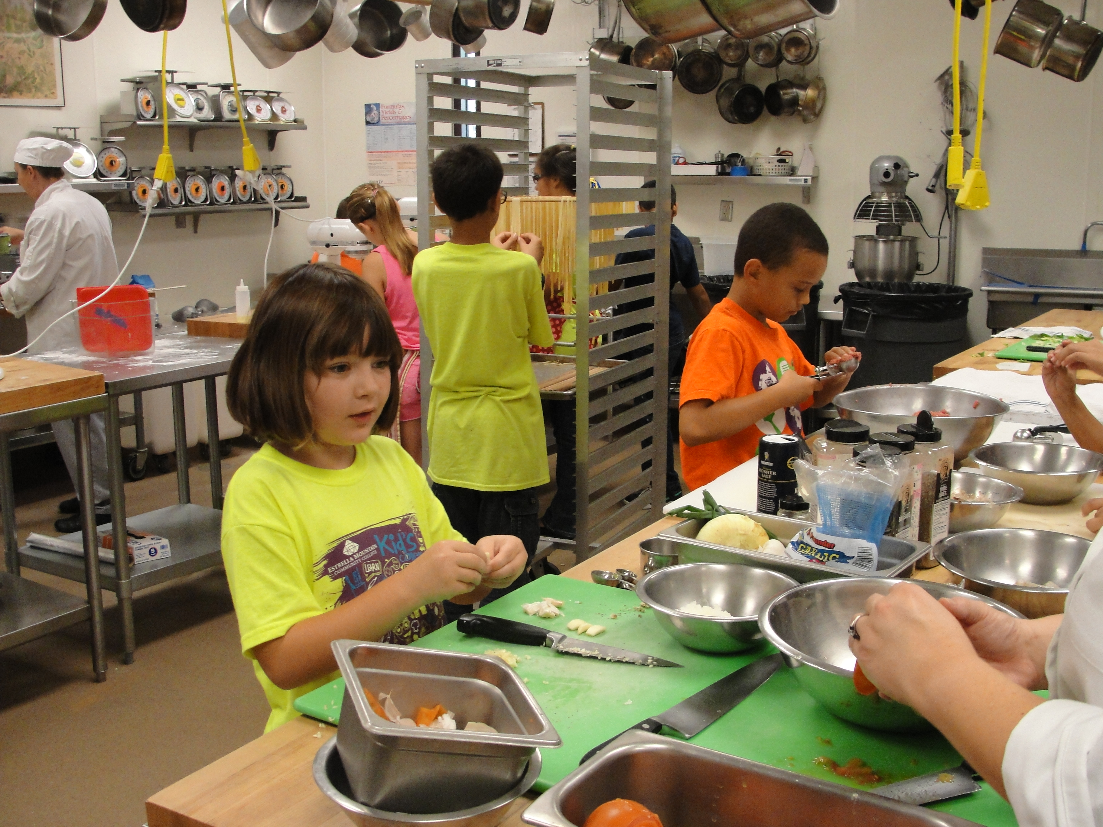
Your takeaway practice for week 7
Connecting – once a week with your buddy
Gratitude Journaling - daily
Practice, choose one of the following and keep doing it for the whole week - daily
  Self-compassion
  15 mins – https://soundcloud.com/mindfullivingcoach/self-compassion-meditation
  15 mins – https://soundcloud.com/awakeningcompassion/awakening-compassion-class-4
  20 mins – http://self-compassion.org/wp-content/uploads/meditations/LKM.self-compassion.MP3
  Mindful Loving Kindness exercise
  15 mins – https://archive.org/details/LovingKindness15Minsb
  20 mins – https://www.tarabrach.com/meditation-loving-presence-2/
Apply Mindful Centering – as needed
Apply Mindful Walking – as needed
For the next and final session: Bring all the questions you have

Slide 15
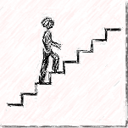


Reflect about today’s exercises
Notes:
As usual, before going into small groups debrief, let’s do a plenary debrief, let’s open the microphone for a few of you who would like to share your reflections about today’s exercises (until about 20 minutes before the end of the session):
Mindful walking
Leadership (Reflecting) Journal
Better Decision Making
Loving Kindness
Take the next few minutes to debrief in small groups (of 4-6). As in previous weeks, when you’re done just leave the session.
Feel free to share:
What you noticed
What you had a hard time with
What you’re reailzing
An intention you have for the week
etc
I wish you happiness!!

Slide 16


Be Mindful, Be Happy /
Prenez conscience, soyez heureux

