Slide 1
COVID-19
Travel restrictions
on Canada.ca
Interdepartmental collaboration
delivering results for Canadians
October 14, 2020

Slide 2
Goals of this project
Improve content about traveling during the COVID19 pandemic: make it easier to find, easier to understand, accessible, mobile friendly
Lessen the burden on departments (reduce calls and emails for questions that can be answered on the website)
Reduce errors for travellers arriving in Canada
Develop collaborative relationships between departments to:
  Accelerate complicated updates that affect multiple mandates
  Reduce duplicate/contradictory travel content across multiple departments
Notes:
A focus on calls, emails and errors will require data collection from participating departments

Slide 3
Optimization methodology
Initiation
Discovery
*Early testing
Design and prototype
Comparison study
Transition
1
2
3
4
5
6
Prototype hand-off and transition to live
Project start-up, define the problem
Initial research, determine tasks
Develop prototype, test and iterate
Test prototype with users, iterate to improve
Test the current service with users
Notes:
*Early testing was done as several smaller studies, which is different than usual DTO working standard with a formal baseline.

Slide 4
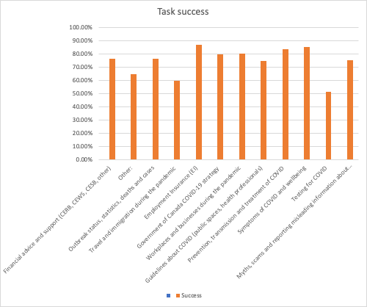
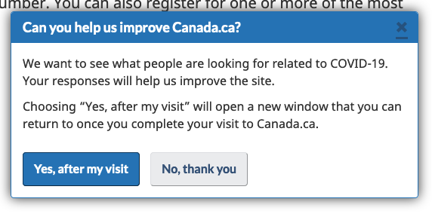
Initiation and discovery
Travel is one of the top COVID tasks visitors attempt online.
Responses from the page success questionnaire showed the average reported success rate for travel was 59.7%.
Call centres, inboxes are receiving a high volume of inquiries that could be managed through web content.
EO Inbox received 8,325* emails and closed 3,398 during the week of Sept 18-24
*Total Unique Enquiries (YTD)
Notes:
https://docs.google.com/presentation/d/1JPmZ3vF2bLNHYdjpydTNobTgBWEpzOEaHBlDkVIn7_c/edit#slide=id.p1
Reference: https://docs.google.com/spreadsheets/d/181V_7zL7UTmPLWWEh4T62gJ-tAW2Q2KtznML3P5XZn8/edit?usp=sharing

Slide 5
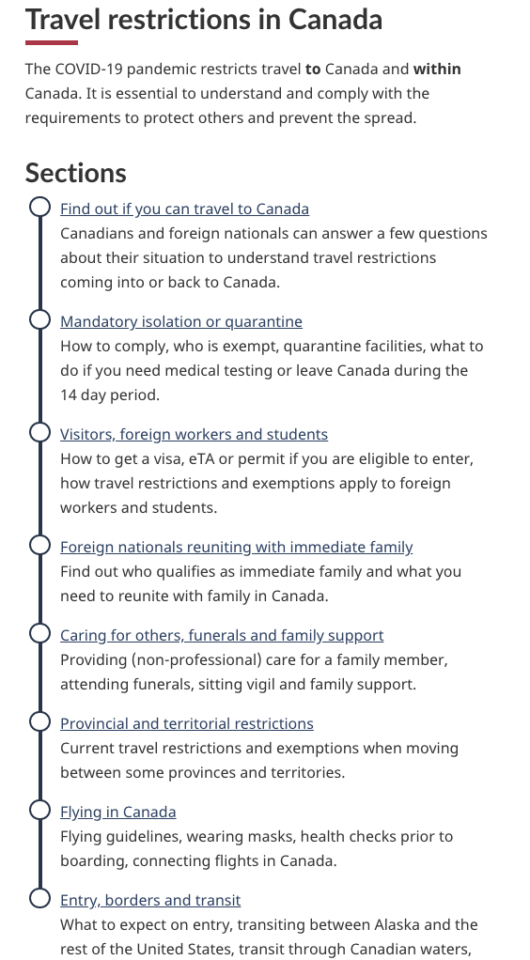
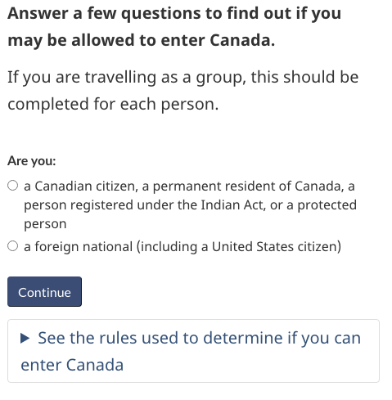
Building a solution together
Through workshop sessions with partners and subject matter experts, the team designed a wizard and a series of supporting pages.
Prototype
People can chose to:
answer questions based on their situation to get a customized answer
look up details for a specific situation themselves within a consolidated, single group of web pages
Prototype link
Notes:
Partners: IRCC, CBSA, PHAC/HC, Transport, PCO

Slide 6
How we improved travel restrictions task success
Answers not information
Make complex simple with wizards
Surface tasks and answers
Answers first and integrate legal as content
74%
One source for travel
Collaborate to craft answers
Words matter
Clear, specific and direct language
task success on the travel prototype
Interactive definitions
Help people understand unusual definitions
Layer complex details
Simplify dense content into specific choices
Notes:
For a first run of optimization, 74% is a great result, given the complexity

Slide 7
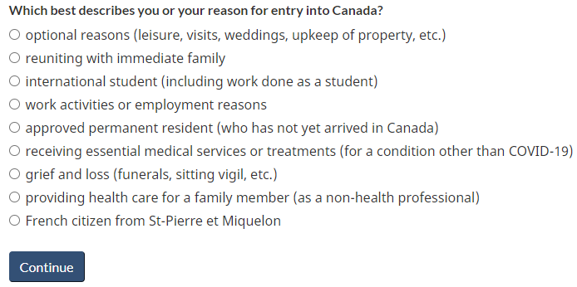
Live site vs prototype results for a similar task
Immediate family task: Farouk lives in Indonesia, and his brother is getting married in British Columbia in August. He plans on being in Canada for 20 days. Will Farouk be able to enter Canada?
Live site, unmoderated (Task 6)
Prototype, moderated (Task 9)
0/10 were correct
18/20 were correct 89%
Notes from July test analysis
Impossible to solve the task from the Travel restrictions page
Definition of “immediate family” is so different from people’s mental model that it needs to be defined more clearly
Wizard
“I’m glad it specifies wedding because a lot of people wouldn’t necessarily view that as optional” (P8)
“I like how it includes weddings, that was clear for me” (P7)
https://www.trymyui.com/pva/II181I7eOFUxV0iL (start at (18:45 - 05:01)
https://www.trymyui.com/pva/II1Y1S7eOwe9OnMv (16:45 - 05:47)
Notes:
Task 6 (in early testing) and task 9 (in prototype) are more directly comparable (wording was the same).
It really shows how it was nearly impossible solve the task in the live pages, and how it became relatively simple in the prototype.

Slide 8
Interdepartmental collaboration for
prototyping and launch

Slide 9
Interdepartmental and program/communications and Travel content
Travel, transport and immigration are handled by multiple departments.
This complicates:
findability for end-users
effort by departements to reduce duplication
Example: Current information for students, workers and visitors is repeated on 3 different long, complex departmental pages
Notes:
Travel restrictions during COVID-19 are complicated for Canadians and those aiming to visit or immigrate to Canada
User testing of current COVID-19 Travel pages
highlighted struggles for those trying to figure out the rules applying to their circumstances
Some information currently overlaps and some
is contradictory depending on the departmental page being viewed
During testing, many participants drew
incorrect conclusions about travel to Canada
Many crucial pages that explain rules for workers, travellers and students are long and complicated

Slide 10
Interdepartmental and program/communications collaboration
A whole-of-Government approach is required to consolidate information and support increased task success.
Putting travel information in one place:
ensures content is not duplicated or contradictory by building together
simplifies the user journey
fewer calls, emails, complaints at the border
Coordinated content management should mean:
formal collaboration between departments
cross-discipline representation from Digital and Strategic Communications, as well as Program and Policy
Notes:
Travel restrictions during COVID-19 are complicated for Canadians and those aiming to visit or immigrate to Canada
User testing of current COVID-19 Travel pages
highlighted struggles for those trying to figure out the rules applying to their circumstances
Some information currently overlaps and some
is contradictory depending on the departmental page being viewed
During testing, many participants drew
incorrect conclusions about travel to Canada
Many crucial pages that explain rules for workers, travellers and students are long and complicated

Slide 11
Governance (distributed accountability)
Governance and maintenance of the coordinated content requires ongoing effort and commitment from partners.
Prototype and content design, interdepartmental delivery leadership: TBS
Interdepartmental collaboration and governance oversight: PCO
Content contributors: CBSA, IRCC, TC, PHAC
Content oversight and validation: PHAC
Technical ownership and production: GAC
Performance measurement: GAC, PHAC
In the old model, each department would have had all these responsibilities.

Slide 12
Governance: Interdepartmental travel working group
The working group:
supports safety and security of travellers with accurate, up-to-date information
provides approvals and substantive guidance to content and approach
focuses on product development with usability at the forefront
stays agile with quick decisions and changes
keeps the web tool focused on call drivers and task success
approves removal of duplicate content post-launch
improves continuously based on evidence and user feedback

Slide 13
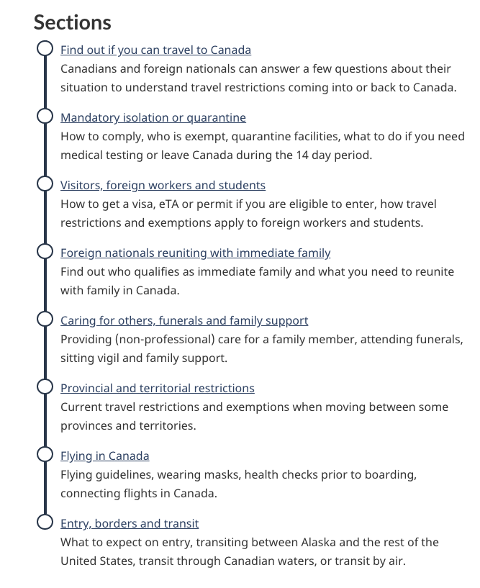
Shared ownership and responsibility
PHAC with contributions from others
Content management and updates
Departments are responsible for specific subject areas and supporting pages
Departments provide simple approved updates to GAC, who publishes the changes
Complex changes will be viewed on a staging site and must go through a more complete UX/QA review by the working group
Wizard
IRCC
Supporting pages
PHAC
Transport
CBSA

Slide 14
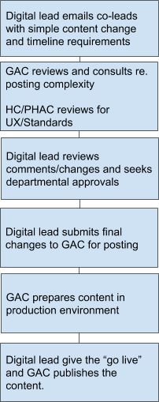
Updating content
Example of a simple request workflow
For complex requests, there will be additional steps to include increased collaboration, quality assurance and approvals.
Content change requests will:
be submitted and tracked following a pre-established workflow
identify all impacted pages within the COVID travel section
respect departmental approval processes and requirements
GAC provides 24/7 publishing for urgent requests

Slide 15
Challenges Solutions
Complex approval processes | Present approval packages in context, using demos
Sequencing of OIC changes and approvals led to heavy workload for programs teams at PHAC | Apply Agile and Lean processes to simplify approvals (to be done)
Concerns about capacity for multiple federal departments to maintain or rapidly update materials | Develop workflow process, maintain interdepartmental working group to manage integrated product, identify clear roles/responsibilities/ownership for post-launch
Keeping team members up to date as development happened during summer vacation period | Bring replacements in early, document research findings and decisions, take time for successful knowledge transfer

Slide 16
Next steps
Launch:
GAC to implement prototype from DTO handoff on September 8
Launch the pages after new OIC changes, adjustments and legal reviews are incorporated - soon
Post Launch: Travel working group to focus on:
Efficient, collaborative updates and improvements
ROT exercises with departments to reduce duplication
Performance measurement and enhancements
Develop lessons learned: successes, areas for improvement

Slide 17
The case for the wizard approach to complex content

Slide 18
Project retrospective
The case for the interactive wizard-based approach to travel restrictions information
Testing: comparative results; improvements
Interdepartmental collaboration for prototyping and launch
  Departments involved: TBS, CBSA, GAC, PCO, PHAC, HC, IRCC
The lessons learned from this project are critical for projects involving multiple stakeholders, that move quickly from rapid prototyping to deployment
Notes:
A focus on calls, emails and errors will require data collection from participating departments

Slide 19
The case for redesign
Travel restrictions during COVID-19 are complicated for Canadians and those aiming to visit or immigrate to Canada
Usability testing highlighted struggles for those trying to figure out the rules that apply to their circumstances
Travel, transport and immigration are handled by multiple departments, complicating efforts at clarity and attempts to reduce duplication

Slide 20
Live site - early testing details
30 minute usability sessions with Canadians
  Remote testing using mobile device on Validately testing service
  6 tasks (updated after the June 23 sessions)
  Sessions were recorded with permission (all participants gave their consent)
June 23
6 participants (all in English) completed informal sessions on Validately
July 9
10 participants (5 in English and 5 in French) completed informal sessions on TryMyUI

Slide 21
Live site - early testing results before prototyping
*We cannot directly compare early testing as a baseline due to different task wording, lack of moderation, and less task performances to compare. However, early testing provided a sense of the struggles with current live content.
T1: Layla resides in Ontario and wants to visit PEI next week for 7 days. Will she be allowed in the province?
T3: Juana's aunt and uncle have offered to come to Canada from their home in California to care for the children for the summer. Will they be allowed into Canada?
T5: Sakura is coming from Japan to study in Canada on a student permit. Will she be allowed into Canada? (Note: Success criteria didn’t require recognition of a non optional reason - ‘having a permit’ was marked correct)
T6: Farouk lives in Indonesia, and his brother is getting married in British Columbia in August. He plans on being in Canada for 20 days. Will Farouk be able to enter Canada?
2/10 were correct
1/6 were correct
10/16 were correct
0/10 were correct
Notes:
Overall success on these four tasks was: 13/42
Important to note that we can’t really directly compare early testing to the prototype testing because of:
only 4 of the 9 tasks were tested in the early testing
of these 4 tasks, the wording changed significantly on 3 of them
Different methodology

Slide 22
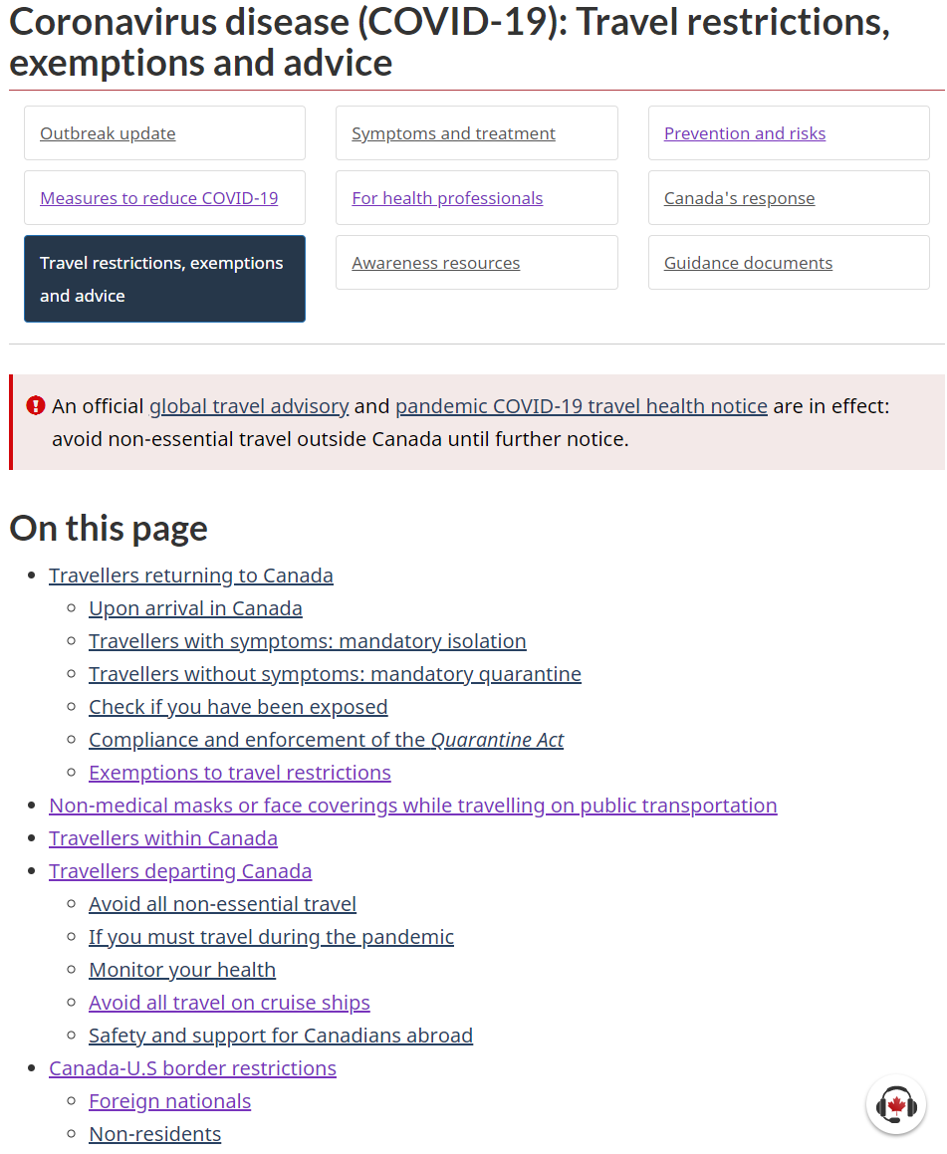
Summary of issues on live site
Usability testing confirmed key challenges with the live content:
  Duplicate and scattered content
  Long pages
  Complex information
  Mix of integrated and siloed content
  Missing and misleading content
Many people failed on the live site.
Watch participants struggle with this page:
https://youtu.be/C99x-rQvqCk?t=994

Slide 23
Testing the prototype with travellers
21 participants completed formal sessions (10 in English and 11 French + 2 pilots not analyzed)
  Testing performed on device of their choice
Recruiting criteria
  Mix of Canadians and non-Canadians
  Half of non-Canadians were not native English/French speakers
  Participants included:
    Canada - 15 (ON - 6 , QC - 5, BC - 1, NS -1, MB -1, NWT -1)
    Abroad - 6 (Poland -1, Nairobi -1, France -2, USA -1, Romania - 1)
60 minute usability sessions
  Remote testing using Zoom
  9 tasks randomized with T9 being last
  Sessions were recorded with permission (all participants gave their consent)

Slide 24
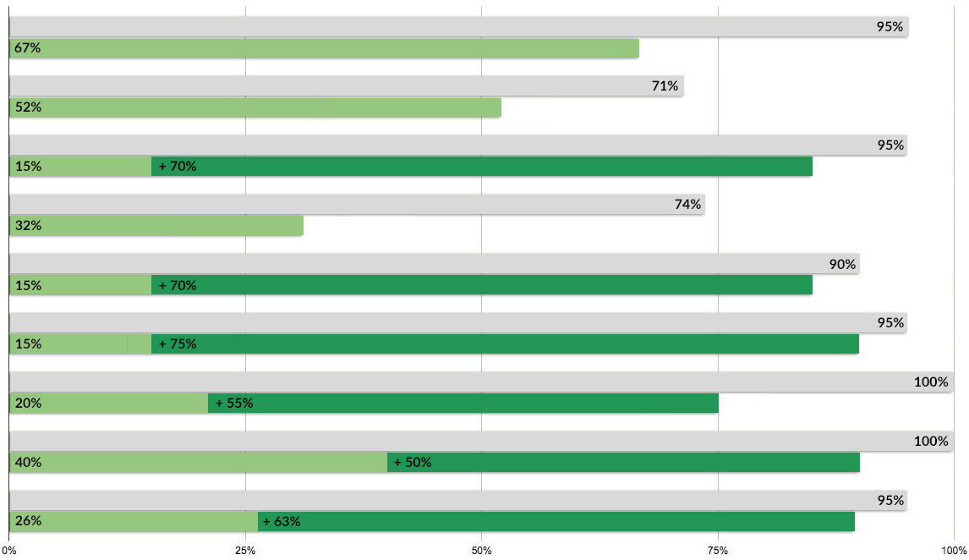


Prototype delivered high task success rates
Results combined EN and FR
T1: Travel within Canada
T2: Connecting flights
T3: Immediate family (wedding)
T4: Leave Canada
T5: Temporary foreign worker
T6: Foreign Student
T7: Grief and loss
T8: Caring (U.S.)
T9: Immediate family (childcare)
Notes:
The grey band represents the percentage of people who got to a place where they could have found the answer
The overall green band represents to the percentage of people who actually found the answer
Light green: % of people who found the answer on the support pages (not the wizard)
Dark green: % of people who found the answer in the wizard
For the tasks that could be answered from the wizard, the wizard is what helped the most

Slide 25
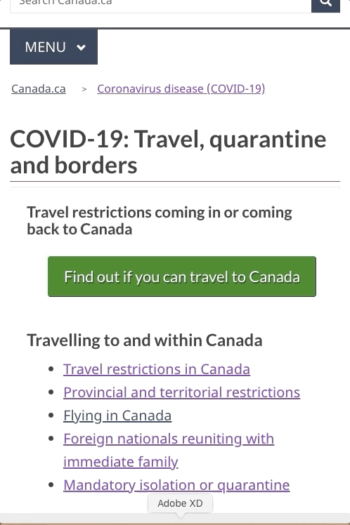
Answers not information:
Wizards are more successful
6 tasks could be completed using either the wizard or the supporting pages.
Wizard: participants chose to use the wizard more than twice as often, and had a success rate of 93%.
Supporting pages: Participants who chose to use the supporting pages had a success rate of 70%.
People get confused by content that is irrelevant to their task. Wizards reduce cognitive load and help people find and focus on customized answers.
(T3, T5, T6, T7, T8 and T9)
Notes:
T1, T2 and T4 are excluded - because they could *only* be answered on supporting pages, and not the wizard
Stats
82 people used the wizard, 76 succeeded. (93%)
37 people used the pages, 26 succeeded. (70%)
The wizard really help people find and understand the content that was relevant for them.

Slide 26
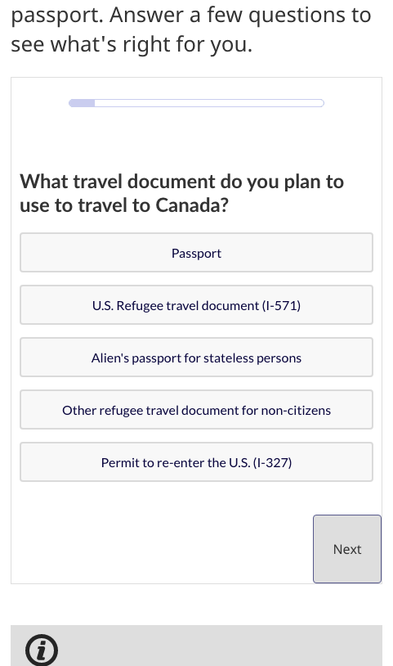

Wizards are not new or risky
Question and answer and interactive ‘wizard’ models have proven to improve task completion (to help people get the service or information they need) in other areas, eg:
IRCC: Find out if you need a visa
  used by millions of visitors 2016-2020
CRA: How to apply to CERB
ISED: Find financial help during COVID
A wizard makes no promises. It gets a user to specific information and reduces distracting details that are irrelevant to the user’s task. It includes disclaimers or warnings
Notes:
Most people need a visa or an Electronic Travel Authorization (eTA) to travel to Canada - it’s complicated
Applying the interactive model
• Question and answer and interactive ‘wizard’ models have proven to improve task completion (to help people get the service or information they need) in other key COVD support and topic areas, eg:
• Individual benefits navigator (ESDC and CDS)
• Business benefits navigator (ISED)
• Program applications, eg CERB and CEWS (CRA)

Slide 27
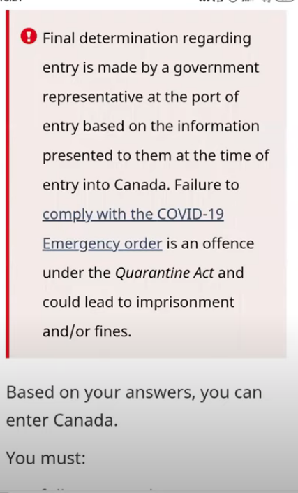
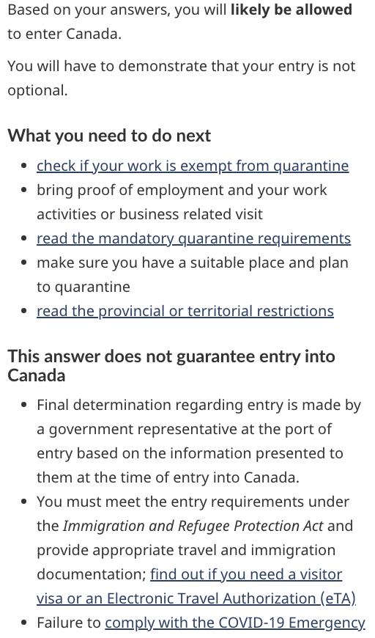
Surface answers, link next steps, integrate the legal
People scrolled past disclaimer each time to see the answer first
Version 1
Version 2
“What you need to do next” heading - people clicked through to read more
“You must” - wasn’t clear these were next steps
People read the legal notice when it was part of the answer
Notes:
Wizards all the way down - we link to the visitor visa / eTA wizard to help people understand what travel documents they’d need.

Slide 28
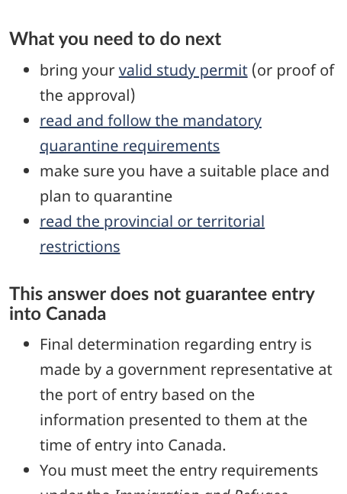
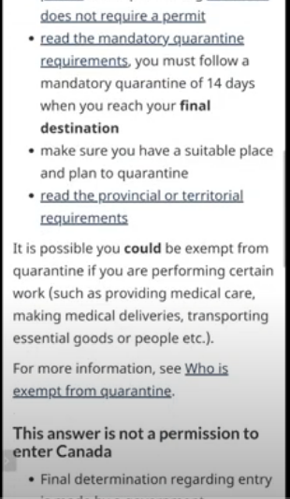
Words matter
Version 2
Link with partial answer (14 days) stopped people from exploring further (satisficing)
Version 1
“Read and follow” encouraged click-through for more details
“Permission” was perceived as something to be granted elsewhere
“Does not guarantee entry” was understood as intended

Slide 29
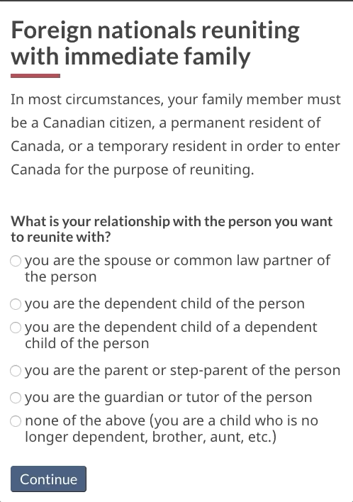
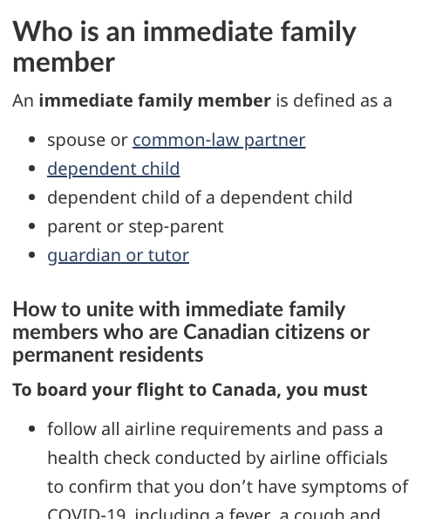
When you break a mental model (idea of family), help people understand
After
Success on live content:
1/6 - aunt/uncle
0/10 - brother
Success using a choice:
17/20 - aunt/uncle
18/20 - brother
Live site

Slide 30
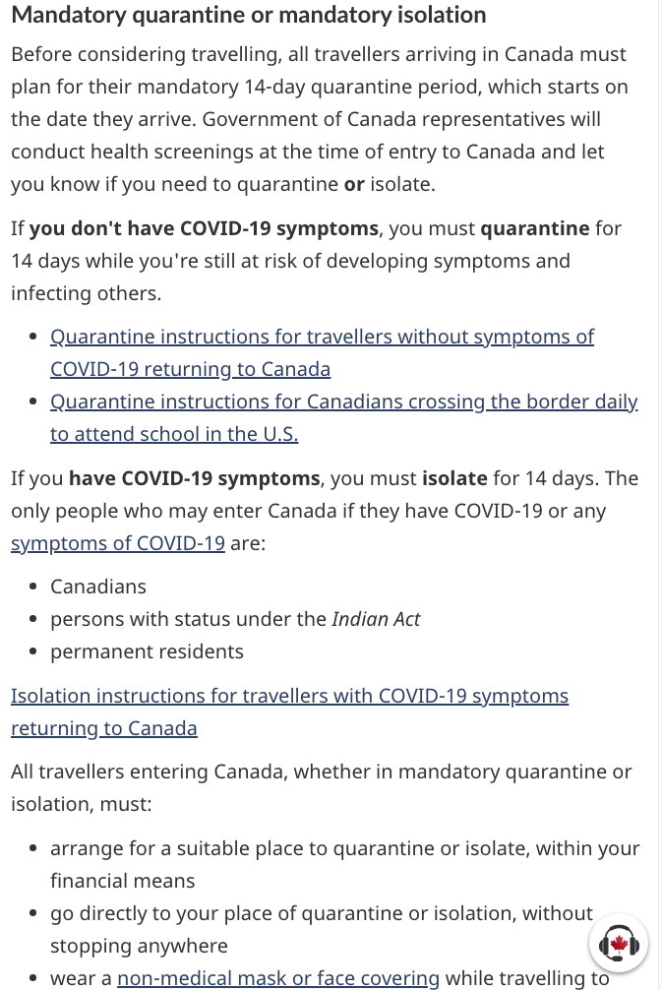
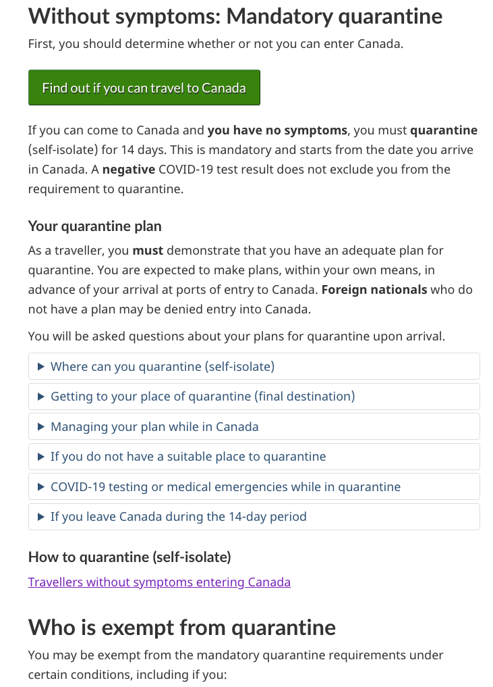
Segment complex details that don’t apply to everyone
Live site
Huge volume of text + isolation, quarantine, exemptions grouped with only small subheadings
After
Quarantine, exemptions, isolation as main headings
Expand/collapse pattern lets users choose the specific detail they want to learn more about

Slide 31
Performance breakdown by task

Slide 32
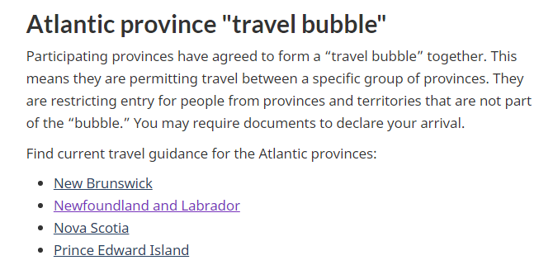
Task 1: Travel restrictions within Canada
Results
14/21 successfully completed the task
  20/21 skipped over the wizard (this wasn’t a wizard task at all)
Findability 20/21
Factors improving success
Strong information scent with Provincial and territorial restrictions page
Adding the Atlantic province “travel bubble” summary
Further improvements
Consider working with provinces and territories to ensure content is consistent across websites
“So that’s me. I’m not in the bubble. If I want to be really sure I can click the link of Newfoundland.” (P8)
Supporting
“Elles limitent l'entrée des personnes provenant des provinces et territoires qui ne font pas partie de la "bulle”. C'est ça.” (P16)
Watch clip: P5, P8, P12, P16

Slide 33
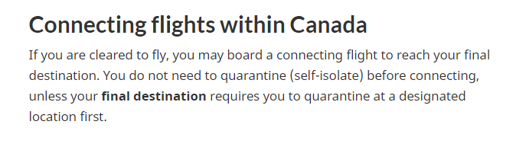
Task 2: Understanding quarantine
“Looks to me that I would be able to go and just have to quarantine when I reach my final destination” (P8)
Results
12/21 successfully completed the task
  4 answered correctly using the link in the wizard answer to go to a supporting page
  2 answered wrong from mandatory quarantine requirements
  How many hit TL? Pretty big issue?
Findability 15/21
Factors improving success
Using green button to access the wizard
Created Connecting flights within Canada content on the provinces page - has high level summary of what to expect
Putting the term “final destination” in bold
Supporting
Watch clip: P8

Slide 34
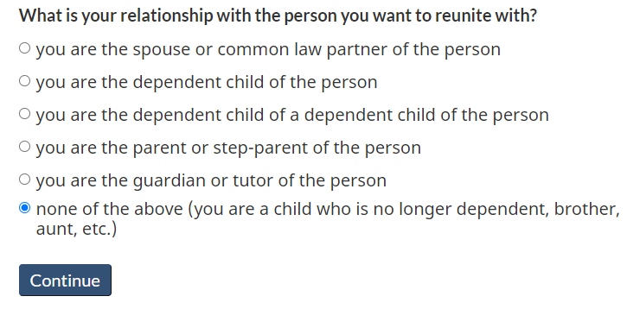
Task 3: Immediate family (Brother’s wedding)
Wizard
Results
17/20 successfully completed the task (1 after the time limit)
  14 answered using the wizard
  2 answered from Foreign nationals reuniting with immediate family
  1 answered in “full rules”
  1 answered wrong (from the Mandatory isolation and quarantine page) and 1 guessed without finding any content
Findability 19/20
Factors improving success
Call to action button access to the wizard
Using a choice to help people understand the definition of immediate family.
Having clear, specific examples included with radio buttons (“weddings, aunt, etc.”)
“I’m glad it specifies wedding because a lot of people wouldn’t necessarily view that as optional” (P8)
“I like how it includes weddings, that was clear for me” (P7)
Supporting
Watch clip: P2, P5, P10

Slide 35
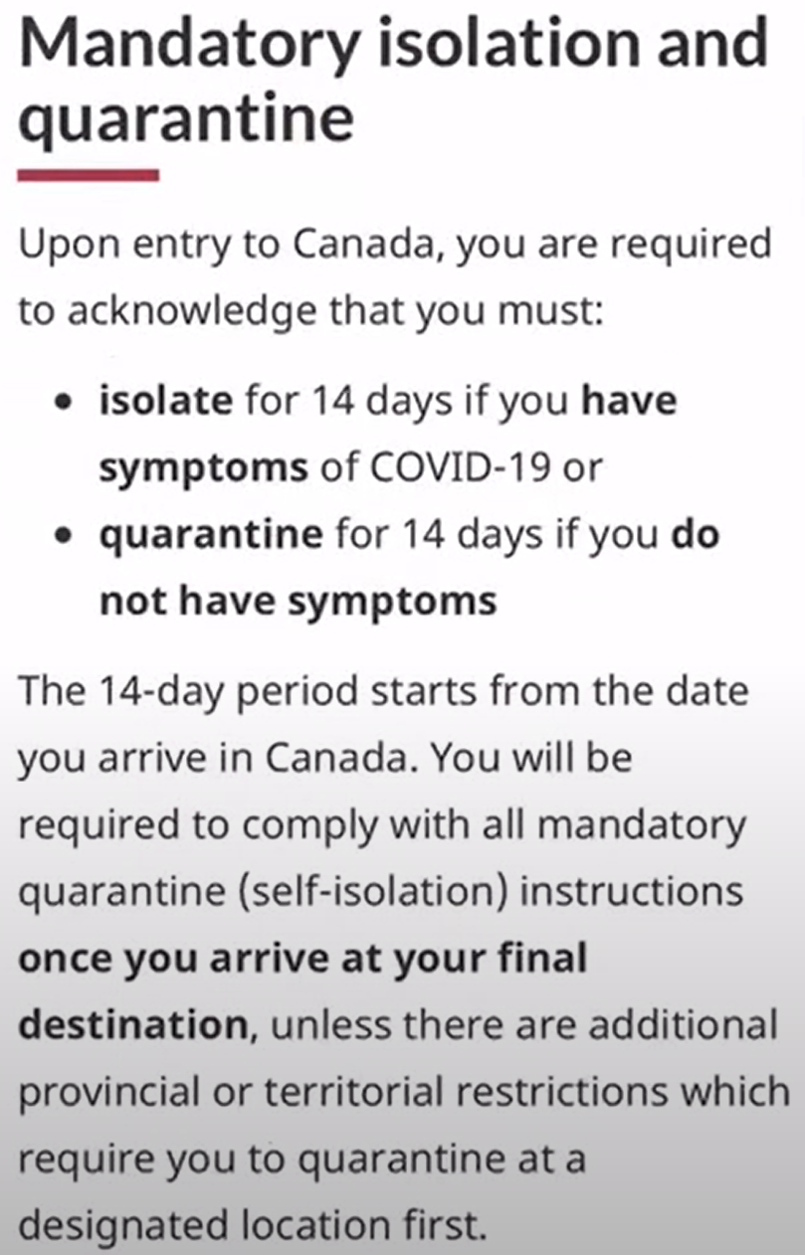
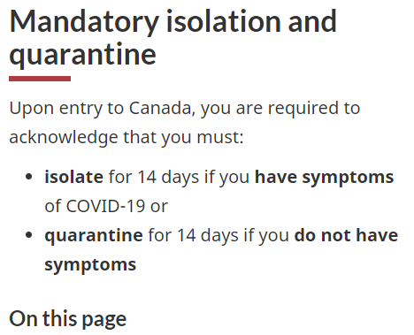
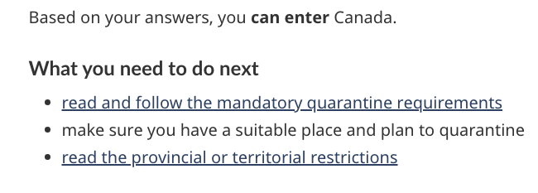
Task 4: Leave Canada (visit for 10 days)
Results
6/19 successfully completed the task (1 after the 5 min time limit)
  8 answered wrong because of “satisficing.” When they read “14-day quarantine” they stopped looking, and concluded there was no way out of it.
  5 ran out of time
Findability 14/19
Factors improving success
Removing content about 14-day quarantine in wizard answer to entice users to keep looking
9/10 clicked through to the isolation page after this change, compared to 6/10 before.
Moving content about quarantine start date from the top of page to an expand/collapse in both subsections with / without symptoms stopped satisficing at the top
Supporting
Wizard
Watch clip: P2, P8, P11, P16
Notes:
Problem was clearly satisficing - we can see how FR did better Strengthen content for Canadians who want to leave Canada - we did create an expand/collapse devoted to leaving in the Isolation/Quarantine page

Slide 36
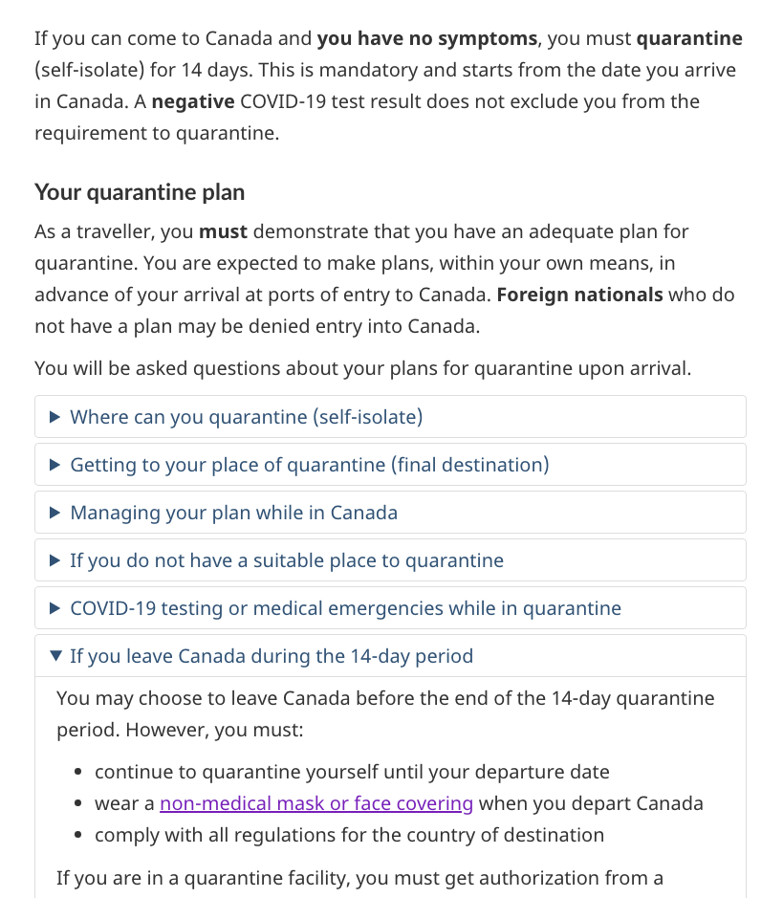
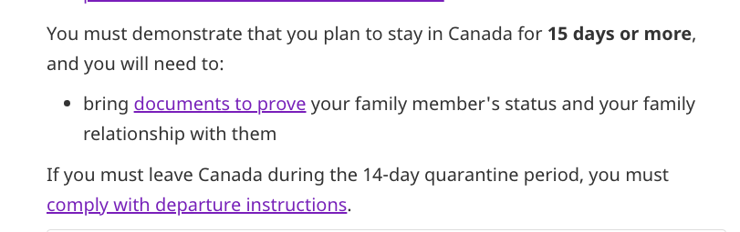
Task 4: Leave Canada - further improvement
Supporting
Satisficing remains a problem
When the 14-day period text was removed from the wizard answer, 9/10 clicked through to the isolation page. 6 satisficed when they saw it on the isolation page, and the other 3 were correct
Trips less than 15 days are discouraged
PHAC asked for content about staying less than 15 days to be removed (FN family page), putting the emphasis on planning to stay and linking to the “if you must leave” content.
It’s a different approach now, “have to leave” vs “want a short visit and can leave”. Further testing / review calls and feedback recommended.
Those who “must leave” might be more successful with this new content, whereas citizens wanting a “short visit” were not (which seems to be the desired messaging now)
Leaving Canada opportunity for rescue link
2 thought “Travelling outside of Canada” would have the answer. A rescue link to the isolation page expand/collapse about leaving while under quarantine would make sense
Supporting
Supporting

Slide 37
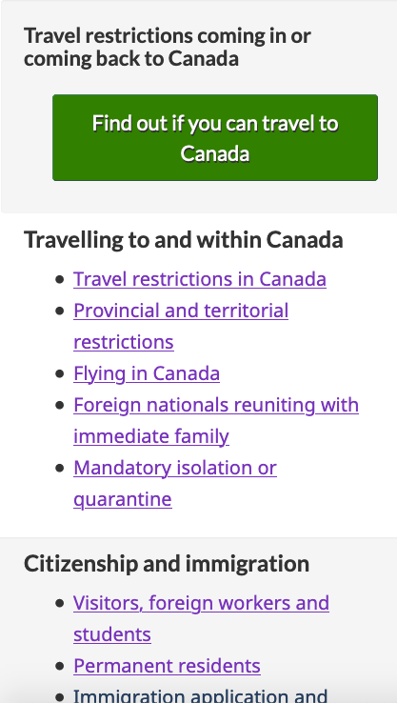
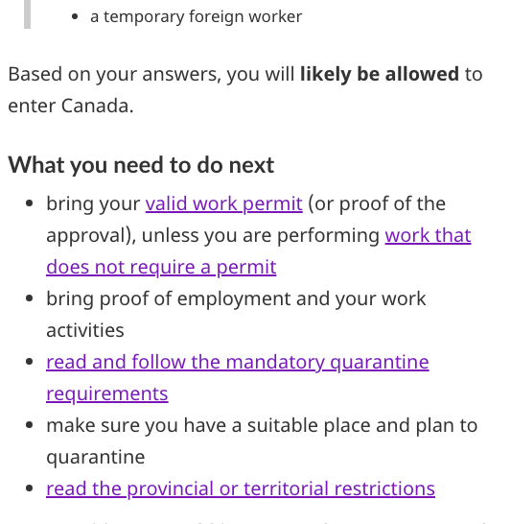
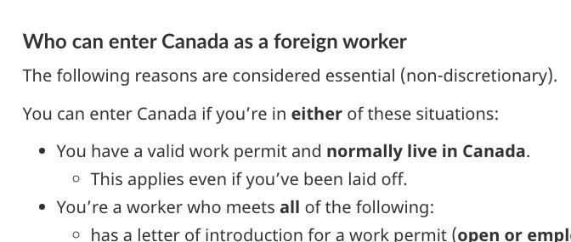
Task 5: Temporary foreign worker
“I’m curious about the big button even though I’m going through and trying to find something specific, my first instinct is to click that.” (P7)
Results
17/20 successfully completed the task
  14 answered correctly using the wizard, 1 was wrong
  3 answered on ‘Visitors, foreign...’
  1 timed out after starting with wizard, backed out
  1 was wrong for guessing correctly but does not actually see the answer
Findability 18/20
Factors improving success
Strong information scent for ‘workers’ in the wizard and ‘Visitors, foreign..’ from the SIT page
Clear and specific headings, clear bullet points on answers
Wizard
Supporting
Watch clip: P7 (EN) and P15
Notes:
It’s confusing to have noticing “border guard” as a success sub bullet. I isn’t a factor in our coding for success. Perhaps we need a slide solely devoted (across ALL tasks) to show CBSA that they saw the notice in this final format better?
https://youtu.be/bZjB9pDaIsg?t=1189

Slide 38
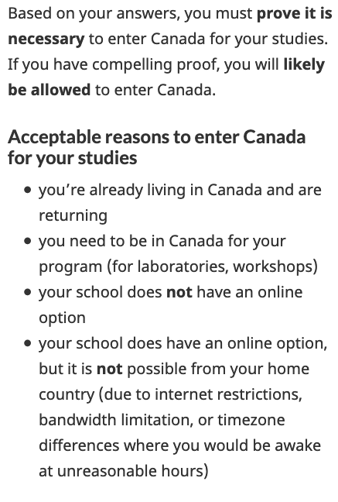
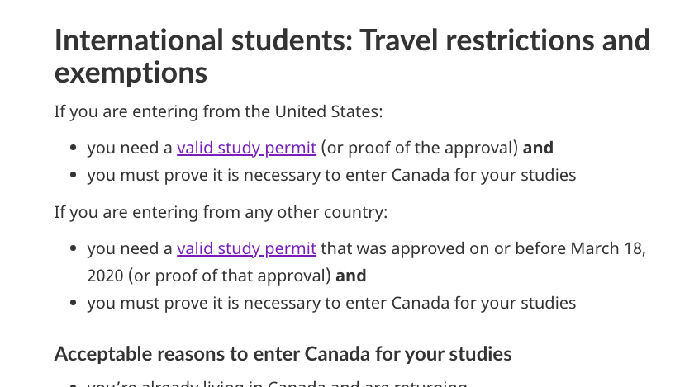
Task 6: Travel restrictions for students (from U.S.)
Results
18/20 successfully completed the task
  15 answered from using the wizard
  3 answered on ‘Visitors, foreign...’
  1 was wrong minor (yes but not quarantine)
Findability 19/20
Factors improving success
Wizard call to action was clear
Strong information scent for ‘students’ in the wizard
Clear headings and concrete examples of situations such as labs and workshops for which they may enter Canada to study
“I find wizards like that so much easier to use than digging through websites on your own” (P2)
Wizard
Supporting
Watch clip: P11 (FR) and P2 (EN)

Slide 39
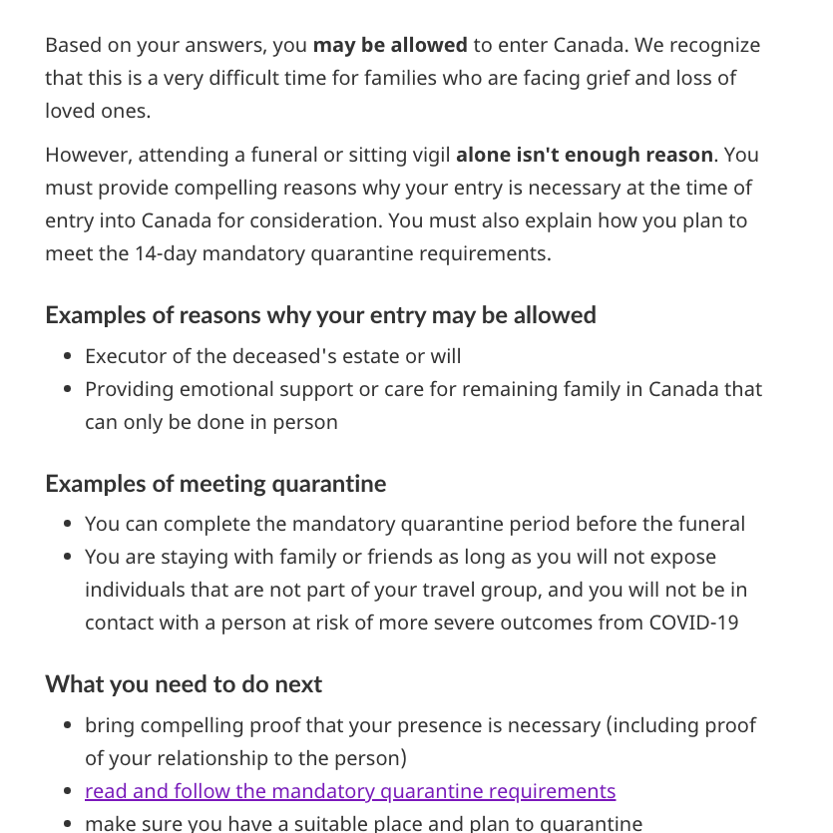
Task 7: Grief and loss (Grandmother’s funeral)
Results
15/20 successfully completed the task
  11 used the wizard to answer correctly (2 timed out, 2 made minor errors)
  4 used the ‘Caring for others’ (1 timed out)
Findability 20/20
Factors improving success
Strong information scent for ‘grief and loss’ from the wizard and ‘Caring for others’ from the SIT page
Clear headings and examples of why entry is considered not optional and and how to meet quarantine
Use of bold text on key points
Well managed expectations - content is open and honest
Wizard
Watch clip: P7, P8, P15

Slide 40
Task 7: Grief and loss (Grandmother’s funeral)
The answer changed while building the prototype
The task was designed for the correct answer to be “No,” but we learned there are special cases where you can come in.
Addressing this required adding information to the task that we hadn’t considered in its design.
We encouraged the facilitator to say “he only wants to attend the funeral” if asked for clarity. However, not everyone asked for clarity so some did not get this prompting to help better understand the complexity.
The task is complex and personal
2 were WM (wrong minor). They knew Naveen had to quarantine, however, they did not seem to recognize how or if they’d know if his entry was optional / not optional or where he could quarantine in order to attend within the 5 days.
3 were TL (time limit). These people tried to find a clear answer for if his entry was optional or not, or if he could quarantine in the same place as the “funeral or vigil”, or if there was another way he could attend in 5 days.
"Seems like you have to plead your case, it might work but admittedly it would be intimidating to travel all that way and not have a clear answer”. (P7)

Slide 41
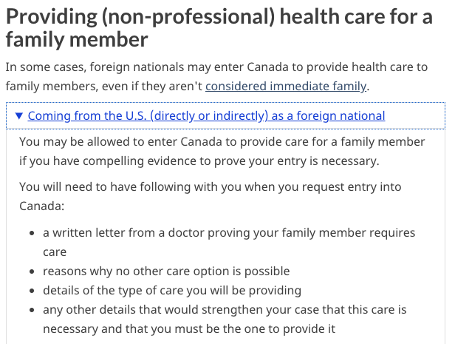
Task 8: Compassionate care (Sick mother)
“‘Caring for others..providing health care for a family member’ seems to be the better choice she’ll need specific documents.” (P9)
Results
18/20 successfully completed the task
  9 first clicked the wizard (10 were correct in wizard)
  9 first clicked to ‘Caring for others ‘
  1 first clicked from ‘Reuniting with family’ and used rescue link ‘Caring for others’
  2/20 reached time limit (1 eventually found the correct answer)
Findability 20/20
Factors improving success
Strong information scent with ‘Caring for others’
Clear heading ‘Providing (non-professional) care’ and expand/collapse heading
Participants understood clearly that entry would be dependent on having the correct items/evidence
Supporting
Watch clip: P8, P14 (FR)

Slide 42
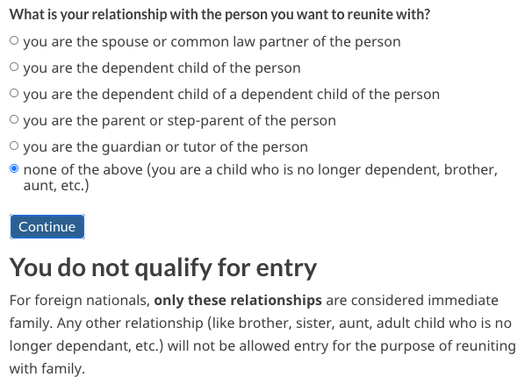
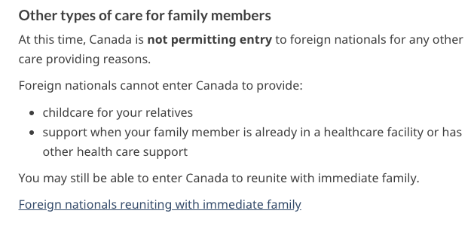
Task 9: Immediate family (childcare)
Results
18/20 successfully completed the task
  12 answered correctly using the wizard
  4 answered from ‘Caring for others’
  2 answered from ‘Reuniting with family’
Findability 19/20
Factors improving success
Wizard question to determine whether immediate family
  When ‘none of the above’ is selected, clear that aunt and uncle are not deemed immediate family
Cross link to ‘Caring for others’ for detailed information on what types of care are application
Heading ‘Other types of care’ further explains that childcare is not a reason for entry
Wizard
Supporting
"I'm not sure exactly if immediate family is family and kids, or [includes] aunt and uncles" (P2)
Watch clip: P2, P4, P15 (FR)
Notes:
Change in the wizard with “you are the guardian” - language changed in the prototype (prototype iteration)
Changed by P5; higher success rate when this was changed

