Slide 1
NNHPD New Employee & Student Welcome Kits Guide

Slide 2
What is it?
Natural and Non-prescription Health Products Directorate
The NNHPD New Employee & Student Welcome Kits act as a central hub where the user can click directly on information that will lead them to files to help guide them through the onboarding process.
It was designed for new employees and new students to the NNHPD in Health Canada so that they have one universal document they can use to walk step by step through the many aspects of starting their new role.
The info contained within the kits is structured in a way that will take the user from one resource to another in a chronological sequence spanning their first 3 months as a new public servant in the NNHPD.
NNHPD Welcome Kit

Slide 3
How does it Work?
Natural and Non-prescription Health Products Directorate
The Placemat contains multiple pages that each represent a different stage of the onboarding process.
Each page has a number of text boxes that are sequentially listed in the order that they should be explored.
As the Red Arrow indicates on the page, the text boxes can be clicked on directly which will link the user to the page(s) necessary to complete that step of the onboarding process.
*Click* on the Text Box to go to the Page
STEP 1
*CLICK* On The Text Box
NNHPD Welcome Kit

Slide 4
How Does it Work?
Natural and Non-prescription Health Products Directorate
STEP 2
NOW LOADING…
NNHPD Welcome Kit

Slide 5
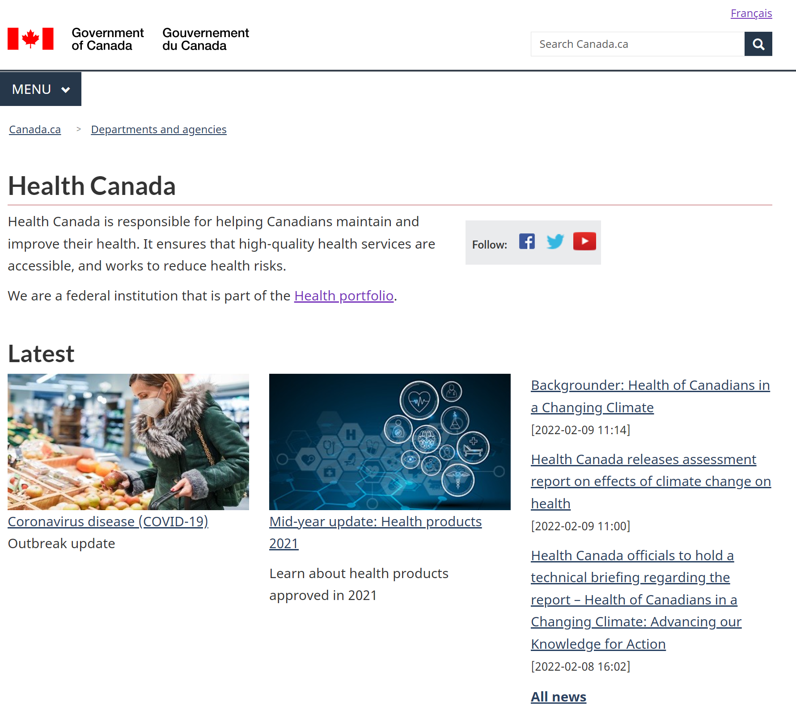
How Does it Work?
Natural and Non-prescription Health Products Directorate
STEP 3
The link has opened!
***Some links will only work when connected to VPN***
NNHPD Welcome Kit

Slide 6
Before You Begin
Natural and Non-prescription Health Products Directorate
These documents and webpages will walk you through the steps necessary to take before you start on your first day in your new role.
There are resources for general Health Canada knowledge, as well as remote and onsite working guides.
It is also important to note that all public servants must be vaccinated per the “COVID-19 Vaccination Policy”.
NNHPD Welcome Kit

Slide 7
Your First Day
Natural and Non-prescription Health Products Directorate
On your first day you will set up your workstation, be introduced to your new team leaders, and learn about the structure of Health Canada and the NNHPD.
An Onboarding Checklist is available as well as additional resources on your first day to ensure you have all of the necessary tools to be set up for success.
You will also set up your SAP account and learn of the critical importance of time tracking.
NNHPD Welcome Kit

Slide 8
Your First Week
Natural and Non-prescription Health Products Directorate
Your first week in your new position will be filled with learnings and training sessions that will help ease you into your new role with the NNHPD.
You will focus on your initial orientation and all of the knowledge you gather from the week will culminate in a brief survey to see how you are feeling based on your new experiences.
NNHPD Welcome Kit

Slide 9
Your First Month
Natural and Non-prescription Health Products Directorate
In addition to the orientation process of your first week, your first month will include additional supplementary training courses that can be accessed to gain a wealth of knowledge specific to your new role.
There are also resources available on pay and benefits, as well as talent management.
NNHPD Welcome Kit

Slide 10
Your First 3 Months
Natural and Non-prescription Health Products Directorate
By this point in time, you will be more familiar with your work environment and the expectations that come with your new position in NNHPD.
There are a few additional administrative tasks that will need to be finalized after the 3 month mark.
Another survey will be available to gauge how you are feeling in your new role, as well as how you feel about your experiences in the overall onboarding process.
NNHPD Welcome Kit

