Slide 1
COVID-19 data integration and visualization
Theme Management Committee and COVID-19 web working groups
July 7&8, 2020

Slide 2
COVID-19 data integration and visualization
Since the outbreak of the COVID-19, there has been a need for visual tools that: - help decision makers interpret and report on the data - help the public understand the data and how decisions are being made - are useful for researchers and health professionals
Accurate, consistent and timely information, collected from a number of sources (PHAC, National Microbiology Lab, StatsCan, Provinces and Territories)
Problem
Multiple data sources
Difficult to understand in raw form leaving room for misinterpretation
Need to provide context
Multiple audiences with different needs (public, media, health professionals, researchers, senior officials)
Accessibility and usability across digital platforms
Data consistency across websites and tools (manual updates)
Goal
Ensure that data is usable by different audiences, that it’s organized in a logical way and findable, that it’s understandable, leaving as little room as possible for misinterpretation, and that the data is consistent across all government channels. (reduce risk of human error and provide a reliable source of information to Canadians and senior officials)
Strategy
Develop and implement visual solutions such as dashboards to meet the needs of senior officials
Share raw data through StatsCan and OpenGov portals for researchers and other stakeholders
Create accessible HTML pages for the public with web written context pieces that draw data from the same sources

Slide 3
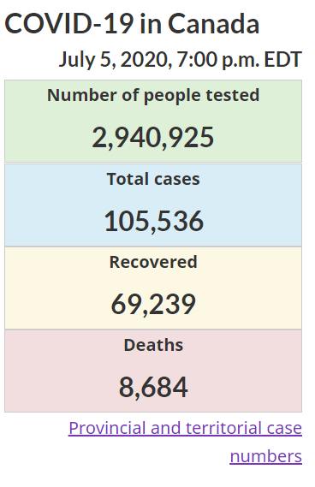
COVID-19 data integration and visualization
Approach
Respond to requests from senior officials
Create data visualization dashboards using ArcGIS platform
Point to tabular data sources (PTs, StatsCan and OpenGov portals)
Leverage Digital Comms team web writers to adapt information from data specialists and write for web audience
Build accessible and mobile friendly web pages that automatically update from the same data sources as the dashboards
Collaborate with colleagues, experts, institutional and interdepartmental partners (PTs, NRCan, StatsCan, HC, PHAC etc)
Promote with social media, depending on audience
Evaluate performance through analytics and Social Media engagement

Slide 4
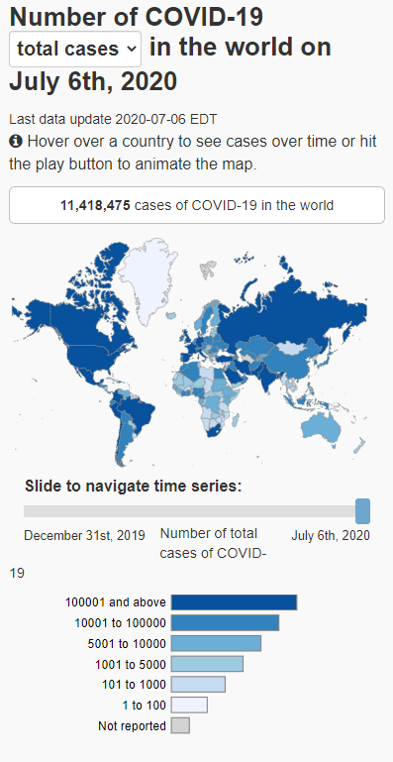
COVID-19 data integration and visualization
Considerations
Crisis communications content design checklist
Who is the audience? (internal officials and employees, public, health professionals, researchers, media)
Ensure that senior officials are informed and able to answer questions
If internal do we risk being seen as withholding information from the public
If external do we risk data overload making it difficult for the public to understand
Can the data be misinterpreted
Much of the data is collected by Provinces and Territories and by reporting on it is the Fed Gov overstepping - responsibilities?
PT’s report at different times can cause inconsistencies in the data
Privacy concerns depending on granularity of data
Urgency to release the data (difficult to meet all accessibility and web writing requirements)
Base release of data on advice and recommendations from senior officials, analytics and environmental scans (what are people looking for)

Slide 5
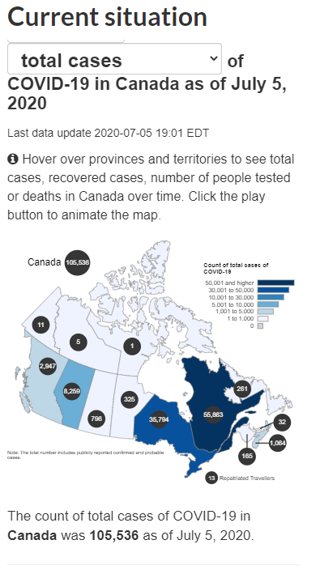
COVID-19 data integration and visualization
Ensuring consistency across digital tools
Automated updates from central data source (import PHAC data automatically every 5 minutes as opposed to manually updated twice a day)
Leverage capacity of Service Canada’s MWS system (AEM) which is built to support high volumes of incoming information
Linking to authoritative sources (Provincial and territorial information, Stats Can, PHAC)

Slide 6
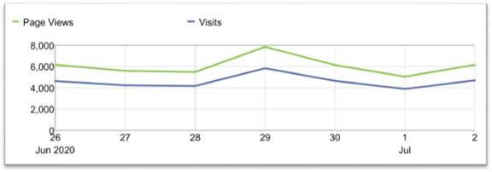
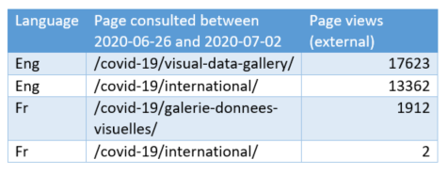
COVID-19 data integration and visualization
Impact
Consistent data across GoC platforms
An informed public
Tools available to help decision makers
Release of more data to meet senior official, stakeholder and public demand
Data available to stakeholders in format that best meets their needs
Epidemiological and economic research data: we’ve received 32K visits last week, for a total of 152K visits since launch.
Notes:
Topic list page with collection:
Epidemiological and economic research data
Data visualizations (Visual data gallery):
Interactive data visualization of COVID-19 in Canada
Interactive data visualization of COVID-19 in the world
Situational Awareness Dashboard
Epidemic curve
Demographics
Canadian Economic Dashboard
Data and modelling
To come:
Second version of the Situational Awareness Dashboard
Vulnerability Dashboard
Disease outcome and government response dashboard
On Hold:
Mobility trend Dashboard

Slide 7
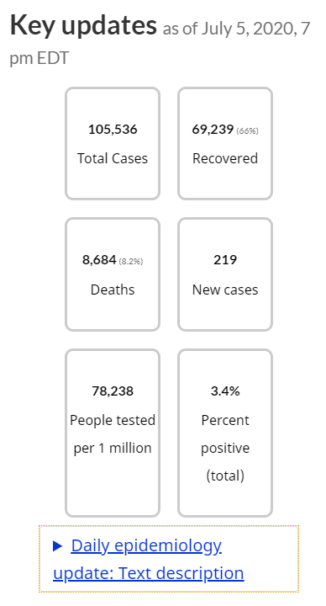
Key Takeaways
This solution is repeatable and can be leveraged for future similar needs for other departments
The collaborative nature of the approach allows for data to be delivered in a timely manner and ensure that it meets the needs of all Canadians and stakeholders

Slide 8
Related content and tools
Crisis communications content design checklist
Topic list page with collection:
Epidemiological and economic research data
Visual data gallery
Interactive data visualization of COVID-19 in Canada
Interactive data visualization of COVID-19 in the world
Situational Awareness Dashboard
Epidemic curve
Demographics
Canadian Economic Dashboard
Data and modelling
To come:
Second version of the Situational Awareness Dashboard
Vulnerability Dashboard
Disease outcome and government response dashboard
On Hold:
Mobility trend Dashboard

