Slide 1
Mindful Change Leadership Development Program
Session 2 (of 8)
May 15, 2023
Notes:
Alison:
Welcome to week 2
Alison, she/her
A reminder this session will be recorded, for those who have missed the session or if anyone would like to review the content again.
Land acknowledgement I am grateful to be speaking to you from the Treaty Lands and Territory of the Mississaugas of the Credit. You may known it as Burlington. Burlington as we know it today is rich in history and modern traditions of many First Nations and the Métis. From the Anishinaabeg to the Haudenosaunee (ho-din-no-shoni), and the Métis.
Wherever you find yourself today, I encourage you, in turn, to think about the presence of the Indigenous Peoples, past and present, who call these lands home."
To mention the following in French:
« Comme avec toutes les sessions du GC, s'il vous plaît, sentez-vous libre d'utiliser la langue de votre choix pour poser des questions ou participer à la discussion., La séance d'aujourd'hui sera conduit principalement en anglais, il y aura d'autres sessions en français qui seront promus via le GCTools (ou donner des dates précises, si disponible). »
As with all GoC sessions, please, feel free to use the language of your choice to ask questions or participate in the discussion., today’s session will be conducted mainly in English, there will be other sessions in French that will be promoted via the GCTools (or give specific dates, if available).

Slide 2
Notes:
Alison: To start with a quotation: it is never too late to be who you might have been.

Slide 3
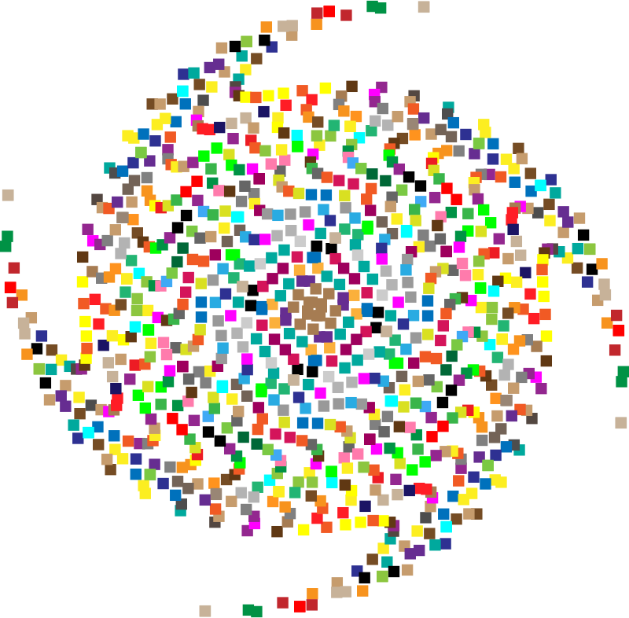
Mindful Breathing Exercise – Centering
Time required: 2 minutes
Sit comfortable, with back as straight as possible
Close your eyes or find a soft gaze
Focus on your breath
Notes:
Alison:
With this we will come into a mindful centering exercise to bring our attention and awareness to this moment and to set the space for a beneficial session for all.
Sit as comfortable as possible in a position that allows you to be awake, attentive and comfortable at the same time
You can put your feet flat on the ground, your palms on you lap, upside or downside as it feels more comfortable
Feel free to close your eyes, or semi close them
Follow my voice as I lead you through the exercise
Gently bring attention to your breath, no need to change the way you’re breathing, just notice it
Let’s not worry about time
Just focus on
Breathing in
Breathing out
If at any time your mind wanders away, being gently with yourself, acknowledge that thought, let it be, and bring back your attention to your focus of attention, your breathing
Breathing in
Breathing out
Now, we’ll take one full minute of breathing for centering ourselves
I’ll let you know when the minute is over
Just continue focusing on your breathing

Slide 4
Debrief from last week
Any insights about:
Your Buddy System
Your practice
Debrief
Any outstanding issues?
Notes:
Alison:
(Give space for 2/3 people to share)
Any specific individual issues, technical or adminstrative we can chat about them at the end of the session
(click)
With honesty, report on :
Were there any challenges?
What you noticed?
Any insights you realized?
(click)
(read from slide)
(click)
(read from slide)

Slide 5
Agenda – Week 2: The brain (focus, clarity)
Breathing exercise – 2 minutes
Debrief from last week
Mindfulness, The Brain & Neuroplasticity
Mindful Change Leadership & The Key Leadership Competencies
Practice: Mindful Breathing
Breakout Rooms Debrief
Notes:
Alison:
The agenda for today…
Today, we will explore two of the skills that a Mindful Leader shows: Clarity and Focus
Today, we’ll practice
Clarity by understanding what happens in the brain and body during stress and mindfulness
Introduce Mindful Leadership concepts
Focus by doing Mindful Breathing

Slide 6
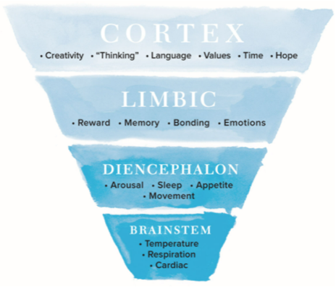
*The Brain
“What Happened to You?...”
Hierarchical organization of the human brain – The brain can be divided into four interconnected areas: brainstem, diencephalon (reptilian, limbic, and neocortex. The structural and functional complexity increases from the lower, simpler areas of the brainstem up to the cortex. The cortex mediates the most uniquely “human” functions such as speech and language, abstract cognition, and the capacity to reflect on the past and envision the future
https://www.amazon.ca/What-Happened-You-Understanding-Resilience/dp/1250223180/
https://www.youtube.com/watch?v=JlS8ApNBtuU&t=7s
Notes:
*(in neuroscience and evolutionary biology it is considered that the model of the three brains (neocortex, limbic and reptilian) is out of phase , among other things, because it understands the development of the brain as a process of construction by "pieces" that have been mounted on each other and that execute certain tasks by themselves. Nowadays, the opposite is believed: that in brain functioning it does not matter so much the function performed by the parts of the brain on their own as the way in which they connect with each other to work together and in real time.)*
This model talks about how the brain is formed; it has 4 parts to it. The interesting part of this model is that the prefrontal cortex is where the creativity, the thinking, the language, the values, the concept of time and the hope occur in the brain.
When the body gets into a fight or fly response, its reaction is to focus on the basic instincts, managed by the Brainstem and focused on the temperature, the respiration and the cardiac functions.
Just reiterating, this program is focused on awareness and how to be present and access the pre-frontal cortex.
((This program is NOT focused on trauma and healing, if you need help on that matter, please contact a specialist or EAP.))
References…
What Happened to you? : Conversations on Trauma, Resilience, and Healing - https://www.amazon.ca/What-Happened-You-Understanding-Resilience/dp/1250223180/
Jay interviewing Oprah - https://www.youtube.com/watch?v=JlS8ApNBtuU&t=7s
05:57 Commonly misunderstood concept about trauma
09:06 Going beyond success to heal your trauma

Slide 7
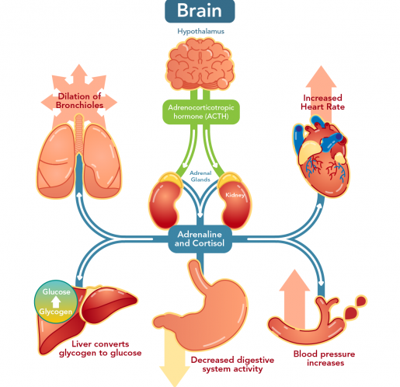
Stress Response
In times of stress, the brain reduces resources that are normally allocated to systems that are not needed during an emergency.
Notes:
Alison:
When under stress, our brains have evolved to automatically shut down the functions that don’t have to do with immediate survival both.
It diverts resources to address the stressor.
Think of fight, flight or freeze symptoms – increasing heart rate and breathing rate incase you need the extra energy to flee or fight.
Immune and digestive functions are suppressed as well as the higher functions like reasoning, and clear thinking. Consider how focused, or clear headed you felt the last time you were dealing with a stressful situation. Being under stress long term can result in more illness and digestive issues.
At the same time, the brain directs energy functions such as increasing blood pressure, stress hormone production like adrenaline, heart rate, breathing rate, and muscle tension) – common symptoms of stress. If you really were in danger and needed to escape increases in blood flow, and adrenaline could really help you. But our bodies are not meant to experience this all the time.
This program through the practice of mindfulness, focuses on developing the awareness of our unconscious stress responses in our daily life, how to be present, increase our focus and clarity intentionally and be less reactive amongst the daily ups and down of everyday life.
https://letstalkscience.ca/educational-resources/backgrounders/stress-and-brain

Slide 8
Neuroplasticity
Notes:
Now we will look at the mindfulness practice and how it can benefit our brain.
Use the raise hand function if you are familiar with this term: Neuroplasticity
Play video: https://www.youtube.com/watch?v=ELpfYCZa87g
OR (if video does not work): It refers to our brains ability to change and grow as we break old habits and create new ones.
Example: for example, say I drive to work the same way every time, it is second nature. One day my route is blocked due to construction. It takes me more effort and takes me a little longer, but eventually I get to work. The following day, my regular route is still blocked but I remember the new route I took yesterday so it becomes easier and quicker. On the third day, it is even easier to take this new route.
Similarly in our brain we have things called neural pathways which allows brain cells to talk to one another and carry out functions in our body, these “turn on” every time we do, think, or feel something. The more we do, think or feel the same thing, the stronger the pathway becomes. In my example my route to work was like a very strong neural pathway.
If you do something new, or change a thinking pattern, a new pathway will form. In my example it was like my new route to work.
Alison:
---
Mindfulness can strengthen our most important pathways:
Pathways of:
Attention control
emotional regulation
Self-awareness
Image resource: How Meditation Increases Neuroplasticity in the Brain? (thinkrightme.com)

Slide 9
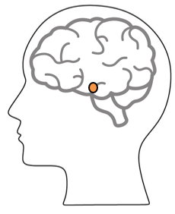
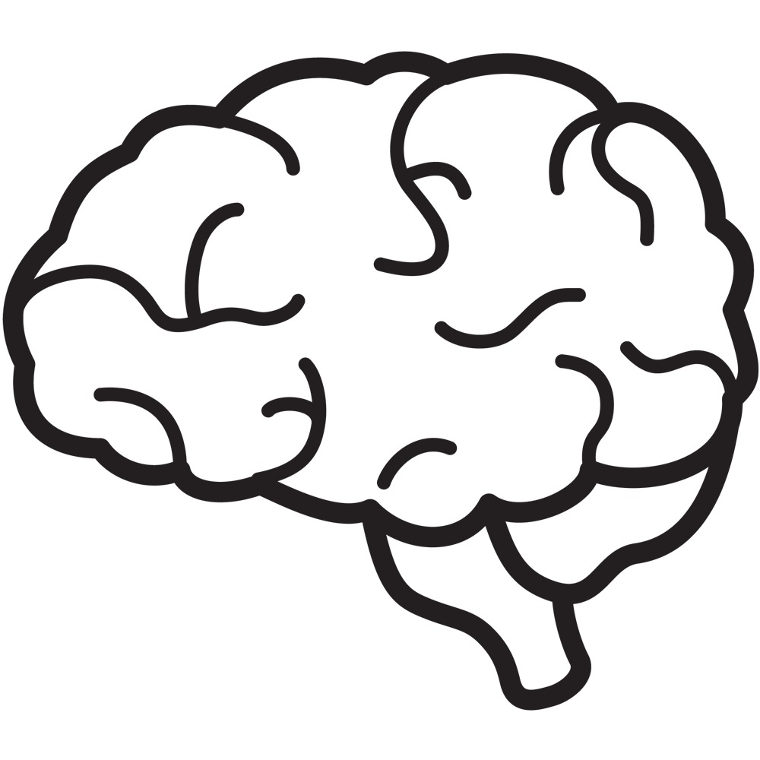
Mindfulness and the Brain
Higher functions:
Reason
Language
Decision making
Work
Family
Social Media
News
day to day over stimulus –> growth of amygdala
Watch this video at home (15 mins): https://www.youtube.com/watch?v=Awd0kgxcZws
or this video (2 mins) : https://www.youtube.com/watch?v=ELpfYCZa87g
Notes:
Alison:
---
Mindfulness can strengthen our most important pathways:
Pathways of:
Attention control
emotional regulation
Self-awareness
Benefits: there is a lot of research to show how the brain is changed for the better through mindfulness practices and mindful awareness throughout your day.
(click) These include growth in the pre frontal cortex – an area responsible for higher-level thinking processes (language, reasoning, decision making
But also mindfulness increases grey matter in the brain (essential for healthy brains) and shrinks the amygdala a small part of the brain where our emotional responses are located, including fear (it initiates the fight, flight or freeze responses/symptoms of stress)
See this animation, to how mindful practices can shrink our amygdala
Here is an individual and brain,
(click) – This orange circle represents the amygdala,
(click)- in most stressed out brains, the brain sees day to day unpredictable, challenging events such as work-related interruptions, family related matters, social media, current events, etc. as “danger” and responds with the fear stress response, stimulating the amygdala
(click) – as the brain continues to respond to day-to-day stimulus as if it is danger, studies have seen the amygdala become overstimulated and grow, making one more sensitive to stress
(click) –in a Mindfulness practice, we can revert these effects and have the amygdala shrink, but also increase grey matter, so other beneficial parts of the brain,
Similar to the muscles in our body, with a practice of Mindfulness we can strengthen our brains
If you are interested in other benefits there are some resources in the deck.
Resources…
https://gcconnex.gc.ca/blog/view/93957388/neuroplasticity-your-survival-superpower-neuroplasticite-votre-superpuissance-de-survie?language=en
https://en.wikipedia.org/wiki/Amygdala_hijack
http://www.gostrengths.com/what-is-an-amygdala-hijack/
https://siyli.org/even-old-dogs-can-learn-siyli-tricks-2/
6 Ways Mindfulness Meditation Affects Your Brain (In a Good Way) — Dr Soph

Slide 10
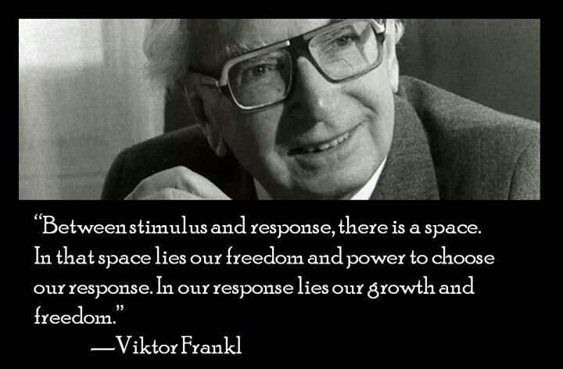
Between stimulus and response there is a space. In that space is our power to choose our response. In our response lies our growth and our freedom.
- Viktor Frankl
Notes:
Alison:
The space Viktor Frankl refers to is the focus of a Mindfulness practice. The idea is to be more conscious about this space, so we can respond to situations in a conscious and wise way as opposed to reacting impulsively due to emotions such as anger or fear.

Slide 11
Why Being Mindful Matters
Increased resilience
Focus and concentration
Workplace harmony
Fewer sick days
Stress reduction
Others? (add to chat)
http://www.mentalworkout.com/white-papers/how-mindfulness-can-help-your-employees-and-improve-your-companys-bottom-line/
Notes:
Robert:
How can a mindfulness practice translate to being mindful in everyday life or in the workplace?
Increased resilience: being mindful increases the ability to be open to new perspectives, to think creatively, to distinguish thoughts from feelings, and to respond to challenges rather than merely reacting. For a leader this helps with strategic thinking.
Focus and concentration: after an eight-week mindfulness course, participants could concentrate better, stay on task longer, more effectively, and remember what they’d done better. In a fast-paced environment where leaders have to react quickly to situation this is a great capacity to have.
Workplace harmony: being mindful promotes and creates more empathy and altruism in the workplace. As a leader we are expected to foster a respectful workplace.
Fewer sick days: those who have a practice missed 76% fewer days of work.
Stress reduction: just being mindful helps in reducing stress, anxiety, and depression. The practice helps reduce the levels of the primary stress hormone. As a leader we are put under a lot of stress and any tools that can help manage the pressure is something to be considered.
*Just a note to say that a mindfulness practice is not the be all solution to every challenge in the workplace, as an organization it is important to provide systemic and organizational support to employees in response to challenges of burnout, and work overload amongst others.
Let’s quickly see some ideas around the importance of Mindfulness... How do you see Mindfulness having an impact in the workplace?
How mindfulness can help your employees and improve your company's bottom line – white paper, Mental workout http://www.mentalworkout.com/white-papers/how-mindfulness-can-help-your-employees-and-improve-your-companys-bottom-line/

Slide 12
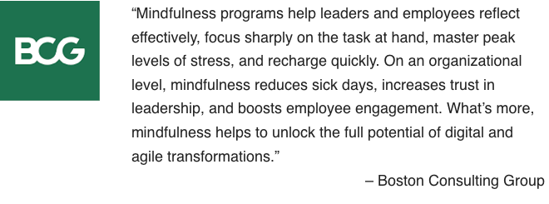
How Mindfulness Practice Benefits CEOs
builds resilience
boosts emotional intelligence
enhances creativity
improves your relationships
helps you focus
Attention
Awareness
Letting things be
Leaning into unpleasant experiences
Appreciation
Getting unstuck
* Adapted from:
https://hbr.org/2015/12/how-meditation-benefits-ceos
https://www.mindful.org/7-qualities-mindfulness-trained-body-scan/
from: https://www.bcg.com/en-ca/publications/2018/unleashing-power-of-mindfulness-in-corporations
Notes:
Robert:
I’ll let people read the two lists at the top
(wait a few seconds)
I just want to highlight on the left “Improves your relationship” because you come more authentic and empathic.
And also on the right, “Leaning into unpleasant experiences”, for example when there is an “elephant on the room” we may feel like we don’t want to talk about it but we need to, mindfulness practice allows you to have a discussion in a more human way, emphatic, compassionate, overall in a better way.
(click)
Now, we have a quote from BCG –which is a huge consultant global group-, I’d like to highlight from the quote that... “Mindfulness practices increases trust in leadership, and boosts employee engagement. What’s more, it helps to unlock the full potential of digital and agile transformation.”
Sources:
https://hbr.org/2015/12/how-meditation-benefits-ceos
https://www.mindful.org/7-qualities-mindfulness-trained-body-scan/
https://www.bcg.com/en-ca/publications/2018/unleashing-power-of-mindfulness-in-corporations

Slide 13
What is Mindful Change Leadership?
Refers to the person who is present, non judgmental and cultivates several aspects during their interactions. These aspects are visible and tangible in the Mindful Change Leader:
Focus (focus of attention)
Clarity (self awareness & emotional intelligence)
Creativity (innovation & decision making)
Compassion in the service of others (presence, deep listening)
Notes:
Robert:
Quickly, a reminder of the goal of the program… (read from the slide)

Slide 14
Which Mindful Change Leadership skills support the Key Leadership Competencies?
 | Focus | Clarity | Creativity | Compassion in the service of others
Create Vision and Strategy
Mobilize People
Uphold Integrity and Respect
Collaborate with Partners and Stakeholders
Promote Innovation and Guide Change
Achieve Results
Notes:
Robert:
In the following table, we have the Key Leadership Competency profile from TBS on the left column, and on the top row we have the Mindful Change Leadership skills
This table indicates which competencies is supported by which skill
(click) – in the case of the “Create Vision and Strategy” competency is supported primarily by Clarity and Compassion in the service of others
(click) – “Mobilize people” competency is supported by Focus, Clarity and Compassion in the service of others
(click) and so on and so forth
Now, you may think, well, actually all of the competencies are supported by all of the skills, in a sense yes, the table indicates the skill most predominant or directly related to the competency.
Resources…
Key Leadership Competency profile and examples of effective and ineffective behaviours…
Create Vision and Strategy
Leaders define the future and chart a path forward. They are adept at understanding and communicating context, factoring in the economic, social and political environment. Intellectually agile, they leverage their deep and broad knowledge, build on diverse ideas and perspectives and create consensus around compelling visions. Leaders balance organizational and government-wide priorities and improve outcomes for Canada and Canadians.
Mobilize People
Leaders inspire and motivate the people they lead. They manage performance, provide constructive and respectful feedback to encourage and enable performance excellence. They lead by example, setting goals for themselves that are more demanding than those that they set for others.
Uphold Integrity and Respect
Leaders exemplify ethical practices, professionalism and personal integrity. They create respectful and trusting work environments where sound advice is valued. They encourage the expression of diverse opinions and perspectives, while fostering collegiality. Leaders are self-aware and seek out opportunities for personal growth.
Collaborate with Partners and Stakeholders
Leaders are deliberate and resourceful about seeking the widest possible spectrum of perspectives. They demonstrate openness and flexibility to forge consensus and improve outcomes. They bring a whole-of-government perspective to their interactions. In negotiating solutions, they are open to alternatives and skillful at managing expectations. Leaders share recognition with their teams and partners.
Promote Innovation and Guide Change
Leaders have the courage and resilience to challenge convention. They create an environment that supports bold thinking, experimentation and intelligent risk taking. They use setbacks as a valuable source of insight and learning. Leaders take change in their stride, aligning and adjusting milestones and targets to maintain forward momentum.
Achieve Results
Leaders mobilize and manage resources to deliver on the priorities of the Government, improve outcomes and add value. They consider context, risks and business intelligence to support high-quality and timely decisions. They anticipate, plan, monitor progress and adjust as needed. Leaders take personal responsibility for their actions and outcomes of their decisions.
From: https://www.canada.ca/en/treasury-board-secretariat/services/professional-development/key-leadership-competency-profile/examples-effective-ineffective-behaviours.html

Slide 15
Reviewing the basics (1/2)
Have an intention of being (as opposed to doing)
Posture: sit with a straight back, as comfortable as possible in your chair, soles of the feet flat on the floor (or cross legged if you feel comfortable)
Keep an open mindset, to just experience things as is
You experience may vary each day, all is good
Focus on the breathing
Notice and observe
It is about feeling the way you feel, about noticing without judging
have no expectations
have no judgement
have a beginner’s mindset
be an observer... our minds may be busy and noisy
Notes:
Robert:
http://www.thecalmmonkey.com/#!meditation-recordings/g6x73

Slide 16
Mindful Breathing Exercise – Breathing (2/2)
Time required: 5 minutes
The trick is to shift from “doing” to “being”
Let’s start by doing the following...
Sit with a straight position, as comfortable as possible
It helps if you close or semi-close your eyes
Let’s not worry about time
And take a minute, only a minute...
To breathe, just to breathe
That simple
I’ll let you know when the time is over.
Just continue breathing… for one more minute
Notes:
Robert:
Mindful breathing https://www.youtube.com/watch?v=ZE-r-x2T4ok
This is one way of doing it, getting it depends on the practice of.
Noticing is very important in the practice of Mindfulness.
Noticing where your thinking is, that’s the first step to become more Mindful.

Slide 17
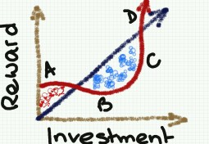
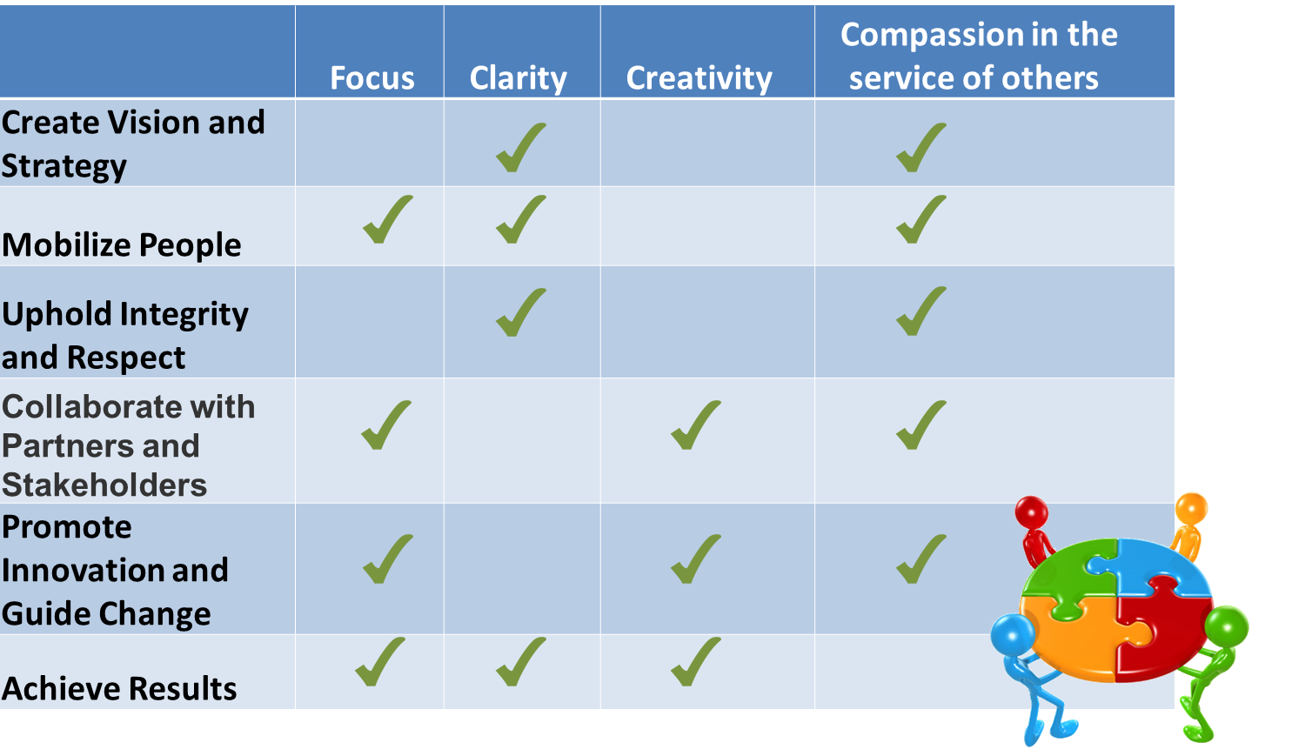
Debrief – Breakout rooms What got your attention?
What got your attention the most?
What Happens under stress and Neuroplasticity
Why Mindfulness Matters and the Benefits to CEO’s
How the Mindful Change Leadership skills support the Key Leadership Competencies
Breathing Exercise (possibly compared to the Body Scan from last week)
Notes:
Robert:
We’re going to do the debriefs in a few minutes, both in plenary and in small groups. Just before we do that, is there any question regarding the homework?
(give people a few seconds)
Well, now, I’d like to open the floor to 2 or 3 people who would like to do a debrief in plenary. If you’re the first one, just open your mike and speak, if you’re the second or third one, please rise your hand.
((prep for the breakout rooms))
And now, you’ll have the opportunity to do a debrief, in small groups of 4-6 people who are randomly assigned. Just be conscious and share the “airtime” among participants
Debrief on today's exercises, Talk about how the experience went for you.
What did you learn ?
What did you notice?
What was difficult or excessively easy?
((open the breakout rooms))
When done, you can simply exit the WebEx, or come back if you have questions or would like to express a comment

Slide 18
Your turn for week 2
Connecting – once a week with your buddies
Recommended call of 5 mins for each person, you may want to chat about what you found interesting, what was challenging, what you like the most
Gratitude Journaling – daily
Practice 5 mins breathing – daily http://marc.ucla.edu/mpeg/01_Breathing_Meditation.mp3 https://soundcloud.com/mindfulmagazine/5-minute-breathing-meditation
In case you have a question, a comment or want to share something, please do so via the Cohort
Notes:
Robert:
For this week, similar to last week… if you have any questions, now is the time to ask…
((click & read from slide until the end))
Other resources…
http://marc.ucla.edu/mindful-meditations
Mindful breathing https://www.youtube.com/watch?v=ZE-r-x2T4ok
3 mins body scan: https://soundcloud.com/mindfulmagazine/3-minute-body-scan-meditation
Bottom-up: https://www.psychologytoday.com/us/blog/conquer-fear-flying/201306/emotional-control-top-down-or-bottom

Slide 19
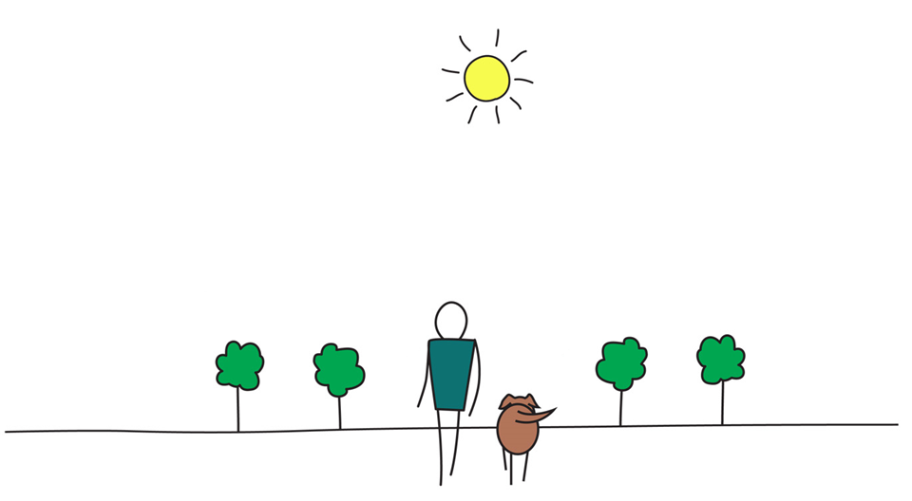
Be Mindful, Be Happy
Notes:
Robert:
Any question?

