Slide 1
Circle Discussion Guide #2
Inclusive Leadership
Notes:
Welcome everyone to our second Circle session on Inclusive Leadership.

Slide 2
Founders’ Message
“Thank you” doesn’t feel like enough to describe how happy we are, for you to have made the commitment to join the Lifting as you Lead Mentoring Circles program 4th edition, organized by the Diversity and Inclusion Office, Materiel Group, National Defence, and open to all Federal Public Service members.
What began as a simple idea from our consultations has grown into a thriving network, addressing the desire for meaningful networking and professional growth.
There’s Power in People Coming Together
You're now part of a diverse network of 1100+ inclusive-minded leaders, assigned to a Circle: a small, trusted group for goal achievement in a safe space. This Circle will facilitate learning from others' experiences and diverse perspectives, expanding your knowledge and tactical skills.
LLMC offers a unique opportunity for everyone to feel valued and respected for their contributions. The relationships you build will accelerate progress and drive accountability.
Nancy Tremblay
Assistant Deputy Minister, Materiel, National Defence
Samantha Moonsammy
Diversity and Inclusion Section Head,
Materiel, National Defence
Notes:
Here's a message from the program founders if you'd like to take a read through in your Discussion Guide PDFs [first of two slides]

Slide 3
Founders’ Message
By actively engaging with your Circle, sharing experiences, and fostering connections, you'll unlock personal and professional growth opportunities. This knowledge empowers you to advance in your career.
The Time to Act is Now!
Thank you for answering the call to action, committing to creating a psychologically safer workplace for all, especially those from equity-deserving groups.
We hope you will feel a real and fundamental shift throughout the program. And together we will celebrate all the hard work you put into this experience. Thank you for showing up for yourself, your family, your organization and the communities you’re called to serve.
Going forward, take advantage of all the networking that will take place, meet new LLMC members in MS Teams and on LinkedIn. Lean into the Masterclasses.
Choose to stay consistent with that next level version of you. We are rooting for you.
Nancy Tremblay
Assistant Deputy Minister, Materiel, National Defence
Samantha Moonsammy
Diversity and Inclusion Section Head,
Materiel, National Defence
Notes:
Here's a message from the program founders if you'd like to take a read through in your Discussion Guide PDFs [second of two slides]

Slide 4
Circle Ground Rules and Values
Equality: Everyone is an equal member
Substance: Share what's important
Openness: Listen and avoid judgements
Respect: Treat others as they would like to be treated
Notes:
Let's take a moment to review the Circle Ground Rules and Values:
Equality: Everyone is an equal member
Substance: Share what's important
Openness: Listen and avoid judgements
Respect: Treat others as they would like to be treated

Slide 5
Participant Ground Rules and Values
Confidentiality - trust is critical
Bring your full self and beginner’s mindset to each session
Come nourished and stay hydrated
Keep your camera on so everyone feels safe and connected
Be candid and honest - listen with empathy
Be ready to engage with your peers
Remove outside distractions
Keep your audio off, except when asking questions and contributing to the discussion
Be fully present and attend all five weeks - no multitasking
Notes:
Let's take a moment to review the Participant Ground Rules and Values:
Confidentiality - trust is critical
Bring your full self and beginner’s mindset to each session
Come nourished and stay hydrated
Keep your camera on so everyone feels safe and connected
Be candid and honest - listen with empathy
Be ready to engage with your peers
Remove outside distractions
Keep your audio off, except when asking questions and contributing to the discussion
Be fully present and attend all five weeks - no multitasking

Slide 6
Inclusive Leadership
“In today’s interconnected and globalised world, it is now commonplace for people of dissimilar world views, faiths and races to live side by side. It is a matter of great urgency, therefore, that we find ways to cooperate with one another in a spirit of mutual acceptance and respect.” Dalai Lama XIV, spiritual leader and head of Tibet “Inclusive leadership is not a destination; it’s a journey of continuous learning, growth, and unlearning biases to create a more inclusive world.” Ava DuVernay, award-winning filmmaker
Notes:
Here are some quotes on Inclusive Leadership to get us started:
“In today’s interconnected and globalised world, it is now commonplace for people of dissimilar world views, faiths and races to live side by side. It is a matter of great urgency, therefore, that we find ways to cooperate with one another in a spirit of mutual acceptance and respect.”
Dalai Lama XIV, spiritual leader and head of Tibet
“Inclusive leadership is not a destination; it’s a journey of continuous learning, growth, and unlearning biases to create a more inclusive world.”
Ava DuVernay, award-winning filmmaker

Slide 7
1. Check-In: Warm up and get going
(18 minutes)
1.1 Welcome
(1 minute)
We, as individuals, are each responsible for building and creating a culture of inclusion, regardless of title or position.
Bonding Moment How do you feel today? What is the weather of your emotions today (sunny, cloudy, rainy, stormy, etc). (10 seconds each)
Notes:
Welcome everyone to our second Circle session on Inclusive Leadership.
Inclusion isn't simply handed down to members by the Deputy Minister or Associate Deputy Minister. We, as individuals, are each responsible for building and creating a culture of inclusion, regardless of title or position. In this week’s Circle, we will explore some of the recommended strategies that people can use to promote inclusion. We will examine ways to create an inclusive climate and consider how people can bring about more inclusivity in decision-making through deliberately creating “inclusion by design” at the individual, team and organizational levels.
Let's open with a bonding moment. How do you feel today? What is the weather of your emotions today (sunny, cloudy, rainy, stormy)? (10 seconds each)

Slide 8
1.2 Your Health Comes First
(1 minute)
Hope for Wellness Helpline
1-855-242-3310
Employee Assistance Program (EAP)
Toll-free: 1-800-268-7708
For persons with hearing impairments:
1-800-567-5803
Notes:
Before we begin today’s Circle, an important reminder. The intent of these sessions is to have safer conversations about important subjects that will help transform the Federal Public Service by creating diverse and inclusive psychologically safer workplaces. The subjects may be difficult for some people to discuss. If at any point during this session you feel that you need to step away, you may leave the session in order to protect your mental health. There’s also a 5 minute break built in partway through the Circle.
Your health comes first.
If you need to talk to someone, whether before, during, or after a circle, there is support available to you 24/7. Please see the support section at the end of this guide for contact information.

Slide 9
1.3 Overview
(1 minute)
Leadership
The art of influencing and developing others to achieve their highest potential.
Inclusive Leadership
Promotes and embraces diversity, equity, inclusion, and accessibility. Cultivates a space of psychological safety.
Notes:
Leadership is often identified as the most critical role in an organisation. It is the art of influencing and developing others to achieve their highest potential.
Inclusive leadership refers to a style of leadership that promotes and embraces diversity, equity, inclusion, and accessibility within an organisation or community, as well as aims to cultivate a space of psychological safety. Inclusive leaders are courageous enough to lead with empathy, compassion, and care. They foster an environment where all individuals feel respected, empowered, and included, and in which everyone's contributions are equally valued and recognized.
Let’s learn how we can enhance our leadership skills to lead across our differences and cultivate a more inclusive workplace, establish trust, build relationships (up, down, and across the public service), lead change through agility and resilience, have difficult conversations, and so much more.
Inclusive leadership has become a business imperative, at both the operational and strategic levels. The value of diverse teams and organizations has been well researched and leads to improvements in decision-making, engagement, retention and more. Let’s get started!

Slide 10
1.4 Icebreaker - Inclusive Leadership Quotes - Share what inspires you
(10 minutes)
The purpose of these sayings is to inspire thought, discussion, and action about making the world a more equitable and respectful place for all.
Instructions: From the list, each member selects a quote and shares why their selected quote resonates with them. (1 minute per member)
Notes:
Quotes are a way to raise the subject and start the discussion without worrying about saying the wrong thing. The purpose of these sayings is to inspire thought, discussion, and action about making the world a more equitable and respectful place for all.
Instructions: From the list, each member selects a quote and shares why their selected quote resonates with them.
(1 minute per member)

Slide 11
Inclusive Leadership Quotes
1 - “We must open the doors and we must see to it they remain open so that others can pass through.”
2 - “Inuit ways of knowing and being are just as valid as any other. We must be open to learning from each other.”
3 - “If you tell me, I may forget. If you teach me, I will remember. But if you involve me, I will definitely learn.”
4 - "Leadership is about making others better as a result of your presence and making sure that impact lasts in your absence."
5 - "It’s hard to keep an open mind if you don’t have an open heart. You don’t have to agree with what people think to learn from how they think. You don’t have to share their identity to be curious about what shaped it. Treating people with civility is a prerequisite for discovery."
6 - “Leadership is not about being in charge. It is about taking care of those in your charge.”
7 - “Belonging can never be at the expense of being who we are. Belonging only happens when we're being embraced for our authenticity, especially for our differences.”
8 - “No culture can live if it attempts to be exclusive.”
9 - “Diversity is being invited to the party; inclusion is being asked to dance.”
10 - “We are strongest when we see the most vulnerable in our society, bear witness to their struggles, and then work to create systems to make it better.”
11 - “Everyone deserves to have their lives elevated through the beauty of truthful representation.”
12 - “Being a leader means taking an active role in ending all forms of discrimination and oppression, consciously and constantly challenging our own biases, and creating an environment in which our employees feel empowered and safe to speak up when they witness barriers to equity and inclusion.”
Notes:
1 - “We must open the doors and we must see to it they remain open so that others can pass through.”
2 - “Inuit ways of knowing and being are just as valid as any other. We must be open to learning from each other.”
3 - “If you tell me, I may forget. If you teach me, I will remember. But if you involve me, I will definitely learn.”
4 - "Leadership is about making others better as a result of your presence and making sure that impact lasts in your absence."
5 - "It’s hard to keep an open mind if you don’t have an open heart. You don’t have to agree with what people think to learn from how they think. You don’t have to share their identity to be curious about what shaped it. Treating people with civility is a prerequisite for discovery."
6 - “Leadership is not about being in charge. It is about taking care of those in your charge.”
7 - “Belonging can never be at the expense of being who we are. Belonging only happens when we're being embraced for our authenticity, especially for our differences.”
8 - “No culture can live if it attempts to be exclusive.”
9 - “Diversity is being invited to the party; inclusion is being asked to dance.”
10 - “We are strongest when we see the most vulnerable in our society, bear witness to their struggles, and then work to create systems to make it better.”
11 - “Everyone deserves to have their lives elevated through the beauty of truthful representation.”
12 - “Being a leader means taking an active role in ending all forms of discrimination and oppression, consciously and constantly challenging our own biases, and creating an environment in which our employees feel empowered and safe to speak up when they witness barriers to equity and inclusion.”

Slide 12
1.5 One Action from the last meeting
(5 minutes)
Instructions: Once you’re warmed up, go around your Circle and have each member share their One Action update from week #1, Sponsorship and Career Building. Your “One Action” is a concrete commitment you made during your previous Circle session. (1 minute per member)
2. Educational Activity: Lean in, get inspired, and add to your
toolkit
(22 minutes)
2.1 Video: Why Good Leaders Make You Feel Safe
(12 minutes)
Instructions: Watch the Simon Sinek Ted Talk “Why Good Leaders Make You Feel Safe.” While watching and listening to the video, reflect on your own experiences of working in environments where you have felt safe and where you have not felt safe. Also, reflect on your own behaviors and how you contribute to creating a psychologically safe environment for others.
Notes:
Now that we're warmed up, let's go around the Circle and have each of us share our One Action update from week #1: Sponsorship and Career Building. Your One Action is a concrete commitment you made during your previous Circle session.
(1 minute or less per member)
Now we’re moving to our next activity. [link to transcript next slide, video is embedded in 2 slides]
Instructions: Watch the Simon Sinek Ted Talk “Why Good Leaders Make You Feel Safe.” While watching and listening to the video, reflect on your own experiences of working in environments where you have felt safe and where you have not felt safe. Also, reflect on your own behaviors and how you contribute to creating a psychologically safe environment for others.

Slide 13
2. Educational Activity: Lean in, get inspired, and add to your toolkit
(22 minutes)
2.1 Video: Why Good Leaders Make You Feel Safe
(12 minutes)
Instructions: Watch the Simon Sinek Ted Talk “Why Good Leaders Make You Feel Safe.”
Follow along with the transcript
Notes:
If you’d like to follow along with the transcript while we watch the video, scan the QR code here. You can also find more information on the video in the pdf version of the discussion guide. [video on next slide]

Slide 15
2.2 Group Discussion #1: Sharing Your Insights
(10 minutes)
Instructions: Share one key takeaway from the video - Why Good Leaders Make You Feel Safe. (1 minute per member)
Interested in learning more about inclusive leadership?
The LLMC Program Team recommends that we continue our learning following the Circle by watching the Ted Talk, “We Need Leaders Who Boldly Champion Inclusion.” In it, June Sarpong makes us consider how we can disrupt the status quo by being inclusive leaders. We can cultivate a sense of security within teams and between colleagues by leading with compassion, care, patience, and understanding.
Notes:
Instructions: Share one key takeaway from the video “Why Good Leaders Make You Feel Safe.”
(1 minute per member)

Slide 16
Your Health Comes First!
Before the next activity, take a 5 minute mind & body
break. Grab some water, use the washroom, stretch—
whatever you need!
Notes:
Before the next activity, take a 5 minute mind & body break. Grab some water, use the washroom, stretch—whatever you need!
We'll be back together in 5 mins.

Slide 17
3. Group Activity: Share your story, learn from others, and
make new connections
(15 minutes)
Fostering Inclusion Checklist
Instructions: Take 5 minutes to look at the checklist on the following slide. Think about how each point relates to you as an individual, to your team, to a manager (past or present), or to your organization as a whole. Check off the elements, behaviours or characteristics that are already in place and working well to foster inclusion. The unchecked areas highlight the challenges that need to be addressed to further enhance inclusion. Then, take 1 minute per member to share your observations of the inclusive behaviours in the following checklist. Are there areas that are doing well? What areas can be improved?
Notes:
Welcome back!
Leadership exists at all levels. Using the list below as a guide, we will consider the elements that contribute to an inclusive workplace.
Instructions: Take 5 minutes to look at the checklist on the following slide. Think about how each point relates to you as an individual, to your team, to a manager (past or present), or to your organization as a whole.
Check off the elements, behaviours or characteristics that are already in place and working well to foster inclusion. The unchecked areas highlight the challenges that need to be addressed to further enhance inclusion.
Then, take 1 minute per member to share your observations of the inclusive behaviours in the following checklist. Are there areas that are doing well? What areas can be improved?

Slide 18
Fostering Inclusion Checklist
Demonstrates self-reflection, growth, and understanding through the use of intentional, professional, and inclusive language.
Embraces mentorship and sponsorship to promote equity within the workspace.
Approaches leadership through a democratic framework by communicating results from staff engagement surveys and applying the data to improve the workspace.
Greets people authentically (takes an interest in everyone).
Speaks up when people are being excluded (intentionally includes everyone on the team).
Demonstrates empathy by connecting with members of the team.
Ensures that equal representation is met at the decision-making table.
Seeks to understand diverse beliefs and practices.
Respects confidentiality with regard to information shared.
Encourages and enables others to participate in Diversity, Equity & Inclusion events and groups.
Uses instances of hurt, miscommunication, and misunderstandings as respectful teachable moments.
Leads the team to establish and follow group norms for a safe and inclusive workplace.
Creates a sense of safety for all by strategically and intentionally cultivating an empowering and affirming workspace.
Adjusts performance goals for team members in ways that exhibit compassion, care, and attentiveness to individual circumstances.
Notes:
What are your observations of the inclusive behaviours in the following checklist. Are there areas that are doing well? What areas can be improved?

Slide 19
4. Inclusion by Design: Apply yourself, pledge to grow, and
inspire others
(15 minutes)
Instructions: Quickly look over the 4 areas for what inclusion by design activities look like (on the next pages) at the individual, team, manager and organizational levels. Then discuss the following with your group. (5 minutes to read, then 1 minute per member to share) What areas do you see that are going well in your workplace? What areas do you see as areas of growth in your workplace? What actions would you like to take personally to bring more inclusion by design approaches into your work, team or organization?
Notes:
Employees and leaders at all levels can practice inclusive leadership in their day-to-day work by adopting behaviours and strategies that promote inclusivity and respect for diversity.
By intentionally designing these elements into your leadership approach, you can create an environment where diverse perspectives are valued, and all employees feel included and empowered.
Implementing these practical steps, leaders can create a more inclusive and supportive environment where all team members feel valued and respected. Practicing inclusive leadership involves concrete actions and behaviours that foster a diverse and inclusive environment.
Next are some practical ways to practice inclusive leadership to help you take this back to your organization to TAKE ACTION!

Slide 20
Inclusion by Design Key Activities
Individual
Active Listening: Make a conscious effort to listen to all team members. Encourage open dialogue and ensure everyone’s voice is heard, especially those who might be less vocal. Acknowledge and Address Bias: Be aware of your own biases and work to mitigate them. Encourage an environment where biases can be openly discussed and addressed without judgment. Model Inclusive Behaviour: Demonstrate inclusive behaviour in your daily actions. This includes using inclusive language, being respectful of different perspectives, and showing empathy and understanding. Ongoing Education: Continuously educate yourself and your team on diversity, equity, and inclusion topics. Attend workshops, training sessions, and stay updated on best practices Hold Yourself Accountable: Set personal goals for inclusive leadership and regularly assess your progress. Seek feedback from your team and be willing to make changes based on their input. Cultivate Self-Awareness: Reflect on your own biases and assumptions. Understand how these can impact your interactions and decisions. Actively work to challenge and overcome them. Provide and Seek Feedback: Give constructive feedback in a way that is supportive and encourages growth. Be open to receiving feedback yourself and use it to improve your own inclusive practices. Support Employee Resource Groups (ERGs): Participate in or support ERGs within your organization. These groups can provide support, networking opportunities, and help drive inclusive initiatives.
Notes:
The individual can practice:
- Active listening
- Acknowledging and addressing bias
- Modelling inclusive behaviour
- Ongoing education
- Holding themselves accountable
- Cultivating self-awareness
- supporting employee resource groups
[allow 2 minutes to read through slide/PDF]

Slide 21
Team
Celebrate Differences: Recognize and celebrate the diverse backgrounds and achievements of your team members. This can include cultural celebrations, recognizing different holidays, and acknowledging unique contributions. Inclusive Meeting Practices: Structure meetings to be inclusive. This can involve setting clear agendas, rotating meeting times to accommodate different time zones, and using technology to include remote team members. Encourage Collaboration: Foster a collaborative environment where team members work together and support each other. Encourage cross-functional projects and teamwork. Communicate Respectfully: Use inclusive language that respects all identities and backgrounds. Avoid jargon or slang that might exclude or alienate others. Be mindful of cultural differences in communication styles. Challenge Non-Inclusive Behaviour: If you notice exclusionary behaviour or language, address it respectfully and constructively. Support a culture where everyone feels comfortable calling out non-inclusive practices. Be Flexible and Adaptable: Show flexibility in accommodating different working styles and needs. This could include supporting flexible working hours or understanding cultural or religious practices.
Notes:
A team can practice:
- Celebrating differences
- Inclusive meeting practices
- Encouraging collaboration
- Communicating respectfully
- Challenging non-inclusive behaviour
- Being flexible and adaptable
[allow 2 minutes to read through slide/PDF]

Slide 22
Manager
Diverse Recruitment: Implement recruitment practices that ensure a diverse pool of candidates. This includes using diverse sourcing channels, creating unbiased job descriptions, and utilizing diverse interview panels. Bias-Free Selection: Use structured and standardized interview processes to minimize bias. Incorporate blind recruitment techniques where possible to focus on skills and qualifications. Foster an Inclusive Culture: Encourage an organizational culture that values diversity and inclusion. This can be achieved through regular communication, celebrating diversity, and creating employee resource groups. Provide Inclusive Feedback: When giving feedback, be mindful of cultural and individual differences. Provide constructive and supportive feedback that helps team members grow and improve. Create Safe Spaces: Establish safe spaces where employees feel comfortable expressing their concerns, ideas, and experiences. This can include regular check-ins, open-door policies, and anonymous feedback channels. Seek Diverse Perspectives: Actively seek out and consider diverse viewpoints when making decisions. This can be done through diverse brainstorming sessions, feedback surveys, or inclusive meeting practices. Empower Others: Delegate responsibilities and provide opportunities for all team members to contribute and take on leadership roles. Empowering others builds confidence and fosters an inclusive environment. Provide Mentorship and Sponsorship: Act as a mentor or sponsor to employees from underrepresented groups. Offer guidance, support, and opportunities to help them advance in their careers.
Notes:
A manager can practice:
- Diverse recruitment
- Bias-free selection
- Fostering an inclusive culture
- Providing inclusive feedback
- Creating safe spaces
- Seeking diverse perspectives
- Empowering others
- Providing mentorship and sponsorship
[allow 2 minutes to read through slide/PDF]

Slide 23
Organization
Define Inclusive Leadership: Clearly articulate what inclusive leadership means for your organization, including the behaviours, values, and outcomes you expect from leaders. Set Clear Goals and Metrics: Establish specific, measurable goals for diversity and inclusion at all leadership levels. Track progress regularly and hold leaders accountable for achieving these goals. Leadership Development Programs: Offer training and development programs focused on inclusive leadership skills. This can include workshops, mentoring, and coaching on topics like unconscious bias, cultural competency, and inclusive decision-making. Inclusive Policies and Practices: Develop and enforce policies that promote inclusivity, such as flexible work arrangements, equitable pay, and anti-discrimination policies. Ensure these policies are communicated effectively and applied consistently. Feedback Mechanisms: Establish channels for employees to provide feedback on leadership inclusivity. Use surveys, focus groups, and open forums to gather insights and make improvements. Role Modelling: Ensure senior leaders exemplify inclusive behaviour. When top leaders prioritize and demonstrate inclusivity, it sets a powerful example for the entire organization.
Notes:
An organization can practice:
- Defining inclusive leadership
- Setting clear goals and metrics
- Implementing leadership development programs
- Implementing inclusive policies and practices
- Establishing feedback mechanisms
- Role modelling
[allow 2 minutes to read through slide/PDF. Summary & questions can be found on next slide]

Slide 24
4.1 Group Discussion #2: Sharing Your Insights
(1 minute per member)
What areas do you see that are going well in your workplace?
What areas do you see as areas of growth in your workplace?
What actions would you like to take personally to bring more inclusion by design approaches into your work, team or organization?
Individual
Active Listening Acknowledge and Address Bias Model Inclusive Behaviour Ongoing Education | Hold Yourself Accountable Cultivate Self-Awareness Provide and Seek Feedback Support Employee Resource Groups
Team
Celebrate Differences Inclusive Meeting Practices Encourage Collaboration Communicate Respectfully | Challenge Non-Inclusive Behaviour Be Flexible and Adaptable
Manager
Diverse Recruitment Bias-Free Selection Foster an Inclusive Culture Provide Inclusive Feedback Create Safe Spaces | Seek Diverse Perspectives Empower Others Provide Mentorship and Sponsorship
Organization
Define Inclusive Leadership Set Clear Goals and Metrics Leadership Development Programs | Inclusive Policies and Practices Feedback Mechanisms Role Modelling
Notes:
So, let's discuss:
What areas do you see that are going well in your workplace?
What areas do you see as areas of growth in your workplace?
What actions would you like to take personally to bring more inclusion by design approaches into your work, team or organization?

Slide 25
5. One Action: Apply yourself, pledge to grow, and inspire
others
(10 minutes)
Instructions: Each member declares their One Action commitment for this week. (1 minute per member)
Notes:
Your “One Action” is a concrete commitment you undertake related to the topics discussed during each Circle. The goal of a One Action is to step outside your comfort zone, practise a new skill, or try something new. Examples of one actions for this Circle can be found in the table that follows:
Instructions: Each member declares their One Action commitment for this week.
(1 minute per member)

Slide 26
Inclusive Leadership |  | One Action
1 | I will balance the mandate for our work while considering the well-being of the people who form my team. | Use the video “We Need Leaders Who Boldly Champion Inclusion” to inform how your One Action makes you an inclusive leader.
2 | I will encourage vulnerability and care within my teams by modelling these characteristics.
3 | I will commit to helping others develop their own leadership skills.
4 | Take your learning Beyond the Circle! | Explore the Learning Library Resources at the end of this guide
5 |  | Write down your One Action commitment in the table cell to the left and get ready to report about it at Circle #3.

Slide 27
6. Wrap-up: What’s next and a few final words
(5 minutes)
Masterclass: Our next Masterclass takes place on Monday, October 21, 2024, at
1:00 pm Eastern Time.
Next Circle: The next Circle session is titled “Mastering the Art of Negotiation.”
Circle Leader and Assistant Circle Leader Selection: Do we have our Circle Leader
and Assistant Circle Leader for next week?
LLMC Written Component: Please share your comments by completing the bi-weekly Written Component forms.
LLMC Lounge: Join this Friday’s LLMC Lounge if you would like to connect and engage more on this week’s topic. This 60-minute session is facilitated by the LLMC Program Team at Materiel Group’s Diversity and Inclusion Office (DIO) every Friday.
Thank you everyone! Be well, take care and see you at Circle #3 on
Mastering the Art of Negotiation
Notes:
Thank you everyone for your active participation in this week’s topic. We now have some new thoughts on inclusive leadership and how we might all use what we have learned to create a safer, more inclusive and diverse working environment. We hope you are able to take what you learned and put it into action.
To recap today’s Circle, please review this Discussion Guide to help you reflect on this Circle session and implement your One Action for inclusive leadership.
Our next Masterclass takes place on Monday, October 21, 2024, at 1:00 pm Eastern Time. This 90-minute Masterclass is a hands-on coaching class on the topic of negotiation. Invitations to all 5 Masterclasses have been sent to you prior to the start of this LLMC cohort. Please see your calendar for details.
The next Circle session is titled “Mastering the Art of Negotiation.” In this session, we will focus on how to achieve an outcome that is a win for all parties. Please review Circle #3 Discussion Guide and watch “Three Steps to Getting What You Want in a Negotiation” prior to our third Circle session.
Do we have our circle leader and assistant circle leader for next week? If leaders for the next Circle were not chosen, ask for volunteers for both positions.
LLMC Written Component: Please share your comments by completing the bi-weekly Written Component forms. A link to the form can be found in your calendar. Completion of these forms is one of the commitments you made when you applied. The LLMC Program team relies upon your feedback to continue to grow the program.
LLMC Lounge: Join this Friday’s LLMC Lounge if you would like to connect and engage more on this week’s topic. This 60-minute session is facilitated by the LLMC Program Team at Materiel Group’s Diversity and Inclusion Office (DIO) every Friday.
Thank you everyone! Be well, take care and see you at Circle #3 on Mastering the Art of Negotiation

Slide 28
To Do Checklist: Next Week at a Glance
Consult the LLMC Program Overview Wiki
page for all checklist links
Watch 3 Steps to Getting What You Want in a Negotiation
Fill out the Reflection Questions (Discussion Guide PDF)
Attend the Masterclass on October 21 at 1:00pm Eastern
Complete your One Action
Attend the LLMC Lounge on Friday at 1:00pm Eastern (optional)
Complete your Written Component
Join the LLMC LinkedIn group
Review Discussion Guide #3 on Mastering the Art of Negotiation
Check out the Beyond the Circle bonus content at the end of this guide & the LLMC Learning Library

Slide 29
Learning Library Resources
Books
The Five Dysfunctions of a Team: A Leadership Fable by Patrick Lencioni
Gestionnaires inspirants: Les 10 règles de communication des leaders par Isabelle Lord
The 21 Irrefutable Laws of Leadership: Follow Them and People Will Follow You by John C. Maxwell
Mastering Leadership by Robert J. Anderson et al.
Le leader sans titre par Robin Sharma
These resources are clickable links!

Slide 30
Learning Library Resources
Articles
How to Mentor and Support Other Women – and Help Them Succeed
Les 10 qualités d’un vrai leader
Diversity at Work
The Key to Inclusive Leadership
6 Leadership Paradoxes for the Post Pandemic Era
These resources are clickable links!

Slide 31
Learning Library Resources
Government of Canada Resources
LinkedIn Learning – learn the practical skills you need to excel in your career (e.g. Become a leader)
Inhersight – a woman-focused career advice and company review website
Key Leadership Competencies
Canada School of Public Service - Becoming a Supervisor
The Governor General’s Canadian Leadership Conference
These resources are clickable links!

Slide 32
Learning Library Resources
Videos
Inclusive Leadership - 2023 LLMC Masterclass #2 (1h 10m 38s)
How Reverse Mentorship Can Help Create Better Leaders (4m 38s)
Want to Truly Succeed? Lift Others up While You Climb (5m 33s)
3 Ways to be a Better Ally in the Workplace (9m 27s)
How to Foster True Diversity and Inclusion at Work (and in Your Community) (22m 51s)
How to Find the Person Who Can Help You Get Ahead at Work (13m 14s)
We Need Leaders Who Boldly Champion Inclusion (14m 35s)
The LLMC Program Team highly recommends this video. In it, June Sarpong makes us consider how we can disrupt the status quo by being inclusive leaders and how we can cultivate a sense of security within teams and between colleagues by leading with compassion, care, patience, and understanding.
These resources are clickable links!

Slide 33
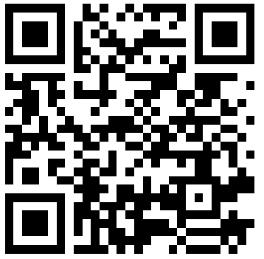
Contact Us
Contact us on the LLMC Support Form
The Lifting as you Lead Mentoring Circles Discussion Guide was created by the Diversity and Inclusion Office, Materiel Group, National Defence.

Slide 34
Support
Employee Assistance Program (EAP)
EAP provides free short-term counselling for personal or work-related problems as well as crisis
counselling.
Toll-free: 1-800-268-7708
TTY (for people with hearing impairments): 1-800-567-5803
https://www.canada.ca/en/government/publicservice/wellness-inclusion-diversity-public-service/
employee-assistance-program.html#E
Hope for Wellness Helpline
24/7 access to Indigenous Counsellors.
Available in French and English and, upon request, Ojibway, Cree and Inuktituk.
1-855-242-3310
Chat line via: https://www.hopeforwellness.ca/
Member and Family Assistance services (Canadian Armed Forces)
The Member and Family Assistance services is a 24 hour, 7 days a week bilingual telephone and face to face counselling service that is voluntary, confidential, and available to Canadian Armed Forces (CAF) members and their families who have personal concerns that affect their well-being and/or work performance.
https://www.canada.ca/en/department-national-defence/services/benefits-military/health-support/member-family-assistance-services.html

Slide 35
Support
Sexual Misconduct Support and Resource Centre (National Defence)
The Sexual Misconduct Support and Resource Centre (SMSRC) was created by the Department of
National Defence but is independent from the CAF chain of command and is not required to report
incidents of sexual misconduct to the CAF. Support services for CAF members, National Defence public
service employees, Cadets and Junior Canadian Rangers affected by sexual misconduct and their
families, aged 16 and older. Guidance and support for leaders and management on addressing sexual
misconduct.
https://www.canada.ca/en/department-national-defence/services/benefits-military/health-support/sexual-misconduct-response.html
The Canada Suicide Prevention Service
Talk Suicide Canada provides nationwide, 24-hour, bilingual support to anyone who is facing suicide.
Toll-free: 1-833-456-4566.
https://www.crisisservicescanada.ca/en/
Wellness Together Canada
Mental Health and Substance Abuse Support.
Toll free: 1-866-585-0445
https://wellnesstogether.ca

Slide 36
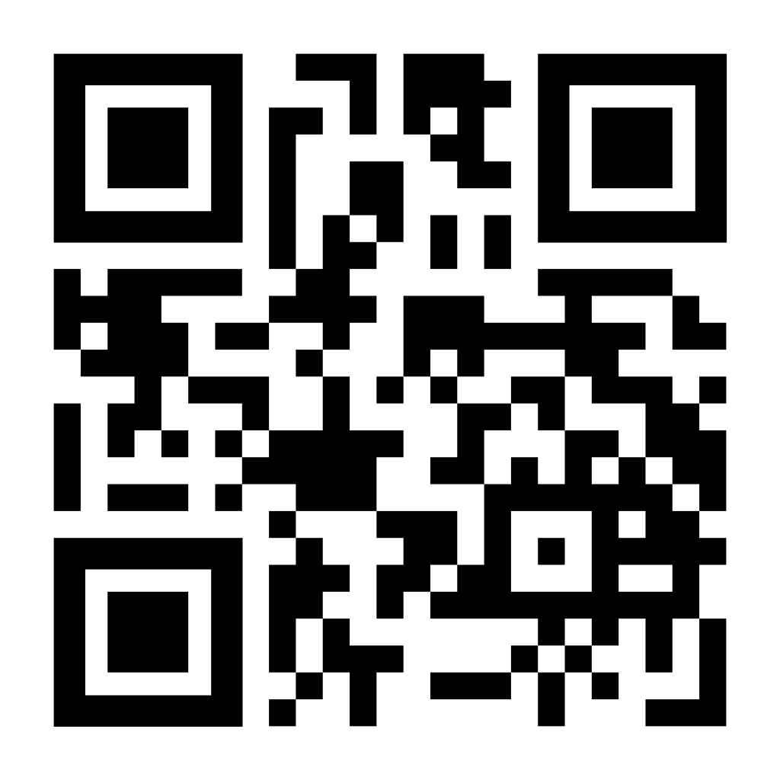
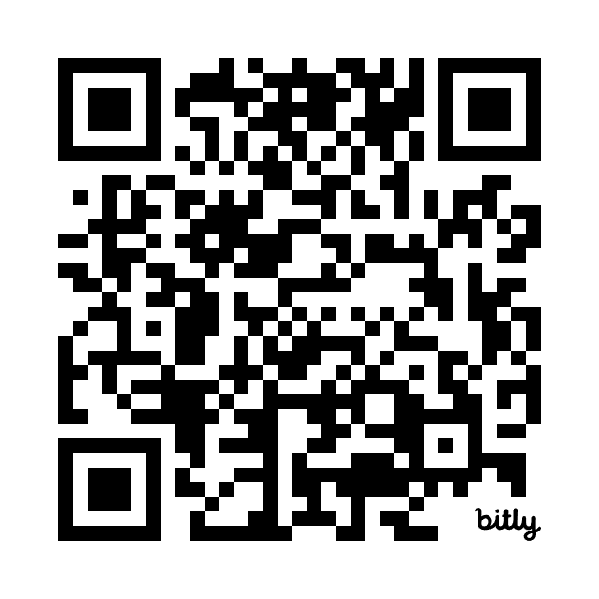
Keep the Conversation Going
Join the LLMC LinkedIn Group
Stay up to date on all Diversity and Inclusion Office Initiatives on our GC Wiki

Slide 37
Thank you all for your participation!
Be well, and take care.

