Slide 1

Official Languages:
How Justice Canada Innovates
Karen Peddle, Senior Policy Analyst
Karina D. Yelle, Deputy Director and Senior Counsel
Official Languages Directorate, Justice in Official Languages Team
November 18 2025

Slide 2

Accomplishments since the modernization of the Official Languages Act (OLA)
  Infographics / Training
  New initiatives for the Departmental Network of Coordinators Responsible for the Implementation of Section 41 of the Official Languages Act (Network 41)
  New initiatives for the FPT Working Group on Access to Justice in Both Official Languages (FPT Working Group) and the Advisory Committee on Access to Justice in Both Official Languages (Advisory Committee)

Slide 3
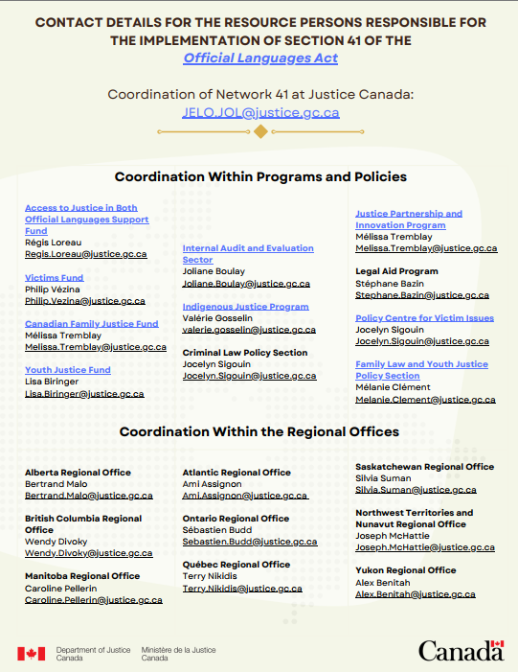
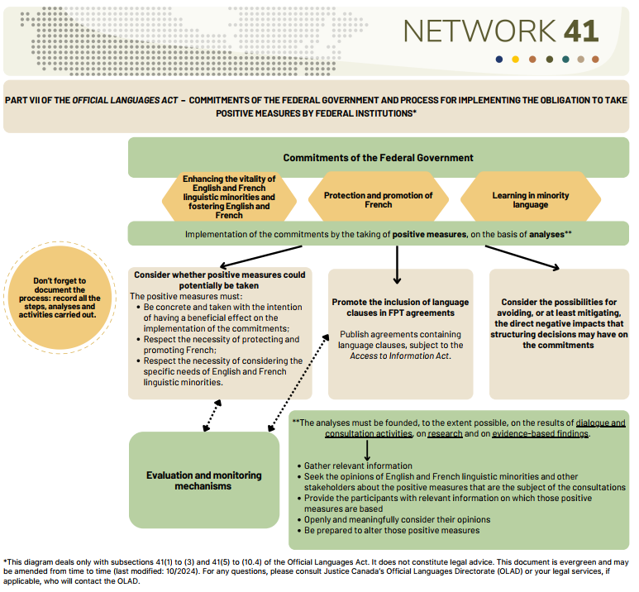
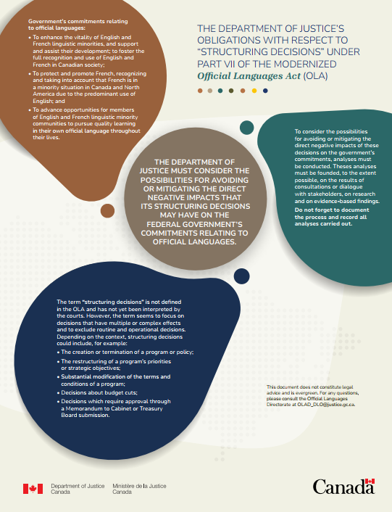
Infographics / training: Part VII
List of Network 41 Coordinators – for external government stakeholders
Summary of the new section 41 under Part VII since the modernization of the OLA in June 2023
Infographic on structuring decisions – subsection 41(7) of the OLA
Upcoming infographics:
4. Analyses – Subsections 41(7) and (8)
5. Language clauses in FPT agreements – Paragraph 41(7) a.1).

Slide 4
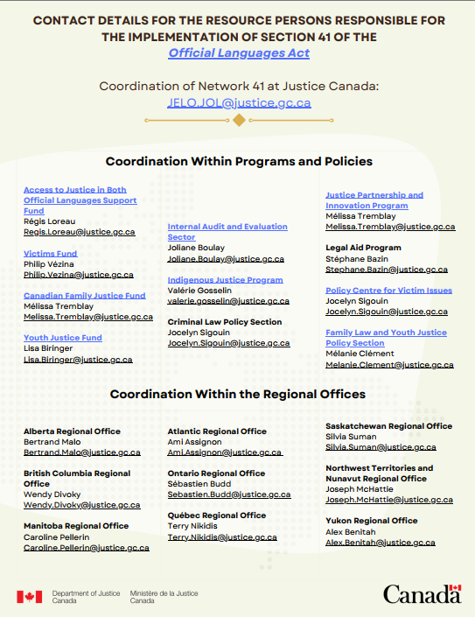

Slide 7

Network 41 (page 1 of 2)
Introduction: How our Network works
Initiatives:
3 new initiatives to promote collaboration between the Network 41 program/policy coordinators and the regional coordinators
  Inform regional coordinators of matters the Deparment is made aware
  Courtesy visits
  Follow-up with the regional coordinators regarding funded projects with an official language lens
Sharing lists of official language minority communities’ organizations by region
Creation of a visual identity for Réseau 41 for documentation, awareness and recognition purposes

Slide 8
Network 41 (page 2 of 2)
Update of our Network 41 Guide following the modernized OLA
Updating our list of coordinators to add new programs that may have an official languages lens
Regular bilateral meetings with coordinators who wish to participate
Publication on our external website:
  Departmental Action Plans on Official Languages
  Review on Official Languages ​​
On Official Languages ​​Day, publication on our external website of our Official Languages Newsletter

Slide 9
New initiatives with external stakeholders – Advisory Committee and FPT working group
Bilateral meetings with stakeholders who request it (FPT Working Group and Advisory Committee members)
Presentation to the FPT Working Group and the Advisory Committee highlighting data related to the performance and results of the Access to Justice in Both Official Languages Support Fund (2024 and 2025)
In 2024, a survey of members of the FPT Working Group and the Advisory Committee on their top 3 issues related to access to justice in both official languages; Comparative analysis and reporting on results in presentation to stakeholders. In 2025, the survey will be done live and discussions will follow right after.
AI: (1) Presentation of Justice Canada's Otto AI tool to the FPT Working Group, and (2) since 2024, use of new translation technologies (e.g. Wordly) in Advisory Committee meetings
In 2025, for the members of the Advisory Committee: presentation of programs/policies coordinators and their respective program/policy and presentation of the department’s Review on OL.

Slide 10
Questions?
Justice in official languages: jelo.jol@justice.gc.ca

