Slide 1
A/B testing and personalization service (Adobe Target)
Principal Publisher
April 2024

Slide 2
Overview
Principal Publisher Analytics Services team offers an A/B testing and personalization service
It is time to confirm which institutions want to use the service in 2024-25
Initial call-out email seeking confirmation of interest was sent the week of April 15
Institutions are asked to confirm interest by May 1

Slide 3
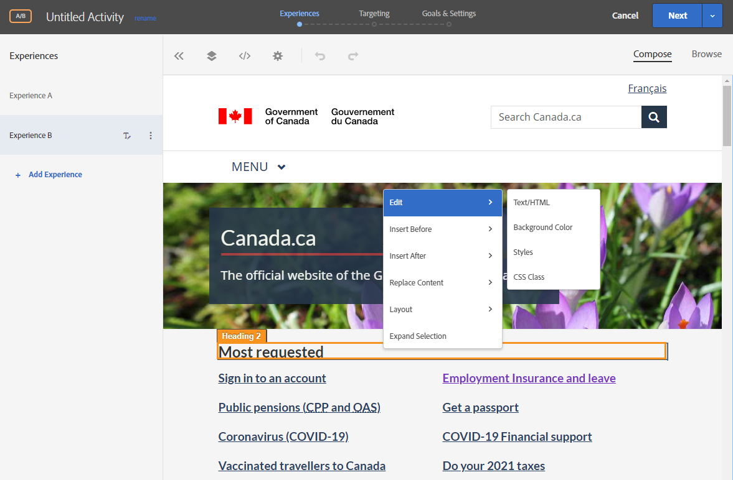
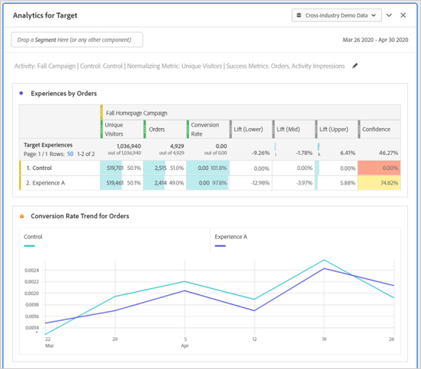
Adobe Target The GC's tool for A/B testing & personalization
Procured and ready for use for the GC
Easy to use interface
Can test & personalize any part of content or entire user journeys
Does not modify original page
Preview links for reviewing before launch
Integrated with Adobe Analytics

Slide 4
What is personalization?
Displaying customized web content to groups of visitors based on pre-defined audience criteria
Examples of audience criteria:
Geographic location​
Mobile vs. desktop
GC vs. public traffic
New vs. returning visitors​
Previous page or landing page​
1
2
Notes:
Natural disasters example (wild fires or hurricane Fiona)

Slide 5
What is A/B testing?
A/B testing is a method where two or more variations of content are randomly shown to visitors in order to determine which variation performs best
What can you test?
Anything on a page! Design, layout, titles/headings, images, text, calls to action, buttons, links, etc.

Slide 6
How A/B testing works
Web traffic is randomly allocated between the variations during the same time period to avoid the influence of external factors (e.g. media/news).
A
50%
50%
B

Slide 7
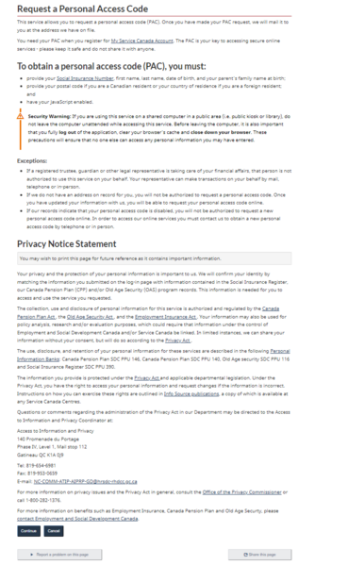
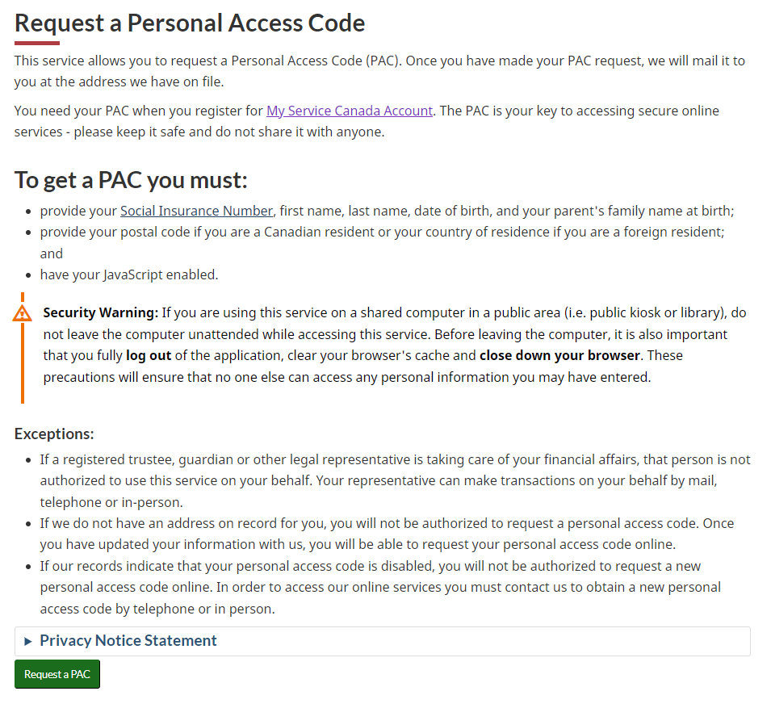
Example: My Service Canada Account Request a Personal Access Code
BEFORE
AFTER
Goal: Improve task completion and time efficiency
How: Reducing visibility of the privacy notice and increasing visibility of the call-to-action button
Test ran for 7 days, using 4 variations of the page
Evaluating success: See if there was an increase on the click-through-rate of the "continue" button
Version with the highest success had the privacy notice in an expand/collapse, and converted the button to the "supertask" style, and removing the cancel button

Slide 8
Examples
Library of past A/B tests & personalization activities in the GC
Library provides a summary of A/B tests and personalizations undertaken with Adobe Target within the GC, including:
The use case's research question or problem
The success metrics used
How the use case was designed and implemented
The results of the use case

Slide 9
Supporting digital government
Canada's Digital Ambition | Policy on Service and Digital | Digital Standards
Strategic theme 2: data-enabled digital services and programs ...unlocking the potential of data will help us improve services and support evidence-based decisions. Priority 4.1: support fully digital delivery by managing a government-wide culture shift ...adopting a responsible experimentation approach, where the objective is to learn fast in a safe manner in order to de-risk our efforts early. | The Policy on Service and Digital advances the delivery of services and the effectiveness of government operations. Item 4.1.3.8 Deputy heads are responsible for providing support for innovation and experimentation in service design and delivery, information, data, IT and cyber security. | Design with users Conduct ongoing testing with users to guide design and development. Iterate and improve frequently Develop services using agile, iterative and user centered methods. Continuously improve in response to user needs. Try new things, start small and scale up.

Slide 10
About the service
Cost-recovered service
Institutions will have access to Adobe Target to create and manage your own tests and personalizations
Unlimited tests and personalizations
Training, support and resources from Principal Publisher
Note: It is strongly recommended that your institution have Adobe Analytics implemented
Learn more about the service via Adobe Target GCpedia page
Tier | Page views | Cost
Tier 1 | >500M | $29,000
Tier 2 | 10-500M | $15,000
Tier 3 | <10M | $7,500

Slide 11
Contact us!
If you’d like to learn more or if you are interested in getting access to Target, email us at:
gc.analytique-analytics.gc@servicecanada.gc.ca
Nicolas Pjontek | a/Director | nicolas.pjontek@servicecanada.gc.ca
Lindsay Beaudoin-Rach | a/Manager | lindsay.beaudoin@servicecanada.gc.ca
Lauren Gregor | Product Lead | lauren.gregor@servicecanada.gc.ca

