Slide 1
GC Task Success Survey:
2024-25 Q3 Results
January 2025 | GCWP, Web Executive Board

Slide 2
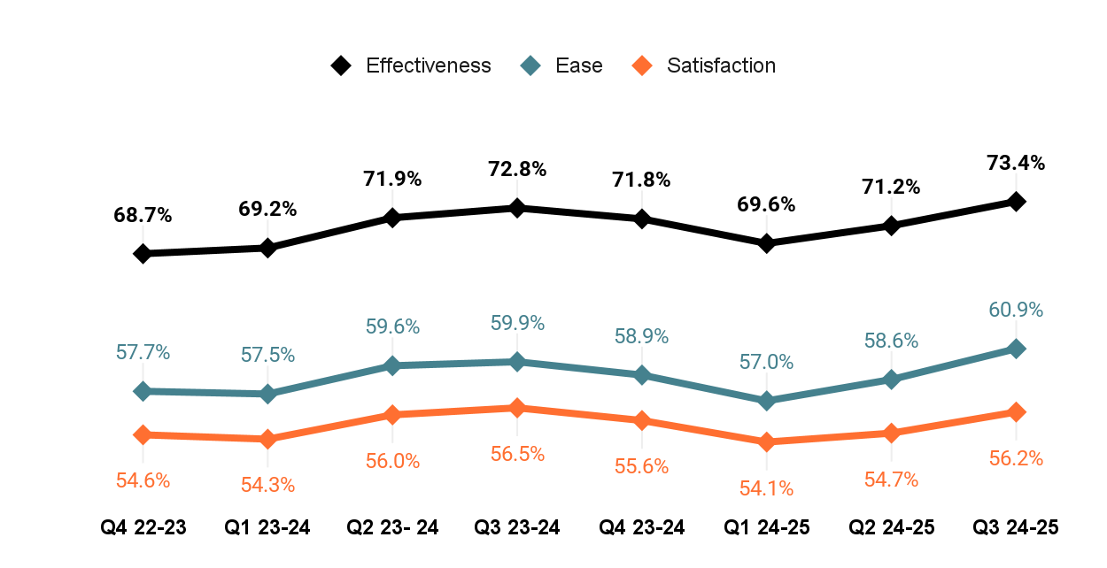
Overview of Q3 2024-25 results
Q3 Completed surveys: 133,615 visitors completed the survey
Q3 Average success: 73.4% said that they were able to complete their task
▲0.6%
Compared to the same quarter last year
Q3 23-24
▲2.2%
Compared to the previous quarter
Q2 24-25

Slide 3
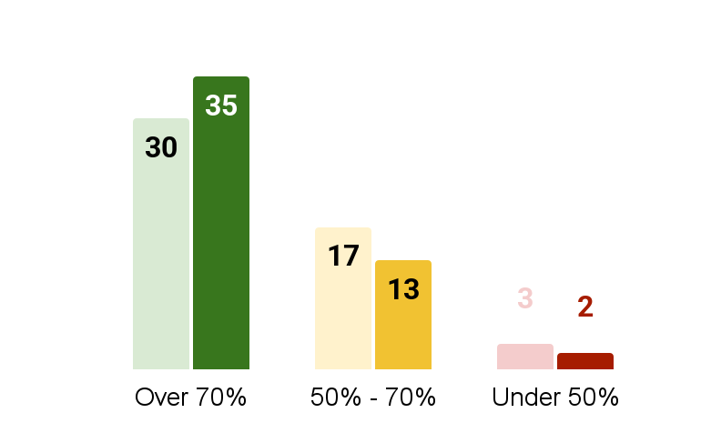
Performance of the top 50 tasks by score in Q3
70%
Of tasks in the top 50 scored over 70%
▲Up from 58% from Q2
Reminder!
We will be moving to a 75% threshold for success on April 1, 2025.
Here’s what Q3 would look like with the new threshold:
26 tasks > 75%
20 tasks 60% - 75%
4 tasks < 60%
Q2 FY24 Q3 FY24
Q2 FY24 Q3 FY24
Q2 FY24 Q3 FY24

Slide 4
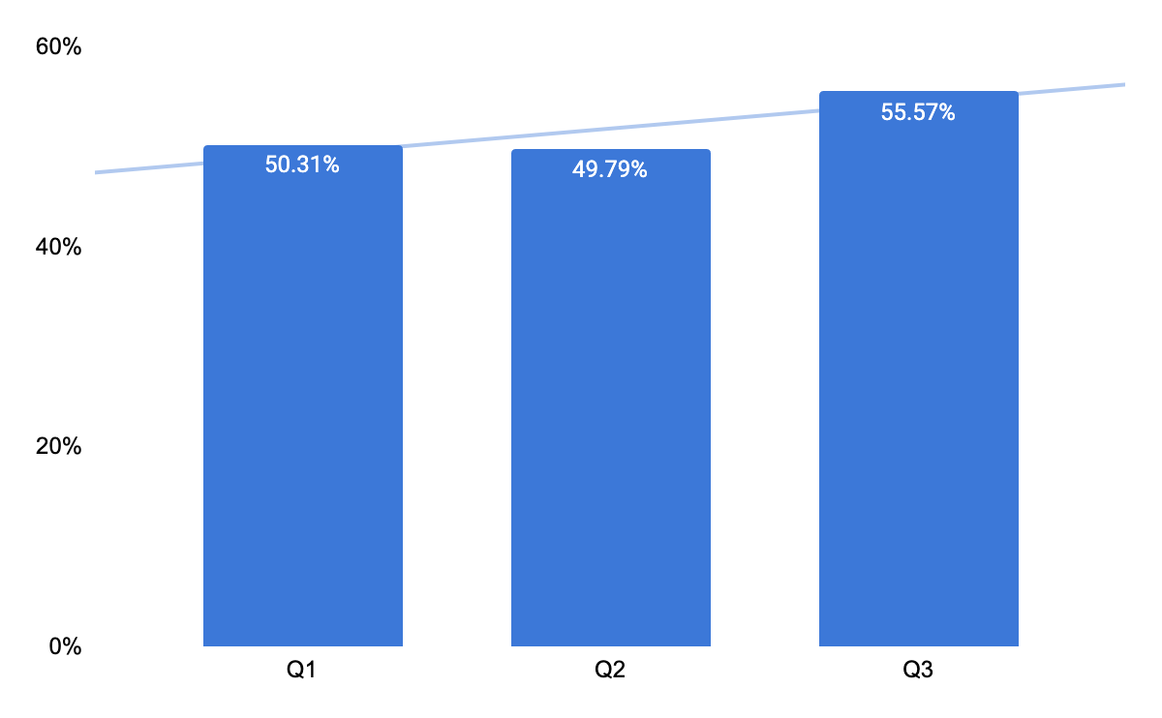
Accounts tasks trend: Improvements seen in Q3!
Tasks included
My Service Canada Account (MSCA) - Register for an account
My Service Canada Account (MSCA) - Sign in
IRCC accounts - sign in and register
Representatives accounts - sign in and register
Access My Account
Access My Business Account
GST/HST - Get access code
GST/HST - Open account
Open a My Account
Open a My Business Account
Sign into or create a Veterans Affairs Canada (VAC) account (excluded - insufficient data)
There are currently 11 tasks that are specific to accounts in the TSS.
Ongoing work to improve the account experience is beginning to show in TSS scores.
Simplifying finding, creating, and signing into accounts is critical work to improve overall task success.
MSCA, IRCC and CRA all adopted the new sign in pattern in the fall of 2024.

Slide 5
Q3 - Top 10 tasks with most responses
TASK | DEPT | Q3 2023 | Q3 2024 | Responses
Apply for a work permit | IRCC | 82.0% | 81.7% | 9,625
Check your application status (IRCC) | IRCC | 78.0% | 79.3% | 6,832
Apply for a visitor visa to Canada | IRCC | 79.1% | 79.0% | 5,376
Immigrate through Express Entry | IRCC | 69.7% | 75.5% | 3,513
Employment Insurance (EI) - Submit an Employment Insurance Report | ESDC | 90.9% | 91.5% | 3,208
Access My Account | CRA | 58.4% | 61.7% | 2,840
My Service Canada Account (MSCA) - Sign in | ESDC | 67.5% | 67.6% | 2,707
Check online mail (CRA) | CRA | 70.9% | 76.0% | 2,579
Employment Insurance (EI) - Apply for Employment Insurance | ESDC | 80.9% | 80.4% | 2,371
Apply for an Electronic Travel Authorization (eTA) | IRCC | 83.4% | 82.8% | 2,349
4 tasks entered the top 10 compared to Q3 last year
Submit and EI report
MSCA - Sign in
Apply for EI
Apply for an eTA
Notes:
Notable changes?

Slide 6
Q3 - 10 Highest completion scores in the top 50 tasks
TASK | DEPT | Q3 2023 | Q3 2024
Pension payment dates | ESDC | 94.4% | 95.40%
Employment Insurance (EI) - Submit an Employment Insurance Report | ESDC | 90.9% | 91.50%
Travel advice and advisories | GAC | 88.5% | 88.00%
Calculate payroll deductions | CRA | 84.5% | 85.20%
Check processing times | IRCC | 83.1% | 85.10%
Weather (current conditions, forecasts, radar, alerts, historical) | ECCC | 89.0% | 84.30%
My Service Canada Account (MSCA) - View payment information | ESDC | 83.4% | 83.80%
Apply for an Electronic Travel Authorization (eTA) | IRCC | 83.4% | 82.80%
Apply for a work permit | IRCC | 82.0% | 81.70%
Canada Pension Plan (CPP) - Check payment information | ESDC | 84.7% | 81.70%
2 tasks entered the top 10 highest completion scores compared to Q3 last year
Check processing times
Apply for a work permit
A couple of tasks dropped slightly compared to last Q3
Weather
CPP Check payment information
Notes:
Find a designated learning institution
Symptoms or risks for a disease or condition
(Bumped out of top 10 based on number of responses)

Slide 7
Q3 - Lowest completion scores in the top 50 tasks
TASK | DEPT | Q3 2023 | Q3 2024 | CHANGE
Sign up for direct deposit or update your banking information | Shared | 57.2% | 49.30% | -7.90%
My Service Canada Account (MSCA) - Register for an account | ESDC | 51.1% | 50.00% | -1.10%
Get, renew or replace a permanent resident card | IRCC | 56.0% | 57.10% | 1.10%
Check the status of a passport application | IRCC | 74.6% | 58.20% | -16.40%
Contact Immigration, Refugees and Citizenship Canada | IRCC | 63.0% | 60.80% | -2.20%
Apply for the Canada Child Benefit (CCB) | CRA | 69.5% | 61.40% | -8.10%
Access My Account | CRA | 58.4% | 61.70% | 3.30%
Benefits for people with disabilities | ESDC | 64.5% | 63.90% | -0.60%
My Service Canada Account (MSCA) - Check your CPP/OAS application status | ESDC | 51.2% | 64.00% | 12.80%
File a Personal tax return | CRA | 62.3% | 64.60% | 2.30%
2 tasks joined the lowest completion scores compared to last Q3
Passport status
Apply for the CCB
Related to Canada Post labour action. Tracking numbers created, but passports held and deliveries were delayed.
No work has been done on this task - so other factors may be affecting it

Slide 8
Biggest improvements in the top 50: Q3 2023 v Q3 2024
TASKS with significant increase | DEPT | Q3 2023 | Q3 2024 | CHANGE
My Service Canada Account (MSCA) - Check your CPP/OAS application status | ESDC | 51.2% | 64.00% | +12.8 % pts
Vaccines and treatment | PHAC | 66.3% | 77.80% | +11.5 % pts
Find an IRCC application package or form | IRCC | 61.2% | 70.40% | +9.2 % pts
IRCC accounts - register, sign in, help | IRCC | 64.7% | 70.80% | +6.1 % pts
Scholarships to study in Canada | GAC | 63.2% | 69.20% | +6.0 % pts
Immigrate through Express Entry | IRCC | 69.7% | 75.50% | +5.8 % pts
Check online mail (CRA) | CRA | 70.9% | 76.00% | +5.1 % pts
Apply for a new Canadian passport | IRCC | 70.9% | 75.90% | +5.0 % pts
Notes:
File a Personal tax return - This task was added June 2023
When looking at biggest improvements - we changed the time frame from a quarter to quarter look to looking at the same quarter from last year. Optimization work (large scale) often takes more than a quarter to complete.

Slide 9
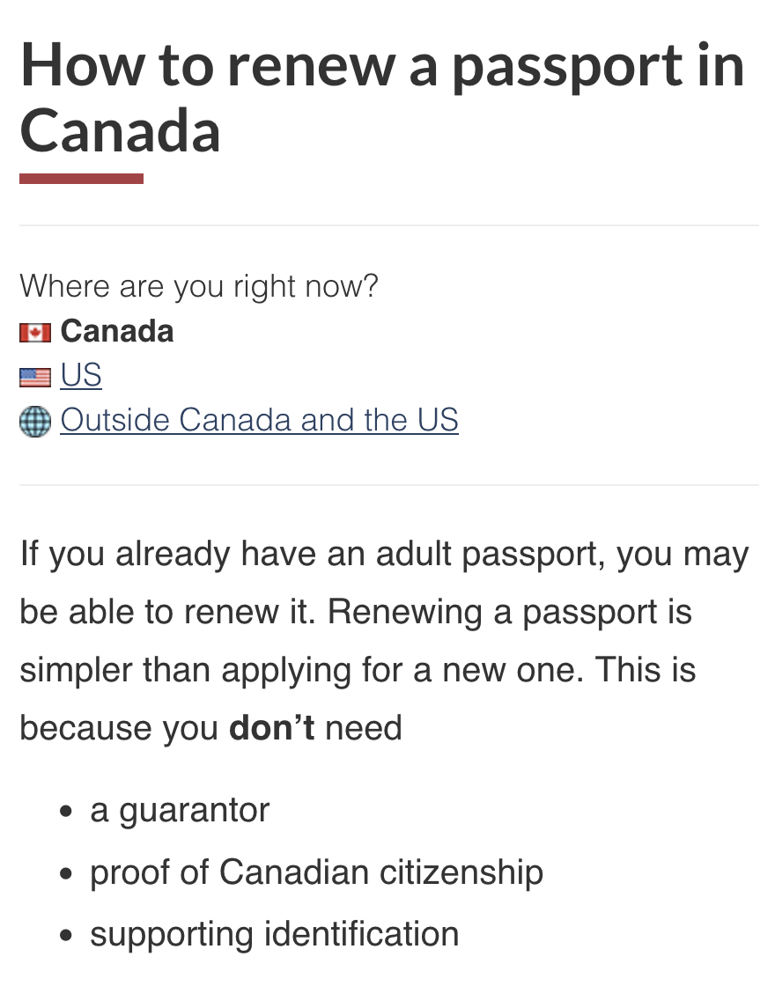
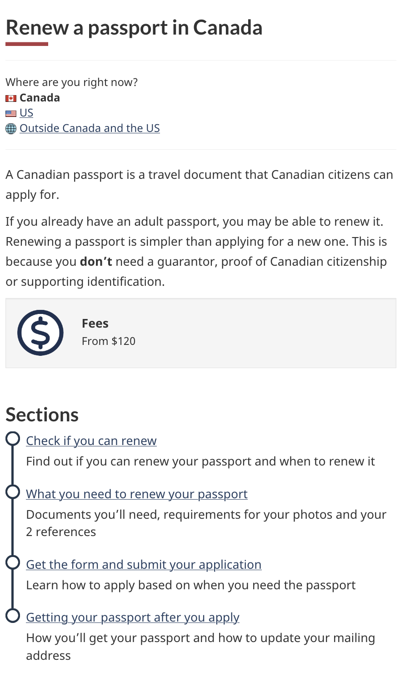
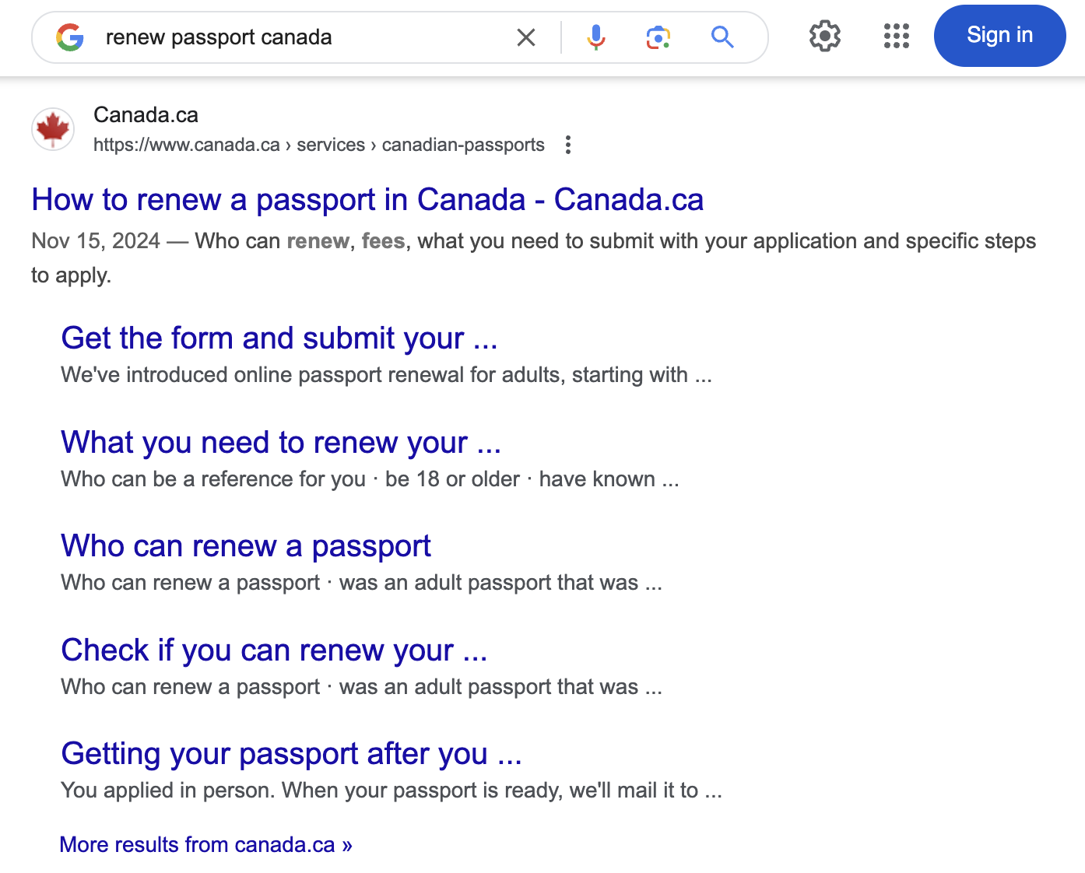
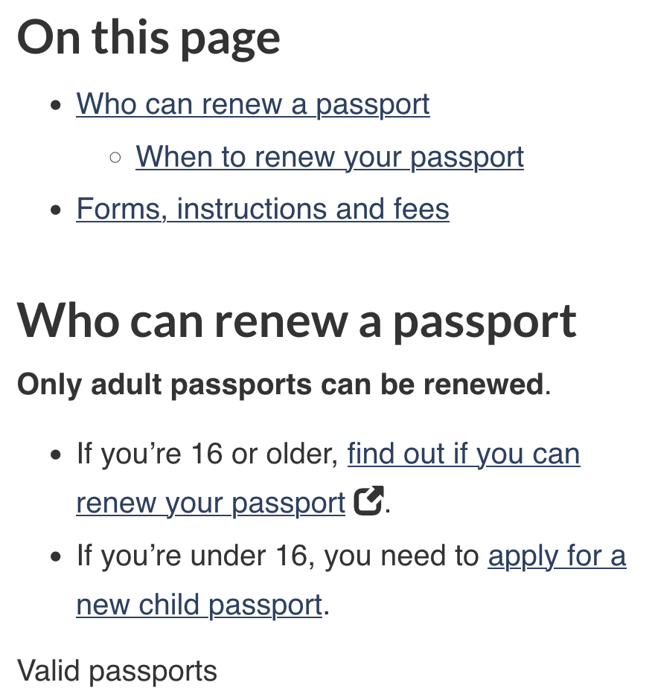
Featured project: IRCC Renew a passport - Subway pattern added
Results
TSS Score
Slight increase to GC TSS score compared to last year: 77.3% → 78.6%
Page Feedback
30%(EN) / 43%(FR) decrease in “No” clicks per 1k visits
30% decrease in overall comments
Note: These increases occurred during the Canada Post labour action
Search results
Google search results became more detailed
Lead: Colin MacDougall, Senior Web Advisor, IRCC Colin.MacDougall@cic.gc.ca

Slide 10
Feature your optimization work
Help us learn how your optimization work may have contributed to increased task success scores!
We’d like to highlight more optimization work going forward.
Notes:
File a Personal tax return - This task was added June 2023
When looking at biggest improvements - we changed the time frame from a quarter to quarter look to looking at the same quarter from last year. Optimization work (large scale) often takes more than a quarter to complete.

Slide 11
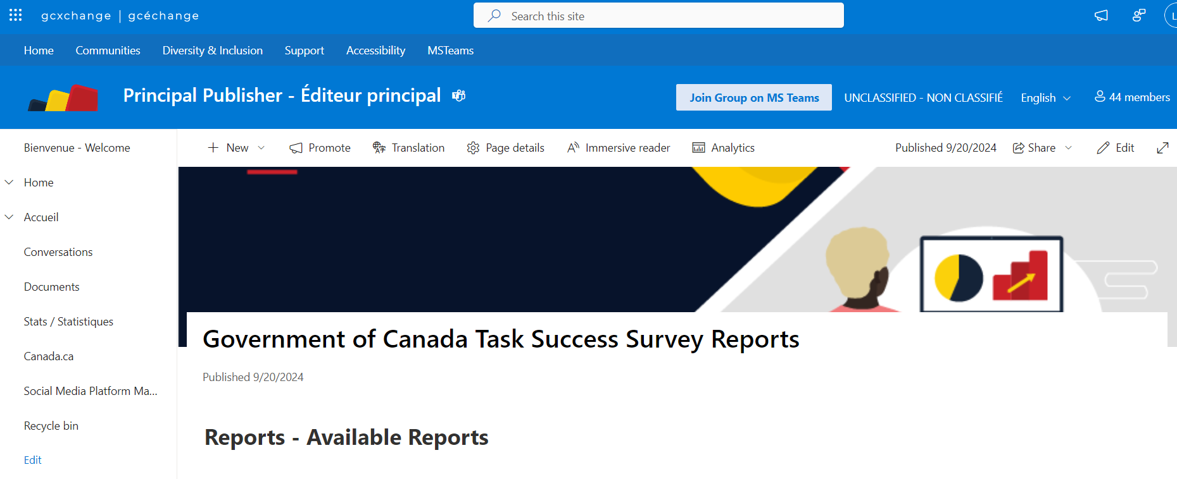
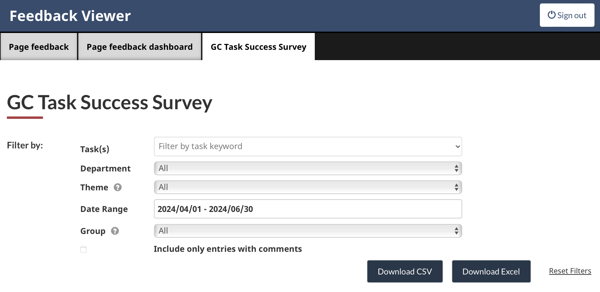
Annual reports, quarterly reports, and feedback
Download the annual and quarterly GC TSS reports on GC Exchange
Download raw survey responses and comments from the Feedback Viewer

Slide 12
Thank you for your time
Lana Stewart
A/Supervisor Data and Performance
Digital Transformation Office
Canada Digital Service
lana.stewart@cds-snc.ca
343-551-5967
Celena Bedford
Analytics Services
Principal Publisher Service Canada
celena.bedford@servicecanada.gc.ca
Reach out to share your case studies or volunteer to pilot new tools.

Slide 13
Annex: Definitions of task types
Task type | Account task | Service task | Action task | Answer task
What it includes | Tasks related to signing in, registering, or getting help with an account. Sign in to an account Register for an account | Usually written as a service or program name Includes a mix of public, authenticated space answers, actions, and account tasks as part of the service. Ex: Renew a passport | Usually a sub-task of a service. Initiate a process Check a status Get help, follow-up Public: Ex. Check if you need a visa or eTA to enter Canada Authenticated (requires sign in): Ex. View or download T4 and other tax slips | Public: Find dates, amounts, forms or use a wizard / calculator / map to get a specific answer Ex. Find the next benefit payment date Authenticated (requires sign in): Specific to a person and requires signing in to an account Ex. Find my Tax-free savings Account (TFSA) contribution limit
Tasks that require sign-in score lower and we should compare similar types of tasks to account for this trend.
Google Docs: Top 100 tasks tagged by type

