Slide 1
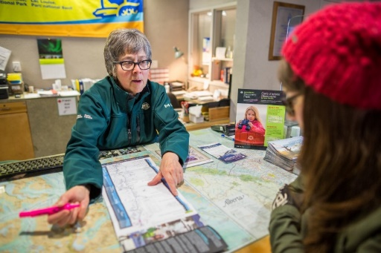
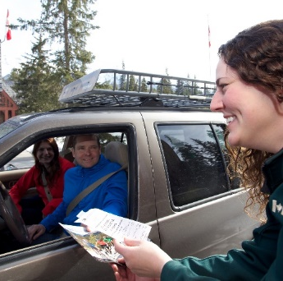
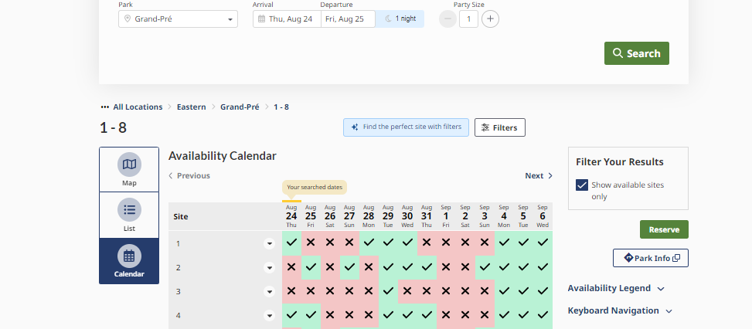
2024
DIGITAL GOVERNMENT LEADERS SUMMIT
Parks Canada Reservation Service (PCRS)
January 29-30, 2024
Marie-Hélène Brisson
Director, Visitor Experience
Michael Beaudet
Advisor, Digital Transaction Renewal

Slide 2
Parks Canada Reservation Service
Parks Canada has operated a centralized reservation service since 2004, replacing dozens of patchwork systems at various locations across the country.
This is the main service for reserving experiences at Parks Canada-managed locations:
Campsites, roofed accommodations, backcountry sites, guided activities, shuttle bus seats and parking spaces at high-demand lots
Provides assurance to visitors travelling long distances, helps manage visitation

Slide 3
Parks Canada Reservation Service
‘Clients’ are NOT departmental employees or industry!
Canadians wanting to go camping this weekend
An elderly couple trying to plan their RV trip
Foreign families visiting Canada for their first time
Users have other options of where to visit and spend their money
An effective PCRS is key to building a sense of connection and
maintaining our competitive place in the market
The PCRS helps meet the GoC commitment for digital services,
and aligns with expectations of tourism industry and younger generations
Helps position Parks Canada with more digital tools to improve efficiency
in a labour market expected to face recruitment challenges into the 2030s

Slide 4
Why is the PCRS Important?
The PCRS has become much more than simply securing a campsite!
VISITORS can…
…travel at a relaxed pace and enjoy their journey along the way, knowing that their site is waiting for them
…keep their wallets in their pocket more often during their visit
…manage their itinerary at any time of day or night, without needing to visit during office hours
…use the online service and go directly to the trailhead, avoiding a long drive to a visitor centre
Even visitors without a reservation arrive with accurate expectations of what is available

Slide 5
Why is the PCRS Important?
The PCRS has become much more than simply securing a campsite!
PARK STAFF enjoy…
…more efficient reception at the park, with people arriving already registered and knowing where to go
…less time spent on administrative work like recording people’s contact info and issuing permits
…reduced congestion; fewer people arrive at the same time
…improved interactions with visitors:
Visitors take out their wallets less often
More visitors arrive with accurate expectations

Slide 6
Why is the PCRS Important?
The PCRS has become much more than simply securing a campsite!
PARK MANAGERS benefit from…
…improved Visitor Safety tools, to quickly alert visitors of factors affecting their visit, or report on who will be in your park on a future date; reduced cash-handling in remote locations
…increased ability to cross-promote and improve awareness of other activities
…improved understanding of our visitors and their trip-planning habits
…staff that spend less time performing administrative work or turning away visitors → happier staff → improved staff retention

Slide 7
Success of PCRS
Places the User at the centre of development
Solution refinements based on visitor comments, including emails to Ministers/PMO
Feedback from campground attendants on the front line
Discussions with tourism industry
The reservation service has grown from 120,000 reservations in 2012 to nearly 700,000 in 2023.
Collects $50M in revenue for the Agency annually.
Notes:
2013: launch of new (current) reservation service
2017: Canada150
2018: Addition of parking space reservations
2019: Whistlers campground (700+ campsites) closed for 2 years, 10% of all reservations
2020: COVID-19 closures, travel restrictions
2021: Addition of shuttle seat reservations

Slide 8
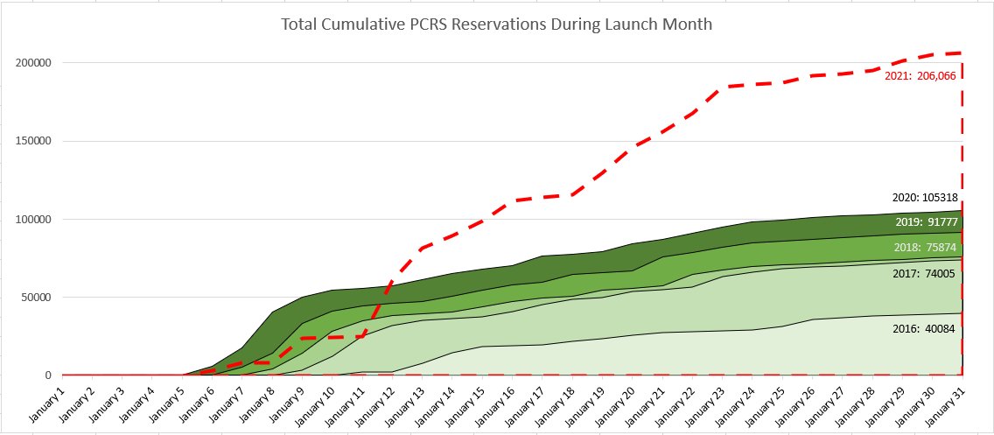
Success of PCRS
Successful pilot and inclusion of opening day queue and random draw process to manage increasingly competitive reservation launches
Calmer experience
for users
Less stress on system
resources
Increased reservations

Slide 9
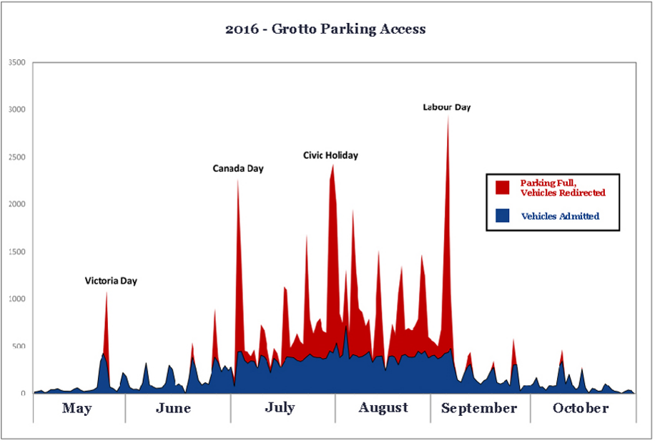
Success of PCRS
Introduction of timed parking reservations at Bruce Peninsula Grotto
Over 24,000 vehicles turned-away at Grotto parking lot in 2016
PCRS launched parking reservations in 2017 → 40% fewer turn-aways
Negative interactions with visitors have been significantly reduced
58,000 annual reservations for visitors who now arrive and immediately begin enjoying the Grotto → reduced idling, congestion, etc.

Slide 10
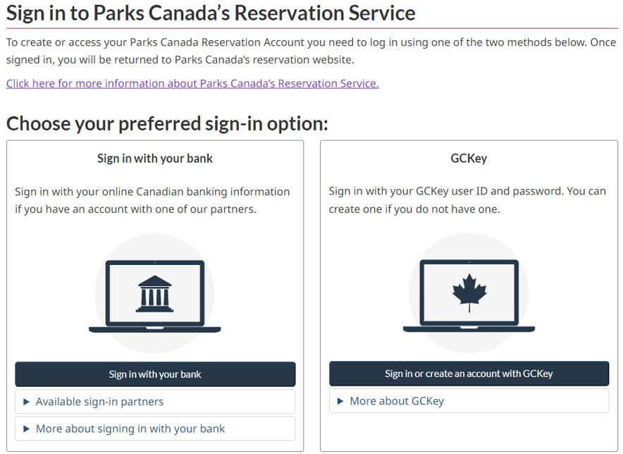
Success of PCRS
Aligning the online sign-in process with our users’ expectations:
Successfully petitioned TB EARB for a simpler online sign-in process, resulting in a GCKey/Interac ID exemption permitting the use of social media sign-in

Slide 11
PCRS Renewal
In 2018, Parks Canada began the process to procure a new PCRS:
Dedicated staff (ongoing PCRS operations do not suffer)
Early and ongoing collaboration between Visitor Experience branch (user experience) and OCIO (technical requirements, modern standards, etc.)
Why a SaaS Solution?
Expertise → PC can learn from vendor’s experience with other clients
Shared goals → PC benefits from enhancements for other clients
Familiar interface for users of other solutions
Feedback → industry peers have moved away from custom-built solutions
Evergreen solution → vendor is responsible to follow evolving industry standards
In 2017, our vendor migrated the PCRS to MS Azure cloud servers:
Increased flexibility to deal with demand spikes, develop new test environments, etc.

Slide 12
PCRS Renewal
In 2023, Parks Canada awarded our new PCRS contract for the next 10 years:
Months of collaboration and research with colleagues in provincial parks, US state parks and internationally
Internal working group of subject experts helped identify ‘must-haves’ vs. ‘nice-to-haves’
Supported by a strong procurement team at PSPC, with internal contracting expertise called on as-needed
Conducted procurement RFI and RRR to ensure our needs aligned with what the industry can provide
ITQ phase narrowed the scope to only experienced vendors: more efficient process

Slide 13
Looking to the Future
Our Visitor Journey researched showed that first-time visitors engaged in much more planning prior to their trip vs. repeat visitors, and encountered more challenges.
Through improvements in usability, communications, cross-promotion and third-party integration, Parks Canada aims to improve the experience for first-time visitors and increase revenue and engagement at PC-managed locations.
On-site staff are highly valued, and their absence can be felt
The new PCRS will host more of Parks Canada’s activities and products under one solution (and one contract), allowing staff to spend less time performing administrative and transactional work, freeing staff to focus on on-site visitor needs

Slide 14
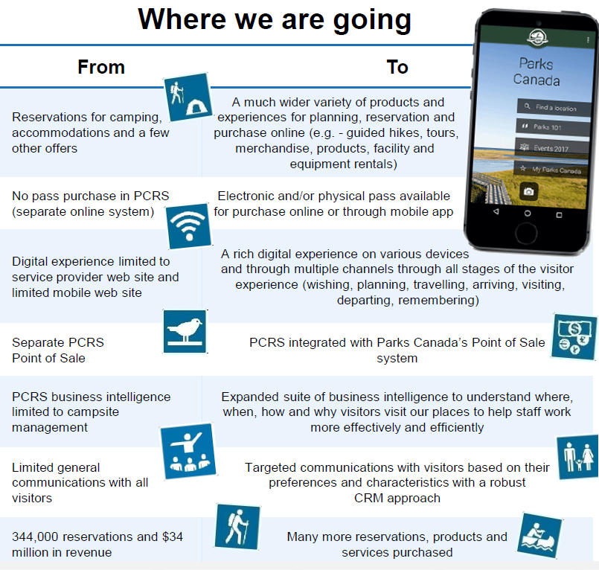
Looking to the Future
Maintain core of flexible campsite reservations
Expand the variety of offers and products available online → “one-stop shop”
Improved user experience for our visitors:
Availability alerts
Targeted communications & promotions
Improved mobile functionality
Support for tour operators: payment-on-account, custom business rules, etc.
Improved integrations with third-party software:
Parks Canada point-of-sale solution
Parks Canada mobile app
Annual pass print provider
Automated entry gates

Slide 15
Parks Canada Reservation Service
reservation.pc.gc.ca
Scan for more info!
Marie-Hélène Brisson
Director, Visitor Experience
Michael Beaudet
Advisor, Digital Transaction Renewal

