Slide 1
Building Photonic Quantum Computers
June 2021

Slide 2
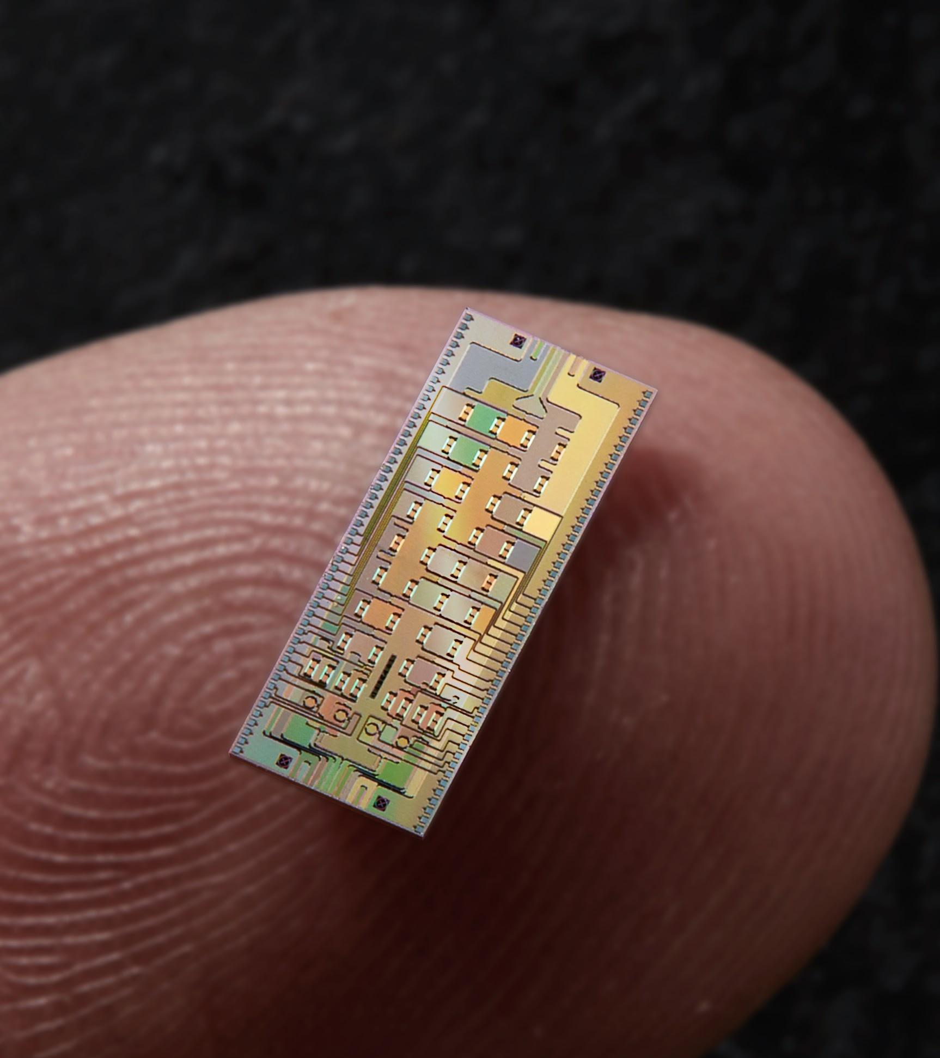
Welcome to Xanadu
Quantum Hardware Validated blueprint to 1M qubits using standard microprocessor fabs and off-the-shelf components.
Xanadu Cloud Platform The only company offering cloud access to photonic processors and founding developers of PennyLane.
World Class Team Amassed a team of 80+ people / 60+ PhDs from all of over the world.
Copyright © 2021 Xanadu Quantum Technologies Inc. | Strictly Confidential

Slide 3
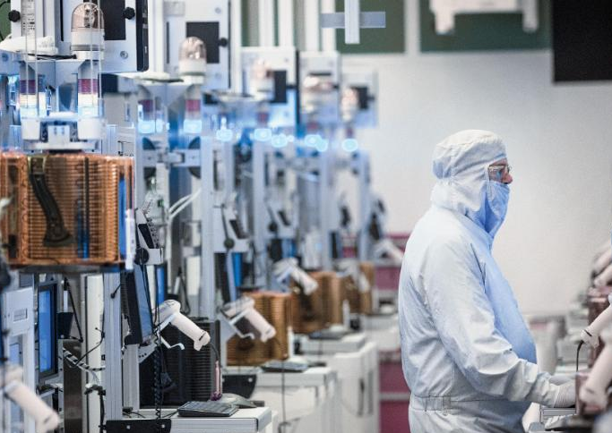
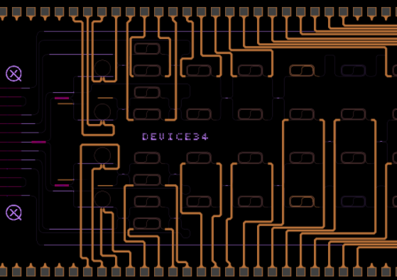
World leading photonic hardware lab & capabilities
PARTNERING WITH WORLD’S BEST FOUNDRIES
CHIP DESIGN
FABRICATION
TESTING
PACKAGING
8 QPU GENERATIONS
15 FOUNDRY CYCLES
1 ADVANCED PHOTONICS FACILITY
7 QUANTUM COMPUTERS

Slide 4
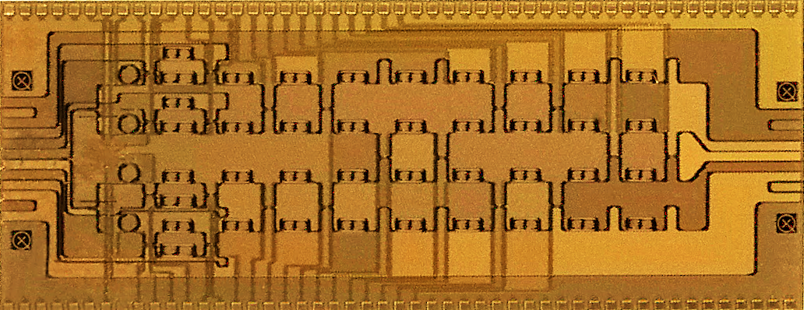
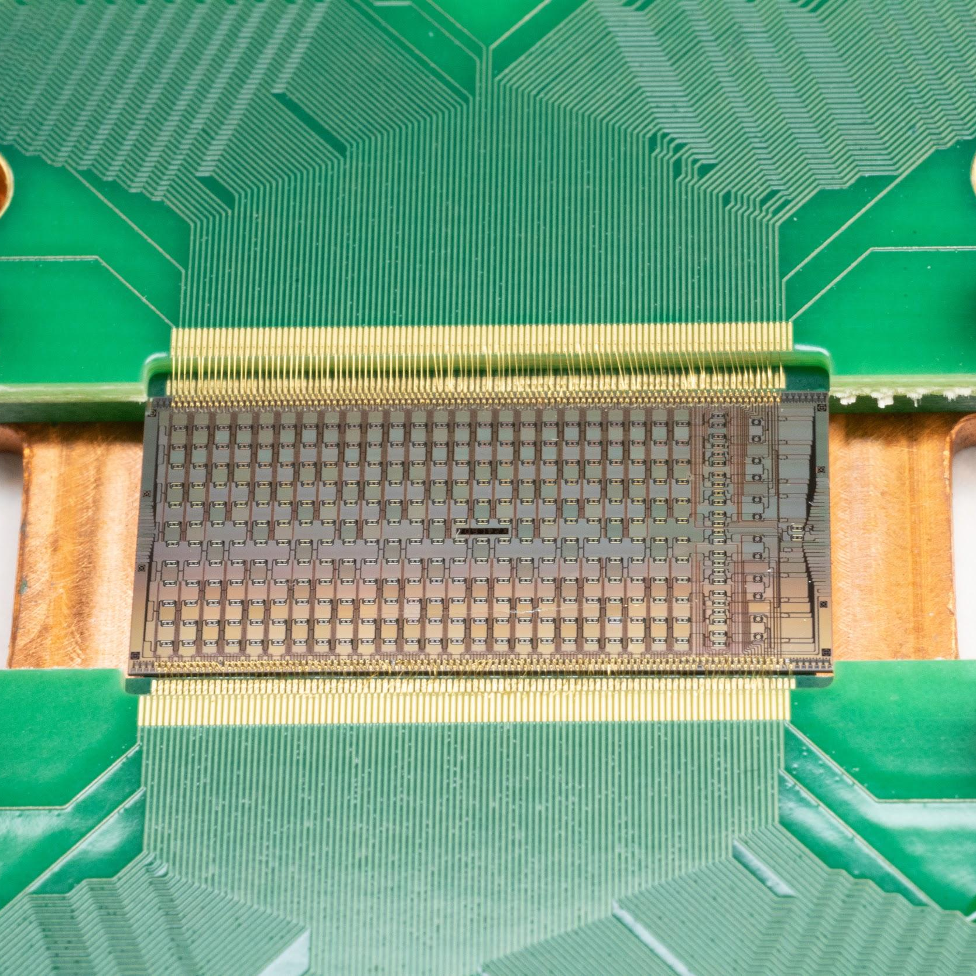
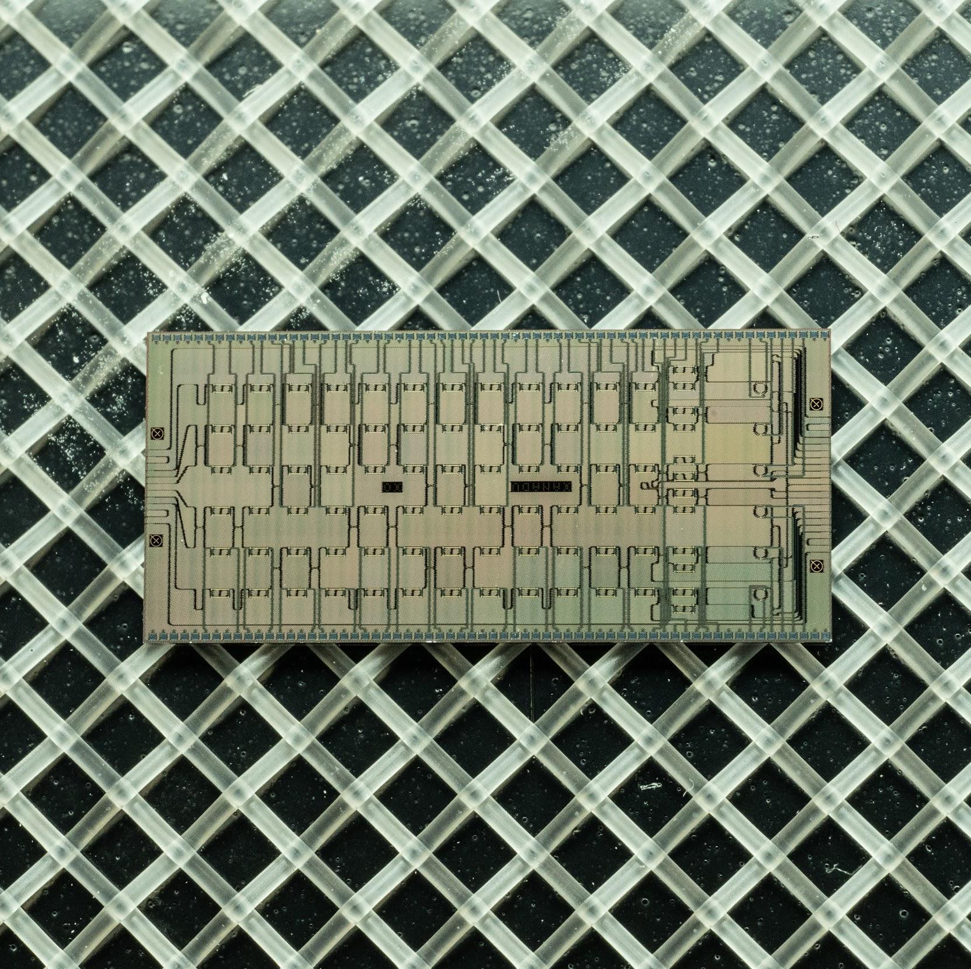
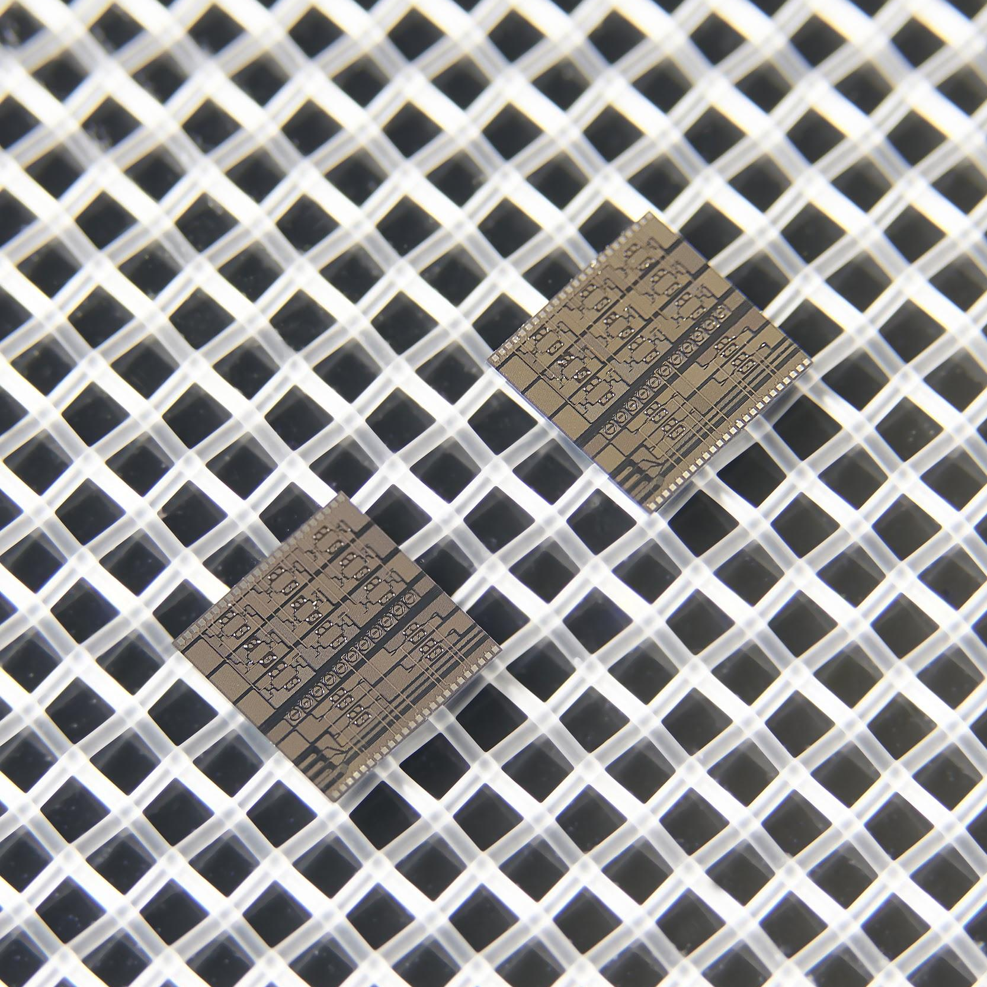
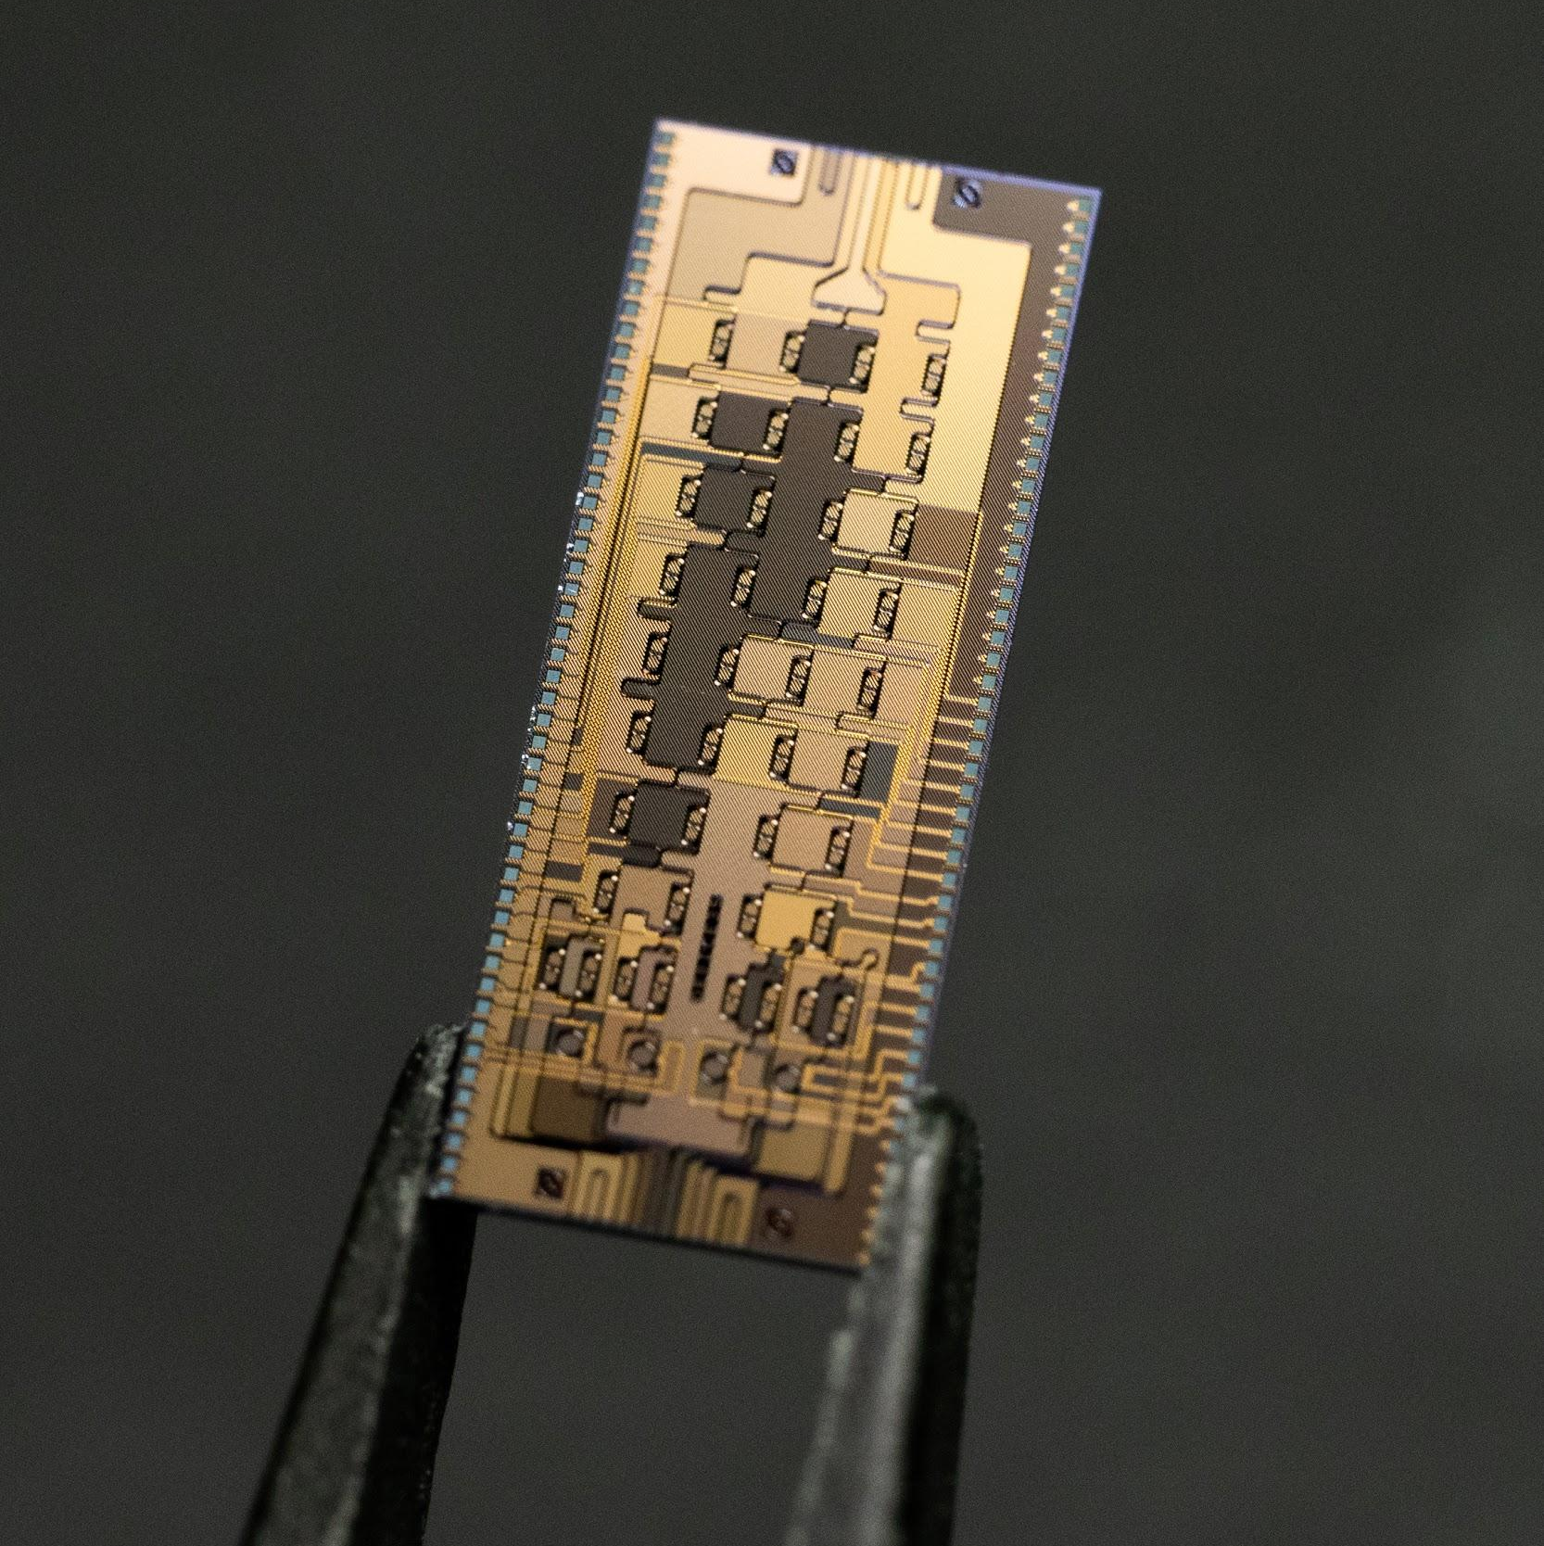
We are moving at light speed
2x every 6 months
40 qubits
A
B
Squeezed light source
Programmable interferometer
24 qubits
12 qubits
8 qubits
4 qubits
2019
2020
2021

Slide 5
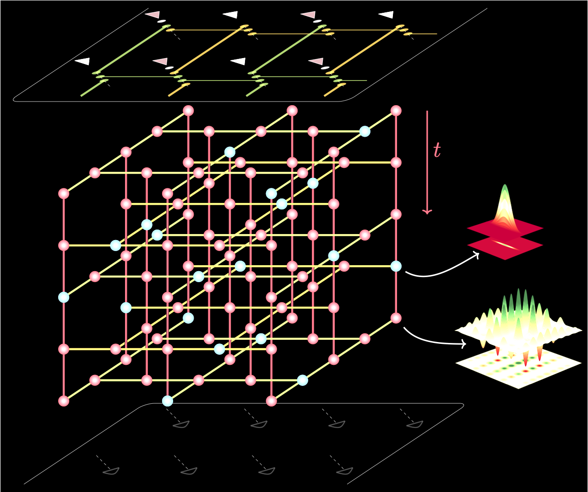
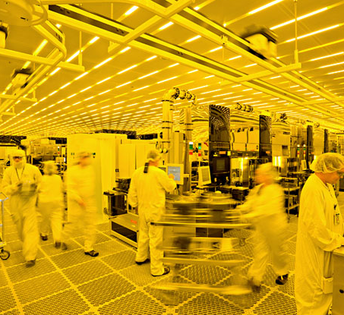
Benefits of photonic quantum computing
BLUEPRINT TO 1M QUBITS
10X FASTER DEVELOPMENT
MANUFACTURABLE
1000X FASTER
Scalability through modularity and optical networking.
Faster to build and cheaper to operate due to room temperature compute.
Made using silicon process in leading foundries (CMOS).
We operate at MHz clock speeds vs kHz for others.

Slide 6
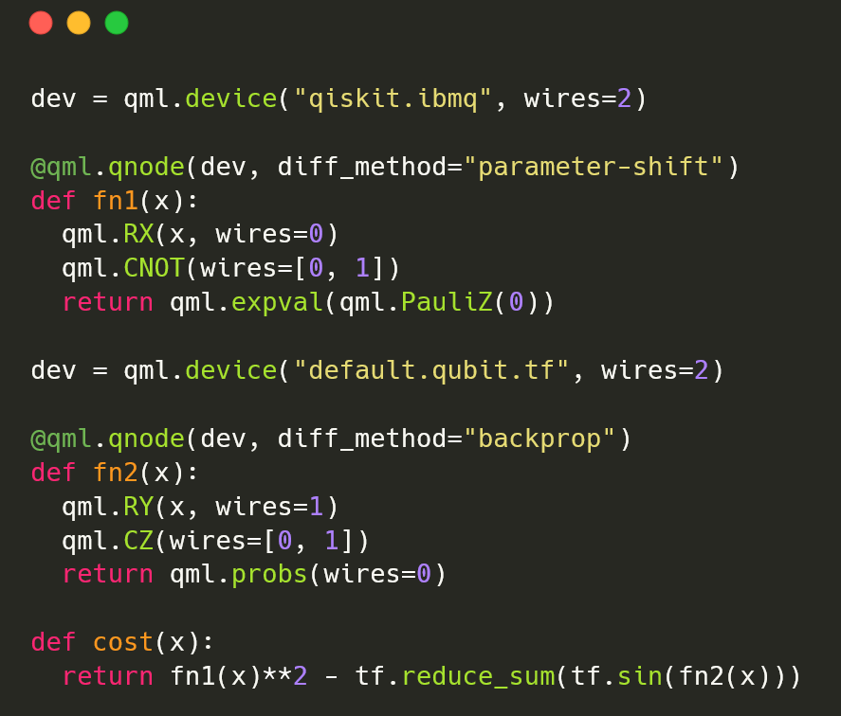
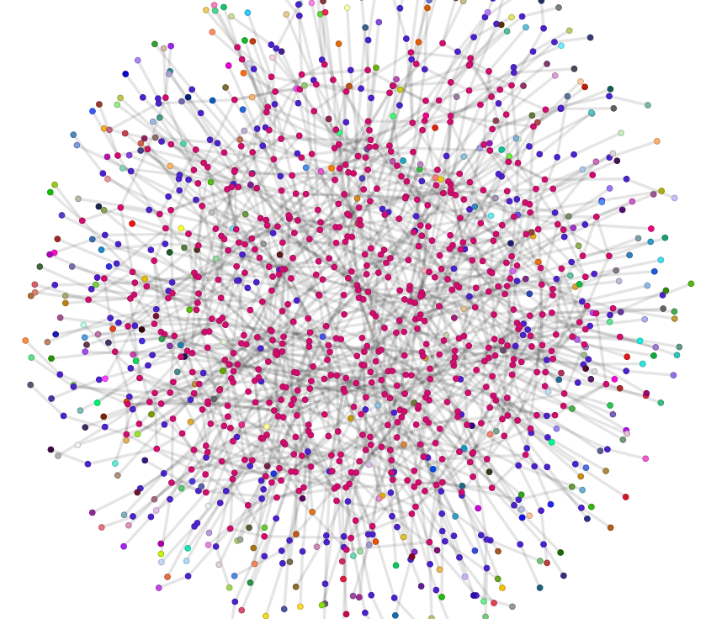
Xanadu cloud for everyone
Providing users with an end-to-end platform for developing and deploying state-of-the-art quantum applications.
Access Photonic QPUs
PennyLane-as-a- Service
High Performance Quantum Simulators

Slide 7
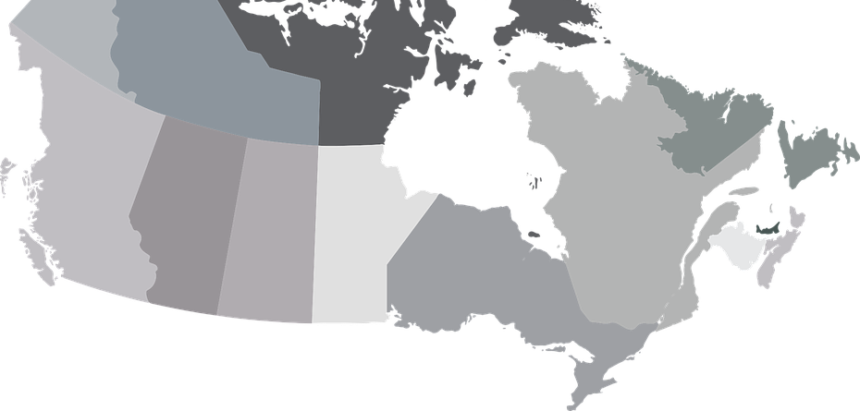
Quantum computing + communication
0-2 years
2+ years
Near-term applications:
Quantum key distribution
Secure identification
Quantum-secure communication
Distributed entanglement
Long-term applications:
Distributed quantum computing and cloud infrastructure
Unhackable elections and voting
Teleportation network
Quantum Sensing & IoT
Xanadu’s Testbed Quantum Network
Ottawa
Toronto

Slide 8
xanadu.ai

