Slide 1
Helping Businesses find COVID-19 programs
An iterative approach
April 2020
INNOVATION.CANADA.CA

Slide 2
A little bit of background
Innovation.canada.ca went live in January 2018 to help businesses find government support to grow their business
Over the past two years, we have been making iterative improvements based on user feedback
When COVID-19 specific programming started to be announced, we moved quickly to incorporate this information into the site

Slide 3
Friday, March 13
Team met to discuss approach to add COVID-19 programs to the site
Determined the best/fastest/most feasible approach was to add a new category to the site that would display to all users
Added a banner to point to the main COVID-19 page for businesses
Content wasn’t filtered at first – all programs were displayed to all users

Slide 4
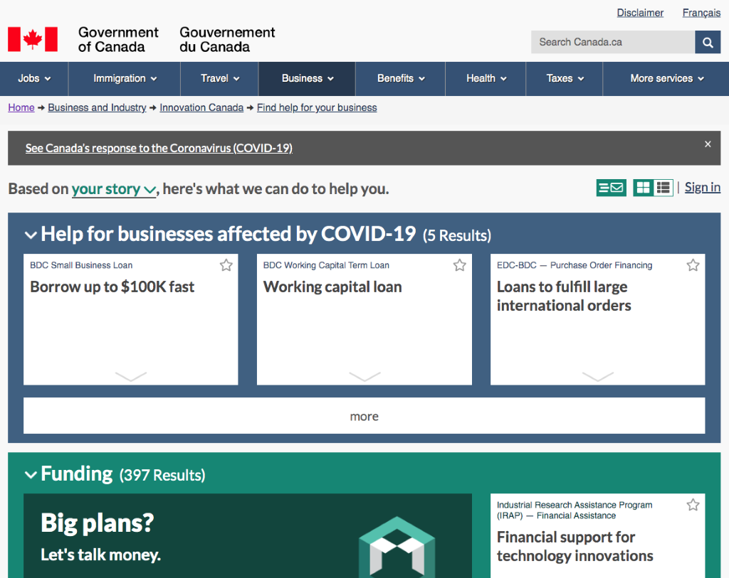
Tuesday, March 17 – Changes went live

Slide 5
Thursday, March 26
Added the ability to filter the COVID-19 programs by province as there were more and more becoming available
Updated the notice on the homepage to take people to the "list view" of our site to be able to quickly filter

Slide 6
Monday, March 30
Started planning to further integrate COVID-19 programs into the site as the list of programs kept growing and the impact will endure
Decided on a two-phased approach to be able to release some initial changes and then following up with larger changes to the site
These changes would:
Adjust the tone – no longer about "growing", now about "supporting"
Add COVID-19 as a specific selection in the story
Apply the rest of the filters to the COVID-19 programs to provide more accurate results

Slide 7
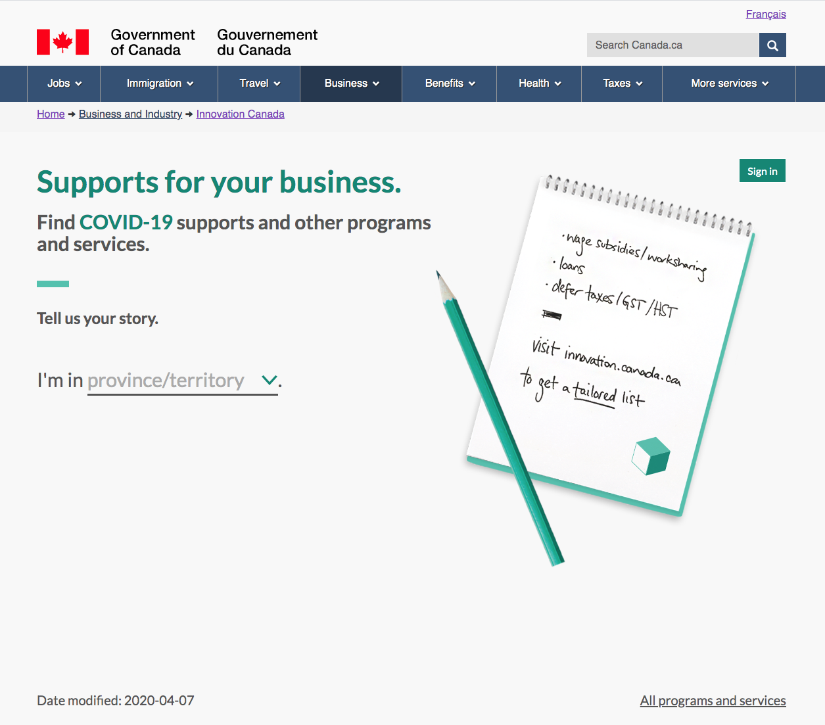
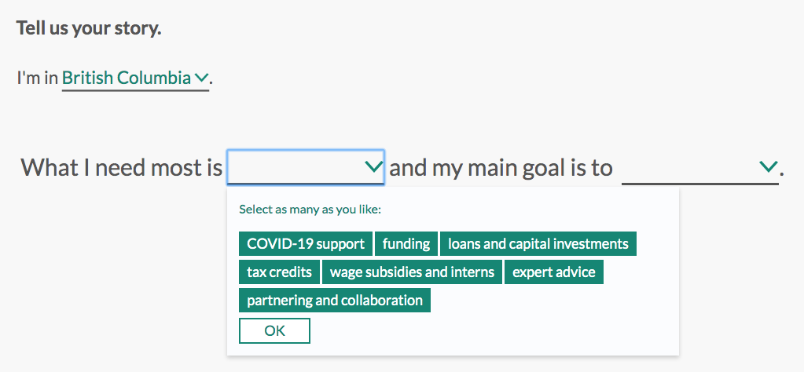
Wednesday, April 8
Phase 1 launched
This included:
Updated text and image on the homepage
New category for "COVID-19 support" displayed in the dropdown
Ability to filter COVID-19 programs by all existing criteria (e.g. sector, number of employees, audience, incorporation status, for profit)
Updates to email notification messages to adjust tone
Small round of usability testing – 4 participants + 3 by DTO-TBS

Slide 8
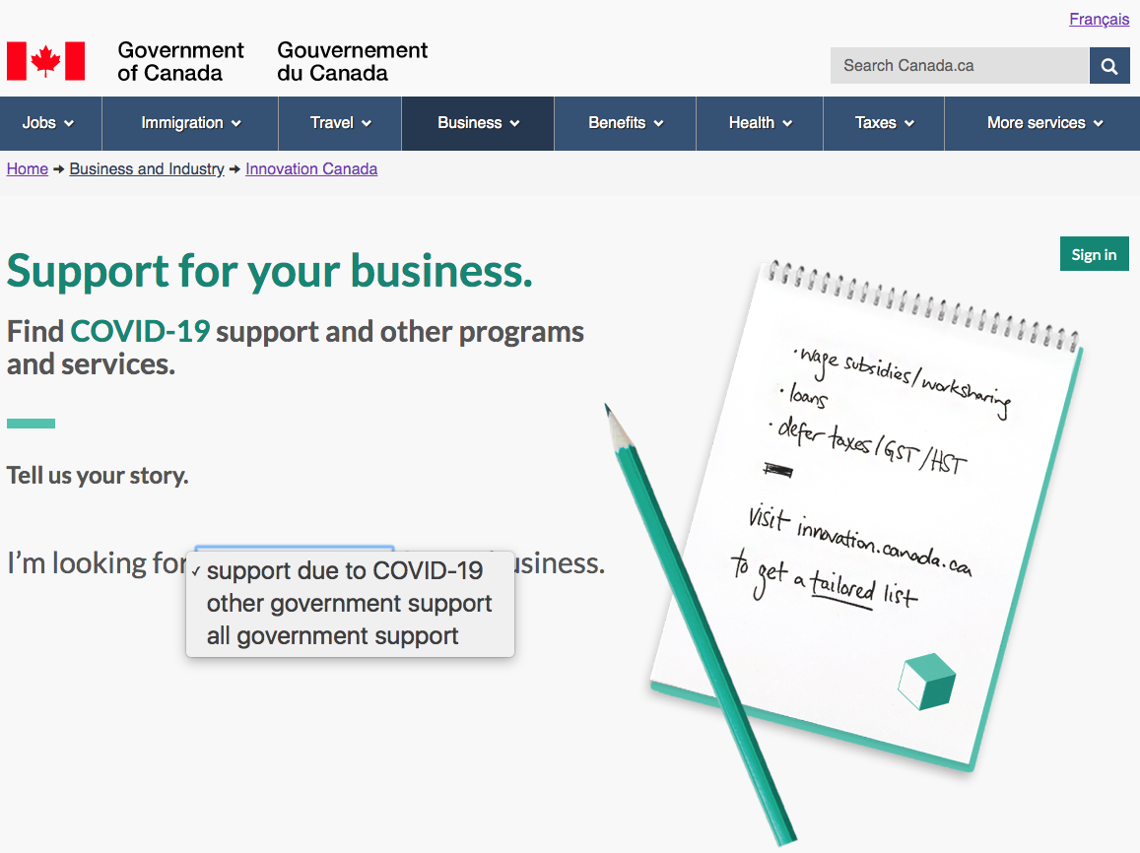
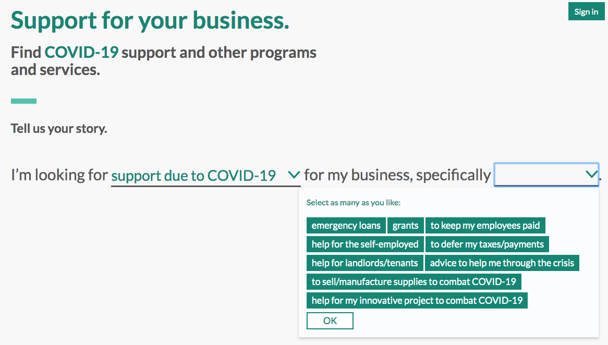
Friday, April 17
Phase 2 launched
Updates included:
Specific selection up front for COVID-19 support vs other support
Ability to filter COVID-19 support using a COVID-19 specific list
Small adjustments to language
Larger round of usability testing – 10 participants

Slide 9
April 24/27
Planned updates include:
Hiding "other" programs when "COVID-19 support" was selected
Continuing to update tone

