Slide 1
Household Travel surveys
Challenges Collecting and Sharing Data
Ilan Elgar, Director Research & Analytics Transportation Planning & Policy, TransLink
Housing, Infrastructure and Communities Canada Conference
November 13, 2024

Slide 2
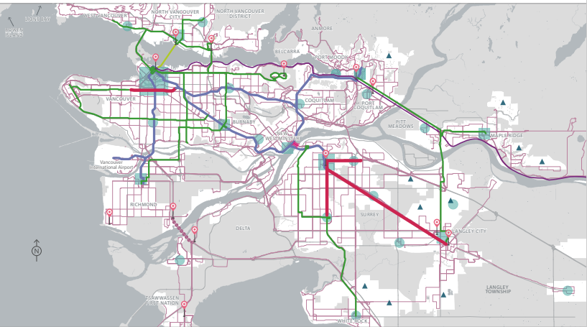
TransLink - Context
​ | Coast Mountain Bus Company​ 220+ bus routes with a fleet of 1,500 vehicles​ | ​ | ​
​ | SeaBus​ 3 passenger-only ferries linking Downtown Vancouver & North Vancouver​ | ​ | ​
​ | Cycling ​ 1,000 km of regional bike paths, locker facilities​ | ​ | ​
​ | HandyDART ​ Custom transit service for people with disabilities (310 fleet vehicles)​ | ​ | ​
​ | SkyTrain​ Expo, Millennium & Canada Lines (68 km)​ | ​ | ​
​ | ​ | ​ | West Coast Express​ 5 daily trains running from Mission to Vancouver & back (67 km)​
​ | ​ | ​ | Major Road Network​ Operation & maintenance of 2,300 lane kms of major roads​
​ | ​ | ​ | Bridges​ Pattullo, Knight Street, Golden Ears & Westham Island Bridges​
​ | ​ | ​ | Transit Police​ Dedicated transit police service (160+ sworn uniformed officers)​
​ | ​ | ​ | ​

Slide 3
Challenges to Data Collection
Other Challenges
Large number of decisions, all involve trade-offs
Cost vs quantity (e.g., sample size)
Quantity vs quality (e.g., number of questions vs response rate)
Quality vs quality (e.g., details vs reliability)
Main Challenge
Plummeting response rates
Survey costs
Sample size
Data quality/representativeness
 | 2011 | 2017 | 2023
Invitation Letters | 125,000 | 492,000 | 697,000
Survey Completions | 22,800 | 28,300 | 16,000
Registration Rate | 52.8% | 6.5% | 5.2%
Completion Rate | 18.3% | 5.7% | 2.3%

Slide 4
Obstacles to Data Sharing
What are the challenges
Privacy concerns
Multiple household and personal identifiers
Complete daily travel behavior
We are not adapt at providing restricted access to data
Bad use of data
Slicing the data to very small samples
Use data at much finer geographic level of aggregation than what they were weighted and expanded for
Potential Solutions
Different levels of data access
Public dashboard of highly aggregated (municipalities) data
Aggregated (subareas) and decoupled detailed data for stakeholders
Partial, less aggregated (TAZ) and decoupled detailed data for specific projects
A handful of staff with access to the full data
External specialized resources
Population Data BC
Others?

