Slide 1


Accessibility, Diversity and Inclusion
[PROJECT LOCATION]
DATE

Slide 2
How to use this document
Instructions – Remove this page before using
OBJECTIVE and FOR WHO: This presentation is intended for your organization's diversity and inclusion committees. It is intended to highlight the many design elements that can be used to provide staff with a more accessible workplace that promotes diversity and inclusion.
You can also use this presentation with human resources and facilities management resources, who are responsible for such things as duty to accommodate requests.
WHEN: It's best to involve your committees in phase 1 of the project, after the announcement to all staff.
HOW: Virtual or face-to-face meeting.
DISCLAIMER
This document presents the main principles for designing a GC workplace. Bear in mind that the Workplace Transformation Program (WTP) focuses on the reuse of existing building divisions, and the conservation of materials and equipment that are still functional. This may limit the application of some of the principles listed in the presentation.
Talk to your PSPC project team to ensure that the various elements apply to your project.
SOURCE : The information presented in this document is extracted from the GCworkplace Design Guide.
* The French version of this document is available here: FR version

Slide 3

Objectives and Agenda
Objective
To present the new workplace from the angle of accessibility and inclusion, demonstrating that it offers appropriate options for meeting specific needs, or simply for working comfortably on modernized floors.
Topics covered
Equal access
Ergonomics
Accessibility
Design for neurodiversity
Options for hypersensitivity
Indigenous-inspired design

Slide 4
Equal Access
In a GC workplace, work points are not assigned. This offers several advantages to employees, including:
Have equal access to numerous work points
Choose the work point that best suits the tasks and activities they need to perform (noise level, available equipment)
Work in a spot that suits personal preferences (temperature, brightness, etc.)

Slide 5
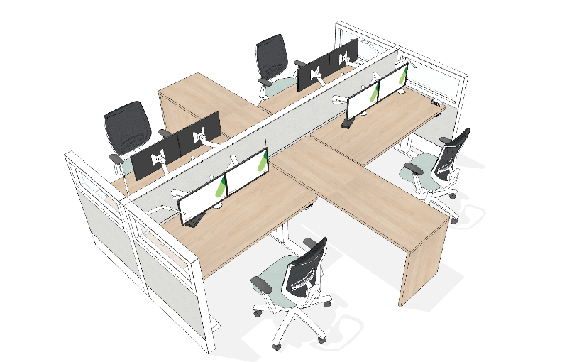
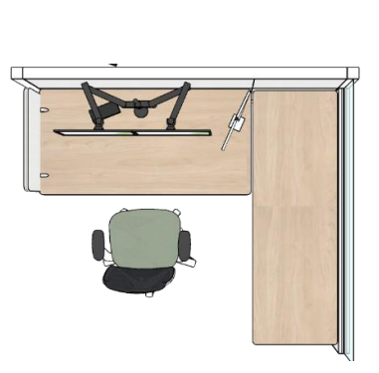
Workstation Ergonomics
Height-adjustable work surfaces (sit/stand)
Height-adjustable chairs
Extendable, easy-to-adjust monitor support arm
Accessible power modules
Dimmable lighting fixture
Notes:
Workstations are ergonomically designed by default, which helps to reduce the number of accommodation requests.
What's more, with power modules at desk height, there's no need to bend over or reach under the desk to plug in devices.

Slide 6
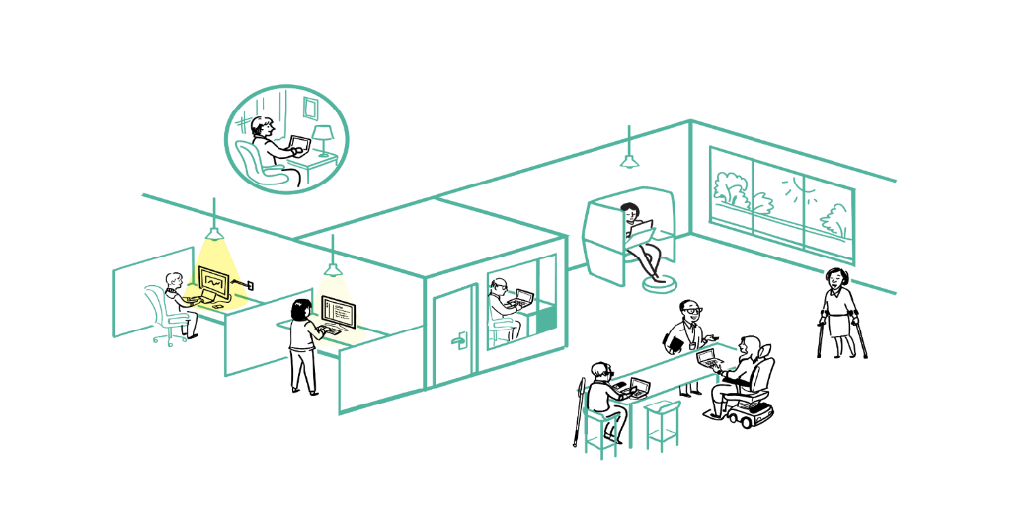

Accessibility in a nutshell
Large enclosed workpoints that can accommodate mobility devices and support cognitive impairments and sound sensitivities
Small enclosed workpoints (phonebooths) that can support the need for stimulus free space for various mental health reasons
Semi-private workpoints with access to daylight and views to support mental health
Being able to work from home to support work-life balance
Generous circulation areas for various mobility requirements
Standing height workpoints for users with larger, upright mobility devices (scooters) or for standing preference
Notes:
At the all-staff Town Hall, we looked at some of the accessibility elements of GC Workplace design.
This presentation goes into more depth, looking at the ergonomics and accessible functionalities of different workstations. We'll also see how the design supports neurodiversity-related needs.

Slide 7
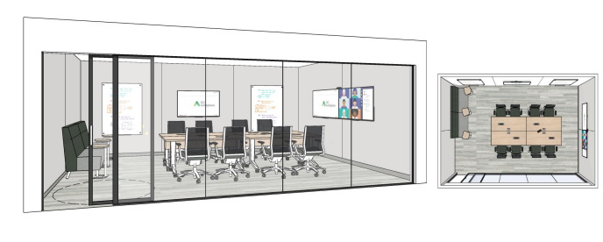
Room Accessibility
Accessibility features applying to concentration, meeting, work and project rooms, as well as accessible phone booths:
Accessible power modules
Height-adjustable conference chairs on castors
Sliding door (must open easily) with handle and contrasting trim
Appropriate aisle widths
Televisions or screens on more than one wall (meeting rooms only)
Example of a meeting room for up to 12 people.
Notes:
The rooms are more accessible and comfortable.They will also offer more privacy than shown in the image, since the glass surfaces are usually covered with frosted film.
In the meeting rooms, the power modules will be in the middle of the tables.

Slide 8
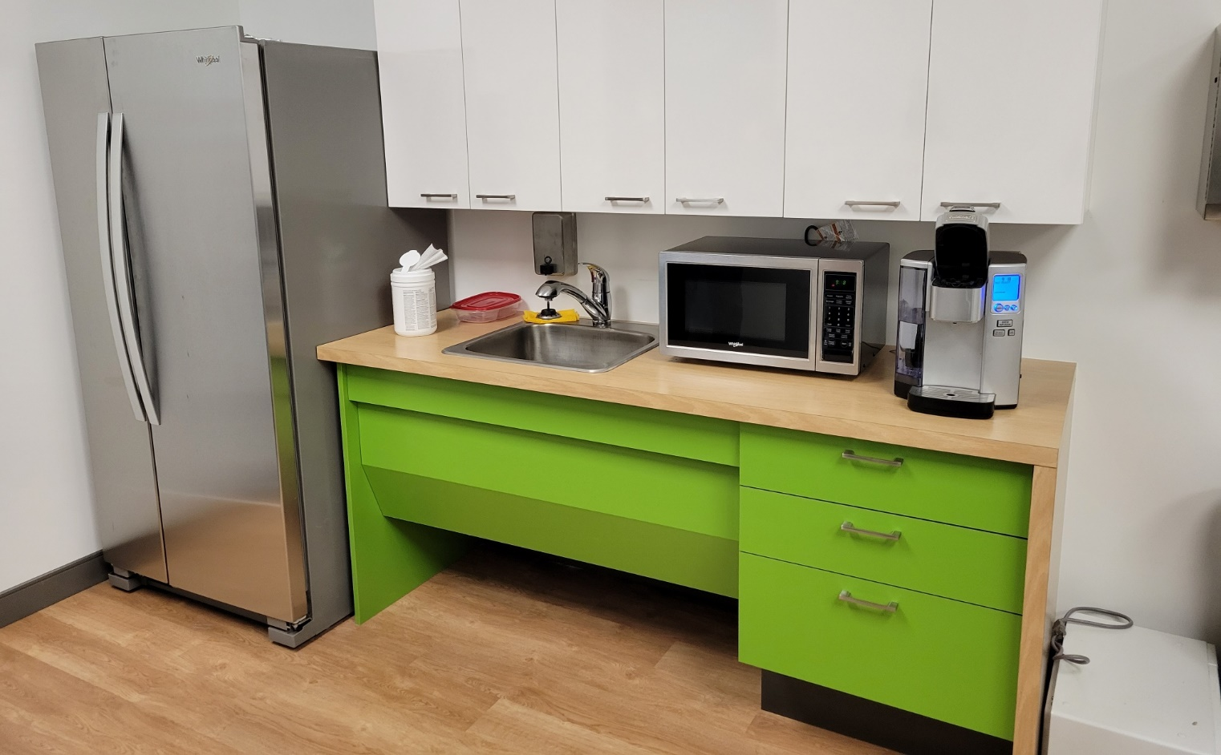
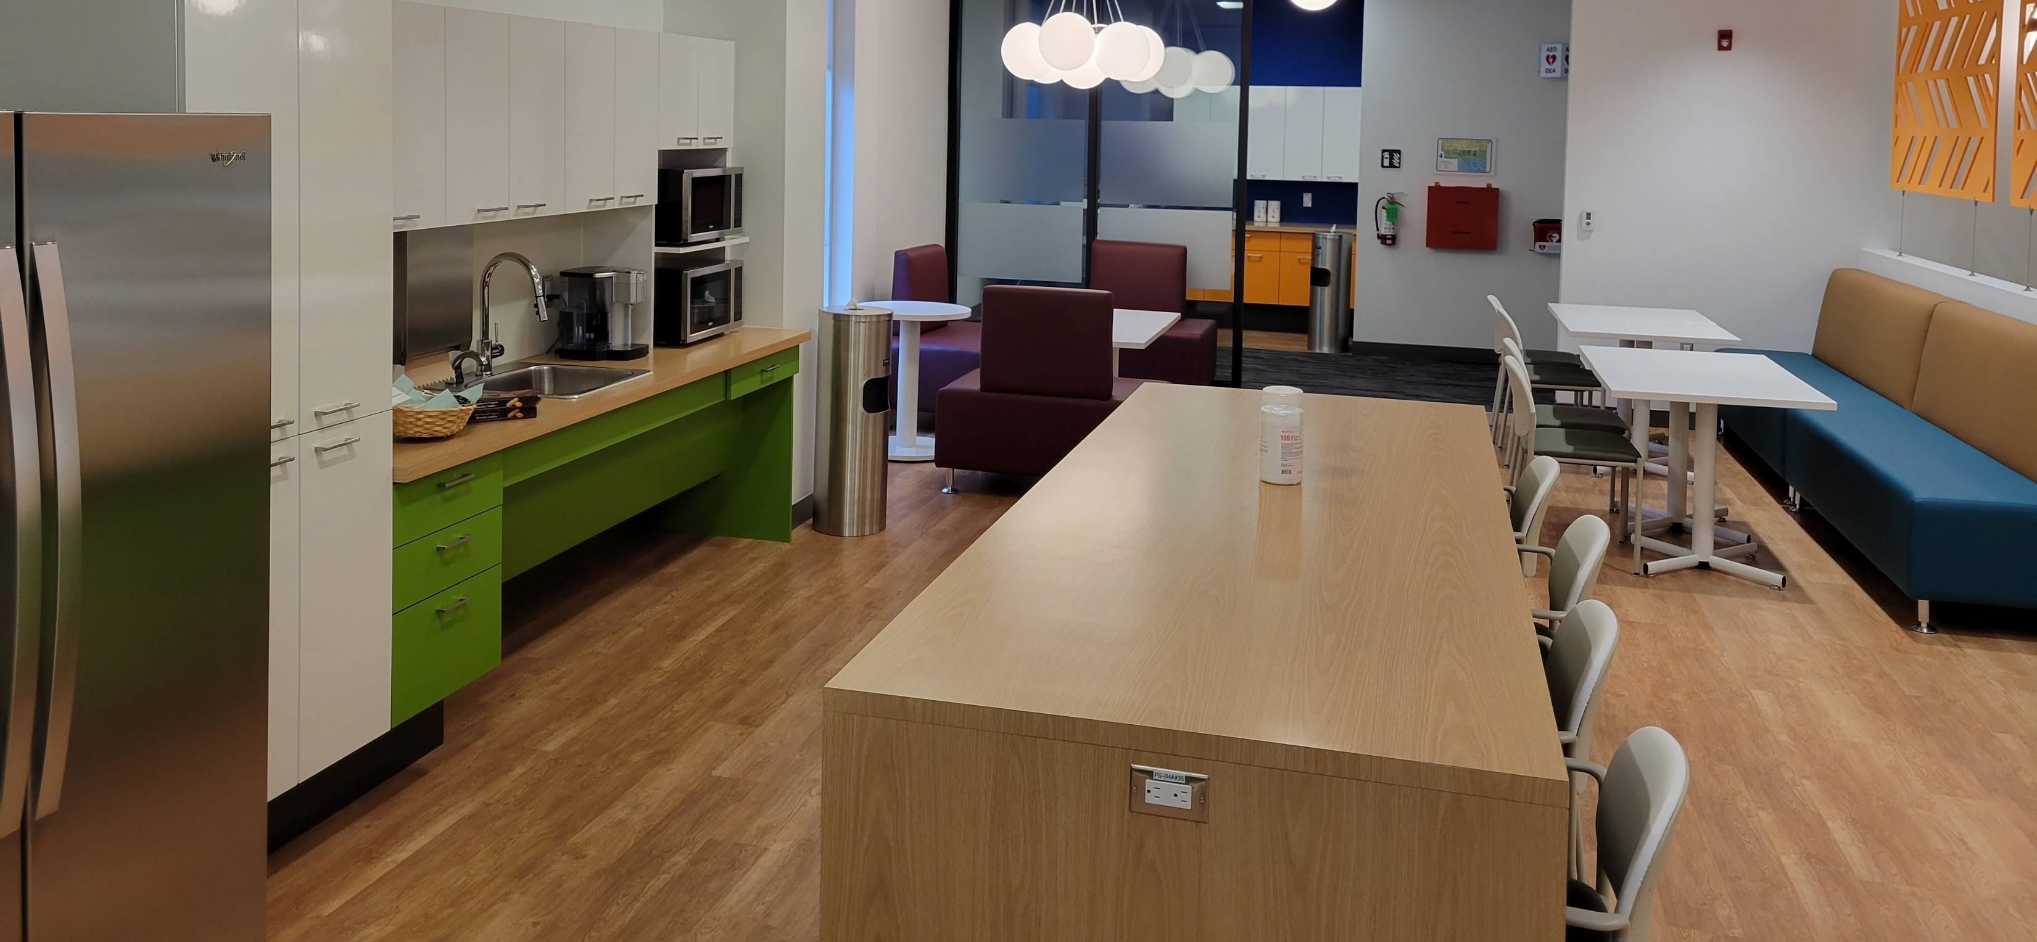
Kitchenette Accessibility
Design
Knee clearance under sink
Varied height between countertop and island
Furnishing and use
Refrigerator with side-by-side doors, or with the freezer located in the lower section.
Items stored in upper cabinets must also be stored in lower cabinets
Variety of seating
Notes:
Design
Clear space under the sink: for easy wheelchair access
Varied height between counter and island: different heights to accommodate as many employees as possible
Furnishings and use
Refrigerator with side-by-side doors: opening smaller doors facilitates access for wheelchair users. If the freezer and refrigerator are side by side, it's even more accessible for people for whom the top-mounted freezer would be unreachable.
This is why the option of the freezer in the lower section and the refrigerated section in the upper section is also preferred.
What's available in the upper cabinets must also be available in the lower cabinets.
Variety of seating options: this ensures that people with different levels of mobility can find what they're looking for. For example, a person with reduced mobility will opt for a chair with armrests to help them sit down and stand up.

Slide 9
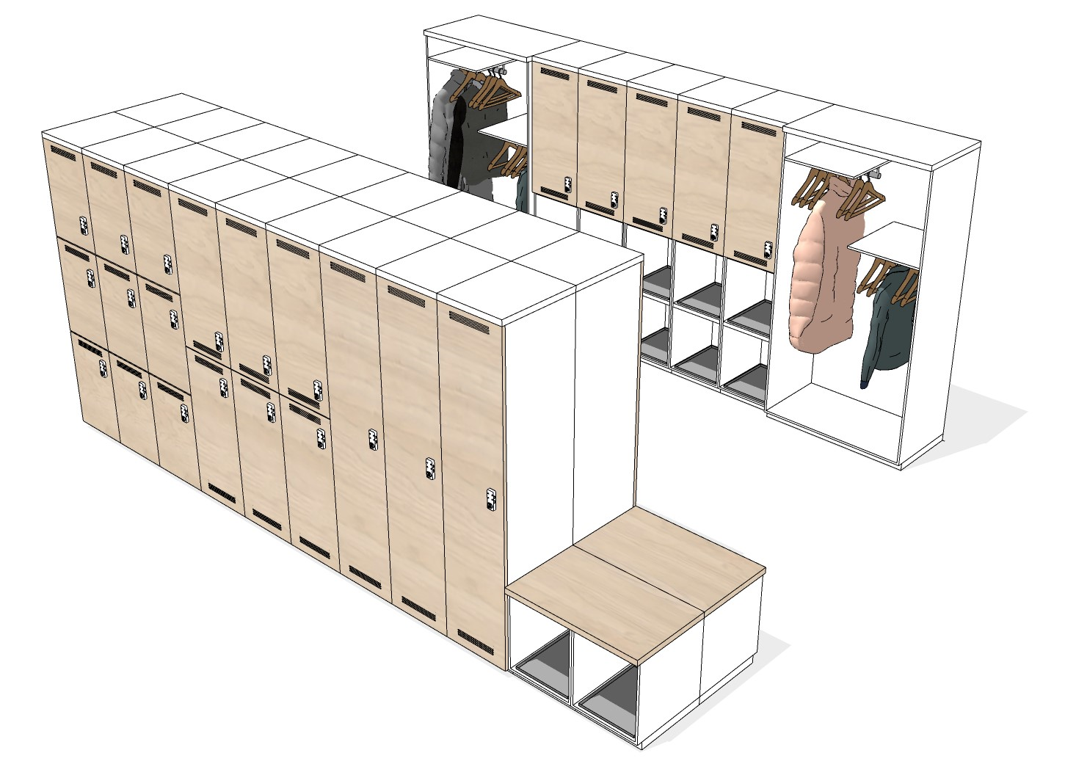
Locker Area Accessibility
The locker area includes coat closets. Closet rods are at different heights for easy access.
There are also benches for people who need to sit down to put on or take off their shoes.
Three locker formats offer access at different heights and meet a variety of storage needs.
Notes:
The locker area is designed to be accessible to wheelchair users and people with different mobility needs.
We are also looking to provide mechanical locks to accommodate staff with dexterity-related needs. *(This is something the Workplace Transformation Program is currently looking into - final solution to be confirmed).

Slide 10
Other Accessibility Elements
Contrast
Where possible, the design includes contrasting colors at transitions between floors and walls, doors and adjacent walls, and doors and door frames.
Braille
The following signs are in Braille in accordance with the Federal Identity Program:
Washrooms
Stairs
Exit stairs

Slide 11
Other Accessibility Éléments (cont’d)
What's not covered by our organization
For base building components, the CSA B651-23 standard on building accessibility sets out minimum accessibility requirements for people with disabilities.
It covers aspects such as:
Accessible routes
Doorways
Ramps
Elevators
Toilets
Alarm systems
Signs
Braille, etc.
These elements cannot be included in our modernization project.

Slide 12
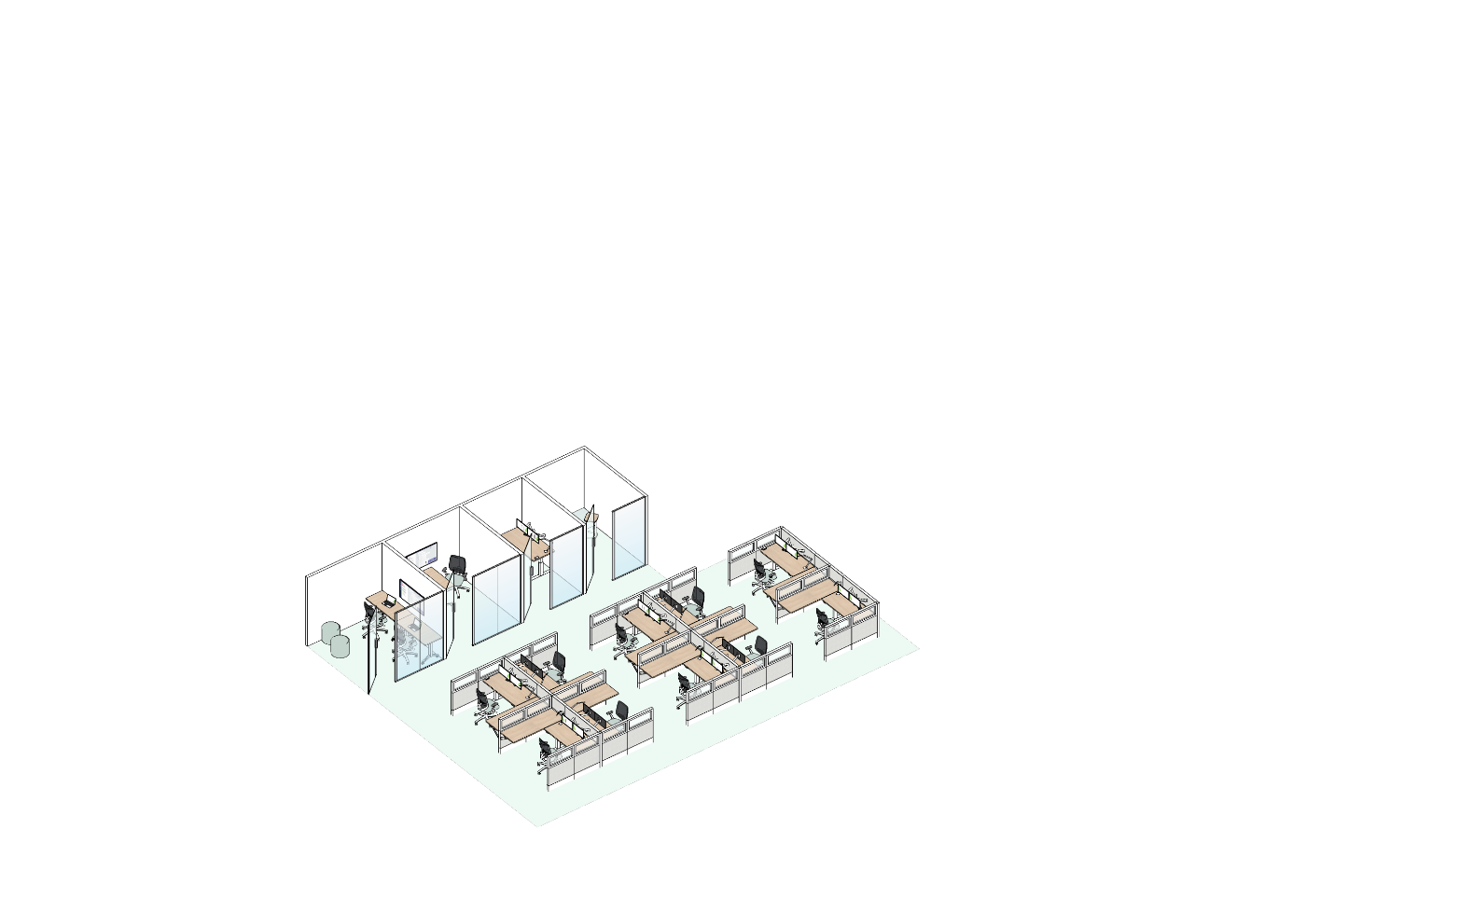
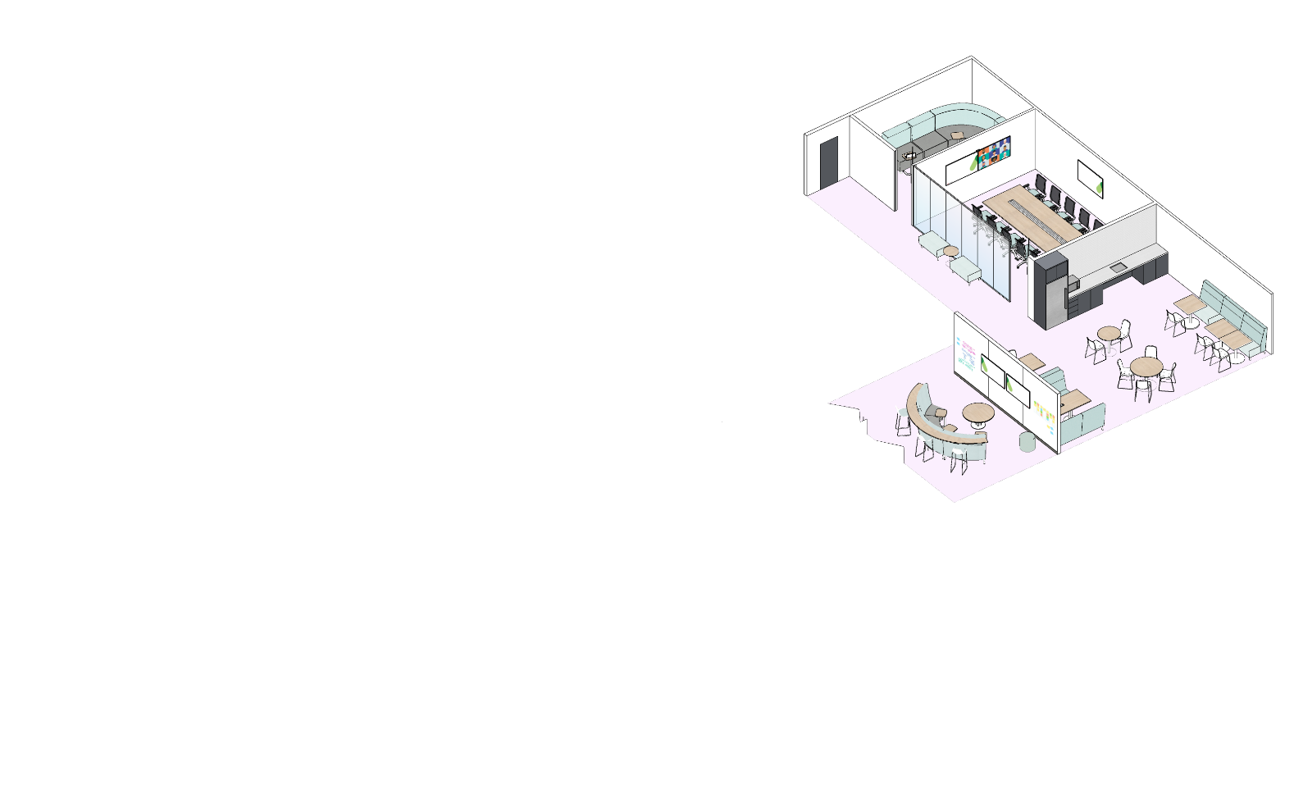
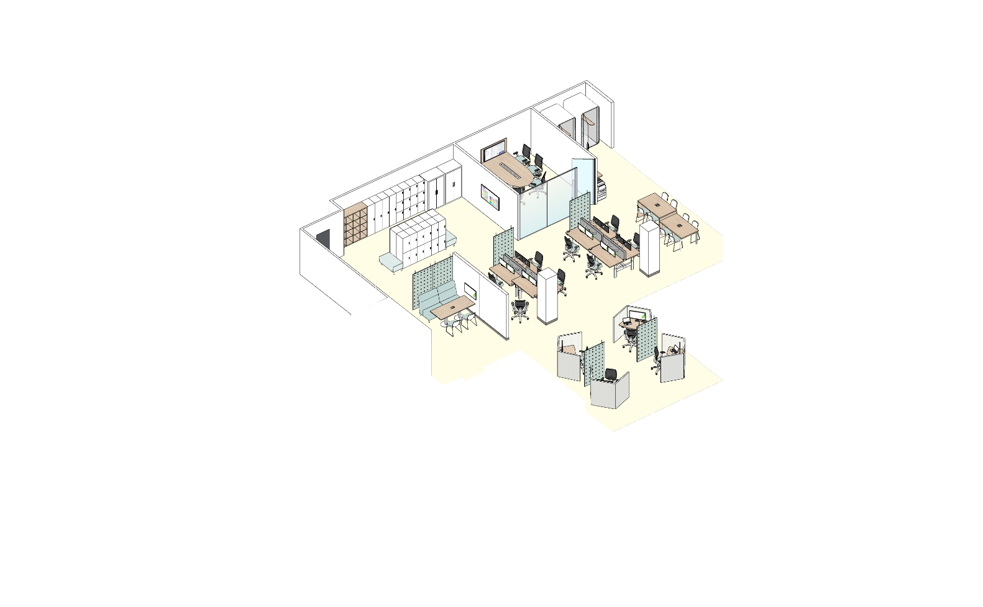
Design for Neurodiversity
GETTING READY
Secluded refuges (phone booth and focus room)
Three distinct functional zones with different levels of stimulation (visual and acoustic)
Quiet Zone
Use of dividers to reduce visual distractions
Transitional Zone
Interactive Zone
Clear and intuitive circulation
(sense of order)
Pleasant space for gathering, socialization and informal collaboration
Refuge spaces
Variety of station layouts and parameters
Notes:
Neurodiversity recognizes that each individual may require a different level of environmental stimulation to feel comfortable and productive in the workplace.
For neurodiversity, we emphasize the importance of having a wide variety of work points, distributed throughout each of the GC Workplace zones.
*** Read the Neurodiversity Concept Guide to find out more : Front cover (gccollab.ca)

Slide 13
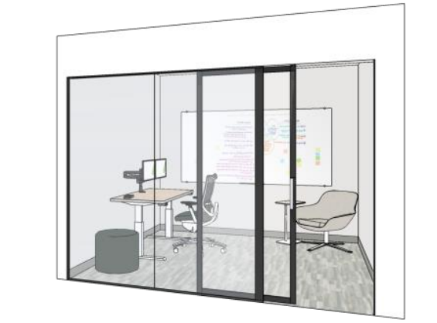
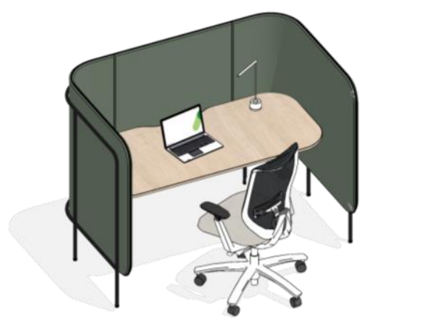
Options for light hypersensitivity
GETTING READY
It may be hypersensitivity to bright light, such as natural light, light from fluorescent bulbs or computer screens.
Employees can:
Use a concentration room equipped with a lamp
Choose a workstation located in a darker area of the floor
Choose a workstation whose screen is not positioned in front of or behind a window
Adjust window blinds or shade
Note
The lighting system is not modified as part of the project.
Focus room and focus pod may be interesting options.
Notes:
* In WTP projects, elements that are part of the base building, such as electricity and lighting, are not modernized.

Slide 14
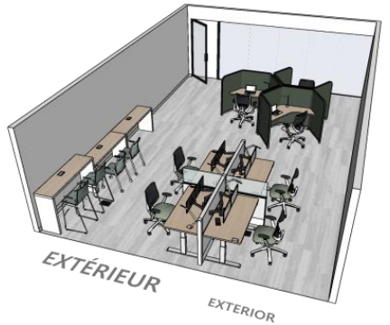
Options for sound hypersensitivity
GETTING READY
It may be hypersensitivity to high noise levels in the workplace, related to employee traffic, discussions or office equipment, which cause difficulties in concentrating.
Employees can:
Set up a workstation in the quiet area of the floor
Choose a workstation in the study room
Move to a concentration room
Use noise-cancelling headphones
The study room is a room of absolute tranquility. It's ideal for work requiring a high level of concentration.
Notes:
*The study room is not always integrated into the design of the space. Please check with the PSPC project team.

Slide 15
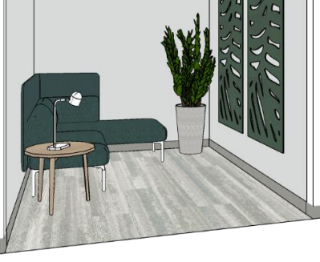
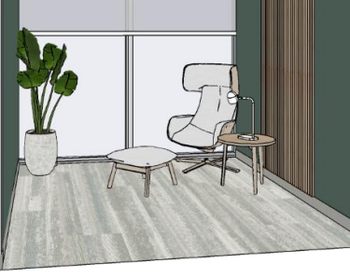
Mental health, physical health and maternity needs
Wellness rooms are available to staff
Features
Different look and feel from the rest of the workplace
Comfortable
Designed to create a sense of isolation in an over-stimulating environment
Possible uses
Quiet reflection
Meditation
Relaxation exercises
Listening to music
Breastfeeding
Sensory relief
Spiritual practices
Notes:
***Check with the PSPC project team to validate how many Wellness rooms are integrated to your project.

Slide 16

Indigenous-inspired design
Nature
Inclusion of natural elements (biophilia)
Optimizing natural light, views and links with the environment
Murals
Choice of colors and materials
Sustainability
Reuse of existing functional furniture and equipment
Recycling and proper disposal of renovation waste
Art
Possibility of installing indigenous artworks*
Land Acknowledgement
Installation of permanent land acknowledgement**
Example of integration of biophilic elements and example of a mural.
Notes:
In support of our organization's commitment to reconciliation, we will incorporate culturally appropriate elements that create economic opportunities for Aboriginal people.
Optional : Indicate if you will engage with your committee to select artwork.
* The acquisition of works of art is a project that will be led by the organization, with the PTMdT providing supports for their installation.
**Land Acknowledgement is an element that PSPC is currently developing – final product to be confirmed later in the project.

Slide 17
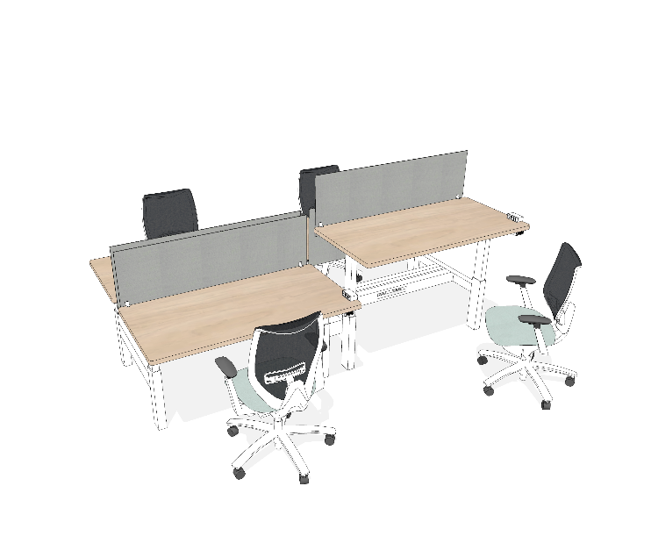
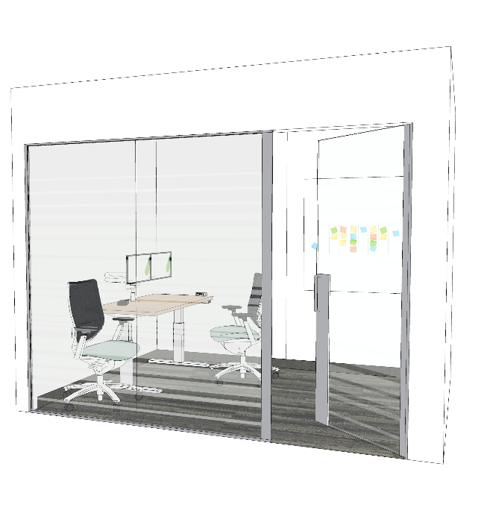
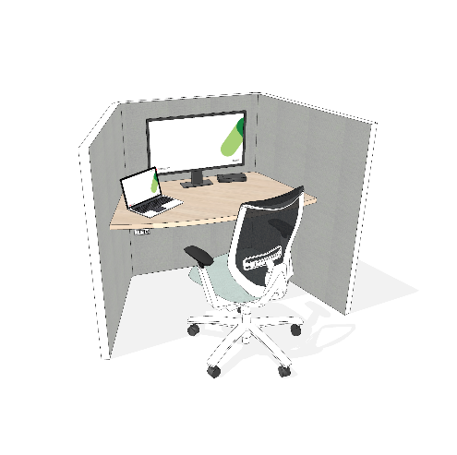
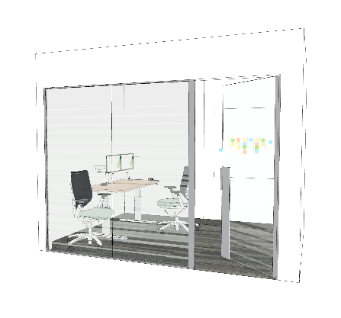

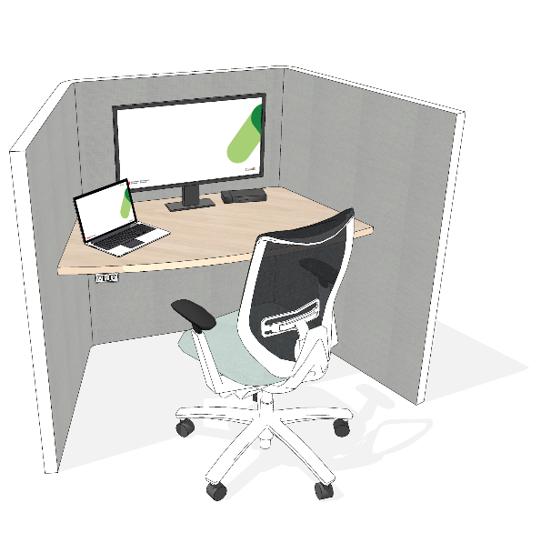
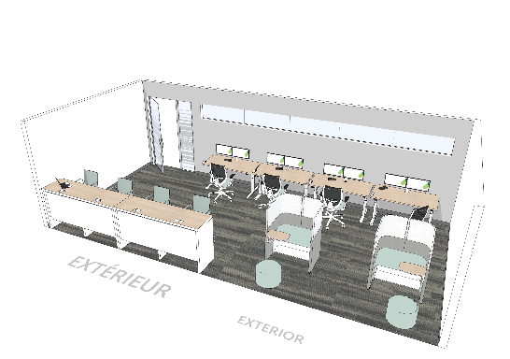
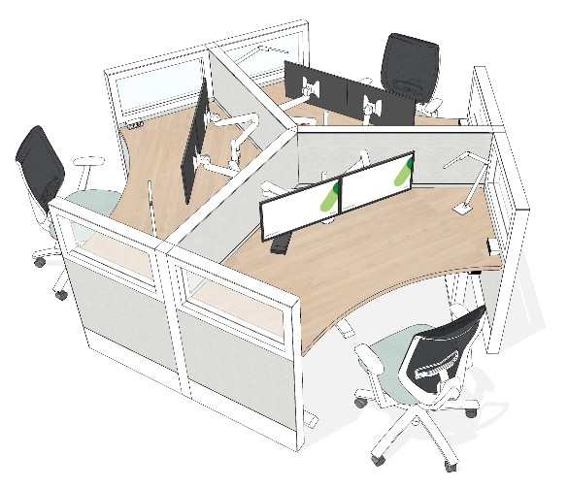
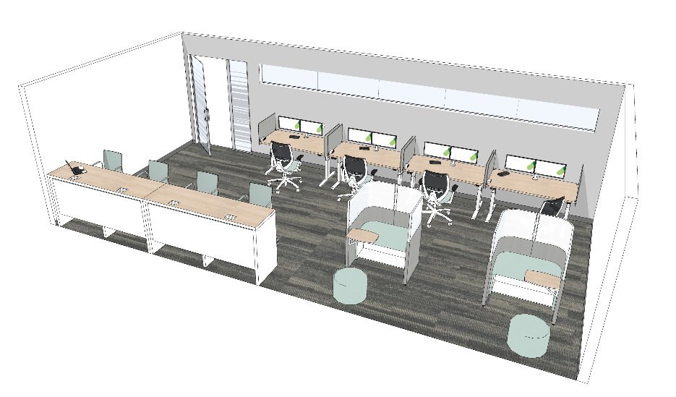
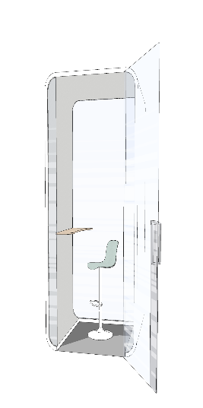
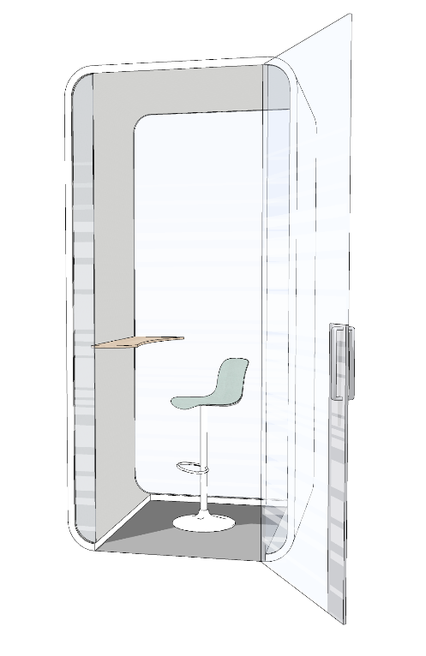
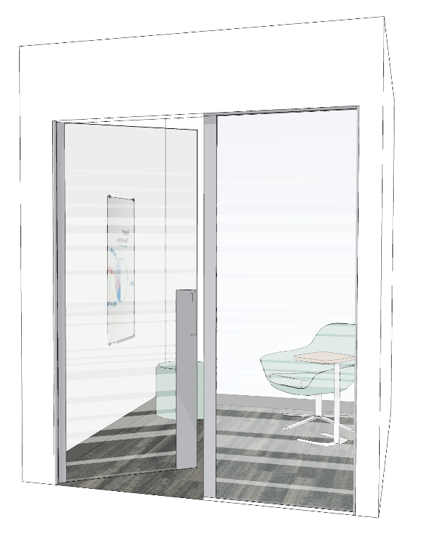
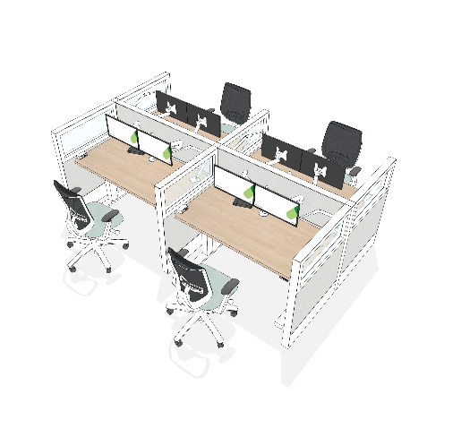
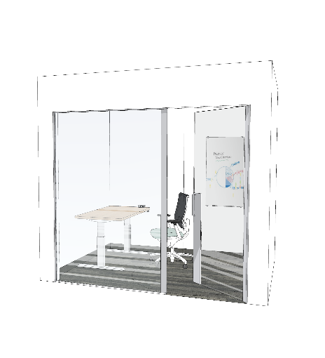
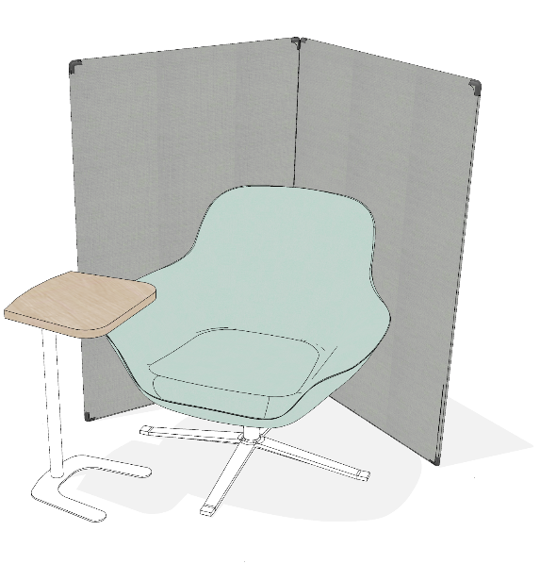
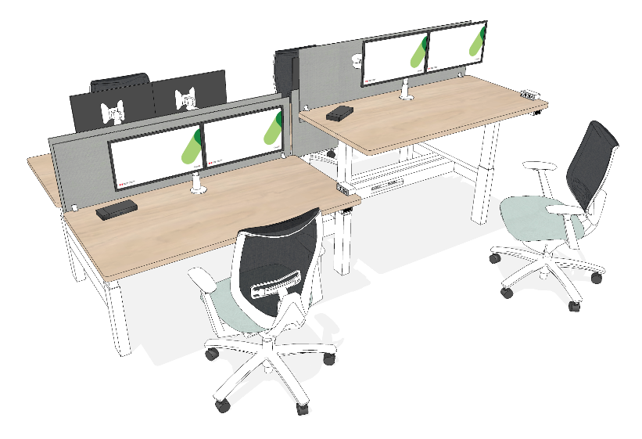
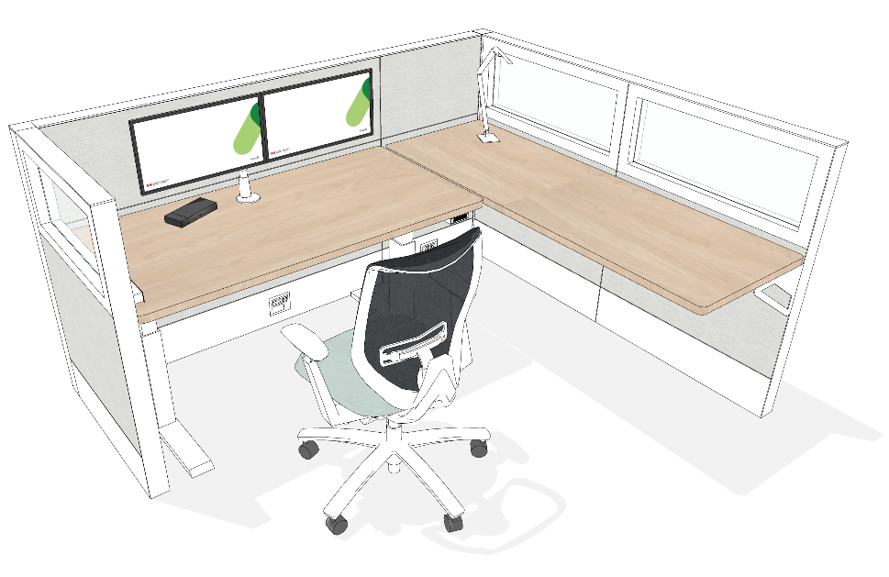
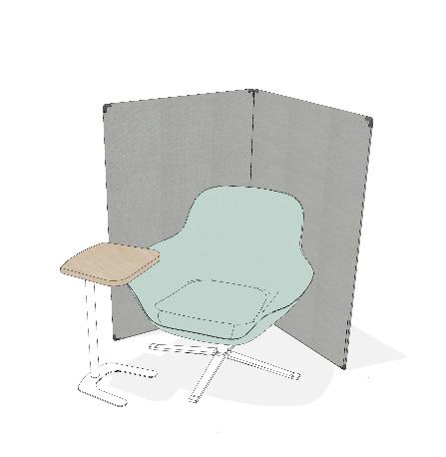
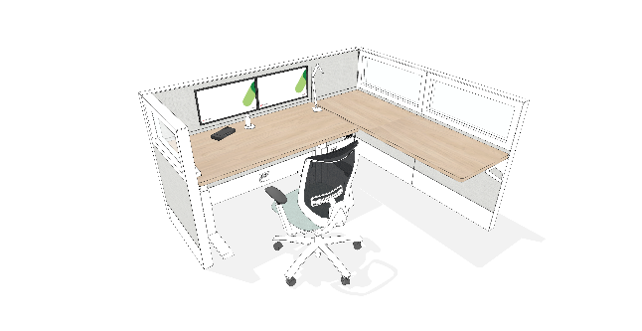
Annex: GC Workplace Design – Individual Workpoints
Touchdown
Focus room
Workstation
Work pod
Study room
Phonebooth
Workstation
Phonebooth
Workstation
Focus pod
Notes:
***Adjust according to the work points on your floor plans.***
As mentioned earlier, the GC Workplace concept is a flexible environment where you choose where to work.
Here are a variety of work points for individual work. Some are open and others closed, so you can choose according to the level of concentration you need, or the noise you'll make, for example, if you have to make calls or take part in virtual meetings.
Many of these workstations offer ergonomic equipment such as ergonomic chairs, height-adjustable desks and two screens (or one gigantic one).

Slide 18
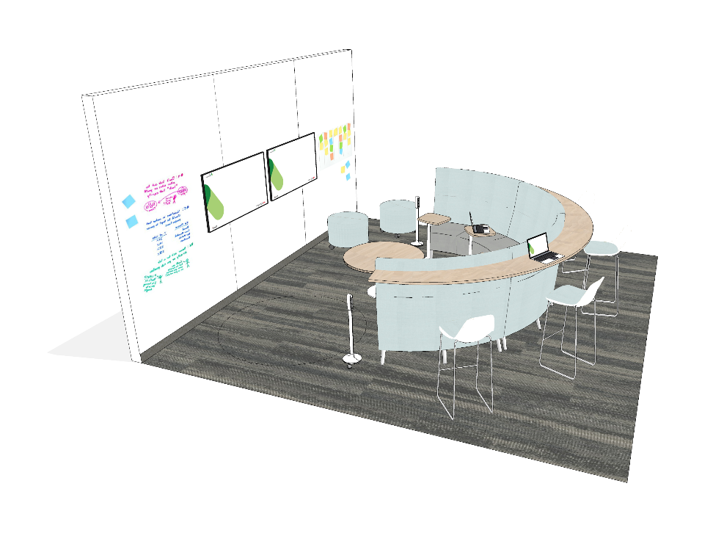
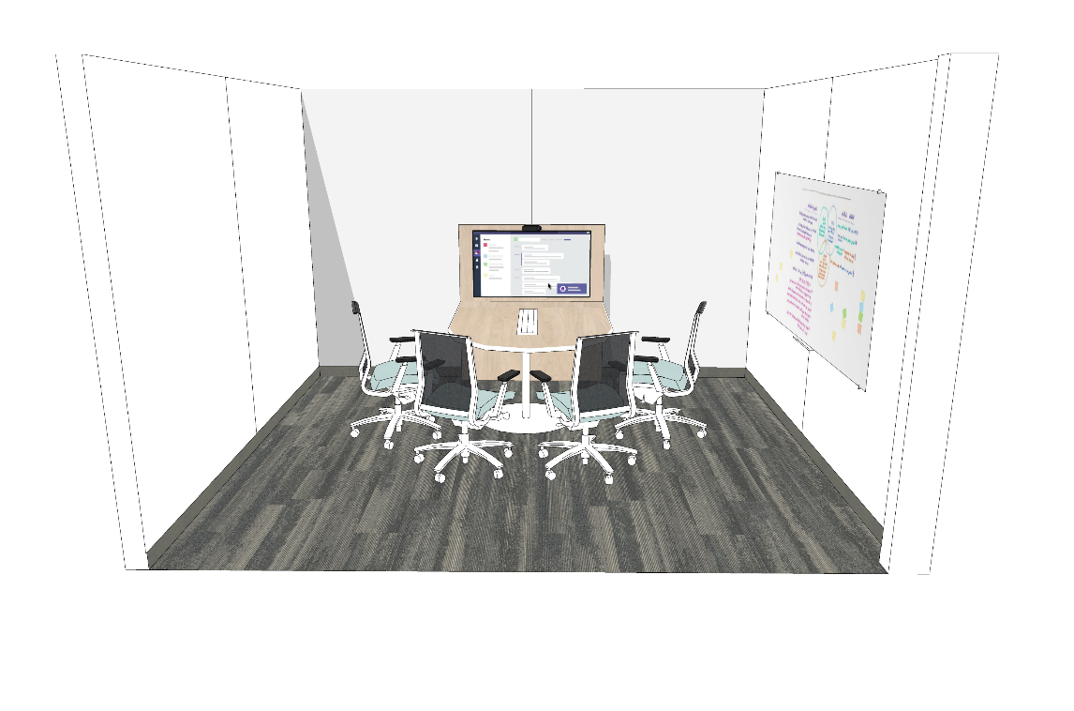
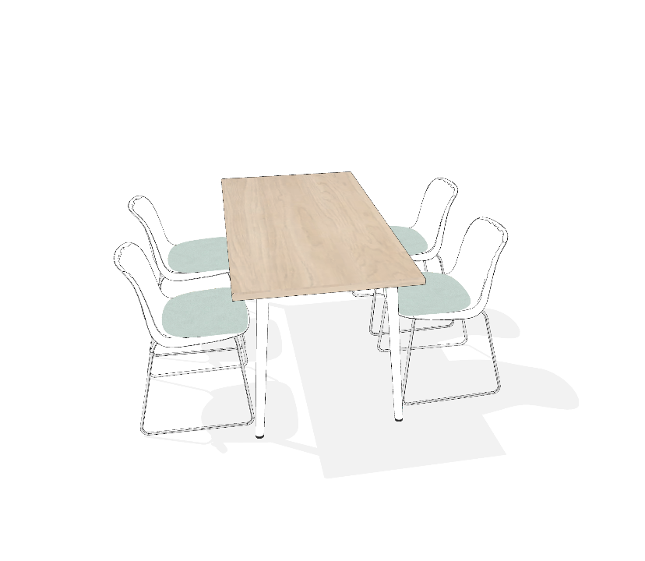
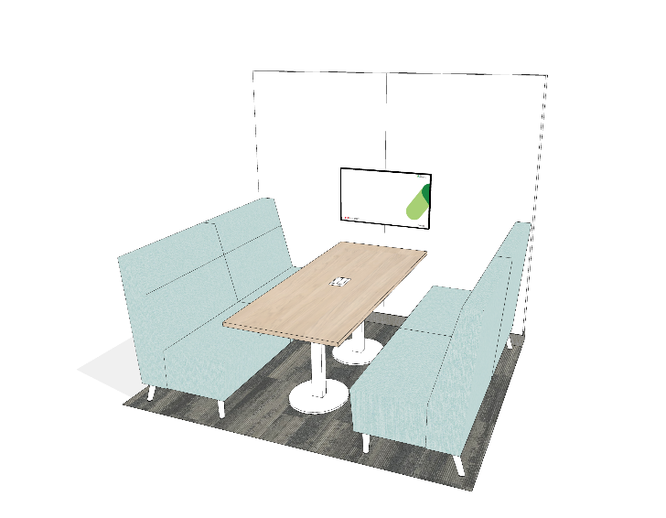
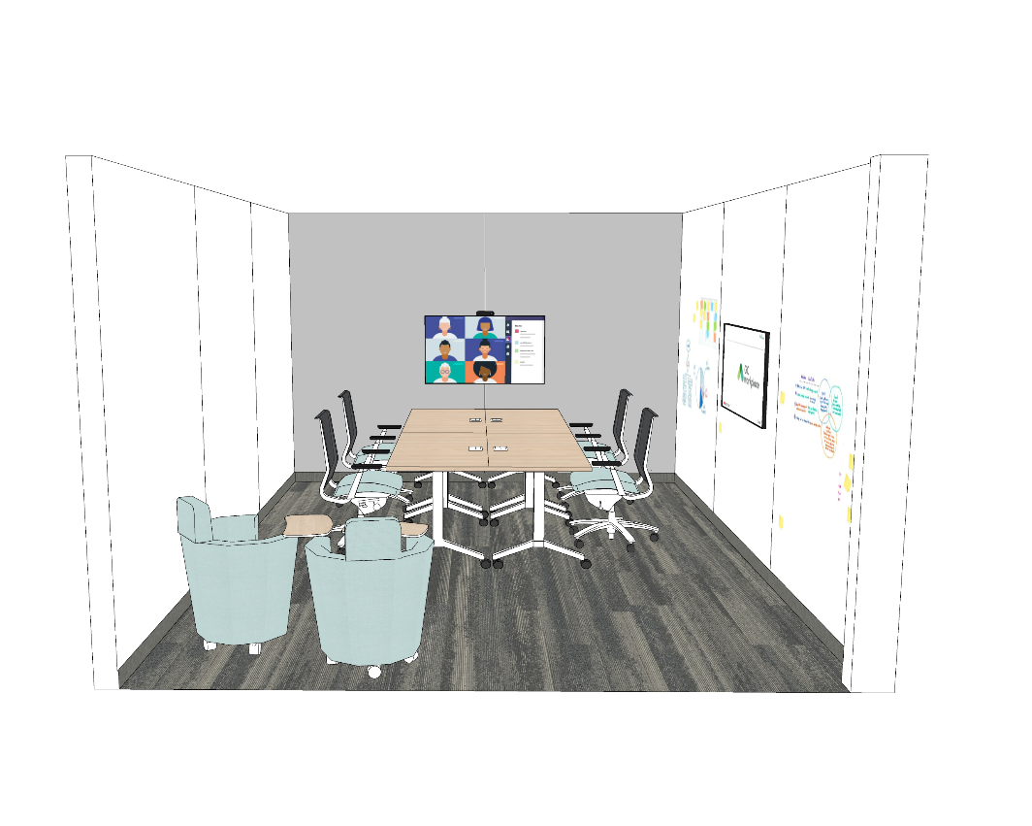
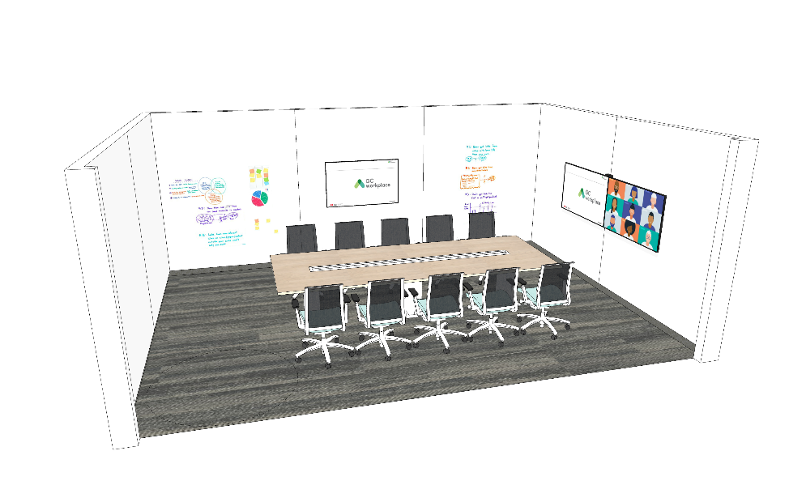
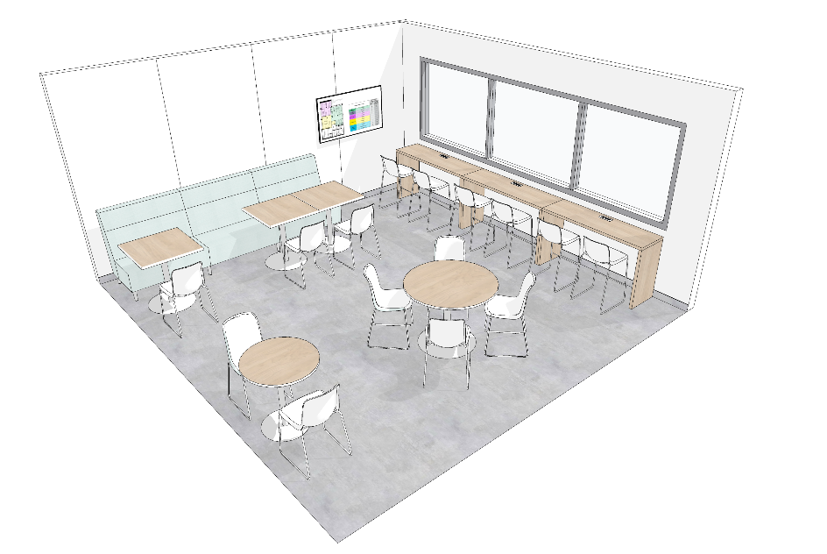
Annex: GC Workplace Design – Collaborative Workpoints
Teaming area
Huddle
Work room
Chat point
Meeting room
Lounge
Project room
Notes:
***Adjust according to the work points on your floor plans.***
You'll have access to different types of rooms and work points to collaborate. You'll be able to choose the most appropriate based on capacity and functionality, whether you need to hold a formal meeting, brainstorm or simply chat with a colleague.
In all, some 15 workstations will be available. Some can be booked in advance via (reservation systems).
But don't worry about all these details, our teams will provide you with all the information you need to plan your working days and move around the space optimally.

