Slide 1
Theme leadership questionnaire
Summary of results
Digital Transformation Office • #CanadaDotCa • May 2023
Notes:
Opening slide

Slide 2
Introduction
Analysis of topic tree demonstrated significant increase in the number of topic pages across Canada.ca
Also found a lot of broken links, out of date content, duplicate content, misused templates
In follow-up meetings with themes to discuss the findings, they appreciated the information but many expressed hesitation about their ability to implement the recommended improvements due to insufficient resources
Led to a desire to learn more about how themes are currently being managed
Notes:
Content example slide #1

Slide 3
Methodology
TBS DTO developed a questionnaire designed to better understand:
What theme leads perceive their role to be
How theme leads measure performance of the theme
How many people, what roles and what tasks are being used to manage the theme
What resources from DTO the theme leads regularly use
What works well and doesn’t work well about the way that themes are managed on Canada.ca
15 themes responded to the questionnaire in January and February 2023
Notes:
Content example slide #1

Slide 4
Respondents
Responses received
About government
Benefits
Business and industry
Culture, history and sport
Environment and natural resources
Health
Immigration and citizenship
Indigenous peoples
Jobs
Money and finances
National security and defence
Policing, justice and emergencies
Public service and military
Science and innovation
Taxes
No response
Canada and the world
Transport and infrastructure
Travel and tourism
Veterans
Youth
Notes:
Content example slide #1

Slide 5
Role of theme leads
Key themes
Manage theme information architecture, doormats and vanity URLs
Ensure users can complete their tasks
Coordinate requests from other departments and contacting other departments about broken links
Liaison between TBS DTO and the institution
Describe in your own words the role of a theme lead on canada.ca in 2023
Some themes describe a broad and proactive role, while others describe a very minimalistic and reactive role
Notes:
Content example slide #2

Slide 6
Performance measurement
Common responses
Web analytics
Task success survey
Usability testing
Feedback (including page feedback tool, call centre feedback, client surveys)
Key issues
Some do nothing proactive to monitor the performance of the theme
Very few themes have established key performance indicators (KPIs)
Several expressed that performance measurement is not a priority because there are no reporting requirements and the objectives and governance for themes is unclear
How do you measure performance for the theme?
Notes:
Content example slide #2

Slide 7
Number of people working on the theme
The number of full-time equivalents (FTEs) working on the themes ranges from 0.025 FTEs to 57 FTEs
The median number is 0.3 FTEs (=30% of one person’s time)
Out of the 14 themes that responded:
9 have fewer than one FTE dedicated to the theme
2 have 1 FTE
3 have between 2 and 3 FTEs
1 has 57 FTEs
Notes:
Content example slide #1

Slide 8
Roles working on the theme
The roles that are involved in managing the theme focus on content, UX, communications, web, data and management functions.
Content | UX | Communications | Web | Data | Managers
Content designer | UX advisor | Digital communications advisor | Web advisor | Web analytics advisor | Product manager
Content strategist | UX designer | Communications advisor | Web officer | Data and usability analyst | Team lead
Content lead | UX researcher | Communications officer | Web developer |  | Manager, Theme and UX
Translation and quality assurance | Interaction designer |  | Web publisher |  | Manager, User-Centred Design
Notes:
Content example slide #1

Slide 9
Blurred lines between theme and institution
Respondents had difficulty breaking out the number of people who work on the theme vs the number of people who work on departmental web content because:
The same people manage the theme and the institutional content
It is not clear where the theme stops and the institutional content starts
Institutional content takes priority due to pressures from senior management and the Minister’s office
Notes:
Content example slide #1

Slide 10
Insufficient resources
“We have found that there is an increase in changes requested. Lots of interdepartmental meetings. The need for more analytics and research requires more time.”
“Our theme is on life support.”
“Although we would like to focus on improving the themes we are understaffed at the moment and are reactive (waiting for others to ask for changes).”
“We do not have enough capacity to have FTEs that work specifically on the theme.”
Notes:
Content example slide #1

Slide 11
Departments stood up teams for the Web Renewal initiative
Once the project ended, resources were reallocated to the department’s web content or were not renewed
Some single institution themes are sufficiently resourced because the institution treats the theme as their website
However, multi-institution themes and topics have been deprioritized and under resourced
Shift since Web Renewal Project ended

Slide 12
Theme tasks
We asked theme leads how often they perform certain tasks for the theme
At least once per week
At least once per month
At least once per year
Less often than once per year
Never
The tasks were in 3 categories:
Research and data
Partner engagement
Content and IA improvements
Overall trend in responses is that very few things are being done on a regular basis and most are being done once per year or less frequently, if at all
Notes:
Content example slide #1

Slide 13
Research and data
 | At least 1x/week | At least 1x/month | At least 1x/quarter | At least 1x/year | Less often than 1x/year | Never
Review and report on analytics | 13% | 13% | 13% | 33% | 20% | 7%
Conduct usability testing | 0% | 20% | 13% | 0% | 47% | 20%
Review top task survey data | 0% | 0% | 53% | 20% | 27% | 0%
Review feedback tool data | 7% | 7% | 33% | 27% | 0% | 27%
Themes are generally not very frequently using data to inform the ongoing maintenance and improvement of their content
Of the data sources, top task survey data and analytics are used more frequently than others
Notes:
Content example slide #1

Slide 14
Partner engagement
 | At least 1x/week | At least 1x/month | At least 1x/quarter | At least 1x/year | Less often than 1x/year | Never
Hold group meetings with partners from other departments and agencies | 0% | 0% | 33% | 0% | 40% | 27%
Send communications to partners about theme updates and priorities | 0% | 0% | 0% | 20% | 53% | 27%
Proactively reach out to partners about content that needs updating | 0% | 13% | 13% | 27% | 27% | 13%
Overall, partner engagement is an infrequent activity for themes, including those that manage themes with large numbers of partners
One theme mentioned that they attend group meetings with partners from other departments and agencies at least once per week
Notes:
Content example slide #1

Slide 15
Content and information architecture
 | At least 1x/week | At least 1x/month | At least 1x/quarter | At least 1x/year | Less often than 1x/year | Never
Make changes to content and IA based on user research and data | 13% | 0% | 20% | 0% | 60% | 7%
Make changes to content and IA based on departmental and partner requests | 0% | 40% | 47% | 0% | 7% | 7%
Lead content optimization for top tasks (advocating for improvements, collaborating with content owners, possibly prototyping and testing solutions) | 13% | 7% | 20% | 7% | 40% | 13%
Fix broken links and redirects | 13% | 40% | 40% | 7% | 0% | 0%
Update most requested links on theme and topic pages | 0% | 0% | 13% | 80% | 0% | 7%
Update features on theme and topic pages | 0% | 20% | 40% | 27% | 13% | 0%
Check for content ROT (redundant, outdated, trivial) and take action to remove it | 0% | 7% | 0% | 53% | 33% | 7%
Notes:
Content example slide #1

Slide 16
Use of canada.ca design system
Theme leads were asked if they have updated to the most recent (beta) topic page template
1 theme has completely updated
Most themes (11 out of 14) have partially updated
2 have not updated at all
When asked why they have not fully updated:
Most themes said that they update to the most recent template when they are making other changes to a page
Others mentioned that they haven’t updated yet because it is just beta (they would update if directed to)
Some mentioned insufficient resources or technical challenges (coding of the full-width most requested band in AEM)
Notes:
Content example slide #1

Slide 17
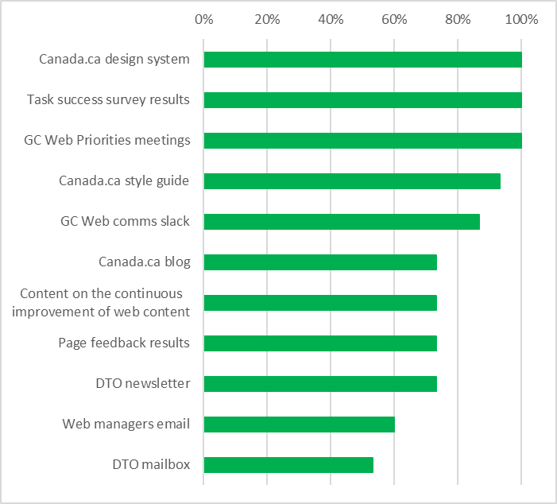
Resources used to manage the theme
Most resources provided by DTO are well-used by the theme leads
Notes:
Content example slide #2

Slide 18
Other resources
Sources that theme leads use for guidance on managing the theme
Most frequently mentioned:
Gerry McGovern
Nielsen Norman
Gov.UK
Other mentions include:
Kristina Halvorsen
Jared Spool
Sarah Winters
Apolitical
Design conferences such as Button, Confab, CanUX, Design and Content, etc.
Other theme leads
Other governments (Australia, US)
Notes:
Content example slide #1b

Slide 19
What works well
According to theme leads
Design system
Style guide
GCWP meetings
Distributed work (e.g. having theme leads, but also topic leads)
Conducting UX testing and sharing results
Slack channel
Notes:
Content example slide #1b

Slide 20
What could be improved
According to theme leads - suggested by more than one respondent
Faster updates to design system
Examples:
Adding new design patterns more quickly
Clearer guidance on what beta means
Ensure guidance is complete (e.g. image size reference info is missing)
Clearer direction/goals for themes
Theme reporting requirements
Example: Theme auditing and compliance reports, content lifecycle management
Assistance getting senior management to resource themes appropriately
A regular meeting to engage theme leads
Stronger hand in preventing duplication
Explicit rules or guidance for common pain points
Examples: PDFs, digital first publications, FAQs, open.gov for data, archiving, online forms, G&C submissions
Notes:
Content example slide #1b

Slide 21
What could be improved
Other ideas suggested by one person
Update the topic tree inventory
Specific technical guidance from L1 to LX
Integrated analytics reporting across themes
Assistance with UX testing of themes
Clearer governance and ownership of content
Master list of themes with contacts and alternate contacts
Streamline GCWP meetings so that there aren’t 2 per day on Mondays and Wednesdays
Increase senior management awareness of theme work
Discontinue use of slack and Google suite in favour of GC-wide approved tools
Improve experience for those publishing in AEM
Renewed focus on ROT is needed
Notes:
Content example slide #1b

Slide 22
Other comments from theme leads
Some express that it is difficult to lead when…
There is unclear direction on the long-term plan for the web
There is little support and resources for theme leads
Senior management does not consider theme work to be a priority
While others are curious to know why we are doing this questionnaire (has DTO received feedback that the current theme management approach is broken or needs improvement?)
Notes:
Content example slide #1

Slide 23
DTO
Update guidance on findability, IA and top tasks based on results of a findability study
Pilot with Business theme
Test findability guidance with focus on top tasks and search
Establish findability baselines
Experiment with creating a theme that is lighter to manage, but also more usable and then test for improvements
Theme leads
Clean up of broken links and other action items from theme packages
Later (once guidance ready): Focus on findability of top tasks
Next steps
What other challenges do you think we should focus on or try to resolve during the pilot or as a community?

