Slide 1
[PROJECT LOCATION]
VIRTUAL TOUR OF YOUR NEW WORKPLACE
DATE

Slide 2
How to use this document
Instructions – Remove this page before using
OBJECTIVE and FOR WHO: This template is for employees impacted by the change. It is great for employees who cannot visit the space in person, full time teleworkers, regional employees, etc. It can also be posted on your intranet page or sent as part of your recurring newsletter. If you wish to use it for audiences other than impacted employees such as Senior Leaders or specific groups such as Union representatives, you will need to adapt the content accordingly. This presentation can also serve to start documenting your project or even be added to new employee onboarding material.
WHEN: This presentation should be made available following your in-person tours, to ensure you have maximum attendance.
HOW: Depending on your project, decide how you would want to use this template. If you have multiple floors, we suggest selecting a floor that best represents all the floors. This is the easiest method as you only have to create one Virtual tour presentation for all employees. If there are significant differences between the floors (i.e. one floor Interactive Zone, one floor Quiet Zone, etc.), you can also prepare one Virtual tour presentation, but include an example of each type of floor by duplicating the Floor Plan slide. If each Branch is assigned a specific floor, you can choose to prepare Virtual tour presentation for each Branch. No matter how you decide to organize your Virtual tour presentation, plan your slide sequence to follow as closely as possible an employee’s journey through the space.
Refer to the In-Person Tour Speaking Points template for content and ideas to replace the ‘PLACEHOLDER FOR ADDITIONAL INFORMATION’ labels. These areas where intentionally left blank to allow for the customization of this document based on your individual project.
* The French version of this document is available here: FR version

Slide 3
Our New Workplace
Include a reminder of your vision and goals for your workplace that were shared throughout your project with employees.

Slide 4
Building Plan (if applicable)
BUILDING ADDRESS
NEIGHBOURHOOD
Branch A
Include this slide to explain your neighbourhood or floor strategy (i.e. Quiet floor, collaborative floor, etc.), if applicable.
Modify the graphic to show employees what the use of neighbourhoods looks like in your building.
Link each floor to their appropriate section in this document, if applicable.
8
7
6
5
4
3
2
1
NEIGHBOURHOOD
Branch B
RESTRICTED
Group Y & Z from Branch B only
NEIGHBOURHOOD
Branch C
SHARED FLOOR
Open to all
DEDICATED
Function X, all branches
SHARED INTERACTIVE FLOOR
Open to all
PLACEHOLDER FOR ADDITIONAL INFORMATION

Slide 5
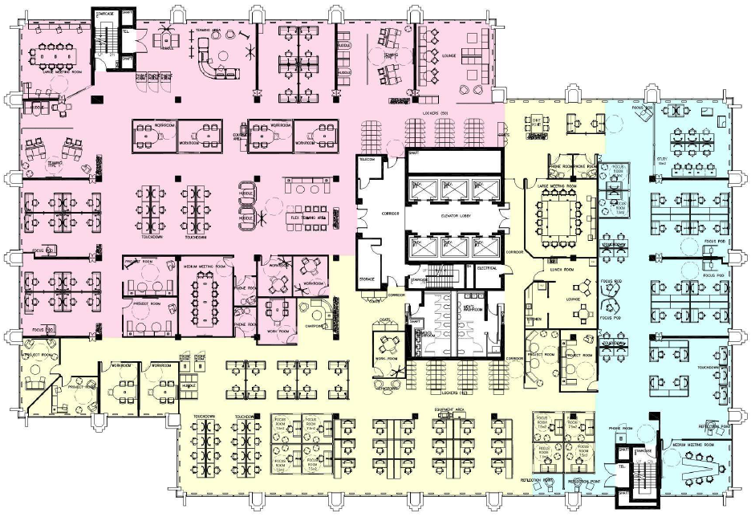
#th Floor Plan
Copy this slide for every floor you want to include in the Employee Virtual Tour. This slide can also be used to organize and plan your in-person tours in conjunction with our Tour Guide Template.
GCworkplace is based on seven dimensions to create a flexible, healthy, efficient, inclusive, collaborative, green and technologically advanced space. Your new workplace leverages these seven dimensions in its design. A focus on employee wellness and the integration of biophilic design creates a healthier and greener work environment for employees.
4
5
6
3
SAMPLE PLAN
Use your floor plan with the zoning identified
2
1
1 Employee Entrance
2 Design Feature
3 Interactive Zone
4 Meeting Rooms
5 Locker Area
6 Quiet Zone
7 Transitional Zone
8 Kitchenettes and Lounges
9 Equipment Room
10 Wellness Room
Interactive Zone
10
8
Transitional Zone
9
7
Quiet Zone
#th Floor Facts:
Occupant Name (organization/branch)
000
Target Occupancy
Individual Seats
000
Collaborative Seats
000

Slide 6
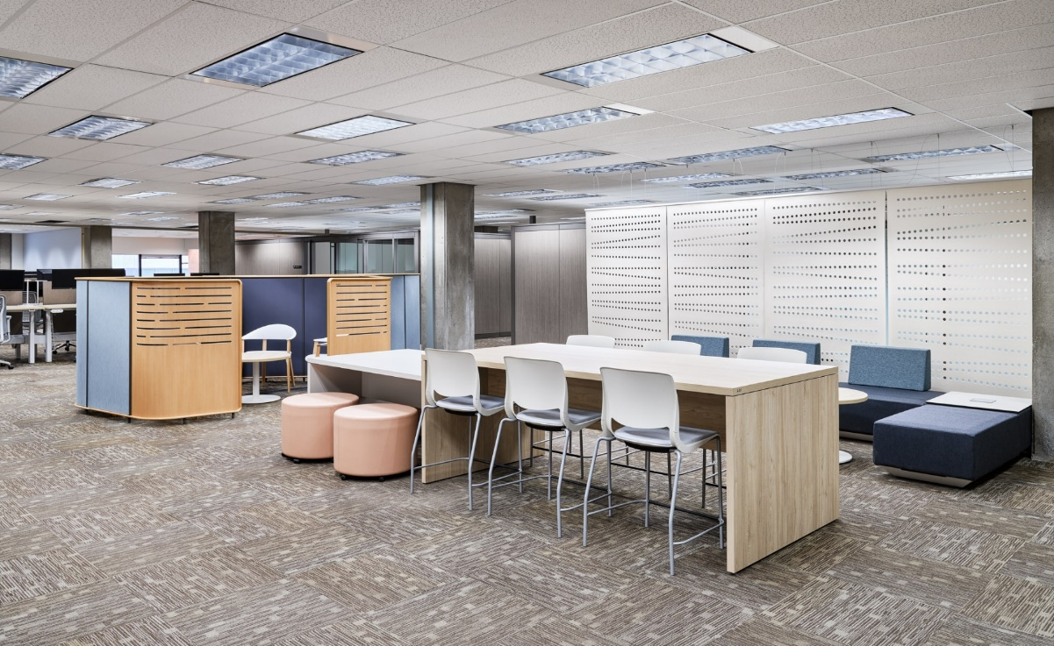
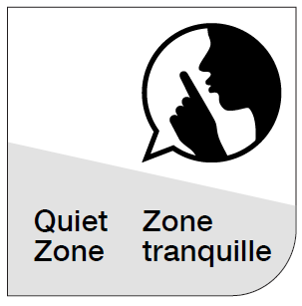
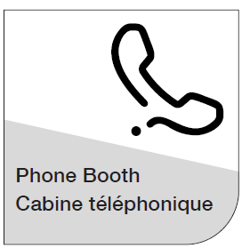
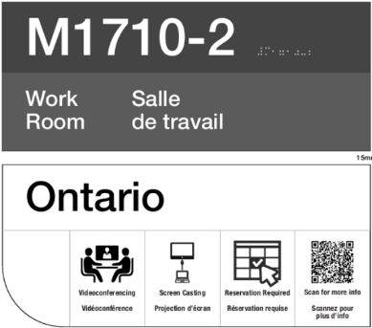
Employee Entrance
In your new workplace there is improved wayfinding through zone identification, as well as clear directional signage for common amenities such as kitchenettes, equipment rooms and locker areas.
PLACEHOLDER IMAGE
REPLACE WITH A PHOTO OF YOUR WORKPLACE
PLACEHOLDER FOR PICTURES OF TYPICAL WAYFINDING AND SIGNAGE
Wi-Fi is available everywhere on the floor, allowing to move seamlessly from workpoint to workpoint.
PLACEHOLDER FOR ADDITIONAL INFORMATION

Slide 7
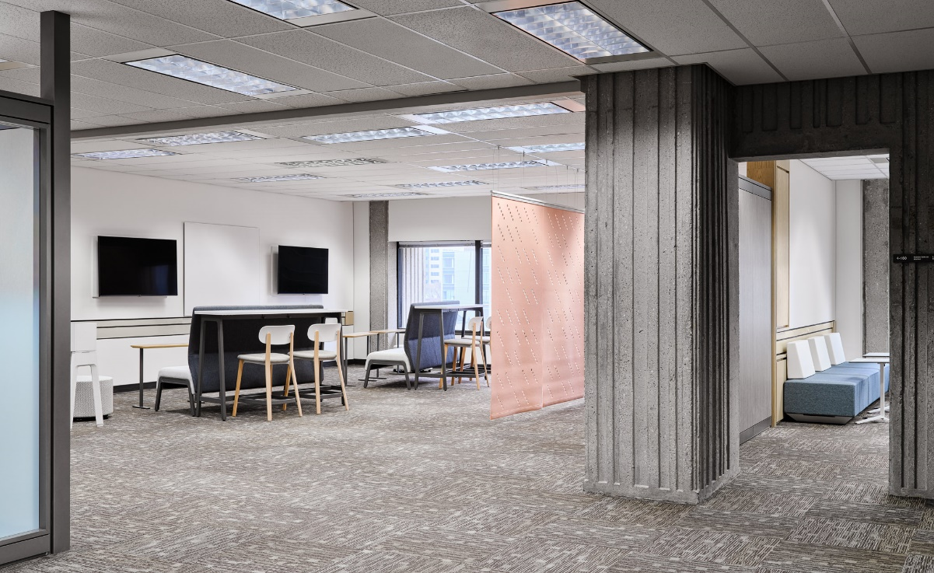
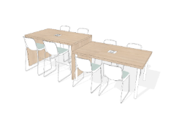
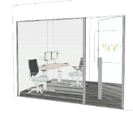
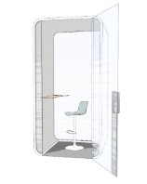
Transitional Zone
The Transitional Zone includes a variety of open and enclosed spaces and acts as an acoustical buffer between the Quiet and Interactive Zones. Noise levels can be a little higher than the tranquility expected in the Quiet Zone.
PLACEHOLDER IMAGE
REPLACE WITH A PHOTO OF YOUR WORKPLACE
KEEP SKETCHES OR REPLACE WITH PICTURES OF YOUR WORKPLACE
Touchdown
Focus Room
Phonebooth
Touchdowns and Phonebooth are non-bookable and available on a first-come-first serve basis. Focus Rooms are bookable and equipped with a height-adjustable desk, an ergonomic chair, 1 or 2 monitors attached to adjustable arms and a port replicator (docking station).
AWARENESS • RESPECT • COURTESY • COMMUNICATION
Be aware of your noise: Use headphones to listen to music or participate in virtual meetings
Modulate your voice: Be considerate of your colleagues when speaking on the phone or collaborating with a co-worker
Take it elsewhere: Use collaborative spaces or appropriate enclosed spaces when discussions get lengthy

Slide 8
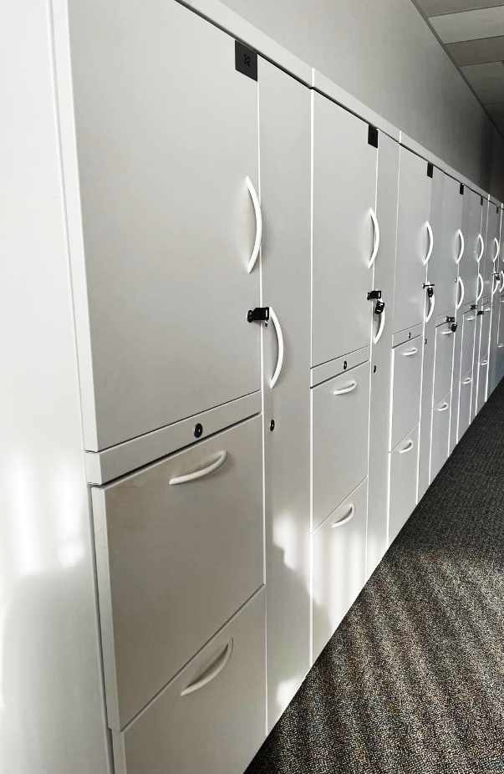
Locker Area
Lockers are available to employees for day-use. All lockers are fitted with a digital lock that can be programmed for each use. Coat closets and coat hooks are available throughout the floor. Scent-free coat closets are identified with a smoke-free icon.
Programming a locker for day use:
Step 1: Start by selecting a locker that is not currently locked.
Step 2: To set a temporary pin, ensure the door is closed. Enter a four-digit code followed by the green arrow on the bottom right-hand side of the keypad. This should set your temporary pin and lock the door.
Step 3: To open the locker follow the same process. Enter your four-digit code followed by the green arrow on the bottom right-hand side of the keypad.
Step 4: At the end of day, remove all personal items and leave the door unlocked for the next user.
PLACEHOLDER IMAGES
REPLACE WITH A PHOTO OF YOUR WORKPLACE
Don't forget to take note of the locker number you are using for the day.
PLACEHOLDER FOR ADDITIONAL INFORMATION

Slide 9
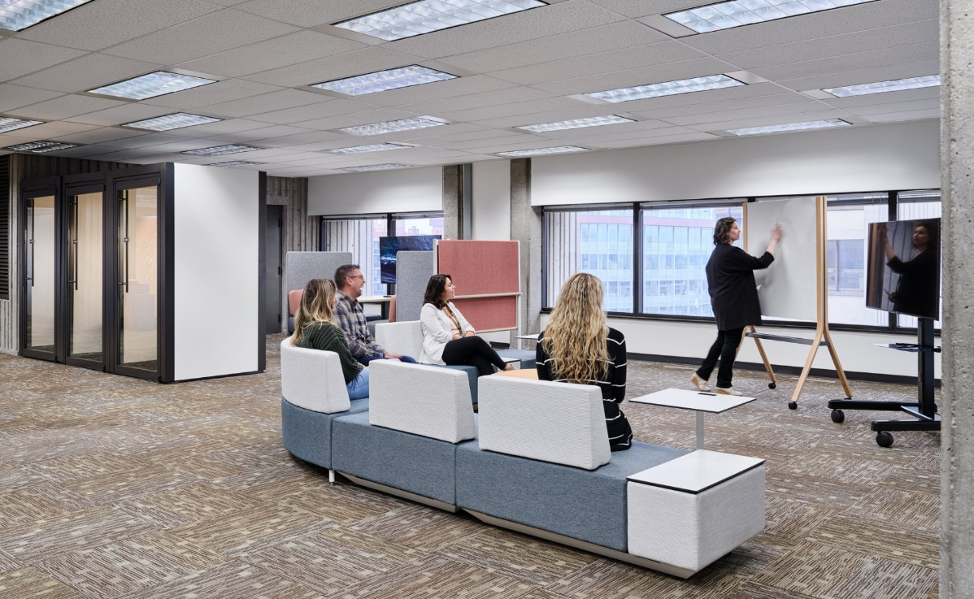
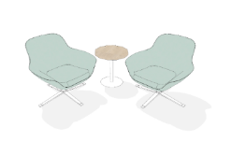
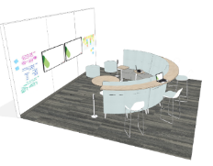
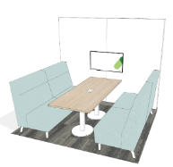
Interactive Zone
In the Interactive Zone, socialization and group collaboration is promoted and strongly encouraged. A variety of group workpoints, located away from Quiet Zones, achieves balance within the workplace which supports all types of work styles.
PLACEHOLDER IMAGE
REPLACE WITH A PHOTO OF YOUR WORKPLACE
KEEP SKETCHES OR REPLACE WITH PICTURES OF YOUR WORKPLACE
Chat Point
Huddle
Teaming Area
Chat Points, Teaming Areas and Huddles are non-bookable and available on a first-come-first serve basis. Teaming Areas and Huddles have displays available for collaboration.
AWARENESS • RESPECT • COURTESY • COMMUNICATION
Be respectful: Avoid inserting yourself into discussions in open areas near you, unless you are invited to do so
Don’t expect silence: Others around you will be collaborating. If you need to focus, move to a quiet/focus area
Be aware of your noise: Use headphones to listen to music or participate in virtual meetings
Notes:
.

Slide 10
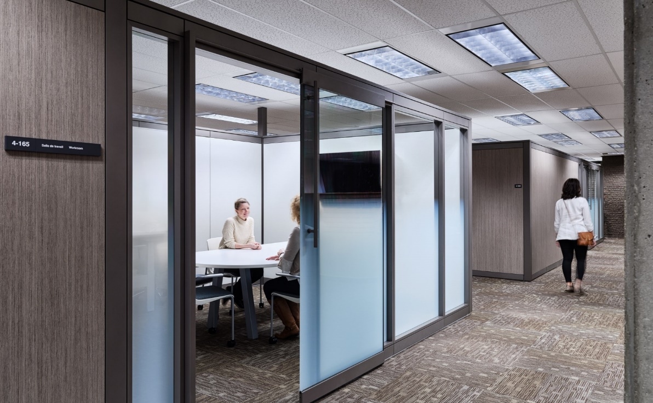
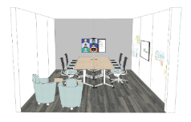
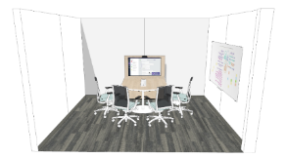
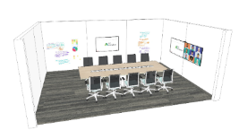
Meeting Rooms
This floor has many Meeting Rooms that offer different room configurations/layouts, capacities and seated postures. Since they are shared resources, it is important to cancel reservations in Outlook that are no longer required in a timely manner to optimize use of the space.
PLACEHOLDER IMAGE
REPLACE WITH A PHOTO OF YOUR WORKPLACE
KEEP SKETCHES OR REPLACE WITH PICTURES OF YOUR WORKPLACE
Project Room
Meeting Room
Workroom
All Meeting Rooms, Workrooms, and Project Rooms are bookable through Outlook and equipped with audio-visual and/or videoconferencing technology to support virtual collaboration.
AWARENESS • RESPECT • COURTESY • COMMUNICATION
Spontaneous use is ok: Check the booking system first
Don’t overstay: Respect scheduled meeting times – wrap it up 5 minutes before the end of your booking
Leave the room ready for others: Clean white boards and return furniture/equipment to original layout

Slide 11
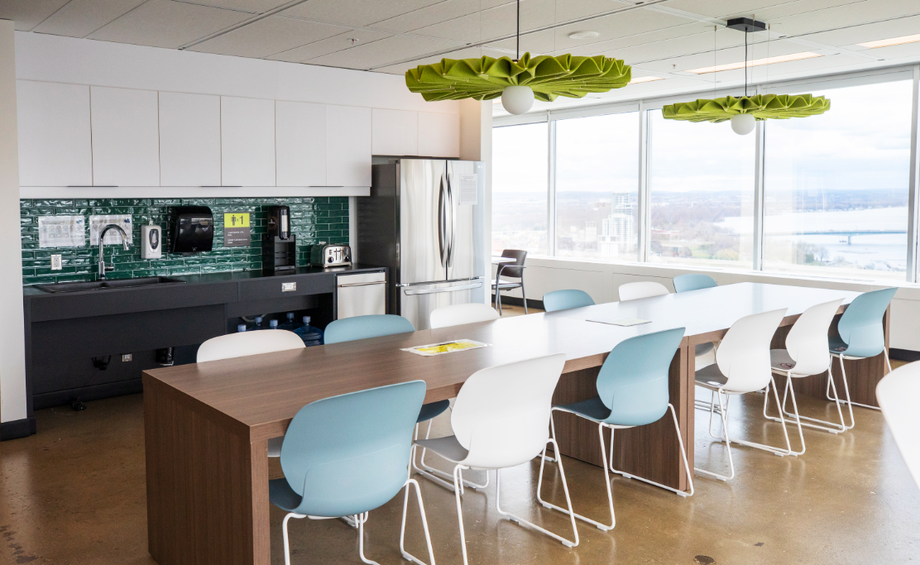
Kitchenettes and Lounges
Kitchenettes are equipped with microwaves, refrigerators and centralized waste receptacles for garbage, recycling and organic waste. You are encouraged to eat your meals and take breaks in the Lounges; this prevents strong odors from entering our workspace.
Kitchenette appliances and amenities
PLACEHOLDER IMAGE
REPLACE WITH A PHOTO OF YOUR WORKPLACE
Refrigerator
with freezer
Microwave
Coffee maker (indicate type)
Reusable utensils and dishes
Kettle
Toaster
ADJUST BASED ON YOUR WORKPLACE
Lounges are not only for enjoying meals, but they are also a great place for informal social interactions, catching up with colleagues, non-confidential one-on-ones and idea generation. Lounges can also be used for larger team socials, celebrations and townhalls.
AWARENESS • RESPECT • COURTESY • COMMUNICATION
Utensils and dishes: Don’t leave dirty utensils and dishes in the sink
Clean and dry what you use and put them back in their place
Shared use of refrigerator: Be mindful of expiry dates of any food you store in the refrigerator

Slide 12
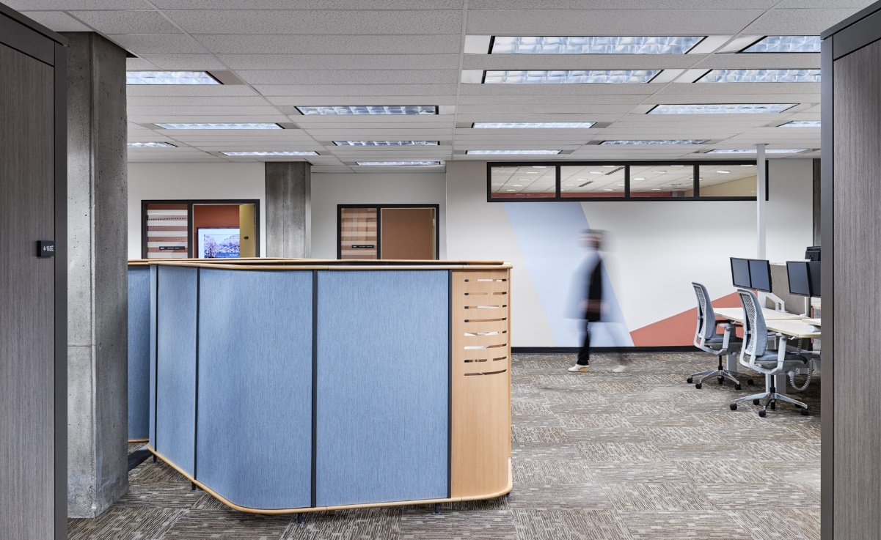
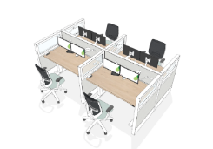
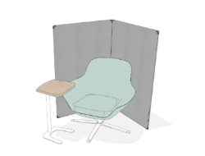
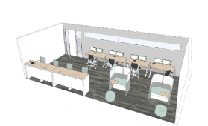
Quiet Zone
The Quiet Zone includes open, semi-enclosed, and enclosed individual workpoints. In this zone, the intent is to encourage individual focus work and to support the need for quiet or private spaces.
PLACEHOLDER IMAGE
REPLACE WITH A PHOTO OF YOUR WORKPLACE
KEEP SKETCHES OR REPLACE WITH PICTURES OF YOUR WORKPLACE
Workstation
Focus Pod
Study
Workstations are bookable and equipped with a height-adjustable desk, an ergonomic chair, 1 or 2 monitors attached to adjustable arms and a port replicator (docking station). USB connections/desk height outlets are also available to allow you to charge devices. Study Rooms host a variety of workpoints that are bookable. Focus pods are non-bookable and available on a first-come-first serve basis.
AWARENESS • RESPECT • COURTESY • COMMUNICATION
Mute your devices: Turn off device volume or use vibrate mode
Take it elsewhere: Use appropriate enclosed spaces for discussions, phone calls or virtual meetings
Ask others to tone it down: It is acceptable to politely remind others that this is a quiet zone

Slide 13
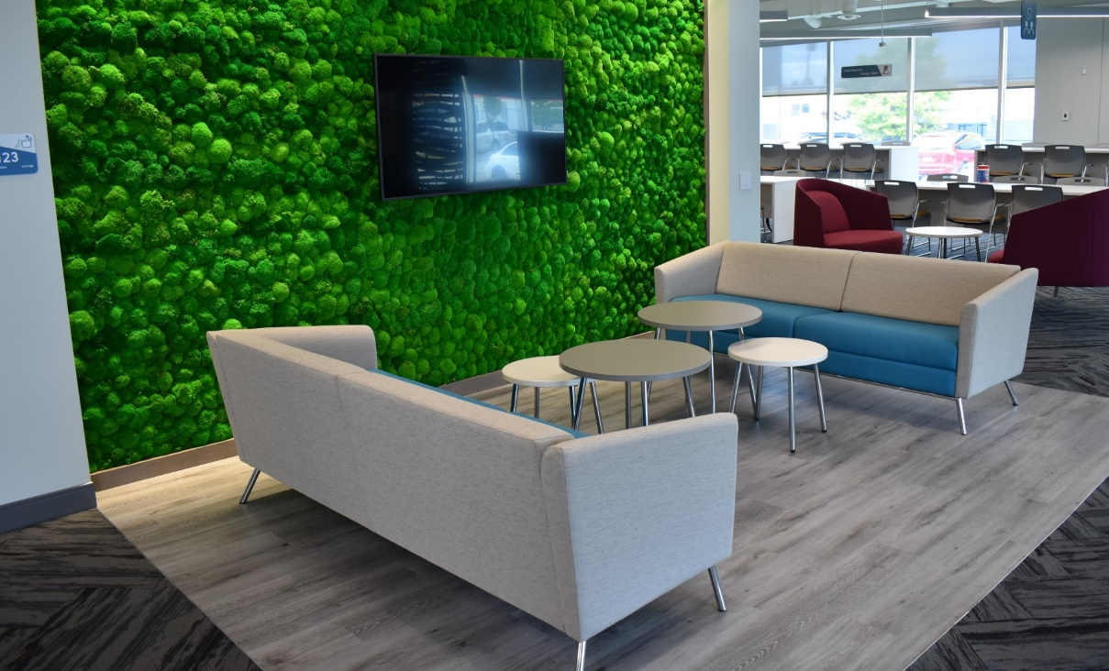
Design Feature
PLACEHOLDER FOR DESCRIPTION OF THE DESIGN FEATURE
PLACEHOLDER IMAGE
REPLACE WITH A PHOTO OF YOUR WORKPLACE
PLACEHOLDER FOR ADDITIONAL INFORMATION
PLACEHOLDER FOR ADDITIONAL INFORMATION
PLACEHOLDER FOR ADDITIONAL INFORMATION
Notes:
SPEAKING POINTS:

Slide 14
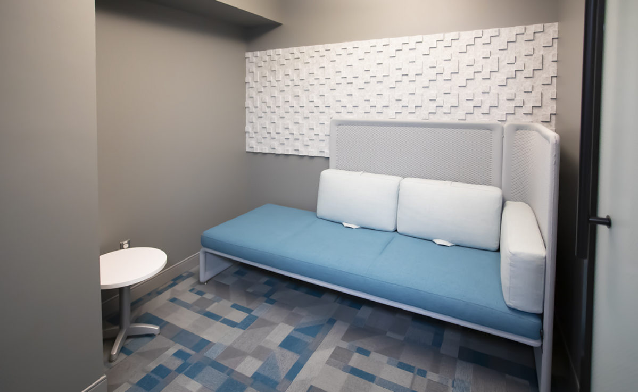
Wellness Room
Wellness Rooms are designed to meet mental health needs, physical needs, spiritual needs or maternal necessities. The rooms can be used for quiet contemplation, stretching, meditating, to perform relaxation exercises, listen to music, breastfeeding, as a refuge or a private sensory relief space.
PLACEHOLDER FOR ADDITIONAL INFORMATION
PLACEHOLDER IMAGE
REPLACE WITH A PHOTO OF YOUR WORKPLACE
The room provides a comfortable environment that is meant to help those that use it feel as secluded as possible from the sometimes-overstimulating office environment. It is meant to be used for short periods of time to ensure all employees can benefit from it.
PLACEHOLDER FOR ADDITIONAL INFORMATION
Notes:
SPEAKING POINTS:

Slide 15
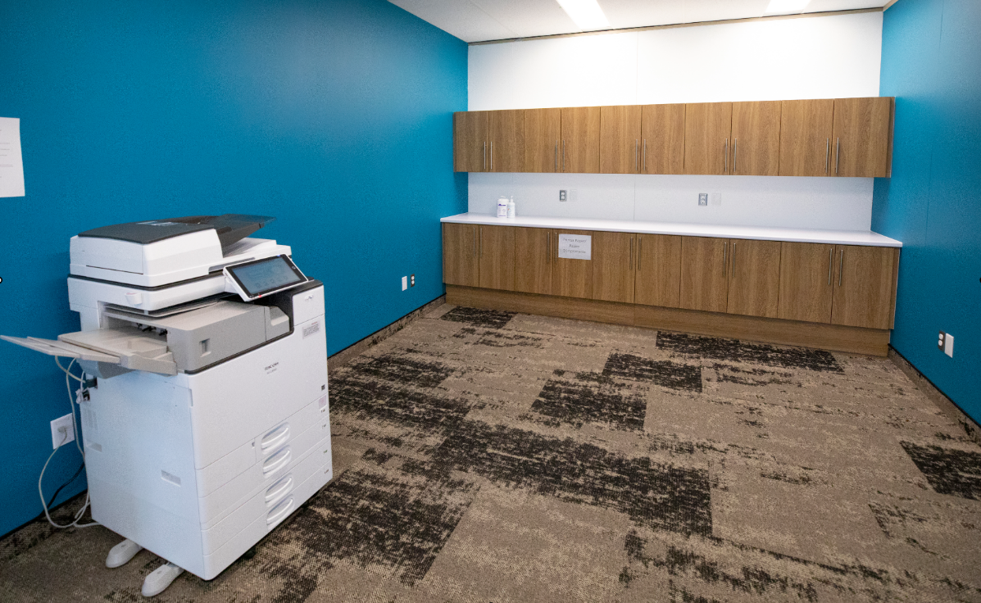
Equipment Room
All Equipment Rooms have printing, scanning and photocopying capacities through new FollowMe Print devices. This is also where Health and Safety notice boards and emergency towers are located
PLACEHOLDER FOR FOLLOWME PRINTING INSTRUCTIONS
PLACEHOLDER IMAGE
REPLACE WITH A PHOTO OF YOUR WORKPLACE
PLACEHOLDER FOR ADDITIONAL INFORMATION
AWARENESS • RESPECT • COURTESY • COMMUNICATION
Think before you print: Try viewing on screen first, print only if necessary
Safety first: Keep area clear of clutter
Think of others: Refill paper trays when empty
Notes:
SPEAKING POINTS:

Slide 16
Workplace Coordinator
OPTIONAL SLIDE Add to the floor plan slide if you decide to include it in your package.
Your Workplace Coordinator can be a great resource to get to know your new workplace! Their role is key to creating a positive experience for employees using the workplace.
The Workplace Coordinator supports employees by:
Providing basic IT technical support
Assisting in the use of the booking system
Providing on-site communications
Supporting Occupational Health and Safety to meet safety requirements
Acting as liaison with accommodations experts for any issues with furniture or equipment
Ensuring your employee experience is positive
PLACEHOLDER IMAGE
REPLACE WITH A PHOTO OF YOUR WORKPLACE
PLACEHOLDER FOR ADDITIONAL INFORMATION
PLACEHOLDER FOR ADDITIONAL INFORMATION
Notes:
SPEAKING POINTS:

Slide 17
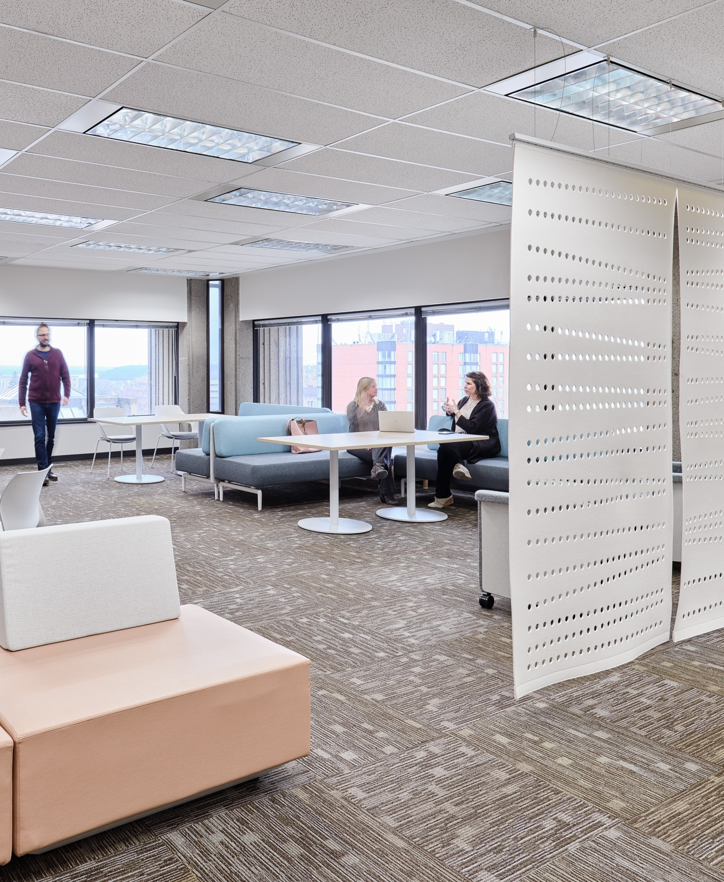
Thank you! We hope you enjoyed this virtual tour or your new workplace.
PLACEHOLDER IMAGE
REPLACE WITH A PHOTO OF YOUR WORKPLACE
You can find additional information here:
[INSERT LINK TO INTRANET]
For questions or comments,
please write to:
[CONTACT]

