Slide 1
Talent Cloud
Results Report
Findings and insights
from 3 years of research

Slide 2
Purpose
To provide a high level overview of the results and insights from the Talent Cloud project
To seek opportunities to integrate promising new directions in theory and design into GC operations, particularly in relation to talent optimization, and diversity and inclusion

Slide 3
What is Talent Cloud?
Talent Cloud was a grassroots, partner-funded initiative launched in summer 2017, with the goal of accelerating the Government of Canada’s readiness to explore and adopt digital age talent models.
The project focused on project-based work with rights and benefits, using the term hiring mechanism.
The team developed and launched a live staffing platform (talent.canada.ca) in October 2018, and ran 50+ staffing processes over two years, studying every aspect - from what causes manager procrastination to how well hires performed a year after their appointment to what attracts and produces a diverse talent pool.

Slide 4
Building for Edge Cases First
The processes and platform were designed for equity-seeking groups first - that means choices were made to prioritize support for the edge cases, not the mainstream. This includes prioritizing accessible designs, promoting remote work as the default (before COVID), applying antiracism and gender theory to all components, starting with Indigenous input, and developing methodologies to recognize the skills of marginalized talent, many of whom have unconventional career paths.
A Multidisciplinary Team Embracing the Digital Standards
Talent Cloud was a policy and product team, made up of experts in a wide range of disciplines, working in different classifications. The success Talent Cloud delivered, rapidly and at low cost, was only achievable because of the application of the Digital Standards across all aspects of the build.

Slide 5
3 Project Outputs
3 Performance Objectives
Real hires for real jobs using a live platform
Reduce Time to Staff
Data and insights from multi-year research
Optimize Talent-to- Team Match
Future-facing theory
Improve Diversity and Inclusion in Hiring

Slide 6
Talent Cloud’s Results
Average time to staff reduced to ~40 days plus security clearance
Savings of ~85 days from initial Talent Cloud average in 2018
Fastest staffing processes at ~20 days plus security clearance
9% of applicants “ready to receive offer” (fully qualified prior to security/OL testing) versus the industry average of ~2%
94% retention rate in GC after 1-2 years; 77% with same team
Development of a new methodological alternative to anonymized/name-blind recruitment that is gaining international attention
Insights and findings on ways to improve inclusion and diversity
Insights and findings on promoting remote work accessible jobs
230 page report, with write ups on 30+ experiments and interventions

Slide 7
Reducing Time to Staff: Where did 110 days of savings come from?
Talent Cloud’s first processes took ~130+ days to verbal offer, and 2 years later it’s fastest took ~20. What changed?
Introduction of an applicant tracking system (with pre-sorted categories).
Interventions related to volume control & optimization of applications.
Real time applicant screening (as applications arrive).
Behavioural nudges to keep managers on task.
Assessment planning tool.
Integrated priority screening.
*Note: In many cases, there were overlaps in the time period of these interventions. Where this occurred, credit for the time savings has been divided between the interventions. What this means, though, is that in order to achieve this result, all these factors need to be in place. Removing Integrated Priority Screening, for example, will likely add 20-30 days to the time to staff, not 10.

Slide 8
Optimizing Talent-to-team Match
People are hired into more than just a job; they’re hired onto teams. Working well with the team makes as much difference to productivity as having the right skills, and yet the vast majority of government hiring looks only at applicant fit to job. Talent Cloud tested a 5 factor model, which proved enormously successful.

Slide 9
Diversity and Inclusion Outcomes
Talent Cloud spent 3 years developing a new methodological approach that foundationally changes how managers look for, see, and assign value to experience and skills gained through non-mainstream life paths. In essence, the methodology rewrites who gets screened in initially, and why… correcting for culture-based systemic bias.
Qualitative data from applicants showed positive experiences and outcomes.
The research uncovered several areas of systemic bias, and developed corrective actions.
To validate this methodology, a study involving a larger sample size will need to be undertaken.
The research yielded insights and practical tips for managers.

Slide 10
Indigenous Talent Portal
Advice for managers on ways to better design advertisements and support Indigenous talent on the team
The Indigenous Talent Portal was designed to provide a space where Indigenous talent could browse and apply to Public Service employment opportunities aimed at the recruitment of Indigenous talent.
It was developed for the Indigenous community - with decisions and directions set by the Indigenous community - “to reclaim our stories and to reset the way Indigenous talent is valued.”
Unfortunately, due to issues around privacy protection and server options, the portal was never approved for launch.
Applicant & employee profiles for Indigenous talent, including traditional territory and ancestral knowledge
“Carousel” approach to self-identification as Inuit, Metis and First Nations, so no group is above another
Ability for talent to claim multiple community affiliations (e.g. not only First Nations)
Integrity pledge including nudges to dissuade non-Indigenous applicants from claiming status

Slide 11
Could the platform be scaled enterprise-wide?
The project was resourced and structured as an experiment, prioritizing minimal viable products for testing concepts and optimizing to deliver results. In its current configuration, it is not resourced to become an an enterprise-wide solution, but with ongoing support, it could greatly scale.
Innovation Insights
Canada is at a turning point in history, when the path of pandemic recovery will determine the trajectory of the country for decades to come. The Government needs to accelerate its ability to innovate, embracing Digital Standards, accessibility, and antiracism approaches into product development and approvals. A project like Talent Cloud is an anomaly, not a given. It poses broader questions for the Government of Canada around whether or not it wants experimental projects such as this, and if so, what steps it’s willing to take to resource and enable them.

Slide 12
Recommendations
3. ESDC and OCIO-CMO
to collaborate on scaling up the Indigenous Apprenticeship Program, leveraging Talent Cloud’s Indigenous Talent Portal and research
4. Results are disseminated access the GC through governance channels and collaboration forums for departments to leverage and apply, as
appropriate
1. OCHRO-OCIO initiate discussion on ways to leverage these new findings and theories to help advance diversity and inclusion in digital & tech recruitment (and more broadly)
2. GC EARB recommendation:
PSC to review
Talent Cloud findings and insights, as it re-initiates its jobs platform procurement process

Slide 13
Annex

Slide 14
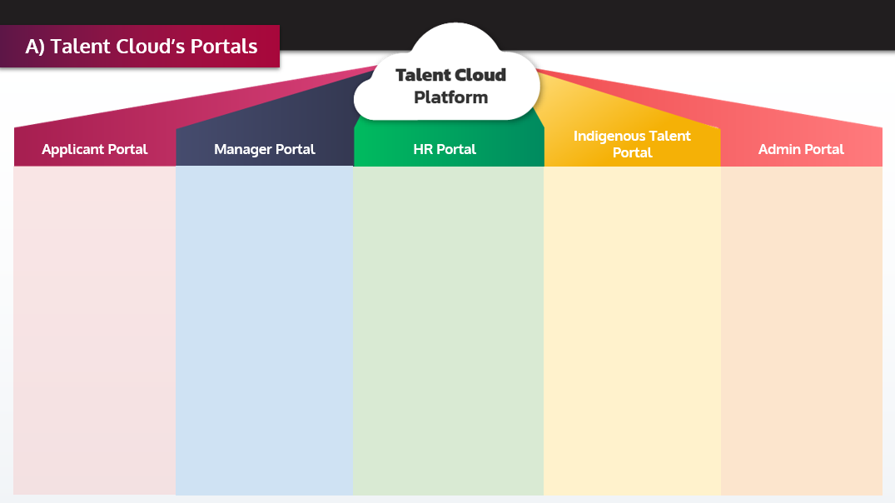
A) Talent Cloud’s Portals
Who: General public and Government of Canada employees seeking job opportunities
What can they do: View jobs, apply to jobs and manage profile
Features: User centric job advertisements, real-time display of number of applicants, skills based merit criteria, honesty pledge, reusable skills and experience, step-by step guidance
Status: Live Oct 2018; relaunched March 2021
Who: Managers in partner departments
What can they do: Create job advertisements, manage profile, create assessment plans, view applications, track applicants
Features: Job advertisement builder tool, skills taxonomy, work environment description tool, pre-sorted applicant list, job applications available as soon as they are received
Status: Live Jan 2019
Who: HR advisors in partner departments
What can they do: Claim job processes, review job advertisements and assessment plans, track applicants
Features: Departmental view of job processes, approval system for job posters, access process and priority clearance numbers, commenting system for communication with managers
Status: Live Feb 2020
Who: Indigenous talent
What can they do: View jobs designated for Indigenous talent, Apply to Jobs, Manage Profile (including Indigenous identity information), Connect to the GC Indigenous Community
Features: Job posters tailored for Indigenous users Community affiliation self-declaration tool, Additional guidance for managers
Status: Waiting for Pro B cloud migration (EE info)
Who: Talent Cloud/ Platform administration team
What can they do: Approve new managers and HR advisors, publish approved job posters, manage behind the scenes content, manage reusable skills taxonomy (including adding and changing definitions)
Features: Resources page to share info with managers and HR
Status: Live March 2019

Slide 15
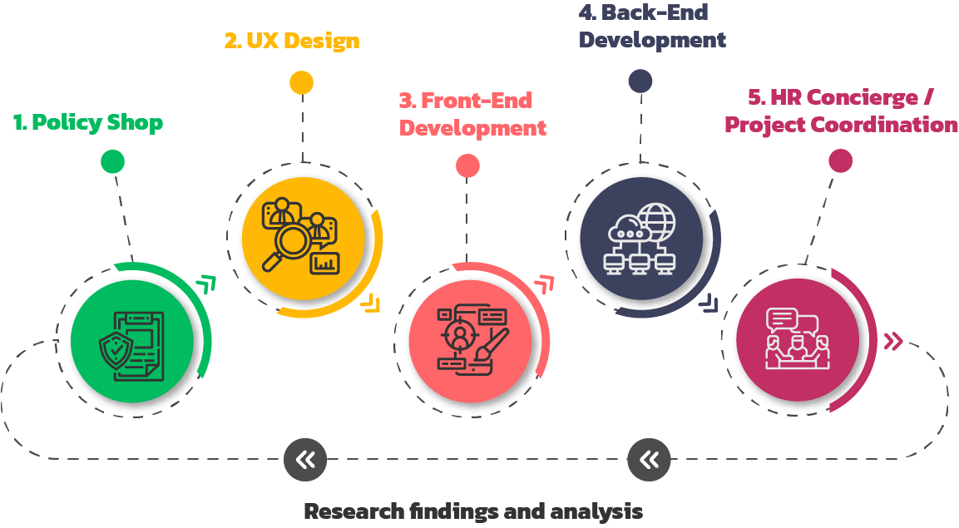
B) The Feature Pipeline of Our Multidisciplinary Team

Slide 16
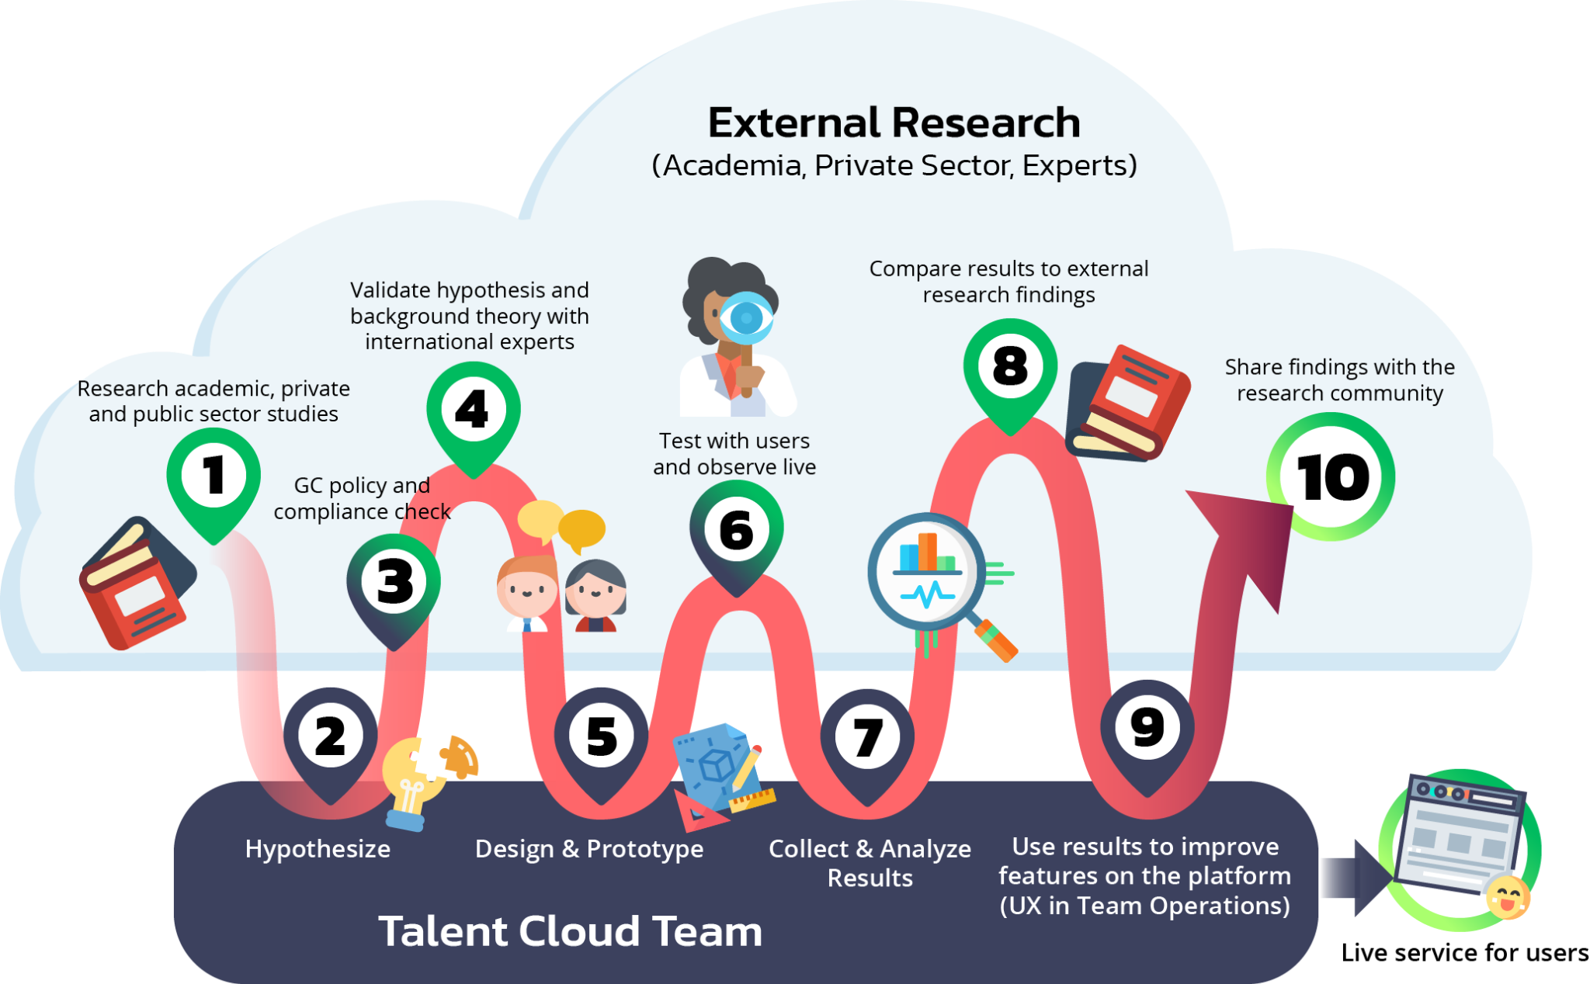
C) Steps Talent Cloud Takes to Produce Research

Slide 17
D) Talent Cloud’s Timeline
October 2018
February 2020
Spring 2018
January 2019
Authority to Operate received.
The Applicant Portal (beta) goes live with real job postings.
Two-Factor Authentication is added to the site.
March 2021
July 2017
The development team starts coding the platform.
The first employee is hired using Talent Cloud.
The Manager Portal goes live.
New Applicant Portal, with Timeline and upgraded bias reduction tools, is launched.
Official Start of the Project.
The HR Advisor Portal goes live.
September 2018
Summer 2019
Summer 2017 -
Spring 2018
Privacy Impact Assessment submitted and approved.
May 2019
Fall 2019
April 2020
April 2021
First full prototypes of the Indigenous Talent Portal are user tested.
Workshops, design sessions and engaging experts on problem scope, process mapping and initial designs..
Side test of portable digital credentials: Blockcerts pilot launched, in collaboration with Free Agents.
Major upgrades to the Manager Portal, including new tools.
Talent Cloud launches GC Reserve for COVID-19 response.
The Talent Cloud experiment, in its current configuration, wraps up.

