Slide 1
Disproportionality Index
Dr. Martin Nicholas, Department of Justice
Catalina Albury, Statistics Canada
Brittny Vongdara, Statistics Canada
Shamir Kanji, Canada Revenue Agency
  IDNEED
  March 2, 2023

Slide 2
Disproportionality Index Agenda
Opening remarks by Dr. Martin Nicholas
Context
  What is a Disproportionality Index
  How was the Disproportionality Index created
  Support for a Disproportionality Index
  Equality vs. Equity – The Numbers
Disproportionality Index in the Core Public Service
Next Steps

Slide 3
Opening Remarks by Dr. Martin Nicholas

Slide 4
What is a Disproportionality Index (DI)?
A disproportionality index is a statistical measure used to determine whether there are differences or disparities between different groups in a particular situation or context. It is often used in social science research to identify potential inequalities in areas such as education, employment, healthcare, or criminal justice.
The index typically compares the proportion of one group's representation in a particular outcome (e.g. the number of students in special education programs) to the proportion of that group's representation in the overall population. If the representation in the outcome is significantly higher or lower than what would be expected based on the population size, this suggests that there may be a disproportionality issue that needs to be further investigated.

Slide 5
How was the Disproportionality Index created?
Disproportionality Index created by Dr. Martin Nicholas, Justice Canada
A partnership for Data Visualization of DI and Salary Analysis was created between:
  Dr. Martin Nicholas, Justice Canada
  Catalina Albury, Statistics Canada
  Brittny Vongdara, Statistics Canada
  Shamir Kanji, Canada Revenue Agency
  With support from:
    Data Science Network (DSN)
    Anti-Racism Ambassadors Network (ARAN)

Slide 6
Support for A Disproportionality Index
Substantive Equality
  Substantive equality is achieved when one takes into account, where necessary, the differences in characteristics and circumstances of minority communities and provides services with distinct content or using a different method of delivery to ensure that the minority receives services of the same quality as the majority. This approach is the norm in Canadian law.
    Equal access
    Equal opportunity
    Equal outcomes
United Nations Human Rights: Office of the High Commissioner | Data for racial justice (2019)
  “…analysis of disaggregated data were crucial to inform policy priorities relating to equality and opportunity for people of African descent. In addition, the refusal by some States to collect and disaggregate data based on race and ethnicity was one of the most serious impediments to the attainment of the Sustainable Development Goals”
Privy Council Call’s to Action (2021)
  “Measuring progress and driving improvements in the employee workplace experience by monitoring disaggregated survey results and related operational data (for example, promotion and mobility rates, tenure) and acting on what the results are telling us”

Slide 7
Equality vs Equity in Numbers
Group
A
B
C
An example: 500 employees, with 3 groups
  A and B: Two groups of self-identifying minority employees
  C: The majority group
Groups A and B both make up 4% of employees, which happens to be about the same as their group’s workforce availability.
At a glance, representation seems equal.
Figure from Employment Equity: An Analysis of Distribution of Salary Ranges of Public Service of Canada Employees

Slide 8

Annual Salary
100.0K+
85.0-99.9K
70.0-84.9K
60.0-69.9K
<60.0K
Group
A
B

Slide 9
Annual Salary
100.0K+
85.0-99.9K
Career Progression
70.0-84.9K
60.0-69.9K
<60.0K
Group
A
B

Slide 10
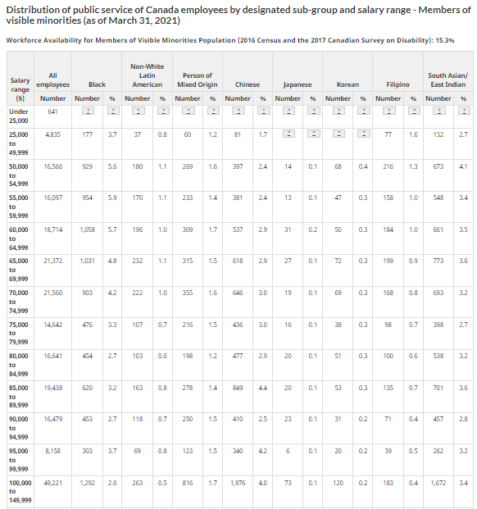
Notes:
https://www.canada.ca/en/treasury-board-secretariat/services/innovation/human-resources-statistics/diversity-inclusion-statistics/distribution-public-service-canada-employees-designated-sub-group-salary-range-members-visible-minorities.html

Slide 11
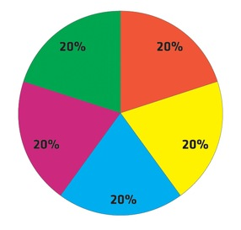
Salary Data
All Core Public Service Employees
Notes:
https://www.canada.ca/en/treasury-board-secretariat/services/innovation/human-resources-statistics/diversity-inclusion-statistics/distribution-public-service-canada-employees-designated-sub-group-salary-range-members-visible-minorities.html

Slide 12
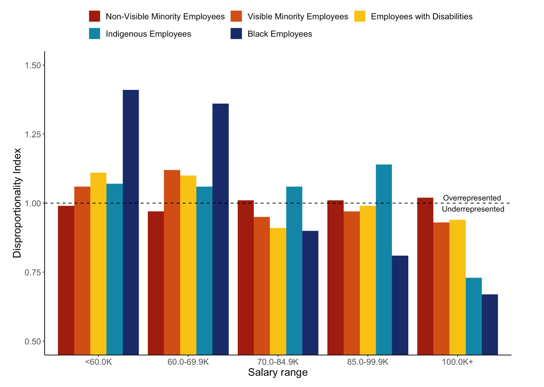
Notes:
Raw numbers of salary bands (Core Public Service, not CRA)
Distribution of public service of Canada employees by designated sub-group and salary range - Members of visible minorities - Canada.ca

Slide 14
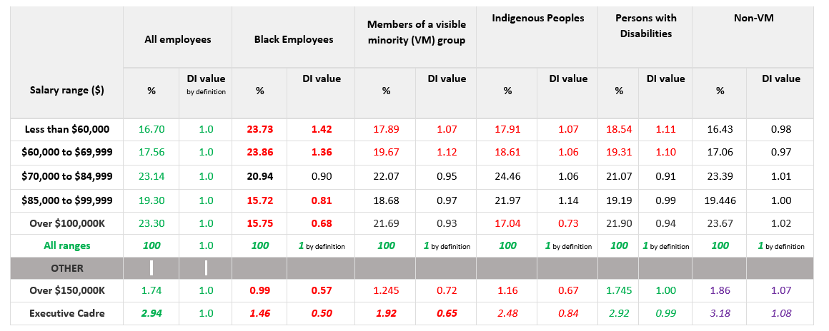
Core Public Service Disproportionality Index
Table - Distribution of Salary Ranges of public service of Canada employees for Black, Visible Minority (VM) Group, Indigenous
Treasury Board Data: Peoples, Persons with Disabilities, and Non-VMs
Notes:
https://www.canada.ca/en/treasury-board-secretariat/services/innovation/human-resources-statistics/diversity-inclusion-statistics/distribution-public-service-canada-employees-designated-sub-group-salary-range-members-visible-minorities.html
Dr. Nicholas ARAN June 23, 2023 Presentation.

Slide 15
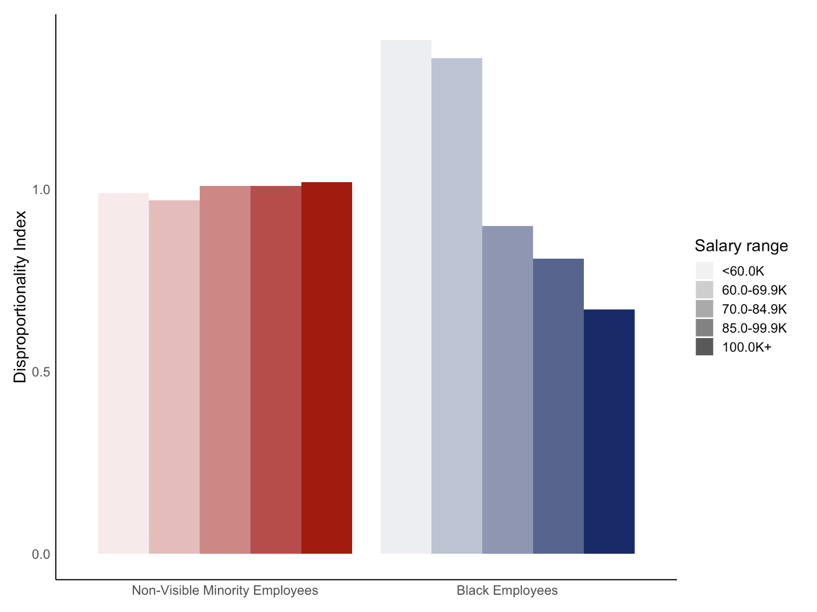

Slide 16
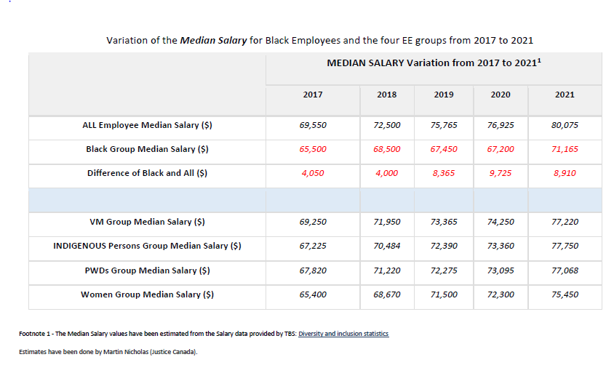
Disproportionality Index – Trend Analysis
Notes:
Lowest value: There is no doubt that the Black group has a significant lower Median salary than the rest examined as per table below.
Non-VM: The non-VM is a good comparator for possible impacts of racism.
Contact Dr. Nicholas to get more details of the method and the expected errors. Errors could be significant for some groups.

Slide 17
Next Steps
Encourage “separate agencies” (non-core public service) to share disaggregated EE salary data, to have a fulsome GC dataset
Disproportionality Index will be presented at the 64th annual ISI World Statistics Congress on July 16-20, 2023 in Ottawa
Explore use of Disproportionality Index in addition to Labour Market Availability (LMA)
  LMA data is based on outdated census data
  Currently in 2023, census data being use from 2016 to populate LMA (until late 2023)
  LMA is the agreed to threshold for all Employment Equity groups, upon which gaps are identified in staffing
Continue to build awareness of the DI in the GC, as how this evidence based data can drive decision making
Notes:
LMA calculates 7 year old quantity
DI calculates more recent disparities in equality of income

Slide 18
Questions?

Slide 19
References
Core public service disaggregated data - salary
Message and guidance for letters on the implementation of the Call to Action on Anti-Racism, Equity and Inclusion - Privy Council Office - Canada.ca - Canada.ca
Population of the federal public service by department - Canada.ca
Employment Equity: An Analysis of Distribution of Salary Ranges of Public Service of Canada Employees (klaxonklaxoff.github.io)

