Slide 1
GC Task Success Survey:
2024-25 Q2 Results
November 2024 | GCWP, Web Executive Board

Slide 2
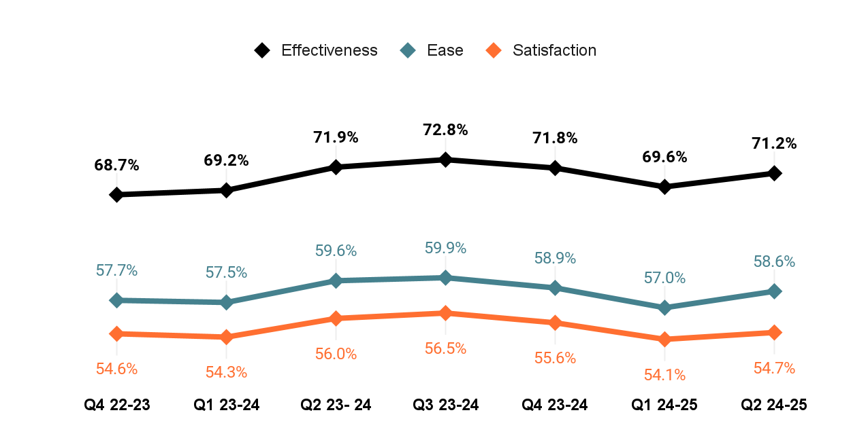
Overview of Q2 2024-25 results
Q2 Completed surveys: 99,000 visitors completed the survey
Q2 Average success: 71.2% said that they were able to complete their task
▼-0.7%
Compared to the same quarter last year
Q2 23-24
▲1.6%
Compared to the previous quarter
Q1 24-25

Slide 3
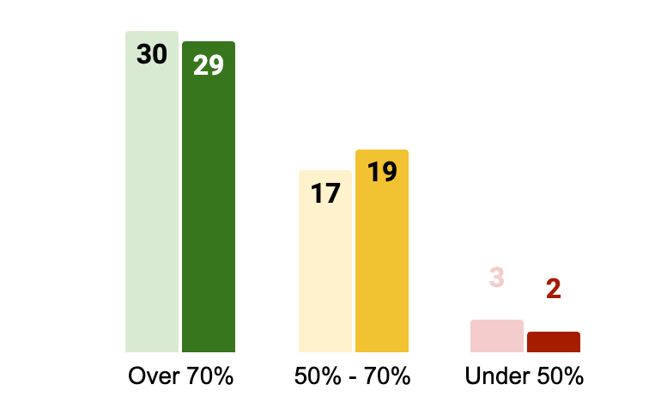
Performance of the top 50 tasks by score in Q2
58%
Of tasks in the top 50 scored over 70%
▲Up from 56% from Q1
29 of the top 50 tasks (58%) have a minimum 70% success score
17 / 29 green tasks required sign-in We are continuing to understand and highlight the impacts of signing into an account on task success
Q1 FY24 Q2 FY24
Q1 FY24 Q2 FY24
Q1 FY24 Q2 FY24

Slide 4
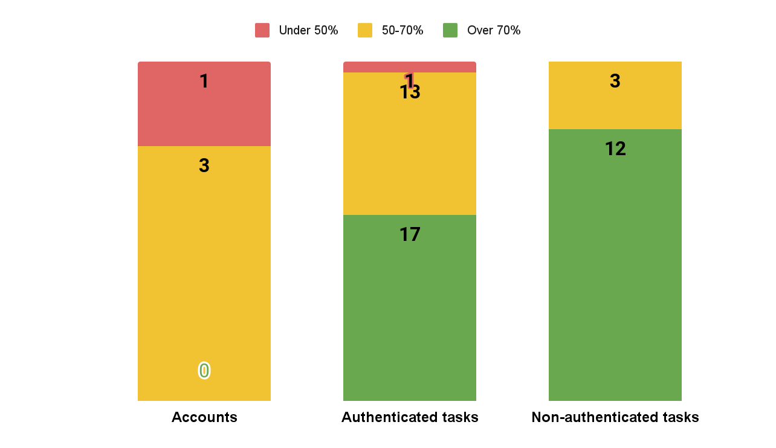
How signing into an account affected task scores in Q2
Did sign-in affect task success in Q2? YES
Tasks that didn’t require signing into account had a higher task completion score
58.2% average for account specific tasks
67.9% average for tasks with sign-in (authenticated)
81.1% average for tasks without sign-in (non-authenticated)
Methodology We tagged tasks in the top 50 by whether they were authenticated (required sign-on) or not.
Authenticated tasks
Account tasks (register, sign-in)
Service tasks (mix public, authenticated space)
Action tasks (authenticated space)
Answer tasks (authenticated space)
Non-authenticated tasks
Action tasks (public)
Answer tasks (public)

Slide 5
Q2 - 10 Highest completion scores in the top 50 tasks 8/10 tasks do not require signing-in to an account
TASK | DEPT | Q2 2023 | Q2 2024 | CHANGE | TASK TYPE
Pension payment dates | ESDC | 96.40% | 96.8% | +0.4% | Answer task: Public
Employment Insurance (EI) - Submit an Employment Insurance Report | ESDC | 92.00% | 92.4% | +0.4% | Action: Public
Calculate payroll deductions | CRA | 92.80% | 86.8% | -6.0% | Action: Public
Travel advice and advisories | GAC | 85.10% | 87.2% | +2.1% | Answer task: Public
My Service Canada Account (MSCA) - View payment information | ESDC | 83.90% | 80.7% | -3.2% | Action: Private
Weather (current conditions, forecasts, radar, alerts, historical) | ECCC | 85.60% | 80.8% | -4.8% | Answer task: Public
Check processing times | IRCC | 82.70% | 85.3% | +2.6% | Answer task: Public
Apply for an Electronic Travel Authorization (eTA) | IRCC | 79.60% | 81.3% | +1.7% | Action: Public
Employment Insurance (EI) - Apply for Employment Insurance | ESDC | 79.70% | 81.2% | +1.5% | Service
Find a job in the private sector | ESDC | 81.20% | 82.3% | +1.1 | Answer task: Public
Notes:
Notable changes?

Slide 6
Q2 - Lowest completion scores in the top 50 tasks
10/ 10 tasks require signing-in to an account to complete them
TASK | DEPT | Q2 2023 | Q2 2024 | CHANGE | TASK TYPE
Find out when I can expect my tax refund | CRA | 47.50% | 42.9% | -4.6% | Action: Private
My Service Canada Account (MSCA) - Register for an account | ESDC | 44.70% | 49.5% | +4.8% | Account sign-in / registration
Get, renew or replace a permanent resident card | IRCC | 54.10% | 50.7% | -3.4% | Service
Access My Account | CRA | 56.60% | 51.5% | -5.1% | Account sign-in / registration
My Service Canada Account (MSCA) - Check your CPP/OAS application status | ESDC | 46.0% | 52.7% | +6.7% | Action: Private
Check the status of a passport application | IRCC | 75.3% | 54.1% | -21.1% | Action: Private
Guaranteed Income Supplement (GIS) | ESDC | 56.7% | 57.1% | +0.4% | Service
File a Personal tax return | CRA | 55.60% | 58.5% | +2.9% | Service
Get a copy of a notice of assessment or reassessment | CRA | 67.20% | 59.7% | -7.5% | Action: private
Apply for the Canada Child Benefit (CCB) | CRA | 68.50% | 60.3% | -8.2% | Action: Private

Slide 7
Biggest improvements in the top 50: Q2 2023 v Q2 2024
TASKS with significant increase | DEPT | Q2 2023 | Q2 2024 | CHANGE | TASK TYPE
IRCC secure account - register, sign in, help | IRCC | 56.9% | 66.1% | 9.2% | Account sign-in / registration
Scholarships to study in Canada | GAC | 58.9% | 67.4% | 8.5% | Answer task: Public
Access your pay (MyGCPay, CWA, Phoenix) | TBS | 60.2% | 68.2% | 8.0% | Action: Private
Immigrate through Express Entry | IRCC | 69.7% | 75.7% | 6.0% | Service
My Service Canada Account (MSCA) - Register for an account | ESDC | 44.7% | 49.5% | 4.8% | Account sign-in / registration
Notes:
File a Personal tax return - This task was added June 2023
When looking at biggest improvements - we changed the time frame from a quarter to quarter look to looking at the same quarter from last year. Optimization work (large scale) often takes more than a quarter to complete.

Slide 8
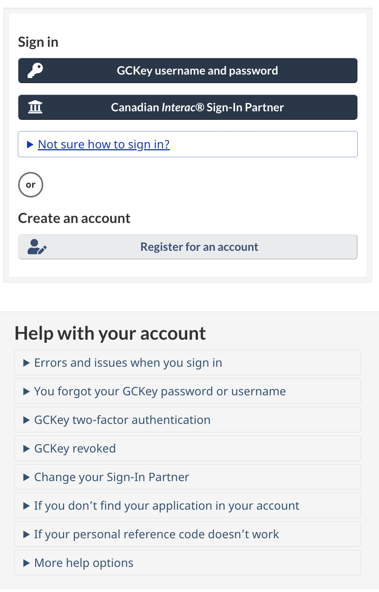
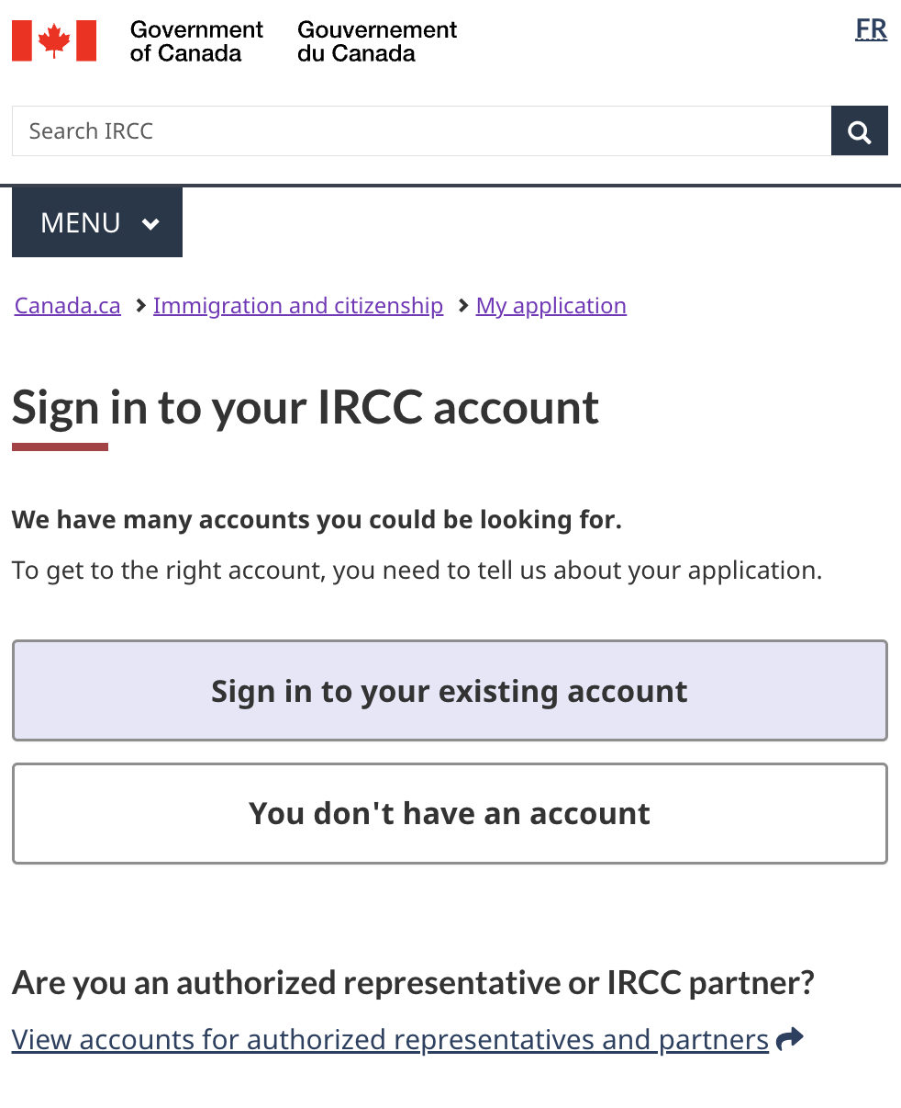
Featured project: IRCC Sign-in
Q2 2023 | Q2 2024 | CHANGE
56.9% | 66.1% | 9.2%
Implemented the new sign-in template across most accounts
Launched an account wizard to direct users to their correct account.
Implemented the sign-in button, directing to the account wizard, on the immigration theme page and IRCC institutional landing page.
Replaced the link to the IRCC secure account on key pages (immigration theme page, My application topic page and the institutional landing page) with a link to the account wizard.
A significant number of clients who don’t need or can’t use the IRCC secure account can get to the correct account more easily and directly.

Slide 9
Feature your optimization work
Help us learn how your optimization work may have contributed to increased task success scores!
We’d like to highlight more optimization work going forward.
Notes:
File a Personal tax return - This task was added June 2023
When looking at biggest improvements - we changed the time frame from a quarter to quarter look to looking at the same quarter from last year. Optimization work (large scale) often takes more than a quarter to complete.

Slide 10
Q1 Research question:
Update: Combining indicators to measure service performance
Developed a template to document a minimal set of core web indicators Findability Usability Sign-in Channel churn We learned there is also a need for a “single source of truth” to document a service’s top tasks and create a common understanding of user needs. Created a draft template to respond to this need DTO will be piloting this with our engagement work, but you can try it out now and suggest improvements.

Slide 11
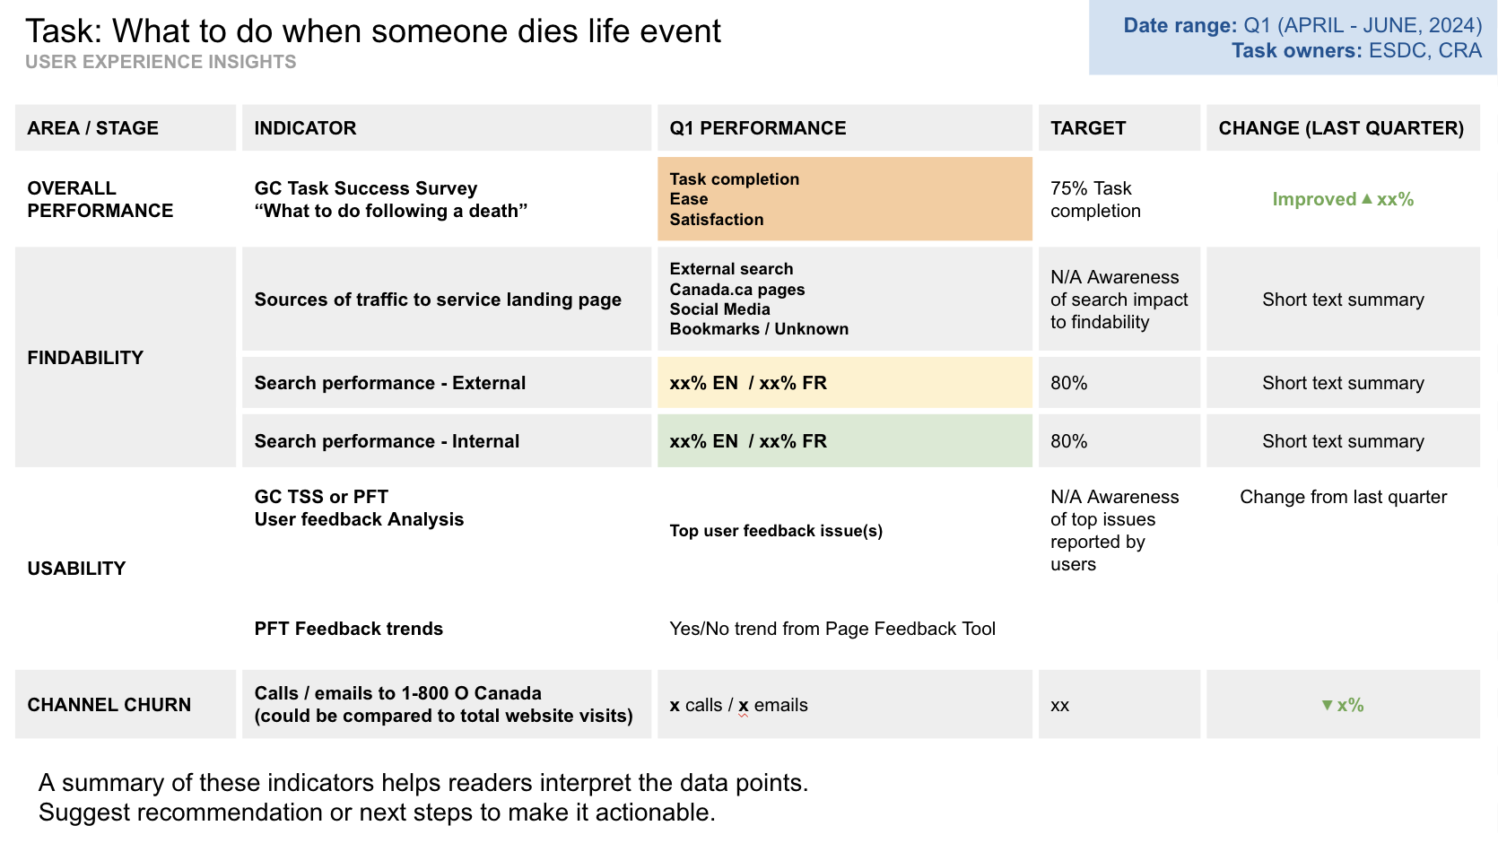
Q1 Research question:
Update: Combining indicators to measure service performance
The User Experience Insights report:
Uses GC Task Success Survey overall score
Focuses on 3 performance areas:
Findability
User experience (usability / satisfaction)
Impact on other channels
Optimized for quarterly reporting cadence
Emphasis on user feedback analysis to pinpoint where pain points exist in the user journey.
Complements existing analytics work
Draft Resource: User Experience Insights template

Slide 12
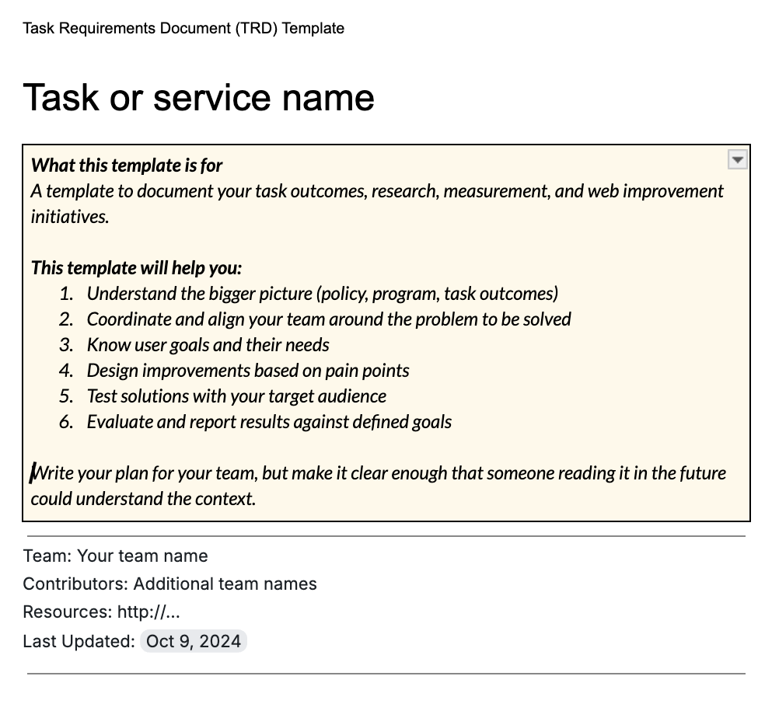
Q1 Research question:
Update: Combining indicators to measure service performance
The Task Requirements Document (TRD) (Also open to a new name for this!)
Provides a single source of truth.
Is used for team alignment.
Becomes a record of the goals and performance measurement of a task.
Is a record of the hypothesis, options and solutions.
Makes up a part of the task history and narrative.
Draft Resource: Task Requirements Document Template

Slide 13
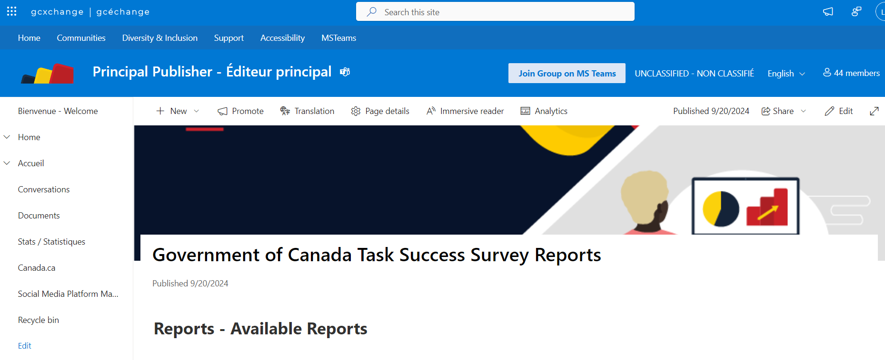
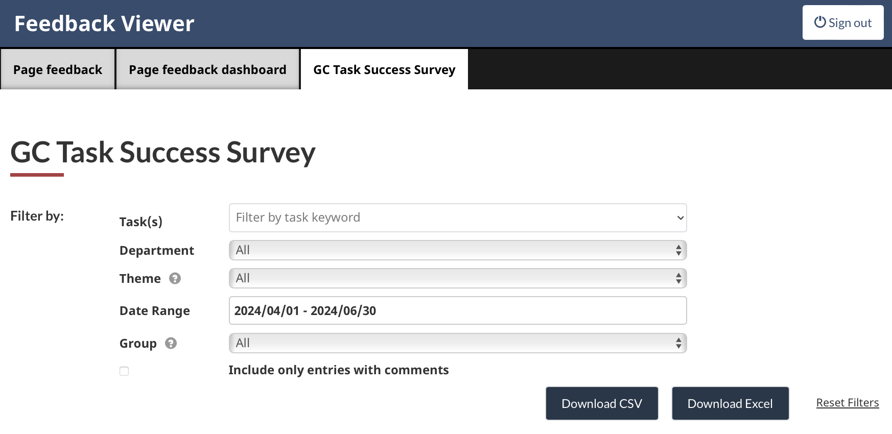
Annual reports, quarterly reports, and feedback
Download the annual and quarterly GC TSS reports on GC Exchange
Download raw survey responses and comments from the Feedback Viewer

Slide 14
Thank you for your time
Lana Stewart
A/Supervisor Data and Performance
Digital Transformation Office
Canada Digital Service
lana.stewart@cds-snc.ca
343-551-5967
Lindsay Beaudoin-Rach
A/Manager, Analytics Services
Principal Publisher Service Canada
lindsay.beaudoin@servicecanada.gc.ca
Reach out to share your case studies or volunteer to pilot new tools.

Slide 15
Annex: Definitions of task types
Task type | Account task | Service task | Action task | Answer task
What it includes | Tasks related to signing in, registering, or getting help with an account. Sign in to an account Register for an account | Usually written as a service or program name Includes a mix of public, authenticated space answers, actions, and account tasks as part of the service. Ex: Renew a passport | Usually a sub-task of a service. Initiate a process Check a status Get help, follow-up Public: Ex. Check if you need a visa or eTA to enter Canada Authenticated (requires sign in): Ex. View or download T4 and other tax slips | Public: Find dates, amounts, forms or use a wizard / calculator / map to get a specific answer Ex. Find the next benefit payment date Authenticated (requires sign in): Specific to a person and requires signing in to an account Ex. Find my Tax-free savings Account (TFSA) contribution limit
Tasks that require sign-in score lower and we should compare similar types of tasks to account for this trend.
Google Docs: Top 100 tasks tagged by type

