Slide 1
Digital Presence COVID-19 Canada’s Response
Canada.ca Theme Management Meeting
March 25, 2020
Notes:
Add references
1

Slide 2
Contents
Roles
Current web space
COVID-19 Digital Communications Strategy - in approvals
Proposed web design for all of Government presence - in approvals
Implementation (overview and tools)
Performance measurement
Action items
Notes:
2

Slide 3
Roles
PHAC/HC-CPAB
Lead website direction, strategy, implementation, communications and measurement
TBS
Lead optimization advice, testing, research, and coordination with theme partners
Principal Publisher (PP)
24x7 Management of web content system, including analytics, metadata, redirects/Vanity, SEO
CPAB /TBS/PCO/PP – Together:
Support consistent communications on digital implementation plan (when approved) and web standards
THEME LEADS:
Review/advise on theme-space content requests, assess for duplication of content across Canada.ca
Identify theme-space content inventory (existing and anticipated) to contribute to content mapping
To apply Content, UTM, Vanity URL, Metadata Guidance where possible

Slide 4
Current COVID-19 web space
By the numbers at PHAC/HC-CPAB:
453 requests since launch
2246 pages (mostly updates)
15-20 web publishing staff*
8 digital comms advisors* with O/T
8 digital transformation staff* (strategic, ux, SEO/metadata, analytics)
*includes management
Main PHAC Landing page
Partner landing pages
Many Vanity URLs
Increasing content pages
Increasing navigation structure

Slide 5
COVID-19 Digital Communications Strategy
The overarching digital strategy aims to guide online efforts to provide:
An all of Government digital presence that supports public education, safety/security of Canadians and enables financial support requests.
Flexibility and responsiveness to audience needs throughout the duration of the pandemic.
Map of what should be published where, why, and how we define success and improvement over time.
Cohesive messaging on COVID-19, its health, safety, social and economic impacts, and what the Government’s response is.

Slide 6
Proposed COVID-19 web presence (in approvals)
RECOMMENDED STRUCTURE
USABILITY TESTING
Grouping pages by task categories (similar to WHO) to enable scalability
Mobile-first design approach to see more links without scrolling (70% of visitors are accessing by phone)
More bullets/tasks vs paragraph writing style (easier to read/scroll quicker to update)
Content tagging for higher search results placement, and back-end content management
TBS-DTO recently performed usability testing on a prototype with mobile users indicating:
task-based design enable users to succeed at finding the right answers
that there was difficulty on reading/accessing print based content such as .pdfs, large tables, complex images

Slide 7
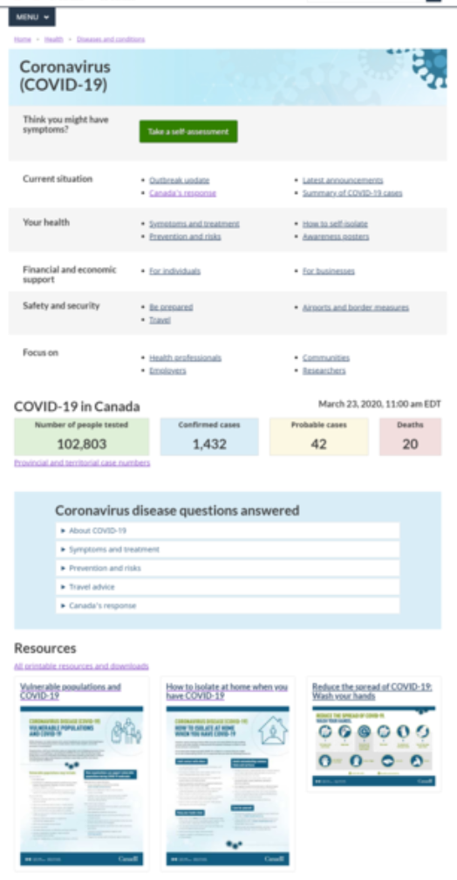
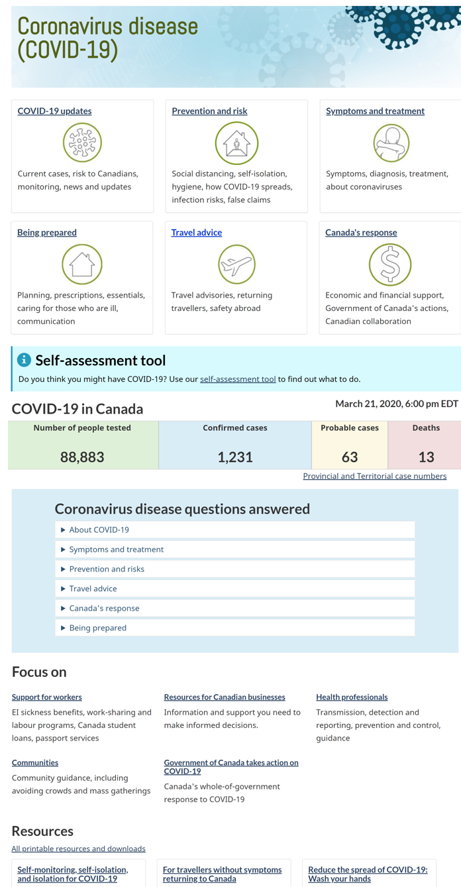
Desktop view (current vs. future)
DRAFT
OPTIMIZED OPTION
Task-based, can add or remove links as needed
Concept is scalable, easy to scroll through
Iterative/adaptable approach
Can consider :
Social feeds
collaboration to reduce duplication

Slide 8
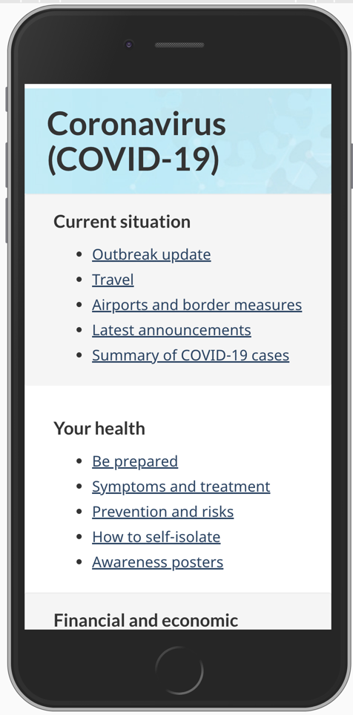
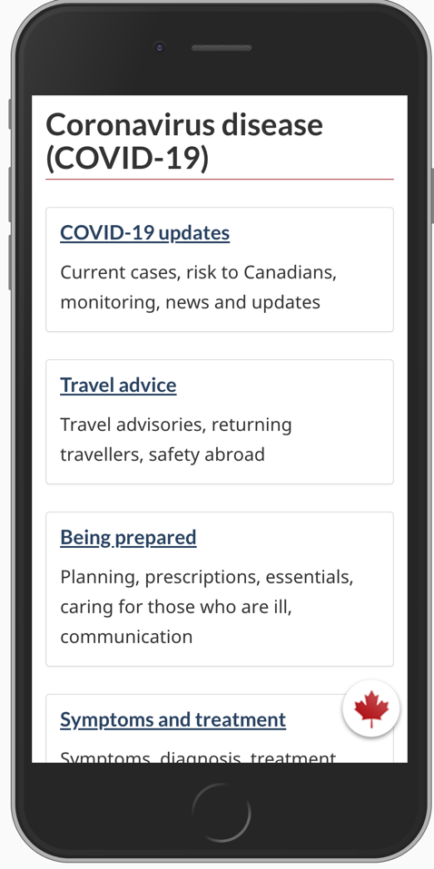
Mobile view (current vs. future)
DRAFT
OPTIMIZED OPTION
Usability testing on a prototype with mobile users, users had a 90% success rate finding the answers they were seeking on COVID-19.
Previous research also supports task-based design.

Slide 9
Proposed Implementation: Phased approach (in approvals)
Phase I – with capacity (ASAP)
Phase 2 – with capacity
Incorporate task-based structure with existing links to content
Validate content map with PHAC/HC-CPAB and OGDs
Assess ability to reduce paragraph format with minimal edits
Assess content against Crisis communications checklist (Annex A)
Support product development and branding use
Implement content map
All new products following checklist where possible (HC/PHAC as with OGDs)
Assess and encourage reduction of duplicated content between OGDs
Apply additional web editing where approved
Continue user testing

Slide 10
Initial Visualization - Content mapping and scaling (TBC)
Current situation:
Outbreak update
Latest announcements
Canada’s response
Your health:
Be prepared
Symptoms and treatment
Prevention and risks
How to self-isolate
Awareness resources
Mental health (PHAC)
Rapid diagnosis (mobile tests) (PHAC)
Financial support:
For businesses
For individuals
For Canadians abroad
Taxes (CRA)
Safety and security:
Travel
Airports and border measures
Securing medical supplies (DND/PHAC)
Your Charter Rights (JUS)
Workplace health and safety (ESDC)
Medical research (PHAC)
Drug shortage reporting (HC)
Quarantine measures (PS/RCMP/PHAC)
Notes:
We need to have a maximum of 6 links per category. Design is iterative - and will be built over time depending on the needs we are presented with. We will have a “focus on” section where we will add in items that support all areas. But until we have a full lens of what is coming, we won’t have an accurate content map at this stage. Will be built with partner intel through an inventory mechanism if possible.

Slide 11
Content inventory validation and mapping
Meeting request included access to content inventory, which is accessible outside the GC network: https://wiki.gccollab.ca/Covid_19_DTO-BTN
Engage theme partners to contribute to the list:
existing content
anticipated content
NEXT STEP - PHAC/HC & Partners to validate content mapping

Slide 12
Branding and accessibility
Through work of our Creative Services, Strategic and Digital Comms teams, we have updated the branding elements for all of Government to access:
https://gcconnex.gc.ca/file/group/61785806/all#
Check accessibility against WCAG during content development and publishing.
Notes:
To access, you need to join GCconnex group - Coronavirus Shared Files
Go into GCConnex
Select tab “Groups”
In the “Search for groups” box, enter coronavirus
Select “Coronavirus Shared Files”
Select the “Join Group” button

Slide 13
Vanity URLs
Use main URLs for promotion:
Canada.ca/coronavirus
Canada.ca/le-coronavirus
Strictly limit creation of new vanity URLs related to COVID-19 and only create if it’s absolutely necessary.
Use task or topic keywords in vanity URLs, instead of department acronym:
canada.ca/coronavirus-taxes or canada.ca/coronavirus-business

Slide 14
Metadata guidance
OVERARCHING CONSIDERATIONS
Unique titles should be used for each page across Canada.ca
Create meta title to fit search display in Google (limited to 600 pixels = about 70 characters)
Create meta title before web page goes live to ensure easier collection and interpretation of performance measurement results
Use words that are trending in the Canadian context via Google Trends
Changes to Canada.ca search can be requested to raise important pages higher in search results, increasing relevance and accuracy
Use http://requestform.portal.gc.ca/tickets.html to submit requests
Notes:
Only one page should have the title coronavirus (COVID-19)

Slide 15
Performance Measurement approach
Align UX and Analytics to measure, report and improve online tasks to ensure Canadians can easily find and use content. Data aims to support evidence-driven decisions.
Since launch (to March 24, 2020):
Total visits: 42.7M visits
Are Canadians finding what they need?
Are Canadians able to use the information easily?
Are there improvements to be made?
Are we building content out effectively?
KPI CREATION
•Task success rate
•% of visits to a priority page
•% of visits with onsite searches
REPORTING
Daily status
Weekly report
Monthly comprehensive report
Notes:
tracking analytics since Jan. 16
• Coronavirus page - general one (not the one specific to COVID-19) went live on January 16 at 5:56 p.m.
• Novel Coronavirus pages - went live on January 21 at 4:17 p.m
• First CDN case was on Jan 25

Slide 16
UTM Guidance There is no need to tag Canada.ca pages linking within Canada.ca. These are tracked automatically.
APPLY UNIQUE TAGS TO:
REMEMBER TO:
Multiple pages residing outside Canada.ca each linking to the main COVID-19 landing page
Email messages to stakeholder groups
Specific social media posts vs. tracking channel
NOTE: Never use the Vanity URL as the hyperlink embedded in the content
Use covid-1920 for the campaign name
Place target link (if you have one) after the utm code, and at the very end of the href (or it will not work)
Identify language (en for English and fr for French)
Use underscores for spaces (there are no spaces or capital letters in UTM codes)

Slide 17
UTM Guidance and contact
A UTM generator guide is available from Health Canada, complete with examples, to help you create your link.
Please send your completed UTM codes and/or questions, to Health Canada’s performance measurement team:
hc.healthwebanalytics-analysewebdelasante.sc@canada.ca

Slide 18
Action items
Given how quickly the communications are moving on this file, we are seeking help from Theme Leads to prioritize:
Contributions to content inventory
Application of UTM tagging (especially out large outreach efforts)
Use of the main Vanity URL rather than creating new ones
Use of approved branding

Slide 19
Annex

Slide 20
How to join GCconnex group
To access the files, you need to join GCconnex group - Coronavirus Shared Files:
Go into GCConnex
Select tab “Groups”
In the “Search for groups” box, enter coronavirus
Select “Coronavirus Shared Files”
Select the “Join Group” button

Slide 21
Crisis communications content design checklist
Checklist developed by TBS and being shared with all Government Departments.
Use a mobile-first style
Do not duplicate content
Follow a news-based page structure
Add the date and timestamp when information changes
Follow guidance for alerts and warnings
Write information as directions
Use headings as answers
Use bulleted lists
Use bold text sparingly
Pull links out of paragraphs
Keep sentences short
Check words to avoid
Keep track of common wording and terms
Identify pages with emergency-related content
Create web content, not documents
Apply accurate, relevant metadata
https://design.canada.ca/crisis/content.html

Slide 22
Metadata guidance Impacting external search result ranking (i.e. Google)
META TITLE (appears in search results as title)
H1 (title on content page)
should accurately summarize the content = your elevator pitch
unique information to distinguish your content from similar pages on Canada.ca
front load by putting the most important, relevant and used terms at the beginning of the title
apply unique descriptive titles
consider ‘unique’ in relation to all of Government approach
short titles
follow principles found in the Canada.ca Content Style Guide

Slide 23
Metadata guidance Mostly impacting internal search result ranking (Canada.ca)
DESCRIPTION
KEYWORDS
ranking factor in search results
give users an accurate description of what they will find on a page
do not repeat the title in this field
ranking factor in search results
use keywords from title and text
use common search terms
no need to add variants of terms

