Slide 1
First engagement activity with employees
Template
For the change project
IRCC Enterprise Change & Learning Academy Branch (ECLA) IRCC.Change-Changement.IRCC@cic.gc.ca October 2021

Slide 2
How to use this document
Ensure that the project sponsor or champion for the change project or initiative will be participating
Plan to have the most senior leader kick off the session to inspire and demonstrate support
For best practices on how to manage engagement sessions, please refer to the Annex section of this presentation.

Slide 3
Opening session
[Can include the following:­]
Opening session or other ceremony typical of your organization culture
Logistics
Information on the use of a voting application such as Slido
Rules of engagement
Agenda
Other

Slide 4
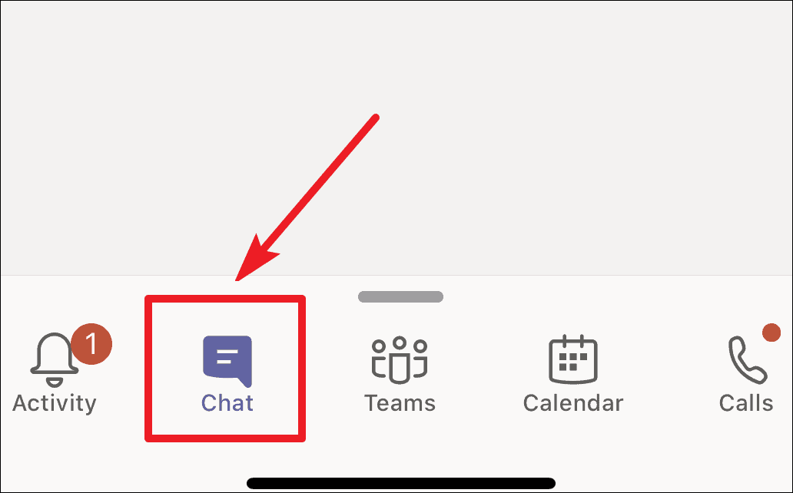
EXAMPLE: RULES OF ENGAGEMENT
MUTE your microphone
TURN OFF your camera
ask QUESTIONS and leave COMMENTS directly in the MS Teams chat panel
or….
send an e-mail to:
Notes:
Bilingual
On screen at the beginning of the session
SPEAKER: Chantal

Slide 5
Departmental modernization strategy
[If developed or available, present the departmental modernization strategy. Put emphasis on the specific change project and how it will enable the new modernized way of delivering programs, providing services and managing operations.]
[Include link to a video, if available­]
Should be presented by the project sponsor or champion

Slide 6
XYZ change project vision
[Deep-dive into the project : what is the vision for the project, what are the key principles that will drive the change project, why does the organization want to change this]
Should be presented by the project sponsor or champion

Slide 7

The future
[Above and beyond the organization’s modernization strategy and the change project, there are opportunities to rethink what the future will be. Include what the organization is thinking, envisioning, assessing on this matter that will have an influence on the future.­]
Examples:
What we have learned this last year
How what we have learned can be turned into opportunities
Opportunities to rethink the way we deliver our business, to integrate new ways of working, equipping employees with new tools, new processes, an enabling and empowering culture, etc.
Include data, if available
Should be presented by the project sponsor or champion

Slide 8
What will the future look like?
If available, integrate elements such as:
an integrated approach to support employees’ experience
Project key principles, delivery process, etc.
Show inspirational or aspirational image, ideas or testimonials

Slide 9
Project(s) timeline
[Include project(s) timeline (high level visual). Could also include how the project fits into upcoming modernization strategy /overall longer term vision, larger transformation programme, etc. ­]

Slide 10
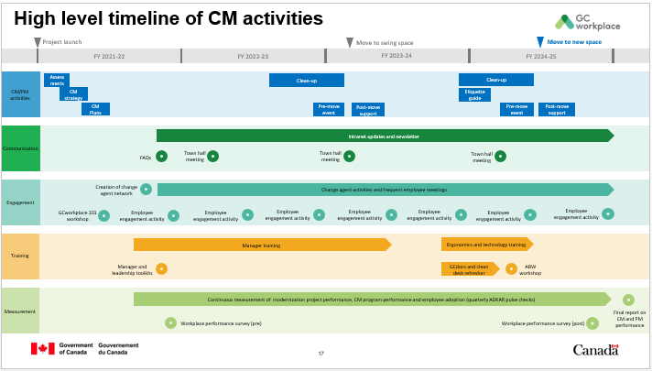
How will you be supported during this transition?
[Include a high level change management approach/program/strategy. Highlight some activities­. Refer to your change management strategy.]
Provide examples:
Explain what we expect from employees: to participate, rethink processes, ways of doing things, take time to learn new ways of working, adopt new IT tools and new processes, etc.
Explain that in order to ensure great employee experience, there will be various activities that will provide the employees with the knowledge and abilities they need to adopt the change.
EXAMPLE

Slide 11
How can you participate?
        Provide examples of areas in which employees will be asked to participate, to play a role, to be an ambassador, etc.
        Refer to your change management strategy. Examples:
        Employee committees
        Employee involvement activities (process mapping, tool naming, etc.)
        Preparation activities (as applicable)
        Etc.

Slide 12
Next steps
[Can include the following:­]
Next project steps (define what the next steps are)
What to expect in terms of engagement activities―when the next employee engagement session will be
Lookout for more information on intranet or web
Other
Recommendations
Have all of the shared information during this session available right after the session ends; either on a shared space or on an intranet page.
Provide key messages and high level project information to all managers so they can be well-equipped to answer questions that their employees might have. See example in IRCC CM Roadmap (i.e. toolkit).

Slide 13
Q&A
[If you wish to facilitate a Q&A session, you can use the Slido application for questions or the “raise your hand” function in MS Teams for those who wish to ask a question live to the audience.­]
There could be 2 options for the facilitation of this Q&A session:
Option 1: Pre-populated questions are being asked through Slido and the moderator can interpret the answers and provide more information (maybe by using the slides in the annex).
Option 2: Opening the floor to any questions thought Slido or via MS Teams being managed by the moderator. The moderator must manage the flow of questions and ask members of the leadership/project team to answer.
Recommendations
Distribute key messages ahead of time to all participating team members.
Prior to the session, define which members will answer which type of questions.
Be prepared to say “we don’t have the answer to that yet; however, we are taking note of it and will provide answers as they become available”.

Slide 14
Annex

Slide 15
GOOD PRACTICES to facilitate engagement sessions
LOGISTIC OF THE SESSION
Identify a moderator that will be able to interconnect the SMEs and the audience. The moderator can also ensure that the questions being asked are appropriate (in person or via a chat function). Remember, a great moderator facilitates the conversation, doesn’t join in or take over.
If the session is facilitated virtually, consider having a third person that will have the role of a “producer”. This person can manage the technical aspect of the session – technical issues reported by participants and facilitators, management of videos, survey platforms, etc.
Have a few questions prepared in case no one is asking questions
Organize a dry-run with the whole team and think about possible questions that may be asked
Think in advance of the likely questions that you’ll receive and give some quality time to considering how you’ll answer them. This is a great discipline as it’ll give you the chance to practice giving clear succinct answers. (There is nothing worse than an answer that turns into a presentation. Always remember to keep answers short and to the point.) The potential questions and answers can be provided before as well as key messages. Prep an answer for odd and inappropriate questions that allows both you and the asker to save face. For example, you might say, ‘That’s a great question and although I don’t feel it’s appropriate to answer at this time, I’d be happy to address it one-on-one after the session.’
For in-person or virtual session, make sure you have the right tools in place – microphone, chat function enabled, Q&A tools (see below), etc.
MANAGING THE SESSION
You might find that some audience members want to engage in a debate during these types of events, especially around controversial topics. The presenter and the moderator should avoid indulging in such debates during the session as they take up time and are often only interesting for the person debating. Instead, if you find that an intense discussion is starting, let the audience know that they can continue the discussion afterwards or give them a way to reach out to contact you after the presentation. This will help the session run more smoothly and without any drama.
When you receive challenging questions:
  Thank the person asking the question regardless. This is especially effective for neutralizing hostile questions posed because the asker is showing off. By thanking them for the new perspective, they’re providing and promising to look into their perspective in the future. This shows openness without giving up authority.
  If possible, pivot irrelevant questions toward something else that you want to address in your Q&A, but have not had a chance to. One technique for doing that is to rephrase the question: “If I understand right, the question is…” and then pivot toward the question you want to answer. Also, works for situations when you can’t quite hear the question, the asker has a strong accent, or you’re just not really sure what they’re asking.
Don't end the session with the Q&A. Because you don't know how it's going to go, open the Q&A after you're done with your last main point of the session. Put your closing remarks AFTER the Q&A. Whether you have one Q&A session at the end or intersperse questions, polling, and discussion, delivering your closing remarks after the Q&A reasserts your control of the information and allows you to underline the conclusions of the discussion. Just make sure to keep it short and direct!

Slide 16
GOOD PRACTICES to facilitate engagement sessions (cont.)
USING A SOFTWARE OR PLATFORM to gather feedbacks, questions, comments.
Use software that makes interacting with your audience, collecting and fielding questions, a cinch. Invest in tools that allow everyone to submit a question via their mobile devices where participant can share and engage with the organizer (Slido or Mentimeter, etc).
Use a software or application that will allow your audience to submit questions or answer a poll on their mobile devices. Free trial are often available or free subscription for basic licensing is also available. Otherwise, the organization could also invest into those tools which will also be useful throughout the project to consult and engage with employees. The benefits to engagement are huge. Because these systems allow your audience to answer a question in real time, you can poll your audience and show them the results, sparking true conversation and idea-building.
You can deploy questions before, during, and after your talk to create a feedback system that will deliver maximum insight and exchange for you and your audience. You can:
  Ask your audience to submit their questions ahead of time. Although you’ll get some unrelated questions, this is a great way to go outside your own head and really figure out what your audience wants to know.
  Allow your audience to vote on the submitted questions. By letting people to vote their favorites, you will end up with a list of priority questions ahead of time.
  Rewrite two or three of the submitted questions as a multiple-choice poll; administer the polls in the beginning and middle of your talk.
The result will be a more democratic, open discussion that will keep your audience fully engaged through the entire presentation period. Most experts agree that the average human will start tuning out after a maximum of 20 minutes; even the most talented speakers will lose their audience for chunks of time. On the other hand, reorganizing your presentation so that it is punctuated by shorter Q&A sessions and group discussions following strategic polling will keep your audience on their toes the entire time!

