Slide 1
Lyndsey Rolheiser, PhD Assistant Professor of Urban and Real Estate Economics Schulich School of Business York University
Bio
Dr. Rolheiser’s research is concerned with how spatial relationships within communities inform and are in turn informed by the built environment. Her diverse training in urban and real estate economics, planning, local public finance, and urban policy allows for the exploration of urban complexities using a variety of methodologies and tools—from planning and economic theory to econometric analysis, GIS, and qualitative methods. Dr. Rolheiser received a PhD in Urban Economics from MIT, an MA in Economics from Simon Fraser University, and a BSc in Mathematics from the University of Alberta.

Slide 2
Real estate as infrastructure in the face of climate change
air pollution (PM_{2.5} and wildfire smoke):
worker health and productivity decline with exposure
firm revenues and employment count decline with exposure
firm exits increase with exposure
office building rents and values decline with exposure
BUT mitigated by building quality!
More attention needed in the space of climate adaptation for commercial real estate
Lack of access to Canadian commercial real estate data limit similar research in the Canadian context

Slide 3
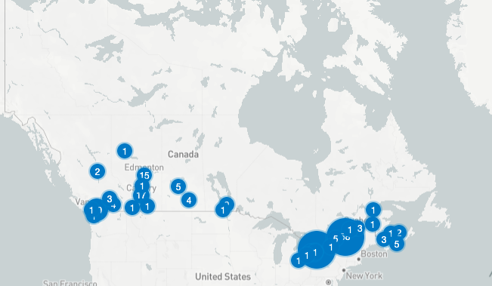
Data Centres as Infrastructure?
New form of infrastructure necessary for digital economy, but requires significant infrastructure capacity for their own operation
Currently 294 data centres across 34 markets in Canada (and growing!)
Governments of all levels keen on attracting capital for these projects (new Minister of AI…)
BUT need transparency AND DATA on pros/cons on the impact on existing infrastructure networks (water, electricity)
Need significant coordination across provinces for robust data collection

Slide 4
Private Investment in Canadian Infrastructure
Quick Facts
Canadian infrastructure market size: $160.99USD
63.5% public investment, 36.6% private investment
11% (of $2.4 trillion) of Maple 8 (Canadian Pension funds) investments in infrastructure
ONLY 7% of this 11% (0.77% of $2.4 trillion) in Canadian infrastructure
Private capital is needed to overcome lack of significant infrastructure investment in past decades, govt cannot go it alone
https://www.mordorintelligence.com/industry-reports/infrastructure-sector-in-canada
https://www.pensionsage.com/pages/DigitalEditions/october_2024/pa_october2024_digi-edition.pdf
https://www.macquarie.com/jp/en/about/company/macquarie-asset-management/institutional-investor/insights/infrastructure-portfolio-allocation.html

Slide 5
Private Investment in Canadian Infrastructure
Canadian institutional investors are leading globally in infrastructure investment but limiting investment in Canada, why?
Need diversification and secure long-term payouts
Prefer large investments to small investments
Historically, Canadian projects have generally been small in comparison to global projects
How to attract private investment?
Bundling/aggregation of projects and larger-scale projects in general
Airports — Maple 8 keen on investing in airports
Role for govt as enabler: support, subsidies, guarantees, regulation certainty, etc.

Slide 6
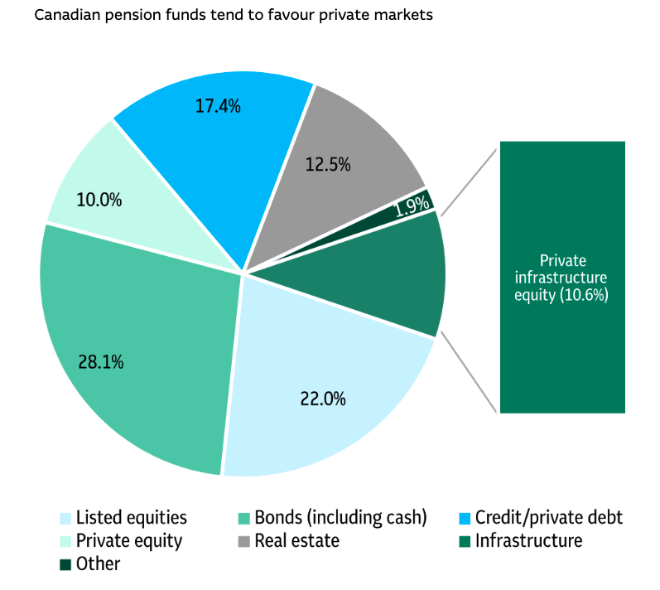
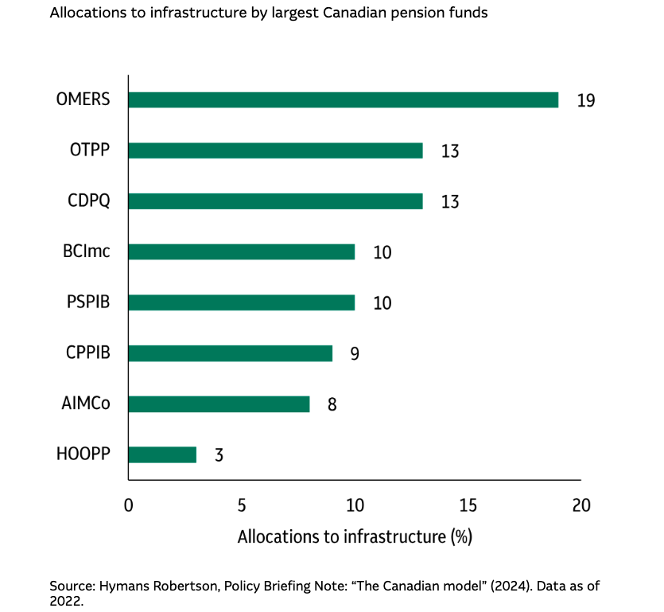
https://www.macquarie.com/jp/en/about/company/macquarie-asset-management/institutional-investor/insights/infrastructure-portfolio-allocation.html

