Slide 1
GCworkplace Demystified
Addressing common misconceptions and concerns
Date: May 2022

Slide 2
Common misconceptions

Slide 3
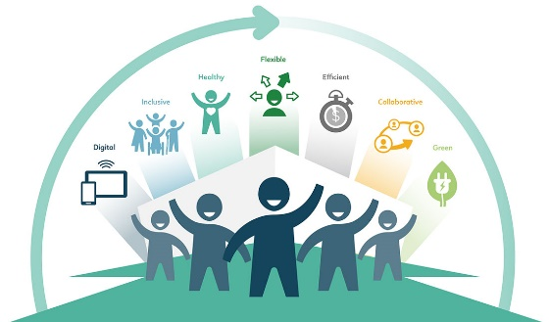
GCworkplace is a space reduction initiative
The Space allocation standards (which aims to describe the maximum space allocations to be applied when planning, acquiring and monitoring use of office accommodation provided by PSPC to client departments) has not changed; therefore, space is allocated following the same calculations as with the previous standards.
GCworkplace is not a space reduction initiative, but rather a space optimization solution.
Federal workplaces are occupied at an average of 60% on any day, because employees are away for various reasons. In an unassigned work environment where all employees have equal access to various workpoints, the ratio of individual workpoints can be reduced, therefore allowing for additional amenities that support the type of work performed by its occupants. This translates to a more efficient use of the space as well as provides employees more spaces, and a greater variety from which to accomplish their activities.
Notes:
YOUTUBE: GC employees present GCworkplace! https://www.youtube.com/watch?v=97KyQ2b9Hc4&list=PL5gT_sS8PEiWo4pOSWvcyh-LGPOz296qR&index=3&t=0s

Slide 4
Telework is a requirement of GCworkplace
Flexible or remote work forms part of the GCworkplace vision, but it is not a prerequisite for the space to function.
GCworkplace was defined well before the pandemic, when telework was not widely adopted by all organizations.
Sharing of workpoints, or an unassigned workplace model is not contingent on telework as the workplace is adequately sized and designed to accommodate all occupants. Sharing workpoints amongst users allows for optimized use of space and leveraging underutilized space to give back more practical amenities for the organization.
There are three activity profiles in the GCworkplace design: autonomous, balanced and interactive. The autonomous profile is designed for organizations who work primarily independently, and have low internal and external mobility, due to specific functions and operations that can only be done onsite.
Notes:
YOUTUBE: What’s an activity-based working environment? GCworkplace is the modern vision for the renewed public service, one that embraces innovation, transformation, and continuous renewal. Watch the animated infographic about activity-based working, an innovative workplace solution that supports a high performing public service.
https://www.youtube.com/watch?v=0lB-5zv93Oc&list=PL5gT_sS8PEiWo4pOSWvcyh-LGPOz296qR&index=3
STATISTICS: Workplace performance pre-occupancy survey data includes responses from 30 projects for a total of 2,247 respondents. Workplace performance post-occupancy survey data includes responses from 11 projects for a total of 816 respondents.

Slide 5
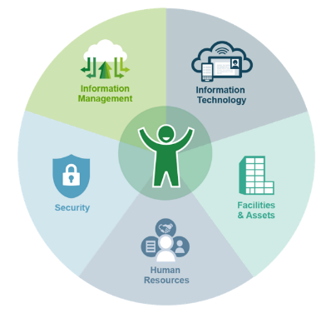
The GCworkplace design solution is only about shared seating
The GCworkplace vision and the activity-based working (ABW) design solution implies that employees move away from a fixed point and choose the optimal setting based on their work activities, their personal preferences and workstyles. For most, the work day is comprised of a number of different activities that can be best supported by different workpoints.
GCworkplace is about more than just new workspaces and new furniture; it’s about designing spaces to support all work activities as well as the new ways of working in a modern and flexible environment, and making sure all GC employees are supported by the right spaces, tools and processes.
Notes:
YOUTUBE: What’s an activity-based working environment? GCworkplace is a modern vision for the renewed public service, one that embraces innovation, transformation, and continuous renewal. Watch the animated infographic about activity-based working, an innovative workplace solution that supports a high performing public service. https://www.youtube.com/watch?v=0lB-5zv93Oc&list=PL5gT_sS8PEiWo4pOSWvcyh-LGPOz296qR&index=3

Slide 6
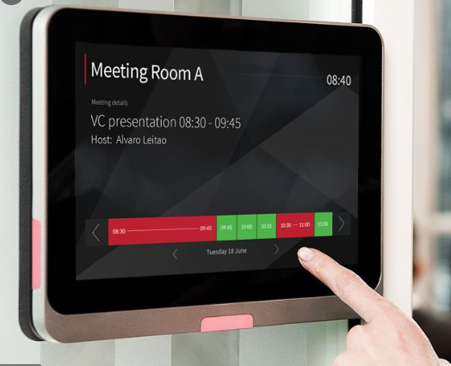
Employees are required to relocate often during the workday
There are varying business rules and protocols established by organizations working in a GCworkplace. It is up to the organization to establish these protocols.
Employees can select a workpoint and remain there for the day or move from one setting to another to accommodate their activities (phone call in a Focus Room, informal chat in a Huddle, responding to emails in the Lounge, etc). This flexibility suits different workstyle preferences and states of mind. Both of these contribute to productivity. Some may even reserve workpoints for long durations if it makes sense operationally and the organization has established this protocol.
Selection and reservation of workpoints is at the discretion of the organization and should reflect the group’s functional requirements while allowing variety for individual preferences.
The type of workpoint and the work zone an employee chooses sends a signal to colleagues about the level of focus he or she requires; someone working in the Quiet Zone is likely focusing and does not want to be interrupted, whereas someone working in the Collaborative Zone would likely welcome ad hoc interactions. Communications and change management also play an important role in making these new workplaces work.
Notes:
YOUTUBE: What’s an activity-based working environment? GCworkplace is the modern vision for the renewed public service, one that embraces innovation, transformation, and continuous renewal. Watch the animated infographic about activity-based working environment, an innovative workplace solution that supports a high performing public service.
https://www.youtube.com/watch?v=0lB-5zv93Oc&list=PL5gT_sS8PEiWo4pOSWvcyh-LGPOz296qR&index=3
STATISTICS: Workplace performance post-occupancy survey data includes responses from 11 projects for a total of 816 respondents.
The data collected after a modernization project via a survey shows that 73% of the respondents agree that their new workspace is more effective.
After moving into an ABW environment, 67% of the respondents find it easy to set up and take down a workpoint every day.

Slide 7
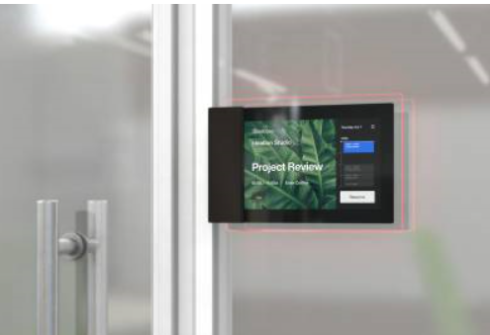
Employees are required to get in early if they want to have a desk
In a GCworkplace, there are typically approximately two workpoints per occupant, meaning that even on the rare occurrence of the workplace being full to capacity, there would never be a shortage of workpoints.
GCworkplace is flexible and can adapt to changing needs; if certain workpoints are needed more than others over time, the space design can be modified to reflect these new requirements.
Large workplaces can be divided into neighborhoods to situate certain groups or functions together. This allows users more opportunities to work amongst their colleagues and any specialized equipment/workpoint that they may need to access regularly.
A booking systems can be implemented to offer the ability to reserve a workpoint prior to arriving at the workplace to secure a preferred workpoint. These booking systems also provide visual indicators of which workpoints are available for ad hoc usage.
Notes:
YOUTUBE: GCworkplace–A guided tour: The GCworkplace’s unique style is in full display. Follow PSPC Real Property Services’ Assistant Deputy Minister, Kevin Radford, and Associate Assistant Deputy Minister, Michael Mills, as they explain how they changed the way they work at Portage III: https://www.youtube.com/watch?v=evQ0wb2wtXE&list=PL5gT_sS8PEiWo4pOSWvcyh-LGPOz296qR&index=5
STATISTICS: Workplace performance post-occupancy survey data includes responses from 11 projects for a total of 816 respondents.

Slide 8
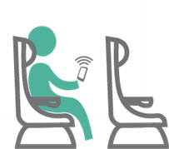
Managers can’t supervise their employees if they can’t see them
Technology challenges traditional ways of working and managing people. With modern tools and a culture of trust and open communication, employees are empowered to decide where and how they feel most productive. Now more than ever, employee performance and productivity should not be measured on physical presence but rather on results.
Trust is an important part of the GCworkplace vision. Management understands that employees can choose where, when and how to work.
Trainings and tools are available to support managers and supervisors as the ways we work are changing.
Here are some available tools:
http://www.gcpedia.gc.ca/wiki/GCworkplace/Resources
http://www.gcpedia.gc.ca/wiki/GCWorkplace_Change_Management_Playbook
https://www.gcpedia.gc.ca/wiki/Gcworkplace_Academy
Notes:
Here are some examples online courses for manager that might be helpful:
https://learn-apprendre.csps-efpc.gc.ca/application/en/content/performance-management-government-canada-g140
https://learn-apprendre.csps-efpc.gc.ca/application/en/content/creating-plan-performance-management-g014
https://learn-apprendre.csps-efpc.gc.ca/application/en/content/leading-teams-managing-virtual-teams-x027
http://www.gcpedia.gc.ca/wiki/Virtual_Web_Meeting_Tips,_Tricks_and_Best_Practices
https://gcconnex.gc.ca/groups/profile/7514834/ssc-virtual-management-la-gestion-virtuelle-a-spc?language=en
http://www.tbs-sct.gc.ca/pol/doc-eng.aspx?id=27146

Slide 9
GCworkplace is an open workplace concept and no one gets an office
A GCworkplace offers MORE enclosed workpoints than Workplace 2.0. All workpoints are shared, so everyone has access to an office.
A GCworkplace provides enclosed spaces such as focus rooms and phonebooths near a quiet zone to encourage people to take phone calls away from open individual workpoints.
All employees need privacy. Privacy is achieved by managing acoustics in open areas and providing ample open AND enclosed individual workpoints.
Individual enclosed workpoints take into account the number of employees who regularly require an individual enclosed space to support their primary function and with sufficient additional enclosed individual workpoints to support the intermittent needs for privacy and focus work of the entire population.
Enclosed individual workpoints provide the greatest level of privacy, and are best suited for highly focused work or for work by individuals with individual accommodations.

Slide 10
A GCworkplace design is only focused on collaboration
It is recognized that federal organizations all work differently, which is why the GCworkplace design is not a one-size-fits-all concept. For this purpose, the GCworkplace design provides three activity profiles: autonomous, balanced and interactive. The autonomous profile is designed for organizations who work primarily independently and have lower levels of collaboration. This profile would offer a high ratio of individual workpoints such as focus rooms and workstations, and a lower ratio of collaborative workpoints such as teaming areas and meeting rooms.
The GCworkplace design includes three functional zones: quiet, transitional and interactive. The quiet zone is designed to support individual, focus work and the interactive zone promotes collaboration. With the autonomous profile, the quiet zone is typically the most prevalent area in the workplace.

Slide 11
Concerns

Slide 12
Executives need an enclosed office
Enclosed offices or what we now call focus rooms are provided in GCworkplace. These rooms can be built for acoustic and visual privacy if needed.
Having shared focus rooms ensures EVERYONE has access to private space when they need it, regardless of rank or title.
Focus rooms can be designed to suit the activities they will support―perhaps a larger layout space is required? Or a specific configuration would be beneficial?
Since the administrative staff works in parallel with the executive, there is a misconception that they must have assigned workspaces. In fact, because of the nature of their work, an executive spends most of the time outside of the office, being in a meeting, visiting other workplaces, or traveling for business. This unutilized space results in a loss of space since other employees could benefit from this enclosed office, as well as the workstation that would be unoccupied by its administrative staff. In addition, the executives and their administrative staff should also be able to benefit from this new way of working, like every other public servant. Largely because of their mobility, they are the first to benefit from having the possibility to work remotely by using the right tools such as electronic document management and virtual meetings.
Notes:
YOUTUBE: GCworkplace–A guided tour: The GCworkplace’s unique style is in full display. Follow PSPC Real Property Services’ Assistant Deputy Minister, Kevin Radford, and Associate Assistant Deputy Minister, Michael Mills, as they explain how they changed the way they work at Portage III: https://www.youtube.com/watch?v=evQ0wb2wtXE&list=PL5gT_sS8PEiWo4pOSWvcyh-LGPOz296qR&index=5

Slide 13
Heavy reliance on paper files
Filing is still permitted and available in GCworkplace; there are no restrictions to filing capacities.
Clean desk procedures are at the discretion of the organization and should reflect the requirements of employees, and the work they perform. Therefore, the need to clear a workspace at the end of the day is not always required. Organizations establish these protocols to align with their business requirements.
Workpoints, such as focus rooms, can be made available to book for a period of time, whether it be an hour, a day or weeks. Files or equipment can remain in place during the entire reservation period.

Slide 14
Complexities of focus work
Several organizations that perform complex focus work have modernized their workplaces to GCworkplace, such as Shared Services Canada, Communications; Public Services and Procurement Canada (PSPC), Translation Bureau; Natural Sciences and Engineering Research Council of Canada; and PSPC, Real Property Services (RPS), Human Resources. Many of these teams also work with secure documents regularly.
Many executives at PSPC RPS, such as DGs (EX-03), AADMs (EX-04) and ADM (EX-05), are now successfully working in GCworkplace environments at Place du Portage where they have no assigned enclosed offices.
Providing a variety of workpoint types, zoned by noise level, allows users to self-select the workpoing type in the zone that best supports their specific task, their personal preferences and abilities, as well as their current state of mind. For some, focusing requires visual and acoustical privacy, others prefer constant ambient noise and being around the ‘hustle and bustle’ and for some it’s anywhere in between and changes every day.
Notes:
PSPC Real Property Services’ former Assistant Deputy Minister, Kevin Radford, and Associate Assistant Deputy Minister, Michael Mills, as they explain how they changed the way they work at Portage III.
https://www.youtube.com/watch?v=evQ0wb2wtXE&list=PL5gT_sS8PEiWo4pOSWvcyh-LGPOz296qR&index=5

Slide 15
Employee wellbeing
The variety of workpoints and the ability to chose a preferred setting empowers employees and provides control over their work experience. This empowerment has shown to contribute to productivity and wellbeing in the workplace.
Allowing employees the choice of workpoint can also alleviate stress and stigma pertaining to special needs or preferences.
The type of workpoint and the work zone an employee chooses send a signal to colleagues about the level of focus he or she requires, which can alleviate stress and disruptions.
As both mental and physical health are important topics for the Government of Canada, a well-designed and comfortable workplace that encourages social connections, provides places of respite and opportunities to choose the best work environment, is a positive step toward keeping employees mentally and physically healthy.

Slide 16
Government of Canada priorities‒Inclusivity and accessibility
PSPC AMWS produced a GBA+ on the GCworkplace design in August 2019. (Full report can be shared)
GCworkplace provides users with full control over the work settings that best suit their personal and functional needs. This creates an accessible and inclusive environment while responding to the need for diversity by giving variety and choice.
Circulation areas can be increased because there is no longer a need to densify the workplace and ensure one dedicated workpoint per employee regardless of mobility (telework) patterns.
Accessibility is a priority for federal workplace design and is embedded in all strategies and specifications of the GCworkplace Design Guide. The PSPC Accommodation Management and Workplace Solutions team works closely with the PSPC RPS Office of Accessibility in the Built Environment in the development and continuous improvement of the GCworkplace Design Guide.
Notes:
GCworkplace is not a space reduction initiative, but rather a space optimization solution. The Space Allocation Standard has not changed (washrooms are not counted in useable space, but rather rentable).

Slide 17
For questions or comments, please write to:
Accommodation Management and Workplace Solutions
TPSGC.SIMilieudeTravailGC-RPSGCWorkplace.PWGSC@tpsgc-pwgsc.gc.ca

