Slide 1
Learning Hub
Short Presentation – 152
Protecting Digital Privacy
Notes:
Welcome to the presentation on protecting digital privacy!

Slide 2
Presentation Outline
Part 1 – Digital Identities and Online Compromise
Part 2 – Digital Profiles, Fingerprints and Tech Giants
Part 3 – Best Practices
Part 4 – Case studies

Slide 3
Part 1 – Digital Identities and Online Compromise
What is a digital identity?
Impact of compromised email account
Indirect targeting and opportunistic hackers
Notes:
<Insert the module description from the LNA.>
Note for the Learning Advisor:
-If you only have 1 objective, write a sentence.
-If you have more than 1 objective, use a bulleted list.
-In both cases, write your objectives according to Bloom’s Taxonomy (measurable objectives).

Slide 4
Digital Identity
Email accounts and cell phone numbers are routinely used to:
Represent our identity (account creation, communication)
Confirm our identity (email confirmation, password reset)
Communicate with us (alerts, ads)
Engage in private communications (family, friends, coworkers)
Perform transactions
Notes:
This is meant to explain that our email addresses and cell phone numbers are closely tied with our online identity. We will often receive sensitive information through it, therefore in the event of a compromise, a breach can not only expose our contacts and habits, but can be used to create, validate and even reset passwords of existing accounts. Emails are highly valued by identity thieves for all of these reasons.
When we hear about breaches, such as the disclosure of an email address in relation to other identifiable information, it can be seen as damaging even if the passwords were not disclosed directly.

Slide 5
Impact of compromised account
In the hands of malicious actors, our digital identity can be used to:
Create new accounts online
Reset passwords of existing accounts
Scam/hack our contacts
Expose our habits, location, behaviours
Disclose personal and private data
Lock us out of our recovery tools
Notes:
Having access to our email account alone, allows malicious actors to achieve a number of goals. Everything in the account can be used to perpetrate the compromise. For example, by simply looking at a history of emails, a very precise profile can likely be created that contains contacts, locations, private documents, mannerisms, and more.
Use the example of the John Brennan email compromise: https://motherboard.vice.com/en_us/article/qkjbvw/john-brennan-aol-email-hack-60-minutes-no-ones-emails-are-safe
FROM Homework slide
Deactivate unused email addresses
Clean and delete old emails
Do not use a work email address for personal purposes
Do not use a personal email address for work purposes
Mitigate risk at every stage:
Prevention – Detection – Containment – Eradication – Recovery
Know how to recover a compromised account (for example Gmail):
https://support.google.com/accounts/answer/6294825?hl=en
Consider both security and privacy in your choice of email provider

Slide 6
Account Compromise
Online service providers are breached almost daily and can affect up to billions of accounts at once
Accounts are not targeted but mass-compromised and breaches can propagate to other accounts
A forgotten account might expose critical information, and every account is a potential point of entry
Security mechanisms are often very poor and password weakness (simple/common/reused) is a vulnerability
Compromises can expose security questions or password hints, or even the plaintext passwords
Notes:
We cannot directly protect our information when it is stored on the online service provider’s infrastructure. However, good cyber hygiene can go a long way in mitigating the impact of a potential compromise.

Slide 7
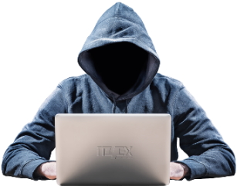
Online Service Compromise
Server A
Email
Password
Security questions
IP Addresses
Financial data
Private data
Server B
Notes:
This is to introduce the concept of a server breach, a compromise to a service provider and what it could mean. Details are not needed here as they will be detailed in further slides. Introduce the concept that there have been a lot of breaches accumulated over the years and this provides some intel to cyber criminals. It is a tie-in to the previous exercise where haveibeenpwned allows to consult some information of prior breaches to our accounts.

Slide 8
Part 2 – Digital Profiles, Fingerprints and Tech Giants
Digital profiles and digital fingerprints
Large scale data gathering and user tracking
Monetization of private information
Privacy legislation
Notes:
<Insert the module description from the LNA.>
Note for the Learning Advisor:
-If you only have 1 objective, write a sentence.
-If you have more than 1 objective, use a bulleted list.
-In both cases, write your objectives according to Bloom’s Taxonomy (measurable objectives).

Slide 9
Definitions and Context
Digital profile – A distinct set of characteristics associated with an individual user of an online service
Accumulated data is linked to the profile, tailored, packaged and sold over and over
Digital fingerprint – Even when not logged in to an account, a fingerprint can be generated and tracked from browsing and online activity
The fingerprint is linked to information including IP address, browser and operating system information, time zone and languages among others
Information is collected via cookies and tracking scripts among others
“You are not the client, you are the product”
Notes:
Who else might also be able to access this information? Governments? Threat actors?
Short case study – Social Media breach with country code and user verification. Low risk in Canada but different in a different country and context
Among others – tracking pixels, host based info

Slide 10
What is in a Digital Profile or Fingerprint?
Profiles and fingerprints assemble valuable personal information including your:
appearance: voice, race, appearance, all biometrics
health: dietary restrictions, fitness level or goals, health concerns
financial situation: career goals, wealth, investment goals
current concerns: pregnancy, travel, home ownership
interests: hobbies, products owned or desired, topics
social connections: family, friends, gatherings, upcoming plans, appointments
Notes:
Political inclinations: activism, political party affiliation and more…
In regards to the Cambridge Analytica scandal, Facebook sent a message to those users believed to be affected, saying the information likely included one's "public profile, page likes, birthday and current city".^{[13]} Some of the app's users gave the app permission to access their News Feed, timeline, and messages.^{[14]} The data was detailed enough for Cambridge Analytica to create psychographic profiles of the subjects of the data.^{[8]} The data also included the locations of each person.^{[8]} For a given political campaign, the data was detailed enough to create a profile which suggested what kind of advertisement would be most effective to persuade a particular person in a particular location for some political event.
The Netflix film “The Great Hack” is very interesting and goes in to some detail on this subject.
The value of personal information is not always obvious. There have been breaches involving only country location, which at first glance did not appear valuable or sensitive, but in the hands of a state that is looking to identify dissenters, it could be tremendously valuable and dangerous.

Slide 11
Data Gathering and Aggregation
Running App
Wearable Data
Recipe Sites
Fitness Level / Goals
GPS
Calendar
Text/ Email
Relations
Books
Shopping
Likes
Interests
Notes:
Data aggregation is accomplished by combining multiple sources of information and painting a clear portrait of a user’s behaviour. Wearable apps, social media platforms, browsers, search engines, geo-location data, along with data obtained from friends, family, co-workers, and others provide the data.
Examples:
Tech giant purchasing a fitness tracker/app company which lets them collect further data about their customers.
Facebook users that installed the app “This is your digital life” allowed it to collect their data. The app also collected data from their Facebook friends without their consent.

Slide 12
Filter Bubble
Browsing is filtered: websites tailor content
search results, ads, discussions, headlines, political messages
Based on the user’s digital profile or fingerprint
Creates a state of intellectual isolation in one’s cultural or ideological bubbles (echo chamber)
Prime examples:
Google Personalized Search results
Facebook personalized news-stream
Discount variation based on profile
Debatable impact on social discourse
Notes:
https://en.wikipedia.org/wiki/Filter_bubble
https://fs.blog/2017/07/filter-bubbles/
https://www.techopedia.com/definition/28556/filter-bubble
https://www.cbc.ca/radio/thesundayedition/social-media-bubbles-dyson-on-race-one-child-policy-til-grey-do-us-part-1.3949841/the-democratic-promise-of-social-media-has-been-killed-by-the-bubble-michael-s-essay-1.3949844

Slide 13
Utility vs Privacy
Online service offerings are robust, with the payment for services often being our personal data
The relationship is entered by agreeing to “Terms of service” and “Privacy policy”
The clients for the providers are: advertisers, marketing firms, …
Service providers have access to private data:
What are the terms of service?
Which third-party will have access to this data?
Is the data anonymized?
How long is it kept for?
Notes:
Security and privacy are different concepts
Security: protecting against unauthorized access to data
Privacy: limiting the access of private data to agreed upon usage
The objective of this workshop is not to scare you away from service providers, social media, or the use of technology. There are very solid arguments to defend that these services do make our lives better, enriched, and even indispensable in this day and age. Advocating to stay away from online banking, shopping, or even using email is not justified.
The goal of this workshop is to learn about measures that can reduce the risk, make it more enjoyable to use and make the most of these services.
The specific concern of the workshop is the potential impact on privacy when using online services.

Slide 14
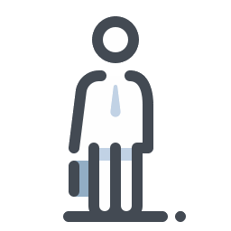
Google Ad Exchange
8.4M websites
Bidding
Online profile
Age
Income
Hobbies
Political inclination
Health issues
Religion
IP address
Coordinates
Advertising ID
…
Advertisers
Ad
Source: Google Ad Exchange in data privacy probe. Naked Security by SOPHOS. May 24, 2019.
Source: Brave uncovers Google's GDPR workaround. Brave. September 4, 2019.
Notes:
Earlier example is Target – Pregnant teen, ads served to household. Father contacted company who said the algorithm selected ads for pregnancy related products base on other searches from the household (IP address).
The Google Ad Exchange program (which goes by several names) is a grey area at best in the field of advertising. When a blogger, website, whichever wants to get ad revenue, they can approach Google Ad Exchange to rent an ad spot on their page. When someone accesses the page, the previously mentioned methods of identification allow Google to immediately know “everything” about that person. This information is submitted to advertisers in a real-time bidding to determine who will win the ad spot and drop an ad to the user. There is no agreement between the user and the website or Google onto how the personal data is gathered, used, propagated, etc. Plus, there is an added risk related to the type of ad. Some malicious actors have used compromised ad content to disseminate attacks in the past. Anybody can buy ad space.

Slide 15
Risks Involving Personal Information Online
Digital profile and digital fingerprint information is gathered from:
what you post and what others post about you on social media, photo sharing sites, forums, blogs, and news sites
your online account activity and shopping data
your browsing habits
This personal information is very valuable to:
companies (tech giants) that create and use profiles to sell ad space
advertisers who are targeting potential customers
threat actors who want to use the information to craft targeted social engineering attacks or use the platform to launch attacks, manipulate people and spread misinformation
Notes:
What happens when things go wrong (breach)?
What about lawful access? The risk is not just advertising and hacking, there is also concerns about privacy breaches and access by third party organizations.
Mention Cambridge Analytica – Political manipulation
Short case study – Social Media breach with country code and user verification. Low risk in Canada but different in a different country and context
To make a point about the value of data, ask the question: Which companies are most valuable today? Among them are Facebook, Google and Amazon. The fact that they can get so much income by selling our private data, is a good indicator that we do not get enough out of the services that they provide. Our data is more valuable that we assume it is.
Note these are US based, which in comparison to Europe, Canada, Oceania - has less that legislatively impedes organizations from collecting personal information.

Slide 16
Privacy Legislation
Personal Information Protection and Electronic Documents Act (PIPEDA)
Canadian federal private-sector privacy law
Uses principles such as consent, limiting collection, safeguards and access
Amended in 2018 to impose data breach notifications
New legislation tabled in Parliament includes new fines and controls
Some provinces have private sector privacy legislation and governments (federal, provincial, and municipal) are also subject to their own privacy laws
Source: Bill C-11. Canada's System of Justice. December 2, 2020.
Reference: Office of the Privacy Commissioner of Canada. August 16, 2022.
Notes:
Bring up GDPR (cookies notices, fines up to 4% of global revenue) and the absence of US federal privacy legislation.
The tech-giant business model is known: provide free services (browsers, email clients, social media accounts, music, movies, etc.) that users willingly install, wear, use, after agreeing to a very lengthy and wordy privacy policy that no one reads. Nothing is directly illegal and the goal is to harvest data to sell back at whoever wants to buy.
Governments are realizing the potential impact and starting to react. Many big events of recent years are widely believed to have been shaped by social media and privacy invasion: US presidential election, Brexit, fake news rise, etc. New regulations are aiming to curb the reach that tech giants have into private information and hold them responsible for how that information is collected, used, disseminated, archived, and destroyed.

Slide 17
Part 3 – Best Practices
Online account best practices
Social media best practices
Online browsing best practices
Privacy enhancing technologies
Notes:
<Insert the module description from the LNA.>
Note for the Learning Advisor:
-If you only have 1 objective, write a sentence.
-If you have more than 1 objective, use a bulleted list.
-In both cases, write your objectives according to Bloom’s Taxonomy (measurable objectives).

Slide 18
Online Account Best Practices
Delete unused accounts (when possible)
Use the “assumed compromise” approach
Use strong, unpredictable and unique passwords for each account
Treat security questions/password hints as if they were passwords
In the event of a compromise, modify password immediately
Notes:
Reduce the exposure, reduce the possibility of cracking/guessing passwords to your accounts, avoid propagation of compromise and react quickly to limit the damage.
From EXERCISE and HOMEWORK slides and from deleted AUTHENTICATION module
Go to the website https://backgroundchecks.org/justdeleteme/ and pinpoint services where you have registered an account
Spot which of these services are flagged as “HARD” (in red) or “IMPOSSIBLE” (in black) to delete
Look at the information on how to manage the anonymity of an “impossible” to delete account, e.g. “Bodybuilding”
Reduce your online exposure:
Delete – Deactivate – Obfuscate – Check settings – Use alternatives
Review the account deactivation / deletion procedures
Consider using “burner” email addresses
Use strong, random, unique passwords for each account
Look at the advice and guidance available from the Cyber Centre and the GetCyberSafe campaign
Enhance protection of passwords:
Use a strong, random, unique password for each account
Keep an offline encrypted copy of passwords
Use 2FA to secure vault access
Use 2FA on a per account basis (Facebook, LinkedIn, Google, …)
Integrate Universal Second Factor (U2F)

Slide 19
Social Media Best Practices
Review and apply security and privacy options on your account
Use a unique password for every account
Be careful when accessing unknown website links or attachments
Be wary of potential misinformation, social engineering, and fraud
Reference: Use of personal social media in the workplace (ITSAP.00.066), Canadian Centre for Cyber Security, March 2019.
Notes:
Often there are controls for managing privacy in a variety of ways.
You can likely look up and learn how to:
Change default privacy settings
Limit who can see a post or a photo
Tag and de-tag a post or a photo
Report someone else’s post or photo to the people who run the site and
Block someone from contacting you
If you have the time/opportunity: Review your account’s website security and privacy policies regularly for changes

Slide 20
Social Media Best Practices (continued)
Be careful about what you share online; minimize your social media presence
Think before you link; know who you are connecting with
Personal information is valuable; it shouldn’t be given out freely
Many apps and websites track a user's internet use and location
Information that is posted online can be around for a long time and can be copied and seen by anyone
Prior to posting, ask yourself:
Is this how I want people to see me?
Could somebody use this to hurt me if they wanted to?
What’s the worst thing that could happen if I shared this?
Reference: Digital Citizenship - Guide for Parents. Media Smarts. 2017.
Reference: US DoD Identity Awareness, Protection and Management Guide. U.S. Department Of Defense. March 2021.
Notes:
This link for families from media smarts:
https://mediasmarts.ca/sites/mediasmarts/files/guides/digital-citizenship-guide.pdf
And this link from media smarts:
https://www.youtube.com/watch?v=W726-whX33c

Slide 21
Online Browsing Best Practices
Keep your browser up-to-date
Find a tutorial on adjusting the permissions, privacy settings and security settings of your browser, apps and online services
Turn off the ‘Remember Me’ feature on websites and disable autofill
Delete unused accounts (when possible)
Reference: Securing Your Web Browser. Cybersecurity & Infrastructure Security Agency. September 8, 2015.
Reference: Just delete me. Background Checks.
Notes:
Instructor can open browser and show to administer privacy and security settings.
Ask applicants what brower they are using. Open a dialogue. Find a tutorial.
How safe do you feel with your current settings?
You don’t have to do these exercises often, they should remain effective for some time.
Ask if the changes impact what you are trying to do. Does making these change impact you negatively all that much?
Applicable to both browser on laptop/computer and browsing on mobile devices (phones and tablets).

Slide 22
Privacy Enhancing Technologies
Privacy Enhancing Technologies (PETs) can help users minimize the data collected about them, understand how their information is used and where it goes, increase their anonymity and better control their personal information
Some examples include:
ad blockers and tracker blockers which can analyze and block cookies and scripts that may collect information about your browsing
privacy-focused browsers and search engines that may limit tracking and provide more security and privacy features
“privacy” mode and “do-not-track” features in a browser that may limit how much information it collects and stores
Virtual Private Networks (VPNs) which encrypt data you send and receive online
Notes:
Tracking and fingerprinting cannot be prevented when you log on to a website using a registered account. Your information will be collected and maintained server-side.
Applicable to both browser on laptop/computer and browsing on mobile devices (phones and tablets).
This link for families from media smarts:
https://mediasmarts.ca/sites/mediasmarts/files/guides/digital-citizenship-guide.pdf
And this link from media smarts:
https://www.youtube.com/watch?v=W726-whX33c

Slide 23
CIRA Canadian Shield
CIRA Canadian Shield is a public DNS resolver
When resolving, it checks to see if the site is malicious based on threat intelligence
It blocks known online scam sites in addition to malware and phishing, and sites with a high likelihood of being fraudulent
Available as a router configuration, device configuration, mobile app and browser extensions
Reference: CIRA Canadian Shield
Notes:
The CIRA organization is a non-profit that does a lot for the Canadian internet community. They partner with CCCS on some tools and programs. And register .ca domain names.

Slide 24
Part 4 – Case Studies
Facial Recognition
Cell Phone Tracking
Location Tracking
Notes:
This module looks at 3 different cases of privacy concerns from emerging and existing tech.

Slide 25
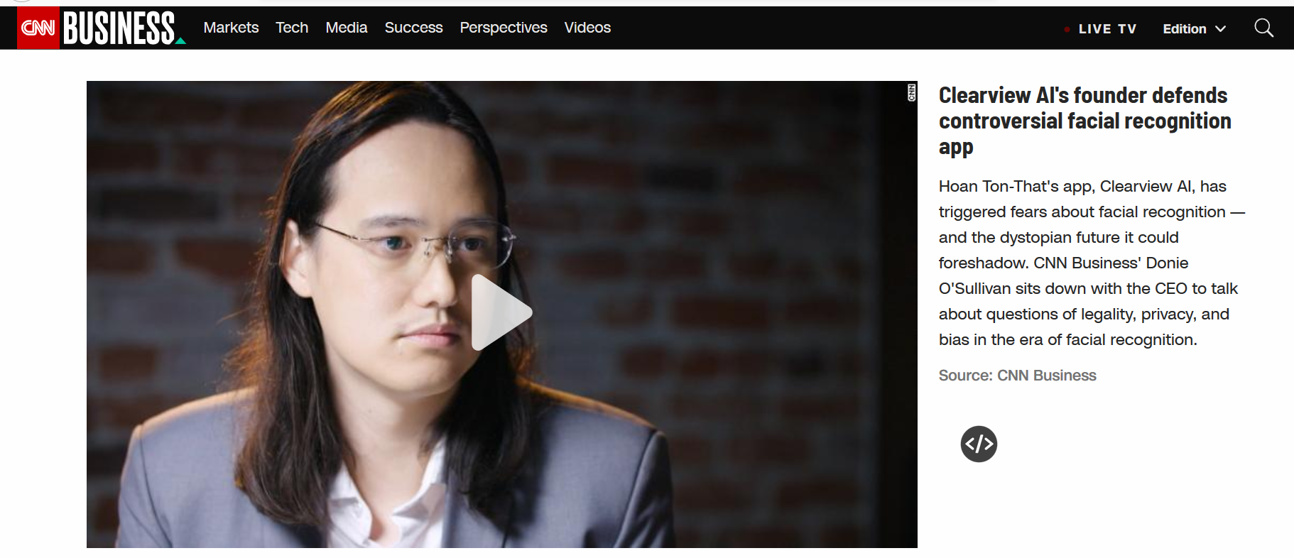
Case Study: Facial Recognition
Source: https://www.cnn.com/videos/business/2020/02/10/clearview-ai-facial-recognition-orig.cnn-business

Slide 26
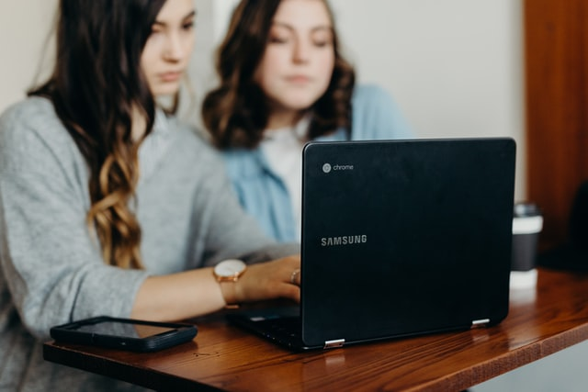
Case Study: Tech-Enabled Surveillance
Dozens of schools in the US are monitoring students electronically
Bluetooth beacons track attendance in classrooms
Wi-Fi tracks students across campus
Multiple behavior indicators are tracked:
Time in dorm room
Sleeping and eating patterns
Physical activities
Social interactions
Students that do not opt-in are penalized
Source: https://www.washingtonpost.com/technology/2019/12/24/colleges-are-turning-students-phones-into-surveillance-machines-tracking-locations-hundreds-thousands/
Notes:
It is an attractive solution for colleges: track attendance, students habits, lifestyle, etc. Early warning of self-deprecating behaviour which could indicate serious mental or physical problems. All of this done automatically. It does raise a lot of questions regarding privacy. How can this be used against students to coerce a certain behaviour, and how it sets up future workers to expect constant surveillance.

Slide 27
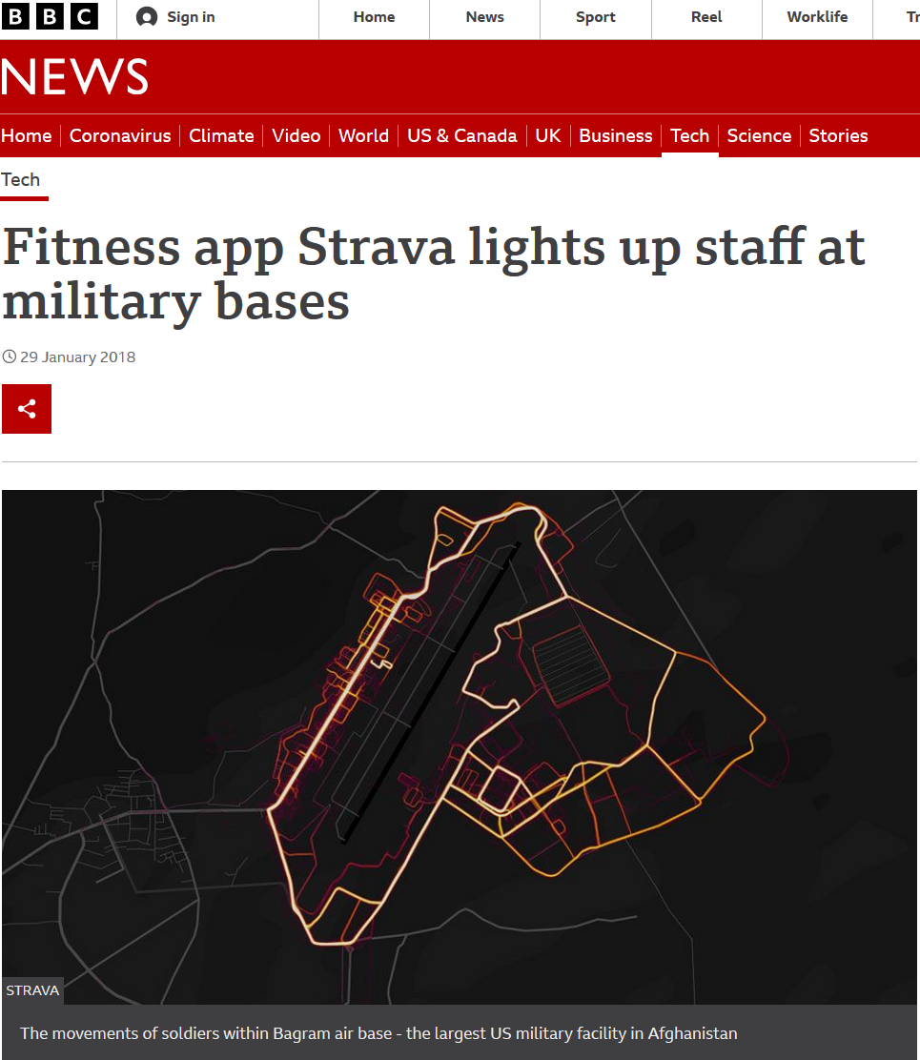
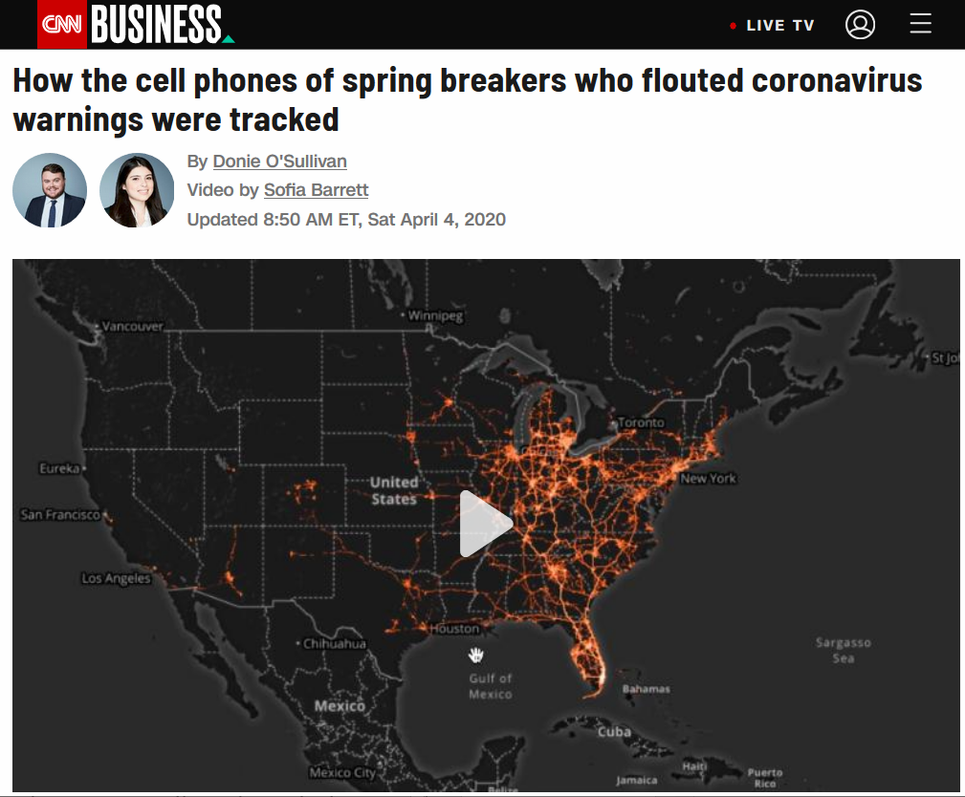
Case Studies: Location Tracking
Source: https://www.bbc.com/news/technology-42853072
Source: https://www.cnn.com/2020/04/04/tech/location-tracking-florida-coronavirus/index.html
Notes:
US citizens should have a reasonable expectation of privacy. Yet, when the circumstances called for it, it was surprisingly easy (or maybe not so much) for the US governments to get the full detail of the whereabouts, social interactions and location tracking of a group of citizens. Other countries (cited in the article) are doing more: tracking by facial recognition, applying measures through constant surveillance.
Canada saw changes to the Lawful Access landscape with R v Spencer, where the standard for requesting subscriber information is now a warrant, according to the Supreme Court of Canada. Telecom providers appear to be ensuring this is done by police before providing information, but there may be exceptional circumstances like the pandemic that change things.

Slide 28
Conclusion
Summary:
Digital Identities and Online Compromise
Digital Profiles, Fingerprints and Tech Giants
Best Practices
Case studies
Notes:
This slide is optional. It can be used if there are courses/ workshops that compliment/enhance the material taught in this course.

Slide 29
Questions

Slide 30
What’s Next?
Expand your knowledge:
Course calendar
Cyber Centre publications
Look to the “What’s new” section of our website to keep informed on up-and-coming training activities

Slide 31
CONNECT WITH US
833-645-3276
education@cyber.gc.ca
https://cyber.gc.ca/en/learning-hub

