Slide 1
Notes:
Carmen 1-6

Slide 2
Mindful Change Leadership Development Program
Week 2 (of 8)
3 May 2022
Notes:
To mention the following in French:
« Comme avec toutes les sessions du GC, s'il vous plaît, sentez-vous libre d'utiliser la langue de votre choix pour poser des questions ou participer à la discussion., La séance d'aujourd'hui sera conduit principalement en anglais, il y aura d'autres sessions en français qui seront promus via le groupe GCConnex (ou donner des dates précises, si disponible). »
As with all GoC sessions, please, feel free to use the language of your choice to ask questions or participate in the discussion., today’s session will be conducted mainly in English, there will be other sessions in French that will be promoted via the GCConnex group (or give specific dates, if available).

Slide 3
Mindful Breathing Exercise – Centering
Time required: 2 minutes
The trick is to shift from “doing” to “being”
Let’s start by doing the following...
Sit with a straight position, as comfortable as possible
It helps if you close or semi-close your eyes
Let’s not worry about time
And take a minute, only a minute...
To breathe, just to breathe
That simple
I’ll let you know when the time is over.
Just continue breathing
We’ll do a short debrief of what you noticed
Notes:
Mindful breathing https://www.youtube.com/watch?v=ZE-r-x2T4ok
This is one way of doing it, getting it depends on the practice of.
Noticing is very important in the practice of Mindfulness.
Noticing where your thinking is, that’s the first step to become more Mindful.

Slide 4
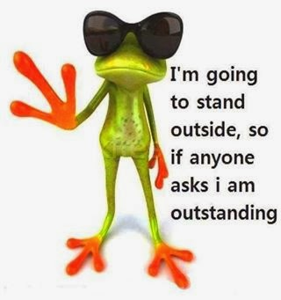
Debrief from last week (1)
Any Insights you’d like to share
Your Buddy Sytem
Your practice
Debrief
Any outstanding issues?
Notes:
10 minutes in « dyads » of 5
With honesty, report on :
Were there any challenges?
What you noticed

Slide 5
Agenda – week 2: The brain (focus, clarity)
Breathing exercise – 2 minutes
From last week’s Comments
Debrief from last week
Today’s session goals
What happens in the brain - neuroplasticity
MCL & The Key Leadership Competencies
Your turn for the week
Practice: Breathing excercise

Slide 6
Today’s Intentions: Clarity and Focus
Two of the skills that a Mindful Leader shows are Clarity and Focus
Today, we’ll practice
Clarity by understanding what happens in the brain – neuroplasticity
Introduce Mindful Leadership concepts
Focus by doing Mindful Breathing
Notes:
Carmen 1-6

Slide 7
“What Happened to You?...”
https://www.amazon.ca/What-Happened-You-Understanding-Resilience/dp/1250223180/
https://www.youtube.com/watch?v=JlS8ApNBtuU&t=7s
Notes:
Alejandro 7 - 14
Jay interviewing Oprah
https://www.youtube.com/watch?v=JlS8ApNBtuU&t=7s
05:57 Commonly misunderstood concept about trauma
09:06 Going beyond success to heal your trauma
Let’s be clear, this program is focused on awareness and how to be present and access the pre-fontral cortex.
This program is NOT focused on trauma and healing, if you need help on that matter please contact an specialist or EAP.

Slide 8
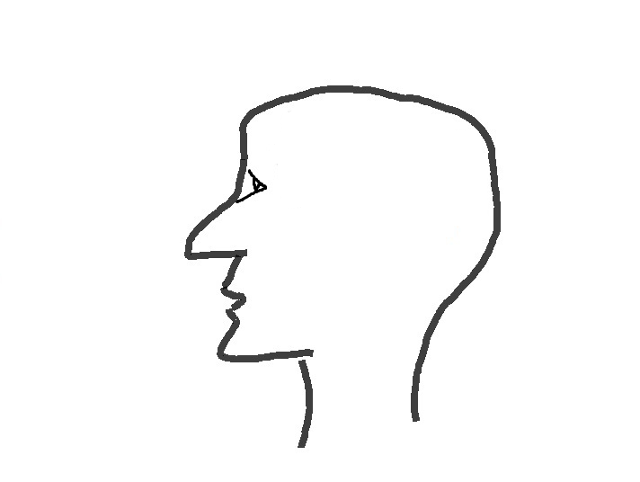
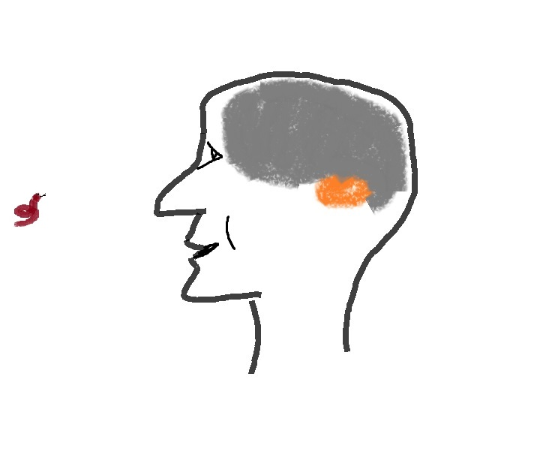
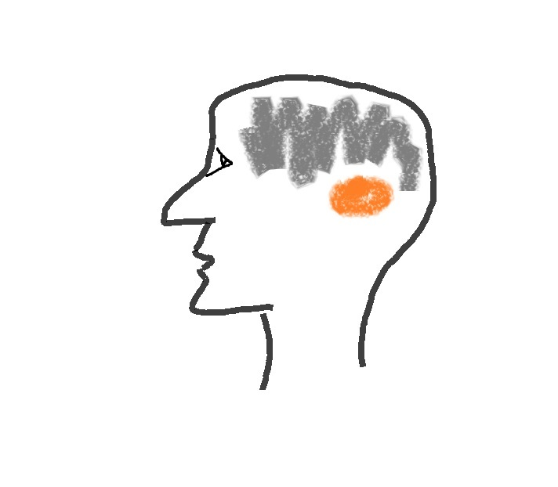
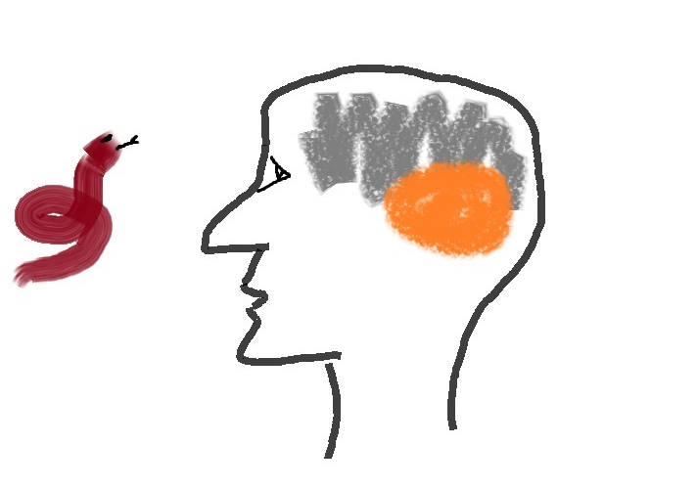
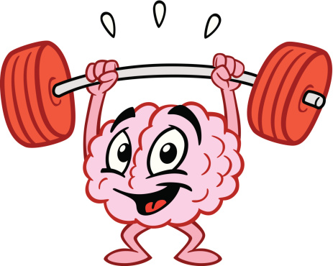
What happens in the brain – the neuroplasticity
Decision making
Emotions
Language
Work
Family
Stress
Media
Amygdala
Mindfulness Practice
Natural dangers
turned → into
Day to day over stimulus
Watch this video at home (15 mins): https://www.youtube.com/watch?v=Awd0kgxcZws
or this video (2 mins) : https://www.youtube.com/watch?v=ELpfYCZa87g
Notes:
Alejandro
https://gcconnex.gc.ca/blog/view/93957388/neuroplasticity-your-survival-superpower-neuroplasticite-votre-superpuissance-de-survie?language=en
https://en.wikipedia.org/wiki/Amygdala_hijack
http://www.gostrengths.com/what-is-an-amygdala-hijack/
http://neurosciencefundamentals.unsw.wikispaces.net/The+limbic+System
https://siyli.org/even-old-dogs-can-learn-siyli-tricks-2/

Slide 9
How The Brain and Body Work Under Stress
In times of stress, the brain reduces energy to its “executive system”.
Notes:
Alejandro

Slide 10
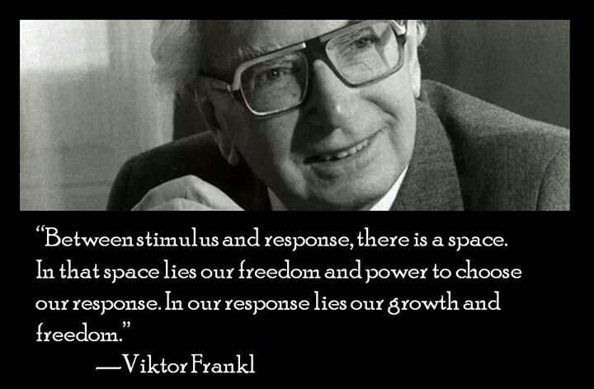
Notes:
Alejandro

Slide 11
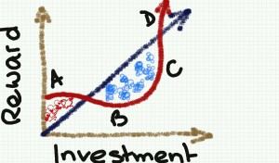
Why Mindfulness Matters
Increased resilience
Focus and concentration
Workplace harmony
Fewer sick days
Greater employee satisfaction and well-being
Stress reduction
Greater creativity
http://www.mentalworkout.com/white-papers/how-mindfulness-can-help-your-employees-and-improve-your-companys-bottom-line/
Notes:
Let’s have some ideas around this... How do you see Mindfulness having an impact in the workplace?
Increased resilience: being mindful increases the ability to be open to new perspectives, to think creatively, to distinguish thoughts from feelings, and to respond to challenges rather than merely reacting. For a leader this helps with strategic thinking.
Focus and concentration: after an eight-week mindfulness course, participants could concentrate better, stay on task longer, more effectively, and remember what they’d done better. In a fast paced environment where leaders have to react quickly to situation this is a great capacity to have.
Workplace harmony: being mindful promotes and creates more empathy and altruism in the workplace. As a leader we are expected to foster a respectful workplace.
Fewer sick days: those who have a practice missed 76% fewer days of work.
Greater employee satisfaction and well-being: being mindful helps significantly to have less emotional exhaustion and more job satisfaction.
Stress reduction: just being mindful helps in reducing stress, anxiety, and depression. The practice helps reducing the levels of the primary stress hormone. As a leader we are put under a lot of stress and any tools that can help manage the pressure is something to be considered.
Greater creativity: Leaders with a mindfulness practice say it helps them create space for innovation and it also helps them to think strategically.
---
How mindfulness can help your employees and improve your company's bottom line – white paper, Mental workout http://www.mentalworkout.com/white-papers/how-mindfulness-can-help-your-employees-and-improve-your-companys-bottom-line/

Slide 12
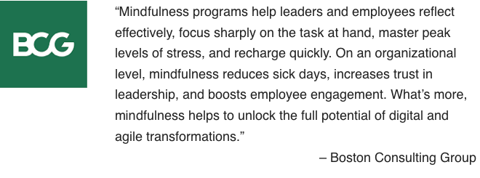
How Mindfulness Practice Benefits CEOs
builds resilience
boosts emotional intelligence
enhances creativity
improves your relationships
helps you focus
Attention
Awareness
Letting be
Leaning into Unpleasant Experiences
Appreciation
Getting unstuck
* Adapted from:
https://hbr.org/2015/12/how-meditation-benefits-ceos
https://www.mindful.org/7-qualities-mindfulness-trained-body-scan/
from: https://www.bcg.com/en-ca/publications/2018/unleashing-power-of-mindfulness-in-corporations
Notes:
https://hbr.org/2015/12/how-meditation-benefits-ceos
https://www.mindful.org/7-qualities-mindfulness-trained-body-scan/
https://www.bcg.com/en-ca/publications/2018/unleashing-power-of-mindfulness-in-corporations
3 mins body scan: https://soundcloud.com/mindfulmagazine/3-minute-body-scan-meditation
Bottom-up: https://www.psychologytoday.com/us/blog/conquer-fear-flying/201306/emotional-control-top-down-or-bottom

Slide 13
What is Mindful Change Leadership?
Refers to the person who is present, non judgmental and cultivates several aspects during their interactions. These aspects are visible and tangible in the Mindful Change Leader:
Focus (focus of attention)
Clarity (self awareness & emotional intelligence)
Creativity (innovation & decision making)
Compassion in the service of others (presence, deep listening)

Slide 14
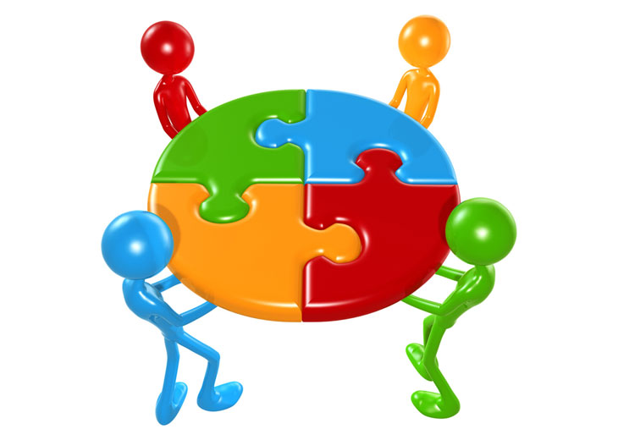
Which Mindful Change Leadership skills support the Key Leadership Competencies?
 | Focus | Clarity | Creativity | Compassion in the service of others
Create Vision and Strategy
Mobilize People
Uphold Integrity and Respect
Collaborate with Partners and Stakeholders
Promote Innovation and Guide Change
Achieve Results
Notes:
Alejandro 7 - 14
From: http://www.tbs-sct.gc.ca/psm-fpfm/learning-apprentissage/pdps-ppfp/klc-ccl/klcp-pccl-eng.asp
Create Vision and Strategy
Leaders define the future and chart a path forward. They are adept at understanding and communicating context, factoring in the economic, social and political environment. Intellectually agile, they leverage their deep and broad knowledge, build on diverse ideas and perspectives and create consensus around compelling visions. Leaders balance organizational and government-wide priorities and improve outcomes for Canada and Canadians.
Mobilize People
Leaders inspire and motivate the people they lead. They manage performance, provide constructive and respectful feedback to encourage and enable performance excellence. They lead by example, setting goals for themselves that are more demanding than those that they set for others.
Uphold Integrity and Respect
Leaders exemplify ethical practices, professionalism and personal integrity. They create respectful and trusting work environments where sound advice is valued. They encourage the expression of diverse opinions and perspectives, while fostering collegiality. Leaders are self-aware and seek out opportunities for personal growth.
Collaborate with Partners and Stakeholders
Leaders are deliberate and resourceful about seeking the widest possible spectrum of perspectives. They demonstrate openness and flexibility to forge consensus and improve outcomes. They bring a whole-of-government perspective to their interactions. In negotiating solutions, they are open to alternatives and skillful at managing expectations. Leaders share recognition with their teams and partners.
Promote Innovation and Guide Change
Leaders have the courage and resilience to challenge convention. They create an environment that supports bold thinking, experimentation and intelligent risk taking. They use setbacks as a valuable source of insight and learning. Leaders take change in their stride, aligning and adjusting milestones and targets to maintain forward momentum.
Achieve Results
Leaders mobilize and manage resources to deliver on the priorities of the Government, improve outcomes and add value. They consider context, risks and business intelligence to support high-quality and timely decisions. They anticipate, plan, monitor progress and adjust as needed. Leaders take personal responsibility for their actions and outcomes of their decisions.

Slide 15
Your turn for week 2
Connecting – once a week with your buddies
Recommended 20 minutes call: 5 mins for each, you can discuss what you found interesting, what was challenging, what you like the most
Gratitude Journaling – daily
Practice 5 mins breathing – daily http://marc.ucla.edu/mpeg/01_Breathing_Meditation.mp3 https://soundcloud.com/mindfulmagazine/5-minute-breathing-meditation
In case you have a question, a comment or want to share something, please do so via the Cohort
Notes:
Carmen 15 - end
http://marc.ucla.edu/mindful-meditations

Slide 16
Reviewing the basics (1/2)
The intention of being (as opposed to doing)
Posture: sit with a straight back, as comfortable as possible in the chair that you are seated, slightly tuck your chin (or cross legged if you feel comfortable)
Mindset: keep an open mind, feel the experience
You experience may vary each day, all is good
Focus on the breathing
Notice
It is about feeling the way you feel, about noticing without judging
have no expectations
have no judgement
have a beginners mind
be an observer... our minds may be busy and noisy
Notes:
http://www.thecalmmonkey.com/#!meditation-recordings/g6x73

Slide 17
Mindful Breathing Exercise – Breathing (2/2)
Time required: 5 minutes
The trick is to shift from “doing” to “being”
Let’s start by doing the following...
Sit with a straight position, as comfortable as possible
It helps if you close or semi-close your eyes
Let’s not worry about time
And take a minute, only a minute...
To breathe, just to breathe
That simple
I’ll let you know when the time is over.
Just continue breathing… for one more minute
Notes:
Mindful breathing https://www.youtube.com/watch?v=ZE-r-x2T4ok
This is one way of doing it, getting it depends on the practice of.
Noticing is very important in the practice of Mindfulness.
Noticing where your thinking is, that’s the first step to become more Mindful.

Slide 18
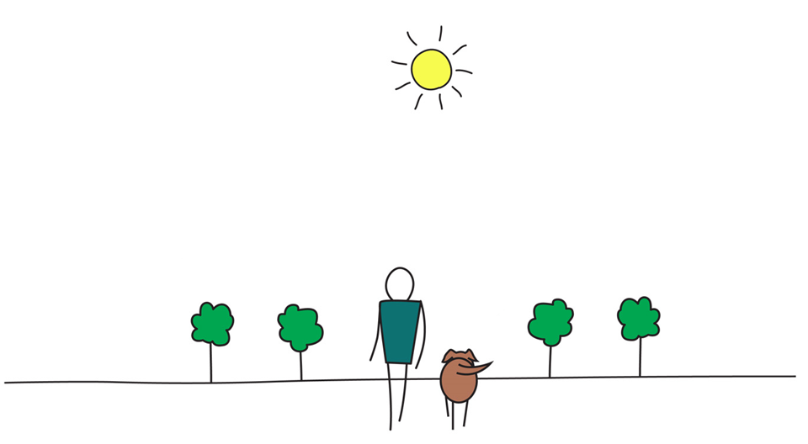
Be Mindful, Be Happy

