Slide 1
Tackling Data Bias in Artificial Intelligence
November 2021
By Shingai Manjengwa

Slide 2
Bias can be found at every step of an AI process.
Objective function
Select approach
Risk/ Legal considerations
Data collection
Engineering
Model development (training/testing/validation)
Model scoring and iterations
Model deployment
Model management
Model disposal
3 approaches to address bias:
Governance
Technical approaches
Diversity
Operationalizing AI for fairness
Notes:
Objective function e.g., Analysts with cars
Data collection e.g., Melanoma Detection
Model scoring and iterations e.g., solving for speed/ accuracy/ precision/ recall
Model management e.g., data set shift/ model drift
Unintended consequences: Uber example

Slide 3
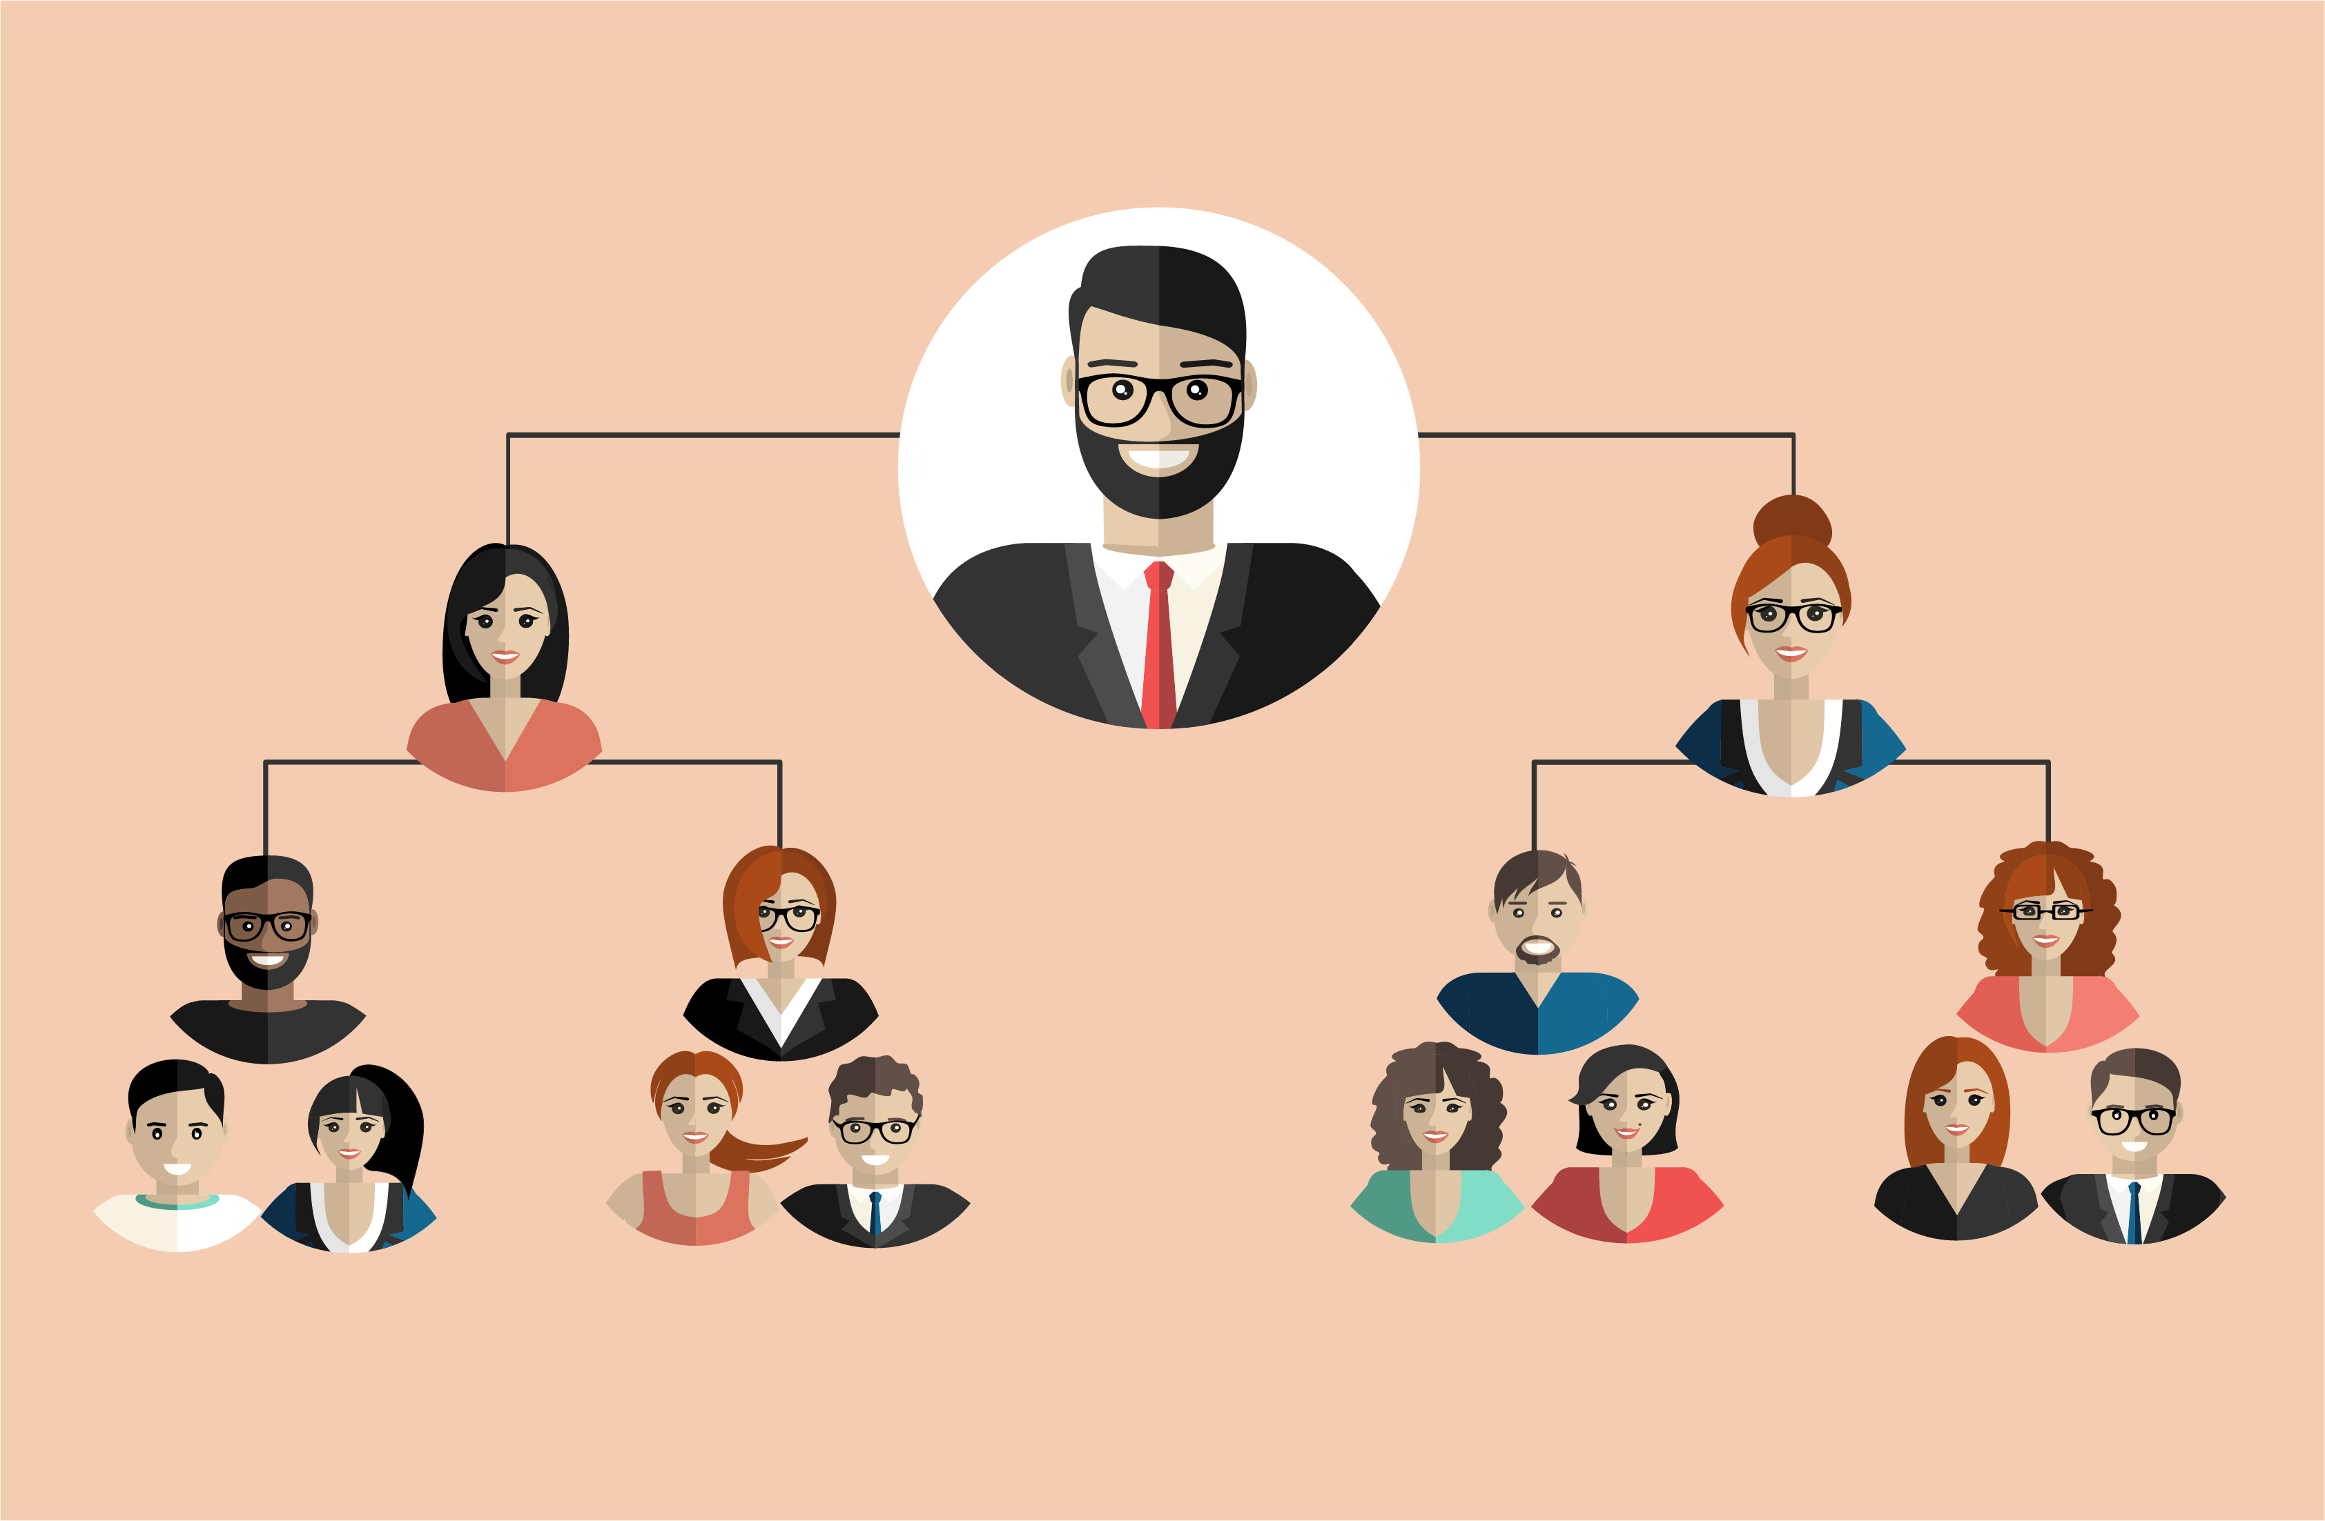
Operationalizing AI for Fairness
Notes:
An evolution in thinking: “Tackling bias requires a systems approach targeted at supporting and empowering leaders/ decision makers to address bias in technical and non-technical ways.”

Slide 4
Operationalizing AI for Fairness
AI Decisions
AI Decisions
AI Projects

Slide 5
Operationalizing AI for Fairness
AI Decisions
Literacy Training
AI Decisions
Technical and
Non-Technical Education
AI Projects

Slide 6
Operationalizing AI for Fairness
Organizations need support for AI operations and decisions. This function must:
Translate
Audit/ Test/ Proof
Record
Maintain
Dispose of
AI systems.
AI Decisions
Literacy Training
AI Decisions
Technical and
Non-Technical Education
AI Projects
Notes:
Tackling bias requires a systems approach targeted at supporting and empowering leaders/ decision makers to address bias in technical and non-technical ways.

Slide 7
Thank you / Merci
Fireside Analytics Inc: info@firesideanalytics.com
High School Data Science: FiresideAnalytics.Academy
Children’s book about data: “The Computer and the Cancelled Music Lessons.”

