Slide 1
TB Policy on Service: Real-Time Performance Information Service Management Committee (SMC) August 22, 2018
UNCLASSIFIED

Slide 2
Purpose
To present an update on the status of work to provide real-time performance information to ESDC clients. This includes an overview of the Real-Time Challenge event in May 2018 and the prototypes that were developed by event participants.
To propose a path forward for offering more of this information online.

Slide 3
Background: Why provide real-time performance information online ?
TB Policy on Service
Policy Requirement 7.7, which came into effect in 2015, requires that departments make real-time service delivery performance information available to clients on Canada.ca for external services.
For 2016-17, ESDC obtained a score of 0% through MAF for the percentage of priority services providing real-time performance information online. The Department received the same score in 2015-16 as well.
ESDC’s score is below the MAF average of 15.4% Only two organizations received a score above 0% (IRCC – 100% and CBSA – 39%), although other Departments are working to address this gap.
GC Service Strategy
Benefits to Clients
What others are doing
The Delivery Charter for the GC Service Strategy states that TBS will work with departments and agencies to establish, review, publicize, and promote real-time performance information.
Making real-time application processing information accessible online will reduce client anxiety, reduce the need for clients to make inquiries at in-person centres or via phone, and provide them with consistent information.
Growing efforts across other departments, governments and private organizations to offer real-time performance information are likely to increase the service expectations of ESDC clients.

Slide 4
Current Status of Real-Time Performance Information Work in the Department
Quebec Region already publishes rough estimates of wait-time information online for its Montreal Passport Offices. The information is updated daily:
*Image captured from www.servicecanada.gc.ca
CSB has developed the capacity to report real-time performance information related to Canada.ca analytics (see Annex A).
SEB is developing the capacity to provide real-time performance information to employers on how quickly ESDC is validating employer files and posting job advertisements for Job Bank.
TISMB is exploring options to publish monthly performance results against the public-facing service standards for OAS, CPP and EI.
SSPB organized a Real-Time Challenge Event in late May 2018 to develop prototypes for providing real-time performance information to clients online covering a range of ESDC services.

Slide 5
Real-Time Challenge: Who was there?
42 Innovative thinkers, including regional staff, with diverse areas of expertise were brought together for 3 days (May 29-31) to participate in an event in the Innovation Lab.
Call centre representatives and front-line officers
Understand what questions clients actually ask
Program Operations
Understand the complexities of program/service delivery
3 Day Challenge in collaboration with the Innovation Lab
Policy representatives
Understand TBS expectations
Data Analysts
Understand what data is available, and how it can be best leveraged
Web developers
Understand the technical opportunities and limitations of Canada.ca

Slide 6
Real-Time Challenge: What happened?
Existing real-time performance information applications were explored to discuss what can be leveraged and areas for improvement.
Empathy exercises were held to understand the needs of clients accessing our services.
Basic application prototypes were developed on paper.

Slide 7
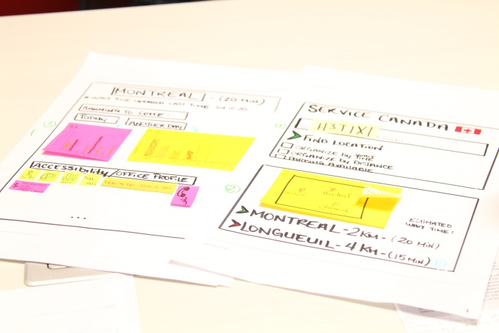
Real-Time Challenge: What happened?
Additional activities, such as storyboard and role playing exercises, were conducted to imagine how clients would benefit from the applications and potential barriers they may face.
Paper prototypes were refined and final touches were added
based on feedback.
Final elevator pitches were made to present the 6 completed prototypes followed by a feedback period to discuss feasibility.
Prototypes were developed for: In-person Service Canada Centres, 1 800 O-Canada, EI, OAS, Job Bank, and Principal Publisher (see attached summaries).

Slide 8
Considerations Moving Forward
Prioritization of real-time performance reporting initiatives must take into consideration:
other major Departmental initiatives already drawing on branch resources; and
cost-benefit of advancing work now vs waiting for major transformation initiatives underway (e.g. BDM and HCSS) that will enhance the Department’s access to real-time data.
Nevertheless, a number of opportunities exist to advance initiatives in the short term by focusing on data that is already available.
Further analysis is required on the desirability of publishing real-time performance information for call centres.

Slide 9
Next Steps
Leverage the Real-Time Challenge prototypes and ESDC initiatives already underway to expand the offering of real-time performance information to clients.
Short Term (Fall 2018)
Principal Publisher:
Canada.ca real-time analytics developed.
EI, OAS and CPP:
Work advancing to publish monthly performance results against the public-facing service standards.
Job Bank:
Work advancing to provide real-time performance information on processing times to employers.

Slide 10
Next Steps (cont’d)
Medium Term (2019-20)
OAS and EI
Leverage the Service Transformation Plan to explore the provision of real-time performance information, using the EI and OAS prototypes.
Specialized Call Centres
Options under consideration for publishing peak-time information.
In-person Service Canada Centres:
CSB and TISMB are exploring options to leverage current initiatives to pilot the provision of wait times.
Prioritization will need to consider branch capacity and existing STP commitments.
Long-term solution would likely require an RFP process.
Job Bank:
Real-Time Challenge prototype being considered as part of efforts for overall website enhancements.
Longer Term (2021+)
Other Priority Services
Leverage STP initiatives and remaining Real-Time Challenge prototypes to further expand the number of services providing real-time service information to clients online.

Slide 11
Discussion questions
What is the organizational risk vs client benefit to publishing live information given significant hourly fluctuations?
Could publishing peak-time information without specific call-answer rates meet client needs?
Do you have any views on how we could communicate real-time reporting in a way that is meaningful to Canadians?

Slide 12
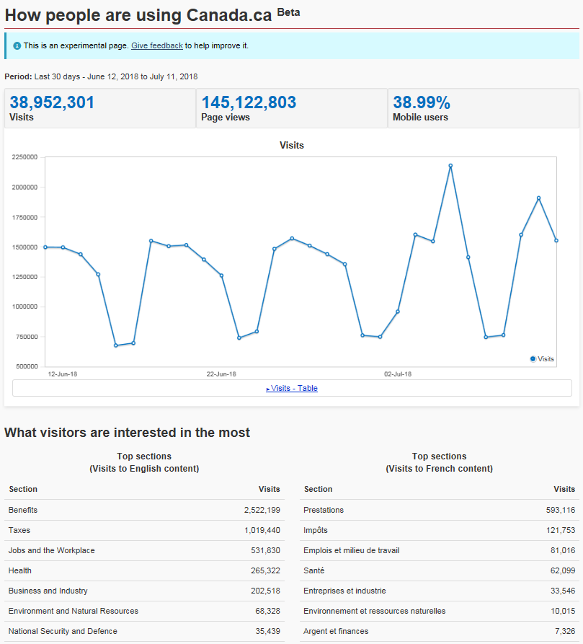
Annex A: Real-Time for Canada.ca

