Slide 1
Our journey communicating in 13 languages
Government Digital Experience Government Communications and Public Engagement

Slide 2
Agenda
Meet the team
Project focus and scope
Overview of our content
Methods and processes
Challenges
Successes and lessons learned
Future goals

Slide 3
Meet the team
Government Digital Experience (GDX)
Product owner for gov.bc.ca
Focus on service design, content design, citizen engagement, training and governance
Internal consultant to other ministries and program areas, works closely with GCPE on digital products
Government Communications & Public Engagement (GCPE)
Individual communication teams in each ministry
Central teams for social media, events, video/livestreaming, translated content, marketing
Owner of COVID-19 branding
Notes:
Add pictures of website, social media post and NR

Slide 4
Meet the team
Government Digital Experience (GDX)
Manager, Content Design
Kaitlyn Rosenburg
Content Designers
Max Johnson
Skyler Erasmus
Previous: CMS Lite wizards
Michael Zadravec
Leslie van Mil
Government Communications & Public Engagement (GCPE)
Manager, Multilingual Services
Masha Kaur
Language Specialists
Alexine Sanchez
Eva Cheng
Nicole Wannamaker
Kate Zhao
Notes:
Add pictures of website, social media post and NR

Slide 5
Project scope
The project is funded by the Ministry of Health to address communications needs for COVID-19 response, including:
Provincial Health Officer (PHO) orders and updates
The Province-wide restrictions page (available in nine languages) summarizes the latest PHO orders for individuals, workplaces, places of worships, etc.
Public health safety information (Emergency Program Act)
Travel & COVID-19 page summarizes travel related restrictions and recommendations
Vaccination related information
Immunization Plan page summarizes B.C.'s long-term vaccination plan
The How to get Vaccinated page helps outline eligibility and the steps needed for people to register and get vaccinated
Pages for targeted population:
Vaccines for Seniors (pages now decommissioned)
Vaccines for Clinically Extremely Vulnerable people
Vaccines in Youth 12 to 17
Economic recovery related information
BC Recovery Benefit for individuals and families
Notes:
What about content that doesn't fall into scope?
Still posting PDFs for content that doesn't fall into scope, like education info

Slide 6
Overview of our content
Web content – gov.bc.ca/covid19
BC Gov social media handles – communicates in up to five languages
News Releases, Statements – BC Gov News
Publishing in 12 additional languages on gov.bc.ca:
Traditional Chinese​
Simplified Chinese​
French​
Punjabi​
Farsi​
Tagalog​
Arabic​​
Spanish​​
Vietnamese​​
Hindi​​
Japanese​​
Korean​
Notes:
Mike
Currently have 130+ pages published!

Slide 7
Growth of content over time
 | Additional languages pages added/removed | Total # pages added | Total # live pages
April to May 2020 | Landing pages (all information was published on standalone landing pages to begin with) | 9 | 9
December 2020 | Province-wide restrictions page | 9 | 18
 | BC Recovery Benefit page | 4 | 22
January 2021 | Immunization Plan page | 12 | 35
 | Landing pages for Japanese, Hindi and Vietnamese | 3 | 37
March 2021 | Vaccines for Clinically Extremely Vulnerable People | 12 | 49
 | Vaccines for Seniors | 12 | 61
 | How to get Vaccinated | 12 | 73
April 2021 | Vaccine for Seniors (Decommissioned) | -12 | 61
 | High-transmission neighbourhood plan page | 12 | 73
 | Current Travel restrictions page | 12 | 85
May 2021 | Paid Sick Leave Vaccines for Youth | 12 12 | 97 109
Total # pages built |  | 121
Notes:
Table outlines number of additional languages’ webpags published since the start of COVID-19 multi-lingual outreach:

Slide 8
Methods and processes
1. Content developed in English
Content design, plain language
Approvals from communications department, legal, Provincial Health Officer (PHO)
Publishing, usually in coordination with PHO/Minister/Premier announcement
2. Content sent to contracted vendors for translation
We use a translation matrix for new content and updates
Goal is to send content before English is published
3. Translated content is loaded into CMS Lite
Recently completed updates for Right-to-Left text
Quality check: Does it match English layout and design? Errors in translations?
4. Translated content is published
English pages then updated to include links to the 12 languages
Notes:
Mike

Slide 9
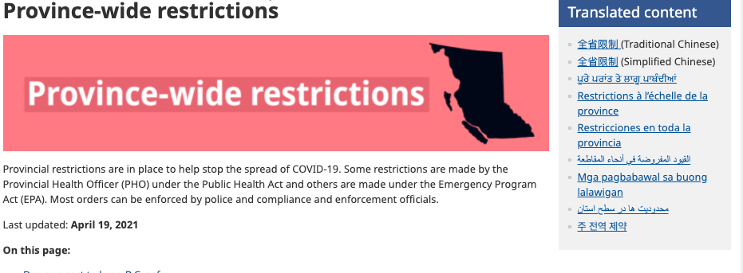
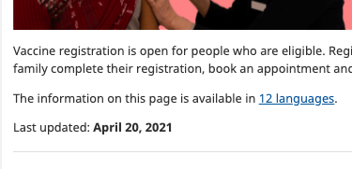
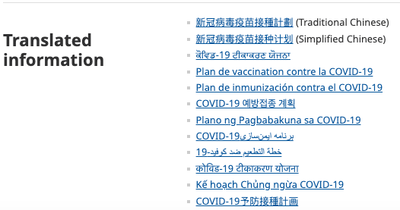
Past placement of language content
Option 1: Using a right-hand column box, linked in language
(On mobile this automatically resizes to bottom of page)
Anchor linking to content at bottom of the page, in language
Option 2: Links written in header in English

Slide 10
Current state
Header: Directly linking to language content in language
"For the website, it was great to see that the translation page links have been moved to the top. Previously, they were on the bottom right of the page. Now, they are at the top and much more accessible." - South Asian Mental Health Alliance
Notes:
What is GDX good at? Evidence that it works, taking feedback, eetc

Slide 11
Web Analytics, April 2021
Total number of page views across 12 languages
316,134
Top views by translated pages
How to get vaccinated, TC 52,091
How to get vaccinated, SC 35,418
How to get vaccinated, Korean 27,970
How to get vaccinated, Farsi 8,122
Comparison to English
5,406,855
Immunization Plan, TC 28,374
Immunization Plan, SC 27,886
Immunization Plan, Korean 15,223
3,581,354
Notes:
Mike

Slide 12
Web Analytics, April 2021
Top views by translated languages​
​
Traditional Chinese (100,376)​
Simplified Chinese (80,035)​
Korean (51,975)​
French (16,078)​
Farsi (15,408)​
Japanese (12,609)​
Spanish (11,441)​
Punjabi (10,043)​
Vietnamese (6,943)​
Tagalog (5,555)​
Arabic (3,384)​
Hindi (2,287)​
Language | # of Speakers​ | % of Total Population​
English​ | 3,632,700​ | 79.0%​
Mandarin (TC and SC)​ | 146,435​ | 3.2%​
Punjabi​ | 139,080​ | 3.0%​
Cantonese​ | 137,075​ | 3.0%​
Korean​ | 38,605​ | 0.8%​
Farsi​ | 28,420​ | 0.6%​
Spanish​ | 22,310​ | 0.5%​
French​ | 16,795​ | 0.4%​
Vietnamese​ | 17,055​ | 0.4%​
Russian​ | 13,310​ | 0.3%​
Hindi​ | 12,310​ | 0.3%​
Arabic​ | 10,415​ | 0.2%​
Official and Non-Official Languages Spoken Most Often at Home (British Columbia, 2016 Census)
Notes:
Mike

Slide 13
Challenges – Yes! We've made mistakes.
Challenge | Mitigation and Successes
Limited in-house language capacity increases dependence on external vendors causing time lags in posting content and challenges around consistency in tone etc. | We have hired language communications specialists expanding our capacity to six languages – Punjabi, Hindi, French, Simplified and Traditional Chinese, Tagalog
Quality control for translated content | Vendors selected after careful review, new in-house team reviews incoming content where possible
Technical challenges like handling languages written from right to left; design components in English language only (Contact Us, Expand All, Related Links) | We recently updated our Content Management System to handle Arabic and Farsi; more language ability was added into CMS with in-language components
Ensuring content reaches the audience. How do you reach vulnerable populations? Traditional communication channels don't work as well | We link to our pages through BC Gov's social media handles to increase reach; paid ads also help drive people to the vaccines' websites
COVID content changes a lot, difficult to keep up with edits | Using common components (phrases, sentences) as much as possible, working towards earlier approvals on English content
Notes:
Posting web content in 12 languages
How it works from drafting content to pressing publishing
Upgrades to our CMS

Slide 14
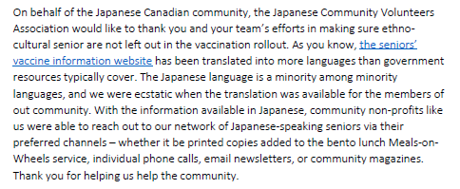
Feedback from the community

Slide 15
Future Goals
Develop a stronger outreach program
Publish more languages at the same time as English
Evaluate how well translated content is meeting needs and what can be improved
Strengthen internal team capacity and knowledge
Iterate on project goals as the team grows and learns
Notes:
Path
Partnering with community organizations and stakeholders to help disseminate information
Translate more languages in-house, move from translation to transcreation of content
Conduct qualitative research with language communities in collaboration with GDX Service Design Team
Refine processes, establish standards of practice, build glossaries for reference
Take an agile approach, letting past learnings inform the future path

