Slide 1
[name of project]
Change management approach and timeline
Date: xxxx-xx-xx

Slide 2
How to use this document (1/3)
Important: This template is meant to be presented to the highest level of governance for your workplace modernization project. Should you be presenting to a different audience, some of the content will need to be amended.
The goal of this presentation is to gain endorsement from a senior audience on your proposed CM approach. To do so, we have included slides on: what is CM, CM approach, high level view of CM activities and timeline. There are also slides on the value of CM in annexe that may be added if you feel your audience needs to be convinced of such.
You may also be seeking funding for your CM program or CM resources; therefore, we have included a slide to that effect. It can be removed if not required.
This presentation was created to serve two purposes: if you don't have enough information on your project to customize the presentation, you can use this as a generic presentation as what is included is what can be typically expected in a workplace modernization project.
Before using this template and preparing your presentation, we highly recommend you fill out the CM-PM integrated plan template. This tool will help you validate your CM activities and timeline; you can then use that information to populate slides 12 to 17. You can also use your own integrated plan if you already have a template that works for you.
ERASE THIS SLIDE

Slide 3
How to use this document (2/3)
Slide 5: Objective(s)
Decide if you have one or more objectives with this presentation and edit the text in red as required.
Slide 6: Context
If this is the first time presenting to this audience, include an introduction to your modernization project (who, what, when, where, why, how)
If they are already familiar with the project, include a recap and also what has been completed since the last time you presented to them.
Slide 7: Change management
Ensure to indicate who was consulted in the development of this presentation. It’s important to show that you are not working in silo and are actively collaborating with your counterparts on the PM side. Senior audiences are also familiar with other initiatives such as IM and IT strategies, People strategy, Beyond 2020, etc.; therefore, it is always a good idea to show the link(s) to them, as applicable.
Slides 12-16: Activities that help create ADKAR in employees
These slides contain lists of typical activities to help build ADKAR in employees; these lists should be modified to reflect your CM-PM integrated plan. However, the examples listed are generic enough that they can be used as potential activities. If you choose not to customize the activity lists, ensure you rename the slides to “Potential activities to help create ADKAR in employees”. To find out more about ADKAR, you can visit the ‘Start here’ section of the CM Playbook.
Slide 17: High level timeline of CM activities
This slide contains a generic timeline for a workplace modernization project. Again, this timeline should be modified to reflect your CM-PM integrated plan; however, it is generic enough that it can be used as a potential timeline. If you choose not to customize the timeline, at a minimum you should review the years and major milestones (grey bar at the top) to align with your project (see slide 18 or alternate timelines). Also, if using the generic timeline, ensure you rename this slide to “Potential High level timeline of CM activities”.
Slide 18: Alternate timelines
We created alternate graphs you can use for the timeline on slide 17. Choose and/or alter the appropriate timeline for your project. You can also create your own.
ERASE THIS SLIDE

Slide 4
How to use this document (3/3)
Slide 19: Resource plan
This slide is optional and can be removed if not required.
You can refer to the CM Playbook in Strategize -> Determine the change management team:
How to find CM resources
Change management team 3Rs template
Roles, functions and key activities of a change manager guide
Slide 20: Next steps
This slide will need to be modified based on where you are in your project. A likely next step is seeking endorsement for your CM strategy. To that effect, we have created a PowerPoint presentation template that you can use to present your strategy once it’s been developed. The templates can be found in our CM Playbook in Strategize -> Draft the change management strategy
Slide 27: Change management investment
If you choose to use this slide, ensure to modify all the text in red, as required. Depending on your situation, you may find that this calculation may not be as favorable as the example shown; we find this can be the case with smaller projects. You can still use the slide, but may need to modify the speaking points. Here is an example that you can use when filling out your table:
ERASE THIS SLIDE
Example project
Overall project budget (approx.) | $15 000 000.00
 | Example A (3%) | Example B (5%)
Change management service costs (% of overall project budget) | $450 000.00 | $750 000.00
Cost per employee (based on 1,800 FTE) | $250.00 | $416.67
Cost per employee per year (~3 years) | $83.33 | $138.89

Slide 5
Objective(s)
To present a high level approach to change management as well as a timeline of proposed activities;
Gain endorsement and approval to move forward with [funding/additional resources­]

Slide 6
Context
Include an introduction or recap on your workplace modernization project (who, what, when, where, why, how)

Slide 7
Change management
The content in this presentation was developed in collaboration with the project management team, HR, IT, and IM taking into account the [list relevant documents e.g. IM strategy, IT strategy, People strategy, Beyond 2020, etc.]

Slide 8
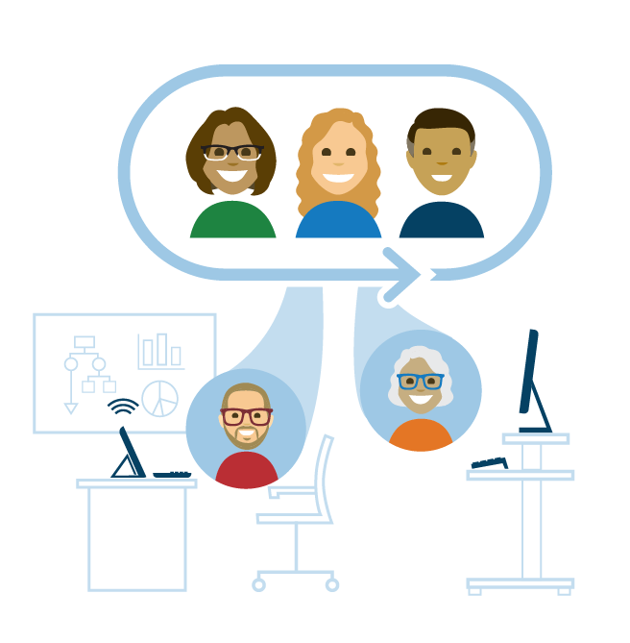
What is change management?
What is change management?
It’s a process to manage the people who are impacted by the change
It starts when the change has been decided
What change management is NOT
Not a decision-making process
Not a way to convince senior management to decide to change or not
PROJECT MANAGEMENT is not enough to ensure success. It focusses on delivering projects on time, on budget, and on scope, and it implements structural and tactical change.
CHANGE MANAGEMENT addresses the people side of the change, e.g. the number of competent users (people) as opposed to the number of updated computers (tactical).
Change management = maximizing the benefits of change projects
Notes:
PROPOSED SPEAKING NOTES:
Change management is about preparing, equipping and supporting employees for their journey and to ensure they are ready to adopt the new workplace.
Change management is a process to manage the people who are impacted by the change and should start when the change has been decided.
It is NOT a decision making process and definitely not a way to convince senior management to decide to change or not.
Project management is not enough to ensure the success of a modernization project. It is through change management that we manage the human side of change. E.g. It’s great if through the project all employees now have access to laptops, but what good are they for if employees are unable to use them because they have no training?

Slide 9
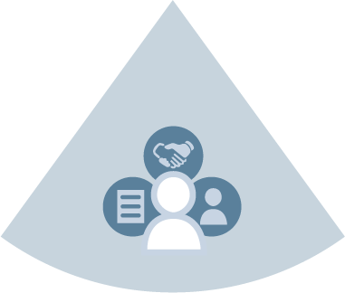
A unified approach to implement change
Project management focuses on delivering the workplace and its enabling elements in an integrated way
Change management ensures that the changes are embraced, adopted and supported by the employees
Notes:
PROPOSED SPEAKING NOTES:
In the context of a workplace modernization project, it’s important for the integrated project team to work closely with the change management team and to use a user-centric approach. All enabling sectors must be aligned to the organization’s vision for the workplace. Their modernization strategies must be integrated to enable/equip employees (in the middle) with the right tools and processes to support fundamental changes in the way they work.

Slide 10
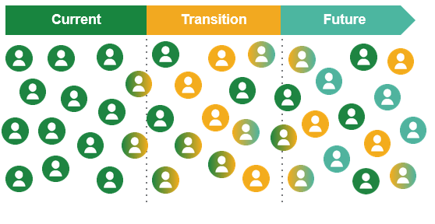
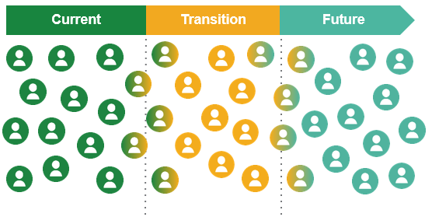
Adopting the change: from current to future state
In all changes, there is a current and a desired state. Organizations don’t change, but it’s the individuals who change and it’s that collective change that creates the future desired state.
Poorly managed change
Very well managed change
VS.
Employees were not well-supported during period of change. Not all employees have been able to move to the future state.
Employees have been well-supported throughout the change, and all have been able to move to the future state
The ultimate objective is that all employees move from the current state to the future state.
Notes:
PROPOSED SPEAKING NOTES:
In all changes, there is a current state and a desired state. Organizations don’t change, but it’s the individuals who change and it’s that collective change that creates the future desired state.
The ultimate objective is that all employees move from the current state to the future state.

Slide 11
Preparing employees
ADKAR model by Prosci: Successful change is dependant on all five elements
Project launch
Move to new space
I will continue to…
I am able to…
I know how…
Reinforcement
I decide to…
Ability
I understand why…
Adopting the new way, living with and sustaining the change
Knowledge
Getting involved and believing in the change, using new knowledge on how to change, new skills and behaviours
Desire
Awareness
Having access to resources on how to change, new skills and behaviours
Willingness to support the change, to participate and engage
Understanding the need for change and the nature of the change
Notes:
PROPOSED SPEAKING NOTES:
Our workplace change management approach is based on the ADKAR model from Prosci.
Through the process of change management, we aim to build ADKAR in the people involved in or impacted by the change.
ADKAR stands for awareness, desire, knowledge, ability and reinforcement. They all must exist to achieve a successful change.
Having a change management strategy and activities ensure that ADKAR is built through all phases of a project, not just at the beginning or the end.
Ultimately, you want employees to understand why the change is needed, decide to participate in the change, know how to change, become able to change and continue with the new way of work.
In the next slides, we will look at each of these elements in more detail.

Slide 12
Activities that help create ADKAR in employees (Awarness)
Project kick-off town hall with employees (announce project and vision)
Ongoing project communication via intranet/newsletter
Announcement of approved floor plans, selected colour scheme and typical furniture layouts
Frequent move information
Recurring town hall meeting with senior leadership
Awareness
Communications
Understanding the need for change and the nature of the change
Notes:
PROPOSED SPEAKING NOTES:
How do you create awareness? With communications which can include the following activities : [Read the slide]

Slide 13
Activities that help create ADKAR in employees (Desire)
Project sponsor quarterly email update on project
Pre-occupancy survey
Quarterly employee pulse check on change adoption
Functional programming engagement with employees
Virtual tour of ABW spaces
Pop-up GCworkplace
Employee committees
Employee involvement activities (selection of artwork, room naming, etc.)
Manager project discussions at team meetings (Q&As, etc.)
Paper clean-up activity
Post-occupancy survey
Desire
Showing benefits, leadership messages, competition/gamification
Willingness to support the change, to participate and engage
Notes:
PROPOSED SPEAKING NOTES:
How do you build desire for something new? How do you motivate people to participate?
By showing the WIIFM (what’s in it for me), leadership messages, etc. which can include the following activities : [Read the slide]

Slide 14
Activities that help create ADKAR in employees (Knowledge)
Fact sheets
FAQs
Initial move information
Digital welcome kit
GCworkplace 101 workshop with employees
Expert panels
Employee-to-employee panels
GCdocs/Clean desk refresher course
Mobile device training
New application training
Office ergonomics training
Managing a mobile team training
Knowledge
Training, skills development
Having access to resources on how to change, new skills and behaviours
Notes:
PROPOSED SPEAKING NOTES:
What about knowledge? How do people know how to do something?
Through training which can include the following activities : [Read the slide]

Slide 15
Activities that help create ADKAR in employees (Ability)
Launch of live-in program/pilot space
Leadership Toolkit
Manager Toolkit
Change agent Toolkit
ABW workshop
Ability
Guidance/How-to, pilots
Getting involved and believing in the change, using new knowledge on how to change, new skills and behaviours
Notes:
PROPOSED SPEAKING NOTES:
How do you build a new ability, or a new competency?
With guidance, pilots which can include the following activities : [Read the slide]

Slide 16
Activities that help create ADKAR in employees (Reinforcement)
Senior leader(s) quarterly communication on new ways of working
Manager discussions on new ways of working at team meetings
Celebration!
Recognition and reward for employees adopting new ways of working
Reinforcement
Reward/recognition
Adopting the new way, living with and sustaining the change
Notes:
PROPOSED SPEAKING NOTES:
How can we reinforce change?
With recognition which can include the following activities : [Read the slide]

Slide 17
High level timeline of CM activities
Project launch
Move to swing space
Move to new space
FY 2021-22
FY 2022-23
FY 2023-24
FY 2024-25
Assessments
Clean-up
Clean-up
CM/PM activities
CM strategy
Etiquette guide
CM Plans
Pre-move event
Post-move support
Pre-move event
Post-move support
Intranet updates and newsletter
Communication
Town hall
meeting
Town hall
meeting
Town hall
meeting
FAQs
Creation of change agent network
Change agent activities and frequent employee meetings
Engagement
GCworkplace 101 workshop
Employee engagement activity
Employee engagement activity
Employee engagement activity
Employee engagement activity
Employee engagement activity
Employee engagement activity
Employee engagement activity
Manager training
Ergonomics and technology training
Training
Manager and leadership toolkits
GCdocs and clean desk refresher
ABW workshop
Continuous measurement of modernization project performance, CM program performance and employee adoption (quarterly ADKAR pulse checks)
Measurement
Final report on CM and PM performance
Workplace performance survey (pre)
Workplace performance survey (post)
Notes:
PROPOSED SPEAKING NOTES:
On this timeline, you can see the major project milestones to which we’ve added our high level CM approach. CM activities aimed at employees are separated in 3 main categories,
communication, engagement and training, which all play a role in helping build awareness, desire, knowledge, ability and reinforcement (ADKAR) in employees.
Measuring effectiveness of the modernization project performance, change management program performance and employee adoption are also important activities to be carried throughout the duration of project. This allows to adjust our change management plans as needed to be as effective as possible.

Slide 18
Alternate timelines
Project launch
Move to swing space
Move to new space
FY 2021-22
FY 2022-23
FY 2023-24
FY 2024-25
Project launch
Move to new space
FY 2021-22
FY 2022-23
ERASE THIS SLIDE
Project launch
Move to new space: phase 1
Move to new space: phase 2
FY 2021-22
FY 2022-23
FY 2023-24
FY 2024-25
Project launch
Move to new space
FY 2022-23
FY 2023-24
FY 2024-25
Project launch
Move to new space
FY 2021-22
FY 2022-23
FY 2023-24
FY 2024-25

Slide 19
Resource plan
Include information on the type of resource(s) you need for your CM program

Slide 20
Next steps
Hire change management resource(s)
Present CM strategy for endorsement (use CM strategy PPT template)

Slide 21
Questions and comments

Slide 22
Annexe
A case for change management

Slide 23
Maximizing the benefits of change projects
Positive
Accelerated adoption
Impact
without change management
with change management
Reduced negative consequences
Negative
Time
Notes:
PROPOSED SPEAKING NOTES:
When change is introduced, employees follow a similar pattern of transition. When they are supported through the change, the negative consequences are reduced and the rate of adoption is accelerated.
CM helps accelerate adoption and reduce negative consequences. This is what we are aiming to accomplish. Better user experience. Better project results.

Slide 24
Benefits of well-managed change
There is a direct correlation with the level of change management and overall employee satisfaction post-occupancy
Source: Workplace Performance Survey results of the inaugural phase (Sept. 2017 – Aug. 2019) 1,274 respondents to post-occupancy surveys of various projects
Notes:
PROPOSED SPEAKING NOTES:
There is a direct correlation with the level of change management and overall employee satisfaction post-occupancy.
Examples of poorly managed change: started too late, no leadership buy-in, not enough resources assigned to manage change, not building ADKAR in employees, etc.
On the other hand, examples of very well-managed change: proactive start, leadership onboarding and buy-in, team of dedicated CM professionals, building ADKAR in employees and tracking progress, etc.
Here you can see the percentages of employee satisfaction with regards to 3 elements; collaboration, personal productivity and team productivity. In each case the % of well managed is significantly higher than poorly managed.

Slide 25
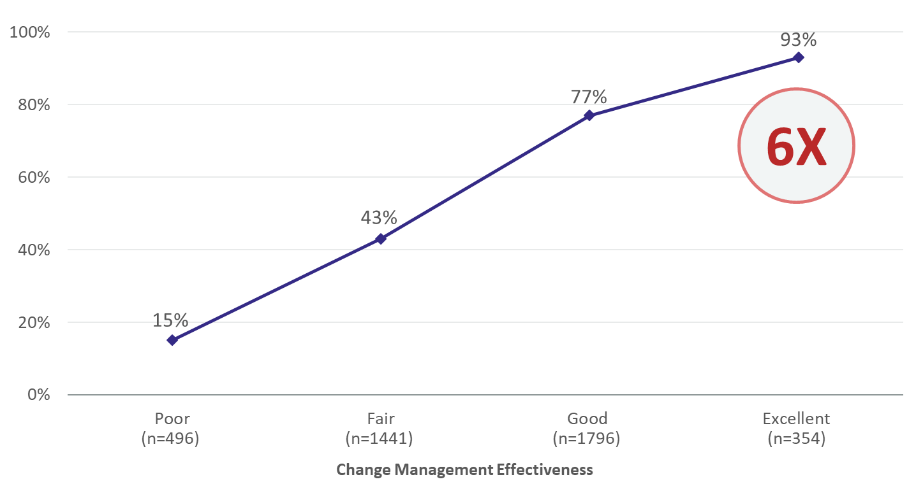
Ensure ROI: connecting CM to benefits and outcomes
Participants with the highest level of change management effectiveness are 6X more likely to meet or exceed project objectives
“93% of participants who reported having excellent change management effectiveness, met or exceeded project objectives”.
Source: PROSCI Benchmarking Data (data from 2007, 2009, 2011, 2013 2015, 2017
Notes:
PROPOSED SPEAKING NOTES:
Projects with excellent change management are 6 times more likely than those with poor change management to meeting project objectives.

Slide 26
Workplace CM value & correlation with project success¹
Not only are projects with excellent change management 6 times more likely than those with poor change management to meet project objectives (93% vs. 15%), but also to stay on or ahead of schedule (69% vs. 14%) and stay on or under budget (78% vs. 49%)
Individual change | The value that the project delivers is tied to speed of adoption, user satisfaction, ultimate utilization, and proficiency in new ways of working supported by the new workplace.
Cost avoidance | There are significant and quantifiable costs when the people side of change is poorly managed, at both the project and the organizational levels. Extra costs and time are required to move through implementation steps when stakeholders are not adequately engaged, as well as to fix the solution after the fact if we fail to engage employees up front and throughout the project.
Risk mitigation | A structured change management approach can mitigate operational and reputational risks by engaging stakeholders at each stage of the project.
Benefits realization insurance | Much of the value of GCworkplace is derived from employees changing the way they work by adopting new workstyles, digital tools and spaces. We avoid eroding the benefits by supporting the adoption of the new behaviours with training and communication.
Probability of meeting objectives | There is a growing body of evidence that project objectives are more likely to be met when an effective change management strategy is applied.
¹ Prosci Cost Benefit Analysis of Change Management
Notes:
PROPOSED SPEAKING NOTES:
They are also more likely to stay on or ahead of schedule and stay on or under budget.
How much of the expected project benefits will be realized if no one adopts flexibility and uses the tools & spaces as intended (if adoption and usage are zero)?
Value comes from employees adopting flexible workstyles, digital tools, and collaboration, not only from the built environment providing modern, inclusive, healthy & sustainable workplaces.

Slide 27
Change management investment
Change management services cost ~3-5% of project budget¹ and contribute significantly to project benefits
Name of project
Overall project budget (approx.) | $000.00
 | Example A (3%) | Example B (5%)
Change management service costs (% of overall project budget) | $000.00 | $000.00
Cost per employee (based on XX FTE) | $0.00 | $0.00
Cost per employee per year (~XX year(s)) | $0.00 | $0.00
Investing in change management minimizes "RE" costs (revert, revisit, redesign, redo, rework) which can vary from 5-20%¹ in some cases.
¹ Percentages provided by BGIS Change Management
Notes:
PROPOSED SPEAKING NOTES [TO BE MODIFIED BASED ON YOUR PARTICULAR PROJECT]:
Is $xxx/FTE too much to invest for employee well-being and to provide them with a great user experience in their new space?
If employees are an organization’s most valuable (and costly) asset, spending 3-5% of the total project is pretty low, especially spread out on the project’s lifecycle. What about if you compare it to the amount of money you may need to spend after?… Not just the “RE costs” (revert, revisit, redesign, redo, rework) mentioned here which can vary from 5-20% . We all know that unhappy, disengaged employees take more sick days. It cost more for 1 employee sick day than the cost you will need to spend on them for CM to the entire project. What about loss in productivity when employees don’t know how to properly use tools or since they haven’t been shown the benefits to use them, revert to their old way of doing things. These are some of the risks you can encounter if change is not appropriately managed.

