Slide 1

A-LAN-A experimenting with an innovative approach to language training
Combining artificial intelligence and human expertise to support second official language learning
Official Languages Symposium
November 19, 2025

Slide 2
Introductions
Canada Revenue Agency - Human Resources Branch
Employment Programs Directorate – Official Languages and Recognition Division
  Sylvie Bolduc : Director of the Official Languages Program
  Abdi Aden Chil : Learning Advisor and Project Coordinator
Leadership and Learning Directorate – Horizontal and Technology Solutions Division
  Michael Ellison : Director, AI and HR Innovation
Successful collaboration between cross-functional teams

Slide 3

What problem are we examining?
A growing gap between language training needs and current offering
Problem
Growing and diverse language needs ↗
Need for flexibility in training approaches ↗
Lack of funding and administrative constraints ↘
How can we increase access to language training to more people at a lower cost through an innovative approach powered by artificial intelligence?

Slide 4
A-LAN-A : an AI tool for language learning tailored to the needs of employees on a limited budget
Our vision and hypothesis
Our hypothesis - Well-structured, A-LAN-A can :
  improve, develop, and maintain language progress
  strengthen learners' autonomy and motivation (andragogical principles)
Explore the potential of this approach to :
  Increase the accessibility and flexibility of language training for a large group of learners
  Reduce the logistical and financial constraints of language training
  Contribute to institutional bilingualism and to digital modernization of the Agency
More flexible, personalized, effective, and innovative language training

Slide 5
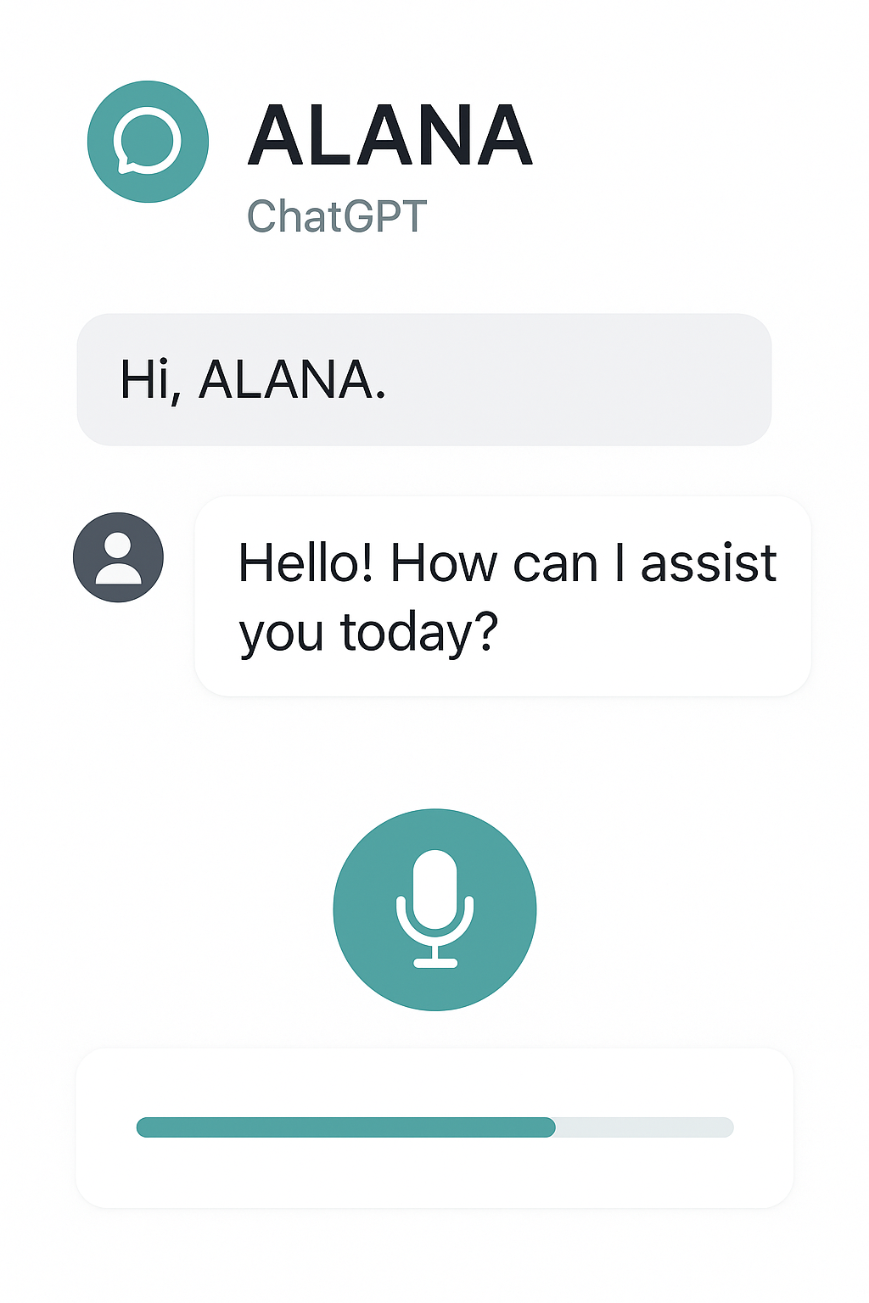
Our experimental framework
A-LAN-A : a practical and accessible experiment with an AI tool
Technology : ChatGpt free version
commande vocale avec microphone
Training program components:
  Language training products from the Canada School of Public Service
  French as a Second Language Program
  English as a Second Language Training – Advanced Level
Experimentation period : 3 months
Participants : 67 participants divided into 3 groups
Support from a language coach at various levels depending on the group
Assessment methods (before and after) et regular progress follow-ups
Rigorous, measurable, and personalized monitoring

Slide 6
What we observed and learned
A-LAN-A : when AI becomes a driver of autonomy and improvement in
language skills development
Strengths of AI approach
  Significant improvement in language skills
  Enhanced self-learning autonomy
  Adaptability to specific profiles and needs
  Linguistic security—due to absence of human judgment
Weaknesses
  Technology limitations
  Lack of structure when no human guidance is provided
Group A 2x month | Group B 2x week
20 participants | 16 participants
45% progress | 75% progress
  Synergy between AI and language coaching produces the best results

Slide 7

A-LAN-A and human coaching – a winning combination
A-LAN-A offers unlimited practice and objective feedback, while human coaching provides guidance, motivation, and personalization
AI Tutor : unlimited practice, immediate feedback, progress tracking, 24/7 accessibility
    81% motivated and engaged
Coaching : personalized support, learning strategies, emotional and context-specific support
    89% satisfied or very satisfied
Complementarity : an effective combination for sustainable, motivating, and flexible learning
Complementarity that makes learning a second official language optimal

Slide 8

A-LAN-A + Human Coaching: tangible efficiency gains
What we recommend
⏱️ Time optimization ↗ : independent and flexible practice, without time constraints
💰 Cost reductions ↘ : More learners trained simultaneously at lower cost
Targeted intervention by human coaches for maximum impact
📈 Economies of scale : A coach can support more learners thanks to the AI tutor, who
handles the practice
More employees trained, at lower cost, without compromising quality of training

Slide 9



Critical steps for a broader implementation
What we would like to achieve next
Cost analysis and selection of the best tool for ROI
Address technology aspects, security, and data protection
Develop coaching skills and embed learning strategies
Testing adaptability for diversity and accessibility needs
We extend an invitation to departments who would like to partner with us

