Slide 1
Adaptive Action - The Power of Inquiry
Initiative Lead: / Leader de l'Initiative : Carey Hall
Leadership Team: / L’equipe du leadership :
Alejandro Gonzalez
Stacey Ileleji
Stephanie Lalonde
May 19, 2020 / 19 mai 2020

Slide 2
Agenda
Informal icebreaker: Introduce yourself, where you work and how you heard about this session.
Grounding/centering mindfulness exercise.
Leverage the collective wisdom of this group and, using the Power of Inquiry, explore a challenge or issue.
Share & Learn from the experience.
Connect with your colleagues -
web cams welcome!
Bring your coffee, water or lunch!

Slide 3
Exploring Mindfulness: Creating a safe, shared space
This short exercise will give us the opportunity to fully arrive to this meeting and create a collective exploration space.
You can close your eyes if you are comfortable doing so or keep your eyes open and have a soft gaze downwards.
Bring attention to how you are sitting and find a comfortable position.
Follow my voice as I lead you through the exercise.
Then, we will do a short debrief of what you noticed.

Slide 4
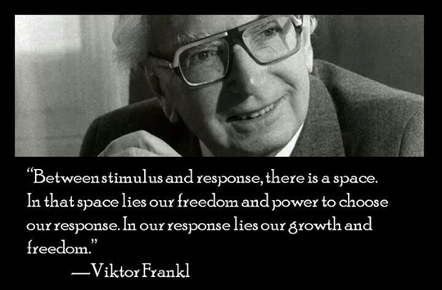
Welcome
Notes:
Slide for when people wait to start the WebEx
REMEMBER:
Give participants the privilege to chat to “all participants” (by Ctl-K, checking the chat for “all participants” box)
Start the recording, and pause it while waiting for the participants to join.
Continue recording for starting the session, just before removing this slide.
Ask participants to use the check for yes and cross for no, so they warm up to the idea of interacting.
---
Please, via the chat box, introduce yourself with
Name
Department or Agency
Where you’re located
Your expectations for this session

Slide 5
What is Mindful Change Leadership?
Mindfulness allows us to be fully aware in the moment. We accept our thoughts, feelings, bodily sensations, and surrounding environment, what we’re sensing, without judgment or interpretation.
The Mindful Change Leader, while acknowledging there is a big picture and ambiguity about the future, is present, curious, and non-judgmental.

Slide 6
Why Inquiry?
“Inquiry is the key to transformation. In a complex system, answers have short shelf-lives, but good questions serve you forever. Questions help you see a wicked challenge clearly, understand it from a new perspective, and find surprising options for transformative action.”
- HSD Institute, Power of Inquiry
In other words, “answers don't last long on complex systems, thus inquiry allows you to identify what the next wise step is.” - Glenda Eoyang, Founder & Executive Director HSD Institute
* Used with permission: https://www.hsdinstitute.org/

Slide 7
What do we mean by Inquiry?
Our intention is to cultivate relationships.
Turn judgment into curiosity
Turn disagreement into shared exploration
Turn defensiveness into self-reflection
Turn assumptions into questions
* Used with permission: https://www.hsdinstitute.org/

Slide 8
What is a Wicked Issue?
Many levels
Many stakeholders
Massive interdependencies
Fuzzy boundaries
Repeating, but never exactly the same
No root cause
Cannot be solved, only influenced
* Used with permission: https://www.hsdinstitute.org/

Slide 9
How do we shift this pattern?
What?
How is the pattern currently manifesting?
See the issue, with whatever you know.
So what?
What do you know? What are your insights and options?
Whatever sense you can make of the situation.
Now what?
What is the next wise action that will shift the pattern in a more productive direction?
With whatever power you have, no need to find something big or work on the whole pattern at one time.
* Used with permission: https://www.hsdinstitute.org/

Slide 10
How do we apply Inquiry to an issue?
Issue is framed in 3 to 5 sentences
Concrete facts and issues.
Where are things “stuck”?
What is the pattern?
Questions that explore the issue
Open-ended
Not disguised as advice
Beyond the knowledge of the asker
Describe your
next wise action
What makes sense now?
What can you do next?
Good questions help create a deeper understanding of the problem space.
* Used with permission: https://www.hsdinstitute.org/

Slide 11
Group reflection
What have we learned?
Any new insights?
* Used with permission: https://www.hsdinstitute.org/

