Slide 1
Fall 2019

Slide 2
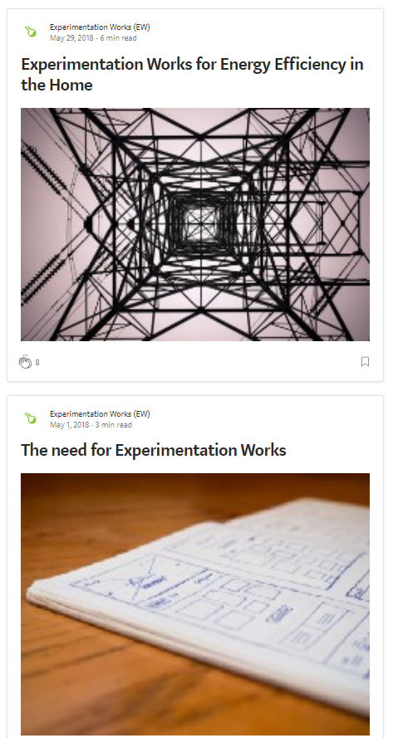
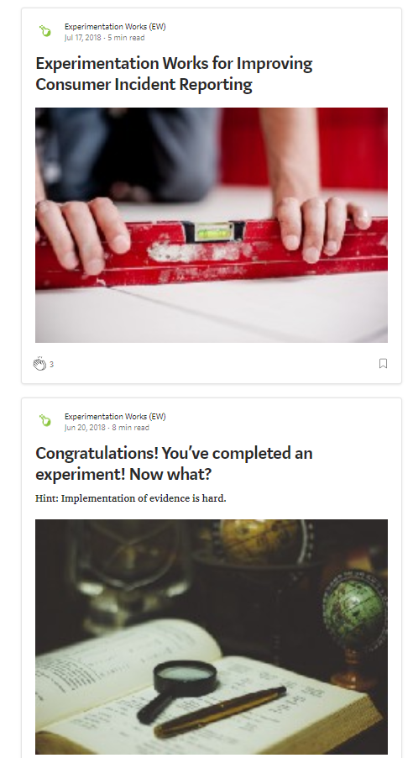
What is Experimentation Works?
Experimentation Works (EW) is a scalable initiative to build the capacity of the public service to experiment through a learning-by-doing model that supports and showcases a variety of experiments in the open.
EW was designed to support the 2016 Experimentation direction for Deputy Heads which encourages “ testing new approaches to learn what works and what does not work using a rigorous method”.

Slide 3
EW FEATURES
PRACTICAL COHORT MODEL
+
SHOWCASES A VARIETY OF EXPERIMENTATION METHODOLOGIES
+
BUILDS NETWORKS AND MOMENTUM
OPEN-BY-DEFAULT ACCESS
+
TANGIBLE RESPONSE TO DEPUTY HEAD EXPERIMENTATION DIRECTION
+
MODEL DESIGNED FOR ITERATION AND SCALE

Slide 4
How EW Works (see slide 12 for timelines):
Identify: TBS engages broadly with potential partners inside and outside of the GOC in order to identify sources of expert support for EW.
Apply: Departments interested in running a proposed experiment project through EW apply to the selection process.
Select: TBS will make the final project selection taking into account advice from an expert panel.
Support: Departmental teams receive support for running their experiment in the form of expert advice, central agency support, and ongoing training and learning events.
Experiment: Departments define, design, run, evaluate and validate their experiments.
Share: EW2 Cohort will regularly share challenges, insights and individual project updates through regular blog posts. A final impact and failure report will also be shared.
HOW

Slide 5
EW Support Team:
A cross-functional team at TBS will be dedicated to ensuring a smooth process and that lessons learned are shared broadly.
Experimentation design experts:
Individuals with experimental design expertise from within and outside the GoC will provide expert support for: EW design, project selection, designing and running experimental projects, and training purposes.
Departmental leads:
The respective leads of each selected departmental project will own and manage their experimentation projects, with support from TBS and experts.
Co-funders and Partners:
EW will benefit from support from key departments and agencies providing funding and partnership.
Central Agency and GOC-wide ADM Support:
As champions for EW, TBS, in partnership with the ADM Committee on Experimentation, will provide enabling supports and, where possible and necessary, address any barriers that arise.
EW1 Mentors:
Departmental leads will benefit from insights of participants from the past cohort, pending cohort availability.
WHO

Slide 6
EW IS:
Intentionally scoped to reflect current capacity
Designed to accommodate a variety of entry-points into experimentation, from the uninitiated to the more advanced
A practical response to demand for GoC experimentation examples and experts
Envisioned as a sampling of what is possible using experimentation
EW IS NOT:
Intended to run your experiment for you
Designed to turn cohort participants into experts by programme end
Created to take on longitudinal or multi-year experiments
Replacing requirement for departments and agencies to take ownership of projects

Slide 7
Overview of EW1:
Between Spring 2018 and Spring 2019, Experimentation Works followed the first cohort of EW participants (EW1) which included public servants running experiments and public servants providing central agency or expert support. Each project team was matched with an experimentation expert to help them develop and execute their vision. Lessons learned were shared along the way and through a series of retrospective reports released in July 2019.
EW1 At-A-Glance
08
11
20
37
DEPARTMENTS
LEARNING EVENTS
BLOG POSTS
COHORT MEMBERS
3 departments ran 4 experiments with the support of 5 other departments, totalling 8 participating departments.
11 learning events were delivered, with a cohort satisfaction rate of 85%.
More than 20 blog posts were published in the open covering the experimentation journey.
EW1 was composed of 37 public servants who either ran experiments or provided support.
TEXT
TEXT
T
4 experiments run in the open.
100+ professional connections formed.
5 national and international acknowledgements and awards.
OUTCOMES:

Slide 8
EW1 Projects At-A-Glance (2018-2019)
Multiculturalism Initiative (PCH)
Consumer Incident Reporting (HC)
EnerGuide Labelling (NRCan)
Energy Efficient Homes (NRCan)
What is the user experience of youth participating in a new micro-grant initiative to promote multiculturalism?
Does improved user experience increase the number of product safety issues reported to Health Canada?
Which EnerGuide label designs are the most effective in conveying information about energy efficiency to home owners?
How effective are different messages at nudging home owners to complete a home energy evaluation?
PROGRAM DESIGN
CONTENT DESIGN
VISUAL DESIGN
MESSAGE DESIGN
Before / After Design
A / B Testing
Randomized Controlled Trial
Randomized Controlled Trial
7

Slide 9
EW1 RETROSPECTIVE
What Worked Well:
Expert-matching seen as key success factor
Cohort model was the appropriate type of approach
Open-by-default emerging as best practice for experimentation spaces worldwide
Network effect seen to have created long-term impact for participating departments
Room for growth (EW2):
Open the proposal process government-wide
Ensure training is better aligned to actual needs
Increase the number and type of GOC and external expert partnerships
Build in more time to experiment and validate results

Slide 10
“I am proud to acknowledge
that not only was this the first time
our branch (or Department) carried out
a randomized, online A/B test, but also
that our results showed that our intervention was successful at driving uptake into our incident reporting
form by over 30%.”
“As an expert, it was
rewarding to guide and advise project hosts
on experimental designs and considerations, and to
see them move their project forward, surmount obstacles, share experiences, and truly recognize the
value of data in telling a story and informing
decision-making.”
Experience from EW participants
- Insights from a public servant EW Expert
- Email from an ADM from a Participating Department
EW is Internationally Recognized for its Impact:
A 2018 Case Study listed in the OECD Observatory of Public Sector Innovation (OPSI)
Shortlisted for the Workplace of the Future Award 2019 by Apolitical, a Certified B Corporation focused on public sector innovation
Reference to EW’s open-by-default approach in an article by Dr. Jen Gold, head of the What Works Centre at the UK Cabinet Office
Video presentation on Canada’s approach to experimentation to Finnish Cabinet (Fall 2018).
“Participating in EW made our
project better. The experts brought knowledge in experimental design that were not readily available to us. With an outside perspective on our project, they challenged us on our understanding of the problem which solidified how we framed the experiment. TBS was our enabler, helping
us tackle and overcome barriers.”
- Insights from a departmental project lead and EW participant

Slide 11
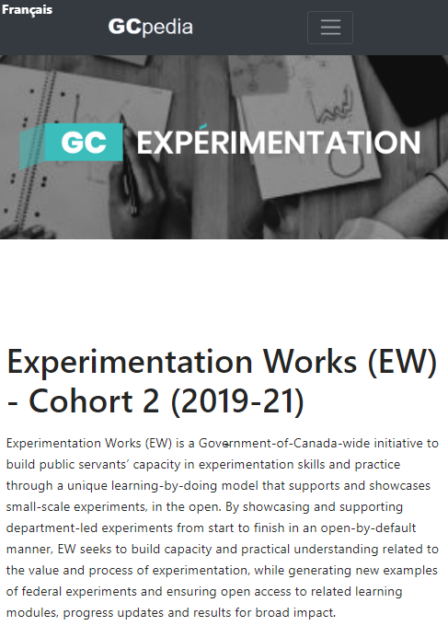
LAUNCHING EW2 (2019-21):
Objective: Continue to build capacity while improving EW based on lived experience, lessons learned and in recognition of growing maturity in the federal experimentation space.
Expanded features of EW2:
1. Launch GoC-wide call for proposals leveraging brand awareness and proven success of model.
2. Develop more robust training material and offer it across the GOC while also providing tailored support to departments based on varying levels of capacity.
3. Broader scope for partnerships including increased number of GOC partners and external partners.
4. More time to experiment based on lessons learned from EW1.

Slide 12
EW2 At-A-Glance
Fall
2019
Winter
2020
2020
Winter
2021
Spring
2021
Outreach & Call-Out Phase
Project Selection
Design & Run Experiments (1 year)
Results & Wrap-Up
Call for proposals with selection criteria will be launched across the GOC in Fall 2019.
Final projects will be assessed based on a variety of factors including feasibility, level of support and diversity.
Ongoing documentation and support for experimentation
Project teams will be matched with experts in early 2020 and benefit from ongoing training and support as they design and run their experiments.
Spring 2021 will feature final project-level and EW-wide reporting and wrap-up.

Slide 13
Is your department looking to champion a more agile, evidence-based and experimental government?
EW seeks to support the growing recognition of the need for a more innovative and effective governance by emphasizing:
A learning culture by mobilizing evidence informed by experimentation to course correct, improve and de-risk programming;
A culture of openness and transparency in government by demonstrating experiments in action;
Talent-matching by recruiting internal and external talent in high-need areas such as experimentation;
High-quality content curation to provide increased resources for the government as-a-whole; and
Link to whole-of-government mechanisms, such as improving quality of responses to the experimentation question in MAF.
WHY
PARTICIPATE IN EW2?

Slide 14
Is your department looking to build capacity or get extra support for ongoing experimentation activities?
EW provides an ‘on-ramp’ for departments looking to kick start experimentation or amplify pre-existing activities by providing:
Training modules and other supportive resources to help guide the completion of each stage;
Access to experts in various stages of experimental design;
Senior-level support to address barriers and needs; and
Access to an emerging network of practitioners.
WHY
PARTICIPATE IN EW2?

Slide 15
Are you thinking of launching, or are about to start, a project that could be an experiment, either at a small or large scale?
Would this project have a strong focus on experimental methodology?
Randomized designs (e.g. randomized controlled trials)
Quasi-experiments (e.g. regression discontinuity designs)
Pre-experimental designs (e.g. qualitative or quantitative research to establish a baseline, to then design and implement an experiment)
Do you/could you have support from management to design and implement your experimental project?
Do you currently have some people interested in the project, and access to some expertise, but perhaps lack the technical and/or analytical expertise to fully implement the project?
Do you think your project could be designed, implemented and finalized within a year?
If you can say YES to the above, we encourage you to apply!
IS EW FOR ME?

Slide 16
A typical project requires:
1 departmental lead ideally coordinating a departmental team. Does all the heavy lifting to keep the project on track & engage within their department; and
Supportive management to conduct experiment and utilize results as expressed through a signed MOU.
A typical project will receive support from:
1 TBS EW coordinator (up to 1h per week);
1 TBS in-house expert (standing access - up to 1h/week);
1 dedicated experimental design expert (up to 2-5h/month); and
1 EW mentor (up to 1h/week, pending availability of EW1 cohort).
WHAT TO EXPECT

Slide 17
We are also looking for individuals with expertise and experience in experimental methodology, as typically demonstrated by:
A postgraduate degree with relevant specialization on experimental methodology (e.g. behavioral economics, psychology, natural sciences, etc.); and/or
Relevant experience in designing, implementing and analyzing experimental projects in any setting (e.g. lab, field, government, etc.).
As an expert you can support EW2 in various ways:
Assessment panel: Review submitted projects.
Expert advisor to a department: Guide and advise participating departments in the implementation of their experimental project.
Cohort support: Provide expert support to the cohort as a whole, e.g. by leading a training session on an experimentation-related topic.
HOW CAN EXPERTS SUPPORT EW2?

Slide 18
By joining EW2 and the wider experimentation community, you will:
Put your highly valuable experimental expertise to good use and will share, exchange and advise project teams based on your specific skill set;
Get hands-on experience at various stages of experimental projects (e.g. design, analysis, dissemination) with various federal organizations and programs;
Expand your network of experts by collaborating with like-minded people on fascinating projects;
Get national and international exposure, through EW communication channels and connections here an abroad (e.g. blogs, publications, events, etc.);
Gain a strong understanding of how experimentation is supported by organizations in the federal landscape.
BENEFITS OF BEING AN EW EXPERT

Slide 19
Apply to become part of the EW2 Cohort by submitting your project proposal as described here: http://www.gcpedia.gc.ca/wiki/Experimentation/ew2
Partner with TBS as a Support Department by providing talent and/or financial resources to secure expertise in experimental design.
Have a question or want to discuss your project idea? Set up a 30 minute chat with us right now using this link: https://calendly.com/gcexperimentation
Help us spread the word by circulating this document widely.
HOW TO GET INVOLVED

Slide 20
For any questions, please get in touch:
Kaili Lévesque, Executive Director: Kaili.Levesque@tbs-sct.gc.ca
Nick Chesterley, Director: Nicholas.Chesterley@tbs-sct.gc.ca
Sarah Chan, Advisor: Sarah.Chan@tbs-sct.gc.ca
TBS Experimentation Team (generic inbox): zzexper@tbs-sct.gc.ca
For more information, check out our content online:
EW2 on GCpedia: http://www.gcpedia.gc.ca/wiki/Experimentation/ew2
TBS Experimentation Team on Gcpedia: http://www.gcpedia.gc.ca/wiki/Experimentation/team
Experimentation Works on Medium: https://medium.com/@exp_works
Experimentation Works on Canada.ca: https://www.canada.ca/en/government/publicservice/modernizing/experimentation-works.html
MORE INFO
& CONTACT

