Slide 1
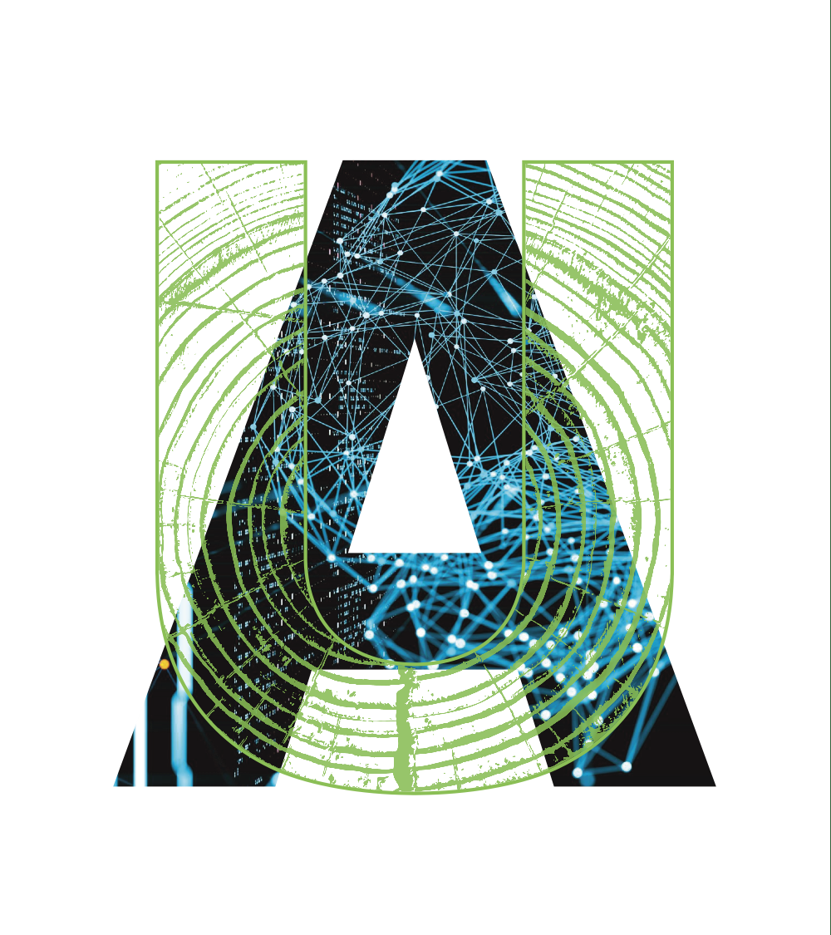

Integration of Resilience in Transportation Infrastructure: Data and Research Opportunities
Dr. Stephen Wong, P.Eng.
Assistant Professor

Slide 2
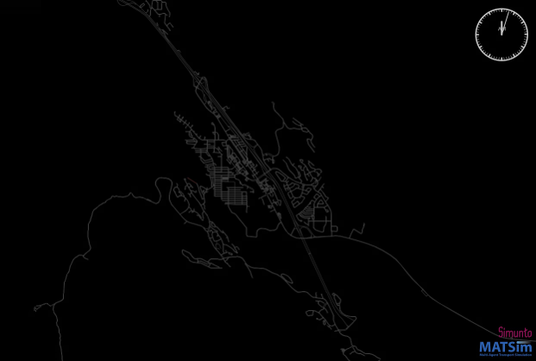
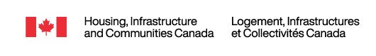
Case 1: Data Integration into Simulations
Joint work by UBC and UofA
Through an agent-based model, assign behaviours to the individual based on survey data
Sample: n≈2,800 in Alberta and British Columbia on intended evacuation choices
Simulation allows for closer inspection of bottlenecks, especially for infrastructure
Future Goal: Apply modelling across Canada
Source: Hassanzadeh et al. (2025)

Slide 3
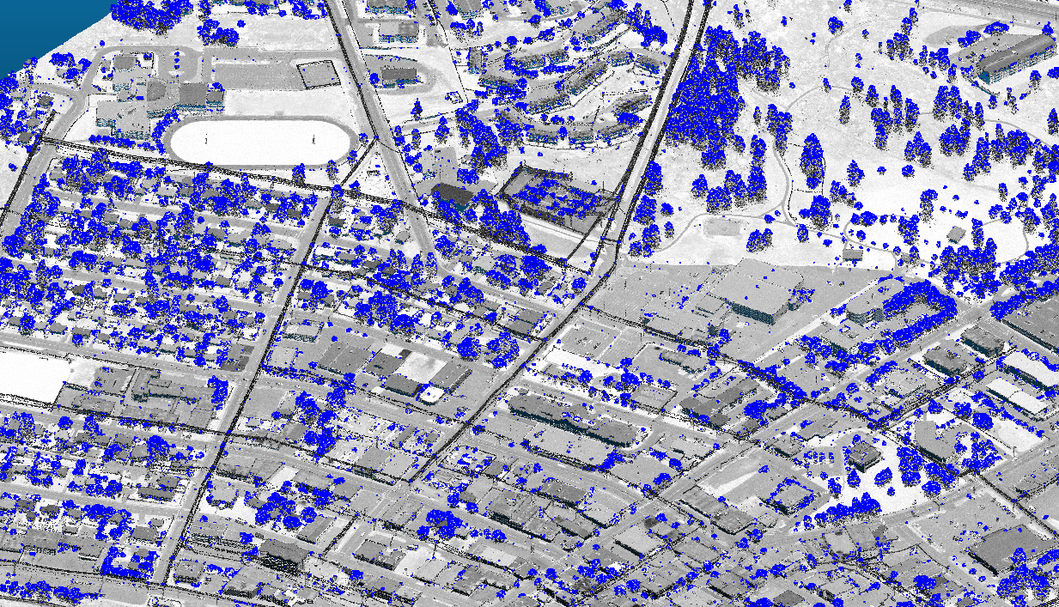


Case 2: LiDAR Assessment of Roadways
Williams Lake, BC
Aerial LiDAR data identifies features of roadways that would inhibit a successful evacuation
  Narrow road widths
  Parked vehicles
  Intersection with hazards
  Discontinuous sidewalks
  Power lines
Nelson, BC and Williams Lake, BC
Future Goal: Automate feature analysis
Segment of Williams Lake with vegetation that surpass 5 meters extracted (blue) using relative height and rasterize tool (Calvo and Wong, 2025)

Slide 4
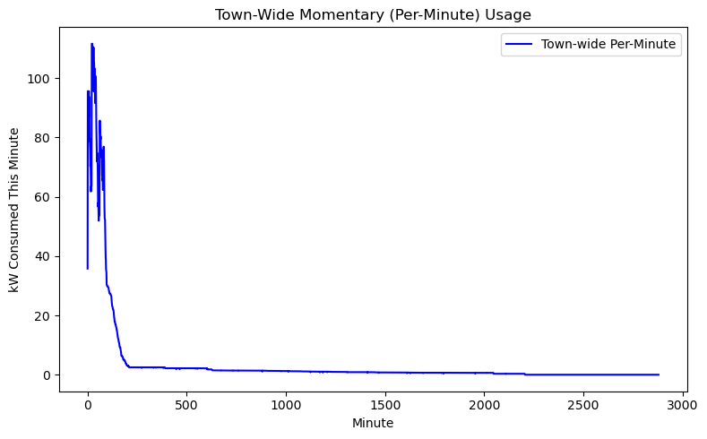
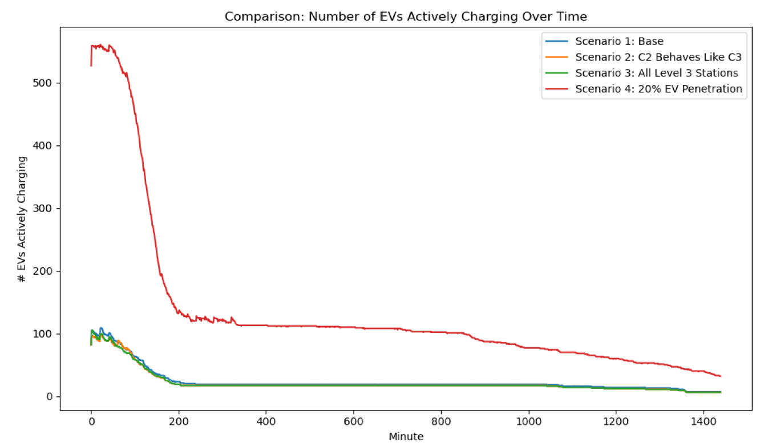


Case 3: Electric Vehicles in Disasters
Create agent-based models using intended charging behaviour data from residents
Helps identify charging needs and electricity demand
Multi-pronged surge in demand, though with lower peaks due to spatiotemporal diversity
Future goal: Inform charging infrastructure design, location, and features
Preliminary results for EV charging of 340 EVs in Canmore, Alberta using agent-based modelling (Babaei and Wong, 2025)

Slide 5
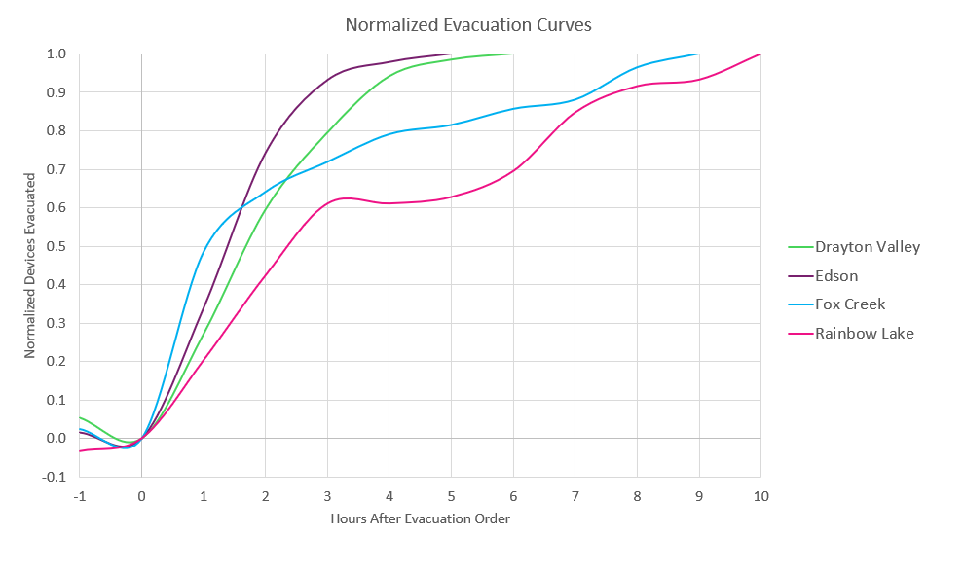


Case 4: Generalizable Evacuation Patterns
2023 Alberta Wildfires and the 2024 Jasper Complex Wildfire (Borody et al., 2025)
Leveraging de-identified, aggregated network mobility data from TELUS
Identify key behavioural patterns before, during, and after wildfires
Calculate evacuation time estimates (ETEs)
Future goal: Continuous reconstruction of wildfires for infrastructure assessments
Source: Borody and Wong (2025)

Slide 6
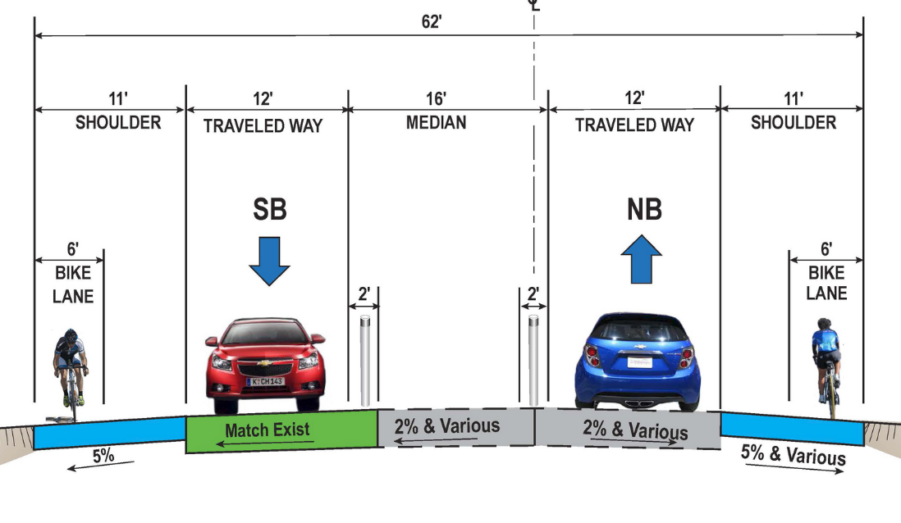
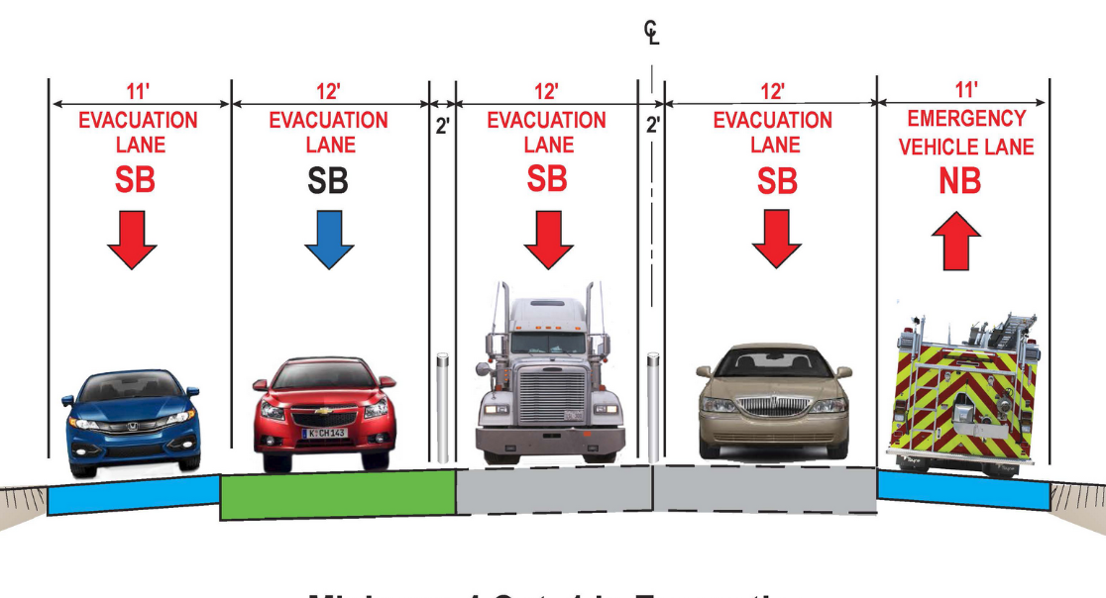

Case 5: Resilient Community Design
Gaps in roadway design guidelines for resilience + possible benefits/tensions of resilience and complete streets (Blain and Wong, 2024)
Considerations for long-term real estate viability and thriving communities
Upcoming assessment of Canmore using LiDAR, field studies, spatial and network analysis, and strategic design
Future Goals: Establish new land use and roadway design guides
Caltrans. (2021) Alternative 6B. State Route 67

Slide 7


References
Babaei, M. & Wong, S. D. (2025). Electric Vehicles and Emergency Evacuations: Infrastructure Challenges and Behavioral Insights from an Agent-Based Model. Forthcoming.
Blain, M., & Wong, S. D. (2024). Integration of Resilient and Complete Streets in Geometric and Roadway Design Guides. Findings. https://findingspress.org/article/116296.pdf
Borody, I., & Wong, S. D. (2025). Evacuation and Reentry Curves for Wildfire Evacuations Using Network Mobility Data. Transportation Research Record, 03611981251331013.
Borody, I., Kinateder, M., Bénichou, N. & Wong, S. D. (2025). A Multi-Source Reconstruction of the 2024 Jasper Wildfire Complex. In Review
Caltrans. (2021) Alternative 6B. State Route 67. [Diagram]. Retrieved March 29, 2024, from: https://dot.ca.gov/caltrans-near-me/district-11/current-projects/sr67-corridor/improvements
Calvo, H. & Wong, S. D. (2025). Identification and Assessment of Transportation Infrastructure Vulnerability for Evacuations using Light Detection and Ranging (LiDAR). Forthcoming.
Hassanzadeh, E., Kim, A., & Wong, S. D. (2025). Incorporating Wildfire Evacuees’ Behavioural Inputs to Agent-Based Evacuation Simulation in Small Canadian Communities. Forthcoming.
stephenwong@ualberta.ca

