Slide 1
What the Evidence Shows:
Racial Discrimination and Health Outcomes for Racialized Public Servants
by Dr. Rose Darly Dalexis
PHAC REN
RESN
ARAN
Notes:
Before we begin, we would like to acknowledge the land. Native-Land.ca | Our home on native land
For those of us joining from the Ottawa/Gatineau region, I acknowledge that we are on the unceded traditional territory of the Algonquin Anishinaabeg People. As we are joining from many different locations today, I also invite you to take a moment to reflect on the Indigenous lands on which you are working. Indigenous peoples have been the traditional stewards of these lands and waters since time immemorial.
For those of us joining Toronto, we acknowledge the traditional territories of the peoples of Turtle Island. The land on which we gather today has been a site of human activity for over 15,000 years and is the territory of the Huron‑Wendat and Petun First Nations, the Seneca, and most recently, the Mississaugas of the Credit River. This territory is governed by the Dish With One Spoon Wampum Belt Covenant, an agreement between the Haudenosaunee Confederacy and the Ojibwe and allied nations to peaceably share and care for the resources of the Great Lakes.
Today, the place known as Toronto continues to be home to many Indigenous peoples from across Turtle Island. We are grateful for the opportunity to live, work, and gather on this land. We also acknowledge that we are all treaty peoples — including those of us who came here as settlers, as migrants in this generation or generations past, and those who were brought here involuntarily, particularly through the Trans‑Atlantic Slave Trade.

Slide 2

Land Acknowledgement
Acknowledgments extend beyond simply recognizing the land you occupy; they encourage settlers, including recent arrivals, to reflect on the history and ongoing impact of colonialism.
For instance, you should consider:
What privileges do settlers benefit from today as a result of colonialism?
How can individuals build meaningful relationships with Indigenous Peoples whose territories they currently inhabit within the modern Canadian context?
What actions are you or your organization taking beyond territorial acknowledgments in your homes, workplaces, or events?
Are there ways in which you may be reinforcing settler colonial futures instead of exploring alternative paths for Canada’s future?
Do you have awareness of the continuing violence and trauma embedded in the colonial system?
https://native-land.ca/
Notes:
Before we begin, we would like to acknowledge the land. Native-Land.ca | Our home on native land
For those of us joining from the Ottawa/Gatineau region, I acknowledge that we are on the unceded traditional territory of the Algonquin Anishinaabeg People. As we are joining from many different locations today, I also invite you to take a moment to reflect on the Indigenous lands on which you are working. Indigenous peoples have been the traditional stewards of these lands and waters since time immemorial.
For those of us joining Toronto, we acknowledge the traditional territories of the peoples of Turtle Island. The land on which we gather today has been a site of human activity for over 15,000 years and is the territory of the Huron‑Wendat and Petun First Nations, the Seneca, and most recently, the Mississaugas of the Credit River. This territory is governed by the Dish With One Spoon Wampum Belt Covenant, an agreement between the Haudenosaunee Confederacy and the Ojibwe and allied nations to peaceably share and care for the resources of the Great Lakes.
Today, the place known as Toronto continues to be home to many Indigenous peoples from across Turtle Island. We are grateful for the opportunity to live, work, and gather on this land. We also acknowledge that we are all treaty peoples — including those of us who came here as settlers, as migrants in this generation or generations past, and those who were brought here involuntarily, particularly through the Trans‑Atlantic Slave Trade.

Slide 3
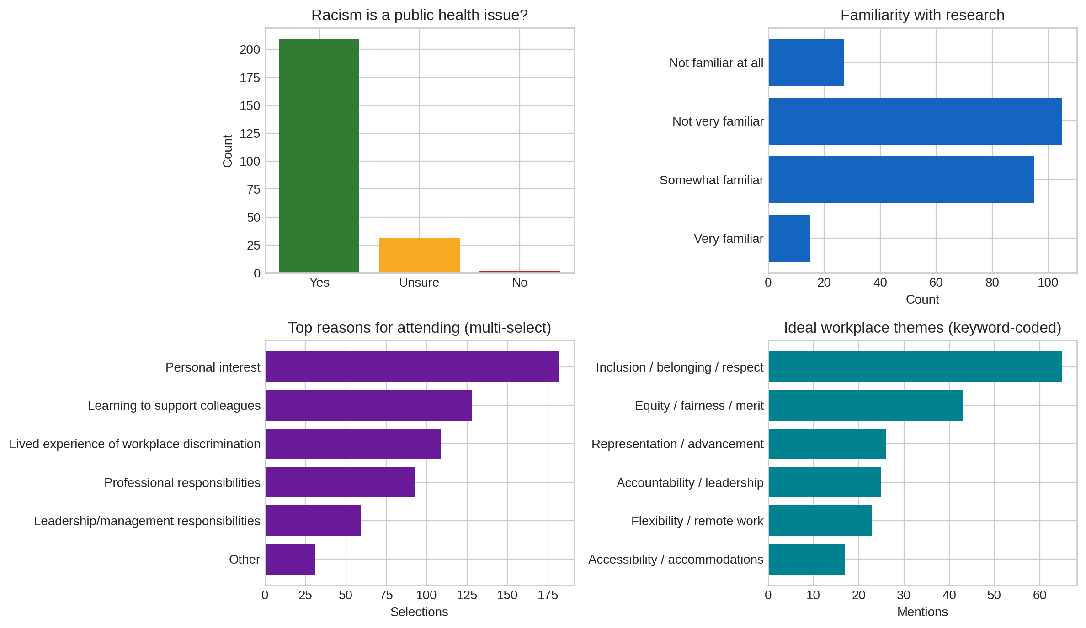
Participant Insights from Registration Data (I–M)
Notes:
Who is in the room
“This audience cuts across government — top representation includes Health Canada, PHAC, PSPC, and ISED, plus a wide mix of employee networks.”
Why they’re here (what to expect from the discussion)
“Motivations are mixed: many are here out of personal interest and to support colleagues, and a large share cite lived experience—so we should expect both learning-focused and experience-grounded perspectives.”
“Most participants are not very or somewhat familiar with the research, so the session should stay accessible and evidence-based rather than overly technical. (118)
What participants want from workplaces (what themes will resonate)
“The strongest workplace themes are inclusion/belonging, fairness/equity, and calls for representation and accountability—these are the areas the participants today will likely listen for in the evidence and in solutions.”
Anchor message
“Finally, there is overwhelming alignment that racism is a public health issue, which gives us a strong shared foundation for the session.” (231 people out of 286)

Slide 4
Participant Insights from Registration Data (I–M)
Racism is overwhelmingly viewed as a public health issue by employees (86.4% “Yes”).
Significant proportions report health impacts tied to racism at work:
• 36.0% “Yes” and 32.6% “Maybe,” indicating two‑thirds experience or suspect harm.
Familiarity with research is low: Only 6.2% are “Very familiar,” and 43.4% are “Not very familiar.” Mean familiarity score is 1.40/3.
Motivations for attending center on personal learning (75.2%), supporting colleagues (52.9%), and lived experience (45.0%).
Every respondent provided an “ideal workplace” description, signalling strong engagement and a wealth of qualitative insight.
TOP Workplace Themes Identified by Participants
Accountability & fairness (transparency, equity): 21.5%
Respect, kindness, empathy: 16.5%
Flexible / remote work: 9.1%
Anti‑racism / anti‑microaggression commitments: 8.7%
Representation in leadership: 6.6%
Learning & career growth: 6.6%
Psychological safety: 6.2%
Accommodations & accessibility: 5.8%
9 in 10 consider racism a public health issue.
Notes:
Do you consider racism to be a public health issue?”
About 9 out of 10 people say yes
About 1 out of 8 people are unsure
Fewer than 1 out of 100 people say no
The registration data shows strong interest in understanding:
– how workplace racism affects mental, physical, and psychological health
– how systemic practices and organizational culture can create risk environments
– what prevention measures, accountability mechanisms, and institutional responsibilities look like in practice
• Many of you also highlighted the need for practical guidance:
– how to recognize risks in your own organizational contexts
– how evidence can be used to drive policy and systems change
– how employees and leaders can contribute to healthier, safer workplaces
• We’ve structured today’s session directly around the themes you identified — the evidence, the health impacts, the organizational risk factors, and the pathways toward prevention. We encourage you to bring your own insights and questions into the Q&A.

Slide 5


What the Evidence Shows:
Racial Discrimination and Health Outcomes for Racialized Public Servants
Examining the profound health consequences of systemic discrimination in Canada's public sector workplace
by Rose Darly Dalexis
Notes:
Ten years ago, I completed my Bachelor’s degree in Industrial Relations.
At the very beginning of my career as a human resources professional, I quickly realized that the experiences of marginalized groups—particularly racialized workers and immigrants—were not the same as those of other groups.
The barriers were numerous: from hiring and salary evaluations to promotion opportunities.
Through both my professional and personal experiences, I developed a deep curiosity to better understand the situation of these workers.
This led me to pursue a Master’s degree, specializing in psychosocial factors affecting mental health.
Back in 2020, there were no race-based data available in Canada — no way to compare or measure the experiences of racialized employees.
That realization motivated me to continue my career in research, focusing on understanding the lived experiences of marginalized workers, and more specifically, on workplace racism among racialized employees.
My goal has always been clear: to help dismantle systemic barriers and equip workers with the knowledge and tools they need to thrive.
My name is Rose Darly Dalexis, and I want to warmly welcome you to today’s webinar on the Impacts of Workplace Racism on the Mental and Physical Health of Black Canadian Public Servants.
Thank you for being here with us today.

Slide 6


PRESENTATION ROADMAP
Overview
Racial Discrimination in the Workplace Among Racialized Employees
Racial Discrimination in the Public Sector Workplace
The Experience of Black Workers in Canada
Narratives: Black Public Servants
Health Consequences of Workplace (WP) Racism
  Mental health effects
  Physical health effects
  Physiological health effects
  Explanation of stress pathways
  (link between discrimination chronic illness)
  Call to Action and Closing Comments
Discussion / Q&A
Notes:
Today, I will highlight the key areas where racial discrimination can occur in the workplace.
I will present the findings from three studies, focusing on the experiences and lived realities of Black public servants, as well as the mental, physical, and physiological health risks associated with these experiences.
We will also explore the voices and testimonies of Black public servants in Canada,
and discuss prevention, redress, and organizational transformation measures that are essential for achieving long-term and sustainable change

Slide 7
The Hidden Crisis
2021-Pan Canadian Survey
Workplace racial discrimination was reported by 2 out of 5 racialized employees, with prevalence rising to
1 in 2 among Black employees (Zhou et al, 2022)
2021-2022
Workplace racial discrimination affected
3 out of 5 racialized Canadian Workers (Forste, 2023)
2021-2022
47% of Black respondents reported discrimination in hiring, promotion, and pay, compared to 23% of Indigenous and 24% of Asian respondents (Foster et al, 2024)
Notes:
- split into 2 slides
Before going any further, it’s essential to look at what the data tell us.
The numbers reveal a troubling reality — a hidden crisis that continues to shape the experiences of racialized employees.
Workplace racism remains a reality that is far too often overlooked. Yet its effects on the mental health, physical well-being, and professional trajectories of racialized individuals are profound — and have long remained under-documented.
In other words, Black workers continue to be the most affected by discriminatory practices in professional settings.
This demonstrates that systemic barriers persist not only at the hiring stage, but throughout the entire career path.
These figures are more than just statistics — they reflect a lived reality experienced daily by thousands of racialized employees.
This hidden crisis calls for institutional recognition, concrete action, and a deep transformation of workplace cultures.
In short, the data speak for themselves: workplace equity remains a goal to be achieved, not yet a lived reality.

Slide 8
Alarming Statistics
FOR DECADES
Black, Filipino, and Indigenous individuals reported the highest rates of Workplace Racial Discrimination, evident in hiring biases, wage gaps, and limited career advancement
2021 to 2024 Social Survey
2024
28% of non-white and 48% of Black participants have reported experienced unfair treatment in hiring, pay or promotion because of their race (Foster et al, 2024)
41% of the racialized individuals and 48% of Black declared having experienced discrimination when applying for jobs or promotions (Statistics Canada, 2024).
Notes:
- split into 2 slides
Before going any further, it’s essential to look at what the data tell us.
The numbers reveal a troubling reality — a hidden crisis that continues to shape the experiences of racialized employees.
Workplace racism remains a reality that is far too often overlooked. Yet its effects on the mental health, physical well-being, and professional trajectories of racialized individuals are profound — and have long remained under-documented.
In other words, Black workers continue to be the most affected by discriminatory practices in professional settings.
This demonstrates that systemic barriers persist not only at the hiring stage, but throughout the entire career path.
These figures are more than just statistics — they reflect a lived reality experienced daily by thousands of racialized employees.
This hidden crisis calls for institutional recognition, concrete action, and a deep transformation of workplace cultures.
In short, the data speak for themselves: workplace equity remains a goal to be achieved, not yet a lived reality.

Slide 9
Workplace Racial Discrimination Among Racialized Workers
69.53% of Racialized workers have experience at least on type of Workplace Racial Discrimination (WP-RD).
Slower promotion and Pay raise and not getting hired are the most prevalent type of WP-RD.
Notes:
This slide illustrates the types of racial discrimination in the workplace from a survey conducted between 2023 and 2024 reported by racialized workers in Canada. This chart shows that workplace racial discrimination is not limited to a single area —
it affects hiring, promotion, compensation, interpersonal relationships, and even job security.
Overall, it impacts the entire career trajectory of racialized employees.
Nearly 70% of respondents stated that they had experienced at least one form of racial discrimination at work.

Slide 10
Workplace Racial Discrimination in Canadian Public Service Workplaces
More than half of the racialized workers have experienced at least one type of WP-RD.
All types of Workplace Racial Discrimination (WP-RD) are more prevalent among the public service in comparison to the other working sectors.
Notes:
This histogram illustrate workplace racial discrimination across working sectors. Has you can see, Public servant participants has reported higher rate of workplace racial discrimination than all other working sectors. Overall, more than half of public servant have experienced either workplace racial discrimination in hiring, slower promotion and pay raises, promotion denials, firing and other types of workplace racial discriminations. Prevalences were higher in firing with about 70% of participant reported being fired as result of workplace racial discrimination, followed by 67% of promotion denial

Slide 11
Work Place Racial Discrimination:
Industry and Racial Background
Across all working sectors, Black workers reported more workplace racial discrimination experiences compared to the other working sectors.
The prevalence is higher in the public working sectors
Notes:
These pie illustrate more desagragated data by race and working sector. Regardless of the employment sector, Black workers reported higher levels of racial discrimination in the workplace. The proportion is higher among Black in public sectore, followed by parapublic, private and other sectors such as OBNL

Slide 12

Domains of WP-RD Among Black Workers 1 of 2
01
02
03
Work Organization
Promotion Denial/Slower Access to Promotion
Inadequate Performance Evaluation
04
05
06
Slower Access to Employment Security
Hiring
Firing, Laid Off or Forced to Resign

Slide 13
Domains of WP-RD Among Black Workers 2 of 2
01
02
Racial Harassment
Personal Harms
Misuse of authority
Social exclusion and isolation
Incivility
Work vandalism / work impeding
Threats
03
Racial Microaggressions

Slide 14
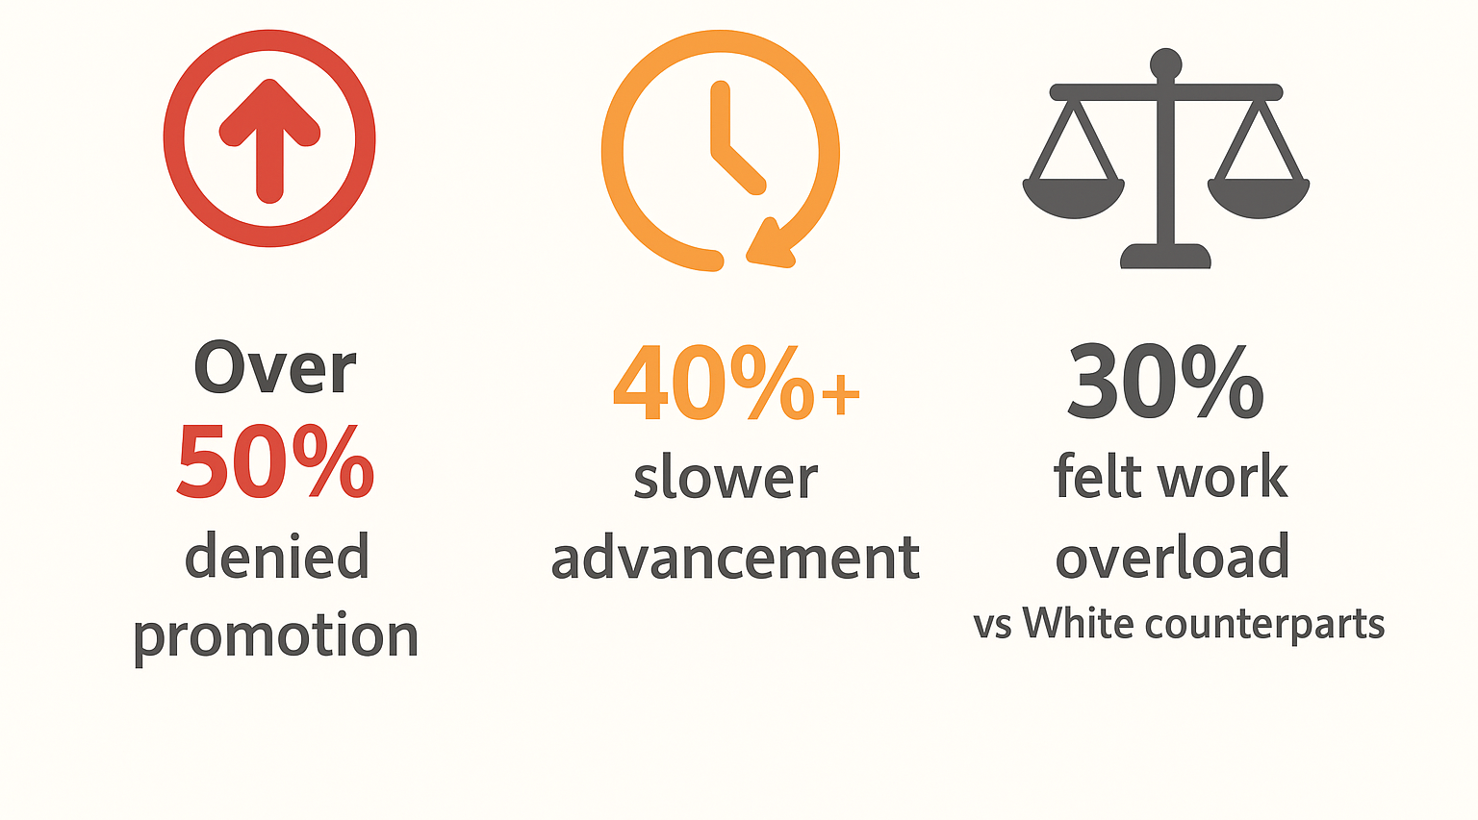



Dr. Rachel Zellers’ report: A Study on the Black Executive Community in the Federal Public Service
Black Executives Experiences
100% faced unfounded allegations
60% experienced harassment
or intimidation
Over
50% denied promotion
40% slower advancement
30%
felt work overload
vs. white counterparts
60% reported Racial
Microaggressions
A Study on the Black Executive Community in the Federal Public Service by Dr. Rachel Zellars, MA, JD, PHD
Notes:
Accessibility- reading order, colour contrast and alt text done.

Slide 15

Real Voices: Experiences from Black Public Servants (1 of 3)
Exclusion from meaningful position
Undesirable Tasks Assignment
“In the process of investigating false accusations against me, of which I was found not guilty, they took away my team, they took away my budget. Despite the end of the process, I didn't return to my initial position”
“She would remove these quote unquote sexy files and give me the not so much. That's right. So, I get to be in the background. You, see?”
Work Overload
Promotion Barriers
“Actually, other employees same level as me have maybe one or two portfolios. Yeah. Yeah… And mine were always over four and five”
“I've been requesting French classes for years, and it was never approved while White colleagues got the French classes they needed”,
“For no reason my supervisor countersigned my scholarship approval, which had already been planned and approved by the other departments”

Slide 16
Real Voices: Experiences from Black Public Servants (2 of 3)
Career advancement barriers
Early Career Exit
My career is blocked. I've been in the same job for 7 years. No one would sponsor my application for higher position since I denounce the racist perpetuators by any means necessary. I'm stuck withing the organization”
On top of all, this last experience made me feel treated lesser than in public push me to retire two years after. It was not the only reason but was definitely one of them.
Promotion Denials
Performance injustice
I have trained many White employees with less experiences than I that became my boss few months later. The higher vacant positions are always offered to them, even if I apply for it too. “I feel like I did not have it not because I am incompetent, but because I am Black” I'd apply for things, whatever it is, a promotion, acting position and not get them, right? The white colleagues would.
I went to one of my White woman bosses, and I said: “hey, I'm just wondering why you gave this acting position to this junior colleague who's only been here for three months, without even offering it to me, who's been here for 10 years”. And she looked me in the face and said: “oh! that's because your work doesn't meet expectations”. However, nothing like this never comes up on my multiple performance reviews.
Notes:
These powerful personal stories highlight the urgent need for comprehensive systemic change throughout Canada's public service institutions.

Slide 17
Real Voices: Experiences from Black Public Servants (3 of 3)
Racial Harassment
“A colleague once came into my office with a red-lipped fluffy monkey. I usually wear red lipstick. She began pretending to babysit the monkey, then she asked me if she could borrow some big markers. She started drawing the monkey on my notepad and eventually made it clear that the drawing was supposed to represent me, implying that I looked like the monkey and that I should be cleaning the toilets. I still have the drawing, in fact. “
Isolation/Exclusion
Incivility
“I was under investigation for false accusations made by a White colleague, of which I was found not guilty. Therefore, everyone was warned not to invite me to any work or social meetings to protect white women. Because she's a victim. They put me in a corner and made fun of me in top of all”
During a meeting where I defended a Black race director against false allegations, someone asked me, “are you sleeping with him?” A similar comment resurfaced when I was granted paid study during a financially difficult time, and people insinuated I might be sleeping with the upper-levels managers
Notes:
These powerful personal stories highlight the urgent need for comprehensive systemic change throughout Canada's public service institutions.

Slide 18
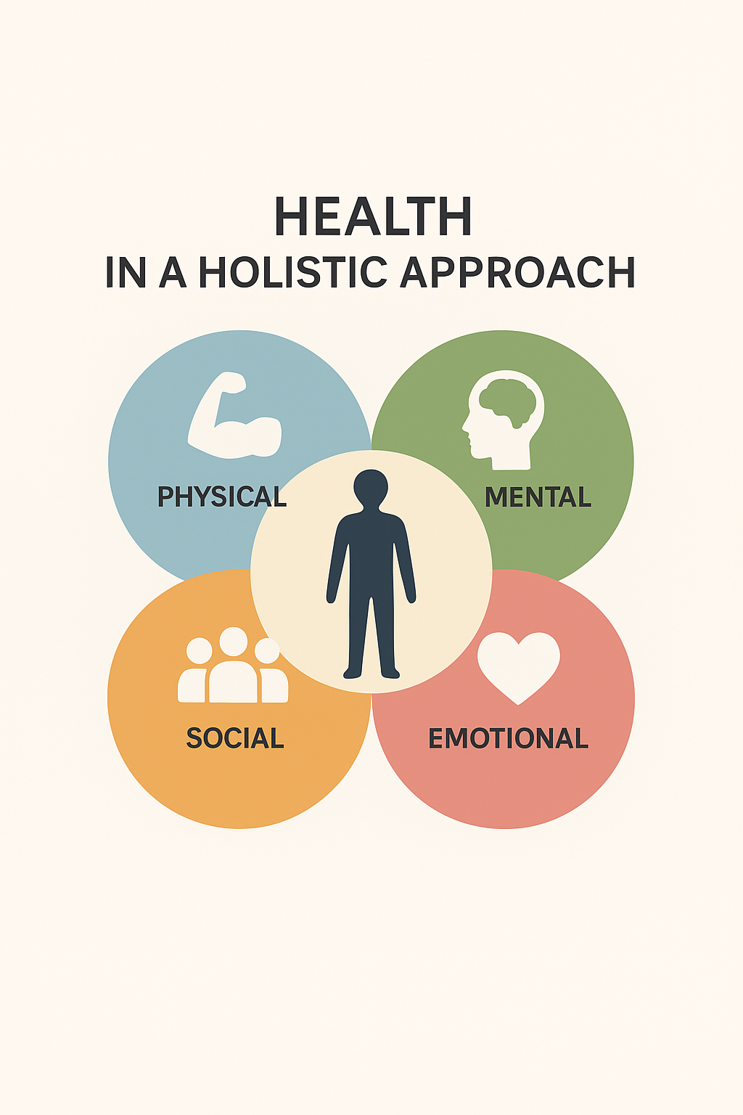
Workplace Racial Discrimination
and
Health
Notes:
Based on the World Healt Organisation, Health doest not mean absence of diseases, it imcompass several interconnected dimensions:
Physical health – proper functioning of the body, disease prevention, and healthy habits (nutrition, sleep, physical activity).
Mental and emotional health – psychological balance, stress management, self-esteem, and resilience.
Social health – quality of human relationships, sense of belonging, and community support.
Environmental health – connection to a healthy and sustainable living environment.

Slide 19

Mental Health Toll:
Mental health problems cost the Canadian economy billions of dollars yearly
WORK RELATED STRESS
Absenteeism
WORKPLACE RACIAL DISCRIMINATION
Anxiety
2X
Moderately stressful
Depression
2X
Burnout
3X
Extremely stressful
Work-related Stress
3X
PTSD
Psychological Distress

Slide 20
Organizational Toll: Economic Burden
Presenteeism
Life Stress
1.4X
Illness, Injury or
Assault as a results
of being at the
workplace or performing
Workplace duties
WORKPLACE RACIAL DISCRIMINATION
2X
Health impacts increase absenteeism, drive up healthcare costs, and substantially reduce overall workforce productivity

Slide 21
Increased Likelihood of Chronic Diseases associated with Racial Discrimination in the Workplace
Go to the accessible version of this slide
TYPE 2 DIABETES
CHOLESTEROL
7X
3X
4X
3X
Promotion
Denial
4X
Slower
promotion
and pay
raises
5X
10X
Firing
3X
Hiring
STROKE
EFFECT
Other
types
BACK
PAIN
2X
3X

Slide 22
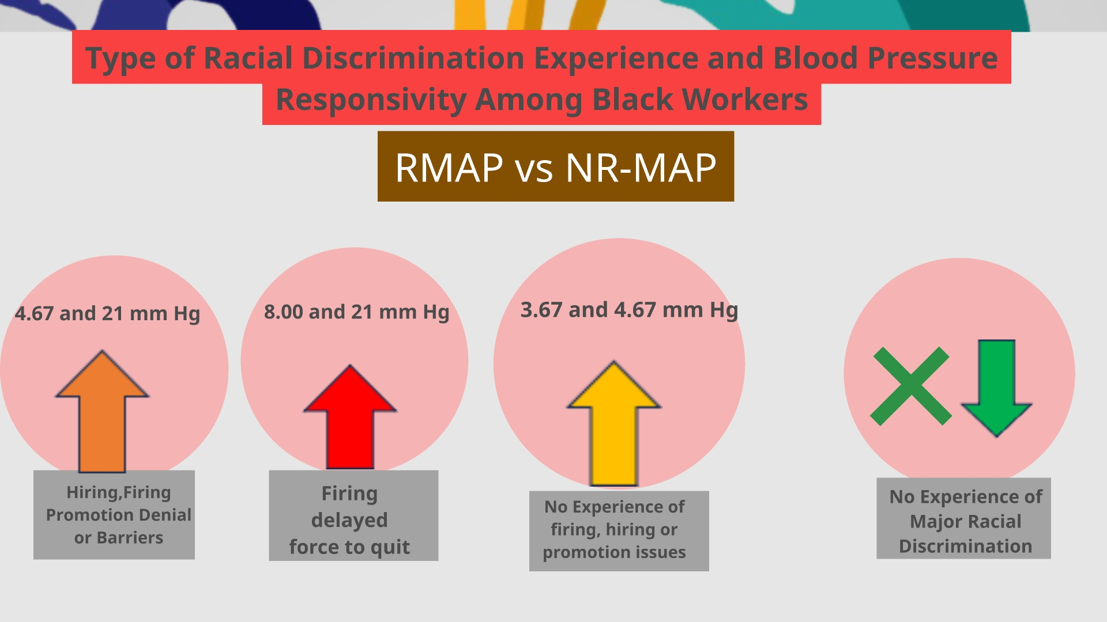
Type of Racial Discrimination Experience and Blood Pressure Responsivity Among Black Workers
Notes:
We have made a comparison of blood pressure measure taken at T3 after recalling the experiences and the measurements at T1 upon arrival. Well, the normal result should shown higher value at T1, which is a non-resting Blood pressure. But, it was surprising to see that People who experienced racial discrimination hiring firing or promotion have shown a overall increase of mean arterial pressures
The increase was greather for those who get fired, laid off or force to quit.
lower increased was found for people who have not experienced racial discrimination in hiring, firing or promotion denial
And people who have experienced other types of racial discrimination except of hiring firing and promotion issues showed a stability or a decreased in their Blood pressure value

Slide 23
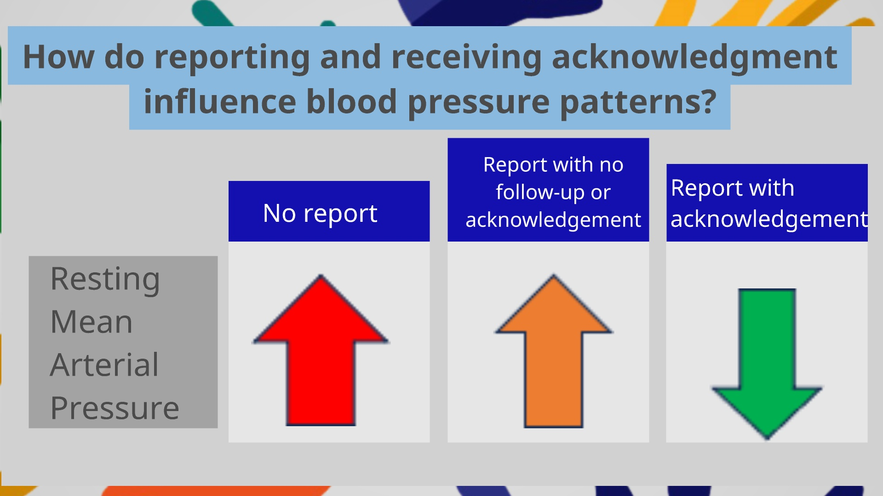
How do reporting and receiving acknowledgement influence blood pressure patterns?
Notes:
As I evaluated their response mechanisme, What do reporting or being acknowledge did in this situation.
At the end of the interview, Blood pressure was higher among those who did not filled complaints
Those who filled complaint, but was ignored or not acknowledge showed slighetly lower BP increased and those who were
akgnowledge for their experiences have shown a decreased in their blood pressure value thouhougt the interview.

Slide 24
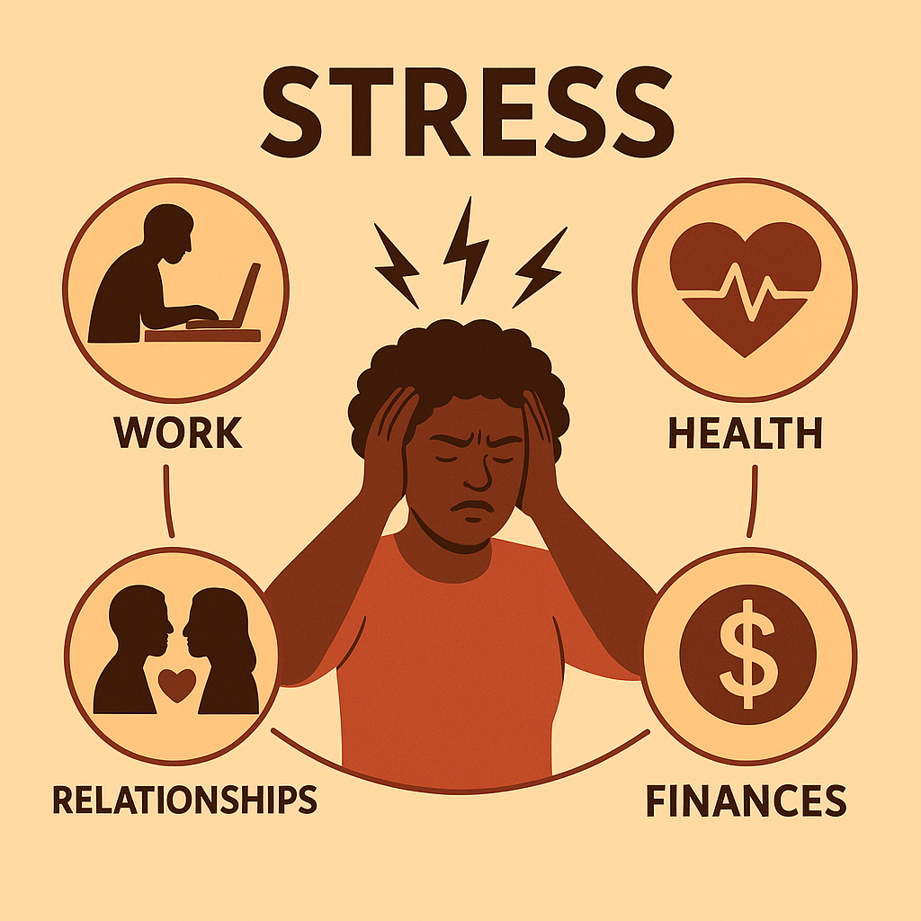
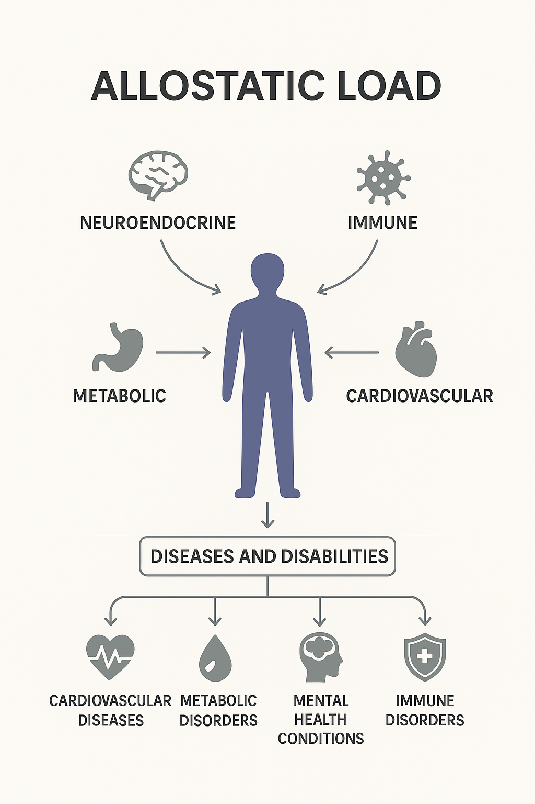
Health Toll: Stress Pathway
WORK-RELATED STRESS
WORKPLACE RACIAL DISCRIMINATION
CHRONIC DISEASES
Prediabetes
Type 2 Diabetes
Blood Pressure
Heart Disease
Cholesterol
Back Pain
Stroke Effect
Workplace racial discrimination
influences health though the
work-related
stress pathway
Notes:
Here’s how this mechanism works:
When a person experiences discrimination, their body activates the stress system, releasing adrenaline and cortisol. This mechanism, useful for dealing with an immediate danger, becomes toxic when it is constant. Over time, it leads to:
chronic inflammation,
immune system fatigue,
and metabolic dysregulation.
This is known as allostatic load—the biological wear and tear caused by repeated stress. In other words, racism gets under the skin.
A fascinating finding from research is that people who are able to openly discuss their experiences and receive institutional acknowledgment for what they’ve endured do not show the same elevation in blood pressure. Their stress levels return to normal. This means that simply being heard, believed, and supported can reduce the physical effects of racism on health. Hence the crucial importance of mechanisms for recognition, reparation, and organizational justice.
In summary, racial discrimination at work:
affects mental health through stress, anxiety, and depression,
harms physical health by increasing the risk of chronic disease,
and disrupts physiological health through a biological overload caused by constant stress.
This is why we are speaking today about a true public health issue. Workplace racism is not just a moral or ethical problem—it is also a matter of health and survival.

Slide 25
Quote
“Racism is a visceral experience...It dislodges brains, blocks airways, rips muscle, extracts organs, cracks bones, breaks teeth... You must never look away from this."
Ta-Nehisi Coates

Slide 26
What the evidence shows
Various forms
Increase work-related stress perception
Associated with mental health and chronic diseases outcomes
Reporting is not a culture
Reporting and receiving acknowledgment might be protective factors
Often ignored
Notes:
Voila in wrapping up what the evidence shows...

Slide 27
TAKE AWAY
Community and culturally-based prevention
Employer
support
Proactive
anti-discrimination policies
Commitment
Recognition

Slide 28


Implications For Us
Notes:
Based on the World Healt Organisation, Health doest not mean absence of diseases, it imcompass several interconnected dimensions:
Physical health – proper functioning of the body, disease prevention, and healthy habits (nutrition, sleep, physical activity).
Mental and emotional health – psychological balance, stress management, self-esteem, and resilience.
Social health – quality of human relationships, sense of belonging, and community support.
Environmental health – connection to a healthy and sustainable living environment.

Slide 29
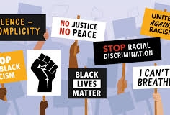
Embedding Racism into Hazard Prevention Programs
What This Means In Practice
If Racism Is Recognized As A Hazard, Departments MUST:
Map Where Racism Can Occur In Structures, Processes, And Culture
Take Proactive Steps To Eliminate Or Control Those Risks
Report On Actions And Progress Every Year
Recognize employee networks as essential partners in preventing workplace harm.
The Role Of Employee Networks
Why employee networks must be at the key tables:
Employee networks offer lived expertise on workplace risks that leadership may not see.
Networks should have structured representation in:
Occupational Health and Safety (OHS) committees
People committees / HR governance committees
Policy review and risk‑assessment processes
Including employee networks ensures harmful policies, processes, and cultural practices are identified early — before they cause harm.
Notes:
Now that we’ve seen the data on how racism affects mental, physical, and physiological health, it’s important to understand that this is not just an HR issue, or a culture issue—it is an Occupational Health & Safety obligation. Under the Canada Labour Code Part II, employers must proactively prevent both physical and psychological injury. That includes the injuries caused by racism, discrimination, exclusion, and inaccessibility.”
To address this issue in our institutions, we must ensure racism and related harms are explicitly classified as psychosocial hazards within our Hazard Prevention Programs. This aligns directly with Part 19 of the Canada Occupational Health and Safety Regulations which requires us to identify all sources of psychological injury—not just those traditionally recognized, like harassment or violence.”
By adding racism and discrimination into our Hazard Prevention Programs was can ensure they are systematically addressed rather than handled ad hoc or informally.”
By Including employee network representation in Occupational Health And Safety Committees we can ensure they benefit from the early insights networks processes thereby improving trust in the system, and ensure that risk assessments reflect the realities employees are experiencing.
This will help ensure our reporting systems themselves are part of the health impact. Co-designing safe, trauma‑informed reporting channels with employee networks ensures employees are not retraumatized when they seek help, and ensures that reporting becomes both safer and more effective.”
Lastly embedding anti-racism, inclusion and culturally safe supervision in to training and reinforced by consequential accountability in PMA's will help advance efforts to create safe and inclusive workplaces for all.

Slide 30
Embedding Racism into Hazard Prevention Programs
Formally classify racism, discrimination, microaggressions, exclusion, and inaccessibility as psychosocial hazards under the Hazard Prevention Program (HPP).
Integrate equity‑related hazards into every step of the Hazard Prevention Program: hazard identification, risk assessment, prevention measures, training, and program evaluation.
Add employee network representatives as voting members of Workplace Health & Safety Committees and the Policy Health & Safety Committee.
Establish trauma‑informed, culturally safe reporting mechanisms co-designed with employee networks.
Embed anti-racism, inclusion, culturally safe supervision, and psychosocial hazard prevention into mandatory manager training and PMAs.
Notes:
“Now that we’ve seen the data on how racism affects mental, physical, and physiological health, it’s important to understand that this is not just an HR issue, or a culture issue—it is an Occupational Health & Safety obligation. Under the Canada Labour Code Part II, employers must proactively prevent both physical and psychological injury. That includes the injuries caused by racism, discrimination, exclusion, and inaccessibility.”
To address this issue in our institutions, we must ensure racism and related harms are explicitly classified as psychosocial hazards within our Hazard Prevention Programs. This aligns directly with Part 19 of the Canada Occupational Health and Safety Regulations which requires us to identify all sources of psychological injury—not just those traditionally recognized, like harassment or violence.”
By adding racism and discrimination into our Hazard Prevention Programs was can ensure they are systematically addressed rather than handled ad hoc or informally.”
By Including employee network representation in Occupational Health And Safety Committees we can ensure they benefit from the early insights networks processes thereby improving trust in the system, and ensure that risk assessments reflect the realities employees are experiencing.
This will help ensure our reporting systems themselves are part of the health impact. Co-designing safe, trauma‑informed reporting channels with employee networks ensures employees are not retraumatized when they seek help, and ensures that reporting becomes both safer and more effective.”
Lastly embedding anti-racism, inclusion and culturally safe supervision in to training and reinforced by consequential accountability in PMA's will help advance efforts to create safe and inclusive workplaces for all.

Slide 31
Why This Matters — The Impact on Employees
The Reality
The public service does not currently track the long‑term health impacts of workplace racism — but research shows the risks are significant and measurable.
• Ignoring this harm contributes to:
– burnout
– long‑term and short‑term disability
– attrition of racialized employees
– chronic stress‑related health conditions
• Recognizing racism as a health and safety issue means the PS can no longer treat it as optional or secondary work.

Slide 32
Closing Reflections:
The harms of systemic racism and discrimination have leveraged legal, regulatory, and policy compliance requirements tied to equity, human rights.
These harms have been highlighted also as organizational risks, linking inequitable workplaces with productivity loss, payouts related to grievances and harassment claims, disability leave, attrition, presenteeism, and absenteeism.
With Dr. Dalexis’ research, we now must contend with the real physical and mental health harm caused by inequitable workplaces.
Notes:
Speaking Notes:
We have long understood that advocating against systemic racism requires more than dialogue - it requires alignment with our legal, regulatory, and policy obligations around equity, occupational health and safety, and human rights.
We have also recognized the organizational risks that inequitable workplaces create:
diminished productivity
increased grievances and harassment complaints
short‑ and long‑term disability claims
higher attrition
presenteeism and absenteeism
These consequences have been well‑documented
But with the research presented today by Dr. Dalexis, we must now widen our lens.
Her findings show that racism and discrimination do not only harm careers — they create measurable physical and mental health impacts, including elevated blood pressure, chronic disease risks, burnout, and long‑term physiological stress responses.
It is our hope that all who are in attendance today will recognize that ensuring equitable, culturally safe, and accessible worksites is a workplace health issue that requires our urgent attention and action,

Slide 33
THANK YOU in several African and Caribbean languages
Niitsíniiyi’taki
MERCI
Wela’lin
MÈSI
TANK YUH
THANKS NAH
ASANTE
THANK YOU
NA GODE
ENKOSI
O SE
IMELA
JËRËJËF
NIA:WEN
NGIYABONGA
AMESEGINALEHU
SHUKRAN
MAITA BASA
DANKI
Notes:
Thank you for listening — and for your continued commitment to meaningful transformation in Canada’s public service.
I want to close by saying “thank you” in several African and Caribbean languages —
as a gesture of respect and celebration for the diversity of Black communities represented here today:
Mèsi. Asante. Ngiyabonga. Tank yuh. Jërëjëf. Ameseginalehu. Imela. O sé.
Thank you all — for being part of this journey toward truth, justice, and collective well-being.

Slide 34

Questions and Answers
Notes:
Image source: Microsoft 365 content library
Q and A sessions foster interactive communication between presenters and audiences. They provide opportunities to clarify doubts, share insights, and engage in meaningful discussions. Effective Q and A encourages participation, builds trust, and enhances understanding of the presented material.

Slide 35
Accessiblity Slides

Slide 36
Increased Likelihood of Chronic Diseases associated with Racial Discrimination in the Workplace (accessible version)
Hiring was associated with
  2X back pain
Slower promotion and pay raises were associated with
  7X Type 2 Diabetes
  3X cholesterol
  3X back pain
Promotion denial was associated with
  4x Type 2 diabetes
  3X cholesterol
  10X stroke effect
Firing was associated with
  4x Type 2 Diabetes
Other types were associated with
  5X Type 2 Diabetes
  3X Back pain
Return to slide 20

