Slide 1
4th review of the Directive on Automated Decision-Making
Overview and proposed modifications
Fall 2024

Slide 2
Purpose
Provide an overview of the 4th review of the Directive on Automated Decision-Making
Seek feedback on policy recommendations and proposed modifications
Discuss proposed updates

Slide 3
Background
Providing better programs and services for Canadians sometimes involves the use of artificial intelligence (AI) to support sound decision making
The Government of Canada (GC) is committed to ensuring that the government's use of AI is governed with clear values, ethics and laws, and in accordance with human rights
Treasury Board of Canada Secretariat (TBS) is responsible for providing government-wide direction on information and data governance, information technology, security, privacy and access to information.
The Directive on Automated Decision-Making (directive) sets rules for how federal departments can use automated systems (including AI) to make or support decisions that impact the legal rights, privileges or interests of clients. For example:
determining eligibility for permits and benefits
assessing eligibility for entry to Canada
deciding to hire an individual to work in the public service
granting market authorization for a pharmaceutical product
launching an investigation into an individual’s conduct

Slide 4
Directive on Automated Decision-Making
The directive seeks to ensure transparency, accountability and procedural fairness in the use of automated decision systems in the federal government.
It requires departments to:
assess the impacts of automated decision systems
be transparent
ensure quality
provide recourse on decisions
report publicly on system effectiveness and efficiency
The directive came into effect in April 2019 and applies to systems developed or procured after April 2020.

Slide 5
Overview of the Directive on Automated Decision-Making
Directive on Automated Decision-Making Requirements
Algorithmic Impact Assessment
Transparency
Quality assurance
Recourse
Understand
Communicate
Prevent
Correct
AIA before production
AIA when scope or functionality changes
Publication of AIA results
Notice before decisions
Explanation after decisions
Access to components
Release of source code
Documentation of decisions
Publication of results in meeting program objectives
Testing and monitoring of outcomes
Data quality
Data governance
Peer review
GBA Plus
Employee training
Continuity management
Security
Consultation with legal services
Human intervention
Recourse options to challenge decisions

Slide 6
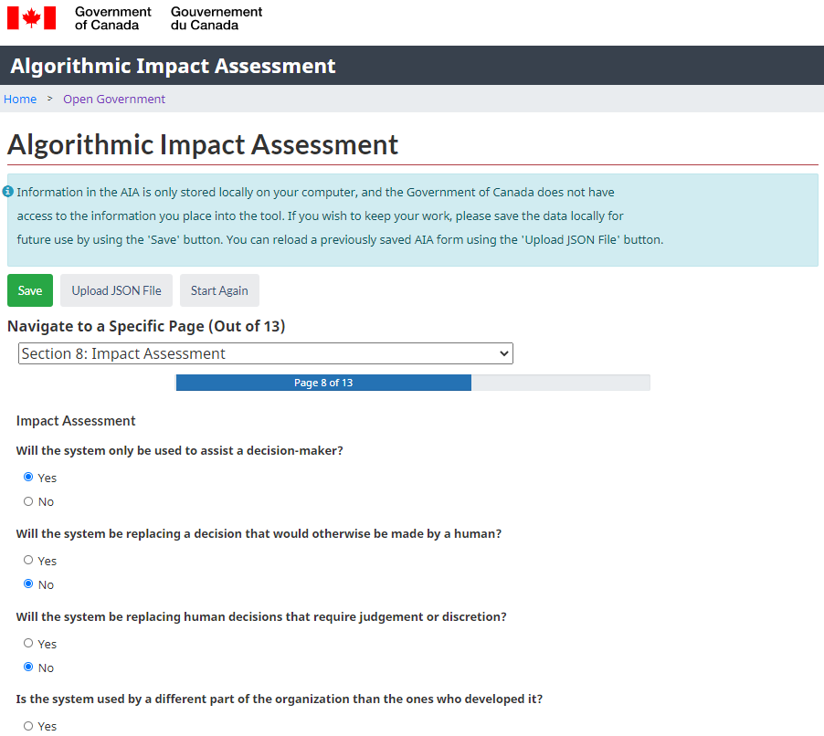
Algorithmic impact assessment (AIA)
Mandatory risk assessment tool
Determines the impact level of an automated decision-system
51 risk and 34 mitigation questions
Scores based on many factors including systems design, algorithm, decision type, impact and data
Developed based on best practices in consultation with both internal and external stakeholders
Developed in the open, and available to the public for sharing and re-use under an open license
https://www.canada.ca/en/government/system/digital-government/digital-government-innovations/responsible-use-ai/algorithmic-impact-assessment.html

Slide 7
Reviewing the Directive
The directive must be reviewed every 2 years to keep the instrument relevant and reflect the evolving technology and regulatory landscape.
1st review (2020-21)
2nd review (2021-22)
3rd review (2022-23)
4th review (2024-25)
Strengthen transparency and quality assurance
Update references to policy instruments
Clarify requirements
Author guidelines supporting interpretation of requirements
Expand scope
Strengthen transparency and quality assurance
Enable inclusive approaches
Improve coherence with other policies
Assess reasons for automation
Assess impacts on persons with disabilities
Clarify requirements
Underway summer 2024 to 2025
Support effective implementation
Strengthen client protections
Enhance assessment of impacts

Slide 8
4th review intended outcomes
Implementing the proposed updates would:
Improve protections to clients and federal institutions
Strengthen compliance with the directive
Reinforce commitments to transparency and accountability
Clarify and improve understanding of requirements and AIA questions to align with intent and interpretation in practice
Reduce redundancies and misalignment across the TBS policy suite

Slide 9
Overview of key themes and issues
Three themes with 7 topics have been identified to address in the 4th review. Each theme has a goal and recommendations to achieve it.
Support effective implementation | Strengthen client protections | Enhance assessment of impacts
Monitor policy implementation Reduce the number of organizations excluded from directive Adopt internationally recognized definition of AI | Clarify obligations and enhance impact assessment of human rights Strengthen protections and assessment of impacts for persons with disabilities Identify banned uses | Clarify and enhance the AIA
In addition to the changes across 3 themes, additional changes are proposed to improve clarity, reduce redundancies and align with other policy instruments. All proposed changes to the Directive and AIA are available on our GCwiki page

Slide 10
Support effective implementation
 | Monitoring policy implementation | Excluded organizations | Definition of AI
Goal | Increase and verify departmental compliance with the directive to support improved outcomes for clients, federal institutions and Canadian society. | Increase the number of organizations that are subject to the directive to expand protections and reduce risks to clients, federal institutions, and Canadian society. | Align the GC definition of AI with a more recent and internationally-recognized definition, increasing compatibility and facilitating understanding.
Recommendations | Add a new reporting requirement for departments to submit a report signed by the responsible assistant deputy minister (ADM) to TBS confirming compliance with the Directive. Add clarity to the role of the CIO of Canada related to compliance monitoring. Add a responsibility for TBS to publish an annual summary of the compliance reports on the Open Government Portal. Add a requirement for the responsible ADM to approve the completed AIA prior to its publication. | Remove the Excluded organizations subsection 9.1.1, such that the directive would apply to Agents of Parliament | Remove the definition of AI from Appendix A of the directive Modify the definition of AI in Appendix A of the Policy on Service and Digital to align with the OECD definition

Slide 11
Strengthen client protections
 | Human rights | Persons with disabilities | Bans
Goal | Clarify obligations and enhance impact assessment of human rights | Strengthen protections and assessment of impacts for persons with disabilities, raising awareness of the impacts of automated decision systems | Identify explicit limits or define circumstances in which automated systems pose an unacceptable risk
Recommendations | Modify the testing and monitoring requirements in the directive to more clearly reference human rights Add targeted questions to the AIA to strengthen the consideration of impacts to a broader range of people | Add a requirement to document system failures and take corrective actions Add new AIA questions to capture compliance with existing accessibility standards and broaden the consideration of impacts | Add a requirement in the Policy on Service and Digital to provide parameters for use Add a requirement and an appendix to the Directive on Service and Digital and prepare supporting guidance to state uses of AI considered unacceptable by the GC

Slide 12
6. Examples of unacceptable AI uses
To manipulate or deceive in a way that alters behaviour resulting in harm or impacts to individual autonomy and fundamental freedoms
Using deepfake technology that can spread misinformation, manipulate public opinion, and lead to increased polarization.
To score or classify people in a way that leads to unjustified censorship or surveillance or that impacts freedom of expression, privacy, and autonomy
Collecting social behaviour and inferred, predicted or observed personal characteristics over time to create a score that impacts individuals’ and groups’ ability to function in society.
Biometric categorization to infer personal information about individuals such as their race, political affiliation, religion, sexual orientation, gender identify and expression, and disability status
Using physical characteristics such as hair and eye colour to infer a person’s ethnicity.
Untargeted facial recognition scraping with the intent to create or expand databases
Taking publicly available images from the internet for identity verification
Real-time and remote biometric identification systems used in public spaces, with limited exceptions when the risk of harm is outweighed by the benefit
Using real-time facial recognition to identify individuals that are subject to a regulatory fine.
Emotion recognition
Relying on AI to infer emotions with the goal of determining risk, capabilities or skills or to make a decision without human oversight.
Determining the risk of a person or group committing an offence based solely on AI profiling or AI assessment of personality traits
Relying on the use of predictive policing techniques to forecast criminal activity.
Unacceptable use
Example of unacceptable use case

Slide 13
Enhance assessment of impacts
 | AIA modifications
Goal | Increase clarity and thoroughness of the AIA tool
Recommendations | Add questions in AIA sections where gaps exist or that support other areas of the 4th review Modify and add questions to respond to feedback and clarify intent Editorial changes
All changes to the AIA can be found here

Slide 14
Tell us what you think
We are seeking your input on the recommendations and directive edits as part of the 4th review of the directive.
Please respond to the survey where you will be asked to:
confirm if the recommendations help to achieve the topic goals
share specific edits to the updated text of the directive and AIA
identify any concerns or gaps
provide input on the approach to the "bans" topic
We recommend that you refer to the following documents as you complete the survey:
Overview of the 4th review of the Directive on Automated Decision-Making
Text changes to the Directive
Text changes to the AIA tool
The survey will be open from November 19, 2024 to January 8, 2025

Slide 15
Next steps
Review the 4th review materials and respond to the survey by January 8
Timeline

Slide 16
Questions for discussion
Do the proposed updates appropriately address the goals for the 7 identified topics? Why or why not?
Are there any proposed changes to the Directive or AIA that are concerning?
Is there a theme or topic that is missing?

Slide 17
Questions?
Please reach out to the TBS Responsible Data and AI team (ai-ia@tbs-sct.gc.ca)

