Slide 1




First page
Empowering Public Servants. Enhancing Accessibility to Language Training. Driving Innovation.
AI-Driven Language
Language Competency Evaluation and Training Tool
Nov 19th, 2025
Presented by Team 1- Public Service Data AI Challenge

Slide 2

Problem Statement no 1
Problem Statement ​
Industry
  Shift of policy
  Shortage in qualified instructors
  Limited scalability
People
  Unequal regional access
  Career development barriers for EE groups
  Maintain commitment to bilingual service delivery
Burdens
  Systemic
  Psychological
  Financial
​

Slide 3







Problem Statement no 2
Demand is High
Barriers Need to be Removed
1 in 3 public servants experienced adverse career impacts from lack of access to second language training¹
An “impossible burden” that disproportionately impacts well-being and careers of Indigenous Peoples³, Persons with a Disability, and racialized groups
Testimonials of discrimination, unconscious bias, psychological insecurity, and trauma³
550 seats given to Black Employees for second language learning⁴
50 000 employees impacted
Language requirements of positions in the core public administration, by employment equity group compared to all employees⁵
Woman
Indigenous people
Persons with disabilities
Member of racialized groups
Supply is Restricted
Estimated cost for second language training per employee per year²
$70,000+
³ Impacts of Official Language Modernization on Indigenous Inclusion in the Federal Public Service Workplace
⁴ Black Employee Action Plan
⁵ Table 15 Annual Report on Official Languages 2022–23
¹ 2024 PSES Q44b
² Cost Estimate for Bill S-209– the estimate assumes full-time training for 4 months per employee

Slide 4
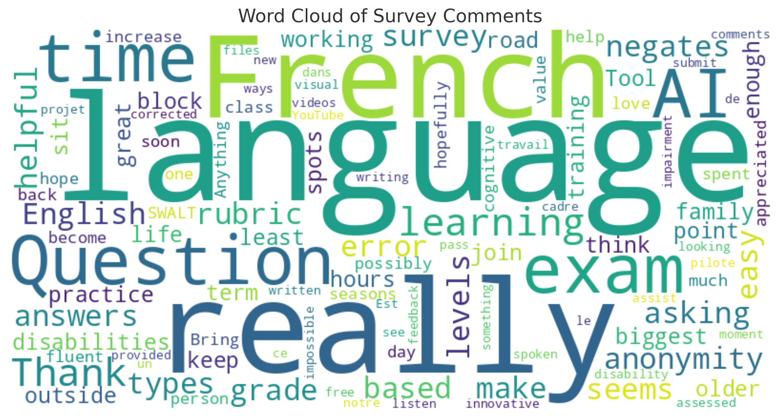


Designing Thinking | Emerging User Research
Designing Thinking | Emerging User Research
349+ respondents from 45+ Departments
How would you rate your overall experience of learning a new language?
99% reported facing barriers
22%
7/10
interested in beta-testing
43%
7%
Woman
Indigenous person
2SLGBTQIA+
GBA+ Analysis
26%
18%
37%
Person with a disability
Member of a racialized group
Not Applicable

Slide 5










Proposed Solution
Proposed Solution
AI-Driven Learning Tool
with
Virtual AI Tutor
Oral Interaction Enhancement
Integration with Government Databases & Canadian IP
Personalized Learning Based on Interests
Real-Time Formative Assessment & Personalized Feedback
Gamification
Adaptive Learning &
AI generated custom questions
Live Translation in
Protected B Environment
Made for Canadians – Secure, Adaptive, and Engaging

Slide 6

Benefits and Value
Benefits and Value
Excellence!
Accessibility and Equity
Efficiency and Effectiveness
Well-being and Engagement
Strategic Alignment
Expanded access to language learning
Eliminating barriers for equity-seeking groups
Customized learning for enhanced efficiency
Substantial cost savings
Promoting learner well-being
Elevated quality of public service delivery
Strengthened bilingual capacity
Alignment with government’s AI Strategy

Slide 7
Risk Identification and Management - Short
Key Risk Identification and Management
Resource Constraints and Budget Overruns
Competitive Pressure
Poor User Experience
AI Hallucination
  Severity: Moderate
  Likelihood: Medium
Mitigation:
Identify value proposition
Niche focus area
Strategic partnerships
  Severity: Moderate
  Likelihood: Low
  Mitigation:
    Identify skill requirements; consider outsourcing/hiring
    Establish clear budgets with expense tracking
    Set clear milestones with review points
    Implement project management best practices
  Severity: Moderate
  Likelihood: Low
Mitigation:
Engaging UI/UX experts in development phase
Use analytics to monitor user behaviour
Interface assessment
  Severity: Moderate
  Likelihood: Medium
  Mitigation:
    Use verified sources: train and ground the AI on official, curated datasets to ensure accuracy
    Continuous fine-tuning: regularly update the model using validated content and user feedback to reduce errors
* Other risks that we examined include market misalignment, low revenue, platform failures, operational risks (resource constraints, customer support overload), and copyright violations. For full risk analysis, see annex.

Slide 8















Building a Coalition
External Sponsors
Building a Coalition
Pilot Partners
Internal Enablers
GAC
PSPC
NRC
Proposed Datasets & Knowledge Pages
GClingua

Slide 9

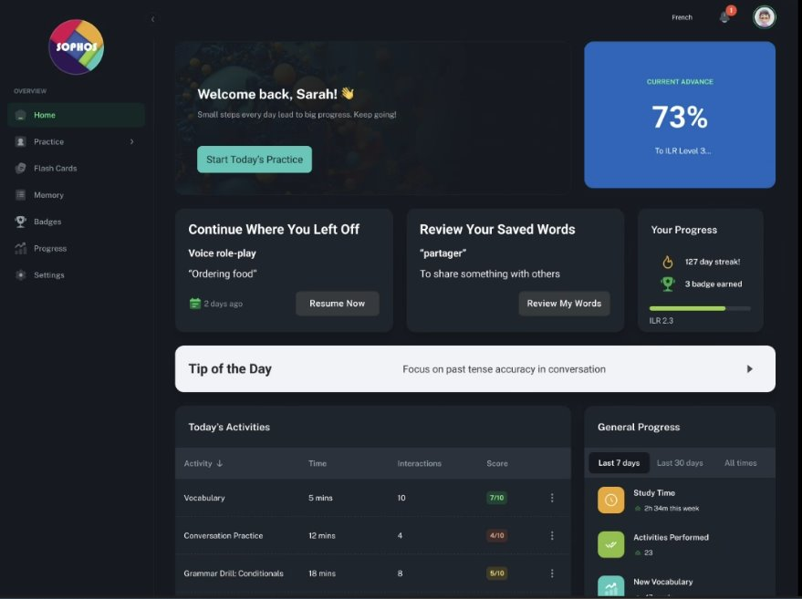






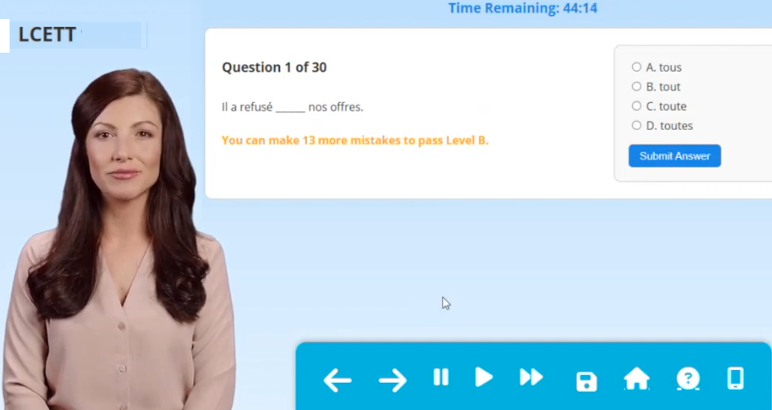




Progression, Experimentation and Path Forward
Final
Progression, Experimentation and Path Forward
Lighthouse project
TBS / PSPC / SSC
GAC / DND / ESDC / CRTC
Bonjour!
Semi-Final
CANADA FOREIGN SERVICE INSTITUTE
Reading & Writing Competencies
Foundational Technologies Considered
MCP
LCETT v2.3
Proof-of-concept app to test reading and written expression
Various apps and LMs can be linked via
Model Context Protocol (MCP) Tech
LCETT v4.0 AI Tutor Concept Video
IBM Orchestrate Proof of Concept
Dell/Nvidia AI Avatar Proof of Concept
Inspired by
Idea Longlisted
Oral Competency
Custom AI French Oral C Coaching agent for preliminary efficacy trials

Slide 10
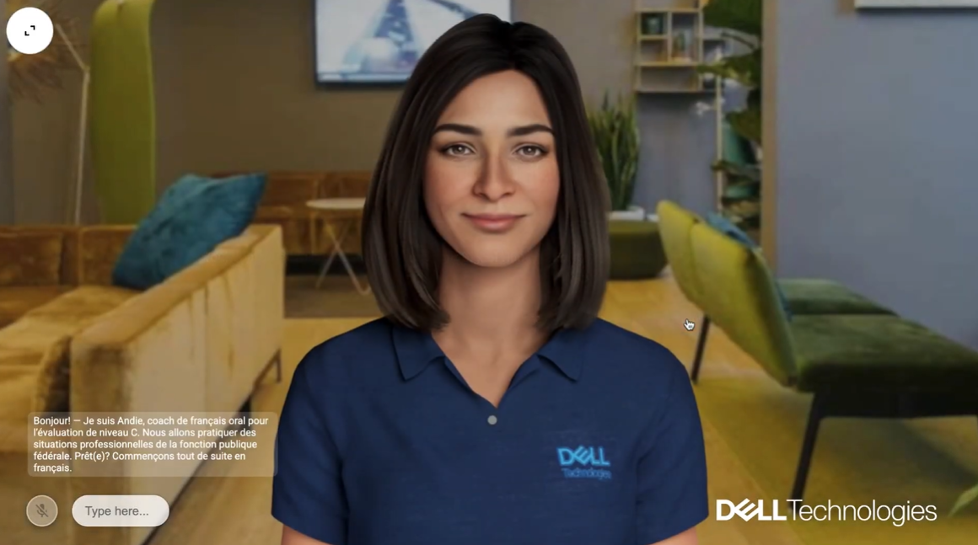
Concept Video - Virtual Tutor
Concept Video - Virtual Tutor

Slide 11



Thinking Ahead​
Language Competency Evaluation and Training Tool Ecosystem
Not simply a technical problem
Incubating inclusive experimentation
What if the technology is too good?

Slide 12
Q & A
Q&A

Slide 13
Who are we?
Tushar Agarwal | Canada Revenue Agency
Michel Charette | Employment and Social Development Canada
Mélissa Roy | Employment and Social Development Canada
Mina Akrami | Federal Economic Development Agency for Southern Ontario
Gisleide Burock | Global Affairs Canada
Ion-Mircea Ghinda | Global Affairs Canada
Nesrin Yarangumelioglu | Global Affairs Canada
Nicholas Deslandes | National Defence
Geneviève Le Bel Beauchesne | National Defence
Abhishek Raj | Natural Resources Canada
Isabelle Seguin | Service Canada
Andrew Pawluch | Treasury Board Secretariat

Slide 14










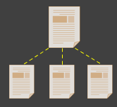


Approaches for full-scale AI integration
Approaches for full-scale AI integration
Approach 1:
Unprotected AWS cloud
Integration with RADIA
Gamification
Voice-to-text
Cons:
Risk of Protected B data being sent overseas
Less appetite for adoption across Government of Canada
Pros:
Easiest, straightforward implementation
Potential to be used for A/B testing the app by September 2025
Personalization
Pros:
Data storage on servers located in Canada.
ORBIT is the consultant to DND and Health Canada
Incorporating dual LLM systems
Cons:
Complicated process requiring hiring of third-party service providers
Cloud
based AI
Version 2.0
Dual-LLM
system
C-Levels
Approach 2:
Integration through Model Context Protocol (MCP)
Version 4.0
Protected B
Sovereign AI
App integration with MCP server

Slide 15
Next Steps & Timeline
Timeline
May 2025
Market Survey Execution
Research
June 2025
Survey Presentation (Semi-final)
Dec. 2025
AI Tutor Alpha Demo (Final)
March 12, 2025
Kick-off of the Public Service Data/AI Challenge!
April 2025
Create AI Prototyping tool
Identify Stakeholders
Aug. 2025
Meeting with Stakeholders
Sept. 2025
Create full environment with the Data
Oct. 2025
Test and control group (AI-generated learning plans and questions)
Winter 2026
Beginning of the deployment plan

