Slide 1

Microsoft Teams Training
Module 3B
CUSTOMIZING TEAMS FOR OWNERS

Slide 2
In this module you will learn how to:
Join a team
Add/remove a team member
Change member roles
Add a channel
Add channel tabs
  GCdocs folder
Customize your interface
  Pin channels
  Hide/show teams and channels
  Manage your team’s channels
Customize your settings
  Status
  Notifications
  Manage your team’s settings

Slide 3
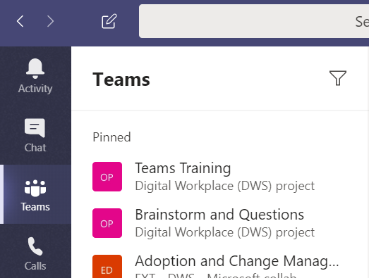

Join a team
Request to Join
To join a specific team:
Click Teams
At the bottom of the Teams panel, select Join or create a team

Slide 4
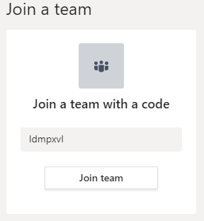
Join a team
Request to Join
To join a team with the team code:
  Enter the team code
  Click join

Slide 5
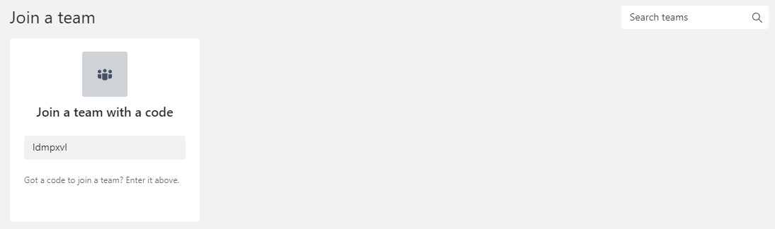
Join a team
Request to Join
To join a team without the team code:
  Search for the team name in the Search teams box
  Select the team you want to join and click Join team

Slide 6
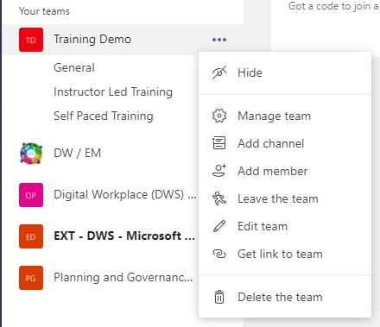
Add a Member
Request to Add a Member
To request someone be added to a team you’re a member of:
Click Teams
Click the three dots beside the team name for More Options
Select Add member

Slide 7
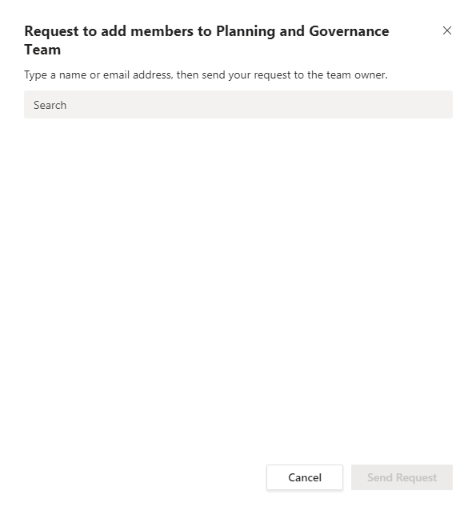
Add a Member
Request to Add a Member
Type the name or email address of the person you’d like to add in the search box
Click Send Request
The team owner(s) will receive an alert that they have a pending request

Slide 8
Add a Member
Add a Member – Method 1
To add a member to a team you are the owner of:
Click Teams
Click the three dots beside the team name for More Options
Select Add member

Slide 9
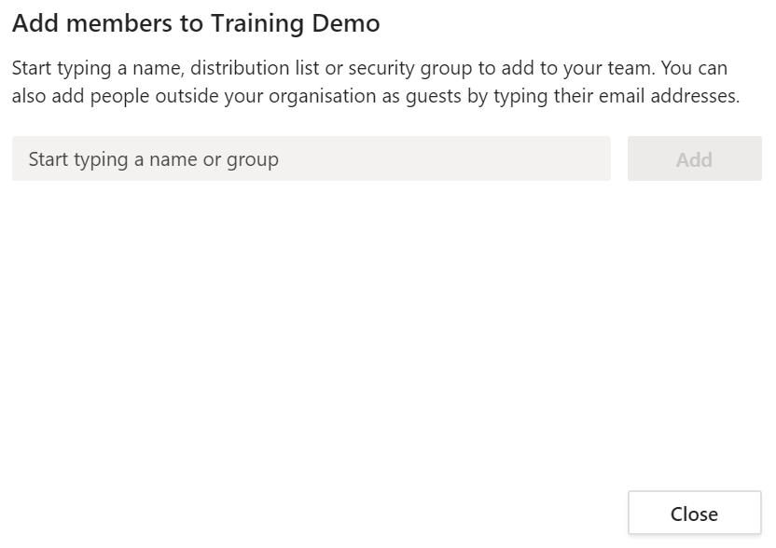
Add a Member
Add a Member – Method 1
Type the name or email address of the person you’d like to add in the search box
Click Add
Close the window

Slide 10
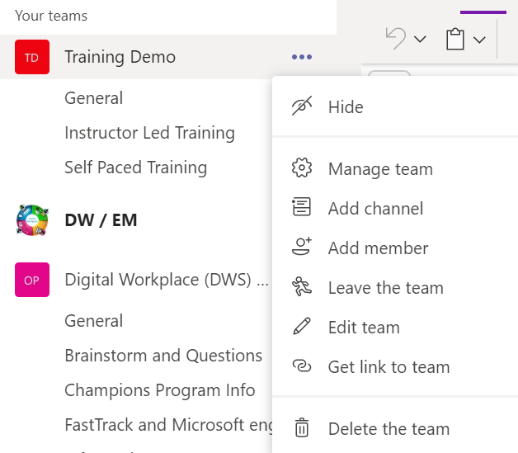
Add a Member
Add a Member – Method 2
Click on Teams to access the Teams panel
Click the three dots beside the team name for More Options
Select Manage Team

Slide 11
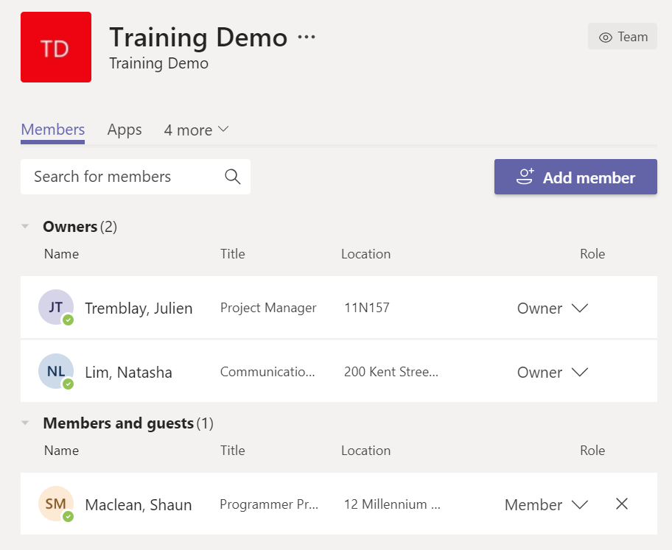
Add a Member
Add a Member – Method 2
Select the Members tab
Click + Add member

Slide 12
Add a Member
Add a Member – Method 2
Type the name or email address of the person you’d like to add in the search box
Click Add
Close the window

Slide 13
Add a Member
Generate a Team Code
To generate a team code to share for people trying to join your team:
Click Teams
Click the three dots beside the team name for More Options
Select Manage Team

Slide 14
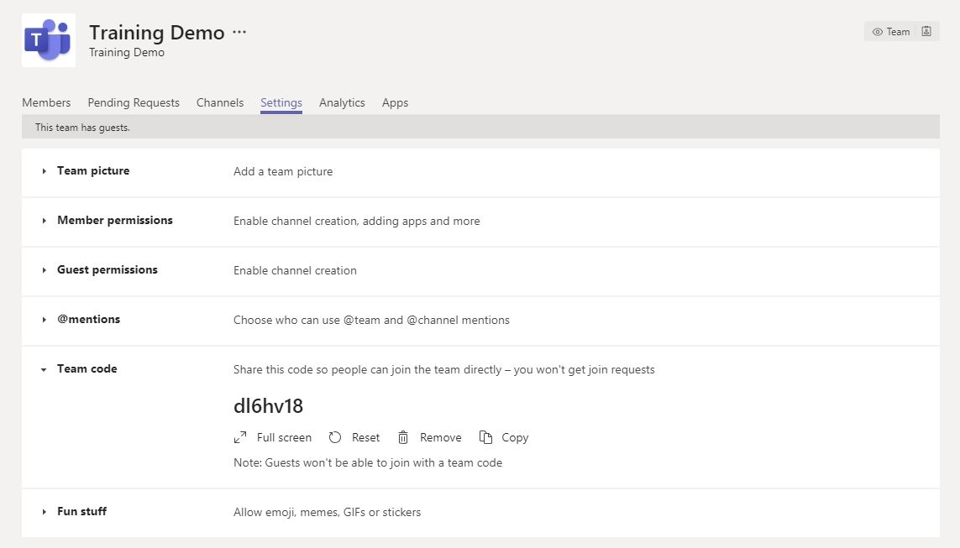
Add a Member
Generate a Team Code
Select the Settings tab
Click on Team code to drop down the section
Click Generate team code
Now you can share this code with people so they can join your team directly.

Slide 15
Remove a Member
Click on Teams to access the Teams panel
Click the three dots beside the team name for More Options
Select Manage Team

Slide 16
Remove a Member
Select the Members tab
Click the X beside the name of the member you want to remove

Slide 17
Change Member Roles
Click on Teams to access the Teams panel
Click the three dots beside the team name for More Options
Select Manage Team

Slide 18
Change Member Roles
Select the Members tab
Click the drop-down menu beside the member’s role
Select the member’s role
  Owner
  Member

Slide 19
Add a Channel
Recall that Teams are made up of channels, which are dedicated to specific topics, departments, or projects
To Create a Channel
Click Teams
Click the three dots beside the team name for More options
Click Add channel

Slide 20
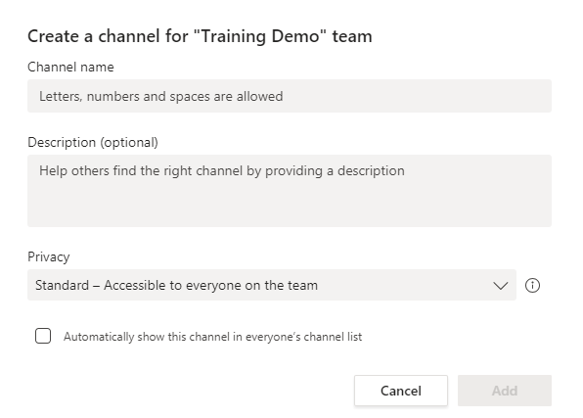
Add a Channel
Enter a Channel name
Enter a Description for the channel
Select the Privacy of the channel
  Standard – accessible to everyone on the team
  Private – only accessible to members you invite
Select whether or not you want the channel to automatically show the channel in everyone’s list
  NOTE: if you do not select this option, the channel will appear as a hidden channel in the team list and users will have to “Unhide” the channel to view it
Click Add to create the channel

Slide 21
Add a Channel
Add a Channel – Method 2
Click on Teams to access the Teams panel
Click the three dots beside the team name for More Options
Select Manage Team

Slide 22
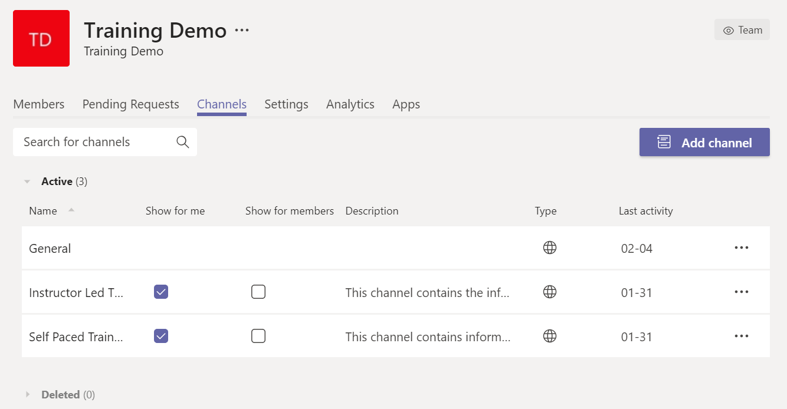
Add a Channel
Add a Channel – Method 2
Select the Channels tab
Click Add channel

Slide 23
Add a Channel
Enter a Channel name
Enter a Description for the channel
Select the Privacy of the channel
  Standard – accessible to everyone on the team
  Private – only accessible to members you invite
Select whether or not you want the channel to automatically show the channel in everyone’s list
  NOTE: if you do not select this option, the channel will appear as a hidden channel in the team list and users will have to “Unhide” the channel to view it
Click Add to create the channel

Slide 24
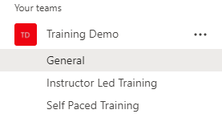
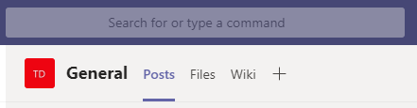
Add a Channel Tab
For every new channel, three tabs are automatically generated: Posts, Files and Wiki
To Create a New Channel Tab
Click on the channel you want to add the tab to
Click on the + at the top of the channel beside the other tabs

Slide 25
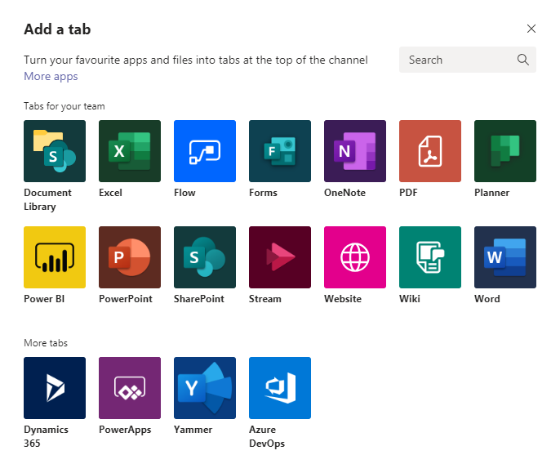
Add a Channel Tab
From here, you can select what type of tab you would like to add:
  An Excel spreadsheet
  A OneNote notebook
  A Planner project plan
  A PowerPoint presentation
  A website
  A Word document
We highly recommend adding the relevant Gcdocs folder to your channel tabs
Click Website

Slide 26
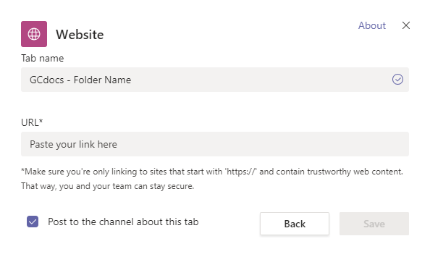
Add a Channel Tab
Go to the relevant GCdocs folder in your web browser and copy the URL
Enter the Tab Name using the naming convention GCdocs – Folder Name
  Ex. GCdocs – Teams Training Documents
Paste the URL in the URL box
Select whether or not you want to Post to the channel about the tab
Click Save

Slide 27

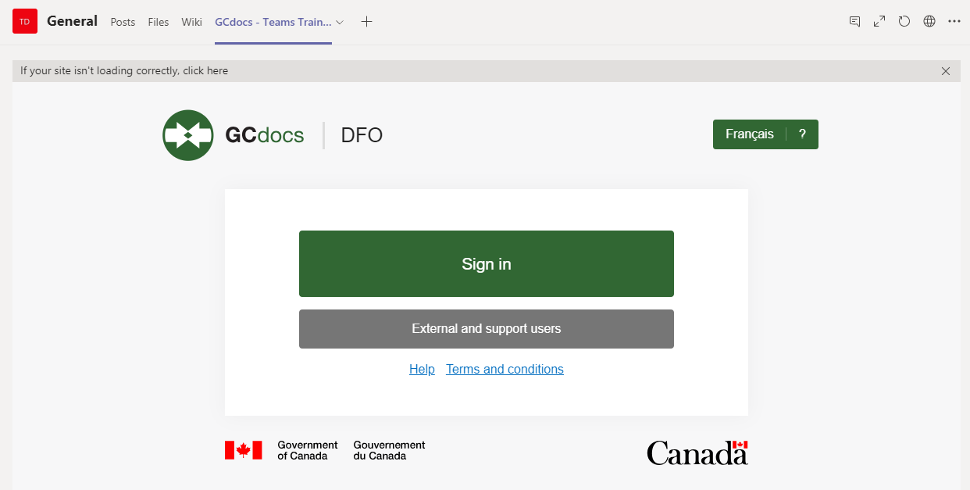
Add a Channel Tab
The tab should now be added at the top of the channel
Click on the tab to access it
You will be prompted to Sign In as usual

Slide 28
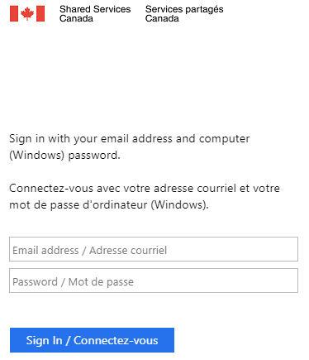
Add a Channel Tab
Sign in with your credentials

Slide 29
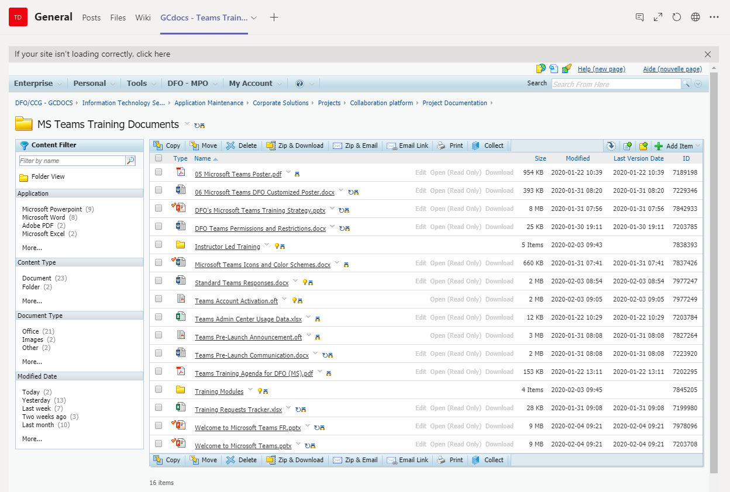
Add a Channel Tab
The GCdocs folder will then open in Teams
You can still drag/drop to add/update files in the folder and should have the full functionalities that the website offers

Slide 30
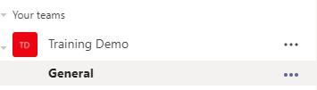
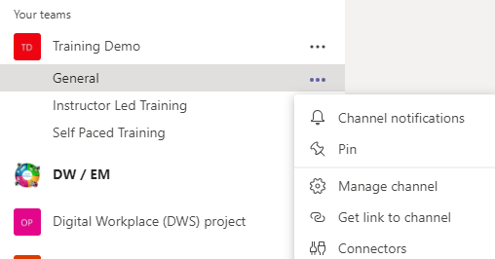
Customize your Interface
Pin your Favorite Channels
Click on the three dots for More Options beside the channel you want to pin
Select Pin to pin the channel to the top of your teams list

Slide 31
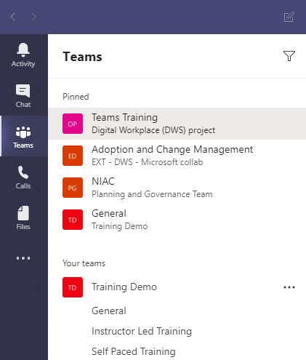
Customize your Interface
The channel will now appear in the Pinned section at the top of your Teams panel

Slide 32
Customize your Interface
Hide a Team or Channel
Click Teams to access your teams panel
Click the three dots beside the team or channel name for More options
Click Hide

Slide 33
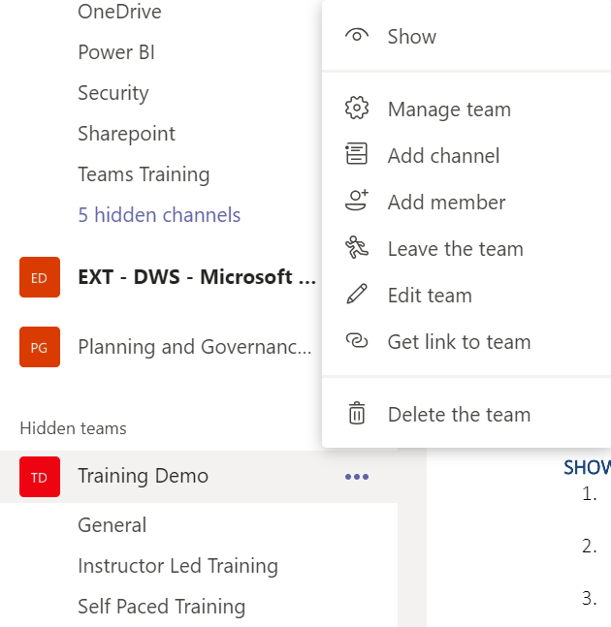
Customize your Interface
Show a Team
Click Teams to access your teams panel list
Select Hidden Team(s) at the bottom of the teams panel list
Click the three dots beside the team or channel name for More options
Click Show

Slide 34
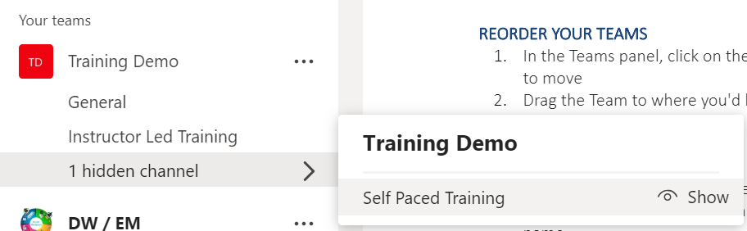
Customize your Interface
Show a Channel
Drop-down the channels list of the team
Select Hidden Channel(s) at the bottom of the team and click Show beside the channel you want to show

Slide 35
Customize your Interface
Manage your Team’s Channels
Click on Teams to access the Teams panel
Click the three dots beside the team name for More Options
Select Manage Team

Slide 36
Customize your Interface
Manage your Team’s Channels
Select the Channels tab
Select whether you want any channel to automatically show up for
  Yourself
  Team members

Slide 37
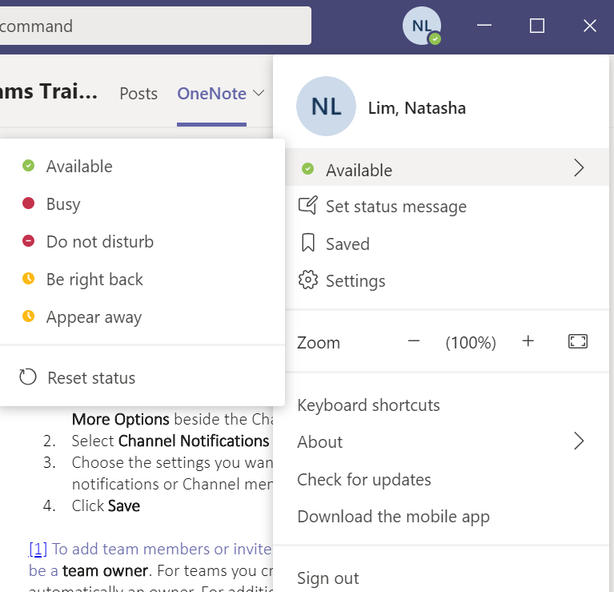
Customize your Settings
Customize your Status
Click on your profile
Hover over your status
Select your desired status
  Available
  Busy
  Do not disturb
  Be right back
  Appear away
  Reset status

Slide 38
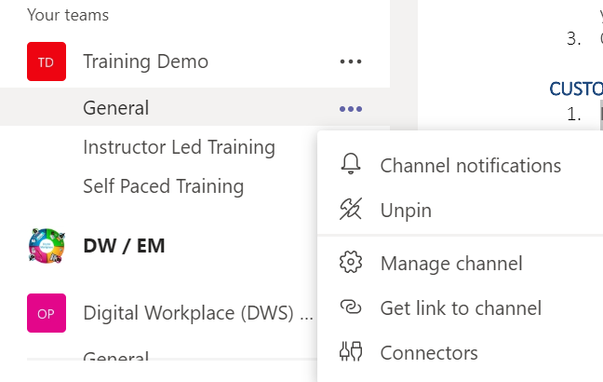
Customize your Settings
Customize your Channel Notifications
In the Teams panel, click on the three dots for More Options beside the Channel name
Select Channel Notifications
Choose the settings you want for post notifications or Channel mentions
Click Save

Slide 39
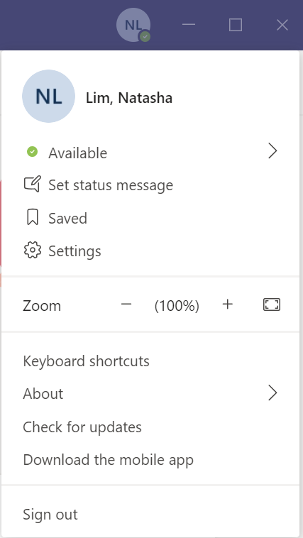
Customize your Settings
Customize All your Notifications
Click on your Profile
Select Settings

Slide 40
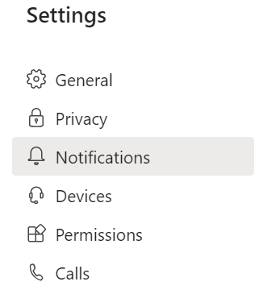
Customize your Settings
Customize All your Notifications
Click on Notifications
Choose the settings you want for:
  @mentions
  Messages
  Meetings
  Other
Exit the settings window and your selections will be saved automatically

Slide 41
Customize your Settings
Manage your Team’s Settings
Click on Teams to access the Teams panel
Click the three dots beside the team name for More Options
Select Manage Team

Slide 42
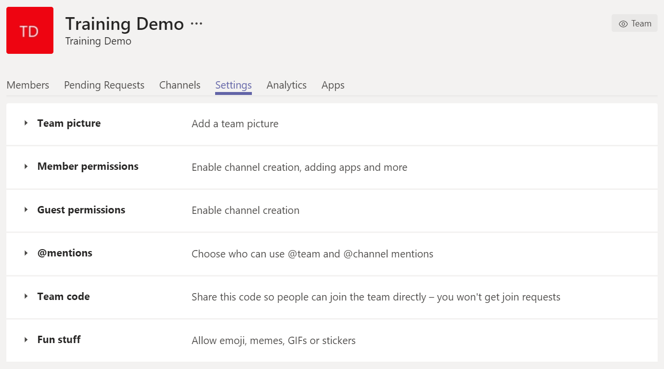
Customize your Settings
Manage your Team’s Settings
Select the Settings tab
From here you can:
  Set a team picture
  Set member permissions
  Set guest permissions
  Enable team @mentions in channels
  Enable usage of GIFs, emojis and stickers

Slide 43
Congratulations!
You should now have a be able to customize your Teams experience.
Start customizing!
Join us in the next learning module Collaborating in Teams & Channels
For questions or feedback please contact DFO.IMTS.DWS-SEN.GIST.MPO@dfo-mpo.gc.ca

