Slide 1
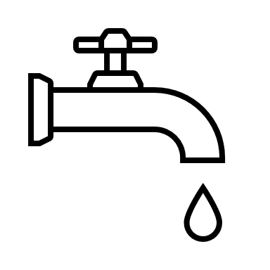
HOUSING, INFRASTRUCTURE COMMUNITIES CANADA INFORMED INVESTOR APPROACH
Through investments in drinking water, wastewater, and stormwater, HICC supports a range of housing, infrastructure and environmental outcomes:
 | Housing supply and smart community growth |  | Improved reliability of drinking water services |  | Reduced water pollution |  | Efficient and resilient water and wastewater infrastructure |  | Reduced greenhouse gas (GHG) emissions.
DATA INFORMS HICC’S SYSTEMS-BASED APPROACH | DATA SUPPORTS HOUSING AND ENVIRONMENTAL OUTCOMES | FILLING DATA GAPS TO INFORM PERFORMANCE | QUESTIONS AS A DATA CONSUMER
Systems-based approach means: Planning based on whole communities, regions, ecosystems, watersheds; Integrating infrastructure programming across critical infrastructure such as water, transit, transport works, community spaces, etc; Driving federal environmental priorities on climate, resilience, nature, watersheds, ecosystems, etc; Driving fiscal priorities within infrastructure asset classes, such as, asset management. planning, full cost accounting alternative finance (e.g. user pay, P3, etc); Multi-solving and harvesting co-benefits across infrastructure classes and within alternative strategies (e.g. natural infrastructure); and Moving beyond program performance to correlate benefits and causality towards addressing societal issues. | Data needs and partnerships are manifold: Data from StatCan, ECCC, CWA, provincial, territorial or municipal sources is required to increase HICC understanding and knowledge of the water sector. Using data on municipal water infrastructure systems ensures policies are informed by the sector’s state and our funding programs target the sector’s needs. WNIS is using other federal departments data (StatCan and ECCC) on: Water use Water leakage Drinking water advisories Remaining useful life Volume of untreated/undertreated effluent Collaboration CWA, StatCan, ECCC and HICC necessary to harmonize data collection and distribution. Opportunity through forthcoming National Freshwater Data Strategy | Data gaps include: Federal database on drinking water advisories Drinking water plants capacity and utilization rate Wastewater treatment plant capacity and utilization rate Unit Real Losses for high and low connection density networks Natural Infrastructure use for stormwater management | Data is our policy fuel: How can we distinguish our contribution from others? How do we measure our performance and effectiveness? How do we course correct, innovate reinvent, and redesign? How do we collectively measure our success and impact and individually distinguish it? Can data show how water infrastructure investment multi-solves across co-benefit areas, such as climate mitigation, and health and wellness?

