Slide 1

Navigating Change: Understanding the People Side of Transformation
Lea Gagne, Service Canada
Marie-Lyne Renaud, Housing, Infrastructure and Communities Canada
August 2025

Slide 2

What is Change Management?
Change management is the science of managing the people side of a change.
Change management comprises the strategy, structured process, plans, tools, competencies and practices aimed at transitioning employees effectively so that the benefits of the new, future state are maximized, and resistance is minimized.

Slide 3

The Goal of Change Management
The ultimate goal of change management is to drive organizational results and outcomes by giving employees the information they need so that they are equipped and able to change.
It includes listening to and engaging with employees in order to inspire their adoption of a new way of working.

Slide 4



Stages of Change
Stages of Change and Defining Change
Present
Change
Future
Begin
End

Slide 5

The Marathon Effect
Causes of Stress During Change – Marathon Effect

Slide 6
Types of Changes : Voluntary and Involuntary
Changes can be based on an external event. Something happens that results in a fundamental difference in your situation.
There are two types of changes:
Voluntary changes are changes that you choose to make and are prepared for
Involuntary changes are changes that happen and are beyond your control

Slide 7
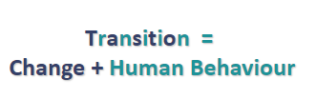
Transition – Reacting to Change Is Personal
How people react and adjust to change is the transition.
A transition is the process people go through when making a change, and it is similar to the stages of grief.
People do not go through the transition as a group, in lock step and at the same time.
Every person experiences change differently and will choose to support or not support the change.

Slide 8



The Three Phases of Transition
New Beginnings
Endings
Neutral Zone
Begin to identify
with the new ways
Have to let go of who we were in the past
Not who we were
Not yet who we will be
William Bridges Model

Slide 9
The Human Side of Change
People react to change in unique ways because their experiences, personalities, and circumstances shape how they process transitions.
Some embrace change with excitement, seeing it as an opportunity for growth, while others may feel uncertain or resistant due to fear of the unknown.​
Personality and mindset
Past experiences
Support Systems
Workload and timing
Communication and clarity

Slide 10
Poll - Emotional Response / Sondage- Réaction émotionnelle
How do you typically feel when faced with workplace change? (Options: Excited, Cautious, Resistant, Overwhelmed, Neutral)​​
Comment vous sentez-vous généralement face à un changement au travail? (Options: excité(e), prudent(e), résistant(e), débordé(e), neutre(e))

Slide 11

Change can cause a range of emotions
Uncertainty arises when expectations are unclear, leading to hesitation or anxiety. People may worry about how the change will affect their role, workload, or stability.​
Resistance occurs when individuals feel a loss of control or fear the impact of change. This can manifest as skepticism, frustration, or disengagement.​
Excitement emerges when change is seen as an opportunity for growth, innovation, or improvement. Those who embrace new challenges often feel energized and motivated.​

Slide 12
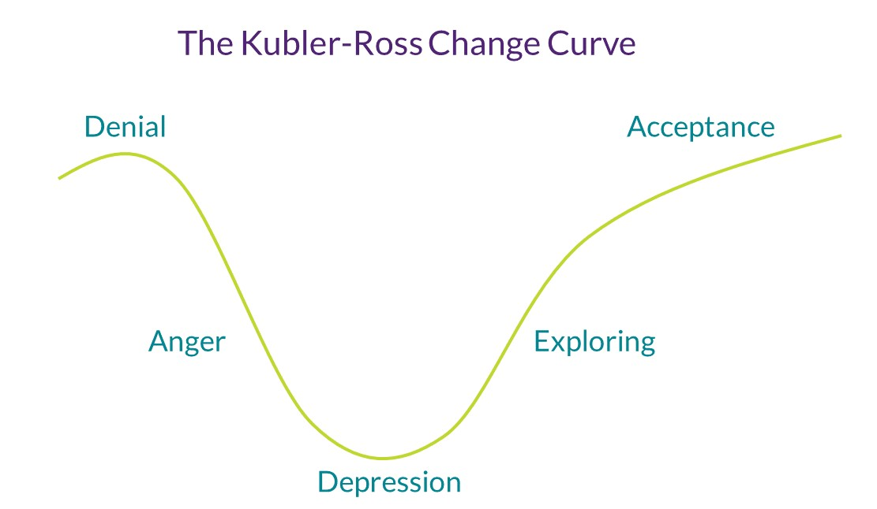
Change curve

Slide 13
Poll : Practical Needs For Adapting
What helps you adapt best to workplace change?
(Options: Clear communications, time to adjust and learn, training, hands-on practice, support from manager / team or seeing results)​
Sondage besoins pratiques pour s’adapter
Qu’est-ce qui vous aide le plus à vous adapter à un changement au travail?
(Une communication claire, du temps pour vous adapter et apprendre, de la formation, de la pratique, du soutien de la gestion / équipe ou voir des résultats)

Slide 14
Resistance to Change
Change can be challenging because it disrupts established routines and introduces uncertainty.
Loss of Control – Employees may feel they have no say in the change process.​
Unclear Benefits – If the purpose and advantages of the change are not well communicated, skepticism can grow.​
Previous Negative Experiences – Past failures in change initiatives can create doubt and reluctance.​

Slide 15
Strategies to Overcome Resistance
Transparent Communication – Clearly explain the reasons for change and how it benefits employees.​​​
Engagement and Participation – Involve employees early in the process and address their concerns.​​​
Training and Support – Provide resources, training, and guidance to help people adapt.​​​
Strong Leadership and Advocacy – Leaders should actively support the change, reinforce its importance, and model positive behavior.​​​

Slide 16
Self-Care in Times of Change
Strategies for Maintaining Well-Being​
Prioritize Rest and Recharge – Regular breaks, sleep, and mindfulness exercises​
help manage stress.​
Stay Connected – Engaging with colleagues and support networks fosters resilience and provides perspective.​
Maintain Routine and Stability – Finding consistency in daily habits can create a sense of control amidst uncertainty.​
Practice Self-Compassion – Adjusting to change takes time; acknowledge challenges without self-judgment.​
Change can be demanding, both mentally and emotionally. Uncertainty, increased workload, and shifting expectations can lead to stress and burnout if not managed proactively. Recognizing the signs—fatigue, decreased motivation, frustration, or difficulty concentrating—is key to maintaining well-being during transitions.

Slide 17


Mindfulness Exercise

Slide 18

Find us via GC Tools platforms!
GCcollab
Government of Canada Organizational Culture and Change (IOCN CM CoP)
GCxchange
Welcome to the IOCN
18 of 73

Slide 19
Questions?

Slide 20
Thank you!

