Slide 1
Canada.ca findability update
Findability for a changing web
GCWP • December 6 2023
Notes:
Opening slide

Slide 2
How the web is changing
Generative AI / AI chatbots
ChatGPT, Bard (Google), Bing (Microsoft)
Use Large Language Models (LLMs) to generate responses to prompts
LLMs are trained on data from the internet
Knowledge graphs / semantic search
Link data about entities (things!) and their relationships
LLMs use knowledge graphs to increase accuracy
Content as data
Serving content via Application Programming Interfaces (APIs)
Headless CMS: deliver to web, apps, call centre, social media, email

Slide 3
How findability is changing
Semantic instead of lexical search: “things not strings”
Knowledge graphs capture entities and their relationships
Entities are people, places, organizations
Assists computers in
disambiguating between concepts
inferring new knowledge

Slide 4
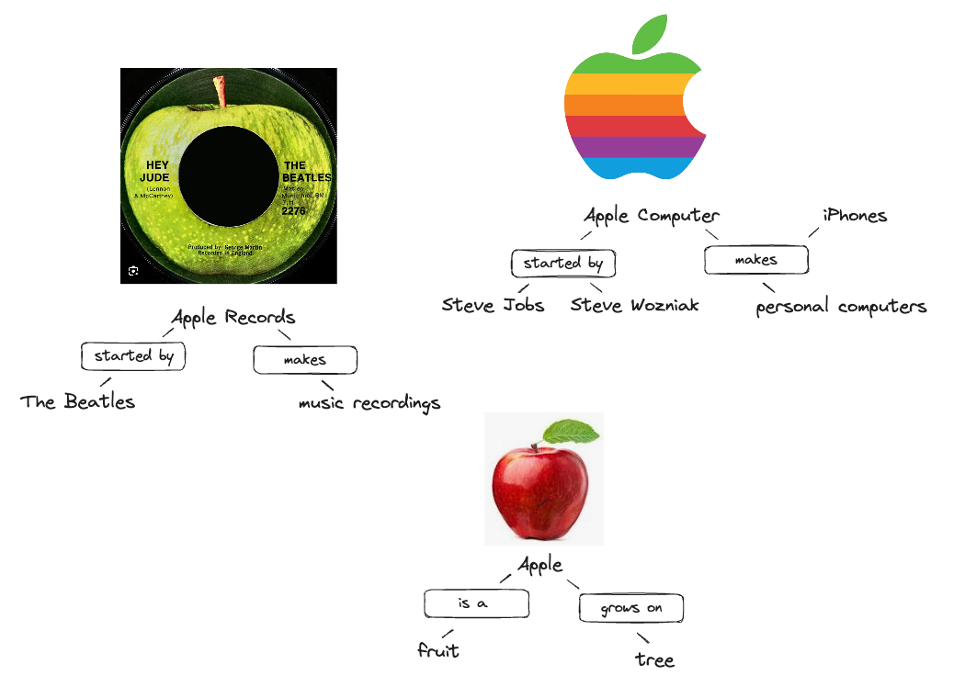

Slide 5
Google’s rules: major impact on SEO as it has been practiced previously
User intent
Informational (learn)
Navigational (take me to)
Commercial (shop)
Transactional (do / buy)
E-E-A-T: Experience, Expertise, Authority, Trustworthiness
Schema markup (structured data using schema.org types and properties)
For search engine result page (SERP) features, yes…
More importantly: authority
FINDABILITY FOR A CHANGING WEB
Notes:
Content example slide #2

Slide 6
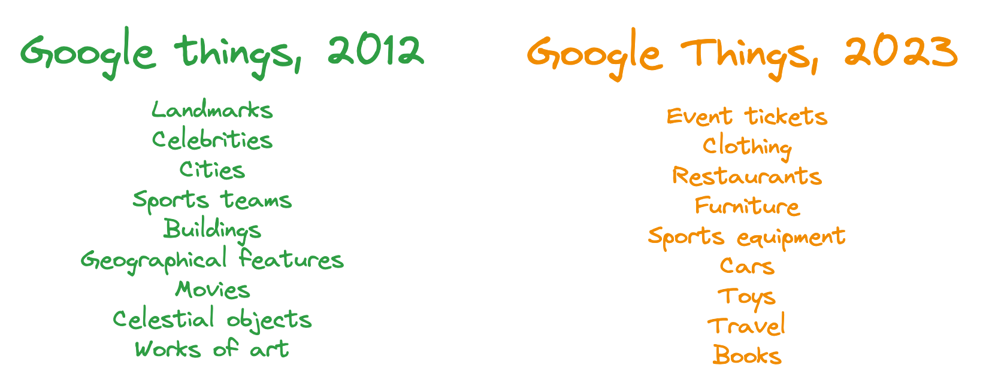
How Google is changing

Slide 7
Limitations of schema.org and Google features
Very few schema.org types and Google “structured data” features that meet the needs of governments
GovernmentOrganization
jurisdiction
AdministrativeArea
GovernmentService
serviceOutputType
GovernmentBenefitsType
Legislation
Extending schema.org is a possibility, but would require dedicated resources and coordinated effort
Multi-functional… sort of IT, sort of IA, sort of IM, sort of AI
FINDABILITY FOR A CHANGING WEB
Notes:
Content example slide #2

Slide 8
Limitations of schema.org and Google features cont’d
Structured data features don’t always fit well with GC content
Breadcrumbs
FAQs are for, well… FAQs
“How to” worked well for tasks with specific steps, but is now deprecated
As part of the business theme pilot, DTO will be deploying some experimental schema markup and reviewing the impact on search results
FINDABILITY FOR A CHANGING WEB
Notes:
Content example slide #2

Slide 9
A schema markup strategy for GC web content
For now, work with schema.org as is, despite its limitations
Develop strategy to deploy on priority pages
Services
Tasks
Answers
Processes
Institutional landing pages
Contact pages
Assess and revise as needed
Propose creation of #schema-markup-balisage channel to share findings, learn from each other
FINDABILITY FOR A CHANGING WEB
Notes:
Content example slide #2

Slide 10
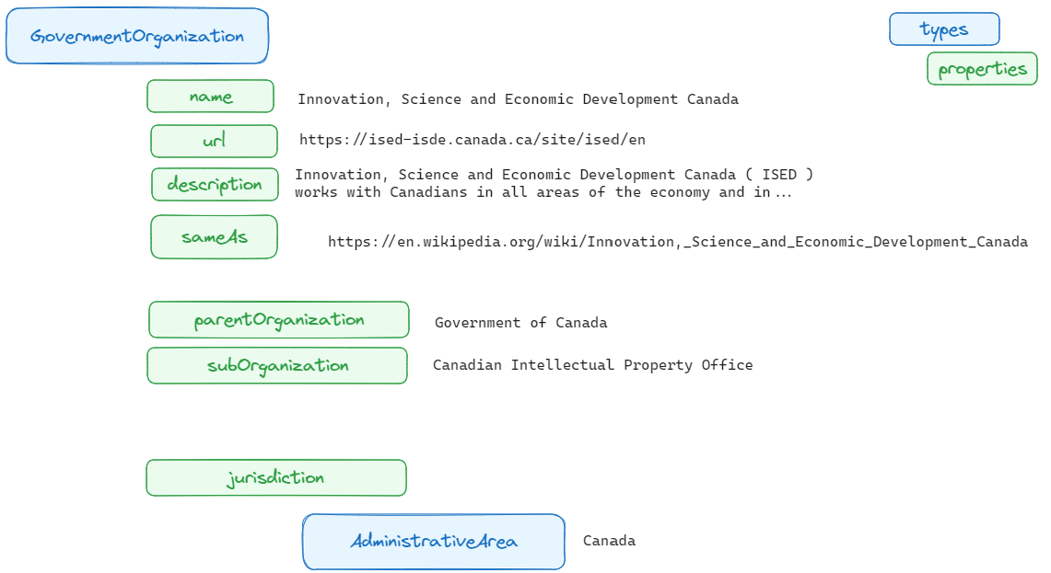
Schema markup: organization
Build knowledge graph by linking to Wikipedia record about the same entity

Slide 11
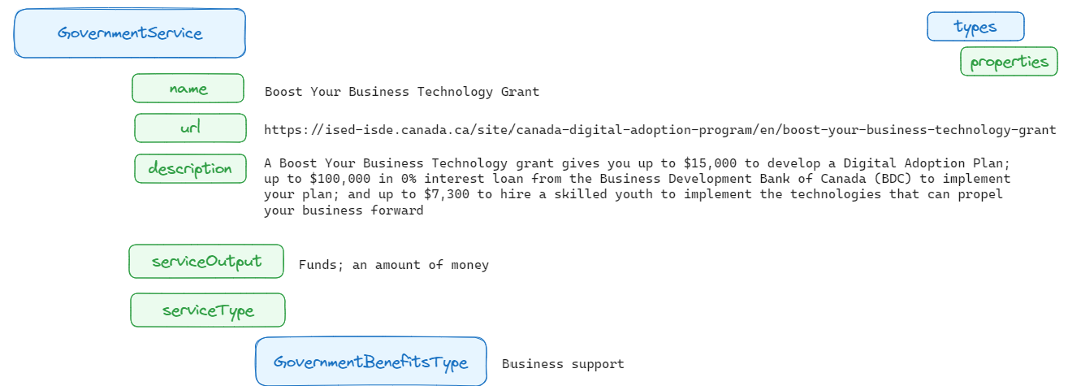
Schema markup: service
Use value from Canadian Governments Reference Model (see Guideline on Service and Digital, C.3.2)
Use value from schema.org GovernmentBenefitsType enumeration

Slide 12
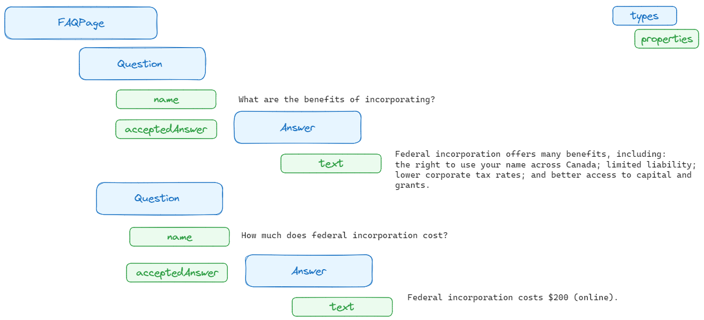
Schema markup : task
We don’t recommend FAQs, but will experiment with using FAQ schema markup to identify question/answer pairs on service pages

Slide 13
Helpful resources
Google Structured Data
Intro to How Structured Data Works
Feature guides for structured data
How Google’s Knowledge Graph works
schema.org
Schema markup validator
SchemaApp
Guide to Knowledge Graph Semantics 101
Blog
Wikidata Lookup by Name

Slide 14
Thank you, more to come!
Jane Stewart
jane.stewart@cds-snc.ca
Consultant / Information architect

