Slide 1


Circle Discussion Guide #3
Mastering the Art of Negotiation
Notes:
Welcome everyone to our third Circle session on Mastering the Art of Negotiation.

Slide 2
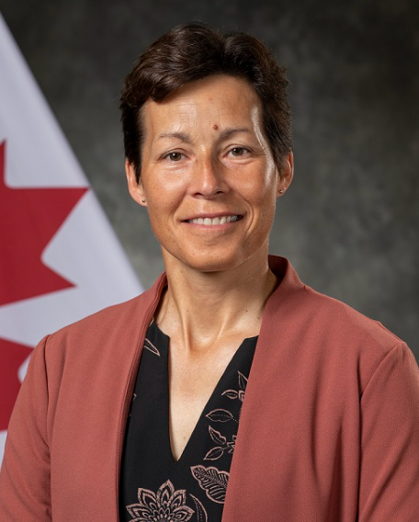



Founders’ Message
“Thank you” doesn’t feel like enough to describe how happy we are, for you to have made the commitment to join the Lifting as you Lead Mentoring Circles program 4th edition, organized by the Diversity and Inclusion Office, Materiel Group, National Defence, and open to all Federal Public Service members.
What began as a simple idea from our consultations has grown into a thriving network, addressing the desire for meaningful networking and professional growth.
There’s Power in People Coming Together
You're now part of a diverse network of 1100+ inclusive-minded leaders, assigned to a Circle: a small, trusted group for goal achievement in a safe space. This Circle will facilitate learning from others' experiences and diverse perspectives, expanding your knowledge and tactical skills.
LLMC offers a unique opportunity for everyone to feel valued and respected for their contributions. The relationships you build will accelerate progress and drive accountability.
Nancy Tremblay
Assistant Deputy Minister, Materiel, National Defence
Samantha Moonsammy
Diversity and Inclusion Section Head,
Materiel, National Defence
Notes:
Here's a message from the program founders if you'd like to take a read through in your Discussion Guide PDFs [first of two slides]

Slide 3
Founders’ Message
By actively engaging with your Circle, sharing experiences, and fostering connections, you'll unlock personal and professional growth opportunities. This knowledge empowers you to advance in your career.
The Time to Act is Now!
Thank you for answering the call to action, committing to creating a psychologically safer workplace for all, especially those from equity-deserving groups.
We hope you will feel a real and fundamental shift throughout the program. And together we will celebrate all the hard work you put into this experience. Thank you for showing up for yourself, your family, your organization and the communities you’re called to serve.
Going forward, take advantage of all the networking that will take place, meet new LLMC members in MS Teams and on LinkedIn. Lean into the Masterclasses.
Choose to stay consistent with that next level version of you. We are rooting for you.
Nancy Tremblay
Assistant Deputy Minister, Materiel, National Defence
Samantha Moonsammy
Diversity and Inclusion Section Head,
Materiel, National Defence
Notes:
Here's a message from the program founders if you'd like to take a read through in your Discussion Guide PDFs [second of two slides]

Slide 4

Circle Ground Rules and Values
  Equality: Everyone is an equal member
  Substance: Share what's important
  Openness: Listen and avoid judgements
  Respect: Treat others as they would like to be treated
Notes:
Let's take a moment to review the Circle Ground Rules and Values:
Equality: Everyone is an equal member
Substance: Share what's important
Openness: Listen and avoid judgements
Respect: Treat others as they would like to be treated

Slide 5
Participant Ground Rules and Values
  Confidentiality - trust is critical
  Bring your full self and beginner’s mindset to each session
  Come nourished and stay hydrated
  Keep your camera on so everyone feels safe and connected
  Be candid and honest - listen with empathy
  Be ready to engage with your peers
  Remove outside distractions
  Keep your audio off, except when asking questions and contributing to the discussion
  Be fully present and attend all five weeks - no multitasking
Notes:
Let's take a moment to review the Participant Ground Rules and Values:
Confidentiality - trust is critical
Bring your full self and beginner’s mindset to each session
Come nourished and stay hydrated
Keep your camera on so everyone feels safe and connected
Be candid and honest - listen with empathy
Be ready to engage with your peers
Remove outside distractions
Keep your audio off, except when asking questions and contributing to the discussion
Be fully present and attend all five weeks - no multitasking

Slide 6

Mastering the Art of Negotiation
"Win-win is a belief in the Third Alternative. It's not your way or my way; it's a better way, a higher way." Stephen Covey, author and educator "There are three ways of dealing with difference: domination, compromise, and integration. By domination only one side gets what it wants; by compromise neither side gets what it wants; by integration we find a way by which both sides may get what they wish." Mary Parker Follett, management consultant, social worker, philosopher, pioneer in the fields of organisational theory and organisational behaviour
Notes:
Here are some quotes on the importance of negotiation to get us started:
"Win-win is a belief in the Third Alternative. It's not your way or my way; it's a better way, a higher way."
Stephen Covey, author and educator
"There are three ways of dealing with difference: domination, compromise, and integration. By domination only one side gets what it wants; by compromise neither side gets what it wants; by integration we find a way by which both sides may get what they wish."
Mary Parker Follett, management consultant, social worker, philosopher, pioneer in the fields of organisational theory and organisational behaviour

Slide 7


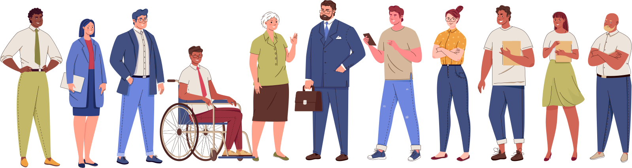
1. Check-In: Warm up and get going
(22 minutes)
1.1 Welcome
(3 minutes)
We often go into a negotiation like it’s a battle, but a negotiation works best for both parties when we focus on a win-win outcome.
Bonding Moment Briefly share one bias you’re aware of in yourself or one you've noticed in others. It could be anything from a bias towards people who speak confidently to a preference for familiar faces. (10 seconds each)
Notes:
Welcome everyone to our third circle. Today, we will be discussing how we can master the art of negotiation.
We have all participated in thousands of negotiations during our lifetime. We negotiate all the time at work. Some things we might negotiate for are time off, second language training, or an assignment in another Department. We often go into a negotiation like it’s a battle, but a negotiation works best for both parties when we focus on a win-win outcome.
Before we begin, let's take a quick moment to reflect on biases, which can significantly impact negotiations. This activity will help us become more aware of our own biases and understand how they might influence our negotiation strategies.
Let's open with a bonding moment. Briefly share one bias you’re aware of in yourself or one you've noticed in others. It could be anything from a bias towards people who speak confidently to a preference for familiar faces.
(10 seconds each)

Slide 8

1.2 Your Health Comes First
(1 minute)
Hope for Wellness Helpline
1-855-242-3310
Employee Assistance Program (EAP)
Toll-free: 1-800-268-7708
For persons with hearing impairments:
1-800-567-5803
Notes:
Before we begin today’s Circle, an important reminder. The intent of these sessions is to have safer conversations about important subjects that will help transform the Federal Public Service by creating diverse and inclusive psychologically safer workplaces. The subjects may be difficult for some people to discuss. If at any point during this session you feel that you need to step away, you may leave the session in order to protect your mental health. There’s also a 5 minute break built in partway through the Circle.
Your health comes first.
If you need to talk to someone, whether before, during, or after a circle, there is support available to you 24/7. Please see the support section at the end of this guide for contact information.

Slide 9
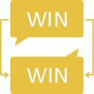
1.3 Overview
(3 minutes)
Notes:
In workplace negotiations, it is important to be well-prepared. This preparation can include gaining a good understanding of your ‘ask’, how it will impact your team or organisation, and ways this impact can be mitigated. Not only can this make you ready to respond to potential objections, it will let the other party know that you have considered more than your needs and are looking to achieve a mutually beneficial outcome. After all, the negotiation process is about crafting a relationship and understanding your needs as well as the other person’s.
There are also cultural considerations, implicit biases, and discriminatory practices that we have to acknowledge. By recognizing biases that may affect how we perceive how people negotiate, we are better able to empower deserving equity groups as they advocate and negotiate for themselves, while also enabling systemic change within our organisations.
When it comes to negotiating, it's super important to remember that people from different cultures are going to communicate and negotiate in their own unique ways. For example, folks from Western countries might get straight to the point, while people from Eastern cultures might be more indirect and focus on building relationships first.
O﻿n top of that, everyone's personal experiences and backgrounds play a big role. Plus, things like personal values, education, and job experience can really shape what people care about and how they go about negotiating. By being aware of these differences and adjusting your approach, you can make sure your negotiations are smoother and more successful for everyone involved.
Developing negotiation skills that increase the likelihood of success not only helps you benefit from that negotiation, but also helps you in future negotiations, as feelings about the process influence how we deal with the next one. Negotiation skills also help to develop a balance between empathy and assertiveness as we learn to manage our emotions and reactions so as to prevent them from affecting our judgement and behaviour.
During this Circle, we will focus on strategies that can result in a positive outcome for all parties in workplace negotiations. Let’s get started!

Slide 10
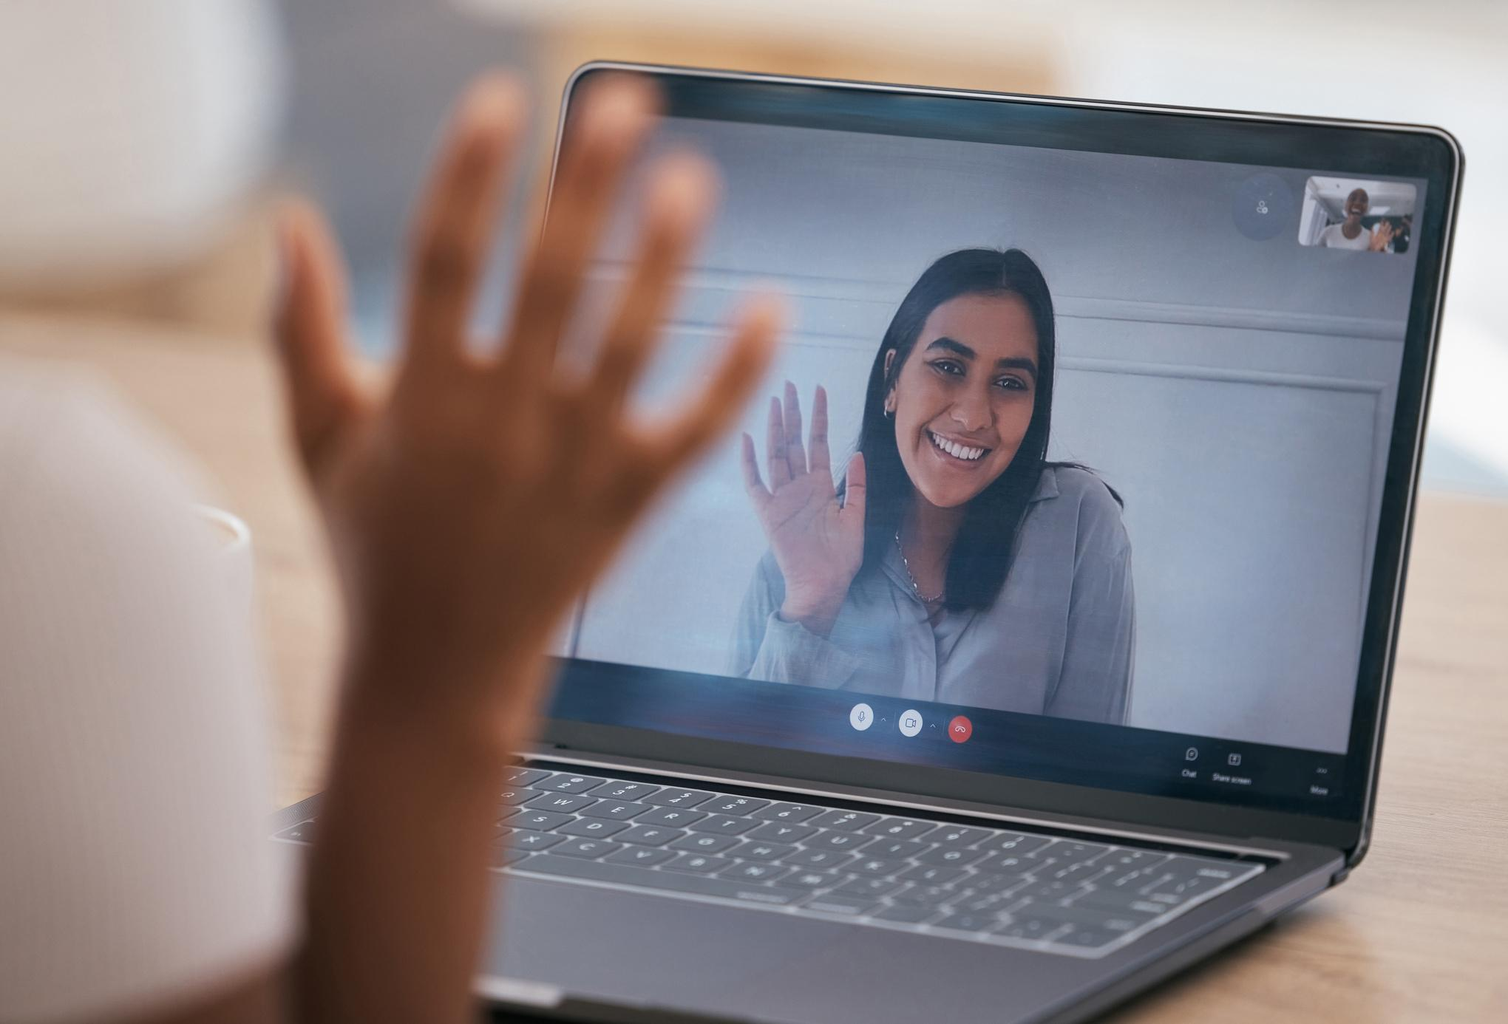
1.4 Icebreaker - Connection Cards
(10 minutes)
Instructions: Share a time when one of the below instances applied to you. (1 minute per member)
  You prepared for a difficult conversation by doing some research
which helped you decide how to approach the situation and
strengthened the reasoning for your request
  You found that cultivating relationships with diverse colleagues generated positive results and higher performance
  You used assertiveness to balance your needs with the needs of others
  You applied emotional distance to a challenging situation
Notes:
Instructions: Share a time when one of the below instances applied to you.
(1 minute per member)
-You prepared for a difficult conversation by doing some research which helped you decide how to approach the situation and strengthened the reasoning for your request
-You found that cultivating relationships with diverse colleagues generated positive results and higher performance
-You used assertiveness to balance your needs with the needs of others
-You applied emotional distance to a challenging situation

Slide 11
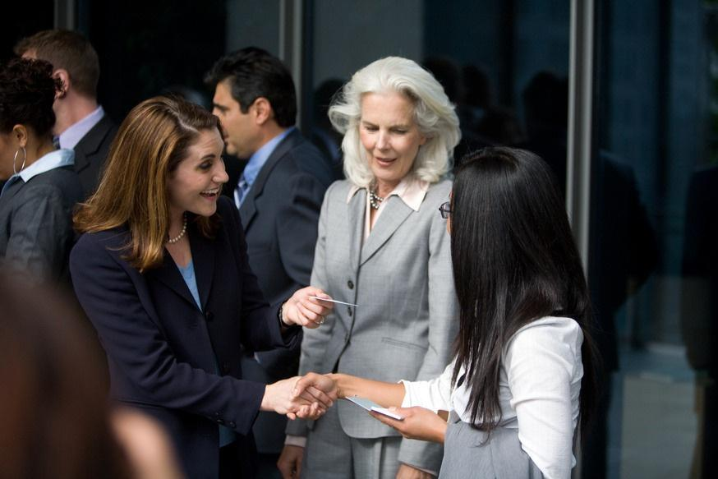
1.5 One Action from the last meeting
(5 minutes)
Instructions: Once you’re warmed up, go around your Circle and have each member share their One Action update from week #2, Inclusive Leadership. Your “One Action” is a concrete commitment you made during your previous Circle session. (1 minute per member)
2. Educational Activity: Lean in, get inspired, and add to your
toolkit
(20 minutes)
Group Choice Learning Activity & Discussion
Instructions: Choose one of the following videos or articles as a group and take a few minutes to read/view it. Then, each member shares one or two key takeaways related to intercultural communication, unconscious bias or another theme that caught your attention.
Notes:
Now that we're warmed up, let's go around the Circle and have each of us share our One Action update from week #2: Inclusive Leadership. Your One Action is a concrete commitment you made during your previous Circle session.
(1 minute or less per member)
Group Choice Learning Activity & Discussion
Instructions: Choose one of the following videos or articles as a group and take a few minutes to read/view it. Then, each member shares one or two key take-aways related to intercultural communication, unconscious bias or another theme that caught your attention. [2 videos and 2 articles to choose from, 1 per slide next 4 slides]

Slide 12
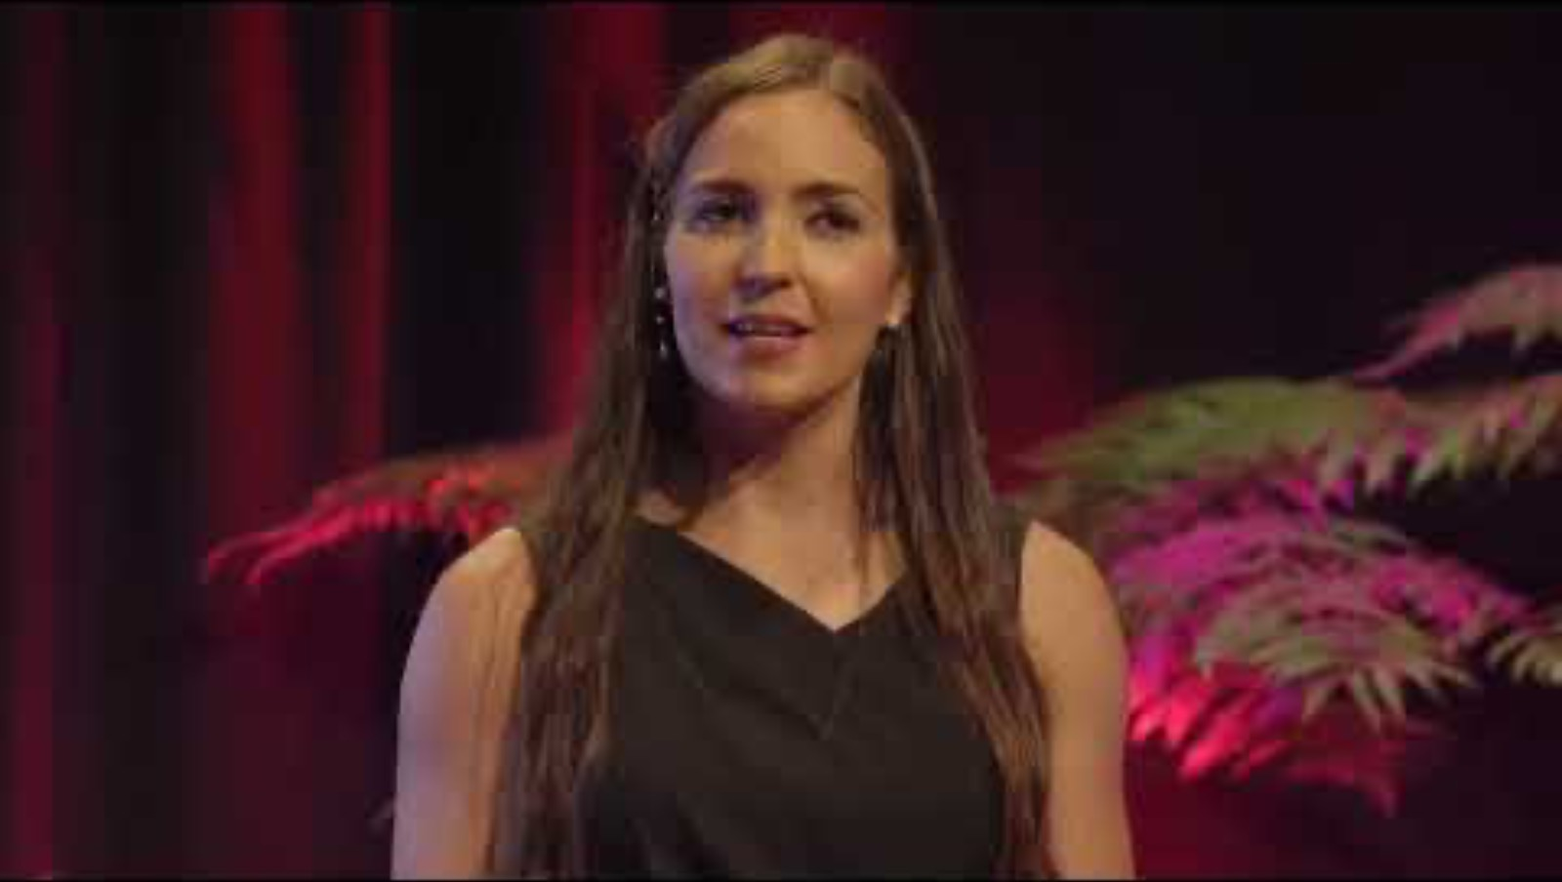
Video 1: The Surprising Paradox to Intercultural Communication
(14m 00s)
Notes:
Helena Merschdorf’s TEDx talk delves into the complexities of intercultural communication and its impact on negotiations, suggesting ways to overcome misunderstandings and build
better connections.

Slide 13
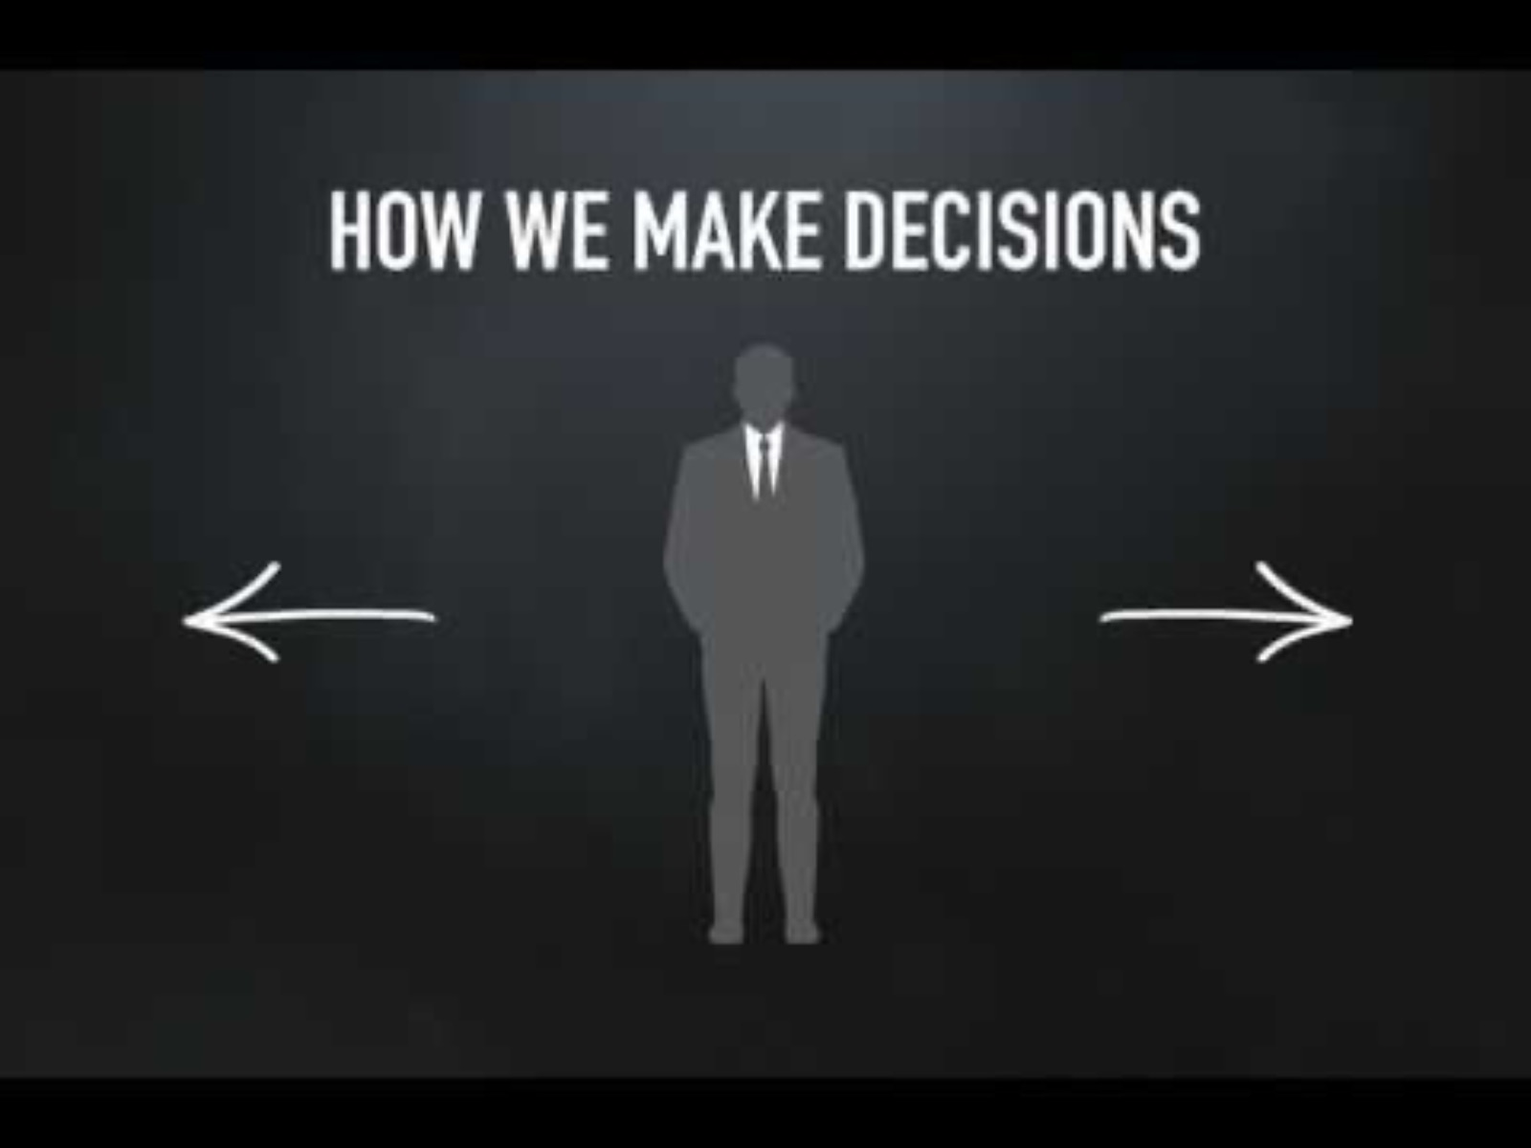
Video 2: How Unconscious Bias Affects Decision Making and How We Can Make Better Workplace Decisions
(1m 07s)
Notes:
This video explains the difference between system 1 and system 2 thinking, and how system 1 can lead to snap judgments based on visual cues or group affiliations.

Slide 14
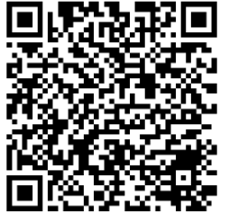
Article 1: Boost Your Negotiation Skills With Cultural Intelligence
(~500 words/3 pages)
https://wiki.gccollab.ca/images/0/07/Boost_Your_Negotiation_Skills_With_Cultural_Intelligence.pdf
Notes:
In today's globalized world, negotiators often find themselves interacting with people from diverse cultural backgrounds. To succeed in such an environment, it is crucial to develop cultural intelligence—the ability to understand, appreciate, and adapt to different cultures.

Slide 15
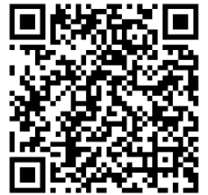
Article 2: Building Cross-Cultural Relationships in a Global Workplace
(~2100 words/7 pages)
https://hbr.org/2024/02/building-cross-cultural-relationships-in-a-global-workplace
Notes:
The article identifies six core elements of the relationship code that are crucial for building relationships across cultures, which is essential for effective negotiations.

Slide 16


Your Health Comes First!
Before the next activity, take a 5 minute mind & body
break. Grab some water, use the washroom, stretch—
whatever you need!
Notes:
Before the next activity, take a 5 minute mind & body break. Grab some water, use the washroom, stretch—whatever you need!
We'll be back together in 5 mins.

Slide 17

3. Group Activity: Share your story, learn from others, and
make new connections
(20 minutes)
Group Discussion: Life is a series of negotiations
Instructions: Share your answer to one or more of the following questions. (2 minutes per member)
  Can you think of cultural and intersectional factors that may inform or hinder how we approach negotiations?
(for example: gender dynamics, race and ethnic origin, disabilities, and/or power
dynamics in the workplace)
  Have you struggled to negotiate for yourself in the workplace? What factors do you think were at play?
  If you are in a position of leadership, what can you do to encourage your team members to feel safe and confident enough to negotiate for themselves? Does the team culture lend itself to negotiation? What tools and resources can you share?
Notes:
Welcome back!
Instructions: Share your answer to one or more of the following questions.
(2 minutes per member)
-Can you think of cultural and intersectional factors that may inform or hinder how we approach negotiations? (for example: gender dynamics, race and ethnic origin, disabilities, and/or power dynamics in the workplace)
-Have you struggled to negotiate for yourself in the workplace? What factors do you think were at play?
-If you are in a position of leadership, what can you do to encourage your team members to feel safe and confident enough to negotiate for themselves? Does the team culture lend itself to negotiation? What tools and resources can you share?

Slide 18

4. One Action: Apply yourself, pledge to grow, and inspire
others
(10 minutes)
Instructions: Each member declares their One Action commitment for this week. (1 minute per member)
Notes:
Your “One Action” is a concrete commitment you undertake related to the topics discussed during each Circle. The goal of a One Action is to step outside your comfort zone, practise a new skill, or try something new. Examples of one actions for this Circle can be found in the table that follows:
Instructions: Each member declares their One Action commitment for this week.
(1 minute per member)

Slide 19
Negotiation |  | One Action
1 | I will cultivate a safe environment where team members feel confident, and can approach me to negotiate their needs. (example: a neurodiverse team member requesting an accommodation). | Use the key video messages, the Circle 3 resources, and the experiences of your fellow Circle members to prepare your One Action.
2 | I will meet with my team leader to add my career aspirations to my Public Service Performance Management agreement.
3 | I will negotiate for an adjustment to my work situation that will benefit me. (This could be an acting assignment, income averaging or second language training).
4 | Take your learning Beyond the Circle! | Explore the Learning Library Resources at the end of this guide
5 |  | Write down your One Action commitment in the table cell to the left and get ready to report about it at Circle #4.

Slide 20

5. Wrap-up: What’s next and a few final words
(5 minutes)
Masterclass: Our next Masterclass takes place on Monday, November 4, 2024, at
1:00 pm Eastern Time.
Next Circle: The next Circle session is titled “Diversity, Equity, Inclusion, and
Accessibility: A Non-Performative Approach.”
Circle Leader and Assistant Circle Leader Selection: Do we have our Circle Leader
and Assistant Circle Leader for next week?
LLMC Written Component: Please share your comments by completing the bi-weekly Written Component forms.
LLMC Lounge: Join this Friday’s LLMC Lounge if you would like to connect and engage more on this week’s topic. This 60-minute session is facilitated by the LLMC Program Team at Materiel Group’s Diversity and Inclusion Office (DIO) every Friday.
Thank you everyone! Be well, take care and see you at Circle #4 on
Diversity, Equity, Inclusion, and Accessibility: A Non-Performative Approach
Notes:
Thank you everyone for your active participation in this week’s topic Mastering the Art of Negotiation. We hope that by seeing negotiation as a collaborative process that can benefit all parties, you will look forward to your next negotiation and feel more confident in your ability to use these newly acquired tools.
Recap: To recap today’s Circle, please consult this Discussion Guide to reflect on this Circle session and think of your One Action
for negotiation.
Masterclass: You are all invited to take part in our next Masterclass on Monday, November 4, 2024 at 1:00 pm Eastern Time. This 90-minute Masterclass is a hands-on coaching class on the topic of Diversity, Equity, Inclusion, and Accessibility: A Non-Performative Approach. Invitations to all 5 Masterclasses have been sent to you prior to the start of this LLMC cohort. Please see your calendar for details.
Next Circle: The next Circle session will be focused on the topic of diversity, equity, inclusion, and accessibility. Please review Discussion Guide #4 prior to the fourth Circle session.
Circle Leader and Assistant Circle Leader Selection: Do we have our circle leader and assistant circle leader for next week? If leaders for the next Circle were not chosen, ask for volunteers for both positions.
LLMC Written Component: Please share your comments by completing the bi-weekly Written Component forms. A link to the form can be found in your calendar. Completion of these forms is one of the commitments you made when you applied. The LLMC Program team relies upon your feedback to continue to grow the program.
LLMC Lounge: Join this Friday’s LLMC Lounge if you would like to connect and engage more on this week’s topic. This 60-minute session is facilitated by the LLMC Program Team at Materiel Group’s Diversity and Inclusion Office (DIO) every Friday.
Thank you everyone! Be well, take care and see you at Circle #4 on Diversity, Equity, Inclusion, and Accessibility: A Non-Performative Approach

Slide 21
To Do Checklist:
Next Week at a Glance
Consult the LLMC Program Overview Wiki
page for all checklist links
Attend the Masterclass on November 4 at 1:00pm Eastern
Fill out the Reflection Questions (Discussion Guide PDF)
Attend the LLMC Lounge on Friday at 1:00pm Eastern (optional)
Complete your One Action
Join the LLMC LinkedIn group
Complete your Written Component
Check out the Beyond the Circle bonus content at the end of this guide & the LLMC Learning Library
Review Discussion Guide #4 on Diversity, Equity, Inclusion, and Accessibility: A Non-Performative Approach

Slide 22
Learning Library Resources
Books
The Art of Persuasion: Winning Without Intimidation by Bob Burg
Negotiating at Work: Turn Small Wins into Big Gains by Deborah M. Kolb & Jessica L. Porter
Psychologie de la négociation par Jean Poitras
Women Don’t Ask – Negotiation and the Gender Divide by Linda Babcock & Sara Laschever
Getting to Yes: Negotiating Agreement Without Giving In by Robert Fisher & William Ury

Slide 23

Learning Library Resources
Articles
Cinq clés pour une conversation difficile
Dix astuces pour devenir un bon négociateur
5 stages of the negotiation process
Emotion and the Art of Negotiation
Negotiating: The Top Ten Ways that Culture Can Affect your Negotiation
How cultural differences impacts contract drafting and negotiation
What are some common cognitive biases that affect negotiation outcomes?
Overcoming Cultural Barriers in Negotiations and the Importance of Communication in International Business Deals
Essential Negotiation Skills: Limiting Cognitive Bias in Negotiation
Counteracting Negotiation Biases Like Race and Gender in the Workplace
Bargaining While Black
Who Can Lean In? The Intersecting Role of Race and Gender in Negotiations
These resources are clickable links!

Slide 24
Learning Library Resources
Government of Canada Resources
Introduction to Negotiation
Collaborative Learning for Managers
Training Workshops - Federal Mediation and Conciliation Services
These resources are clickable links!

Slide 25
Learning Library Resources
Videos
Negotiation - 2023 LLMC Masterclass #3 (1h 13m 58s)
Negotiation Advice: Win by Working Together (3m 57s)
Interview Tips, Salary Negotiation Strategies & How to Reclaim your Value (39m 06s)
Négociation: ne cherchez pas le compromis (16m 49s)
La négociation gagnant-gagnant (1m 58s)
How to prepare for a negotiation (3m 45s)
How to Overcome Bias in Negotiation with Critical Thinking (5m 17s)
Gender and Privilege in Negotiation (1h 21m 32s)
3 steps to getting what you want in a negotiation (5m 00s, more info on next 2 slides)
These resources are clickable links!

Slide 26
Learning Library Resources
Video: 3 Steps to Getting What You Want in a Negotiation
https://www.ted.com/talks/ruchi_sinha_3_steps_to_getting_what_you_want_in_a_negotiation
Key Video Messages
This video empowers you with the tools and strategies for successful self-negotiation. You’ll discover how an empathetic approach and how
conscientiously thinking about the various dimensions at stake in a particular request can lead to a most deserving win. By embracing a collaborative perspective, you'll take into account what your manager wants and leverage that knowledge to strike a mutually beneficial deal. This video also elaborates on the importance of strategic negotiation:
  Do your research
    Preparing for the negotiation by understanding your own needs, those of your organisation and what solutions may be available will likely lead to a more successful outcome. Thoughtful preparation shows that you took the time to consider the needs of your team and organisation. It is also an indicator of the respect you have for the person with whom you are in negotiations.
    Instead of viewing negotiation as a win/lose scenario, approach it as an opportunity for collaboration and troubleshooting. Engaging in the negotiation process enables us to build stronger relationships, as we acknowledge that cooperation involves both giving and taking.

Slide 27
Learning Library Resources
Video: 3 Steps to Getting What You Want in a Negotiation
https://www.ted.com/talks/ruchi_sinha_3_steps_to_getting_what_you_want_in_a_negotiation
Key Video Messages (continued)
  Mentally Prepare
    Prepare yourself for the possibility that your request will be denied. Embrace defensive pessimism, anticipating the worst while recognizing that the results are not reflective of your inherent worth. By adopting this mindset, you are less likely to be anxious and to disrupt your negotiation. A lack of emotional attachment to any outcome will empower you to handle potential objections and be open to other possible alternatives. It is also worth recognizing when to walk away if your minimum requirement is not being met. Note: The LLMC Team acknowledges that some negotiations may be of a nature that do not allow us to embrace defensive pessimism.
  Put yourself in another’s shoes
    Understand that your request has the potential to impact the professional lives of others, including the person with whom you are in negotiation. How will this impact their relationship with the rest of the team, their workload and how they are seen by the individuals to whom they report? Will they even have the authority to allow your request? Communicate your request with a clear rationale, emphasising that it's not just about you but rather about achieving your professional goals and benefiting the entire team.

Slide 28

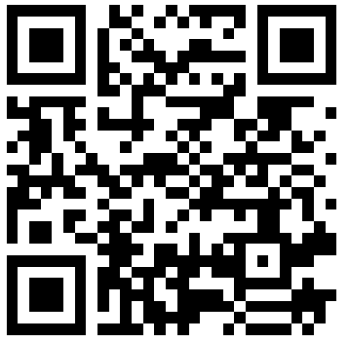
Contact Us
Contact us on the LLMC Support Form
The Lifting as you Lead Mentoring Circles Discussion Guide was created by the Diversity and Inclusion Office, Materiel Group, National Defence.

Slide 29
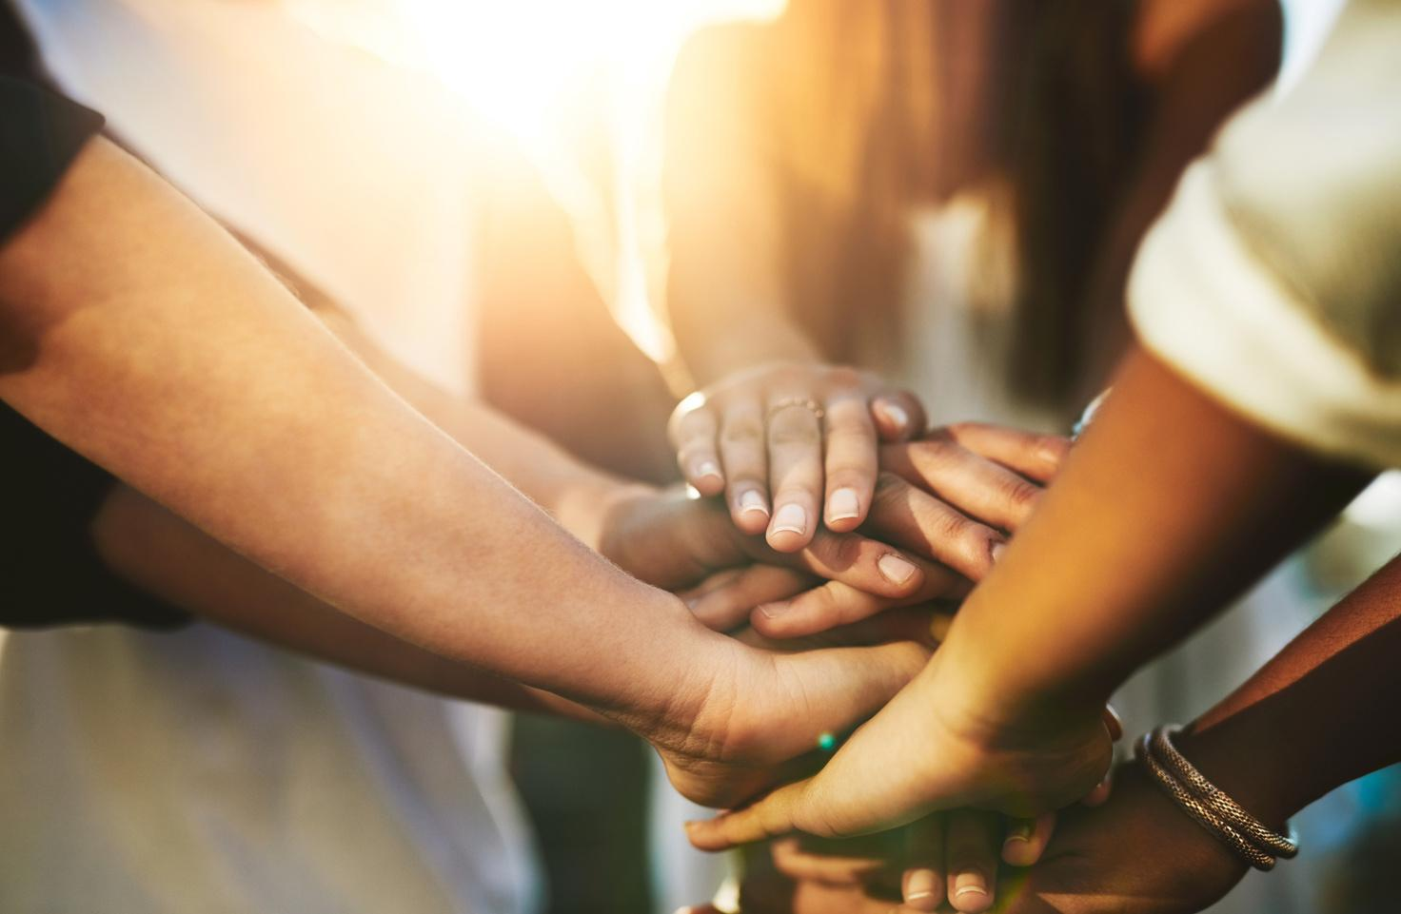
Support
Employee Assistance Program (EAP)
EAP provides free short-term counselling for personal or work-related problems as well as crisis
counselling.
Toll-free: 1-800-268-7708
TTY (for people with hearing impairments): 1-800-567-5803
https://www.canada.ca/en/government/publicservice/wellness-inclusion-diversity-public-service/
employee-assistance-program.html#E
Hope for Wellness Helpline
24/7 access to Indigenous Counsellors.
Available in French and English and, upon request, Ojibway, Cree and Inuktituk.
1-855-242-3310
Chat line via: https://www.hopeforwellness.ca/
Member and Family Assistance services (Canadian Armed Forces)
The Member and Family Assistance services is a 24 hour, 7 days a week bilingual telephone and face to face counselling service that is voluntary, confidential, and available to Canadian Armed Forces (CAF) members and their families who have personal concerns that affect their well-being and/or work performance.
https://www.canada.ca/en/department-national-defence/services/benefits-military/health-support/member-family-assistance-services.html

Slide 30

Support
Sexual Misconduct Support and Resource Centre (National Defence)
The Sexual Misconduct Support and Resource Centre (SMSRC) was created by the Department of
National Defence but is independent from the CAF chain of command and is not required to report
incidents of sexual misconduct to the CAF. Support services for CAF members, National Defence public
service employees, Cadets and Junior Canadian Rangers affected by sexual misconduct and their
families, aged 16 and older. Guidance and support for leaders and management on addressing sexual
misconduct.
https://www.canada.ca/en/department-national-defence/services/benefits-military/health-support/sexual-misconduct-response.html
The Canada Suicide Prevention Service
Talk Suicide Canada provides nationwide, 24-hour, bilingual support to anyone who is facing suicide.
Toll-free: 1-833-456-4566.
https://www.crisisservicescanada.ca/en/
Wellness Together Canada
Mental Health and Substance Abuse Support.
Toll free: 1-866-585-0445
https://wellnesstogether.ca

Slide 31
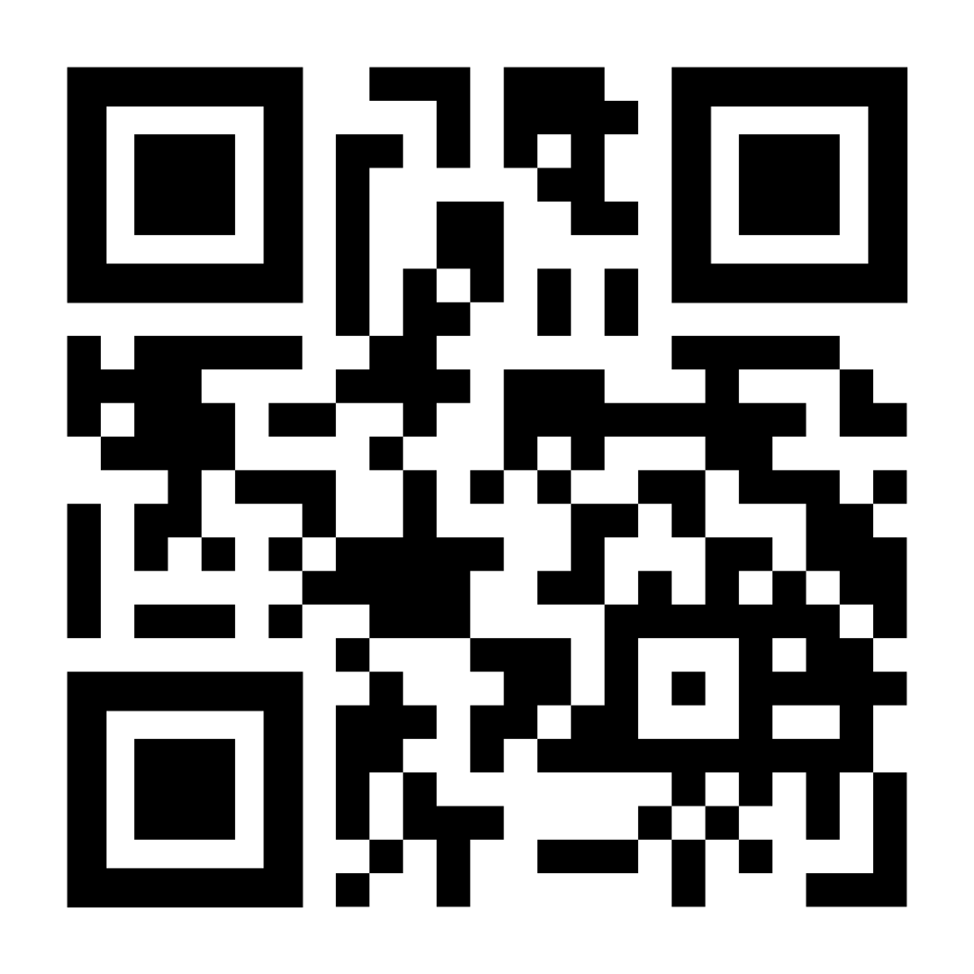
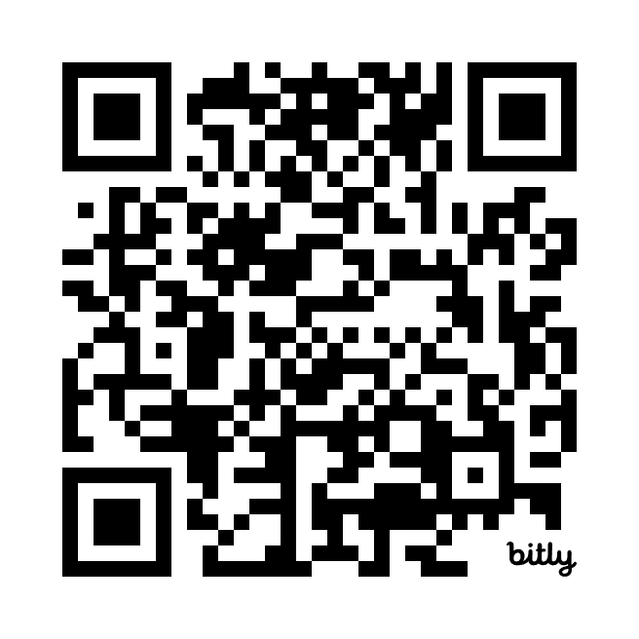
Keep the Conversation Going
Join the LLMC LinkedIn Group
Stay up to date on all Diversity and Inclusion Office Initiatives on our GC Wiki

Slide 32
Thank you all for your participation!
Be well, and take care.

