Slide 1
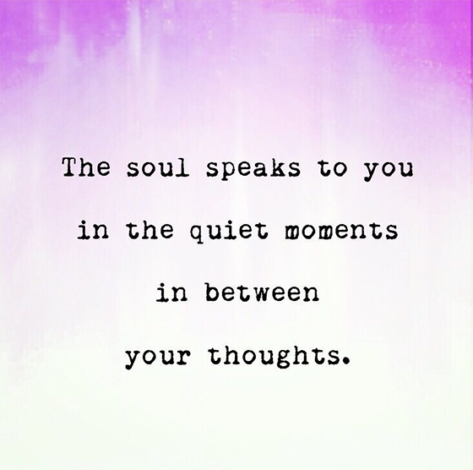
Notes:
(Friendly reminder: prep for sharing audio & video, including French CC and 100% font size)
SCARF Model https://www.youtube.com/watch?v=hNAcCc1oWR4
Self-compassion break, 5 mins: https://self-compassion.org/wp-content/uploads/2020/08/self-compassion.break__01-cleanedbydan.mp3
How to Practice Mindful Emailing: https://www.youtube.com/watch?v=qBBy5Jx_xrQ
https://my.happify.com/hd/why-you-should-treat-yourself-like-someone-you-love/

Slide 2
Mindful Change Leadership Development Program
Week 5 (of 8)
24 May 2021
Notes:
« Vous savez maintenant que vous pouvez utiliser la langue de votre choix pour exprimer vos commentaires ou vos questions »
By now, you know you can use the language of your choice to express your comments or questions

Slide 3
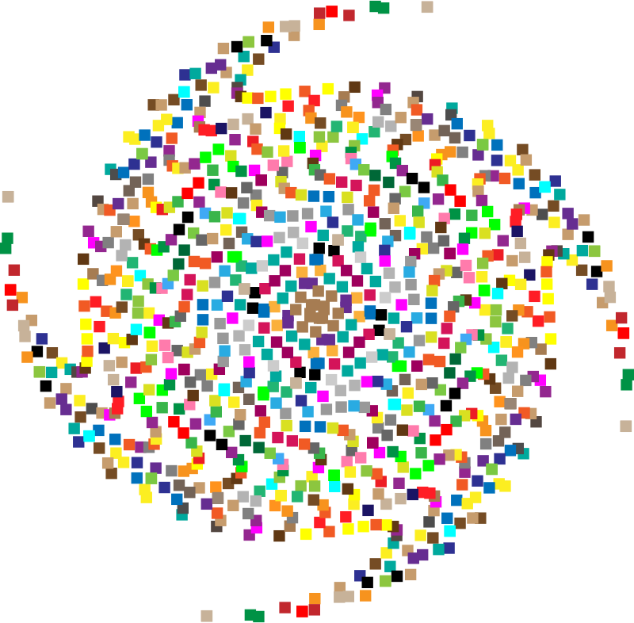
Mindful Self-Compassion Exercise – Centering
Mindful breathing https://www.youtube.com/watch?v=ZE-r-x2T4ok
Notes:
For today’s centering exercise, we’ll use a slight variation…. Similar to previous ones, the trick is to shift from “doing” to “being”
Let’s start by doing the following...
Sit with a straight position, as comfortable as possible
It helps if you close or semi-close your eyes
Focus on your breathing and repeat in your mind the following sentences that feel right to you, in this moment…
Repeat twice or three times, pausing between each phrase:
May I be safe
May I be peaceful
May I be kind to myself
May I accept myself as I am

Slide 4
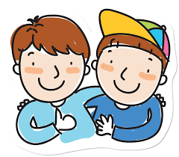
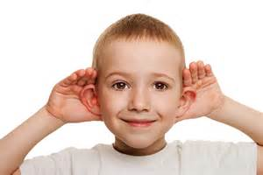
Insights from last week (4)
Your Buddy System
Your practice :
Plenary
Notes:
Let’s have a few people share some insights, challenges or surprises you experienced or noticed from last week’s practice, including
the gratitud journaling.
the Mindfulness Breathing or Body Scan,
Mindful Water Drinking
Self-Compassion
Cleaning up your e-environment
Feel free to raise your hand to speak or type in your comments and question in the chat. We would love to hear from some of the people that we haven’t heard from previously.
A friendly reminder that if you are joining by telephone, press *6 to to unmute yourself and then press *6 again to mute. If you don’t bridge your telephone to webex, the breakout rooms will likely not work for you.

Slide 5
Poll Results from Last Week (4)
Q1.I have done my daily mindfulness practice, either body scan or breathing exercises…
Q2.The daily mindfulness practice I do, either body scan or breathing exercises, I do it for…
Q3.I have done my daily gratitude journaling...
Q4.I have been connecting with my Buddy System...
Q5.What I have liked the most about these sessions is...
Q6.Any additional comment you may want to share?
Plenary
Notes:
The goal at this time is to go over the results from last week’s survey, to give us a sense of awareness of what happened on the results.
Quick scan over the results obtained through the survey.
Depending on the results if issues with buddy systems, please contact us and we will see what we can do for you.

Slide 6
Agenda – week 5
Centering breathing exercise
Debrief from last week 4
Today’s session intentions: Compassion, Clarity, Creativity
The SCARF model
Technique – SBN RailRoad
Your take away assignment
Notes:
Carmen

Slide 7
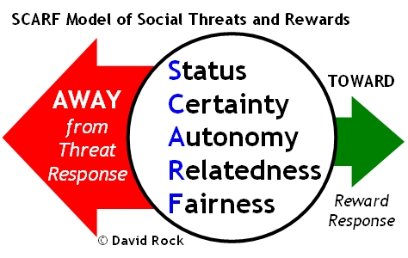
SCARF Model
Status is about relative importance to others.
Certainty concerns being able to predict the future.
Autonomy provides a sense of control over events.
Relatedness is a sense of safety with others – of friend rather than foe.
Fairness is a perception of fair exchanges between people
http://www.edbatista.com/2010/03/scarf.html
Notes:
It is a very interesting model, it is not easy to grasp at once but once understood all of it or the intention of it, it is really valuable.
(state what each letter signifies for SCARF)
We have prepared 2 more slides in order for us to share with you and explain what this model means. The thing is to identify what we walk away from as a threat response because we feel as though something is threatening us. So we change this from a threat response to a reward response. I will explain from the slides and there is also a short video. (Read what the slide states for each letter).
Resources in English:
http://www.edbatista.com/2010/03/scarf.html
https://www.psychologyafrica.com/2013/05/when-leaders-use-their-brain/ https://jvrafricagroup.co.za/blog/when-leaders-use-their-brain

Slide 8
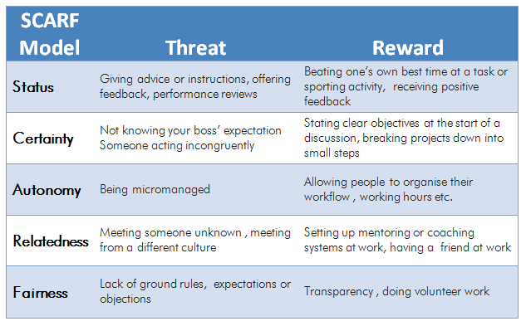
SCARF Model – Some Examples of Actions
That can evoke either a threat response or a reward response:
https://www.psychologyafrica.com/2013/05/when-leaders-use-their-brain/
Notes:
“In explaining this we can identify what is a threat or a reward – what we see as a threat or a reward the way something is presented.”
(explains what is perceived as a threat and what is perceived as a reward based on the slide)
Have a minute to think and reflect about a situation when we chose one or the other, Threat or Reward response
https://childcareta.acf.hhs.gov/systemsbuilding/systems-guides/leadership/leading-ourselves/scarf-model
https://www.mindtools.com/pages/article/SCARF.htm

Slide 9
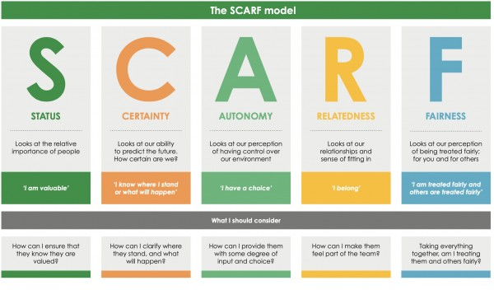
https://www.youtube.com/watch?v=hNAcCc1oWR4
Notes:
Alejandro
https://www.youtube.com/watch?v=hNAcCc1oWR4

Slide 10
Technique – SBN-RR
SBN-RR
Stop – whenever you feel a trigger coming
Breathe – focus your mind on your breath
Notice – experience how you feel, notice your emotions
Reflect – where is that coming from? Is there any judgment?
Respond – take the opportunity to respond with a positive and compassionate outcome in mind.
This is a technique that could be used in your everyday work.
https://siyli.org/take-the-railroad-to-avoid-triggers/
Notes:
The following technique is used for helping regulating our reactions and emotions, called SBNRR tool for “Stop / Breathe / Notice / Reflect / Respond”. Or in French: “Stop / Respire / Constate / Réfléchis / Réponds”. When an external event triggers a sudden surge of emotions in me, following this sequence allows me to give the neocortex time to do its work of distancing, analyzing and regulating emotions, for a more effective response.
(read the slide)
Think about it for a minute and come up with real examples on when this technique could have been used for good.
Come up with real examples
Ressources in English:
Technique SBN-RR - https://siyli.org/take-the-railroad-to-avoid-triggers/
Ressource en français :
L’outil SBN-RR : https://www.aureliendaudet.com/muscler-intelligence-emotionnelle-2-jours-4-semaines/

Slide 11
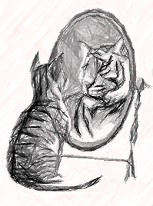
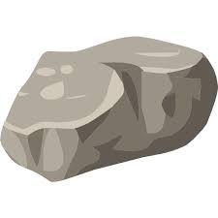
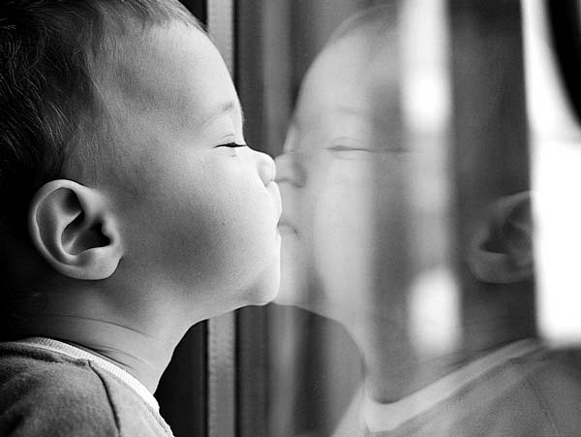
Treat yourself as if you were worthy of love… because you are
Double check the videos
https://my.happify.com/hd/why-you-should-treat-yourself-like-someone-you-love/
https://www.youtube.com/watch?v=rDFpHzYu6rE
https://youtu.be/2g1q3aSBhwQ?t=135
Notes:
This slide is about treating yourself as if you are worthy of love because you are. You have here the Rock, as a child he used to get attacked. He did not know how to deal with his life, he became a rock in order to protect his heart because other were a threat to himself so he became a rock. But as he grew up, he learned how to be himself and be gentle, vulnerable. Don’t be ashamed of who you are, be yourself.
How to find the perfect relationship - https://www.youtube.com/watch?v=bUMFZM5WBrI
Self Love Practice: https://www.youtube.com/watch?v=rDFpHzYu6rE
Self-Love Exercise - https://youtu.be/2g1q3aSBhwQ?t=135
Resources in English:
How to find the perfect relationship - https://my.happify.com/hd/why-you-should-treat-yourself-like-someone-you-love/
"they had us in the first half not gonna lie" https://www.youtube.com/watch?v=xaqdK6JPpcg
How To Let Your Light Shine Bright - https://www.youtube.com/watch?v=CWpiCOmbVuY
Ressources en français :
Voila ce qu’il faut faire pour réussir à s’aimer soi même, 6 mins – https://www.youtube.com/watch?v=18jn-K34aNA&t=39s
Exercice dans le miroir, Augmenter l'amour de soi, 4 min - https://www.youtube.com/watch?v=HTlnAbAax_0
Apprendre à vous aimer, 6 min - https://www.youtube.com/watch?v=6L0vo7dx_SE
Se traiter soi-même comme on traiterait un ami- https://www.sarah-baumann-hypnose.com/post/se-traiter-soi-m%C3%AAme-comme-on-traiterait-un-ami
Développer l’éstime personelle
1 - https://www.youtube.com/shorts/TkjSsCZxwEs
2 - https://www.youtube.com/shorts/GBMDjw8h_co
3 – https://www.youtube.com/shorts/kpn4L_uvAH4
4 - https://www.youtube.com/shorts/SfTQNTvRPMg
Mylène Muller - https://www.youtube.com/channel/UCryuWe_q6Z_pLn8fd7E0Cyg/search?query=aimer%20soi-meme

Slide 12
Traitez-vous comme si vous étiez digne d'amour… parce que vous êtes
Aime toi toi-même
Voila ce qu’il faut faire pour réussir à s’aimer soi même, 6 mins – https://www.youtube.com/watch?v=18jn-K34aNA&t=39s
Exercice dans le miroir, Augmenter l'amour de soi, 4 min - https://www.youtube.com/watch?v=HTlnAbAax_0
Notes:
Cette diapositive parle de vous traiter comme si vous méritiez d'être aimé parce que vous l'êtes. Vous avez ici le Rocher, enfant, il se faisait attaquer. Il ne savait pas comment gérer sa vie, il est devenu un rocher afin de protéger son cœur parce que les autres étaient une menace pour lui-même alors il est devenu un rocher. Mais en grandissant, il a appris à être lui-même et à être doux, vulnérable. N'aie pas honte de qui tu es, sois toi-même.

Slide 13
Your take away practice for week 5
Connecting – Buddy System
Gratitude Journaling – daily
Practice up to 15 mins… chose one - daily
Body scan or Breathing 15 mins – https://www.rightlifeproject.com/meditate (may need to scroll down) 15 mins – https://soundcloud.com/dharma-gus/15-min-body-scan-augusta-mbsr
Self-compassion 10 mins – https://soundcloud.com/breathworks-mindfulness/mindfulness-for-women-track-5-self-compassion-meditation 10 mins – https://soundcloud.com/user-640851605/self-compassion-giving-and-receiving-meditation-10-minutes 15 mins – https://soundcloud.com/mindfullivingcoach/self-compassion-meditation 15 mins – https://soundcloud.com/awakeningcompassion/awakening-compassion-class-4 20 mins – http://self-compassion.org/wp-content/uploads/meditations/LKM.self-compassion.MP3
Apply the SCARF Model – as needed
Technique - SiBerian North RailRoad
Reminder… Mindful Cleaning Your Environment
Reminder… Mindful – self-compassion
Notes:
Carmen
Be aware: next week we’ll do a Mindful Eating exercise, you’ll need a small fruit or a veggie for this, something like a grape, blueberry or a slice of an orange or mandarin, a piece of a carrot, cucumber or any veggie

Slide 14
Reflect about the 3 exercises
Plenary & Small Groups
SBN-RR
Notes:
Carmen
Now, before going into small groups debrief, let’s do a plenary debrief, let’s open the microphone for a few of you who would like to share your reflections about today’s exercises in plenary
Give the voice to 2-4
Then create breakout rooms of 6
As in previous weeks, you’re going to be randomly assigned to a breakout room to do your debriefs, when you’re done just leave the session.
Feel free to share:
What you noticed
What you had a hard time with
What you’re reailzing
An intention you have for the week
About the SCARF model,
The SiBerian North RailRoad
etc
I wish you happiness!!

Slide 15
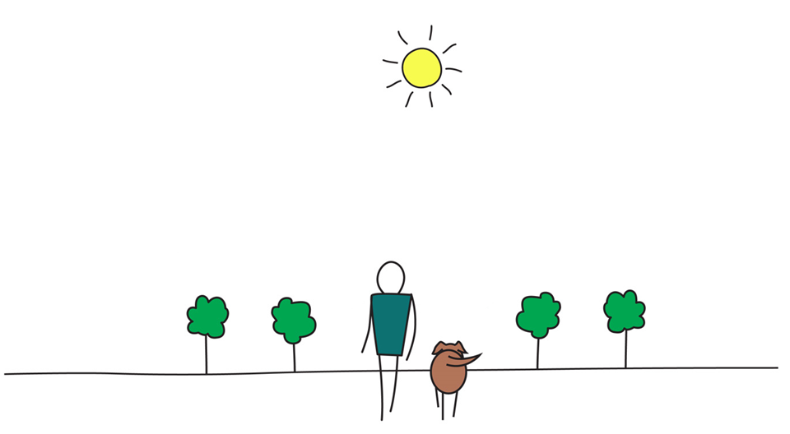
Be Mindful, Be Happy /
Prenez pleine-conscience, soyez heureux
Alejandro Gonzalez https://gcconnex.gc.ca/profile/alejgonz

