Slide 1
Regulatory Experimentation: Learning by Doing
December 1, 2020

Slide 2
Objectives for this webinar
By the end of this webinar, participants will know more about CRI and Nesta’s approach to regulatory innovation and experimentation, how to design a regulatory experiment, and how to apply to the Regulatory Experimentation Expense Fund.
Specifically, the webinar will cover:
An introduction to the CRI and Nesta
CRI’s role in promoting regulatory experimentation
The context - why should regulators think about using experimentation?
Examples of regulatory experiments and key elements in designing a useful regulatory experiment
How to apply to the CRI’s Regulatory Experimentation Expense Fund

Slide 3
Agenda
Introductions - CRI & Nesta | 10 mins
Regulation & innovation: background | 10 mins
Regulatory experimentation: why, what, when | 20 mins
Questions | 5 mins
Break | 10 mins
What makes a good regulatory experiment | 20 mins
Poll answers and discussion | 15 mins
Applying to the Experimentation Fund | 20 mins
Questions | 10 mins

Slide 4
Introducing the CRI Team
Bruce
Randall
(Brennan Young as of Jan 4, 2021)
Senior Director
Marc-André
Labelle
Senior Analyst
Hersha
Goldberg
Executive
Assistant
Holly
Melanson
Analyst
Ramisa
Huq
Analyst
Jessica
Dyck
Analyst
Pamela
Bruder
Analyst
Notes:
Icons from the Noun Project: Ian Ransley, Tatyana, Yu luck, Brecris, Oksana Latysheva, dDara, Drahomir Hajek.

Slide 5
Centre for Regulatory Innovation (CRI)
As part of the Government’s regulatory modernization agenda, the CRI, located within TBS Regulatory Affairs sector, supports regulatory experimentation that promotes innovation and competitiveness in Canada. The CRI was stood up in late 2019 with a mandate to:
Support a whole-of-government approach to regulatory experimentation;
Help regulators to respond to technological advances; and,
Support industry in bringing applications of new technologies into the Canadian marketplace.

Slide 6
CRI Goals
SHORT-TERM
LONG-TERM
Create opportunities for regulatory experimentation.
Enhance capacity of regulators to analyze and respond to technological advances.
Support a regulatory framework conducive to innovation.
Maximize opportunities offered by emerging technologies while continuing to protect health, safety, the environment and the economy.

Slide 7
Nesta introductions
Chris Gorst
Director at Nesta Challenges
Andrea Richardson
Programme
Manager
Nicola Tulk
Programme
Manager

Slide 8
Nesta’s role with the CRI
Work in partnership with CRI to…
Share learning from our work in regulatory innovation
Including insights to help design the Experimentation Fund application process
Provide guidance and support to regulators implementing, overseeing and evaluating regulatory experiments
Including guidance to develop / refine proposals for CRI’s Experimentation Fund
Build a regulators’ toolkit based on learning from CRI’s initial work and international examples

Slide 9
Background
Regulation and Innovation

Slide 10
Innovation - a blind spot in regulatory theory?
How we regulate has changed little through waves of technological and commercial innovation
Internet, mobile computing, AI, biological engineering etc.
Assumptions underlying regulatory models have come increasingly into question: rational economic agents, competitive market paradigm, stable equilibrium
Theory provides little practically useful guidance on:
How regulation affects innovation
Implications of different types of innovation for regulation and regulatory practice
Ad hoc approach to innovations
With bias towards inaction? Personal data sharing, AI, cryptocurrency...
Notes:
Harry’s notes
Environment regulators emerged from is different from today. The regulators role was to make sure the market was operating efficiently. Competition, efficiency will lead to innovation, consumer benefit, and choice. Role of regulator was to step back, let the market function and step in only when obvious issues emerge. Only get involved when really necessary.

Slide 11
Regulation and innovation - a tradeoff?
Regulate too early or too much and innovation could be stifled
Regulate too little or too late and innovation could lead to lasting harms to the public
Sweet spot?

Slide 12
There is no straightforward tradeoff
“Wait and see” approach is not necessarily good for innovation in the long run and is inadequate in tackling global challenges
“Regulatory drag” and path dependence- potential regulatory tax on innovation
Missing regulatory frameworks create uncertainty, cedes ground to potentially harmful innovation
Innovation not emerging where needed - critical for global challenges like climate change, COVID, inequality etc

Slide 13
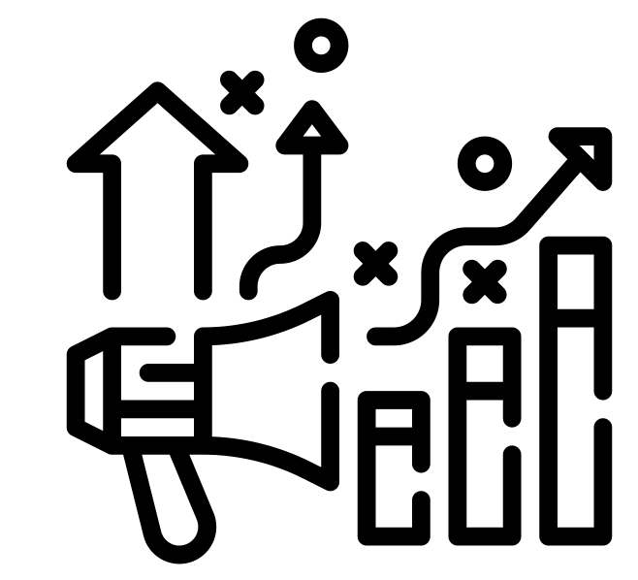
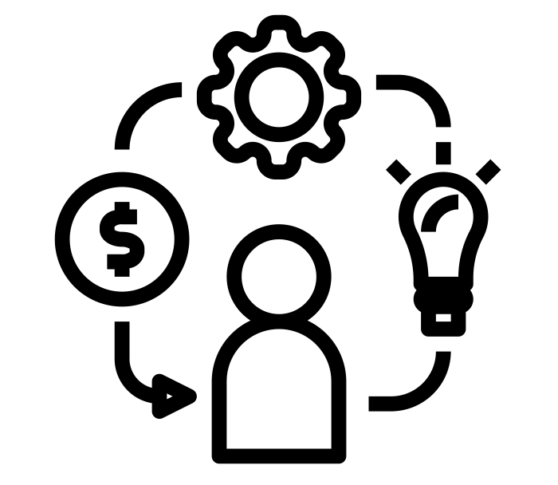
In taking a new approach, regulators have to contend with a number of challenges
Pressure for regulation and regulatory action To support innovation and respond to unchecked digital innovation, new technologies and business models. Uncertainty around what needs to be regulated and how it should be regulated
Radically different environments
Decentred regulation (eg self regulation), changing power dynamics, new types of harms and opportunities, erosion of sectoral boundaries, Uncertainty around how regulators can adopt new ways of working to respond (eg co-design)
Pressure for more innovation
Growing business and political pressure to ease regulation, stagnant productivity growth and international competition as well as the need to respond to global crises. Uncertainty on regulators role in respect to innovation and how to balance innovation along with other elements of their mandate (eg safety)
Internal challenges
Development and adoption basic playbook not effective. Uncertainty around how better processes, ways of working or regulatory frameworks might work
Notes:
Icons from Tippawan Sookruay on The Noun Project

Slide 14
Experimentation can be a valuable tool for regulators grappling with innovation and uncertainty
Innovation is inherently uncertain
Which innovations will emerge, which will gain traction, how they will evolve, how consumers will use them, what ethical issues they raise etc.
The impact and effectiveness of regulatory action is also often uncertain
Acutely so in relation to innovations
Where the stakes are high, regulators need tools that reduce uncertainty to inform their decision making
Experimentation can be an effective way to generate evidence and information to inform regulatory decision making under uncertainty
Notes:
HA

Slide 15
Why, What, When
Regulatory Experimentation

Slide 16
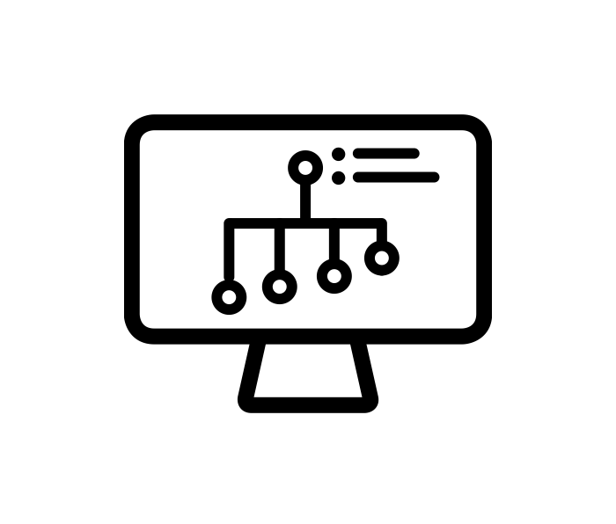
What is a regulatory experiment?
A regulatory experiment is a trial or test of a new product, service, approach, or process, designed to generate evidence or information that can inform the design or administration of a regulatory regime.
Trial or test - where something is tried out under time-limited conditions - with a clear beginning and end
The product, service, approach or process that is tried has an angle that is new
The primary goal is to generate evidence or information - to learn something
The purpose for seeking evidence is to inform the design or administration of a regulatory regime
Notes:
All icons from the Noun Project
testing by Vectors Market from the Noun Project
knowledge idea by Vectors Point from the Noun Project
data chart by Ivan Colic from the Noun Project
regulation by Nithinan Tatah from the Noun Project
A regulatory experiment is a trial or test of a new product, service, approach, or process, designed to generate evidence or information that can inform the design or administration of a regulatory regime. To demonstrate that their project is a regulatory experiment the applicant will have to demonstrate the following:
1. The project includes a trial or test where something is tried-out under time limited conditions with a clear beginning and end.
2. The product, service, approach, or process that is tried must have an angle that is new. Examples include a new thing, or an old thing used in a new way, for a new purpose or in a new environment.
3. The primary goal of an experiment is to generate evidence or information. In general, this means that the purpose is to learn something.
4. The purpose for seeking information or evidence must be to inform the design or administration of a regulatory regime. This means informing either:
· the administration of Acts or Regulations
· the design of new Acts or Regulations
· the design of revised Acts or Regulations

Slide 17
Why experiment?
The core reason to undertake regulatory experimentation is to provide evidence or information to inform regulatory decision making
A structured approach to systematically generate high quality evidence
A powerful way to test alternative approaches and identify potentially better approaches
Help regulators reduce risk and uncertainty
Generate information in a controlled and purposeful way
Experiments can generate information in complex, changing systems
Help to build consensus around a regulatory option or issue
Notes:
They provide a structured approach to systematically generate high quality evidence to inform regulators’ decisions. Experimentation provides a way in which valuable new information (e.g. how well a new regulatory approach works) can be generated through a structured process. Building a robust evidence base is an essential component of better regulation.
They are a powerful way to test alternative approaches and to identify potentially better approaches to achieving regulatory objectives. This might include new regulatory approaches (e.g. for a new technology, product or service) or improvements to existing regulatory approaches (e.g. to reduce the compliance burden without increasing compliance risk).
Experiments help regulators to reduce the risk and uncertainty associated with a new regulatory approach prior to implementing it at scale. An experiment may be the only chance to observe, control and learn before a regulatory approach is fully implemented and may lead to irreversible consequences.
Experiments allow policy makers and regulators to generate information in a controlled and purposeful way. Experiments allow for a much greater degree of control and more effective monitoring to isolate aspects of particular interest than is possible in a ‘real world’ setting (where there is greater complexity).
Experiments can generate information in complex, changing systems. They can be particularly useful in rapidly changing circumstances where previous research and theory may become quickly outdated or offer little guidance.
By building a more robust evidence base they help to build consensus around a particular regulatory option or issue that may otherwise be contested.

Slide 18
When to experiment - a checklist
Is there a clear and important question that needs to be answered?
Can an experiment be designed that would provide evidence to answer the question?
What are the possible outcomes from the experiment, and how would they be interpreted?
What alternatives are there to an experiment?
E.g. experience/intuition; do nothing/‘wait and see’; implement then evaluate; public consultation; desk research; experts
How do the alternatives compare?
Feasibility, cost, timing, robustness of evidence, speed/ timeliness, ethical and legal considerations
Notes:
Alternatives - experience/intuition, theory, using existing related research, consultation, post-implementation evaluation

Slide 19
Poll question 1
What are the barriers to Canadian regulators conducting experiments?
[Select as many as applicable]
Unclear when to experiment
Unclear how to experiment
Difficult to develop useful metrics
“Buy-in” - no culture of experimentation
Considered high risk
Required resources - time, money, people
Required external buy-in - other regulators, other parts of gov, industry, public
Ethical concerns
Notes:
Icons from thenounproject.com bu Larea

Slide 20
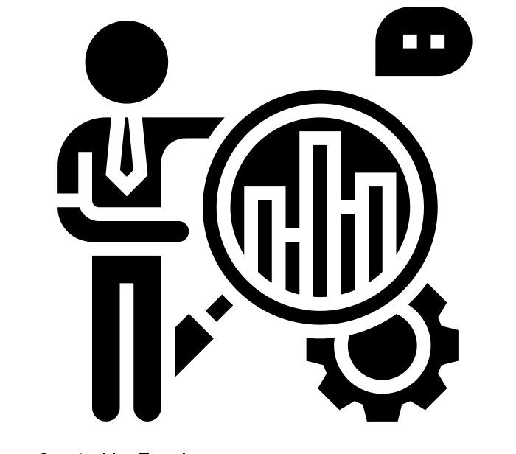
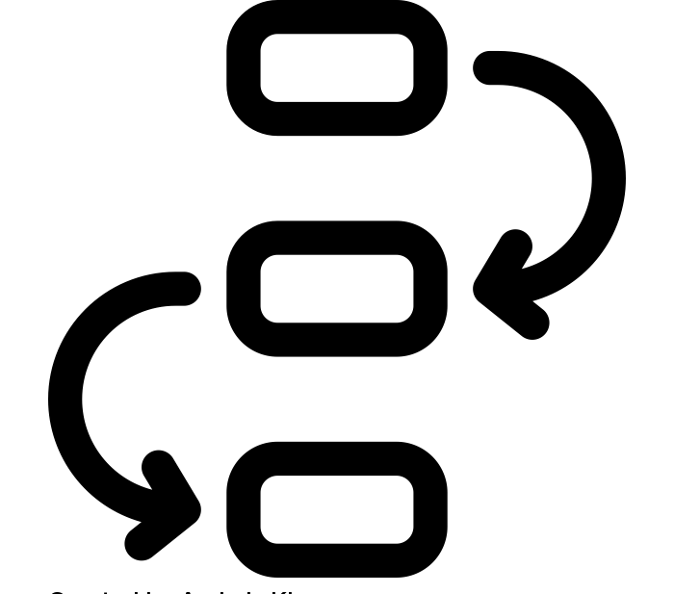
Examples of what regulators might experiment with
A regulated ‘object’ e.g. new products, services, business models
Assess the implications of new innovations if they were used in the real world
Assess the effectiveness of existing regulations for new innovations
A regulation or piece of legislation
Test new regulation in controlled circumstances e.g. a sandbox, within a specific location, or with a specific group of regulated entities
A regulatory process
Test different ways of giving regulatory advice
Test a new approach to compliance or licencing
Test new ways of working e.g. co-design, public engagement
Notes:
All icons from https://thenounproject.com/ by Andrejs Kirma, Eucalyp, and Martin Markstein

Slide 21
Are sandboxes experiments?
The term “sandbox” is used to cover a range of different initiatives
Other terms - “testbeds”, “living labs”, “innovation spaces”
Usually sandboxes are testing environments, usually for innovative products or services, that simulate a ‘real world’ environment while carefully controlling risk
Although sandboxes can provide a platform for regulatory experimentation, most sandboxes are not in practice run as experiments
Often partial/time-limited regulatory approval combined with observation
In order to be considered an experiment, they need to be rigorously designed with a focus on learning and counterfactuals
When we refer to regulatory sandboxes for experimentation, we mean...
...spaces for regulators to work directly with innovators to safely experiment with new products, services and business models in a ‘live’ environment (e.g. with customers) under supervision, possibly with regulatory waivers.

Slide 22
Example - Remotely Piloted Aircraft Systems (RPAS) with Transport Canada
Context
Need
Objectives
Experiment
Drone technology emerging but absence of a regulatory framework is limiting innovation and economic opportunity
Greater understanding of the technology, capabilities and applications.
Timely and iterative amendments to Canadian Aviation Regulations
Provide online and accessible services to Canadians
Expand pilot projects (some currently ongoing with aviation and technology industries) to develop Canadian expertise and experience

Slide 23
Experimenting with regulated products/services - Singapore Telemedicine Sandbox
Context
Need
Objectives
Experiment
Growth in the telemedicine sector
Existing regulations don’t permit some services, others out of current purview of Ministry of Health
To better understand innovative telemedicine services
To develop a new regulatory framework for telemedicine
Enable new and innovative services to be developed in a safe and controlled environment, ensuring patient safety
Time-limited sandbox
Sandbox has played a significant role in developing a new regulatory framework

Slide 24
Experimenting with regulation - Open Banking
Context
Need
Objectives
Experiment
Lack of effective competition in retail banking leading to lack of choice for consumers and limited innovation in products and services
Reduce consumers’ tie in to their current account provider through enabling easy and secure sharing of data with permissioned third parties
Define and implement a common open banking standard
In UK, the implementation of open banking, led by newly created body, is the experiment
Will open banking deliver improvements in consumer choice, competition and innovation?

Slide 25
Experimenting with regulatory process - regulatory collaboration through the Global Financial Innovation Network (GFIN)
Context
Need
Objectives
Experiment
Emerging trends within financial services are increasingly global
Positive feedback to date from national sandboxes e.g. FCA Sandbox
More efficient ways for innovative firms to interact with regulators and navigate between countries
Greater cooperation between regulators to share experience
To create a new framework for co-operation between financial services regulators on innovation related topics
Pilot of cross-border testing
Regular member engagement

Slide 26
Poll question 2
If you were to apply to the CRI Experimentation Fund, which of the following would you be most interested in experimenting with?
[Select one]
A policy or regulatory process
A regulated ‘object’, new products, services and business models that create regulatory uncertainty
A new approach to regulating
Notes:
Icons from thenounproject.com bu Larea

Slide 27
Questions
Notes:
Questions for Nesta, CRI or Ryan

Slide 28
Break
Please return in 10 minutes

Slide 29
What makes a good regulatory experiment?

Slide 30
Design
Design
Design
How does example compare?
A good experiment addresses a clear problem and question
Defining your problem may require some up front research
Your question to answer should help solve this problem
What information or evidence are you missing?
How would this help you resolve your problem?
Example: Ofgem consumer engagement
Problem - consumers are not switching to the best energy providers for them. Regulator’s remit includes ensuring energy market is working for all consumers.
Question - what interventions work in increasing customer engagement?
Notes:
https://www.ofgem.gov.uk/ofgem-publications/156422
Open with explanation of Ofgem + experiment
Mention that this is not necessarily a gold star experiment for reasons we’ll explain later - at each stage our evaluation of this experiment vs what we believe makes a good experiment is indicated by the traffic light in the top right hand corner
When talking about up front research, mention that things they might consider could include:
Problem framing
Thinking about your problem from different perspectives to see if you uncover new insights from looking at it in a different light.
User and stakeholder research
Gathering the perspectives from a range of potential users or stakeholders will help inform the problem and what might be effective to tackle it.
Evidence mapping
Exploring existing evidence and research around what works will also help you to shape the direction of your experiment.
Systems mapping
If you haven’t already, doing a systems mapping exercise can help you to understand what else might be affecting your problem and where it might be most useful to intervene.
Solutions mapping
Looking at existing solutions from other domains can help spark ideas of what might be transferrable or possible in your own domain.

Slide 31
Design
Design
Design
How does example compare?
A good experiment is used where an experiment is the best approach
Is there a clear question that needs to be answered?
Can an experiment be designed that would provide evidence to answer the question?
What alternatives are there to an experiment?
How do the alternatives compare?
Example: Ofgem consumer engagement
Yes - see previous slide
Yes - alternative engagement approaches can be tried and the outcomes are measurable
Consumer research, consumer consultation, full implementation
Alternatives are less conclusive, takes away ability to compare, full implementation is expensive
Notes:
Is there a clear question that needs to be answered?
Experiments can answer questions around impact and a need for evidence - Did something work? And why? Not all questions that regulators have necessarily need an experiment to be answered. For example:
Strategic questions e.g. ‘What areas of regulatory policy should we focus our attention on?’
Process questions e.g. ‘Are our compliance mechanisms effective and appropriate?’
Can an experiment be designed that would provide evidence to answer the question?
What are the possible outcomes from the experiment, and how would they be interpreted?
What alternatives are there to an experiment?
E.g. do nothing / ‘wait and see’; implement then evaluate; public consultation; desk research; experts
How do the alternatives compare? Feasibility, cost, timing, robustness of result, ethics
Example - consumer research = “what would make you switch”, consumer consultation = “would you switch”. Takes away ability to compare = no control group

Slide 32
Design
Design
How does example compare?
A good experiment has a clear hypothesis and metrics
Hypothesis - a statement that sets-out the expected outcome that is being tested through the experiment.
Metrics - what you are going to measure to understand if the outcomes are being achieved?
Good metrics are relevant, measurable, replicable, actionable, understandable
Example: Ofgem consumer engagement
Hypothesis - removing hassle and simplifying the switching process by signposting (via letter / emailed) to three personalised, cheaper offers will encourage customers to switch energy providers
Key metric - proportion of customers switching who received the signposting vs those who did not
Notes:
No “golden” number of metrics - but the best metrics are tied really closely to outcomes or objectives - which means probably won’t have very many
In other words, if really clear about what trying to test, won’t have very many metrics

Slide 33
Design
Design
How does example compare?
A good experiment defines a counterfactual or baseline for comparison
What would have happened if the experiment hadn’t taken place?
A counterfactual may be from a control group or may be determined by comparing one group before and after.
Example: Ofgem consumer engagement
Counterfactual or baseline for comparison was the group of usual consumers who did not receive a letter.
Treatment vs control group was randomised.
Notes:
Explain that in the CRI definition of regulatory experiment, there could be cases where it is not possible to establish a counterfactual. The sandbox example could be a good one. If the product is illegal, the counterfactual can only be that the product is not on the market, which is of little use.

Slide 34
Design
How does example compare?
A good experiment has a plan to apply learning in practice
How will you act on the results of your experiment?
And going back to your initial problem - will this learning indeed help solve this problem?
Example: Ofgem consumer engagement
The interventions were effective - Ofgem learned letters / emails DID encourage customers to switch
But Ofgem did not have a clear plan to act on these results; has not yet resulted in a design or administrative change to the regulatory regime.
Notes:
Did not have a clear plan to act on results - because experiment was only weakly tied to actual policy decisions
Good use would have been to role out nation-wide new obligations on energy companies to communicate with consumers about how they can be on better deals

Slide 35
Implementation
How does example compare?
A good experiment has a defined ending
When will the experiment end?
Time limited, outcomes achieved, particular # of tests, etc
While the longer the experiment, usually, the more rigorous it likely is, there is typically a need to balance against other constraints - cost, resource, time, need for results, etc
Example: Ofgem consumer engagement
This was a series of 10 slightly different trials, each ~6 months (time limited)
Notes:
Exactly how long each was is unclear from any public information

Slide 36
Implementation
How does example compare?
A good experiment has built-in stage-gates for reflection
Should consider both monitoring (“what” changes have occurred since the beginning of the experiment) and evaluation ("whether" the hypothesis has been confirmed)
How will you know when an experiment has “failed” (not getting desired learning)?
Example: Ofgem consumer engagement
Each trial built on learnings from previous trials, but reflection did not consider how learnings were going to be implemented.

Slide 37
Implementation
How does example compare?
A good experiment has an appropriately resourced team
Capability
Capacity
Depends on experiment and team’s existing skills
Important to think about specialist skills not already on team - data science, behavioural science...
Senior management buy-in
Example: Ofgem consumer engagement
Partnered with Behavioural Insights Team to ensure adequate behavioural insights capability (as relevant for this particular experiment)
(Can assume adequate capacity - dedicated team for 1+ years - and senior-management buy-in as involved 1m+ consumers)
Notes:
main challenge, in our experience, is demonstrating value
the experimentation benefits doc CRIis sharing with REEF applicants should help demonstrate values
advocacy work is helpful - get management involved early on and need to share in a compelling way that meets senior management’s objectives
If proving value is not the buy-in barrier regulators are coming up against with senior management, would be interested in hearing in our final question period what is instead the barrier

Slide 38
Implementation
How does example compare?
A good experiment considers other partners / stakeholders to engage
Who else needs to be engaged for this to be successful?
Public, industry, other regulators, other jurisdictions
Example: Ofgem consumer engagement
Direct interaction with consumers (intervention tested directly on consumers); unknown whether consumers were consulted in design
Collaboration with energy providers
Notes:
Reminder to through to TC to speak about their experience - for example where industry is more involved

Slide 39
Implementation
How does example compare?
A good experiment plans for barriers to success (and mitigations)
Funding
Licence
Absence of regulatory authorities
Access to data or tools
Other
Example: Ofgem consumer engagement
Significant logistical challenges anticipated and overcome
Hadn’t thought through barriers to acting on results
Long-term implementation would need to be done by energy companies - a barrier perhaps not mitigated
Notes:
Logistical = reaching 1m+ consumers - got energy companies on board
Implementing learning - need energy companies to implement; doesn’t seem to be planned for

Slide 40
Poll answers and discussion
Notes:
HA

Slide 41
Poll responses...
Notes:
HA

Slide 42
The CRI’s Regulatory Experimentation Expense Fund

Slide 43
What is the Regulatory Experimentation Expense Fund?
The objective of the Fund is to promote regulatory experimentation to support innovation and competitiveness and help regulators keep pace with technological advances.
Serves to offset expenses incurred by federal organizations in the course of undertaking approved regulatory experiments.
The CRI will also provide advice and support in the development and implementation of a regulatory experiment, as requested.

Slide 44
Who can apply?
Canadian federal regulatory departments, agencies, and organizations may apply for funding.
Regulators are encouraged to collaborate with external partners on experiments that would support businesses in bringing applications of new and emerging technologies into the Canadian marketplace or support competitiveness.
In 2020, the CRI received 12 applications from 4 organizations: Competition Bureau, CFIA, ISED, and TC.

Slide 45
CRI 2020 Experimentation Timelines
Round One Call-out
Feb 5, 2020 - First call out for the Regulatory Experimentation Expense Fund (REEF)
Spring 2020 – Expressions of Interests (EOI) assessed and proposal development
Sept 2020 – 3 proposals selected for funding, MOUs in development
Autumn 2020 – 2022 – MOUs signed and projects underway
Notes:
Trying to start earlier this year so funds will be available at the start of the fiscal year.

Slide 46
CRI 2020-2021 Experimentation Projects
Organization | Project Title
Competition Bureau Canada | Merger Intelligence: Using new tools to identify anticompetitive mergers
Environment and Climate Change Canada | Using Experimentation in National Stakeholder Engagement to Advance Supply Chain Transparency for Chemicals In Products
Innovation, Science and Economic Development Canada | Enabling Regulators and Businesses to Ease Regulatory Burden through Digital Credentials and Wallets

Slide 47
How to Apply to the Fund
Identify a regulatory problem that you want to investigate and resolve.
Develop an Expression of Interest (EOI)
Reach out to the CRI if you have questions or want to discuss before submitting
EOIs will be assessed by the CRI Steering Committee. Applicants that meet the requirements and have the most promising EOIs will be asked to submit a proposal.
Proposals will be assessed; follow-up may be required.
Successful applicants will sign an MOU with TBS

Slide 48
Eligibility Criteria
1
2
3
The project must be a regulatory experiment.
Addresses one of the following:
defined business need
technological challenge
market opportunity
The project must support innovation.

Slide 49
What is a regulatory experiment?
1
A regulatory experiment is a test or trial of a new product, service, approach or process designed to generate evidence or information that can inform the design or administration of a regulatory regime.
Notes:
Insert examples here:
Use of a new technology that is not currently allowed under the current regulations – could be a time-limited sandbox. (drones for oversight, new machines to check-in passengers at an airport, etc)
Trialling a new way to regulate, for example, self monitoring by regulated entities in a particular sector.
Working with a start-up to observe the capabilities and risks of a new technology in order to determine how (or if ) it will be regulated.

Slide 50
What is a defined business need?
2
A business need is a requirement identified by a business to run efficiently and sustainably.
Identify the need you are trying to address such as:
removing competition barriers
reducing administrative and/or compliance burden
removing regulatory trade barriers
Indicate if the need was identified by industry or if you are proactively anticipating the needs of your regulated entities or other stakeholders.

Slide 51
What is a technological challenge?
2
A technological challenge exists when
the development or administration of Acts or regulations is challenged by a new or evolving technology, or
when the application of Acts or regulations to a new technology is not optimal
Some examples are:
Being unsure whether a new technology can comply with existing regulations.
When new technologies allow for circumvention of the regulations, creating regulatory gaps.
Technologies that support more effective ways to do business but are prohibited by an existing regulatory framework

Slide 52
What is a market opportunity?
2
A market opportunity exists when a company has developed a new product or service with market potential.
To meet this criterion, the applicant needs to describe the product or service and explain how the experiment would support or accelerate the introduction of the product or service into the Canadian market.

Slide 53
How do we describe innovation?
3
To meet this criterion, applicants must describe how their proposed experiment supports innovation such as:
The acceleration of the introduction of innovative products, services, business models and processes into the Canadian marketplace.
Novel approaches to any or all stages of the regulatory lifecycle (issue definition and instrument choice, regulatory development, compliance, and evaluation). Examples include iterative co-development, multi-sectoral partnerships, outcome-based regulations or the use of sandboxes.
New or creative solutions to longstanding issues

Slide 54
Assessment Criteria
Public benefit
Viability

Slide 55
Public Benefit
Public benefit is a measure of the extent to which Canadians will or could benefit from the learnings or evidence that the experiment seeks to generate.
Applicants are encouraged to describe how the experiment could support any of the elements below:
The Canadian economy
Canada’s regulatory competitiveness
Health and/or safety of Canadians
The environment
Government of Canada priorities or investments

Slide 56
Public Benefit
Applicants should include information to clearly demonstrate the anticipated benefits of their experiment and provide quantitative or qualitative descriptions when feasible.
This could include:
size of market
economical value
number individuals, companies and/or organizations that will benefit

Slide 57
Viability
Viability is a measure of the likelihood the experiment will deliver the evidence or learning that is sought.
Elements to be assessed include:
value for money
link between the evidence sought and the problem the experiment aims to address, and
an evaluation of the applicant’s ability to deliver the evidence or information

Slide 58
Viability
Applicants will be asked to provide:
their reasons for conducting an experiment to obtain the information or evidence rather than another method
their plan for using the experimental findings to resolve their regulatory problem.
the level of support they have obtained to conduct the proposed experiment (DG level or equivalent, at minimum)
a description of the internal expertise available to run the experiment or what external expertise will be hired or contracted
anticipated risks and mitigations
an experimentation plan including a description of the method and metrics to be used
Anticipated costs and funding requested from the CRI

Slide 59
CRI Experimentation Funding
Available funding envelope for experiments to begin in April 2021 is $250,000.
Maximum funding available per experiment is $100,000 for 2021-2022.
$1M
$1.4M
$1.4M
Apr. 2021
2021–2022
2022–2023
2023–2024
Ongoing
Applicants may request funding for an experiment for up to two years.
The REEF is designed to be supplemental funding.

Slide 60
What can the funds be used for?
Applicants can request funding for any eligible expenditure including:
- Contracting for professional services
- Supplies
- Travel
- Staffing, etc.
Funds will be provided as Goods and Services (O&M). Costs associated with transferring any funds to salary dollars will be the responsibility of the recipient organization.
Notes:
Contracting for professional services (IT, evaluation, subject matter experts, etc.)
Only expenses incurred after the MOU is signed are eligible for reimbursement.

Slide 61
Round Two Call-out - Key Dates
Nov 18, 2020 – Second call-out for the REEF
Jan 15, 2020 - Deadline for Expressions of Interest (EOI)
Feb 10, 2021 – Assessment of EOIs
Mar 17, 2021 – Deadline for Experimentation Proposals
Mar 30, 2021 – Assessment of Proposals
April-June 2021 – MOU development, start of projects

Slide 62
Questions
Notes:
For Nesta, CRI, Ryan

Slide 63
Contact us
For more information about the Centre and how to apply, please reach out!
Visit our GCpedia page: https://www.gcpedia.gc.ca/wiki/Centre_for_Regulatory_Innovation
Email: cri-cir@tbs-sct.gc.ca

Slide 64
Thank you

