Slide 1


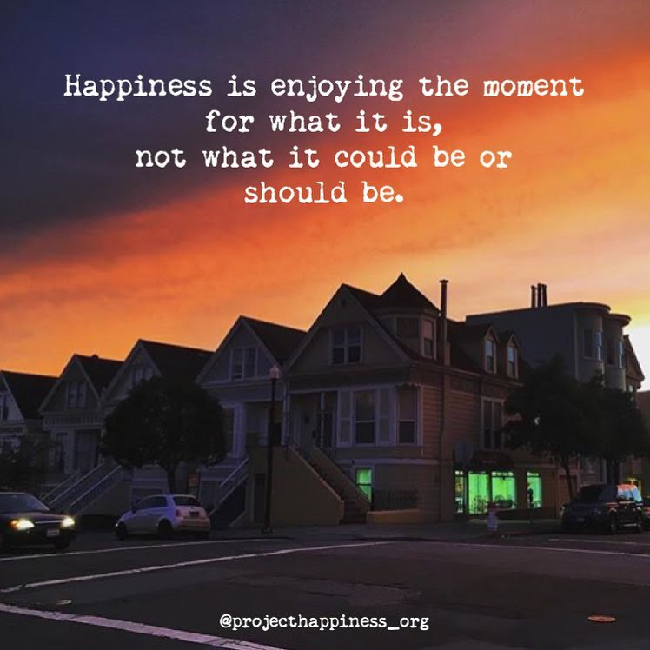
Welcome
Notes:
Slide for when people wait to start the WebEx
REMEMBER:
Give participants the privilege to chat to “all participants” (by Ctl-K, checking the chat for “all participants” box)
Start the recording, and pause it while waiting for the participants to join.
Continue recording for starting the session, just before removing this slide.
Ask participants to use the check for yes and cross for no, so they warm up to the idea of interacting.
---
Please, via the chat box, introduce yourself with
Name
Department or Agency
Where you’re located
Your expectations for this session

Slide 2
Mindful Change Leadership Development Program
Week 8 (of 8)
17 Jun 2021

Slide 3



Mindful Centering Exercise
Time required: 2 minutes
Repeat the following phrases, aloud if possible and whispering is good too
  I am a kind person (Je suis amiable)
  I love myself (Je m’aime)
  I do my best (Je fais de mon mieux)
  I am enough (je suis assez moi-même)
Notes:
Mindful breathing https://www.youtube.com/watch?v=ZE-r-x2T4ok
This is one way of doing it, getting it depends on the practice of.
Noticing is very important in the practice of Mindfulness.
Noticing where your thinking is, that’s the first step to become more Mindful.

Slide 4













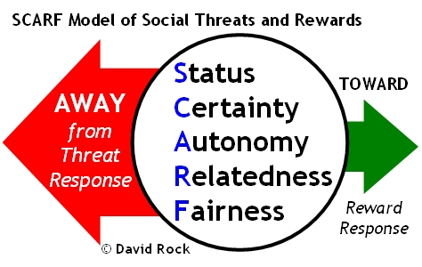

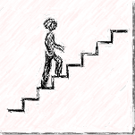





Questions/Insights from last week (7)
Notes:
Plenary: Open mic to have your comments, challenges, surprises… particularly would like to hear from someone who hasn’t spoke
Raise your hand to speak, type in the chat… be mindful about the time, let’s take as many as we can in 10 mins.

Slide 5

Agenda – week 8
Centering exercise
Questions/Insights from last week (7)
Today’s session goals
Snail speed - from unaware to unaware
Assessments – pre, now, post.
Some book references
Farewell
Your practice – What from now?

Slide 6

Today’s Goals: Focus, Compassion, Clarity, Creativity
  Mindful on the spot

Slide 7



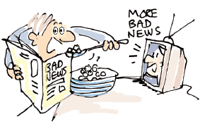
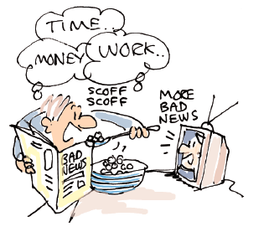
Snail model – From unaware to unaware
Desired
Aware - Desired
Unaware - Desired
Behaviours
Aware
Unaware
D i s r u p t i o n
Aware - Undesired
Unaware - Undesired
Undesired
Notes:
The disruption could’ve happened before this program
This program is focused on self-awareness, and practice

Slide 8
Mindful On The Spot… While
Breathing, once, with/out a sigh
Joining an e-meeting
Saying “hi!”, “good morning!”, “how was your weekend?”
Coloring
Walking in the present
Being aware of my thinking style
Showering
Washing dishes
Making the bed
Cooking
Eating
Petting my pet
Any other th-ing?
https://www.centerforresilience.org/5-ways-to-practice-mindfulness-right-now
https://positivepsychology.com/meditation-exercises-activities/
https://www.thepathway2success.com/10-mindfulness-activities-you-can-try-today/
Notes:
https://www.centerforresilience.org/5-ways-to-practice-mindfulness-right-now
https://positivepsychology.com/meditation-exercises-activities/
https://www.thepathway2success.com/10-mindfulness-activities-you-can-try-today/

Slide 9
















Some Book references
Notes:
References to the books:
First row
https://www.amazon.ca/Search-Inside-Yourself-Productivity-Creativity/dp/0062116924
https://www.amazon.ca/Presence-Human-Purpose-Field-Future/dp/0385516304/
https://www.amazon.ca/Leading-Emerging-Future-Ego-System-Eco-System/dp/1605099260/
https://www.amazon.ca/Finding-Space-Lead-Practical-Leadership/dp/1620402475/
https://www.amazon.ca/Mindful-Leadership-Self-Awareness-Transforming-Inspiring/dp/1118127110/
https://www.amazon.ca/Joy-Demand-Discovering-Happiness-Within/dp/0062378872
Second row
https://www.amazon.ca/Self-Compassion-Proven-Power-Being-Yourself/dp/0061733520
https://www.amazon.ca/Mindful-Leader-Management-Mindfulness-Meditation/dp/1590306201/
https://www.amazon.ca/Mindfulness-Merloyd-Lawrence-Langer-Reprinted/dp/B00C6OOLR6/
https://www.amazon.ca/Eleven-Rings-Success-Phil-Jackson/dp/1594205116/
https://www.amazon.ca/Dare-Lead-Brave-Conversations-Hearts/dp/0399592520
Third row
https://www.amazon.ca/Mindful-Leader-Embodying-Christian-wisdom-ebook/dp/B07KJGHXDW/
https://www.amazon.ca/Creating-Mindful-Leaders-Power-Forward/dp/1119484782/
https://www.amazon.ca/Seven-Practices-Mindful-Leader-Monastery/dp/1608685195/
https://www.amazon.ca/Art-Mindfulness-HarperOne-Select-Selects-ebook/dp/B005HG4H24/
https://www.amazon.ca/Mindful-Coach-Facilitating-Leader-Development-ebook/dp/B00362XL64/

Slide 10




Some App references
https://www.puregym.com/blog/top-free-mindfulness-apps/
https://www.mindful.org/free-mindfulness-apps-worthy-of-your-attention/
Notes:
References to some apps:
Calm
Headspace
Insight timer
https://mobile.va.gov/app/mindfulness-coach

Slide 11

Mindfulness Leadershiping Development Program
- English pilot
To develop the Mindful Leader in you by attending the following skills:
Focus
CrEa^{TiVi}_{Ty}
Clarity
Compassion

Slide 12
WordCloud
In one word, What's the skill you improved the most, or the best, during the MCL Program?
slido.com with #MCL
https://app.sli.do/event/owujhkjy

Slide 13
Mindfulness Leadershiping Development Program
- English pilot
To develop the Mindful Leader in you by attending the following skills:
Focus
Do you think we succeeded?
CrEa^{TiVi}_{Ty}
Clarity
Compassion

Slide 14





Success
Notes:
Now I’m delivering
Intro to Mindfulness @Work
Intro to Mindful Leadership
Mindful Leadershiping Development program – 8 weeks English pilot v2, @ 2nd week now with 30+ participants registered.
Since its beginnings in Nov 2013 used webex,
Make it inclusive of the regions
Accessible for those not able to attend live
Have over 20 sessions recorded and available
All of the session delivered include an experiential learning exercise, from the shortest 15 minutes to usually 1 hour to the longest 2 hours, and the 8 week program.
Some sessions I have had invitees, some have been co-delivered, and there was a session delivered by a colleague to an office in Japan (about 20 participants)
During this time, about 3 and a half years now, I started inviting people interested in talking about Mindfulness, where sessions went from 5, 7, 2, 0 participants with a good intentions slide, to structured sessions with an increasing number of participants every time.
The latest session I delivered to 185+ participants, with 96% saying they “… learned something useful and I can use/apply it right away”, with people attending from Canada wide.
And we have reached a total of 1,100+ participants and growing

Slide 15
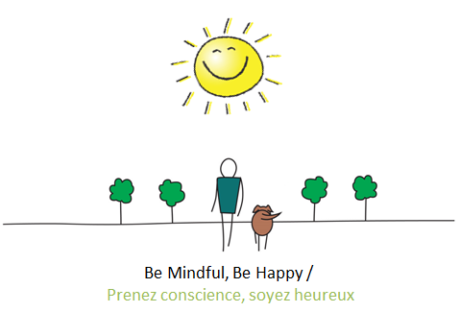

Your practice – What now?
Please, comment on the chat
In one sentence,
What is the one thing that you’ll bring with you from this program?

Slide 16
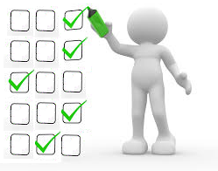
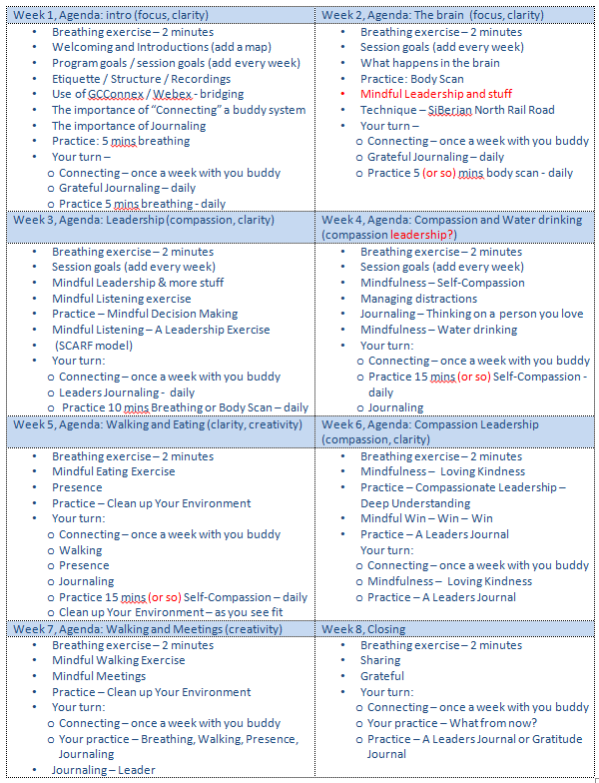
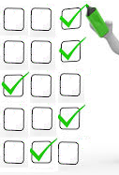
Friendly Reminder: Assessments
– pre, now, post
Obtaining your self-assessments is very important, as they help support the case for this program.
Today, please take 5 minutes to do so, when you receive an email with the assessment.
Then, I will do a follow up email in 3 months, and I’ll ask you to do the assessment again.
time
Activity
retention
How much
is kept
Benchmark

Slide 17

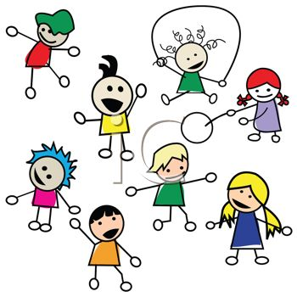


Farewells
Hint: Share a quick thought or a phrase
Saying good bye in small groups
Notes:
And before closing with the Elder’s prayer, I invite you to spend some time in small groups to say good bye to your colleagues… although you may end up meeting new people in the last day, remember we all partcipated in this program during the last 8 weeks.
Time available… until 20 mins before

