Slide 1
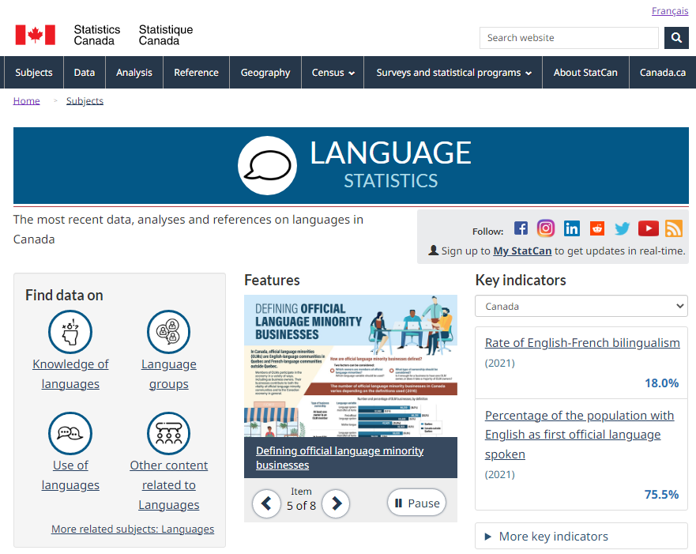
BEST PRACTICES FORUM ON OFFICIAL LANGUAGES, 2023
NEW resources on languages from the 2021 Census of population, Statistics Canada
FRANÇAIS
DATA ECOSYSTEM on children eligible for instruction in English in Quebec and in French in the rest of Canada
Visit our Language Statistics PORTAL for the most recent data, analyses and references on languages in Canada
The PORTAL also gives you access to maps, data visualization tools, tables, videos and more
Thematic Maps - Information leaflet
SPOKEN languages and Canada’s linguistic DIVERSITY
CONCEPT videos
Infographics 1 and 2 - Focus on geography - Data viewer
Languages of WORK
Thematic maps - Data tables
?
FEBRUARY 6, 1:30 - 2:30 P.M. (ET)
STILL GOT QUESTIONS?
CLICK ON A DAY TO TALK TO A STATCAN REPRESENTATIVE!
FEBRUARY 10, 11:00 AM- 12:00 P.M. (ET)
Note: The Language Statistics Portal is being updated on a regular basis. Some of the resources presented here, and found online, may not yet be available on the portal.

