Slide 1
A Data Input Methodology for PHAC reporting Systems
Decoupling a Data Owner’s processes from the Data Gathering process creates collateral benefits as well:
Presents a sort of “CCIDC cloud” view to Reporting Authority, and,
Enables the opportunity for RA to experiment with a Continuous Cycle

Slide 2
The Problem
Requests for data updates have evolved into data gathering campaigns by the reporting authority
Campaigns put too much emphasis on the individuals responsible for data gathering to “enforce” adherence to time lines and validate inputs.
Soon the sustaining cycle became punctuated with toxic data gathering events
The events take on too large a profile in the minds of the data creators
The group providing inputs becomes sullen and reactive not confident and proactive.

Slide 3
The Solution:
Decouple The Data Owner’s processes from those of reporting system’s data gathering process
Reporting Authority creates, provides Data Collection spreadsheets and instructions to Data Owners. (ensures Data Owner and Reporting Authority data elements are aligned)
Automated macro sends a dump of data for reports to a folder on the Data Owner’s “C” drive.
RA uses an .odc connection to connect to the folder contents: Data Owner’s inputs to the system.
The choice of file type of the file located in the folder and it’s data contents is made by the RA which has included a daily export macro in the spreadsheet inorder to automate the file refresh process.

Slide 4
Values
Data Owner’s work is not interrupted by data gathering campaigns.
CRAC is reduced significantly because the spread sheet input cells validate the inputs using Excel’s respectable validate techniques
Reduces possible toxic responses to requests or multiple requests driven by CRAC issues.
Reporting authority does not need to publish a schedule of input requests nor manage the data owner’s efforts to input to the system.
Reporting Authority can experiment with continuous reporting.
Ad Hoc reports’ demand for data no longer impacts the Data Owner.
Both Email volumes in the Centre and usage of “V” drive resources will diminish as the requirement for keeping information diminishes.
Reporting authority’s span of authority is enforced by managing the spreadsheet functional attributes and the automated exporting function
CRAC
Correct
Return
Add
Clarify

Slide 5
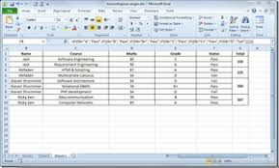
“As-Is”
Email Call Out for Data: Spreadsheet to collect inputs
Performance Reporting PC
Reports
Call Out for Data
Call Out for Data
Public
Data entered and returned by Email
Data entered and returned by Email
Data entered and returned by Email
Strategic data PC
Strategic data PC
Strategic data PC

Slide 6
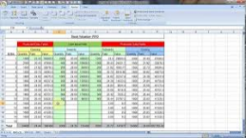
“To-be”
CCIDC cloud
Performance Reporting PC
Reports
Shared Resource
Strategic data PC

Slide 7
The Decoupling also enables:
i. CCIDC cloud
By setting up “ODC” connections from the Reporting Authority to each of the Data Owners, a “view” of participating, accessible machines (individuals) is created. Since the view is created by bringing together a small piece of the “C” drive from each of the participating machines, that virtual collection of all of the participating individual’s dedicated PMR storage areas can be loosely referred to as a “Cloud”.
ii. Continuous Cycle Because the retrieval of data is transparent, the RA can pick up data at any time and/or produce reports at any time. This means the RA can experiment with a continuous treatment of inputs and reports.

Slide 8
“To-be”
CCIDC cloud
Performance Reporting PC
Reports
CCIDC Cloud
CCIDC
Strategic data PC

Slide 9
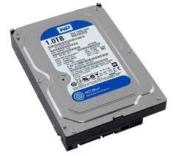
“To-be”
Using a Novell Connection
Reports
Performance
Reporting PC
Connections
Novell Connection
Strategic
data PC
Novell Connection definition is embedded in the active Spread Sheet
C Drive
Folder for Cloud
100 Mb max requirement

Slide 10
“To-be”
CCIDC cloud
Performance Reporting PC
Reports
CCIDC cloud
CCIDC Cloud
ODC Connection
ODC Connection
ODC Connection
Strategic data PC

Slide 11
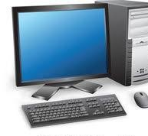
Office Data Connection (ODC)
Data Connection:
a set of information describing how to locate, log in, query, and access the external data source.
Performance
Reporting PC
Connection information can either be stored in the workbook or in a connection file, such as;
an Office Data Connection (ODC) file (.odc)
a Universal Data Connection (UDC) file (.udcx).
Connection files are particularly useful for sharing connections on a consistent basis and for facilitating data source administration.
The external data source is connected to the workbook through a Data Connection
Data Connection (ODC)
Workbook
External Data Source

Slide 12
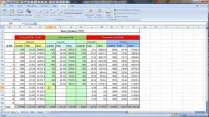
New Workbook = New Connections
RBM Workbook
Financials Workbook
Cost Centre Managers

Slide 13
How do we start?
PMR Workbook

Slide 14
Performance Reporting PC
Analyze data without repeatedly copying the data
The main benefit of connecting to external data is that you can periodically analyze this data in Microsoft Office Excel without repeatedly copying the data, which is an operation that can be time-consuming and error-prone.
After connecting to external data, you can also automatically refresh (or update) your Excel workbooks from the original data source whenever the data source is updated with new information.
Continuous Cycle
Reporting Authority can move from Quarterly data gathering and reporting to any frequency they wish without impacting the data supply processes
Connect to and Import External Data process (Office Support)
https://support.office.com/en-us/article/connect-to-import-external-data-9967afd8-85ee-4df3-aa06-753bcc1a2724

