Slide 1
Change management toolkit to plan the return to the workplace August 2020

Slide 2
“Clear, direct and timely communications to employees will be critical to an organization’s ability to establish trust and to successfully manage the complex and challenging process with which we are confronted in the return to the worksite. Messaging will need to be frequent, employee-centric, empathetic and empowering, while reflecting the seriousness of the current landscape. Where employees may be asked to return to the worksite, the communications timeline will need to be mindful that employees will require appropriate notice and adequate lead time in order to prepare. Internal communications teams may need to be ramped up in the short to medium-term to support this significant change management initiative.”
Source: https://www.canada.ca/en/government/publicservice/covid-19/easing-restrictions/departmental-guidebook/federal-worksites.html
Hyperlinks are only accessible when in presentation mode

Slide 3
About this toolkit
This toolkit includes 2 documents: this PowerPoint document as well as an Excel document titled RTW PM-CM Integrated plan‒Change inventory and impact assessment. This toolkit was designed to help the change manager or project team create the best possible employee experience, when planning the return to the workplace (RTW). It offers a change management approach to follow based on the RTW plan being developed or implemented by your organization.
It is a good starting point to identify how the current pandemic situation is impacting the workplace and the employees who will be working in it.
What is included:
Process to create an employee-centric approach for the RTW
Examples of communication, engagement and training activities
Tools in the document RTW PM-CM Integrated plan‒Change inventory and impact assessment:
1- Change inventory and impact assessment
2- Return to the workplace (RTW) integrated plan
Links to reference material
Hyperlinks are only accessible when in presentation mode

Slide 4
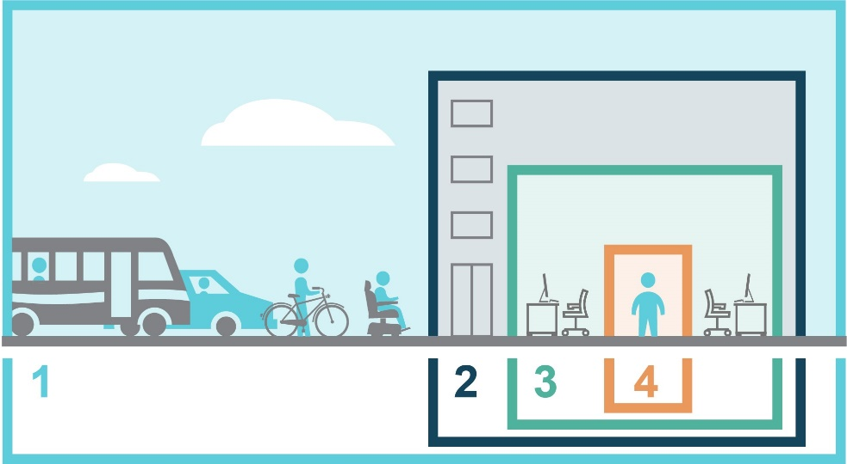
An employee-centric approach at home or at the office
Creating the best possible employee experience whether they are working from home or returning to the workplace by using a change management methodology:
prioritizes mental and physical wellbeing
considers safety first
is progressive
offers flexibility
focuses on changing mindsets and behaviors
ensures
access to proper tools and training
An employee-centric approach…

Slide 5
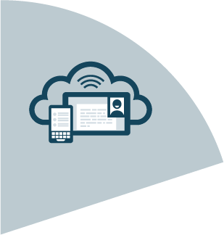
A unified approach to implement the RTW plan
Best possible
employee
experience
A RTW project plan focuses on the delivery and implementation of new or temporary measures, new tools and new processes
Change management ensures that the changes such as new tools, protocols, procedures and ways of working are being embraced and adopted

Slide 6
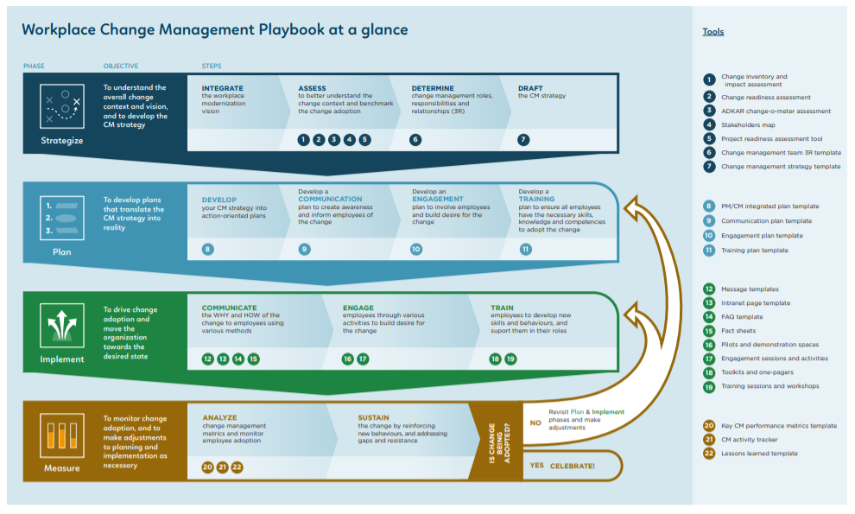
Steps to the employee-centric approach
*step colours match our At-a-glance document for easy reference (click for link)
1. Evaluate
Evaluate the current RTW plan
2. Identify
Identify what has changed or will change
3. Develop
Develop and implement a CM plan to promote those changes
4. Support
Support the organization in ensuring employees adopt new measures
How will temporary changes to the workplace impact employees?
How will the organization support employees?
Let’s explore these 4 steps in detail

Slide 7
1. Evaluate the current RTW plan
Read the RTW plan that has been developed by your organization.
By collaborating with the RTW project team, try to imagine the employees’ experience from the time they enter the building to the time they are sitting at a workpoint.
Highlight what will be different for employees during this scenario and potential changes that might have an impact on them.

Slide 8
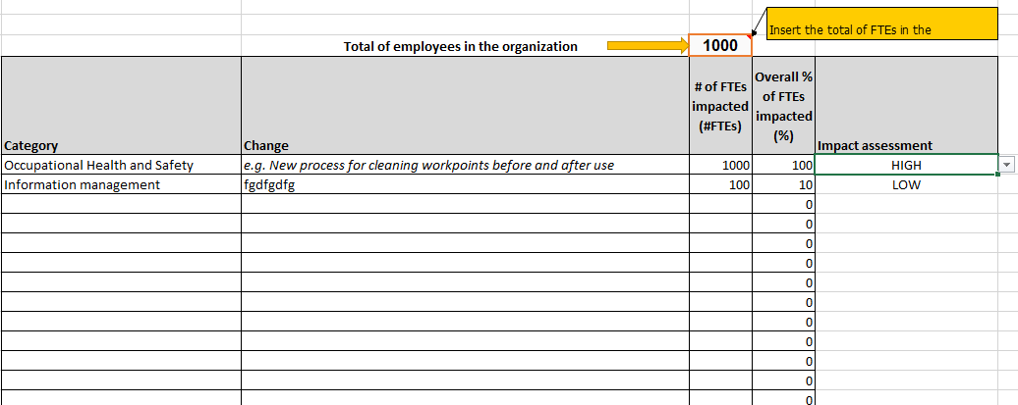
2. Identify what has changed or will change
After reviewing the RTW plan, use Tab 1 of the RTW PM-CM Integrated plan‒Change inventory and impact assessment document to:
Create an inventory of changes that employees will have to be prepared for when they return to the workplace. Please refer to the Collection of changes and lessons learned;
Assess the scope and impact of those changes for employees.
Tab 1 - Change inventory and impact assessment tool
Hyperlinks are only accessible when in presentation mode

Slide 9
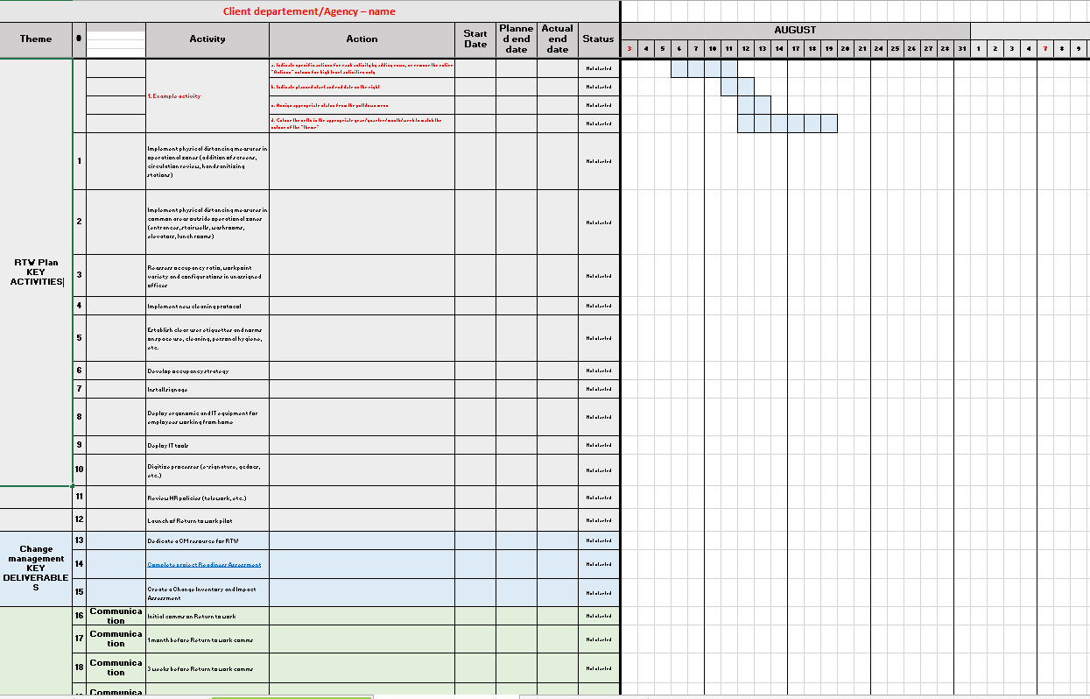
3. Develop and implement a change management plan
To avoid duplicating efforts, don’t forget to check if your organization has already created tools and activities.
With your changes identified, use Tab 2 of the RTW PM-CM Integrated plan‒Change inventory and impact assessment document to create a change management plan:
For each change and based on its level of impact, define an activity/action that will help users understand the change and get ready to adopt it. For ideas and best practices on communication, engagement and training activities, please refer to the Annex section.
Implement communication, engagement and training activities.
Provide support and coaching to managers and senior leaders.
Tab 2 - RTW integrated plan tool
Hyperlinks are only accessible when in presentation mode

Slide 10
4. Support the organization in ensuring employees adopt new measures
Monitor the adoption of the new measures, tools, protocols, procedures and ways of working.
Reinforce new behaviours and mindsets, if required. There are various ways to reinforce behaviours and manage resistance, we’ve included some best practices in the Annex section.

Slide 11
Best practices and activities
Annex

Slide 12
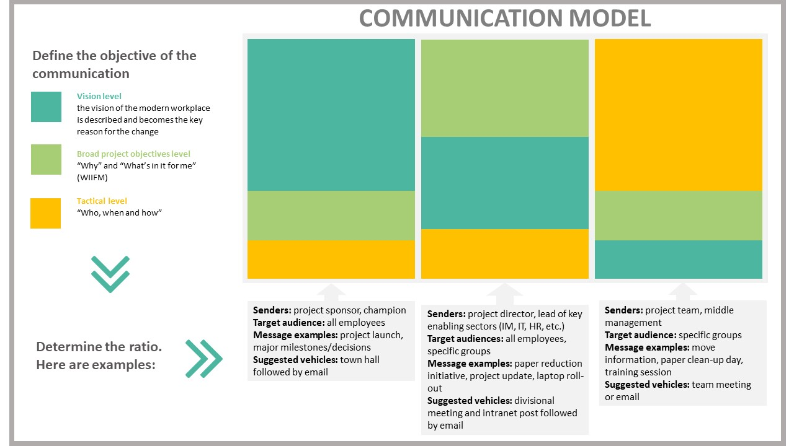
Communication best practices and activities
This model is from the Change Management Playbook in the context of a workplace modernization project. The same principles can be applied for a RTW communication plan:
Depending on the objectives of the communication and the target audience, consider who is the best sender and which communication vehicle should be used

Slide 13
Communication best practices and activities
Communication is key to ensure employees understand what to expect in the workplace upon re-occupancy. This should include verbal and written communications, and signage.
An email is not always the best method of communication for information of high importance.
Clear communication about what has changed (physical and protocols) and what remains the same will help reduce anxiety.
Hold meetings using a platform which allows for the participation of all employees.
Communication channels: consider that people need to hear information in multiple ways.
Consider that messages will need to be communicated multiple times: before, during and after they return to the workplace
Work with all implicated stakeholders to ensure alignment on key messages and protocols to avoid confusion
Develop messaging to be able to explain how and why the return to workplace will be phased
Develop messages about what is changing, how it will change, when it will change and why
Develop updates and progress report messages
Identify the best sender to communicate messages: leader of the organization or manager
Transparency and accuracy in communications is critical to credibility and trust
Use plain language and empathy to respect emotional responses
Best practices
If applicable, develop sequential communications on:
new protocols in place for reintegration into the workplace, working from home, arrival processes, what to bring to the office, what is not permitted, screening protocols if required, emergency evacuation processes, etc.;
how to work virtually and from home—reference material is available on the TBS and CSPS websites (see references).
Activities

Slide 14
Engagement best practices and activities
Consider engaging employees in giving feedback, sharing their concerns and their needs
Consider putting in place a mechanism to gather employees feedback on processes, available tools, shared information and support they need to perform their work at home and at the office
Be prepared to listen and act on employees’ concerns
Managers should engage often with their team and employees
Best practices
Surveys (formal survey covering many elements)
Pulse check (quick informal survey for a specific element)
Virtual consultations
Generic inbox
Activities

Slide 15
Training best practices and activities
Ensure that employees receive training on new measures, new tools, protocols, procedures, ways of working, etc.
Ensure managers are equipped to support employees through the transition. As outlined in the roles and responsibilities of the Guidebook for departments on easing of restrictions: Federal worksites, managers play a key role in employees’ return to the workplace experience; therefore, is it critical they themselves be adequately equipped. Here is an example of a manager toolkit that can be adapted.
Best practices
Virtual site visit for employees returning to the workplace
Onsite welcome team for employees returning to the workplace
Online training on new measures, new tools, protocols, procedures, ways of working
Web-based guide/welcome kit for employees and managers returning to the workplace on new measures, new tools, protocols, procedures, ways of working
1550 D'Estimauville Avenue Pilot Project
Place Bonaventure Pilot Project
Activities

Slide 16
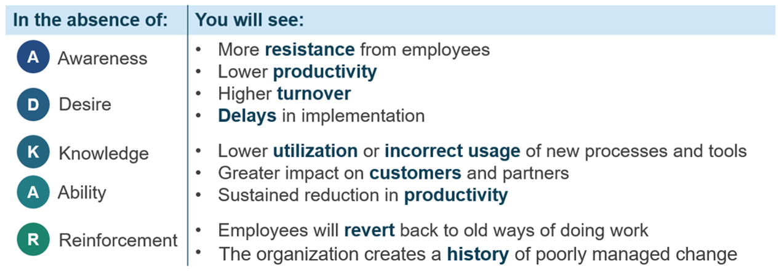
Best practices in reinforcing behaviors
Ensure constant reinforcement messages about WHY the protocols are important
Provide coaching and supporting session to reinforce new behaviors and etiquette
Hold targeted training sessions
Administer surveys to gather feedback and needs
Signage to encourage and prompt behavior
Ensure that undesired behaviors are addressed quickly
ATTENTION
Watch for signs of distress
Manage conflict appropriately
Tips in managing resistance

Slide 17
References
Workplace Change Management Playbook
PSPC Guidance and Practices for the Safe Return to Workplaces in Light of the Easing of Restrictions
PSPC Building Management Direction for Coronavirus Disease 2019 (COVID-19)
Information for Government of Canada employees: Coronavirus disease (COVID-19)
Orientation Package to Support the Easing Of Restrictions at Federal Worksites
https://www.csps-efpc.gc.ca/tools/jobaids/orientation-package-eng.aspx
https://www.csps-efpc.gc.ca/tools/jobaids/pdfs/orientation-package-eng.pdf
Summary of the Workplace Change Management Community of Practice session Adapting to change held on June 9th, 2020. The objective of the session was to create a collection of workplace changes and lessons learned from the current pandemic situation.

