Slide 1
Bringing solutions to key challenges for Canadians Fournir des solutions aux Canadiens sur des défis majeurs
Daniel De Lisle

Slide 2
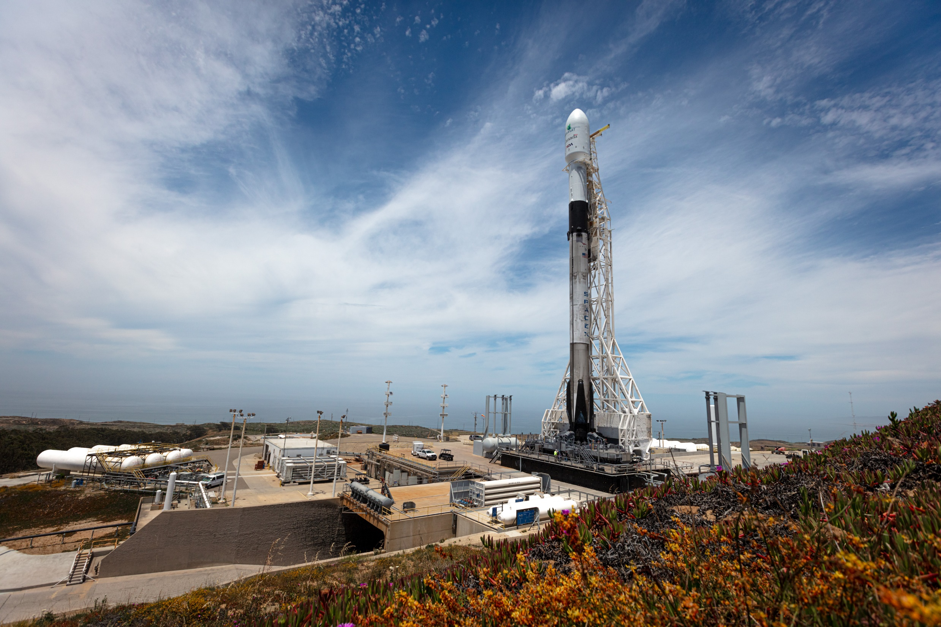

Slide 3
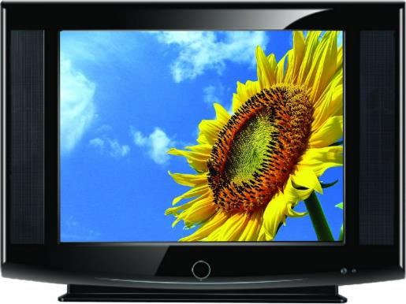
 | RADARSAT-1 (1995-2013) | RADARSAT-2 (2007 - ) | RCM (2019)

Slide 4
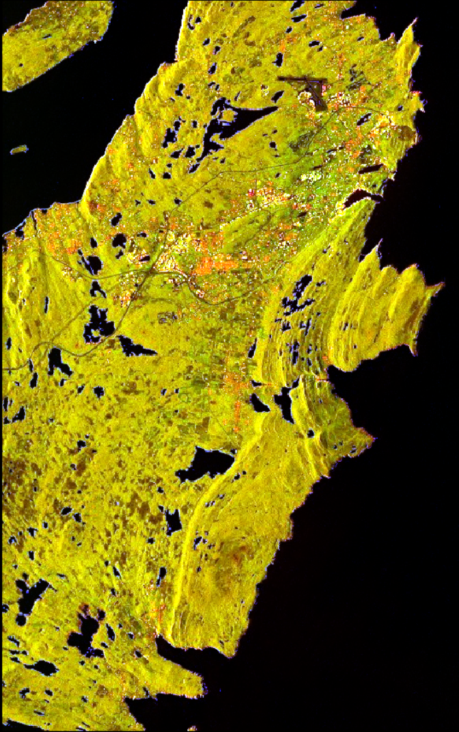

Slide 6
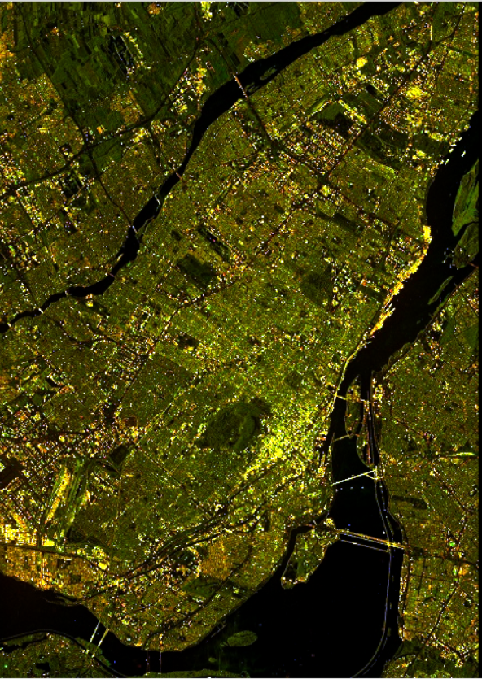
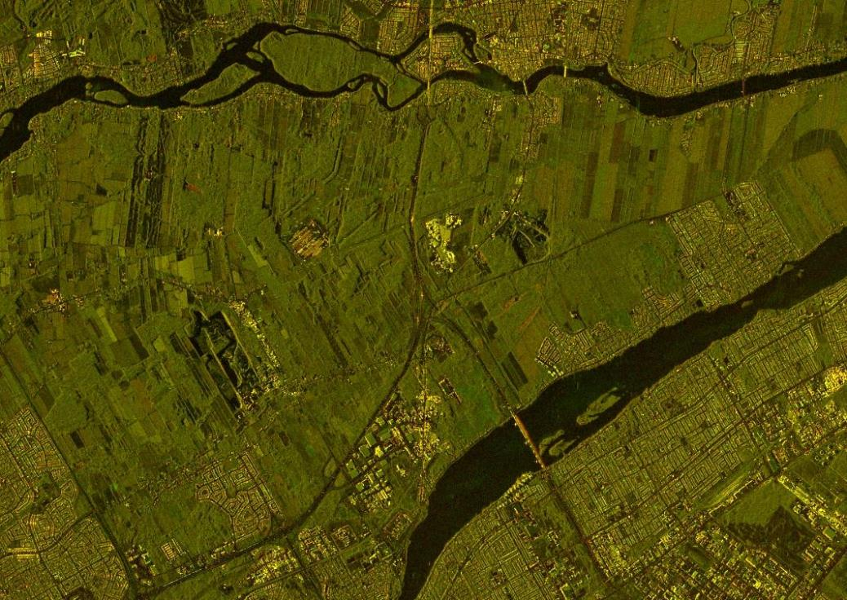

Slide 7
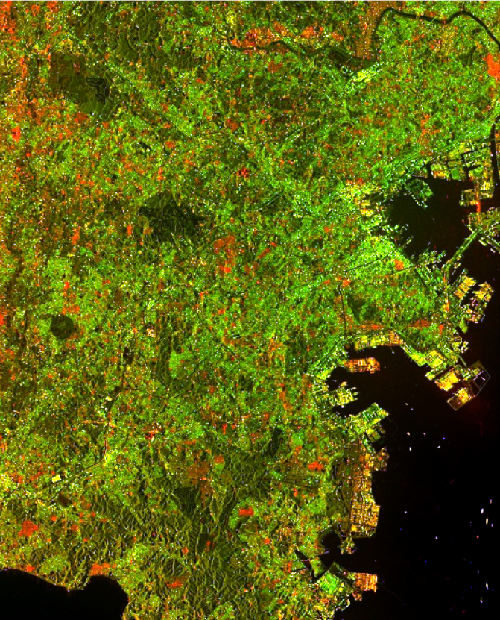
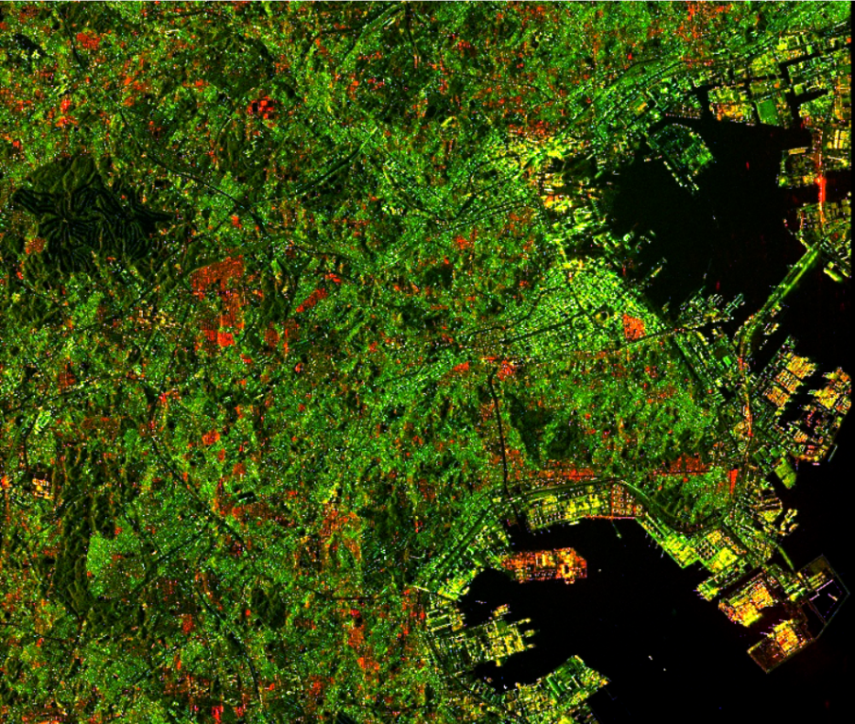

Slide 8
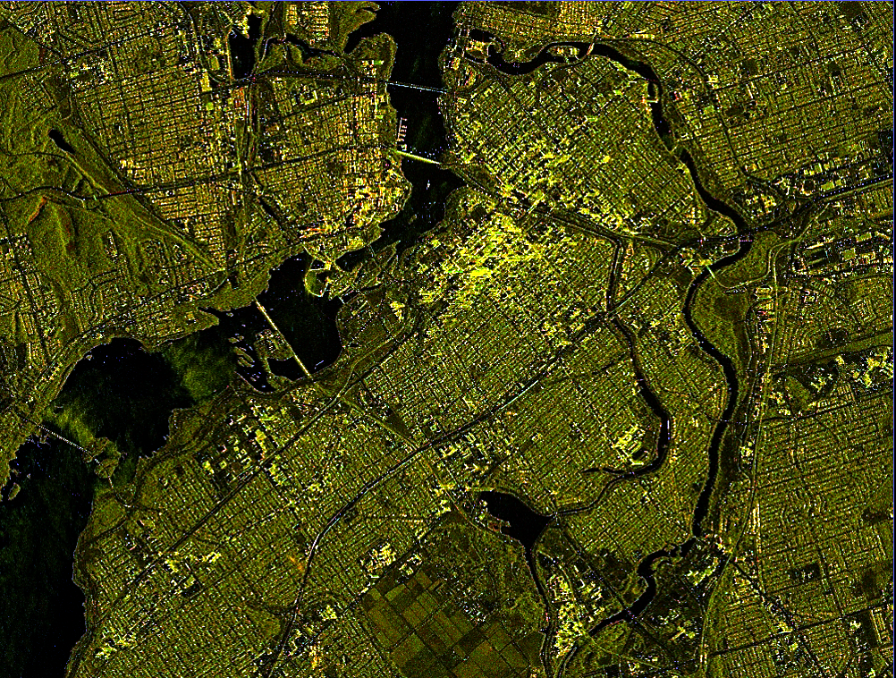

Slide 9
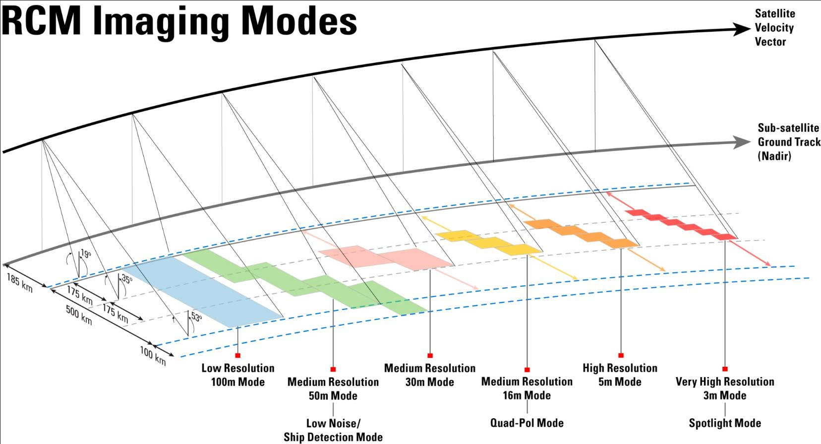
RCM SAR Imaging Modes

Slide 10
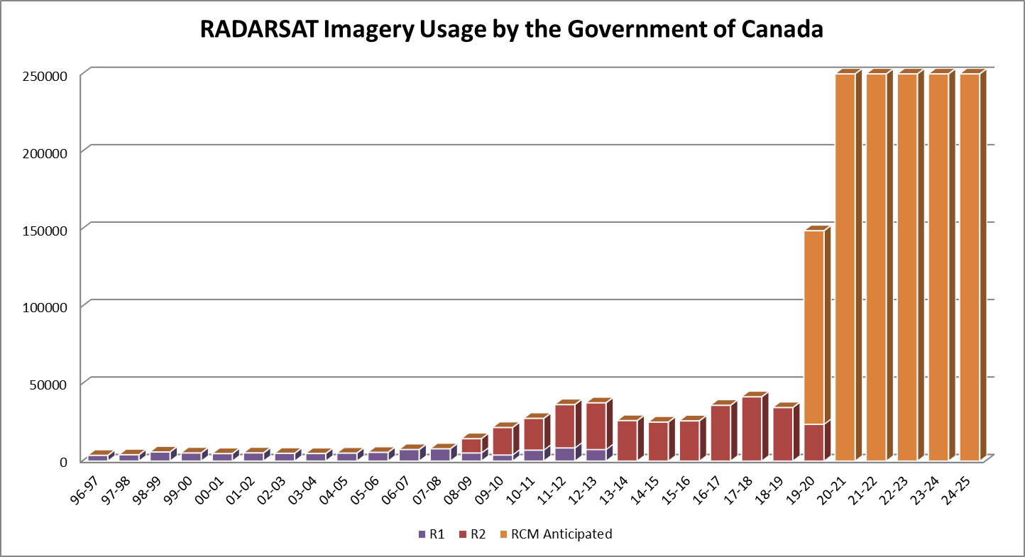
Evolution of RADARSAT Data usage by Government of Canada
50x
from R1 to RCM
Images
5x
from R1 to R2
GoC user departments currently forecast that they will use approximately 250,000 RCM images per year.

Slide 11
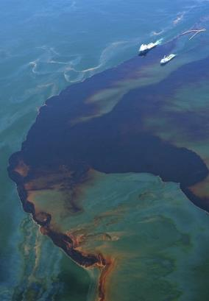
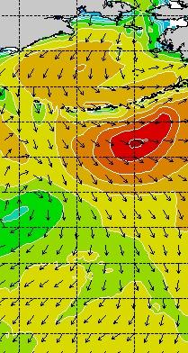
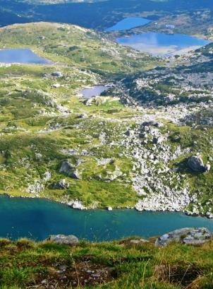
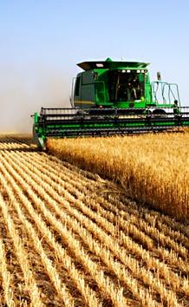
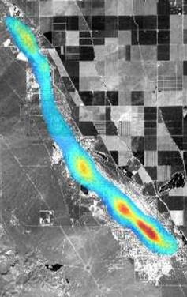
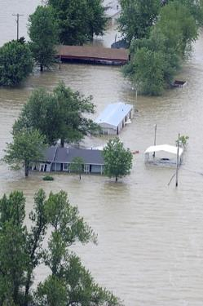
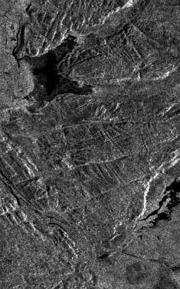
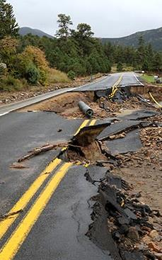
RCM Data Fully Integrated in Government of Canada Service Delivery
Environment and
Climate Change Canada
Ice
Oil
Winds
Ecosystem
Land
National
Defence
Ice & Icebergs
Integrated Satellite Tracking of Pollution (ISTOP)
National SAR Winds
Arctic Coastline
Land Surface
& Water Extent
Agriculture and Agri-Foods
Canada
Ice data Assimilation
Natural Resources
Canada
Wind Data Assimilation
Wetland monitoring
Ice Dynamics
Fisheries and Oceans
Canada
Parks Canada
Agriculture
Security & Defence
Monitoring
Emergency
Products
R&D
Crop Inventory
Ocean Features
INSAR
Hazards
Deformation
Infrastructure
Glacier
Emergency Geomatics Service
Value Added Products
Filtered Orthorectified
Pol. Decomp.
Compact Pol
CCD
Geohazards
Wetlands
Security & Defence
Public Safety
Canada
Transport Canada
Maritime Surveillance
Soil Moisture
Public Health
Agency of Canada
Land Surveillance
Crown-Indigenous Relations and Northern Affairs Canada
RCM acquisitions will be planned to supply data required for Government of Canada (GoC) service delivery

Slide 12
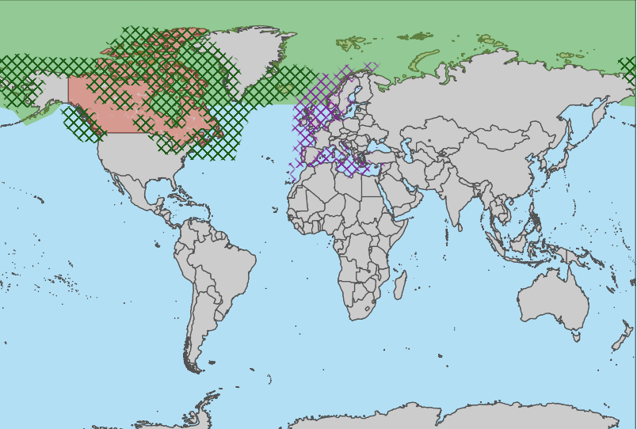
Year-round coverage
RCM Standard Coverages
Med. Res. 50m - GRD
Dual Pol. - Avg. Daily
Med. Res. 50m - GRD Dual Pol. - Every 3 day
Med. Res. 30m - SLC
Compact Pol. Weekly to Monthly
Ship Detection Mode - GRD
Single Pol. - Weekly
Generalized representation
Coverage may be changed without notice to meet requirements of the Government of Canada.
Domestic and global coverages that are exclusively for defence and security are not shown.

Slide 13
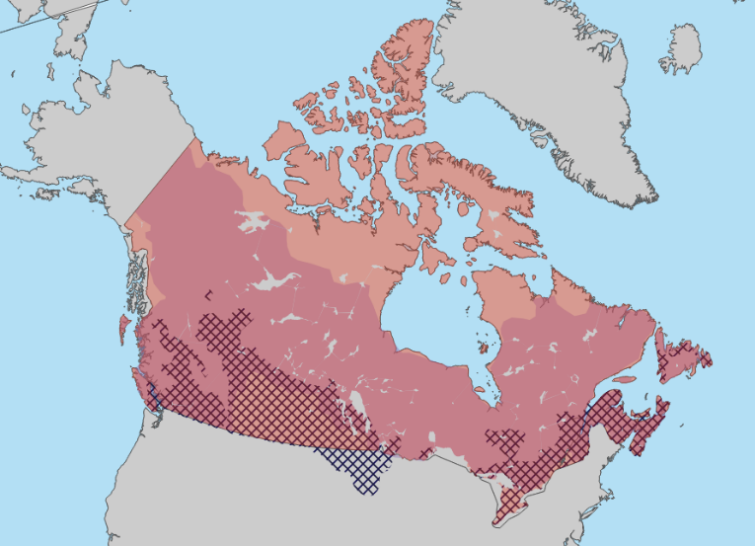
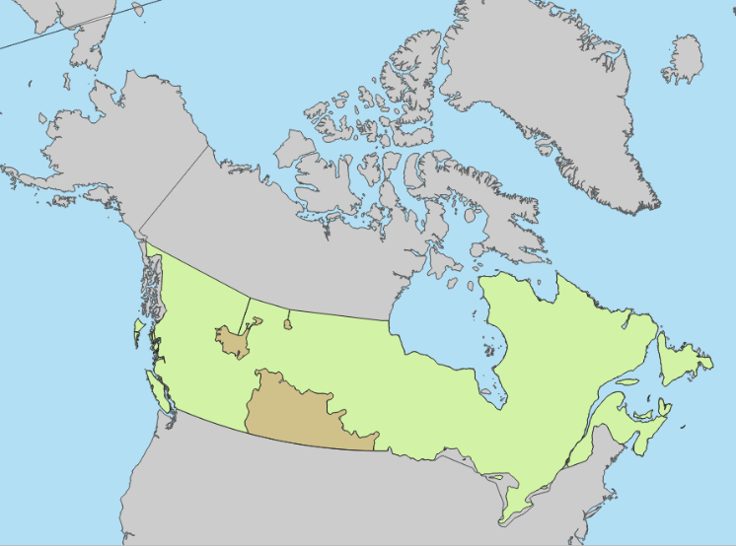
RCM Standard Coverages
Seasonal coverage (growing season)
Med. Res. 16m – SLC-32 bit Dual Pol. – Every 2 weeks
Med. Res. 16m – SLC-32 bit Dual Pol. – Once a year
Med. Res. 30m – SLC – 16 bit
Compact Pol. - Weekly
Med. Res. 30m - SLC – 32 bit -> Monthly
Compact Pol. - SLC – 16 bit -> Weekly
Med. Res. 30m – SLC (16 bit) -> Asc.+Des.
Compact Pol. – Weekly
Generalized representation
Coverage may be changed without notice to meet requirements of the Government of Canada.
Domestic and global coverages that are exclusively for defence and security are not shown.

Slide 14
Merci / Thank you
daniel.delisle@canada.ca

