Slide 1
Ministerial Profile Updates
Fall 2021

Slide 2
Swearing-in day - centralized process
All Ministerial profiles will be updated on swearing-in day.
As requested by TBS and PCO, Principal publisher will:
Update all ministerial profiles in a centralized location
Use the updated template, but only include bios and photos
Source pre-approved bio copy from pm.gc.ca
Reuse existing photos where possible; source new photos from PCO

Slide 3
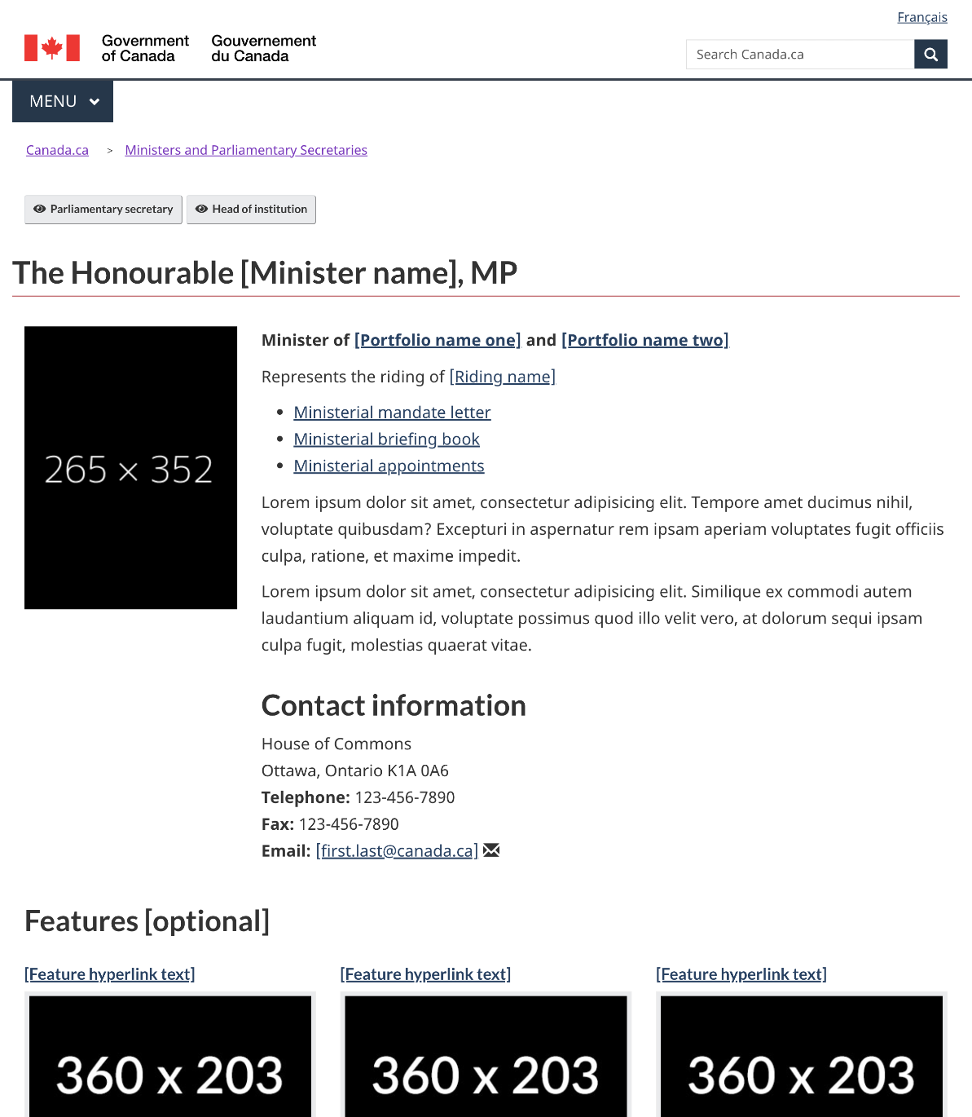
Full Ministerial profile template: https://design.canada.ca/mandatory-templates/ministerial-profile-pages.html

Slide 4
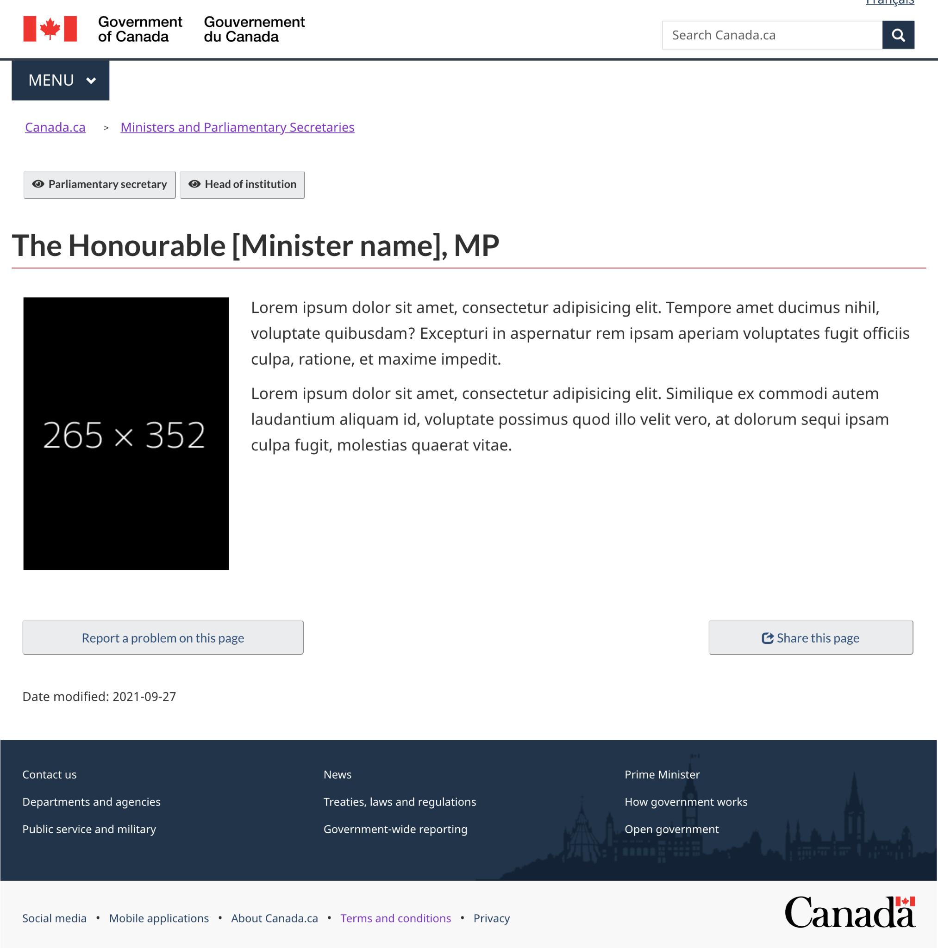
On swearing-in day, Ministerial profiles will look like this

Slide 5
Swearing-in day - what institutions need to do
Do’s
Wait for PP to notify institutions when new Ministerial profiles are live
Update links from your institutional landing page (ILP) and any other pages to point to new Ministerial profile in AEM
Don’ts
Duplicate centralized Ministerial profiles under your own ILPs
Ask for new links prior to swearing-in day

Slide 6
After swearing-in day - other mandatory elements
Principal publisher will add the following as they become available:
Riding links from www.parl.gc.ca
Mandate letter links from pm.gc.ca
Institutions to provide PP with the following as applicable:
Ministerial contact information
Briefing books or transition binder links
Ministerial appointment calendar links
Use the PP request form for these: http://requestform.portal.gc.ca/tickets.html

Slide 7
After Swearing-in day - other updates and optional elements
If further updates are required, use PP request form for:
Any updates to links, photos or contact info
Any optional additions below the mandatory parts of the template

Slide 8
What about parliamentary secretaries?
We will follow the same process whenever they are announced!
PP will create basic profiles with bios, photos, links to Ministers
Institutions to provide contact info and other optional elements as needed, using PP request form
Do
Link to centralized profiles from your ILPs
Don’t
Duplicate this content under your ILPs

Slide 9
Questions?

